Slide 1
PYTHON FUNDAMENTALS
1. INTRODUCTION TO PYTHON

Slide 2
Why USE Python?
SIMPLE : simple, feels like reading English sentence. More clarity and less syntax.
EASY TO LEARN: Python uses very few keywords.
DYNAMICALLY TYPED: no need to declare anything. Assignment binds name to object.
PLATFORM INDEPENDENT: Run on all operating systems and hardware, because of its way its complied and interpreted.
PORTABLE: Python programs give same results since they are platform independent.
PROCEDURE AND OBJECT ORIENTED
OPEN SOURCE

Slide 3
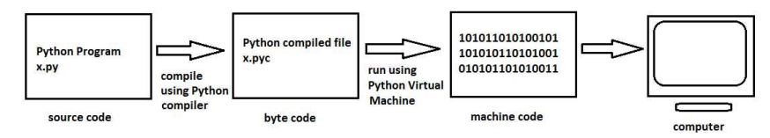
CONT..
INTERPRETED:
EXTENSIBLE: Programs or pieces of code written in C or C++ can be integrated in to python and executed using PVM.
EMDEDDABLE: We can insert python programs in to C or C++, Delphi, PHP, Java, and .NET programs.
HUGE LIBRARY: Python has huge library and are available as modules. ( database, networking, web, GUI etc..)

Slide 4
CONT..
SCRIPTING LANGUAGE: A scripting language is programming language which does not use a complier for executing the source code. Generally scripting languages performs supporting tasks in bigger applications.
DATABASE CONNECTIVITY: Python provides interfaces to connect its program to all major databases like Oracle, Sybase or MySql.
PACKAGES: Huge library of Python contains several small applications or small packages which are already developed and immediately available to programmers;
Argparse : command line parsing library.
Botois: amazon web services library.
Cryptography: offers cryptographic techniques for the programmers.
Etc..

Slide 5
What can you do with Python ?
System Programming
Python’s built-in interfaces to operating-system services make it ideal for writing portable, maintainable system-administration tools and utilities.
Python programs can search files and directory trees, launch other programs, do parallel processing with processes and threads, and so on.
Support for:
environment variables,
files,
sockets,
pipes,
processes,

Slide 6
Contd ..
multiple threads,
regular expression
pattern matching,
command-line arguments,
standard stream interfaces,
shell-command launchers,
filename expansion,
zip file utilities, XML and JSON parsers, CSV file handlers, and more.
GUI’s
Component integration
Rapid Prototyping
Numeric and Scientific Programming

Slide 7
Contd ..
Internet Scripting: Python comes with standard Internet modules that allow Python programs to perform a wide variety of networking tasks, in client and server modes.
Scripts can communicate over sockets:
extract form information sent to server-side CGI scripts;
transfer files by FTP;
parse and generate XML and JSON documents;
send, receive, compose, and parse email;
fetch web pages by URLs;
parse the HTML of fetched web pages;
communicate over XML-RPC, SOAP, and Telnet; and more.
Python’s libraries make these tasks remarkably simple.

Slide 8
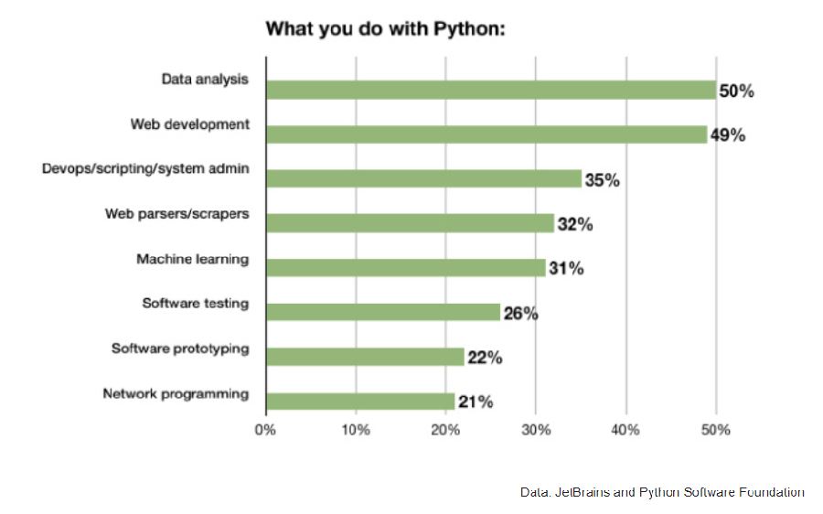
Contd ..

Slide 9
EXECUTION OF A PYTHON PROGRAM
Python programs have .py extension and its byte code .pyc
Compile the program with python compiler into another code called byte code. ( pyc – python compiled file )
Convert byte code to machine code using PVM. ( Python Virtual Machine ) PVM uses interpreter to understands the byte code and converts to machine code.
Interpreter translates the program source code line by line. So it is slow.

Slide 10
LAB ☺
Write Python program to add two numbers; let it be add.py.
Run it: C:\python add.py ( it does everything, compiler, interpret and display the results)
To create .pyc file: C:\python –m py_compile add.py
-m : is module
py_compile : module name
Execute the .pyc C:\python add.cpython-36.pyc
Viewing ByteCode:
C:\python –m dis add.py

Slide 11
Flavors of Python
CPython: Standard python compiler implemented in C language.
JPython: Implementation of python programming language which is designed to run on Java Platform.
IronPyhton: Implementation of python programming language for .NET framework.
PyPy: Python implementation using Python language.
RubyPython: Bridge between Ruby and Python Interpreter.
More…

Slide 12
LAB: Using ‘help’
Type ‘python’, to invoke shell.
Type ‘help()’, it will take you to another shell (help shell)
Type ‘topics’
Type any of the listed functions for details.
exit()
Type help(print) // without going to “help shell’

Slide 13
Where Python falls short
Python is a high-level language, so it’s not suitable for system-level programming—device drivers or OS kernels are out of the picture.
It’s also not ideal for situations that call for cross-platform standalone binaries. You could build a standalone Python app for Windows, MacOS, and Linux, but not elegantly or simply.
Python is not the best choice when speed is an absolute priority in every aspect of the application.

Slide 14
Python Data types ( Notes )
LIST vs TUPLES
You can’t add elements to a tuple. There’s no append() or extend() method for tuples,
You can’t remove elements from a tuple. Tuples have no remove() or pop() method,
You can find elements in a tuple since this doesn’t change the tuple.
You can also use the in operator to check if an element exists in the tuple.
Note: So, if you’re defining a constant set of values and all you’re going to do with it is iterate through it, use a tuple instead of a list. It will be faster than working with lists and also safer, as the tuples contain “write-protect” data.

Slide 15
Python Data types ( Notes )
LIST vs DICTIONARIES
A list stores an ordered collection of items, so it keeps some order. Dictionaries don’t have any order.
Dictionaries are known to associate each key with a value, while lists just contain values.
Note: Use a dictionary when you have an unordered set of unique keys that map to values.

Slide 16
Python Data types ( Notes )
LIST vs SETS
Just like dictionaries, sets have no order in their collection of items. Not like lists.
Set requires the items contained in it to be hashable, lists store non-hashable items.
Sets require your items to be unique and immutable. Duplicates are not allowed in sets, while lists allow for duplicates and are mutable.
Note: You should make use of sets when you have an unordered set of unique, immutable values that are hashable.

Slide 17
References
https://www.infoworld.com/article/3269582/python/python-developers-profiled-what-you-use-what-you-do.html
https://www.infoworld.com/article/3204016/python/what-is-python.html
https://www.datacamp.com/community/tutorials/18-most-common-python-list-questions-learn-python

