Slide 1

Network Anomaly Detection Using LSTM Based Autoencoder
Desai Dhyani Dhaval

Slide 2
Agenda
Introduction
Problem Statement
Objective
Applications
Architecture
Dataset
The Preprocessing Stage
Implementation
LSTM-AE Architecture
Model Building
One-Class SVM Architecture
Results
Conclusion
Future Work

Slide 3
Introduction
The basic idea of anomaly detection with LSTM neural network is this: the system looks at the previous values over hours or days and predicts the behavior for the next minute. If the actual value a minute later is within, let’s say, one standard deviation, then there is no problem. If it is more, it is an anomaly.
Our team agreed the solution had to include a machine learning system able to learn the trends over time on per customer and per region basis. The system had to also learn the variability on hourly, daily, weekly and monthly basis.

Slide 4
Problem Statement
Intrusion is the main cause of a security breach, where a malicious user can damage or steal vital information of the network system in a short time and cause huge financial loss.
Even though many rule-based(signature) models have been developed in the past the intruder techniques have been evolved using sophisticated tools to create attacks exploiting vulnerabilities in the server protocols.
With the era of IoT and big data, an extensive rule- based model not only makes the database relativity large but the task of continuous updating of the database slows down system performance.
The traditional signature-based models fails to detect Unkown or novel attacks and hence a system needs to be developed that can discover attacks that are not used in training models

Slide 5
Objective
To build an anomaly detection model that discovers patterns in data that do not confirm the expected normal behaviour with a higher detection rate and low processing time.
The model should generate output that classifies the network as either a normal or a novel attack and should have a high detection rate and generate a low false alarm.
The model should also overcome the shortcoming to operate in high dimensions.

Slide 6
Applications
Fraud detection
Medical application
Video Surveillance
Data leakage prevention
Intrusion detection

Slide 7
Architecture
Autoencoder
RNN to LSTM
One-Class SVM

Slide 8
Dataset : InSDN
It contains more than 80 statistical features in CSV file format such as Protocol, Duration, Number of bytes, Number of packets, etc.
The total number of dataset instances are 343,939 for normal and attack traffic, where the normal data brings a total of 68,424, and attack traffic contains 275,515 instances
The dataset contains tvarious attack scenarios and attack classes such as DoS, DDoS, Web attacks, Password-Guessing, Botnet, Exploitation, and Probe attacks.
InSDN includes various popular application services such as HTTPS, HTTP, DNS, Email, FTP, SSH.
The source of attacks in the dataset comes from internal and external network to mimic the real attack scenarios.

Slide 9
The Preprocessing Stage
Removal certain useless data features and to avoid the overfitting problem ,the final datasets consists of 77 features.
01
Standardize the values as the features span accross different ranges
02
Convert labelled string to numerical value using one-hot encoding to 0 and 1.
03

Slide 10
Implementation
The deep learning based on LSTM-autoencoder model for anomaly detection is trained using normal data only. In this case, the model is capable of replicating the input data at the output layer with a low reconstruction error. In the case of anomalies, the trained model fails to reconstruct anomalous instances, given a high error rate. The error is used as an indicator to differentiate between normal and anomalies instances.
Therefore, we use a fixed threshold in the reconstruction error for the binary classification of normal and anomalous traffic data. The threshold value is used as a decision boundary for detecting anomalous data. The observations that have a reconstruction error greater than the threshold will be classified as anomalous, whereas the ones with reconstruction error less than the threshold as normal traffic data.
The lower dimension of the input data (i.e., extracted from the LSTM-autoencoder model) are trained with the OC-SVM algorithm to achieve better classification results, whilst significantly reducing the training time
It is trained only on the ‘normal’ data to learn the boundaries of these points. Then, it is able to classify any points that lie outside the boundary i.e., outliers.

Slide 11
LSTM – AUTOENCODER Architecture
The autoencoder in our proposed model for anomaly detection is the fact that the autoencoder is trying to learn the best parameters to reconstruct the input at the output layer
The LSTM algorithm for our model to solve the issues of the standard RNN technique, such as vanishing and exploding gradient problems
It contains multiple layers of encoder and decoder stages, and each stage consists of multiple LSTM units.
The input data is encoded via the encoder block to generate a fixed range feature vector We set timestamp = 1 for our LSTM blocks. We used the LSTM blocks for individual events, and not for time series.
The encoder block sequentially reduces the dimension of the 77-dimension initial feature vector.
The dimensions are reduced to 128, 64, 32, and 16, after the first, second, third and fourth layers of the encoder respectively

Slide 12
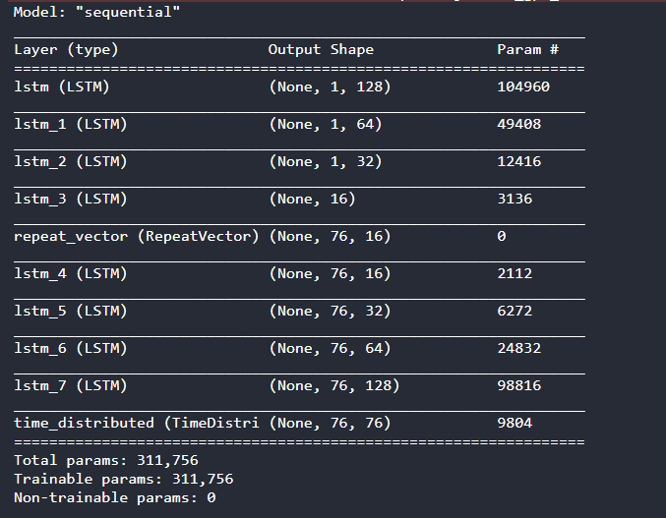
Model Building

Slide 13
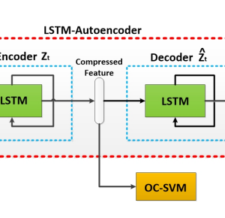
Model Architecture

Slide 14
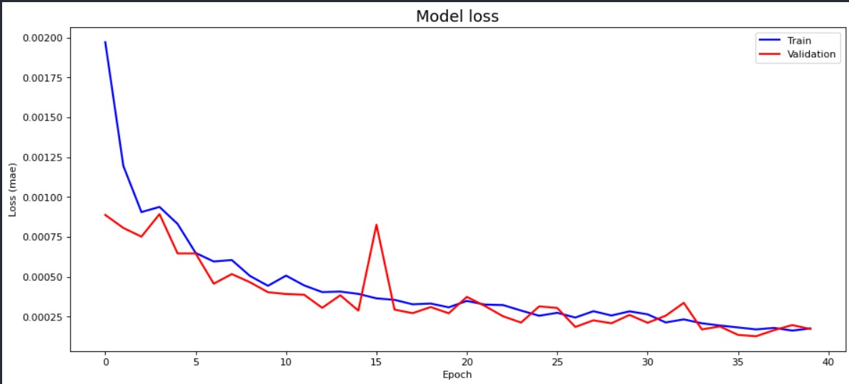
GRAPHICAL INTERFACE

Slide 15
Parameters of the LSTM-AUTOENCODER Model
Parameters | Best Values
Hidden layers | 4
Hidden layer size(neurons) | 128,64,32 and 16
Optimizer | Adam
Loss function | MSE
Activation function | Tanh
Learning rate | 0.0001
Batch size | 32

Slide 16
One-Class SVM
To discover anomalies in an unsupervised fashion we use one-class SVM.
It is trained only on the ‘normal’ data to learn the boundaries of these points.
The main objective is to find a hyper sphere, which contains most of the training samples obtained consequently from the target region.
After training, the decision boundary may allow us to choose the most appropriate candidate region.
The testing accuracy is very good for abnormal data, and the model identifies the anomalies accurately but normal data while deciding the boundary has very little accuracy.
For the OC-SVM model, the parameters gammas=0.001, nu=0.4 and a Radial Basic Function (RBF) kernel are chosen for the experiment.

Slide 17
ONE-CLASS SVM RESULTS
DATA TYPE | ACCURACY |  | SIZE
NORMAL DATA | TEST DATA | TRAIN DATA | TEST SIZE | TRAIN SIZE
 | 78% | 60.5% | 21413 | 54739
ABNORMAL DATA | 95% |  | 138722
Precision | Recall | F1-measure | Support
1.00 | 0.04 | 0.08 | 138722

Slide 18
The final results
Precision | Recall | F1-measure | Accuracy
0.9 | 0.85 | 0.93 | 89.75%
Threshold | Precision | Recall | F1-measure | Accuracy
0.04 | 0.65 | 0.9 | 0.78 | 0.66
0.05 | 0.69 | 0.94 | 0.81 | 0.7
0.07 | 0.7 | 0.96 | 0.82 | 0.741
0.1 | 0.58 | 0.58 | 0.5 | 0.47
0.2 | 0.45 | 0.36 | 0.09 | 0.46

Slide 19
Conclusion
Good accuracy by semi supervised approach
Hybrid model performs better
Training on normal data sets out good boundaries
Changing parameters do not improve accuracy
One-class SVM model alone also gives better accuracy but only on training data as compared to our model.

Slide 20
Future Work
The binary classification problem can also be extended into a multi-class classification problem, in order to identify the type of network attacks.
Different classifiers instead of one-class SVM can be used.
Processing time should also be taken into consideration!!

Slide 21

Thank You

