Slide 1


Image Steganography
Python Mini Project Presentation
Presented By:
Dhyay Popat 18DIT061

Slide 2
About
Steganography is a method of hiding secret data, by embedding it into an audio, video, image or text file. It is one of the methods employed to protect secret or sensitive data from malicious attacks.
Image Steganography refers to the process of hiding data within an image file. The image selected for this purpose is called the cover-image and the image obtained after steganography is called the stego-image.

Slide 3
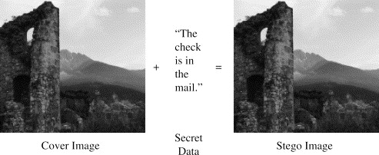
Example

Slide 4
Concepts Used
Functions.
Conditional Statements.
Exception Handling.
Package Used : PIL(Python Imaging Library).
PIL (Python Imaging Library) is a free library for the Python programming language that adds support for opening, manipulating, and saving many different image file formats.

Slide 5
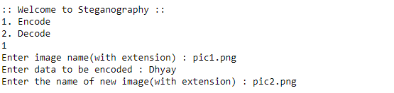
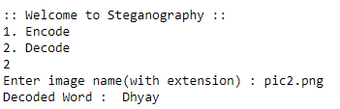
Output Screenshots
1] Encoding
2] Decoding

Slide 6
THANK YOU

