Slide 1
Reddit Sentiment Analysis
And Its Application on Government Protocol
Owen, Dhyey, Sam, Noah

Slide 2
Executive Summary
Data
Predictive Model
01
03
Analysis
Recommendations
02
04
Qualitatively reviewing the data and cleaning for analysis
Predicting the impact of selected words on sentiment and trust
Creating new variables and visualizing the data in different ways to draw insights
What actions different government bodies should take to increase trust and overall sentiment

Slide 3
MISSION STATEMENT
Data

Slide 4
Background on Data
Reddit
Timeline
Announcement
Content of 5000 posts as part of the coronavirus subreddit
The data spans over a 20-day period, from March 1st - March 20th
The global pandemic was officially announced on March 11th

Slide 5
Cleaning Data
Isolate words
1
Remove punctuation and numbers
2
Stem words
4
3
Remove stop words
5
6
Combine meaningful words
Remove ‘coronavirus’ and ‘covid’

Slide 6
MISSION STATEMENT
Analysis

Slide 7
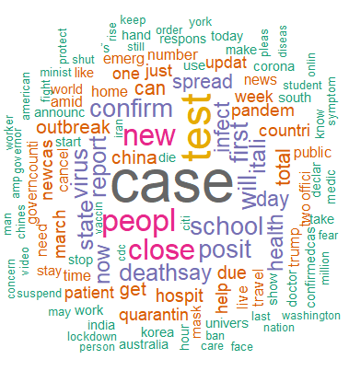
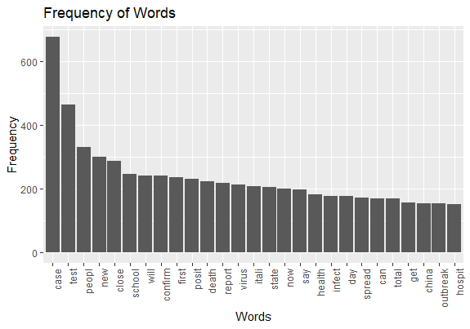
Frequency

Slide 8
Sentiment
Min
Max
Mean
NA’s
-1
1
0.027
11

Slide 9
Sentiment
NRC Sentiment
Initial findings were limited
Looking more specifically at 8 emotions, and overall positive and negative sentiments

Slide 10
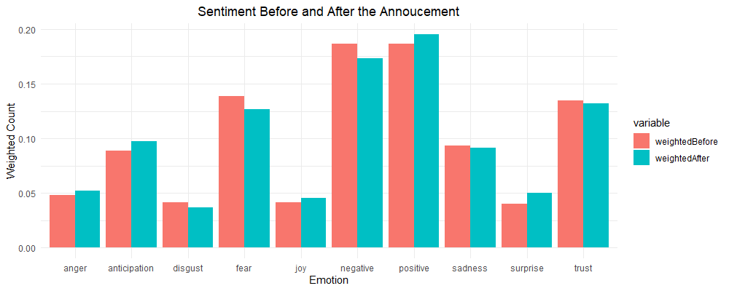
NRC Sentiment

Slide 11
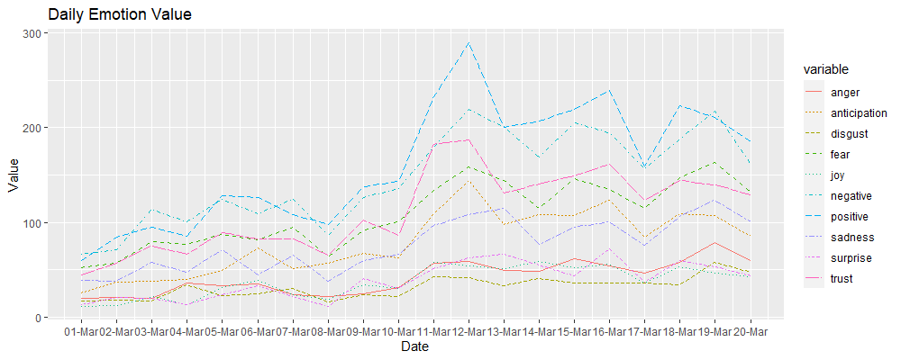
NRC Sentiment

Slide 12
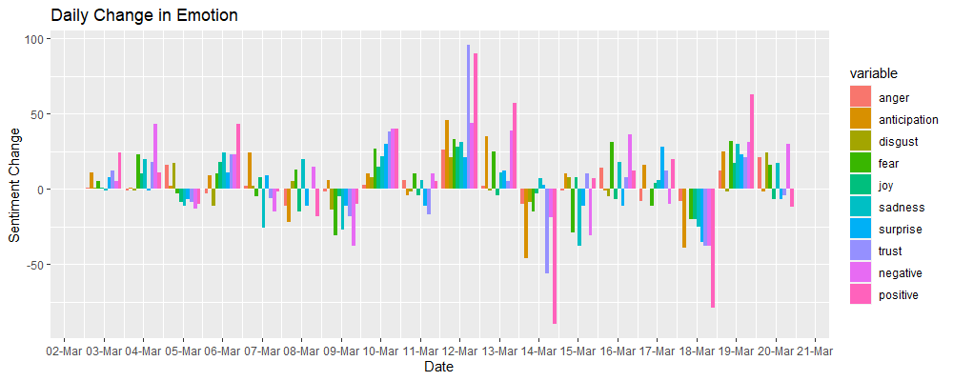
NRC Sentiment

Slide 13
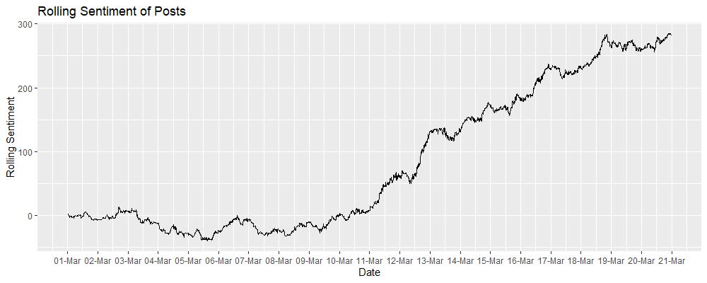
Rolling Sentiment

Slide 14
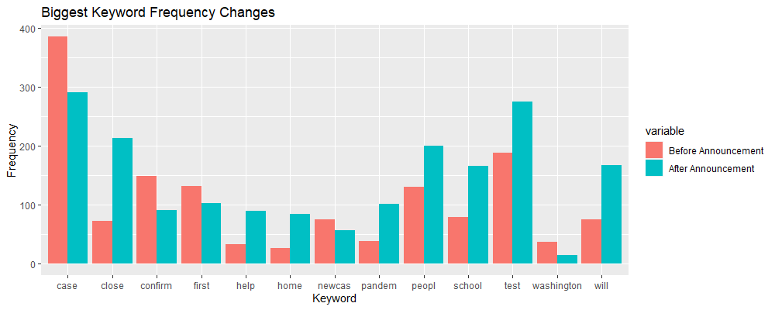
Substantial Changes

Slide 15
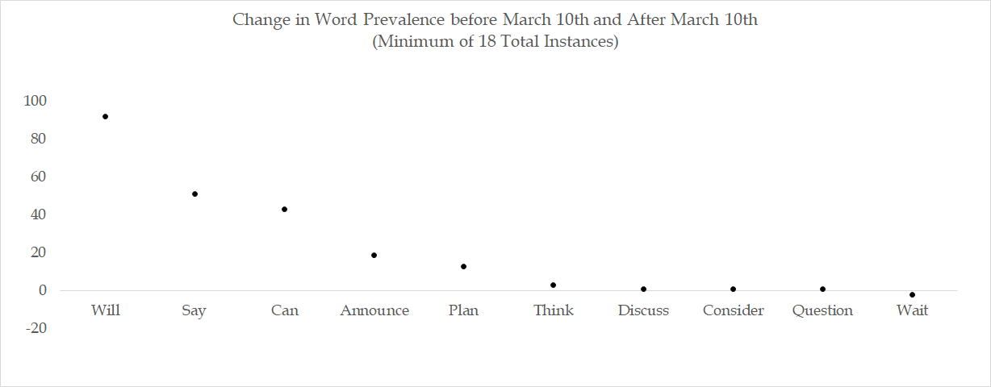
Action Words

Slide 16
MISSION STATEMENT
Predictive Model

Slide 17
Model 1
Independent Variables
Dependent Variable
Case
Will
School
Pandemic
Lockdown
Quarantine
Trump
Infect
Say
Home
Close
Vaccine
Spread
Travel
Death
Restaurant
Question
Test
People
Work
Confirm
Rolling sum of sentiment in the subsequent 10 hours

Slide 18
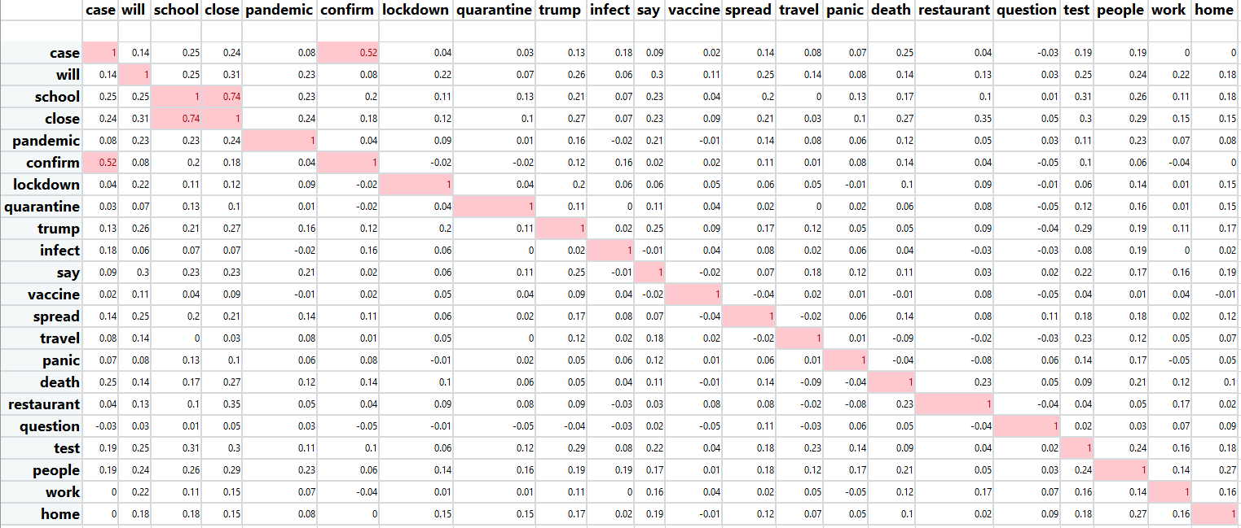
Correlation Matrix

Slide 19
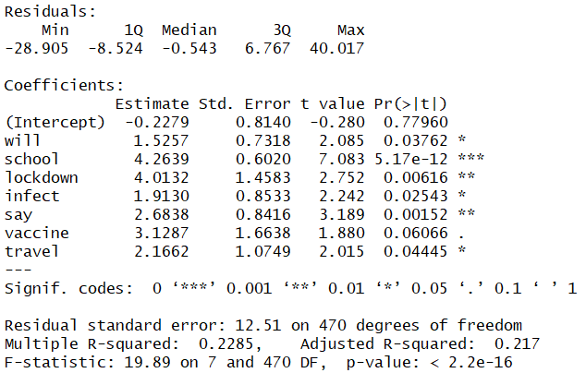
Model 1 Results
School, lockdown and vaccine have high coefficients showing that posts about these topics is driving up sentiment in the subsequent 10 hours
Talks of finding a vaccine, and closing down school through a lockdown would help everyone maintain positivity in short term

Slide 20
Model 2
Independent Variables
Dependent Variable
Case
Will
School
Pandemic
Lockdown
Quarantine
Trump
Infect
Say
Home
Vaccine
Spread
Travel
Death
Restaurant
Question
Test
People
Work
Rolling mean of trust in the subsequent 10 hours

Slide 21
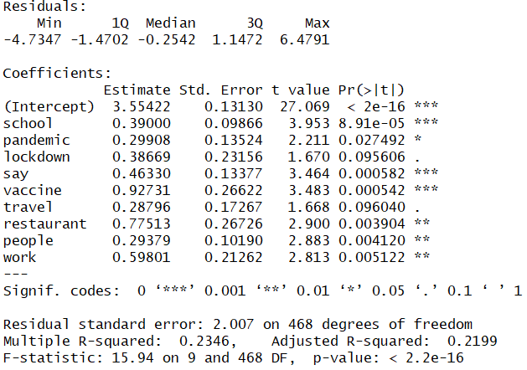
Model 2 Results
The words in the trust model are similar to the sentiment model, but with changes in words related to level of restriction
The word with the highest coefficient in this model is vaccine

Slide 22
Recommendations
MISSION STATEMENT

Slide 23
Recommendations
Policy
Public Spaces
Healthcare
Pandemic
Lockdown
Vaccine
Test
Infect
School
Restaurant

Slide 24
Risks & Mitigations
The model that was generated is only based off 20 days of data
If the pandemic continues for an extended period of time, we don’t know how accurate the model will be
This is a dynamic model that can take in new data and be updated using more relevant data

