Slide 1

NGO Volunteer Management System
DBMS PBL Mini Hackathon
Project-ID :- 10238
Presented by: Dhyey A. Raja
Enrollment: 92610116003

Slide 2

Project Overview
Goal: To design and build a centralized database system for an NGO to track volunteer activities.
Volunteer Registration & Profiles
Centralized volunteer onboarding and profile management
Skills & Proficiency Tracking
Map volunteer capabilities to project needs
Projects, Campaigns & Events
Organize and manage all NGO initiatives
Hours Logged & Donations
Track participation hours and donation records

Slide 3
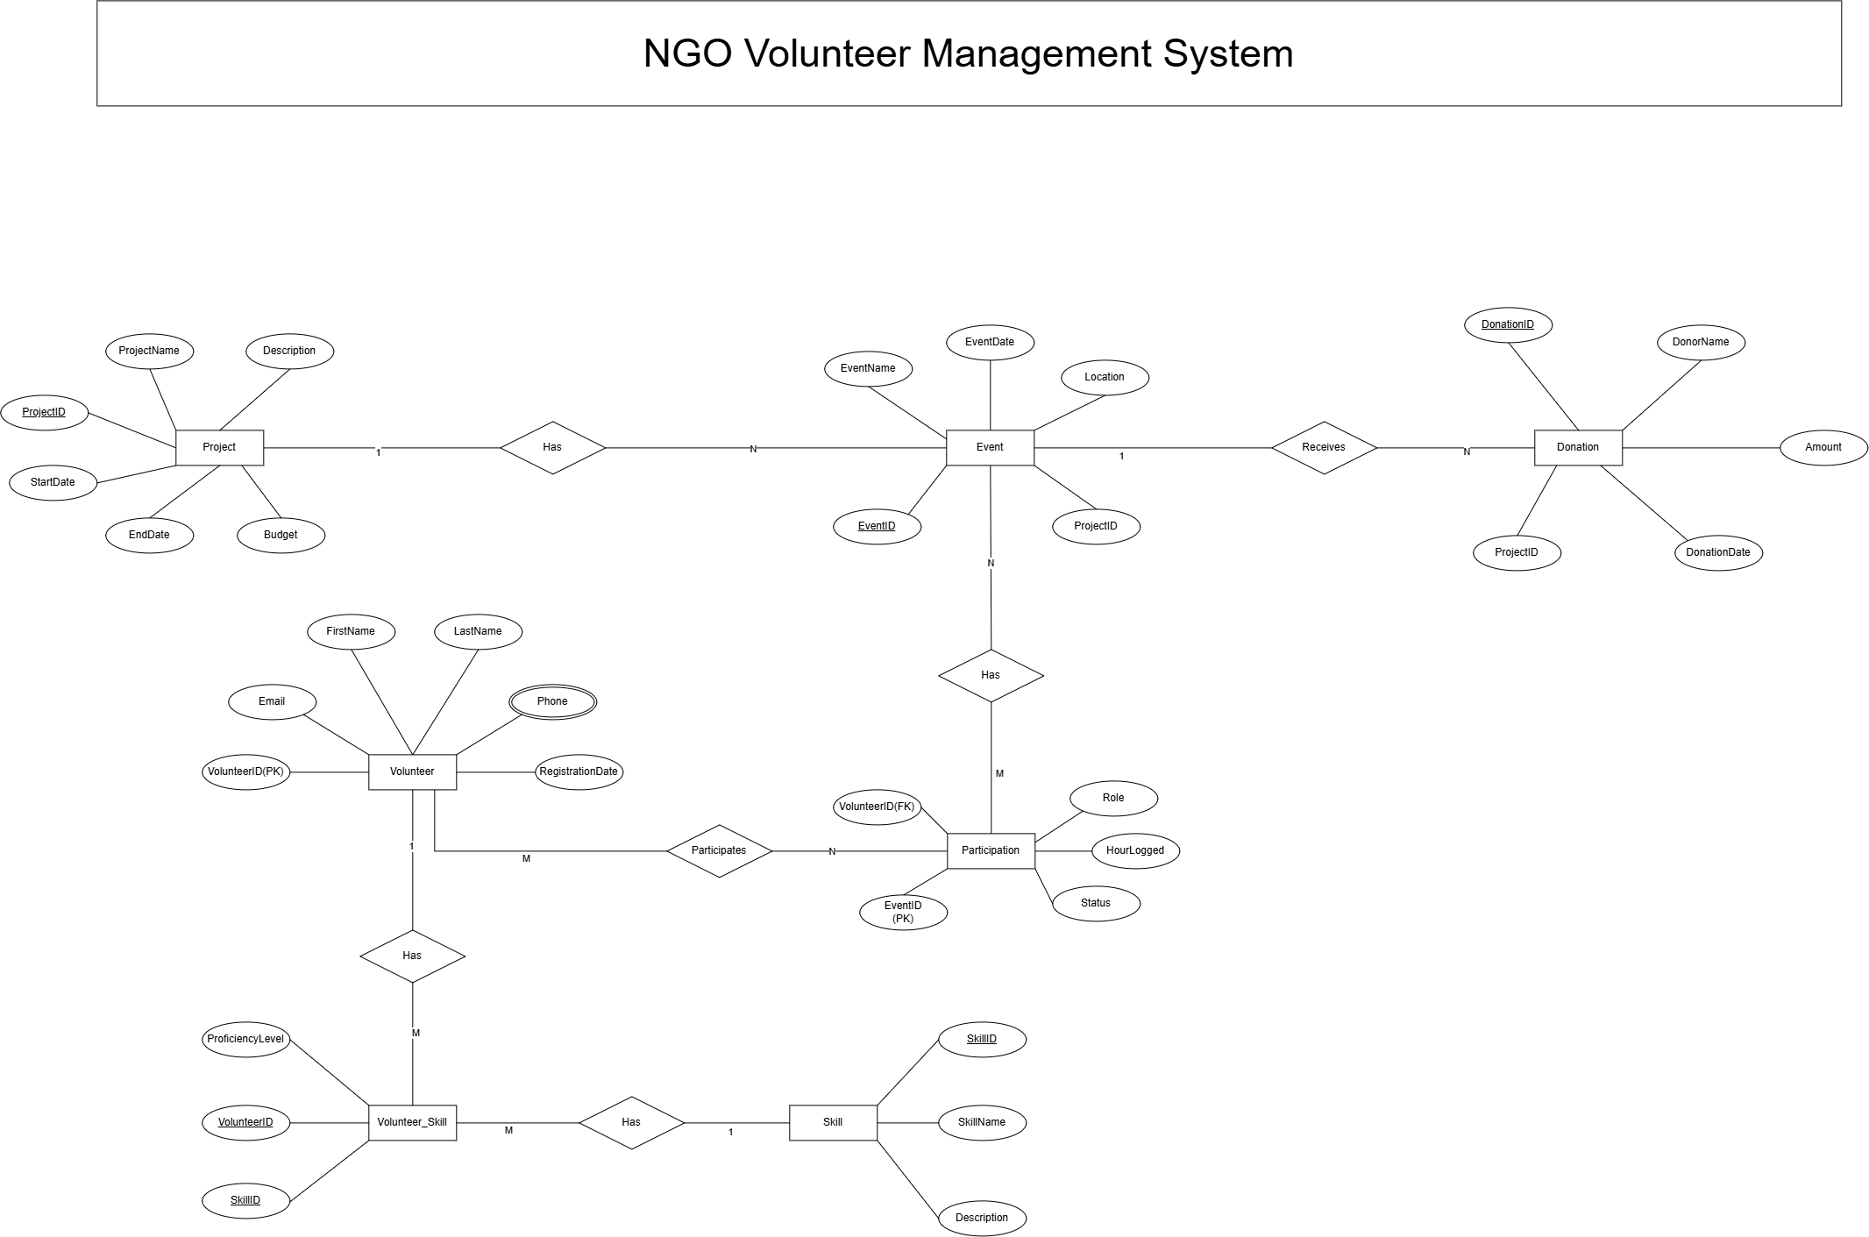

ER Model & Architecture
Volunteer
Project & Event
Core entity — profiles, contact info, registration date
Hierarchical: Events belong to Projects
Skill
Participation & Donation
M:N relationship with Volunteer via Volunteer_Skill
Bridge tables capturing hours logged and donor records
7 Entities total — includes both 1:N and M:N relationships. Screenshot of Classical ER Diagram to be added here.

Slide 4
Database Schema Design
Table | Primary Key | Key Columns
Volunteer | VolunteerID | FirstName, LastName, Email, Phone, RegDate
Project | ProjectID | ProjectName, Description, StartDate, EndDate, Budget
Event | EventID | ProjectID (FK), EventName, EventDate, Location
Skill | SkillID | SkillName, Description
Volunteer_Skill | VolunteerID + SkillID | ProficiencyLevel
Participation | VolunteerID + EventID | Role, HoursLogged, Status
Donation | DonationID | ProjectID (FK), DonorName, Amount, DonationDate

Slide 5


Interactive Web Dashboard
Python / Flask Backend
Fully functional dynamic web interface connecting directly to the relational database
Tabbed Dashboard UI
Responsive, tabbed layout built with Tailwind CSS for intuitive navigation
Live CRUD Operations
Create, Read, Update, and Delete records directly from the browser interface
Screenshot of Tailwind UI dashboard to be added here.

Slide 6
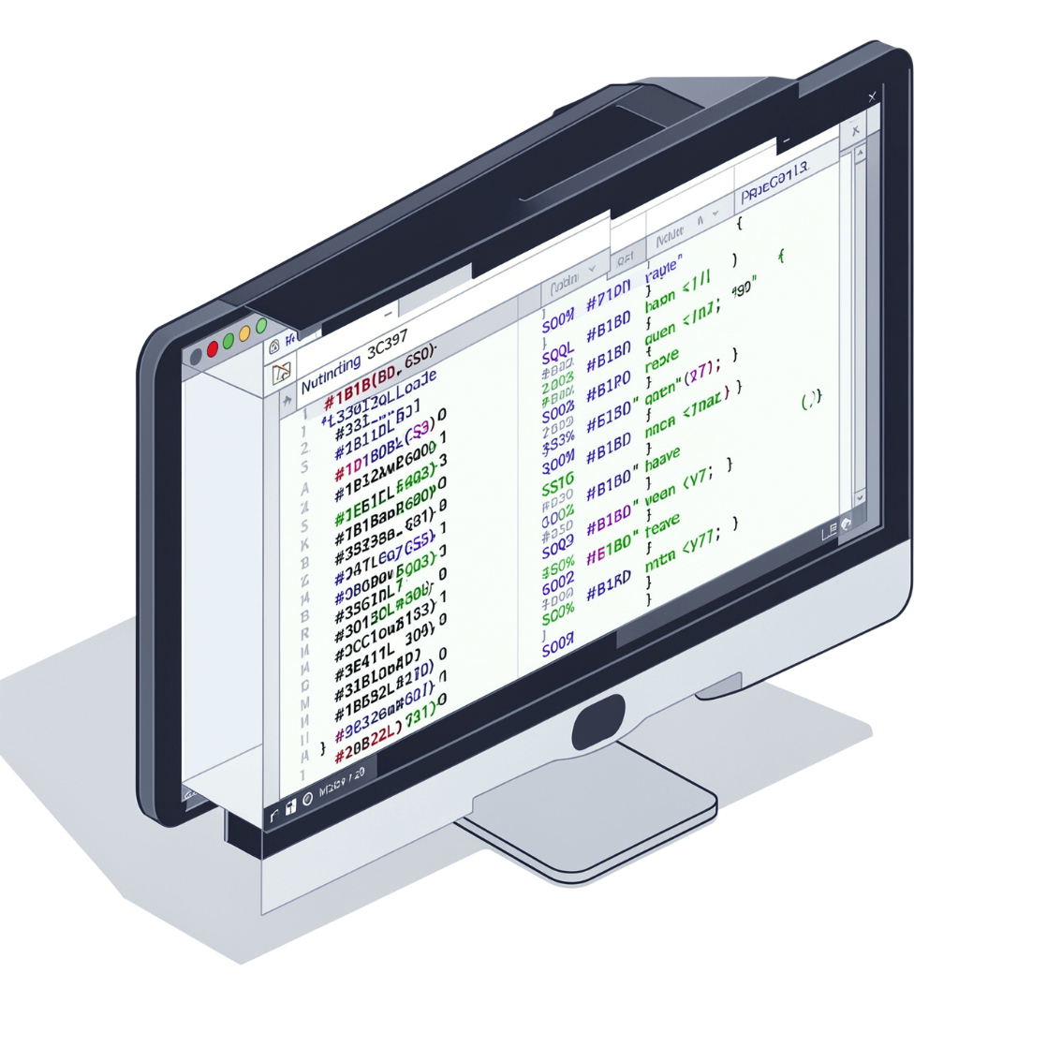
Advanced Data Retrieval
Finding Total Hours by Volunteer
SELECT v.FirstName,
SUM(p.HoursLogged) AS TotalHours
FROM Volunteer v
JOIN Participation p
ON v.VolunteerID = p.VolunteerID
GROUP BY v.VolunteerID;
Project Donation Totals
SELECT p.ProjectName,
SUM(d.Amount) AS TotalDonations
FROM Project p
LEFT JOIN Donation d
ON p.ProjectID = d.ProjectID
GROUP BY p.ProjectID;
Aggregate queries using JOIN, GROUP BY, and SUM() power the dashboard's live reporting — surfacing volunteer impact and fundraising performance at a glance.

Slide 7

Thank You!
Any Questions?

