Slide 1
Feature Optimization for Netflix Stock Price Prediction
Shourya Mukherjee, Snehashish Reddy Manda, Dhiren Gangishetty, Girish Rengadurai, Dhyey Shah
Notes:
Ashish

Slide 2
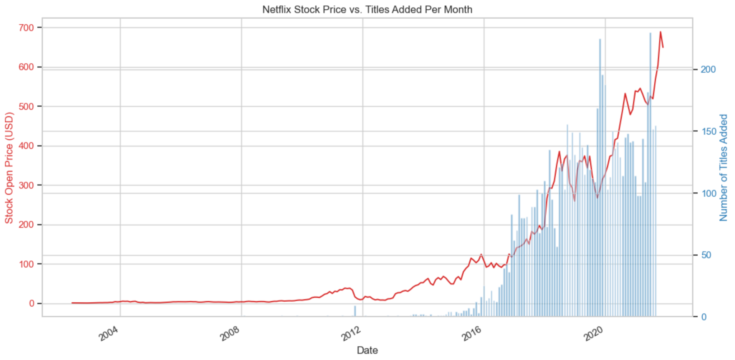
Exploratory Data Analysis
Number of titles in the IMDB database added to Netflix per month
Displays the stock price at the beginning of the first day of each month.

Slide 3
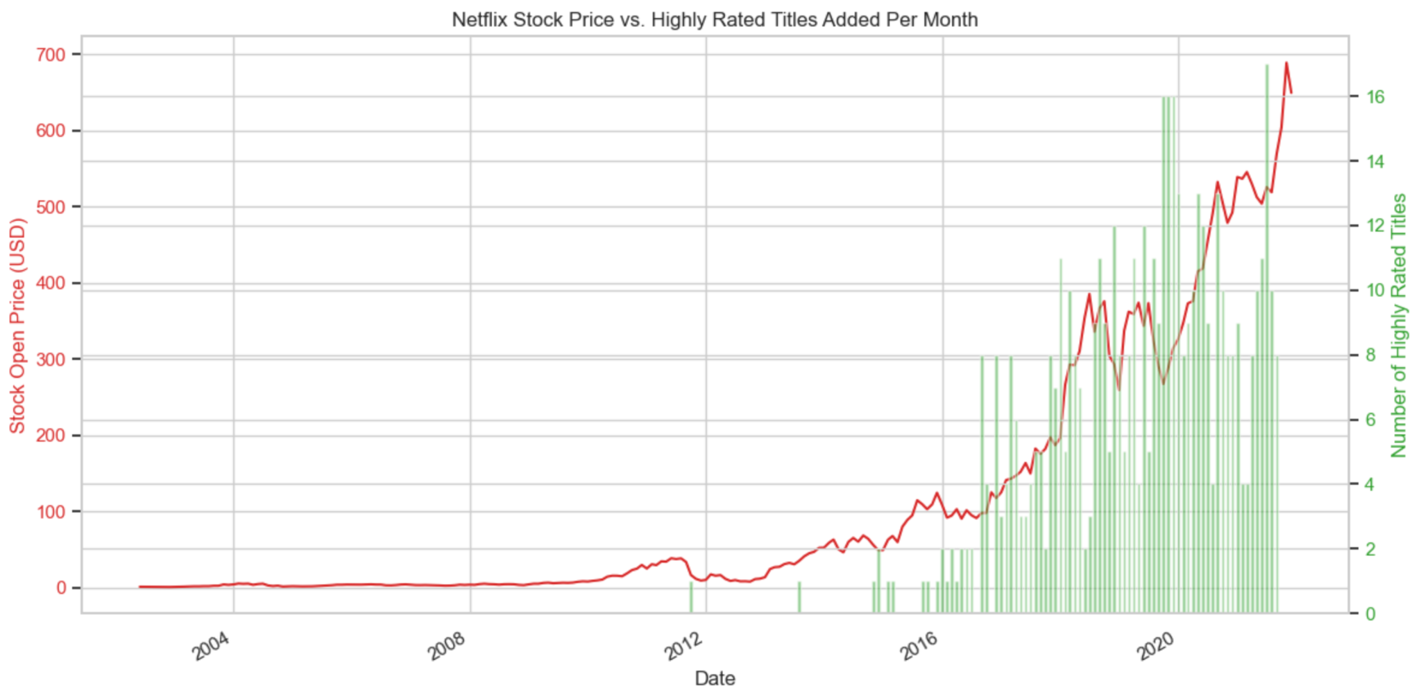
Exploratory Data Analysis
Attack on Titan (9.1)
Sherlock (9.1)
Breaking Bad (9.5)
Filters only titles that have IMDB score greater than 8.0
LOTR: Return of the King (9.0)

Slide 4
Methods
Label
Monthly Price Movement
Grid Search Hyperparameter Tuning
Open
L2 Regularization
Close
Features
Volume
Logistic Regression
k-fold Cross Validation
High
Low
Label Prediction
Features
High Rated Titles Added Last Month
Notes:
Shourya

Slide 5
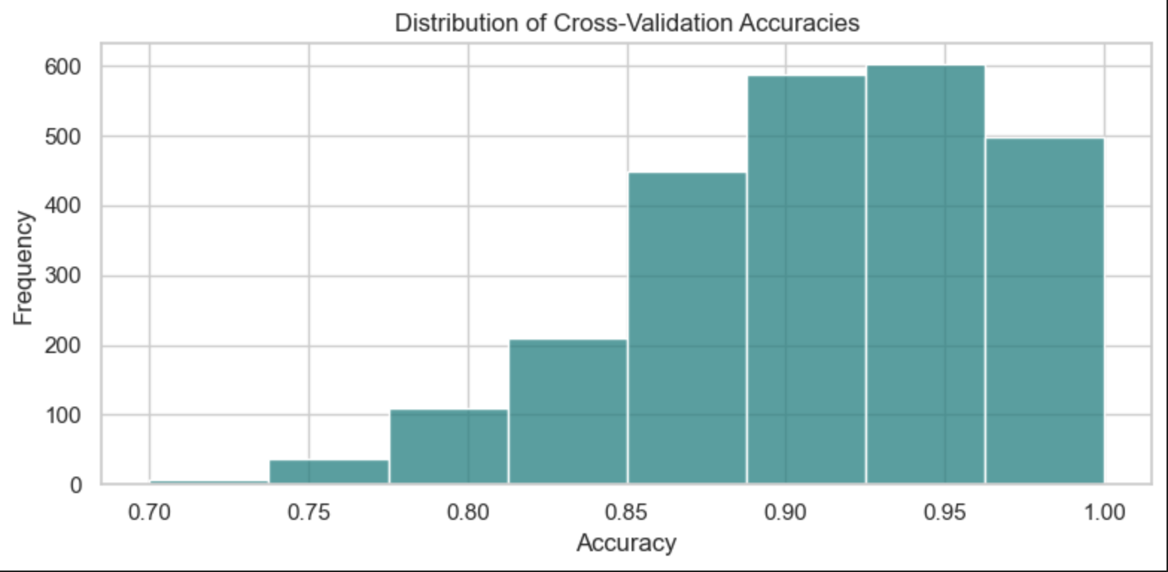
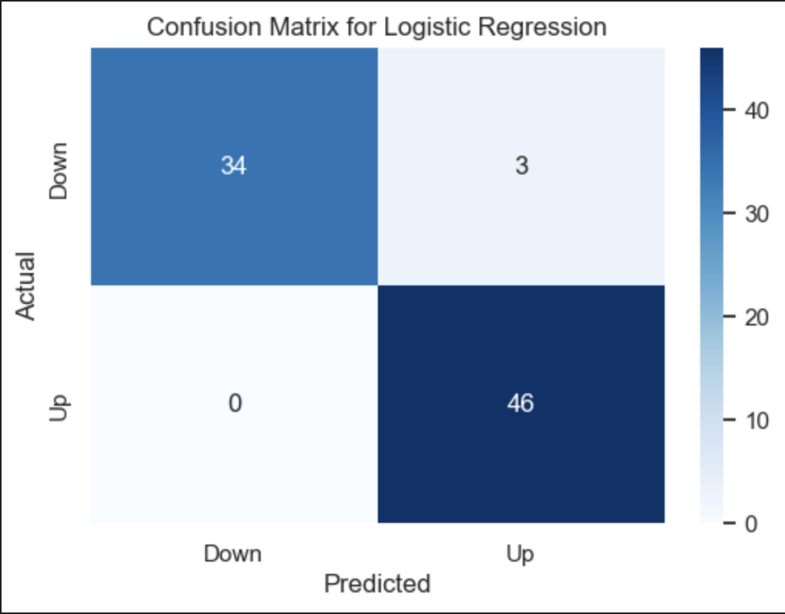
Results
Feature Set
Open
Close
Prev_Close
Volume
High_Rated_Titles_Added_Last_Month
Metric | Value
Mean Accuracy | 0.9055
Standard Deviation | 0.0518
Min Accuracy | 0.7
Max Accuracy | 1
This particular case achieves 96% accuracy.
The model was trained on 70% of the total data. The remaining 30% was used as test data.
Choice of training data creates variability in model accuracy.
Notes:
Shourya

Slide 6
Thank You

