Slide 1
Introduction to 3D Printing
Dave Hylands
dhylands@gmail.com
https://github.com/dhylands/h4ck-3d-intro

Slide 2
Additive Manufacturing
3D Printing is a type of Additive Manufacturing (AM)
CNC Milling machines are a form of subtractive manufacturing
Seashells and snails shells are natures 3D printer

Slide 3
SLS, SLA, DLP
Selective Solidification
  Stereo Lithography (SLA) – invented in 1984 by Chuck Hull of 3D Systems Corporation.
  Process of curing photopolymers using a UV Laser (sometimes called resin printers)
Selective Laser Sintering - SLS
  Process of binding a powdered material using a laser.
Selective Deposition
  Fused Deposition Modeling (FDM)
  Trademarked term, so often Fused Filament Fabrication (FFF) is used
Stereo Lithography (STL) file format invented for this

Slide 4
RepRap Movement
After FDM patents expired, Adrian Bowyer thought he could create a filament extruding 3D printer which could create parts for other 3D printers.
First design for Darwin released in 2007
Mendel was next in 2009
Josef Prusa simplified the Mendel and released the Pruse Mendel – 2010
Designed rapidly evolved.
  See http://reprap.org/wiki/RepRap_Family_Tree

Slide 5
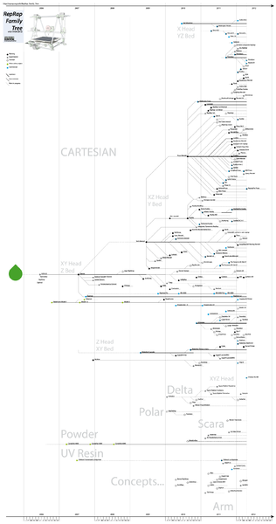
http://reprap.org/wiki/RepRap_Family_Tree

Slide 6
Enabling Technologies
Crowdfunding
  Kickstarter
  Indiegogo
Arduino
Github
RepRap wiki
MakerBot - Thingiverse

Slide 7
3D Printing Process
Design your Model
  Typically using a CAD program
Some CAD Programs
  Blender - http://www.blender.org/
  123D (Autodesk) - http://www.123dapp.com/
  SketchUp - http://www.sketchup.com/
  FreeCAD - http://freecadweb.org/
  TinkerCAD - https://tinkercad.com/
  NetFabb - http://www.netfabb.com/hobbyists.php
  OpenSCAD - http://www.openscad.org/

Slide 8
Process – Download
Thingiverse (MakerBot) - http://www.thingiverse.com/
YouMagine (Ultimaker)- https://www.youmagine.com/
123D (Autodesk) - http://www.123dapp.com/Gallery/content/all
Nasa - http://nasa3d.arc.nasa.gov/models
http://www.hongkiat.com/blog/download-free-stl-3d-models/

Slide 9
3D Printing Process
Slice
  Coverts STL file into layers
  Generates G-Code commands which printer how to move extruder around and how much filament to extrude.

Slide 10
Process - Some Slicers
Cura - https://www.ultimaker.com/pages/support/manuals
Slic3r - http://slic3r.org/
KISSlicer - http://kisslicer.com/
SkeinForge - http://reprap.org/wiki/Skeinforge
Simplify3D - http://www.simplify3d.com/ $(140)
MatterControl - http://www.mattercontrol.com/ (Win/Mac only)

Slide 11
Process – Control
Takes the G-Code and sends it to the 3D printer.
Allows manual control of the printer
  Change filament
  Clean nozzle
  Test limit switches
  Preheat

Slide 12
Process – Control Software
Many Slicers have some control capability
Repetier Host - http://www.repetier.com/
PronterFace/PrintRun - http://reprap.org/wiki/Printrun
OctoPrint - http://octoprint.org/

Slide 13
Software I use
Design
  FreeCAD - http://www.freecadweb.org/
  OpenSCAD - http://www.openscad.org/
Slice
  Cura - http://www.openscad.org/
  Slic3r - http://slic3r.org/
Control
  Repetier Host - http://www.repetier.com/
  OctiPrint - http://octoprint.org/
  PrintRun - http://reprap.org/wiki/Printrun

Slide 14
Resources
http://www.3ders.org/3d-software/3d-software-list.html

