Slide 1
Introduction to Electronics
Dave Hylands
dhylands@gmail.com
https://github.com/dhylands/h4ck-electronics-intro

Slide 2
Overview
Identifying Components
Voltage Regulator
Dark Detector
555 Timer as LED Flasher

Slide 3
Identifying Components
Solderless Breadboard
Wire
Resistors
Capacitors
LEDs
Transistors
Integrated Circuits
Misc

Slide 4
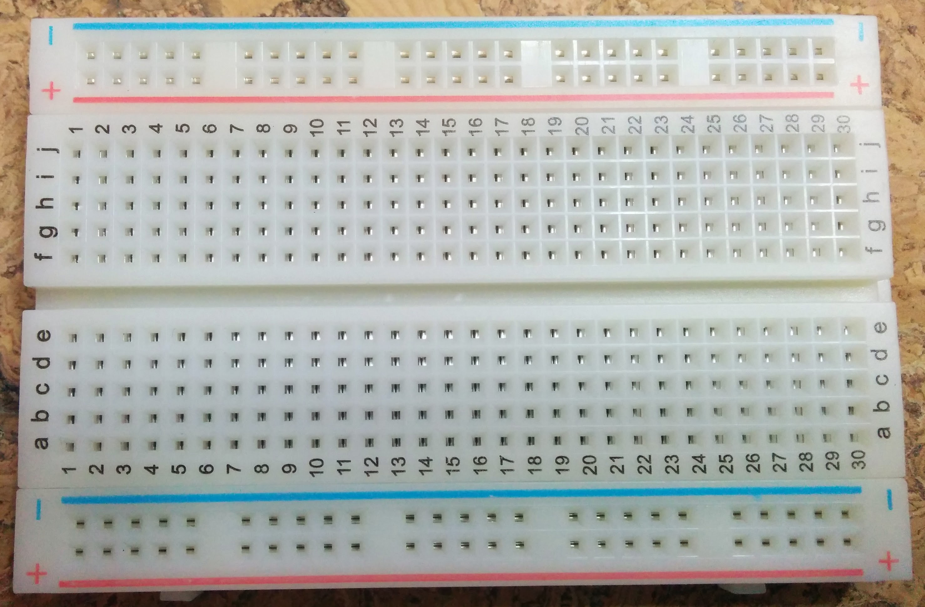
Solderless Breadboard

Slide 5
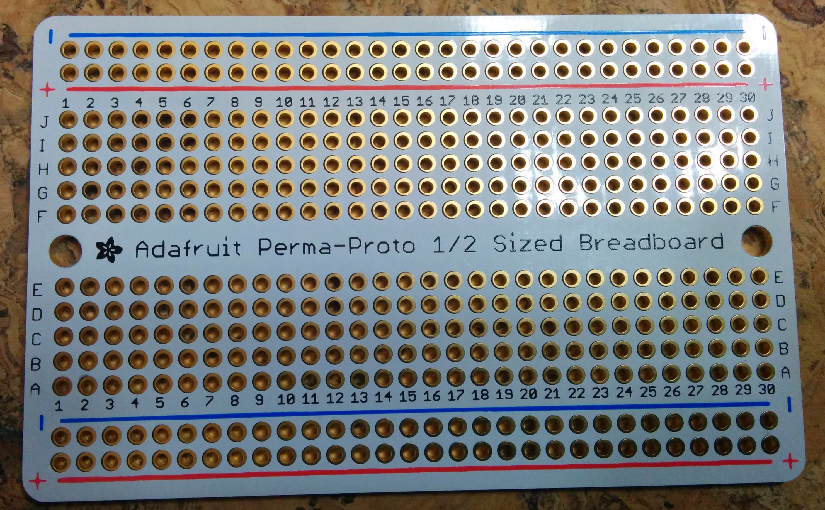
Adafruit Perma-Proto

Slide 6
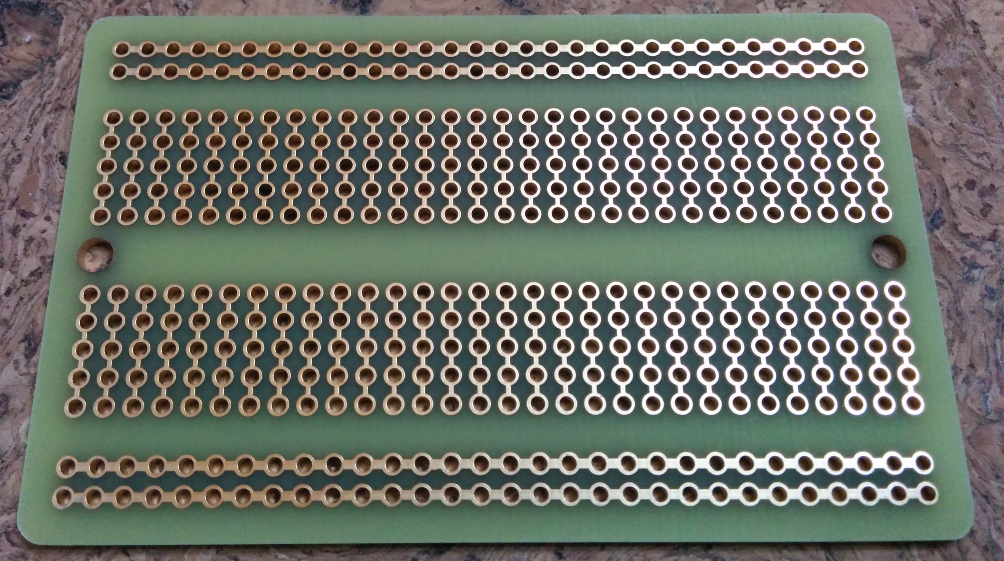
Backside of PermaProto
This shows the electrical connections for a typical solderless breadboard.

Slide 7
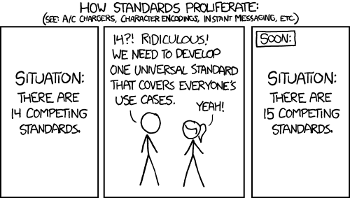
Standards

Slide 8
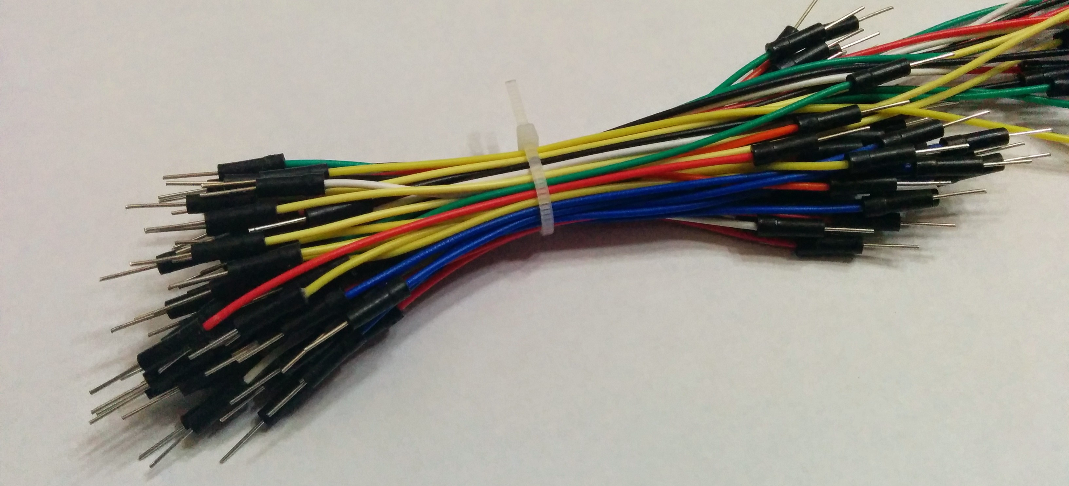
Jumper Wire

Slide 9
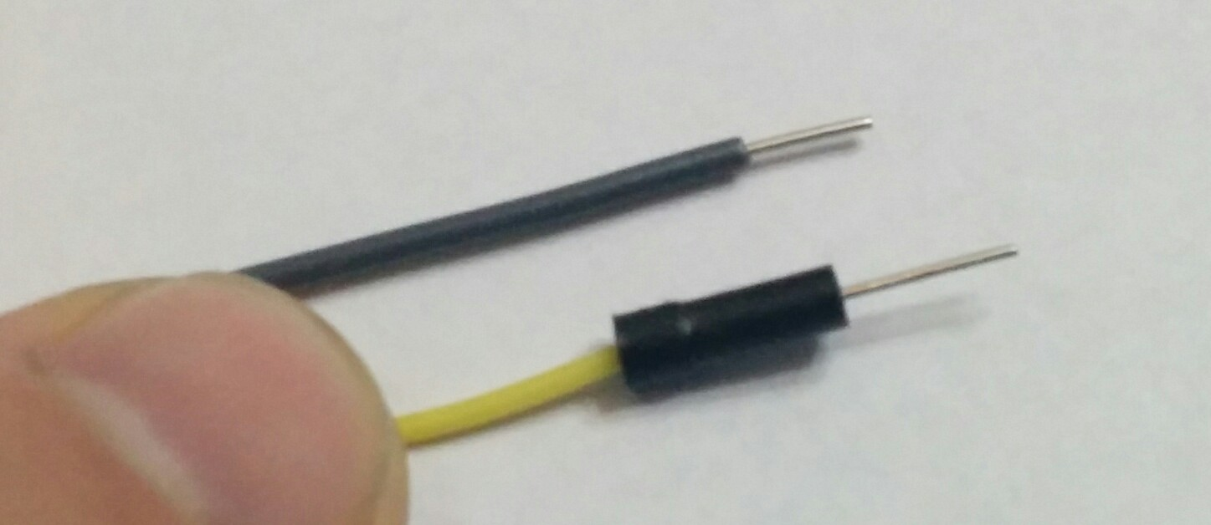
Wire – Solid 22 AWH
Gray wire is 22 AWG solid. Yellow is a jumper wire for comparison.

Slide 10
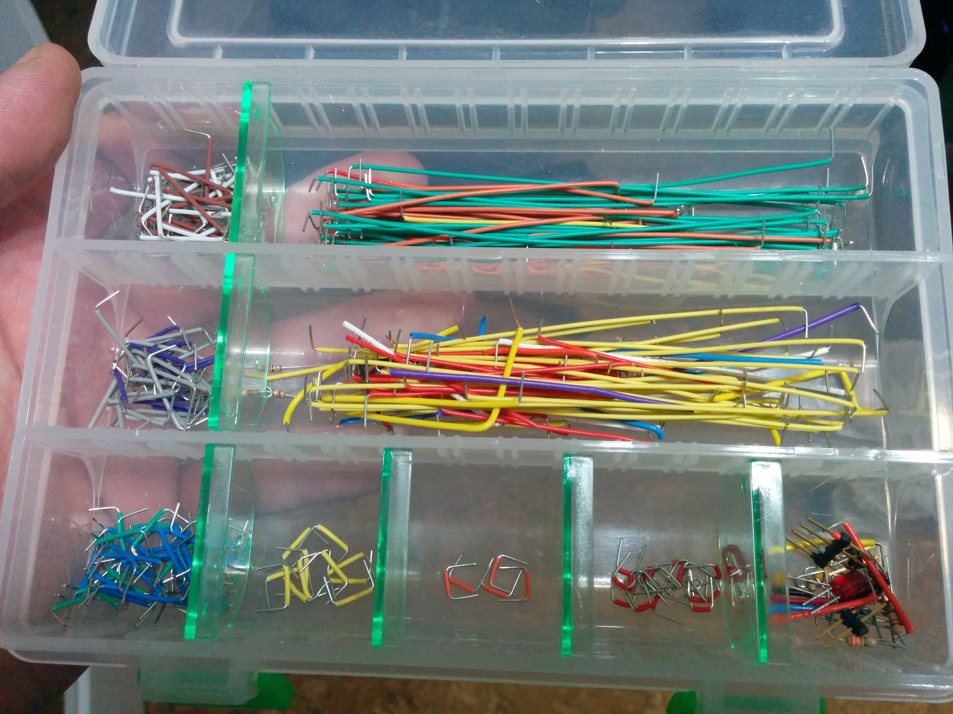
Wire Precut Lengths
Length uses resistor color codes.

Slide 11
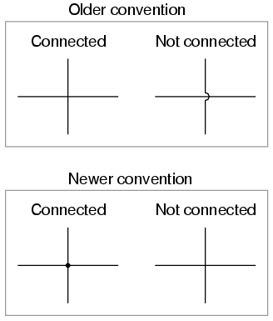
Wire - Schematics
Color Conventions
Black – Ground
Red - Power
Note: 120v House wiring uses
Different conventions
Black/Red – Hot/Line
White – Neutral/Return
Green/Bare - Ground

Slide 12
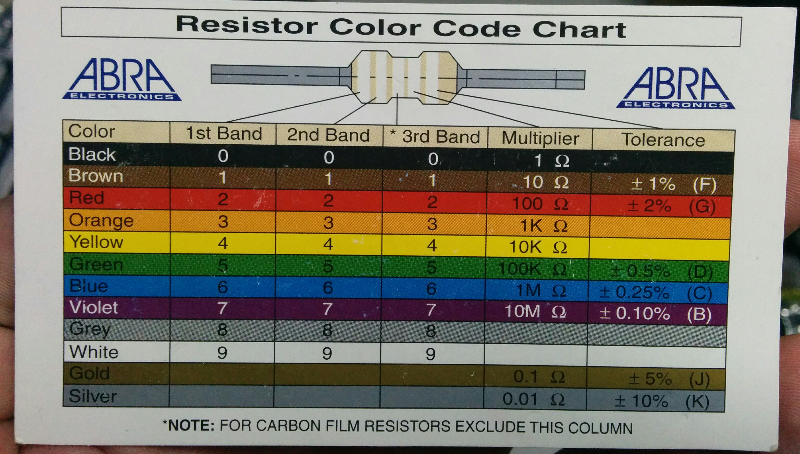
Resistor Color Codes

Slide 13
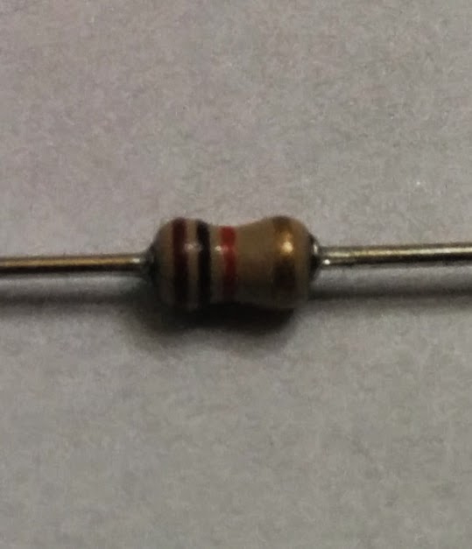
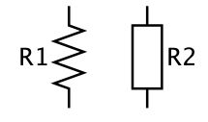
Resistor – 1K ohms
Brown-Black-Red-Gold – 102 – 1K ohms – 5% - 1/8 watt

Slide 14
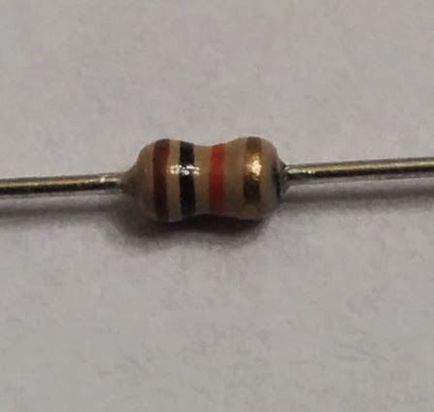
Resistor – 10K ohms
Brown-Black-Orange-Gold – 103 – 10K ohms 5% - 1/8 watt

Slide 15
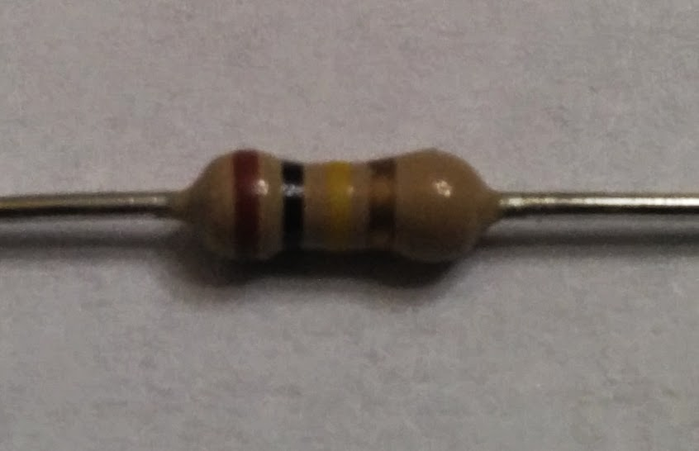
Resistor – 100K ohms
Brown-Black-Yellow-Gold – 104 – 100K ohms 5% 1/4 watt

Slide 16
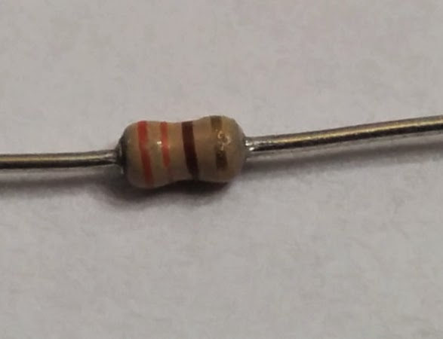
Resistor – 330 ohms
Orange-Orange-Brown-Gold – 331 – 330 ohms 5% - 1/8 watt

Slide 17
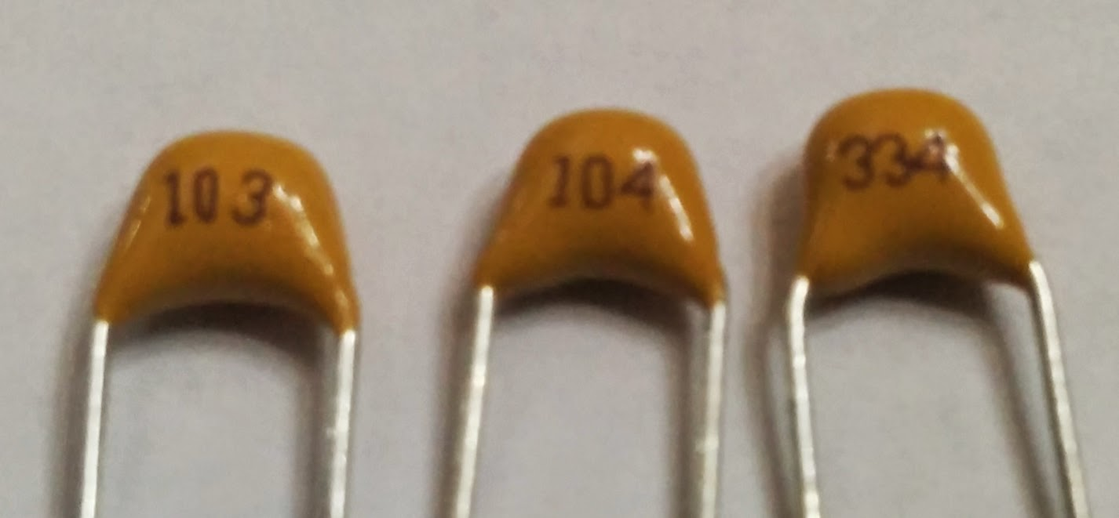
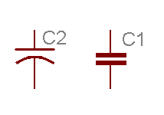
Capacitor - Ceramic
Non-polarized. Measured in pF (pico Farads) – typically 10%
103 = 10000 pF = 10 nF = 0.01 uF
104 = 100000 pF = 100 nF = 0.1 uF
334 = 330000 pF = 330 nF = 0.33 uF

Slide 18
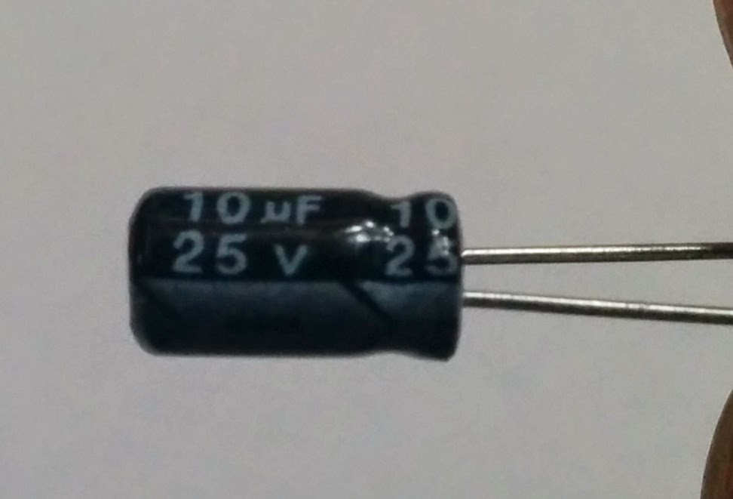
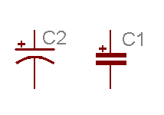
Capacitor – Electrolytic
Value iis typically printed on capacitor.
Polarized. Important to connect plus and minus properly.
Short leg is negative.

Slide 19
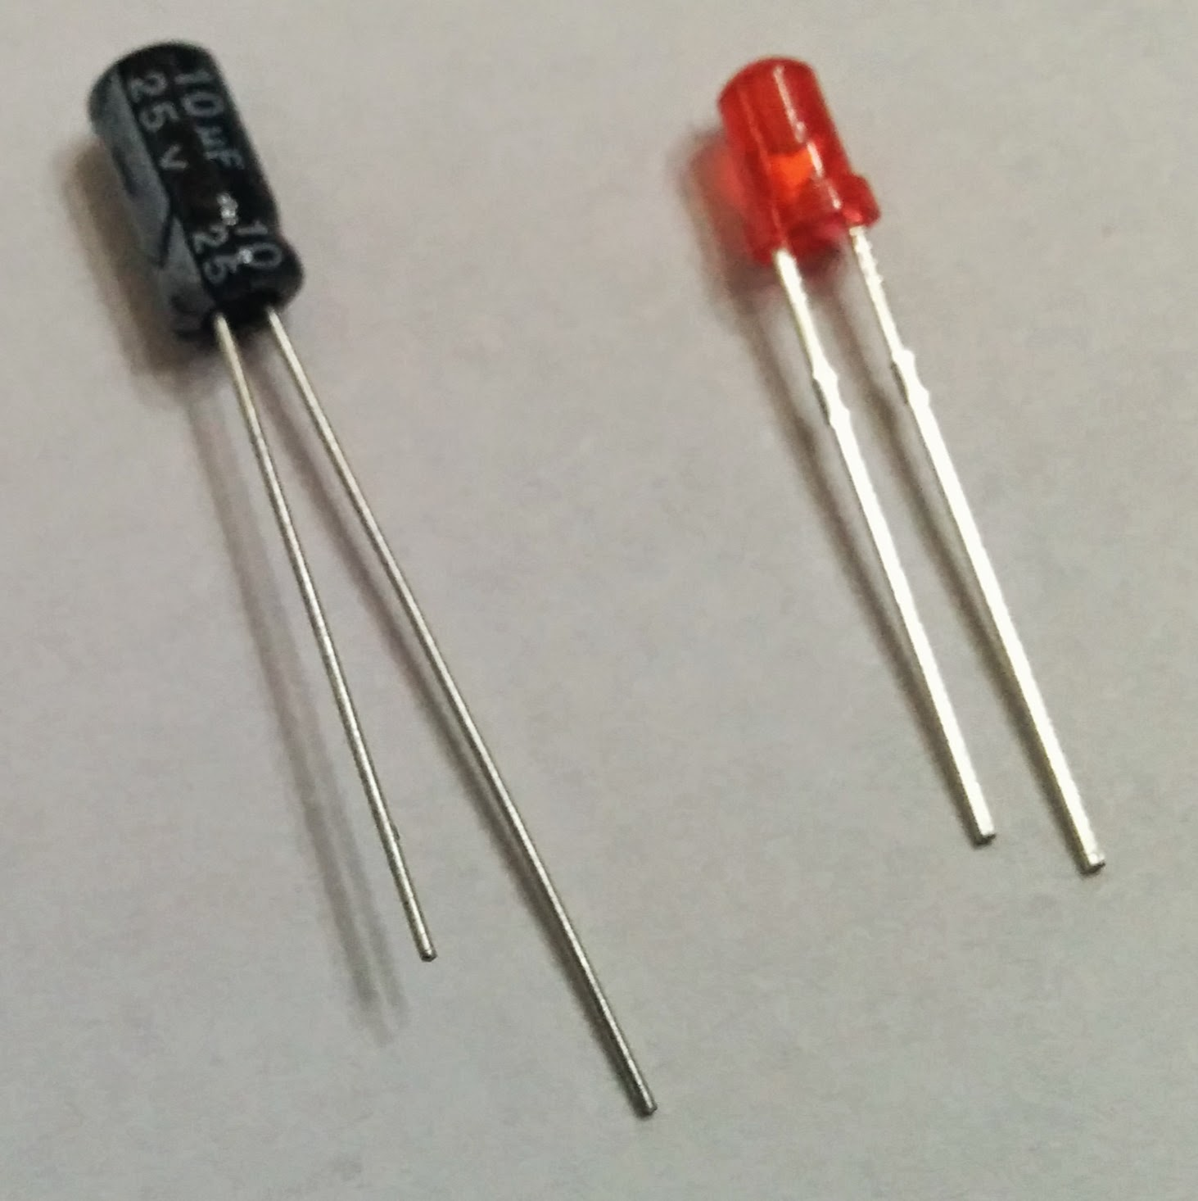
Short Legs - Negative
Electrolytic capacitors and LEDs typically have a short leg,
which is typically negative.

Slide 20
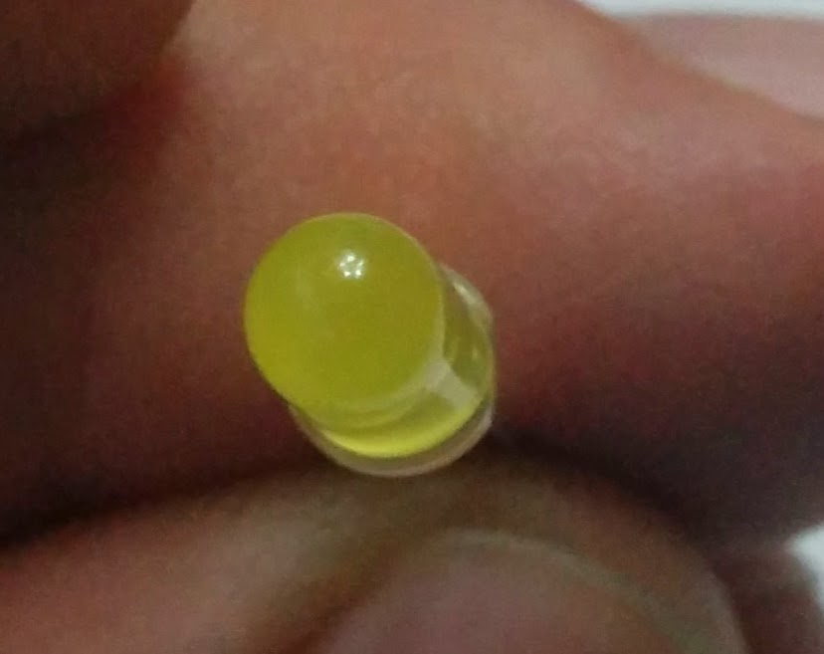
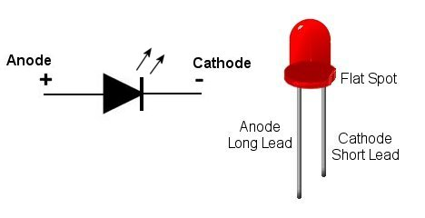
LED – Light Emitting Diode
LED – Flat Side typically negative

Slide 21
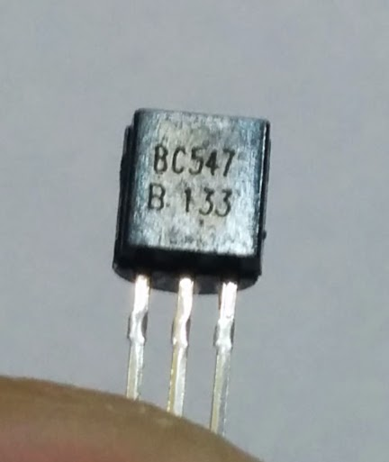
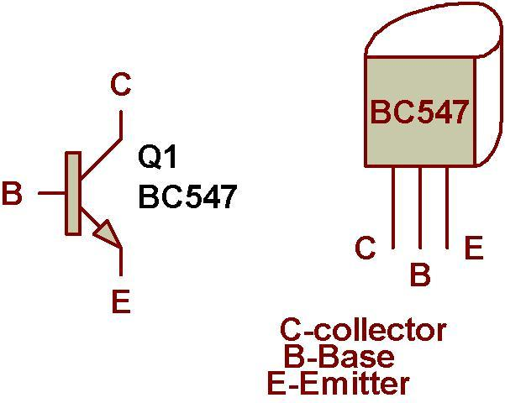
NPN Transistor

Slide 22
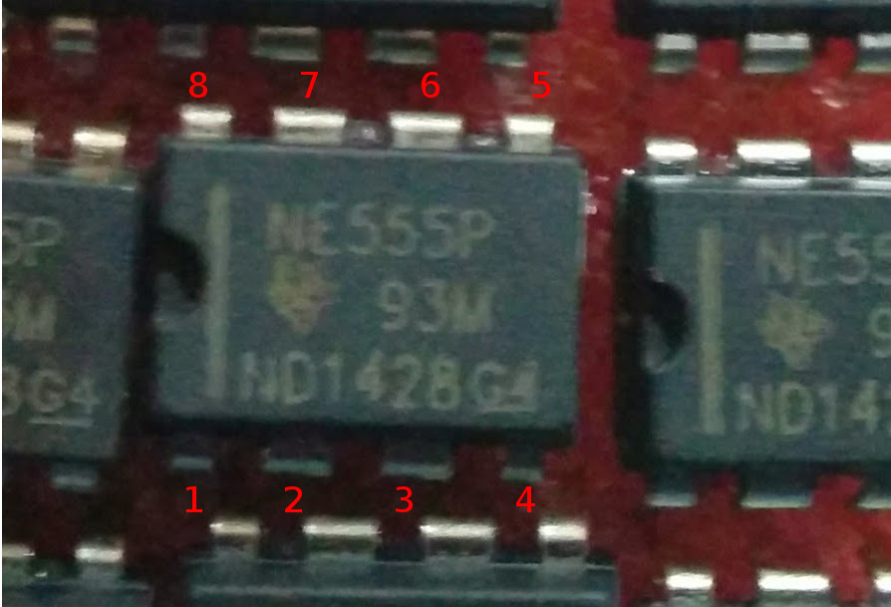
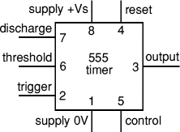
Integrated Circuits
555 Timer Chip – 8 pin DIP (Dual Inline Pins)

Slide 23
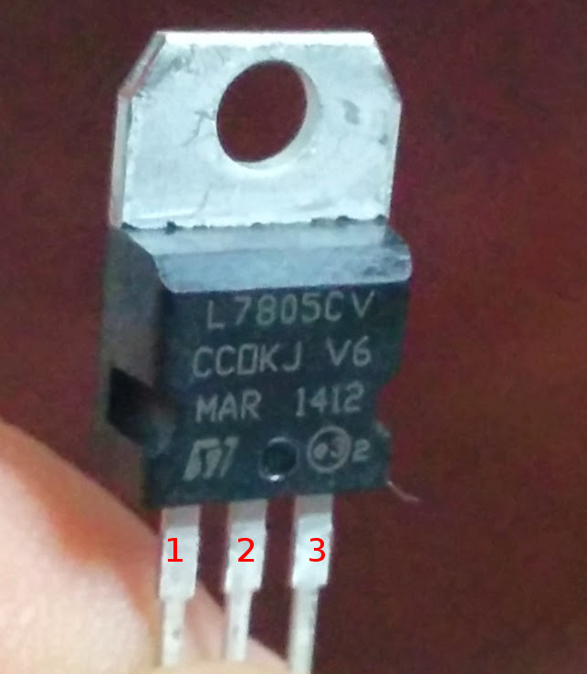
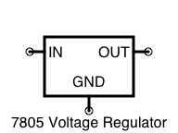
Voltage Regulator
7805 - +5V linear regulator

Slide 24
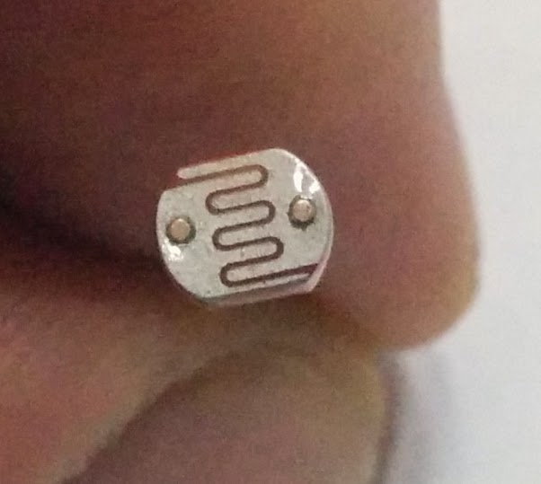
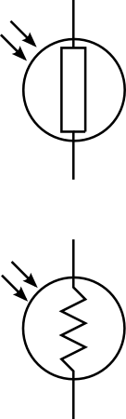
Light Dependent Resistor

Slide 25
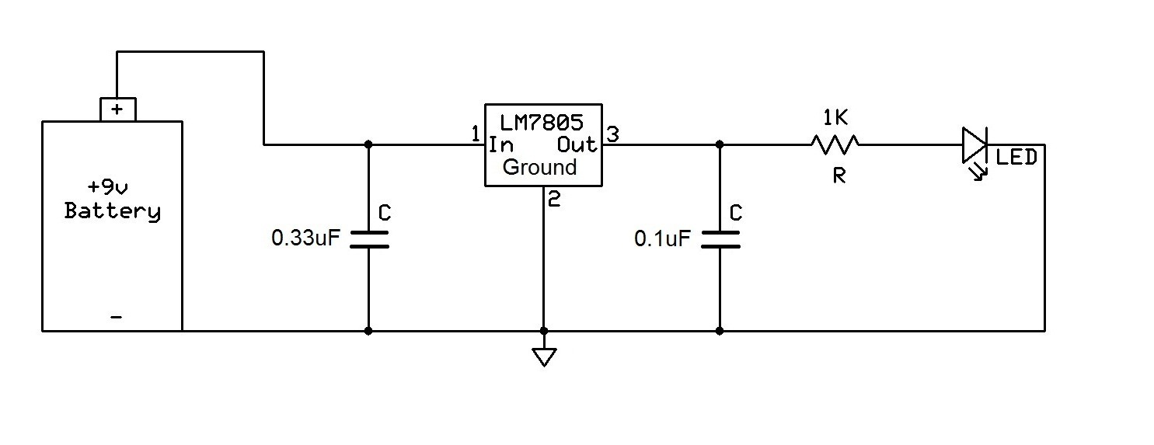
Voltage Regulator
http://www.learningaboutelectronics.com/Articles/How-to-connect-a-voltage-regulator-in-a-circuit
0.33uF = 334
0.1uF = 104
1K = Brown-Black-Red

Slide 26
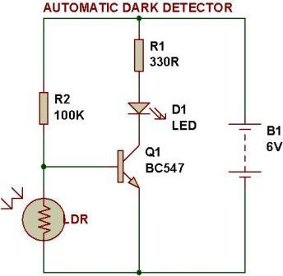
Dark Detector
http://www.buildcircuit.com/building-a-circuit-on-breadboard/
330 = Orange-Orange-Brown
100K = Brown-Black-Yellow

Slide 27
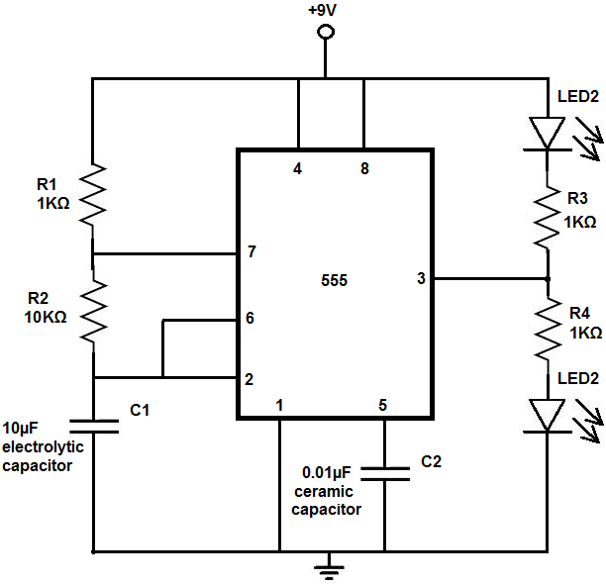
555 Timer – LED Flasher
http://www.learningaboutelectronics.com/Articles/LED-flasher-circuit.php

Slide 28
Resources
Encyclopedia of Electronic Components
  Volume 1 - Resistors, Capacitors, Inductors, Switches, Encoders, Relays, Transistors
  Volume 2 - LEDs, LCDs, Audio, Thyristors, Digital Logic, and Amplification
  Volume 3 - Light, Sound, Heat, Motion, Ambient, and Electrical Sensors

