Slide 1
DDH networks
Case study 2025
Presentation by
Darren D Huynh

Slide 2
Objectives
Discuss VLSM Scheme and Logical Topology
Configure OSPFv2 and RIP for routing
Configure GRE and Secure GRE Tunnel with IPsec
Discuss NAT and Germany ACL
DHCP and VLAN Configurations
Verification and Testing
Questions
Presentation by
Darren D Huynh

Slide 3
PHASE 1: LAN/WAN and INTERFACES

Slide 4

GERMANY
COLORADO
LIMA
BELGUM

Slide 5
VLSM SCHEME
IP ADDRESS | SUBNET | CIDR | ACTIVE | NAME | REQUIRED HOST
172.26.0.0 | 255.255.252.0 | /22 | YES | GERMANY | 512
172.26.4.0 | 255.255.255.0 | /24 | YES | COLORADO VLAN 100 | 250
172.26.5.0 | 255.255.255.0 | /24 | YES | COLORADO VLAN 200 | 250
172.26.6.0 | 255.255.255.0 | /24 | YES | COLORADO VLAN 300 | 250
172.26.7.0 | 255.255.255.192 | /26 | YES | LIMA | 50
172.26.255.236 | 255.255.255.252 | /30 | YES | SYSLOG SERVER | 2
172.26.255.240 | 255.255.255.252 | /30 | YES | SNMP SERVER | 2
172.26.255.244 | 255.255.255.252 | /30 | YES | MANAGEMENT | 2
172.26.255.248 | 255.255.255.252 | /30 | YES | LINK to COLORADO | 2
172.26.255.252 | 255.255.255.252 | /30 | YES | LINK to LIMA | 2
209.165.100.0 | 255.255.255.252 | /30 | YES | GERMANY to ISP | 2
209.165.200.0 | 255.255.255.252 | /30 | YES | COLORADO to ISP | 2

Slide 6
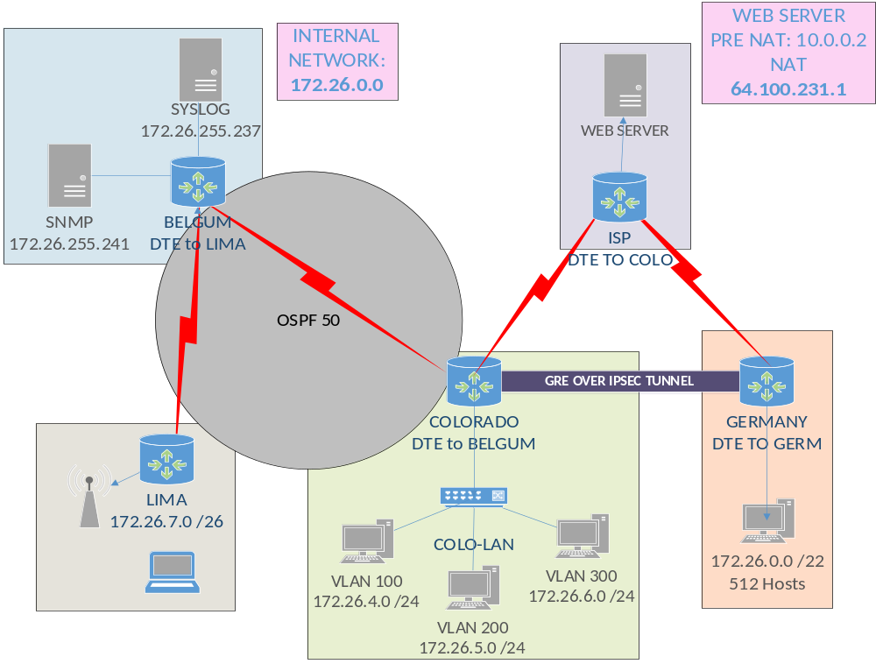
LOGICAL TOPOLOGY

Slide 7
COLORADO INTERFACES
ROUTER | INTERFACES | IP ADDRESS | CIDR | CONNECTION TYPE | ACTIVE | DESCRIPTION
COLORADO | G0/0/1 | N/A | N/A | ETHERNET | YES | LINK to COLO-LAN
COLORADO | G0/0/1.100 | 172.26.4.1 | /24 | ENCAPSULATED | YES | LINK to VLAN 100
COLORADO | G0/0/1.200 | 172.26.5.1 | /24 | ENCAPSULATED | YES | LINK to VLAN 200
COLORADO | G0/0/1.300 | 172.26.6.1 | /24 | ENCAPSULATED | YES | LINK to VLAN 300
COLORADO | G0/0/1.401 | 172.26.255.245 | /30 | ENCAPSULATED | YES | LINK to VLAN 401
COLORADO | S0/1/0 | 209.165.200.1 | /30 | SERIAL | YES | LINK to ISP
COLORADO | S0/1/1 | 172.26.255.250 | /30 | SERIAL | YES | LINK to BELGUM
COLORADO | Tunnel0 | 1.1.1.1 | /30 | TUNNEL | YES | TUNNEL to GERMANY
COLORADO | Lo0 | 10.10.10.10 | /32 | LOOPBACK | YES | LOOPBACK for COLORADO

Slide 8
GERMANY INTERFACES
ROUTER | INTERFACES | IP ADDRESS | CIDR | CONNECTION TYPE | ACTIVE | DESCRIPTION
GERMANY | G0/0/0 | 172.26.0.0 | /22 | ETHERNET | YES | LINK to GERMANY-LAN
GERMANY | S0/1/0 | 209.165.100.2 | /30 | SERIAL | YES | LINK to ISP
GERMANY | Tunnel0 | 1.1.1.2 | /30 | TUNNEL/SERIAL | YES | TUNNEL to COLORADO

Slide 9
LIMA INTERFACES
ROUTER | INTERFACES | IP ADDRESS | CIDR | CONNECTION TYPE | ACTIVE | DESCRIPTION
LIMA | G0/0/0 | 172.26.7.1 | /26 | ETHERNET | YES | LINK to LIMA-LAN
LIMA | S0/1/0 | 172.26.255.254 | /30 | SERIAL | YES | LINK to BELGUM
LIMA | Lo0 | 30.30.30.30 | /32 | LOOPBACK | YES | LOOPBACK for LIMA

Slide 10
BELGUM INTERFACES
ROUTER | INTERFACES | IP ADDRESS | CIDR NOTATION | CONNECTION TYPE | ACTIVE | DESCRIPTION
BELGUM | G0/0/0 | 172.26.255.237 | /30 | ETHERNET | YES | LINK to SYSLOG
BELGUM | G0/0/1 | 172.26.255.241 | /30 | ETHERNET | YES | LINK to SNMP
BELGUM | S0/1/0 | 172.26.255.249 | /30 | SERIAL | YES | LINK to COLORADO
BELGUM | S0/1/1 | 172.26.255.253 | /30 | SERIAL | YES | LINK to LIMA
BELGUM | Lo0 | 20.20.20.20 | /32 | LOOPBACK | YES | LOOPBACK for BELGUM

Slide 11
PHASE 2:
OSPFv2 and Ripv2

Slide 12
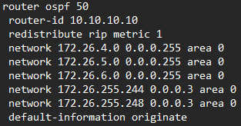

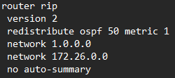
OSPFv2 and ripv2
COLORADO
GERMANY

Slide 13
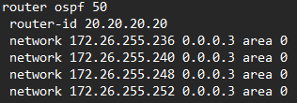

OSPFv2 and ripv2
BELGUM
LIMA

Slide 14
PHASE 3: CONFIGURATIONS

Slide 15


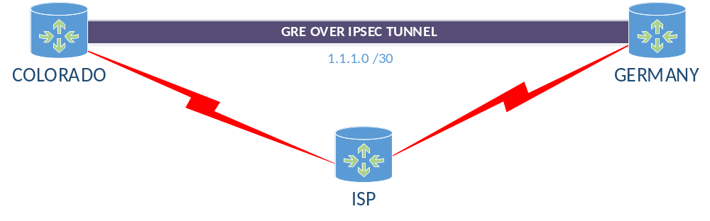
NAT with pat
Configs

Slide 16
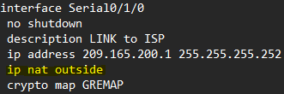
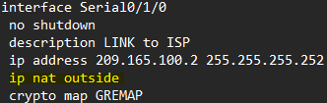

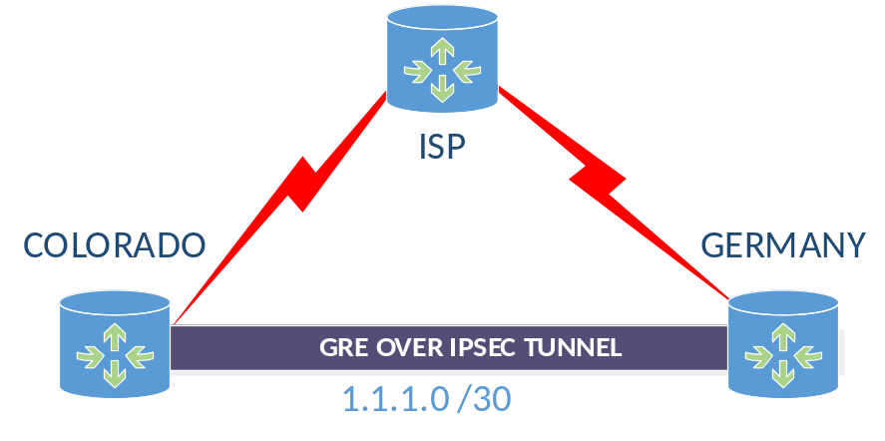

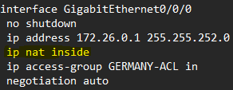

NAT with pat
Configs

Slide 17

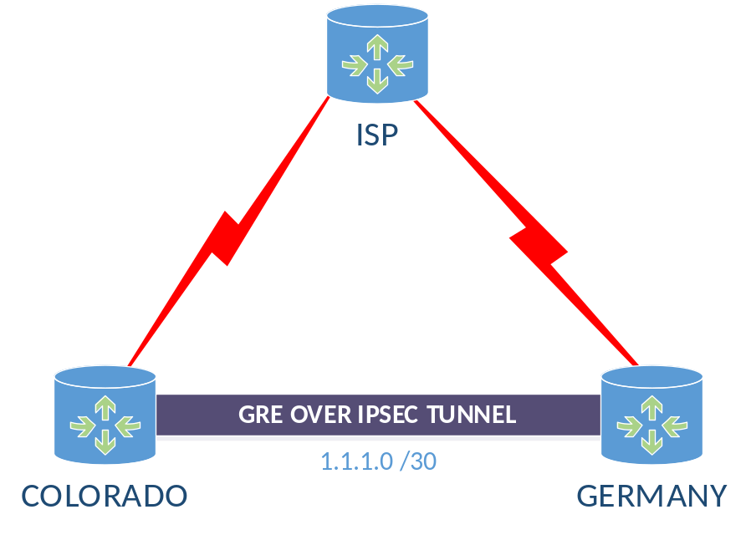

GRE TUNNEL

Slide 18
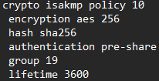


IPsec Configs
ISAKMP POLICY
TRANSFORM SET
COLORADO KEY
GERMANY KEY
COLO CRYPTO MAP
GERMANY CRYPTO MAP

Slide 19
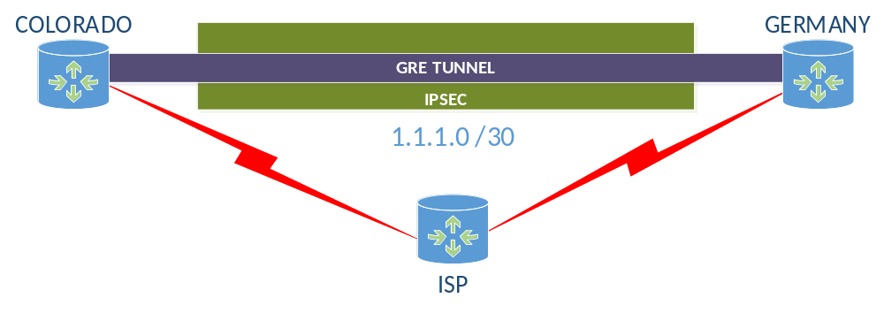
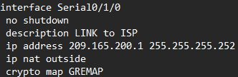
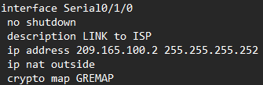


IPsec Configs

Slide 20
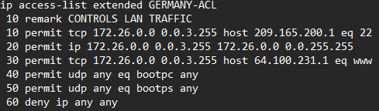
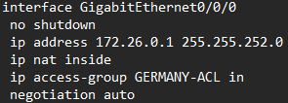
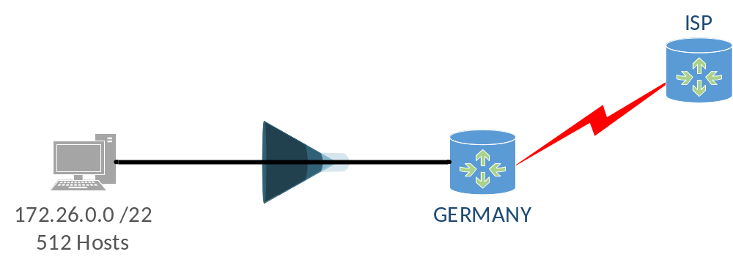
GERMANY ACL

Slide 21
PHASE 3:
DHCP AND VLAN

Slide 22
DHCP POOLS
POOL | NETWORK | SUBNET | EXCLUDED-ADDRESS | ADDRESS RANGE | DOMAIN NAME | DEFAULT ROUTER
COLO VLAN 100 | 172.26.4.0 | /24 | 172.26.4.1-.10 | 172.26.4.11-254 | COLO.com | 172.26.4.1
COLO VLAN 200 | 172.26.5.0 | /24 | 172.26.5.1-.10 | 172.26.5.11-.254 | COLO.com | 172.26.5.1
COLO VLAN 300 | 172.26.6.0 | /24 | 172.26.6.1-.10 | 172.26.6.11-.254 | COLO.com | 172.26.6.1
GERMANY | 172.26.0.0 | /22 | 172.26.0.1-.20 | 172.26.0.21 - 172.26.3.254 | GERM.com | 172.26.0.1
LIMA | 172.26.7.0 | /26 | 172.26.7.1-.10 | 172.26.7.11-.254 | LIMA.com | 172.26.7.1

Slide 23
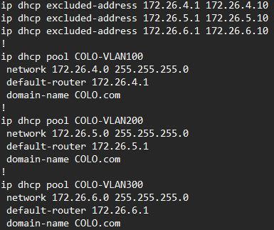


DHCP CONFIGS

Slide 24
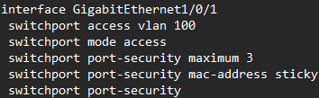
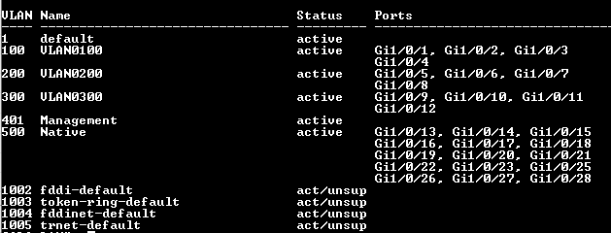
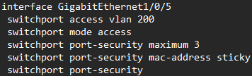
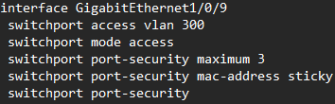
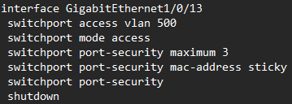
VLANs
MANAGEMENT VLAN: 192.168.255.246

Slide 25
PHASE 4:
TESTING AND VERIFICATION

Slide 26
TESTING AND VERIFICATION
SOURCE | DESTINATION | PROTOCOL | EXPECTED RESULT
Host on VLAN1 | ISP | HTTP | PASS
Host on VLAN1 | Host on Germany LAN | ICMP | PASS
Host on VLAN1 | Host on VLAN 2 | ICMP | PASS
Host on VLAN1 | Host on VLAN 3 | ICMP | PASS
Host on VLAN 2 | Host on VLAN 3 | ICMP | PASS
Host on VLAN 2 | Host on Germany LAN | ICMP | PASS
Host on VLAN 2 | ISP | HTTP | PASS
Host on VLAN 3 | Host on Germany LAN | ICMP | PASS
Host on VLAN 3 | ISP | HTTP | PASS
Host on Germany | ISP | HTTP | PASS
Host on Germany | ISP | Telnet | FAIL
Router on Colorado | SYSLog Server | LOGS | PASS
NAT on Germany |  | NAT | PASS
NAT on Colorado |  | NAT | PASS
NAT on ISP | ISP | WEB | PASS
TELNET | ISP | TELNET | FAIL

Slide 27





NAT VERIFICAITON

Slide 28
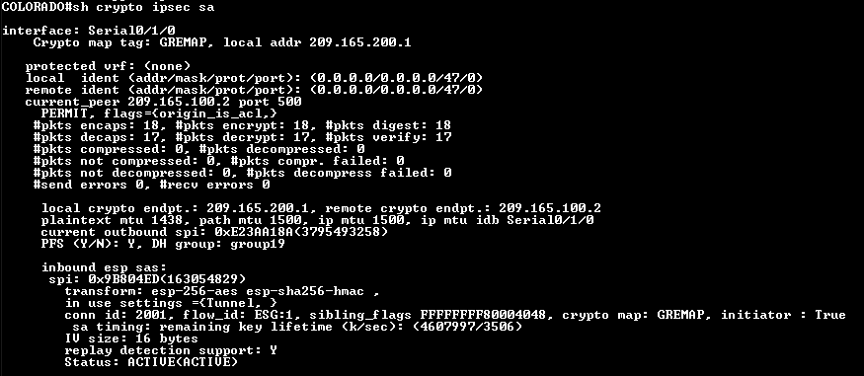

IPsec Verification

Slide 29
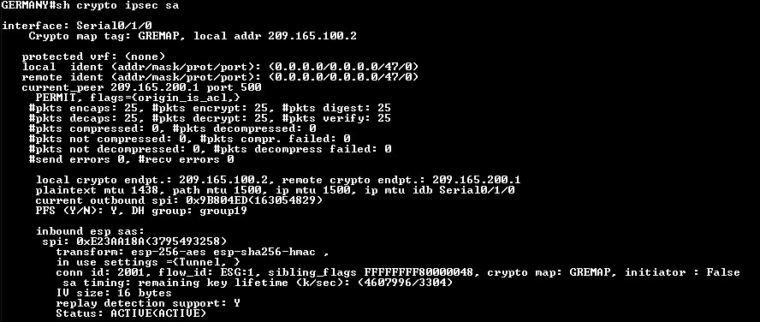

IPsec Verification

Slide 30
GERMANY VERIFICATION
SOURCE | DESTINATION | PROTOCOL | RESULT
Host on Germany | ISP | ICMP | FAIL
Host on Germany | ISP | HTTP | PASS
Host on Germany | LIMA | ICMP | PASS
Host on Germany | SNMP | ICMP | PASS
Host on Germany | SYSLOG | ICMP | PASS
Host on Germany | VLAN 100 | ICMP | PASS
Host on Germany | VLAN 200 | ICMP | PASS
Host on Germany | VLAN 300 | ICMP | PASS

Slide 31
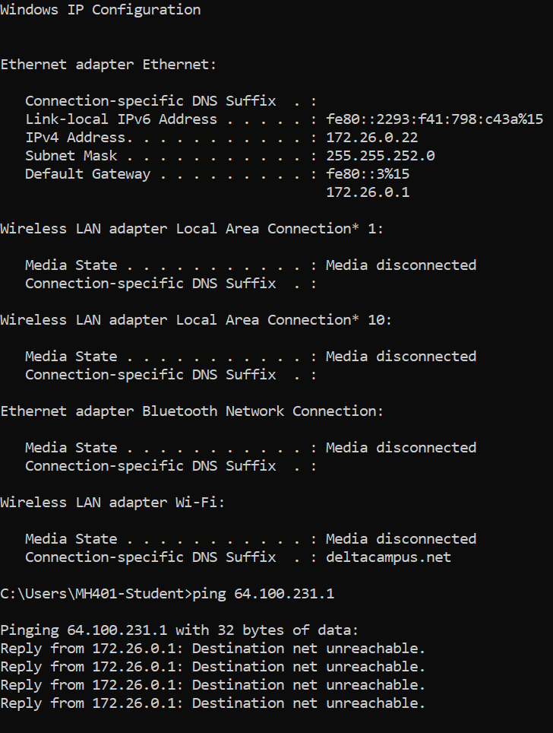
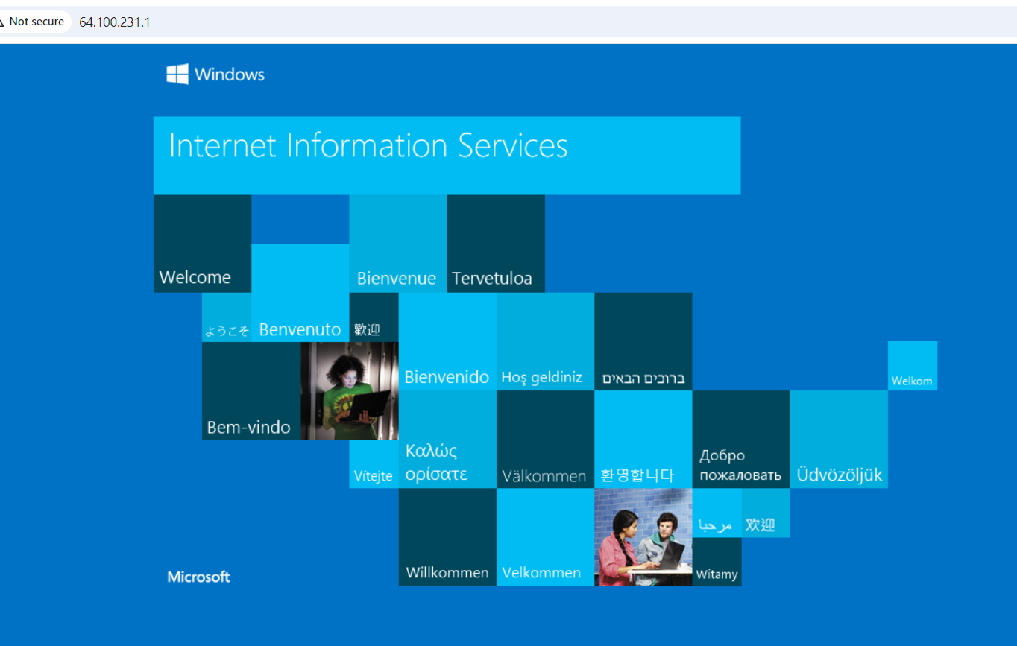
GERMANY VERIFICATION

Slide 32
GERMANY VERIFICATION

Slide 33
Colorado VLAN 100 verification
SOURCE | DESTINATION | PROTOCOL | EXPECTED RESULT
VLAN 100 | ISP | HTTP | PASS
VLAN 100 | LIMA | ICMP | PASS
VLAN 100 | SNMP | ICMP | PASS
VLAN 100 | SYSLOG | ICMP | PASS
VLAN 100 | GERMANY | ICMP | PASS
VLAN 100 | VLAN 200 | ICMP | PASS
VLAN 100 | VLAN 300 | ICMP | PASS

Slide 34
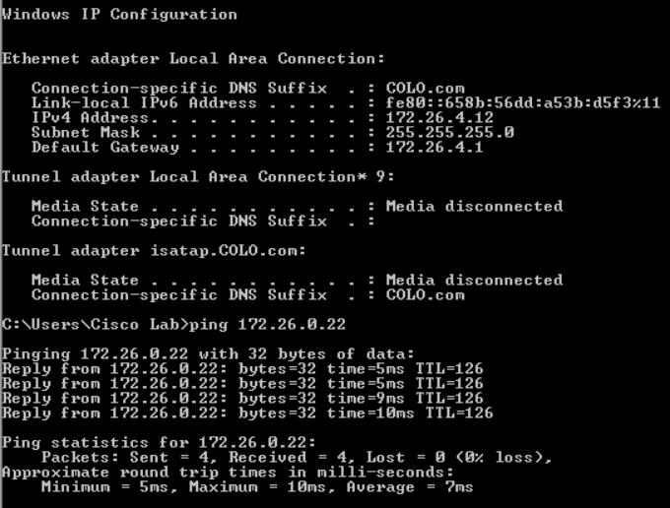
Colorado VLAN 100 verification

Slide 35
Colorado VLAN 200 verification
SOURCE | DESTINATION | PROTOCOL | EXPECTED RESULT
VLAN 200 | ISP | HTTP | PASS
VLAN 200 | LIMA | ICMP | PASS
VLAN 200 | SNMP | ICMP | PASS
VLAN 200 | SYSLOG | ICMP | PASS
VLAN 200 | GERMANY | ICMP | PASS
VLAN 200 | VLAN 100 | ICMP | PASS
VLAN 200 | VLAN 300 | ICMP | PASS

Slide 36
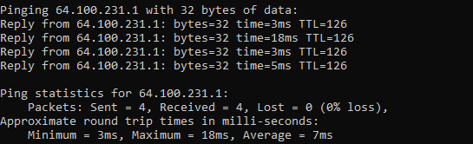
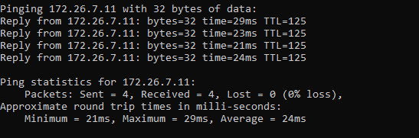
Colorado VLAN 200 verification

Slide 37
Colorado VLAN 300 verification
SOURCE | DESTINATION | PROTOCOL | EXPECTED RESULT
VLAN 300 | ISP | HTTP | PASS
VLAN 300 | LIMA | ICMP | PASS
VLAN 300 | SNMP | ICMP | PASS
VLAN 300 | SYSLOG | ICMP | PASS
VLAN 300 | GERMANY | ICMP | PASS
VLAN 300 | VLAN 100 | ICMP | PASS
VLAN 300 | VLAN 200 | ICMP | PASS

Slide 38
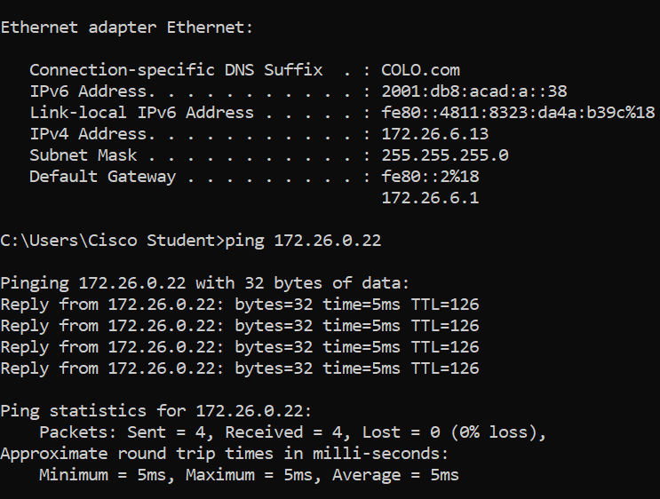
Colorado VLAN 300 verification

Slide 39
LIMA verification
SOURCE | DESTINATION | PROTOCOL | EXPECTED RESULT
Host on LIMA | ISP | HTTP | PASS
Host on LIMA | GERMANY | ICMP | PASS
Host on LIMA | SNMP | ICMP | PASS
Host on LIMA | SYSLOG | ICMP | PASS
Host on LIMA | VLAN 100 | ICMP | PASS
Host on LIMA | VLAN 200 | ICMP | PASS
Host on LIMA | VLAN 300 | ICMP | PASS

Slide 40
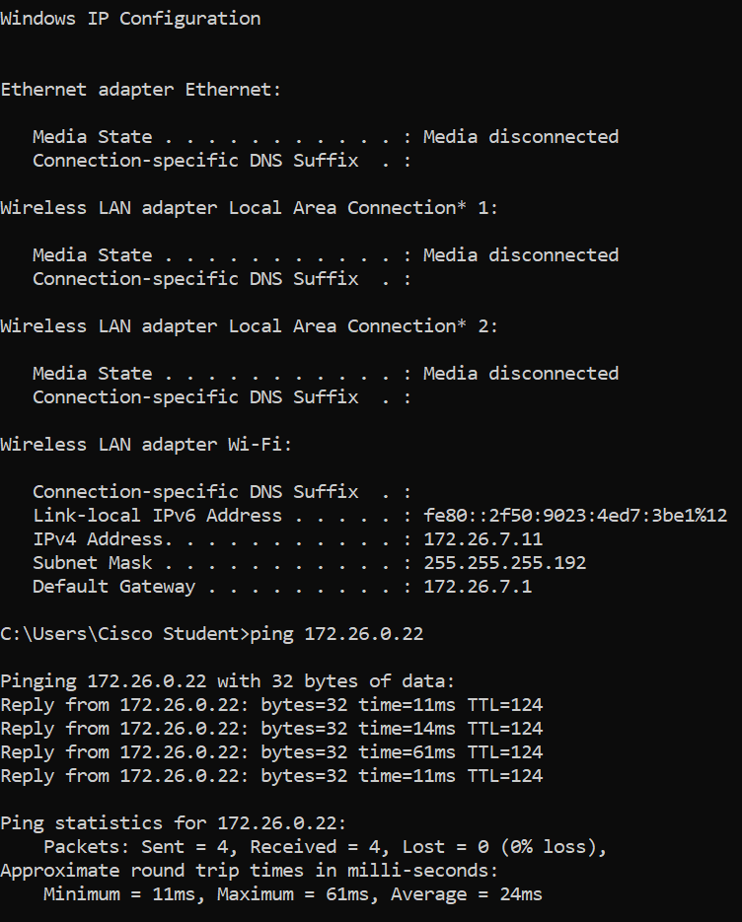
LIMA verification

Slide 41
BELGUM verification
SOURCE | DESTINATION | PROTOCOL | EXPECTED RESULT
SYSLOG | ISP | HTTP | PASS
SYSLOG | GERMANY | ICMP | PASS
SYSLOG | LIMA | ICMP | PASS
SYSLOG | SNMP | ICMP | PASS
SYSLOG | VLAN 100 | ICMP | PASS
SYSLOG | VLAN 200 | ICMP | PASS
SYSLOG | VLAN 300 | ICMP | PASS
SOURCE | DESTINATION | PROTOCOL | EXPECTED RESULT
SNMP | ISP | HTTP | PASS
SNMP | GERMANY | ICMP | PASS
SNMP | LIMA | ICMP | PASS
SNMP | SYSLOG | ICMP | PASS
SNMP | VLAN 100 | ICMP | PASS
SNMP | VLAN 200 | ICMP | PASS
SNMP | VLAN 300 | ICMP | PASS

Slide 42
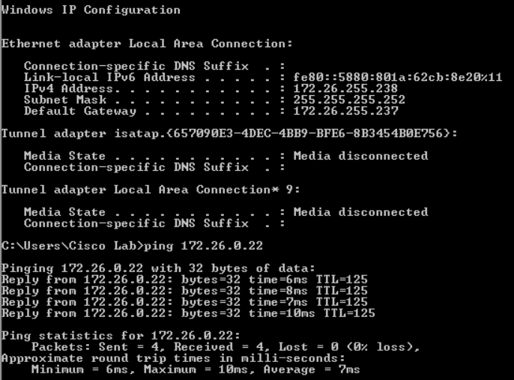
BELGUM verification
(SYSLOG)

Slide 43
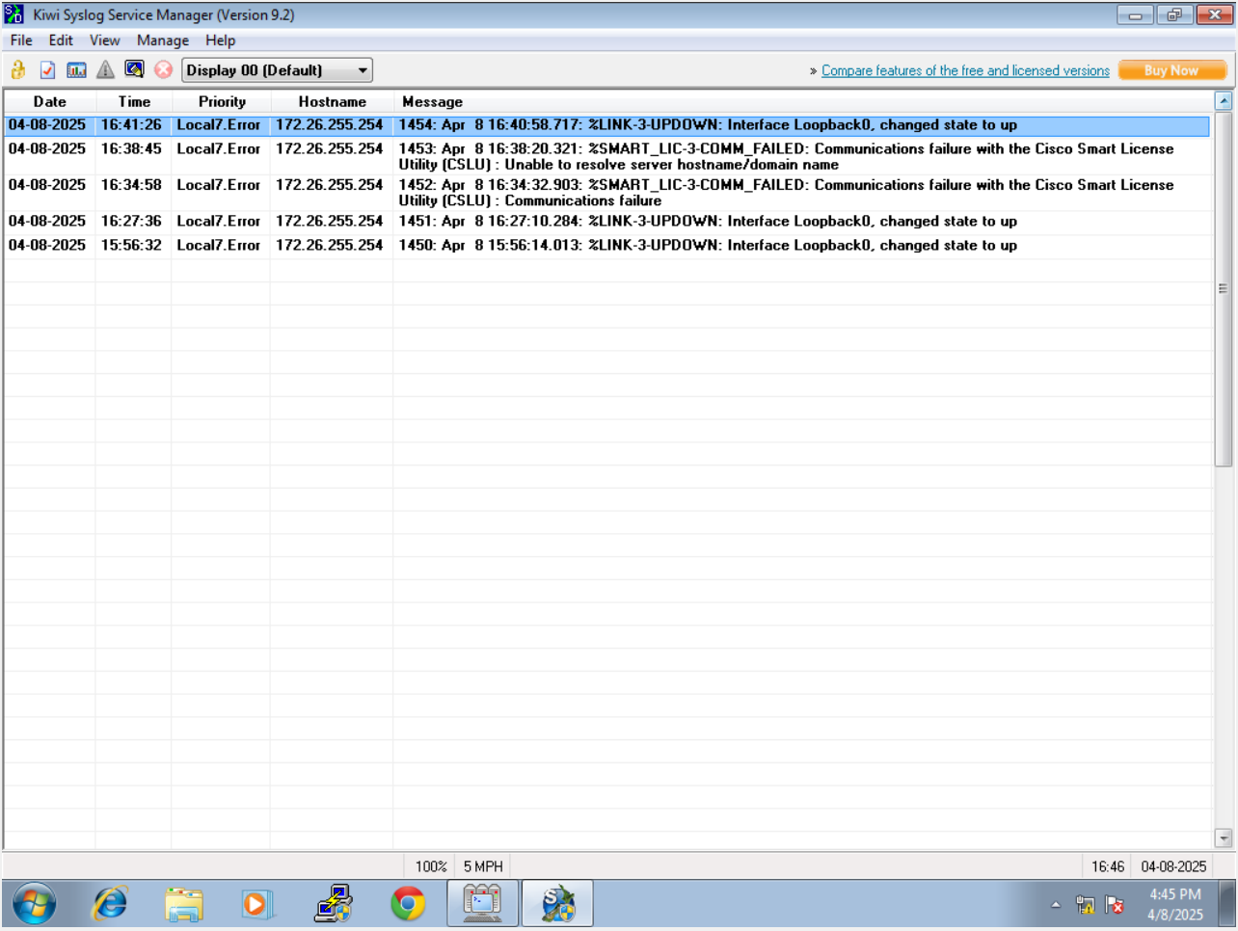
SYSLOG VERIFICAITON

Slide 44
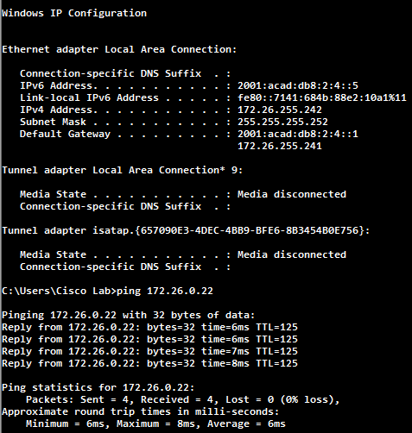
BELGUM verification
(SNMP)

Slide 45
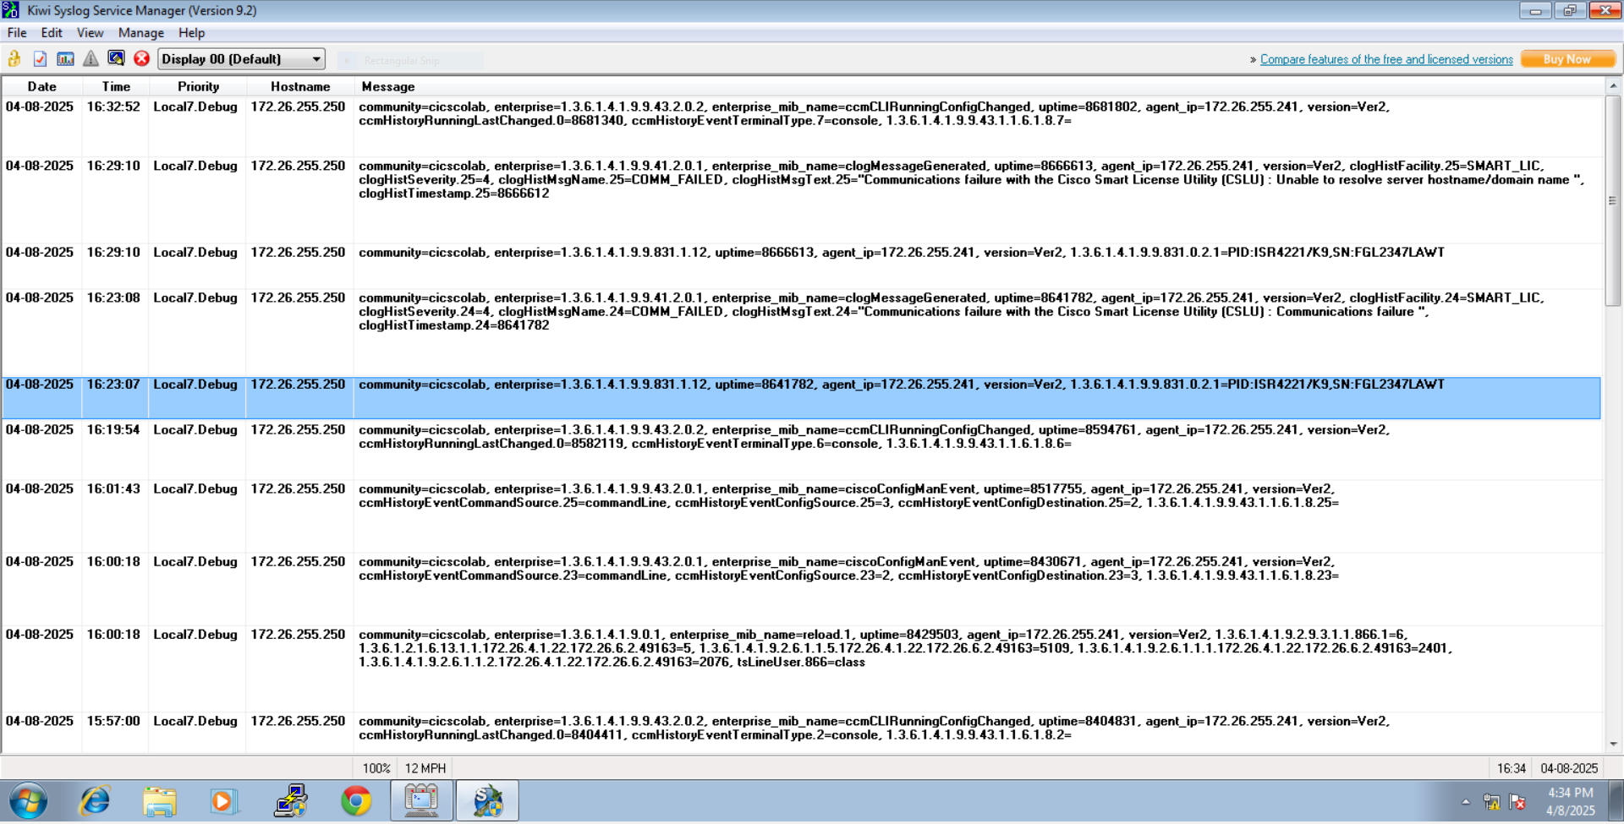
SNMP VERIFICAITON

Slide 46


Slide 47

Thank you
Darren Huynh

