Slide 1
ITConnect – NoSQL Database Migration
Migration from MS SQL Server to MongoDB

Slide 2
Introduction
This project demonstrates the full cycle of migrating structured relational data from MS SQL Server to MongoDB. It involves schema design, data population, data transformation, and document-based modeling. The system simulates a digital agency managing departments, employees, clients, projects, and contracts.

Slide 3
Relational Database Design
iWe created 6 interconnected tables: Departamenti, Punëtori, Klientët, Projekti, Kontrata, and PunonPerProjektin. These tables reflect business operations in an agency and were linked using primary and foreign keys. Each table was populated with 20 meaningful records.

Slide 4
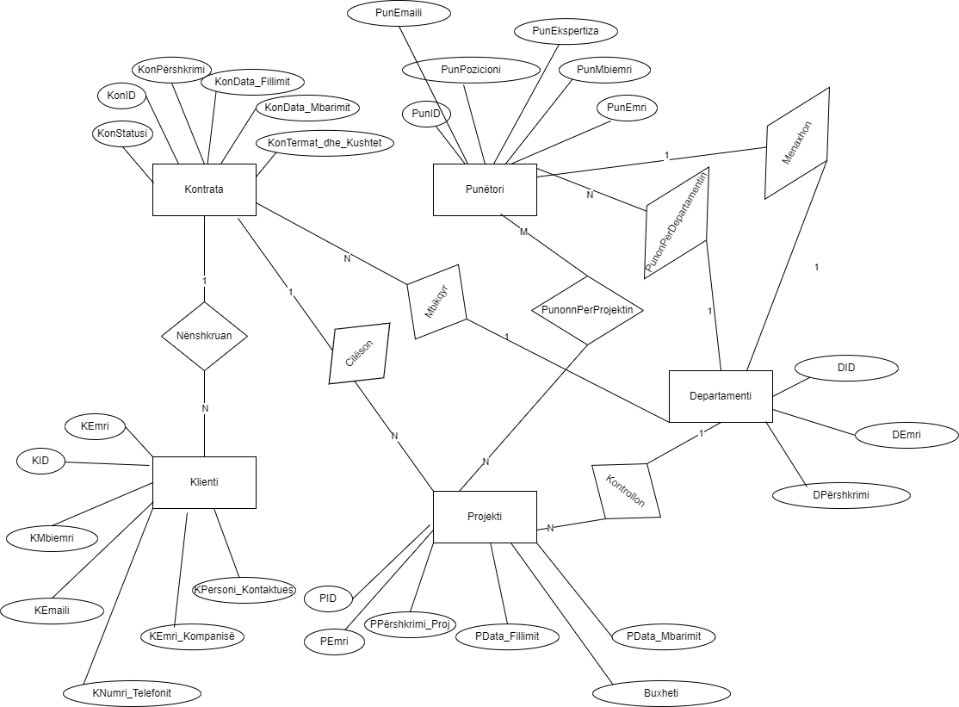
ER Diagram
The ER diagram defines 1:N and M:N relationships such as one department managing many employees, and projects assigned to multiple employees. These relations helped us normalize the data and maintain referential integrity.

Slide 5
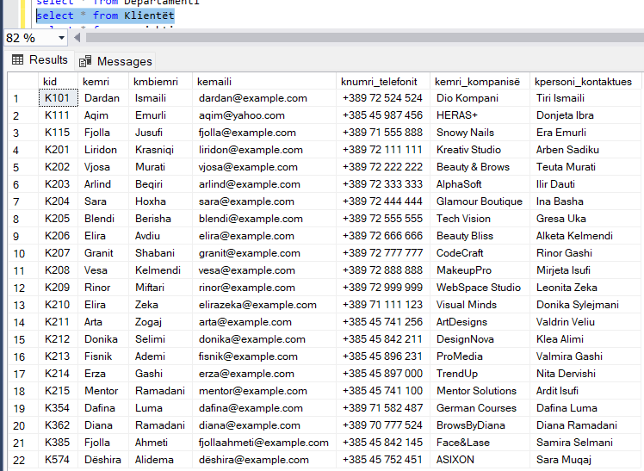
Data Population
Data was inserted manually into each table with realistic entries. Screenshots from SSMS show full population of tables like Klientët, Punëtori, and Kontrata. Each table contains over 20 diverse records simulating real-world usage.

Slide 6
Why MongoDB?
MongoDB was selected due to its document-based model, which is ideal for nested structures such as contracts with embedded projects. Compared to Redis (key-value, lacks structure) and Neo4j (graph-based, ideal for different use cases), MongoDB supports flexible schemas and scales horizontally.

Slide 7
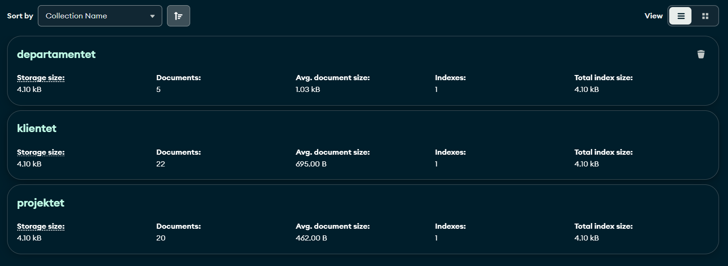
NoSQL Modeling
Relational data was reshaped into documents: Klientët contain Kontrata, which embed Projekti. Departamenti embeds Punëtori. Projects reference employees through IDs. This reduces joins and improves read efficiency.

Slide 8
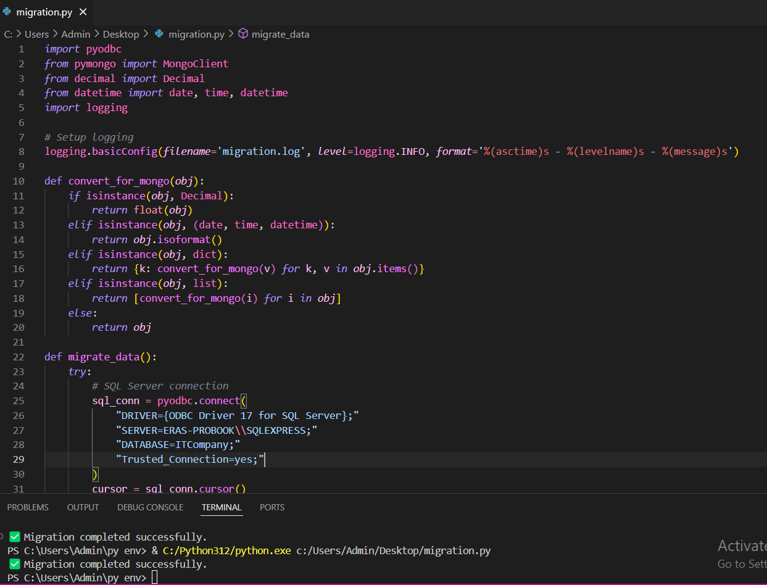
Migration Script
Python with pyodbc and pymongo libraries was used to connect to SQL Server and MongoDB. The script handles transformation of dates, decimals, and nested relationships. Each document is structured and inserted into the appropriate MongoDB collection.

Slide 9
Error Handling
Custom functions handle type conversion for unsupported types like Decimal and Date. Try-except blocks capture database connection or insertion errors. Logging was enabled to track operations and failures in 'migration.log'.

Slide 10
Conclusion
The project successfully demonstrated relational-to-NoSQL migration. We practiced schema normalization, embedding strategies, and scripting. MongoDB proved effective for nested document storage. We learned key data engineering principles and advanced Python-DB integration.

Slide 11
THANK YOU!

