Slide 1




AGENTIC
ENGINEERING 101
From LLM to Working AI Agent
NO MATH • ENGINEERING INTUITION • LIVE DEMOS
BEAWORLD
ENGINEERING WORKSHOP
Isham Rashik
AI Engineer
Future OS, Expo City, Dubai, UAE
A hands-on journey from answers to actions
BEAWORLD / AGENTIC ENGINEERING 101
01 / 32
Notes:
Welcome to Agentic Engineering 101, adapted for Bangladeshi Engineers & Architects Worldwide. We will use an HVAC case study and learn by progressing from a base LLM to tools, agents, rag, and human-approved workflows. No math is needed.

Slide 2
WHY NOW?
Why did AI surge so rapidly since late 2022?
It feels sudden — but the current wave is the visible result of more than 50 years of AI research.
THE BIG IDEA
Why it exploded publicly
People could suddenly talk to AI directly. That made the technology visible and useful to millions, not just researchers.
1950s–2016
Foundations: AI research, expert systems, machine learning, neural networks.
2017–2021
Transformers, larger models, more compute, better tooling, better data pipelines.
Why this matters now
Organizations moved from curiosity to prototypes, then to workflows, copilots, and agentic applications.
Late 2022 onward
AI became easy to use: chat interfaces, code assistants, image tools, rapid product adoption.
Why we are learning this today
Engineers now need to understand not only AI models, but also tools, RAG, agents, safety, and real-world deployment.
This session helps make sense of the boom: from LLMs to tools, RAG, agents, and full agentic AI applications.
B E A W O R L D / A G E N T I C E N G I N E E R I N G 1 0 1
02 / 32
Notes:
Slide 2 — Speaker Notes
Before we get into Agentic AI, I want to address something important.
Why did Artificial Intelligence suddenly become so popular towards the end of 2022?
You might have noticed that before 2022, AI was mostly something we heard about in research papers, universities, and specialized industries. But suddenly, everyone started talking about it!
Students, engineers, businesses, and even governments began exploring AI.
So, did AI suddenly appear in 2022?
Absolutely not!
Artificial Intelligence has been an active area of research since the 1950s. What we are witnessing today is the result of more than 50 years of research, experimentation, successes, and failures.
Over the decades, researchers developed machine learning algorithms, artificial neural networks, and eventually deep learning.
A major breakthrough came in 2017 with the introduction of the Transformer architecture, which became the foundation for many modern Large Language Models, including GPT.
At the same time, computing hardware became more powerful, larger datasets became available, and researchers developed better ways to train increasingly capable models.
Then came November 2022, when OpenAI introduced ChatGPT to the public.
And this changed how ordinary people interacted with AI.
Previously, using powerful AI systems often required specialized technical knowledge. Suddenly, people could interact with an advanced language model simply by typing a question in natural language.
You didn't need to understand machine learning algorithms or write complicated programs to get useful results.
AI became much more accessible.
As a result, adoption and experimentation accelerated across education, engineering, healthcare, businesses, and government services.
But here's something even more interesting.
Initially, most people were using AI to ask questions, generate content, or write code.
Today, we are increasingly exploring how AI can interact with external tools, retrieve information, and assist in completing complex tasks.
And this brings us to the topic of today's workshop: Agentic Engineering.
We are moving from systems that primarily generate answers towards applications that can help perform actions.
So the purpose of today's session is not simply to learn how to use ChatGPT. It is to understand how we can engineer useful AI systems around these powerful language models.
And this is particularly relevant here in the UAE, where AI adoption is becoming an important part of government digital transformation.
Let's look at what the UAE is doing in this space.

Slide 3
WELCOME
Your mission today
Build intuition first. Code second.
By the end: explain all five
1 LLM — generates responses
2 Tool — reads data or acts
3 RAG — retrieves trusted context
4 AI agent — chooses next steps
5 Agentic AI app — governs actions
TODAY’S RULE
Every new AI concept must connect to a familiar engineering idea.
BEAWORLD / AGENTIC ENGINEERING 101
03 / 32
Notes:
State the five learning goals explicitly: (1) Large Language Model (LLM), (2) tool, (3) Retrieval-Augmented Generation (RAG), (4) AI agent, and (5) agentic AI application. No computer science background is assumed. Each concept connects to a familiar engineering idea: explanation, instrument, manual lookup, decision loop, and controlled system.

Slide 4
CASE STUDY
Meet the Air Handling Unit (AHU-01)
An AHU moves and conditions air inside a building. Here, an office is too warm.
THE PROBLEM
Available evidence
“The office is still warm.
Can you investigate?”
• Sensor readings
• Maintenance history
• Equipment manual
• Ticketing system
TARGET 22°C
BEAWORLD / AGENTIC ENGINEERING 101
04 / 32
Notes:
AHU stands for Air Handling Unit. Explain it simply: a piece of HVAC equipment that handles air movement and conditioning in a building. AHU-01 is a fictional unit for the exercises; no live building, sensors or maintenance database are connected. The engineer remains responsible for diagnosis and decisions.

Slide 5
THE BIG QUESTION
Answers are useful. Actions go further.
What changes when AI can interact with the environment?
Chatbot response
Agent-assisted investigation
“Check the filter, fan and refrigeration system.”
Useful guidance — but no inspection happened.
Check readings → look up service history → consult manual → propose next step.
Same language model family. Different system capabilities.
BEAWORLD / AGENTIC ENGINEERING 101
05 / 32
Notes:
Do not portray agents as magic. The model is one component within a software system, and permissions are provided by application code.

Slide 6
JUST ENOUGH LLM
How LLM works — in 30 seconds
PROMPT
TOKENS
TRANSFORMER
RESPONSE
→
→
→
Your question
Small pieces of text
Uses context to predict
what comes next
Words generated
one piece at a time
LLM generates an answer. It does not automatically read AHU-01 sensors.
BEAWORLD / AGENTIC ENGINEERING 101
06 / 32
Notes:
GPT processes tokens and uses a Transformer to generate the next tokens according to learned patterns and the current context. Avoid claims that it is literally thinking like a human.

Slide 7
REAL-WORLD LIMITATIONS
Can GPT know the temperature now?
Not unless our application provides that information.
“The AHU may have restricted airflow.”
“But has it actually measured the airflow?”
LESSON: GENERATED TEXT ≠ LIVE MEASUREMENT
BEAWORLD / AGENTIC ENGINEERING 101
07 / 32
Notes:
This slide explains why tools are necessary. Language models can suggest probable faults based on context, but cannot invent actual sensor readings.

Slide 8
THREE APPROACHES
Chatbot vs automation vs agent
All useful. Pick the simplest approach that solves the task.
EXPLAINS
FOLLOWS RULES
CHOOSES STEPS
CHATBOT
AUTOMATION
AI AGENT
Engineer asks why a pump is overheating.
AI explains possible causes.
When temperature crosses a fixed threshold, send an alert.
Chooses whether to read sensors, check records, or ask for more information.
BEAWORLD / AGENTIC ENGINEERING 101
08 / 32
Notes:
An agent is not automatically superior. A fixed alert should often remain deterministic, predictable software.

Slide 9
ENGINEERING ANALOGY
Think: observe → decide → act → check
A feedback-like loop, not a magical black box.
01
02
03
04
OBSERVE
→
DECIDE
→
ACT
→
CHECK
Read information
Select next step
Use an allowed tool
Inspect result
ENGINEER’S CAUTION
LLM agents are not deterministic industrial controllers. Keep safety-critical control separate.
BEAWORLD / AGENTIC ENGINEERING 101
09 / 32
Notes:
The analogy is about the agent execution loop. It does not imply the agent meets timing, stability, or safety guarantees of a certified controller.

Slide 10
SYSTEM ARCHITECTURE
Five ingredients of a practical agent
The model is only one piece.
1
2
3
4
5
LLM
TOOLS
STATE
ORCHESTRATOR
GUARDRAILS
Interprets task
Interact with data
Tracks progress
Runs the loop
Controls risk
Tools and permissions come from the application — not the model itself.
BEAWORLD / AGENTIC ENGINEERING 101
10 / 32
Notes:
In most agent frameworks, the orchestrator is standard application code, which decides when to run the model and how to execute tool calls.

Slide 11
TOOLS
An agent’s engineering instruments
Software functions are the equivalent of instruments and interfaces.
SENSOR API
DOCUMENT SEARCH
Read simulated temperature
Find manual instructions
MAINTENANCE DB
TICKETING TOOL
Retrieve service history
Prepare a work order
BEAWORLD / AGENTIC ENGINEERING 101
11 / 32
Notes:
A tool can be a Python function or an external API. Later the LLM will request tools, while application code performs the actual call.

Slide 12
TOOL CALLING
Who really presses the button?
The model requests; the application executes.
1 · USER
“Read AHU-01.”
2 · LLM
Requests get_ahu_readings
3 · PYTHON APP
Runs the function
4 · RESULT
Returns simulated readings
5 · LLM
Explains what was found
BEAWORLD / AGENTIC ENGINEERING 101
12 / 32
Notes:
Explain the two-sided contract: tool name and arguments are generated by the model, but validated and executed by the host program.

Slide 13
GROUNDING
RAG: search first, answer with evidence
Retrieval-Augmented Generation (RAG) finds relevant sources before answering.
A maintenance question
↓ Search the document
↓ Retrieve relevant passage
↓ Explain with evidence
RAG ≠ AUTOMATICALLY CORRECT
BEAWORLD / AGENTIC ENGINEERING 101
13 / 32
Notes:
Spell out Retrieval-Augmented Generation (RAG). Example: ask why AHU-01 has poor airflow. A system searches a maintenance manual and retrieves a passage about filters and airflow before a model writes its explanation. RAG is a grounding technique, not itself an AI agent. Mini audience exercise: compare a model guessing the cause versus a model given the exact relevant manual excerpt. Retrieval is not automatically correct and source relevance still matters.

Slide 14
STATE & MEMORY
What happened earlier in the investigation?
An agent needs to retain task information across steps.
REQUEST
OBSERVATION
HISTORY
NEXT ACTION
Investigate AHU-01
Airflow is low
Filter service overdue
Recommend engineer inspection
Short-term state = what happened during the current task.
BEAWORLD / AGENTIC ENGINEERING 101
14 / 32
Notes:
State stores the sequence of messages, tool results and task progress. Longer-term memory is optional and requires intentional storage and access design.

Slide 15
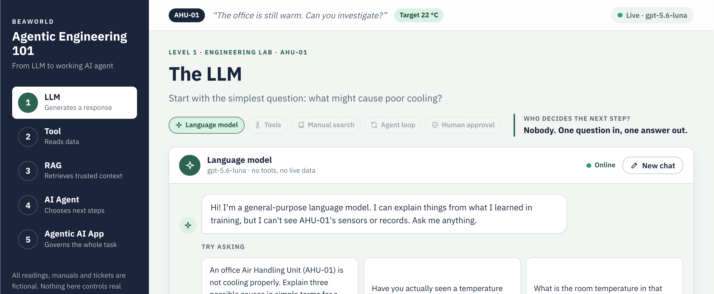
LIVE DEMO
One app, five levels
Every level of today's workshop runs live in the browser, step by step.
Demo app · http://127.0.0.1:8791
Same AHU-01 case,
every step on screen.
BEAWORLD / AGENTIC ENGINEERING 101
15 / 32
Notes:
Introduce the demo app before Level 1.
Before the session, start it from a terminal: cd backend && source .venv/bin/activate && python -m app. The browser opens at http://127.0.0.1:8791 and the badge at the top right should read 'Live · gpt-5.6-luna'.
Point out what every level screen shows: the five steps on the left (the same journey as this deck), 'Who decides the next step?', the chips showing which building blocks are switched on, and the 'Question for the room' at the bottom.
Move between levels with the arrow keys, Page Up / Page Down, a clicker, or the keys 1-5. All readings, manuals and tickets are fictional.

Slide 16
LEVEL 1
The LLM
Start with the simplest question: “What might cause poor cooling?”
ENGINEERING LAB · AHU-01
BEAWORLD / AGENTIC ENGINEERING 101
16 / 32
Notes:
Exercise introduction: The LLM. Start with the simplest question: “What might cause poor cooling?”

Slide 17
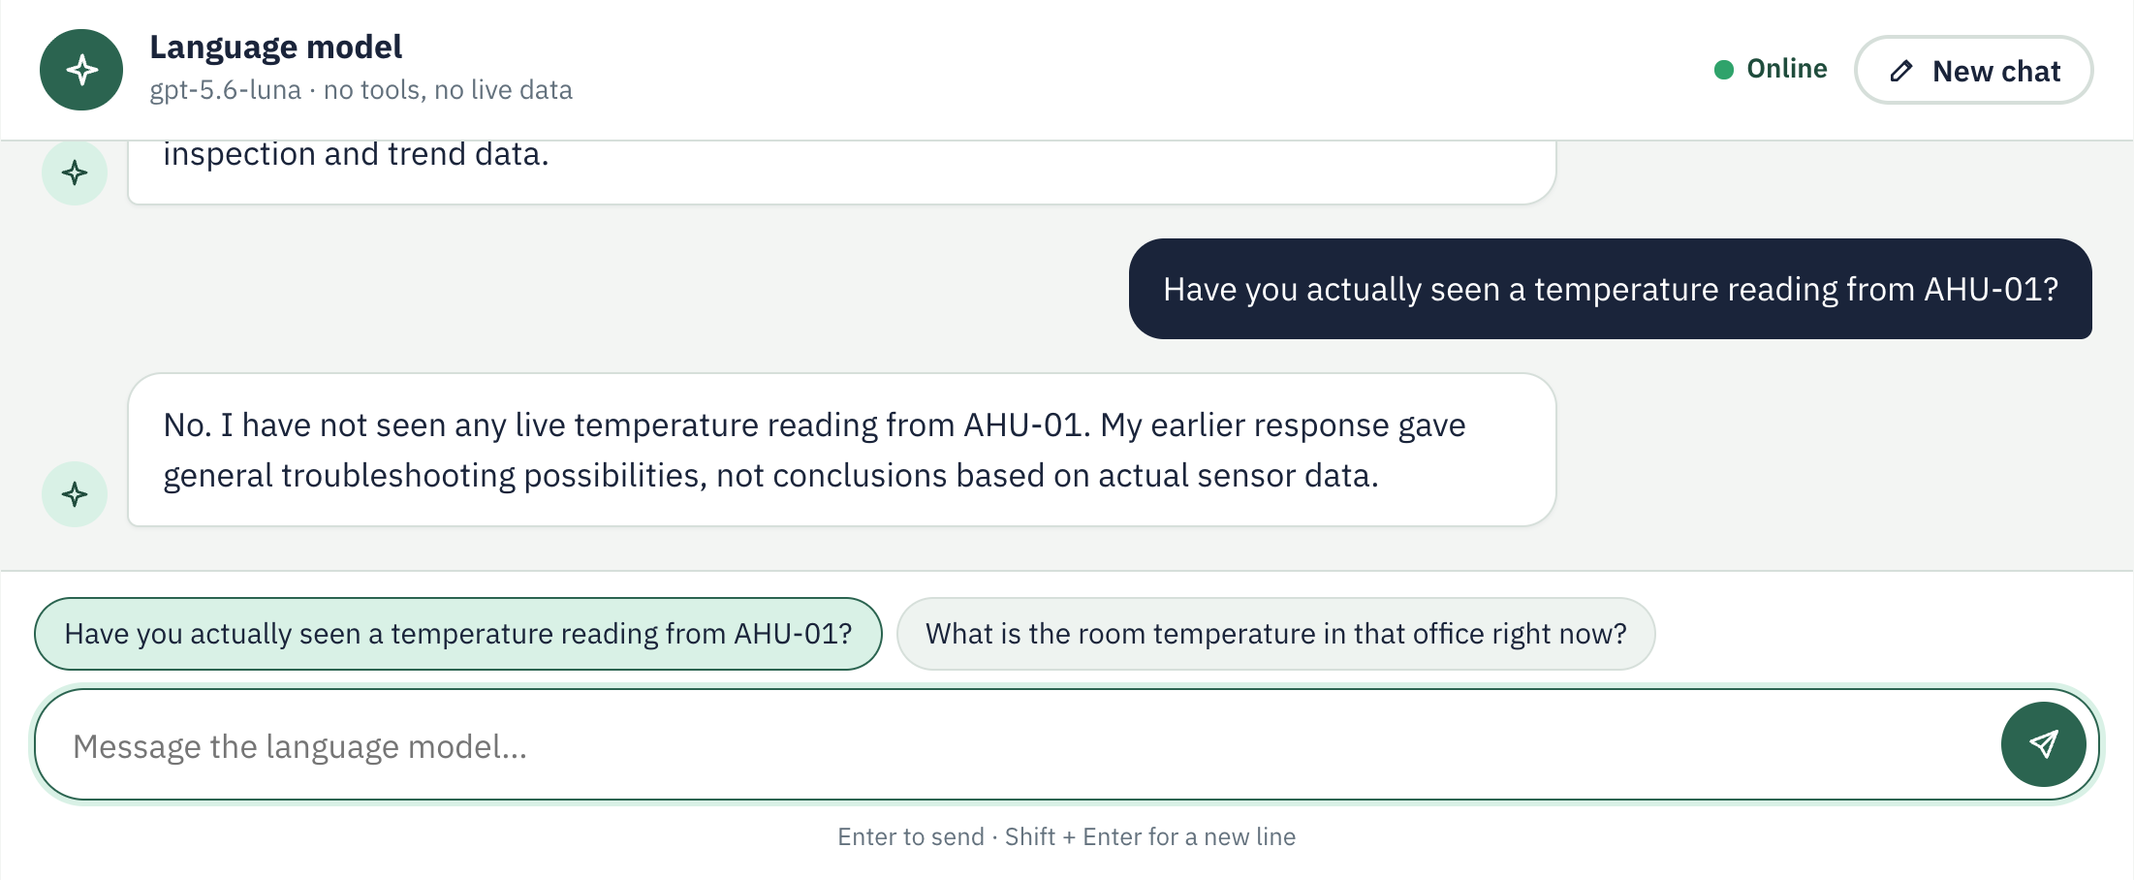
EXERCISE 1
Ask the LLM a question
Answers without live measurements
Live demo · Level 1 · Chat with the model
Question for the room:
Did we measure anything?
BEAWORLD / AGENTIC ENGINEERING 101
17 / 32
Notes:
Demo, Level 1 (chat). Click the first suggested question (the exercise question). The answer streams in word by word, as slide 6 described.
Then click the follow-up 'Have you actually seen a temperature reading from AHU-01?'. The model says it has not: it only knows what it learned in training.
Question for the room: did we measure anything? No. Reveal the answer on screen. Use 'New chat' to reset.

Slide 18
LEVEL 2
The Tool
Add one simple sensor-reading function. The tool knows data; it does not make decisions.
ENGINEERING LAB · AHU-01
BEAWORLD / AGENTIC ENGINEERING 101
18 / 32
Notes:
Exercise introduction: The Tool. Add one simple sensor-reading function. The tool knows data; it does not make decisions.

Slide 19
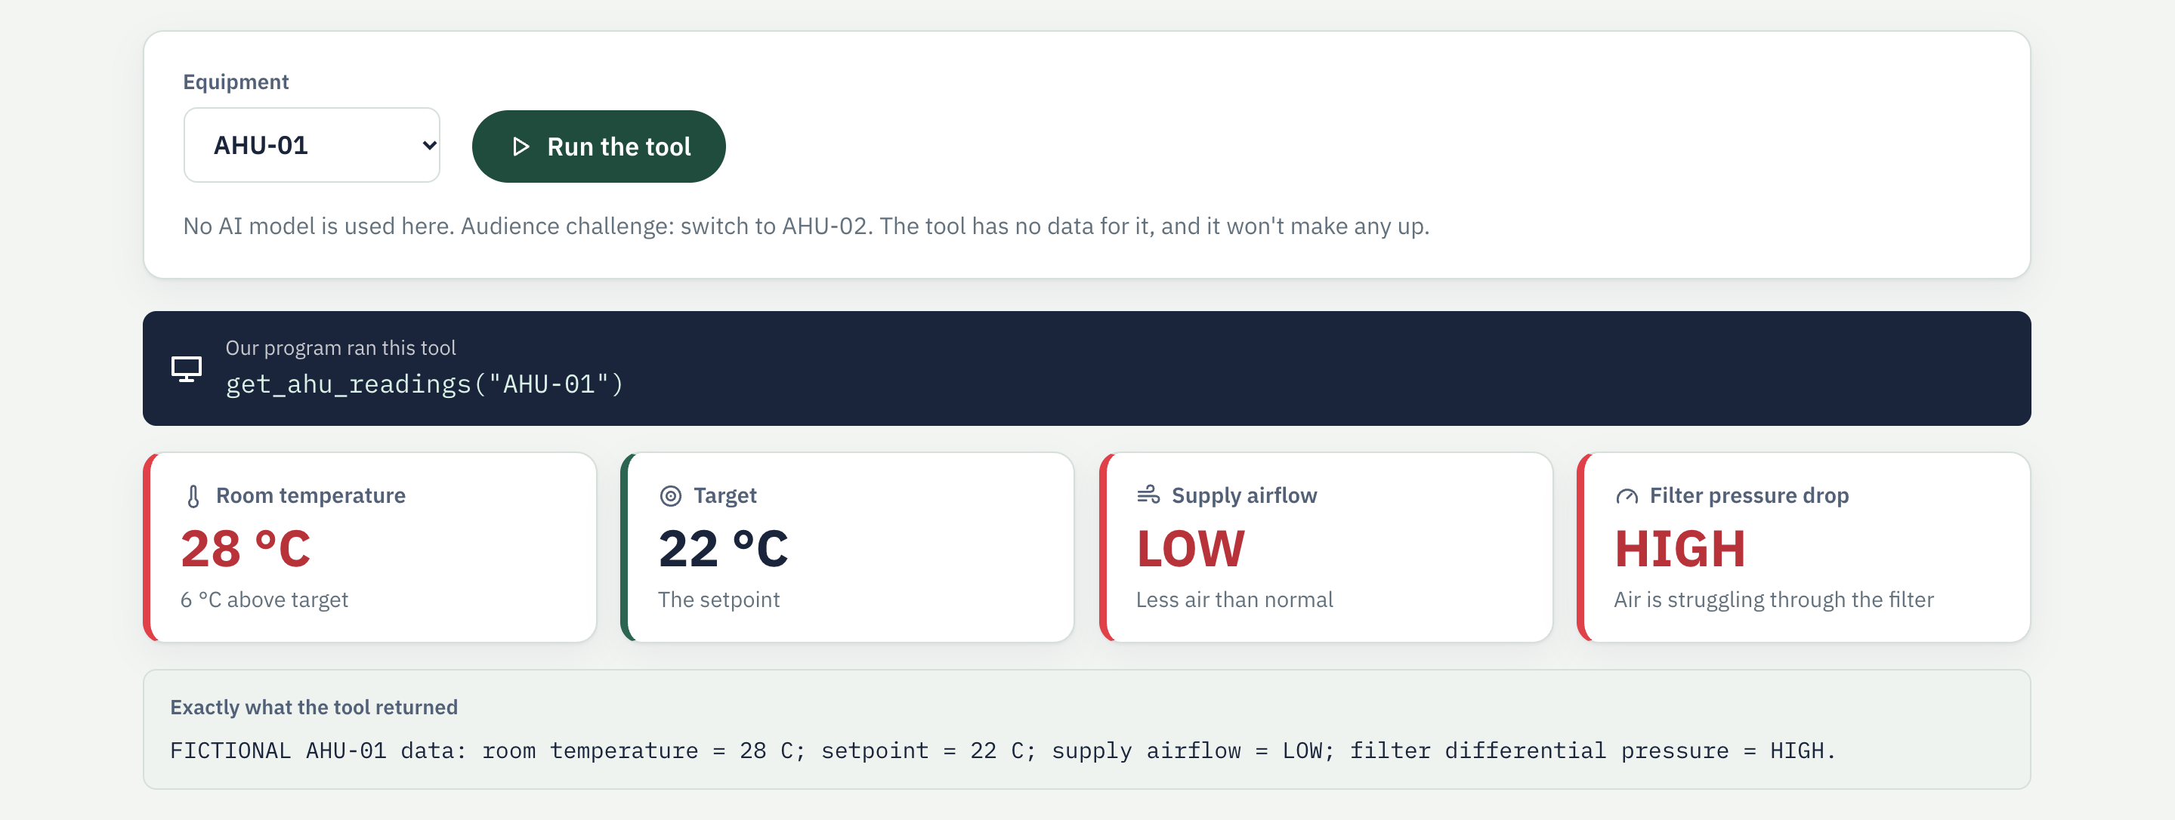
EXERCISE 2
Make a Python function available as a tool
Simulated readings, no real equipment connection
Live demo · Level 2 · Run the tool
THIS IS A TOOL — NOT YET AN AGENT
BEAWORLD / AGENTIC ENGINEERING 101
19 / 32
Notes:
Demo, Level 2 (tool). With AHU-01 selected, click 'Run the tool'. Our program, not a model, calls get_ahu_readings and shows the result as tiles: 28 °C against a 22 °C target, airflow LOW, filter pressure drop HIGH.
Audience challenge: switch to AHU-02 and run again. The tool has no data for it, so it says so instead of inventing a reading.
No language model is used at this level.

Slide 20
LEVEL 3
RAG: Search Before Answering
Retrieval-Augmented Generation finds relevant evidence in the maintenance manual before GPT answers.
ENGINEERING LAB · AHU-01
BEAWORLD / AGENTIC ENGINEERING 101
20 / 32
Notes:
Exercise introduction: RAG. Retrieval-Augmented Generation finds relevant evidence in the maintenance manual before the model answers.

Slide 21
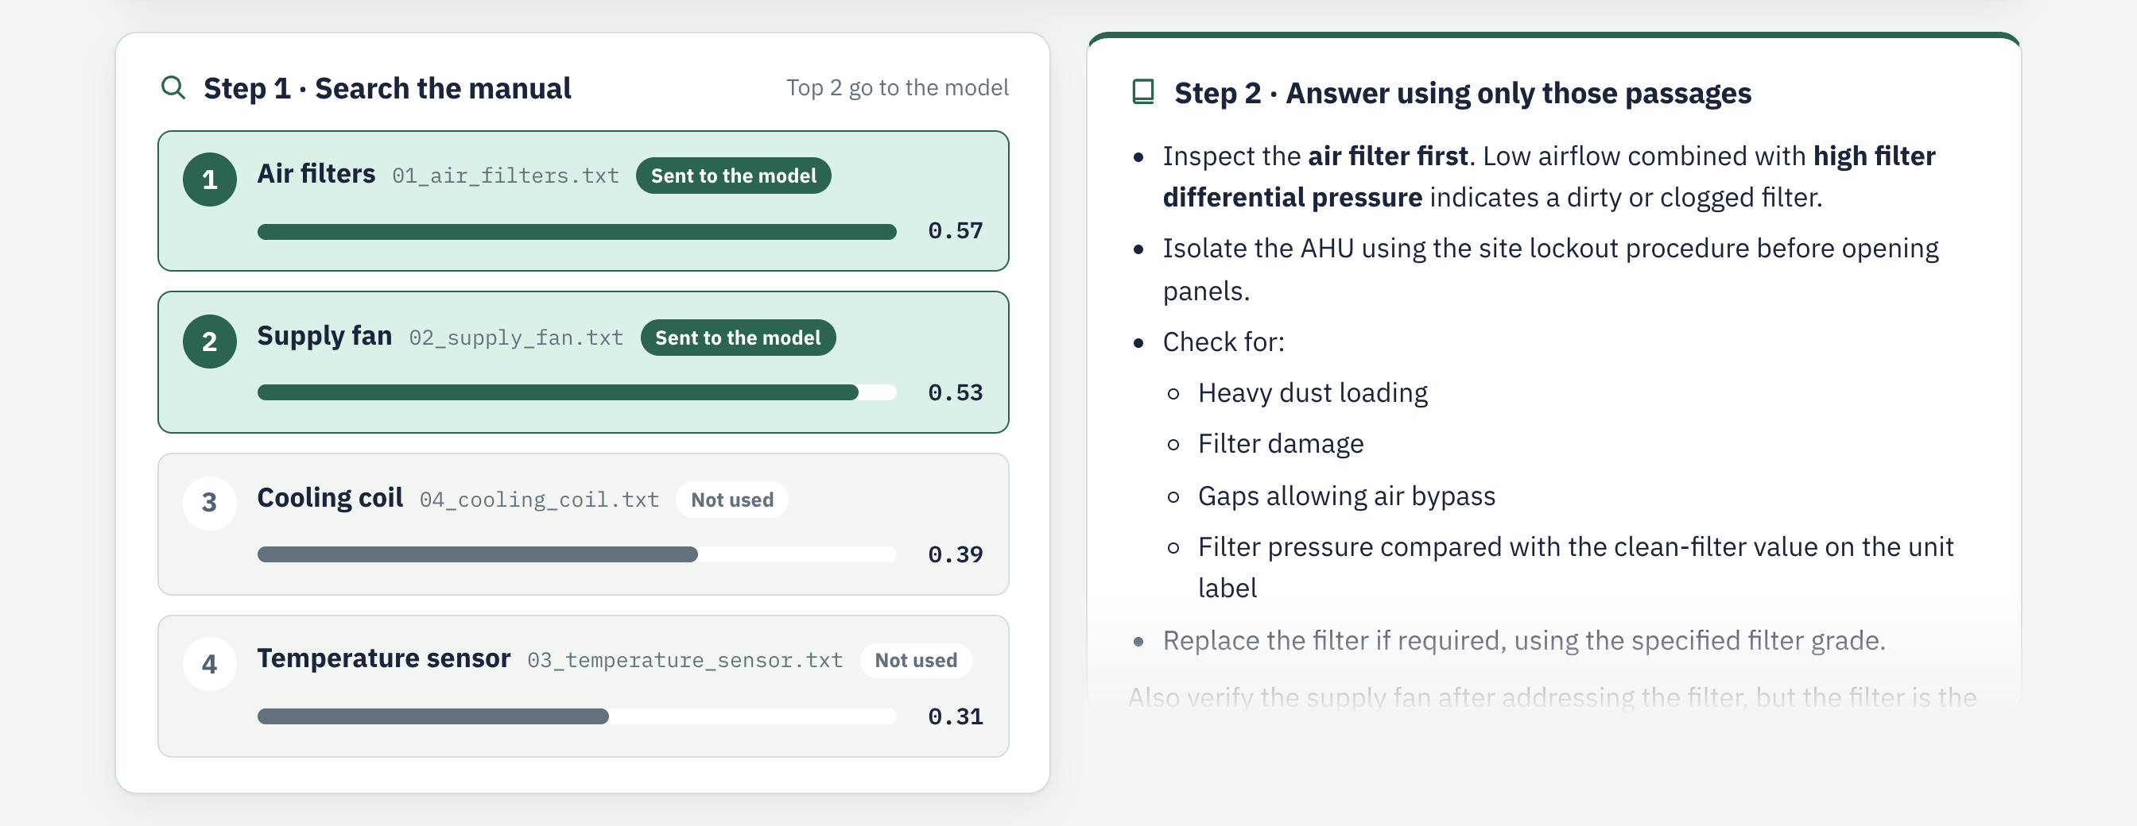
EXERCISE 3
Find a manual passage before answering
7 min · Retrieval-Augmented Generation (RAG)
Live demo · Level 3 · Search, then answer
New ability:
answers use documents.
BEAWORLD / AGENTIC ENGINEERING 101
21 / 32
Notes:
Demo, Level 3 (RAG). Click 'Search the manual, then answer'. Step 1 scores every manual section against the question; the top two are sent to the model. Step 2 is the answer, which cites the source files.
Audience challenge: open 'Edit the manual', change the air-filter section (for example, replace it with an unrelated sentence) and search again. The scores and citations change. The files on disk are not modified.
Question for the room: who decided when to search? Our fixed workflow. RAG is not an agent.

Slide 22
LEVEL 4
The AI Agent
Let GPT decide whether to read sensors, check service history, or retrieve manual guidance.
ENGINEERING LAB · AHU-01
BEAWORLD / AGENTIC ENGINEERING 101
22 / 32
Notes:
Exercise introduction: The AI Agent. Let the model decide whether to read sensors, check service history, or retrieve manual guidance.

Slide 23
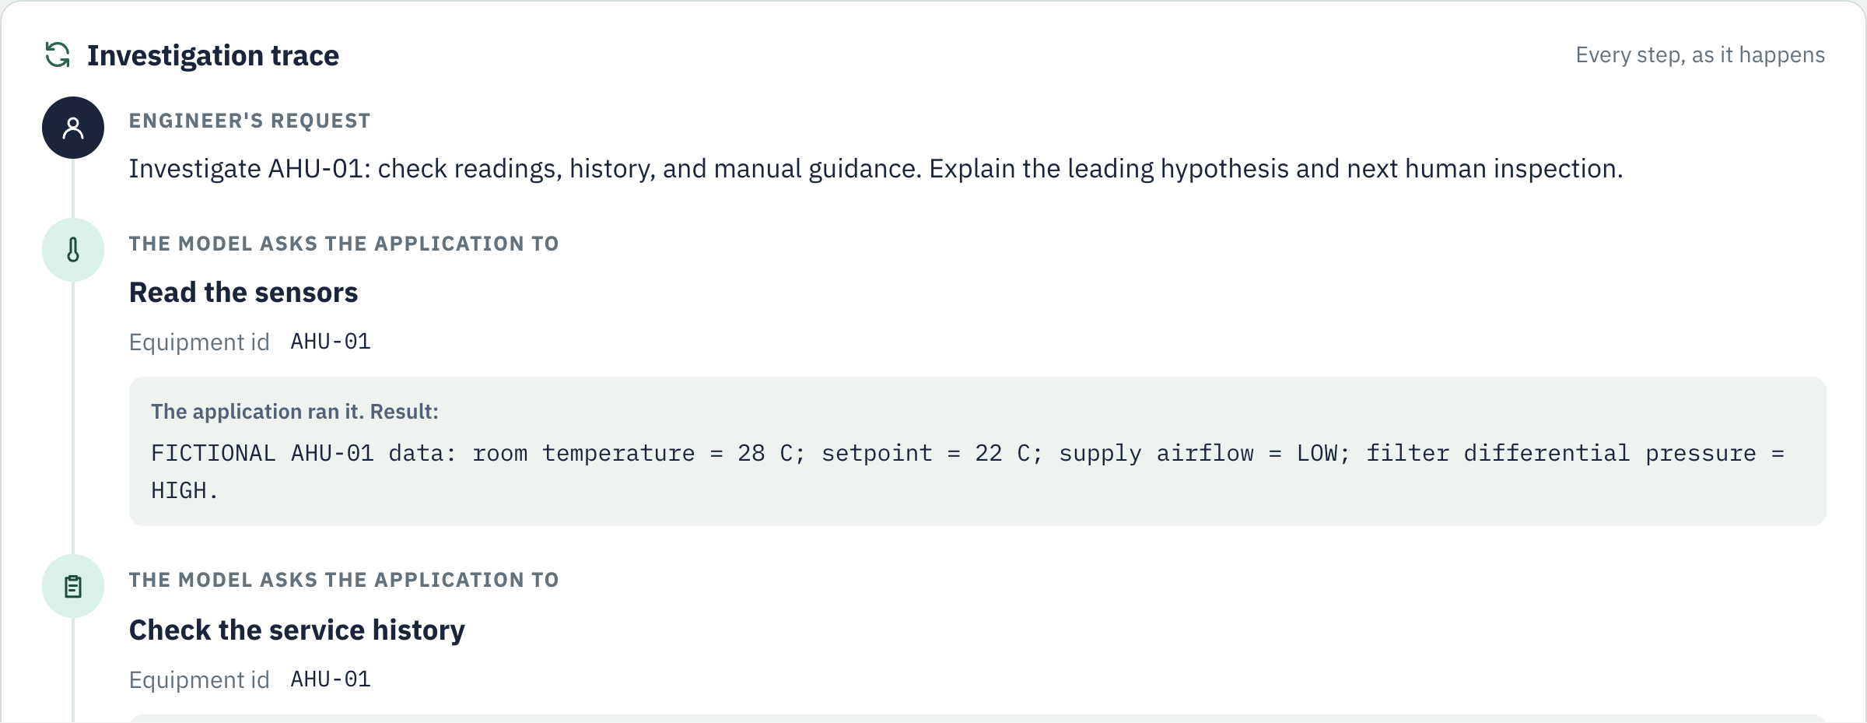
EXERCISE 4
Let the model choose the next tool
10 min · LangChain create_agent
Live demo · Level 4 · Investigation trace
New ability:
the route can change.
BEAWORLD / AGENTIC ENGINEERING 101
23 / 32
Notes:
Demo, Level 4 (AI agent). Click 'Start the investigation'. The trace shows each step as it happens: the model asks the application to read the sensors, check the service history and search the manual; the application runs each tool and returns the result. The conclusion appears at the end.
Audience challenge: switch on 'the filter was replaced last week' and run again. The service record changes, and so does the reasoning.
Question for the room: which tools did the model ask for, and in what order? 'Reveal the answer' shows this run's order. The order can change between runs.

Slide 24
AGENT TRACE
A possible investigation path
Illustrative output — not a guaranteed sequence.
USER
Investigate AHU-01
AGENT → TOOL
get_ahu_readings("AHU-01")
TOOL RESULT
Airflow LOW · Filter drop HIGH
AGENT → TOOL
get_maintenance_history("AHU-01")
TOOL RESULT
Filter replacement overdue
AGENT
Recommend inspection; do not claim certainty
BEAWORLD / AGENTIC ENGINEERING 101
24 / 32
Notes:
Use this as a possible trace, not as an actual execution transcript. The agent may select another sequence or need explicit prompting for both tools.
Level 4 in the demo app shows this trace live. In our runs the model also searched the manual (search_manual) before giving its conclusion.

Slide 25
LEVEL 5
Agentic AI Application
Combine the agent, tools, task state and approval rules into one controlled application.
ENGINEERING LAB · AHU-01
BEAWORLD / AGENTIC ENGINEERING 101
25 / 32
Notes:
Explain the distinction. An AI agent is the decision-making component that can choose tools in a loop. An agentic AI application is the wider engineered system around it: the agent, tools, saved state, business rules, monitoring and human approvals. Agentic AI is a broad label, not a rigidly separate technology category. The example pauses before ticket creation.

Slide 26
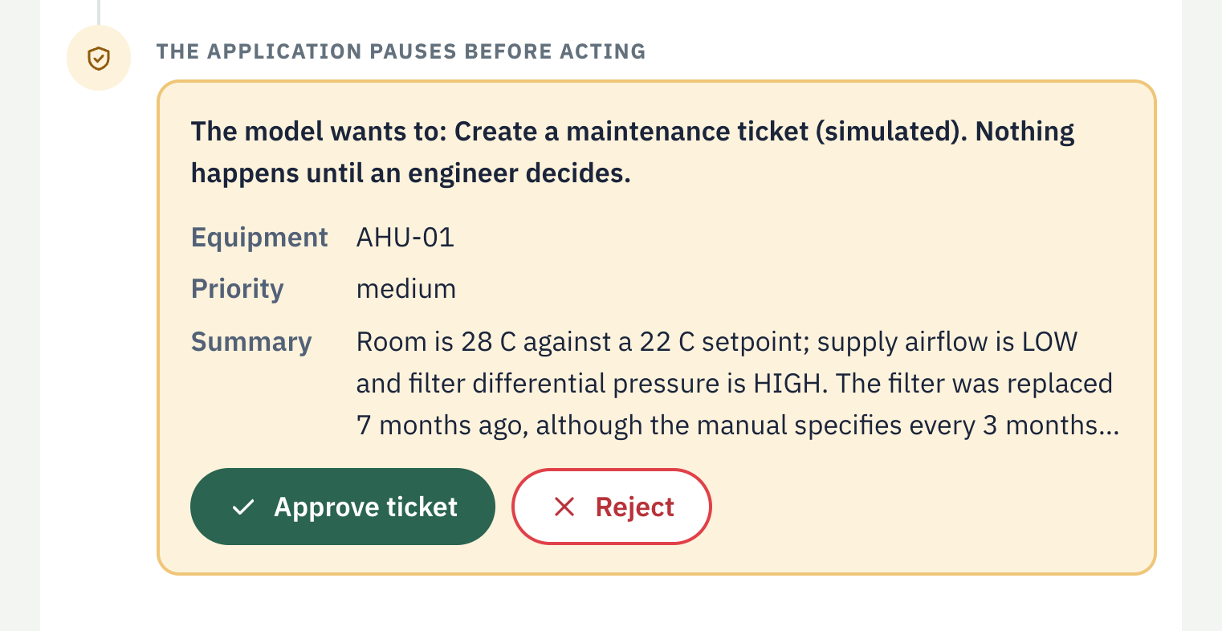
EXERCISE 5
The agent proposes. The engineer approves.
10 min · Add state, safeguards and human approval.
Live demo · Level 5 · The pause
1 Investigate fault
2 Propose maintenance ticket
3 Pause for human approval
4 Approve → create / Reject → stop
Simulated ticket only. No physical equipment control.
BEAWORLD / AGENTIC ENGINEERING 101
26 / 32
Notes:
Demo, Level 5 (agentic AI application). Click 'Start the investigation'. After the three read-only tools, the model asks for create_maintenance_ticket. The application pauses before the tool runs and shows the proposed ticket with Approve and Reject.
Run it twice. Approve: the simulated ticket is created and the agent confirms. Reject: the ticket tool never runs and the agent summarises instead.
Behind the scenes: LangChain's HumanInTheLoopMiddleware with a checkpointer and thread ID; the decision resumes the saved investigation, and each pause can only be answered once. Approving a maintenance ticket is distinct from approving a physical action.
Question for the room: could the model create the ticket on its own? No. Permission is separate from the model's recommendation.

Slide 27
SAFETY
Can we trust an AI agent?
Engineering principles still apply.
BEFORE DEPLOYMENT
RED FLAGS
✓ Restricted tool permissions
✓ Validation of measurements
✓ Human approval for actions
✓ Logs, limits and timeouts
✕ Made-up readings
✕ Repeated tool calls
✕ False certainty
✕ Unapproved actions
BEAWORLD / AGENTIC ENGINEERING 101
27 / 32
Notes:
High-stakes engineering decisions must not be delegated blindly to an LLM. Safety-critical process control needs engineered, verifiable guarantees outside the language model.

Slide 28
EVALUATION
One successful demo is not enough
Test your agent like an engineering system.
GOOD DATA
MISSING DATA
Does it choose an appropriate tool?
Does it ask instead of guessing?
CONFLICTING DATA
UNSAFE REQUEST
Does it surface uncertainty?
Does it stop and request approval?
BEAWORLD / AGENTIC ENGINEERING 101
28 / 32
Notes:
Emphasize robust evaluations across scenarios, rather than only one hand-picked successful prompt. Capture traces, measure task success, invalid tool calls and unsafe behavior.

Slide 29
AUDIENCE QUIZ
Which one is the agent?
Ask participants to vote before revealing.
A
Explains possible pump failures
B
Returns a stored sensor measurement
Chooses whether to inspect logs or sensors
D
Sends a fixed daily status email
C
BEAWORLD / AGENTIC ENGINEERING 101
29 / 32
Notes:
Reveal the answer after participants vote: C. A is an LLM response, B is a tool, D is fixed automation. D might have an LLM for wording but follows a fixed schedule.

Slide 30
AUDIENCE QUIZ
Which one is the agent?
Ask participants to vote before revealing.
A
Explains possible pump failures
B
Returns a stored sensor measurement
C
Chooses whether to inspect logs or sensors
D
Sends a fixed daily status email
Answer: C — a model dynamically decides which tool to use.
BEAWORLD / AGENTIC ENGINEERING 101
30 / 32
Notes:
Reveal the answer after participants vote: C. A is an LLM response, B is a tool, D is fixed automation. D might have an LLM for wording but follows a fixed schedule.

Slide 31
THE JOURNEY
Five concepts — one clear picture
Each concept solves a different part of the engineering problem.
01
LLM
02
Tool
03
RAG
Large Language Model
A function or API
Retrieval-Augmented Generation
Explains what might be wrong
Reads sensor data
Finds guidance in a manual
04
AI Agent
05
Agentic AI Application
Model + tools + decision loop
Agent + state + rules + approvals
Chooses which information to check
Coordinates and governs the full task
REMEMBER: The LLM is not the whole system. The application supplies access, control and accountability.
BEAWORLD / AGENTIC ENGINEERING 101
31 / 32
Notes:
Use this slide as the learning-outcome recap. Ask the room to define each term before revealing or reading its card: LLM = Large Language Model, generates useful text; tool = a function/API that reads data or performs an action; RAG = Retrieval-Augmented Generation, fetches relevant documents to ground answers; AI agent = a model-controlled loop selecting tool calls based on feedback; agentic AI application = the entire engineered solution including tools, state, constraints, human approval, monitoring and evaluation. RAG is optional for an agent; the five concepts are not always sequential layers.

Slide 32
THANK YOU
Let’s build useful AI systems — responsibly.
BEAWorld · Bangladeshi Engineers & Architects Worldwide
BEAWORLD / AGENTIC ENGINEERING 101
32 / 32
Notes:
Final discussion: invite questions about possible tools for engineering disciplines including mechanical, civil, electrical and architecture. Resources: BEAWorld website and official LangChain documentation.

