Slide 1
JimenezLopez_Diego_DA301_2Market_Dashboard
File created on: 18/02/2026 16:49:17 GMT

Slide 2
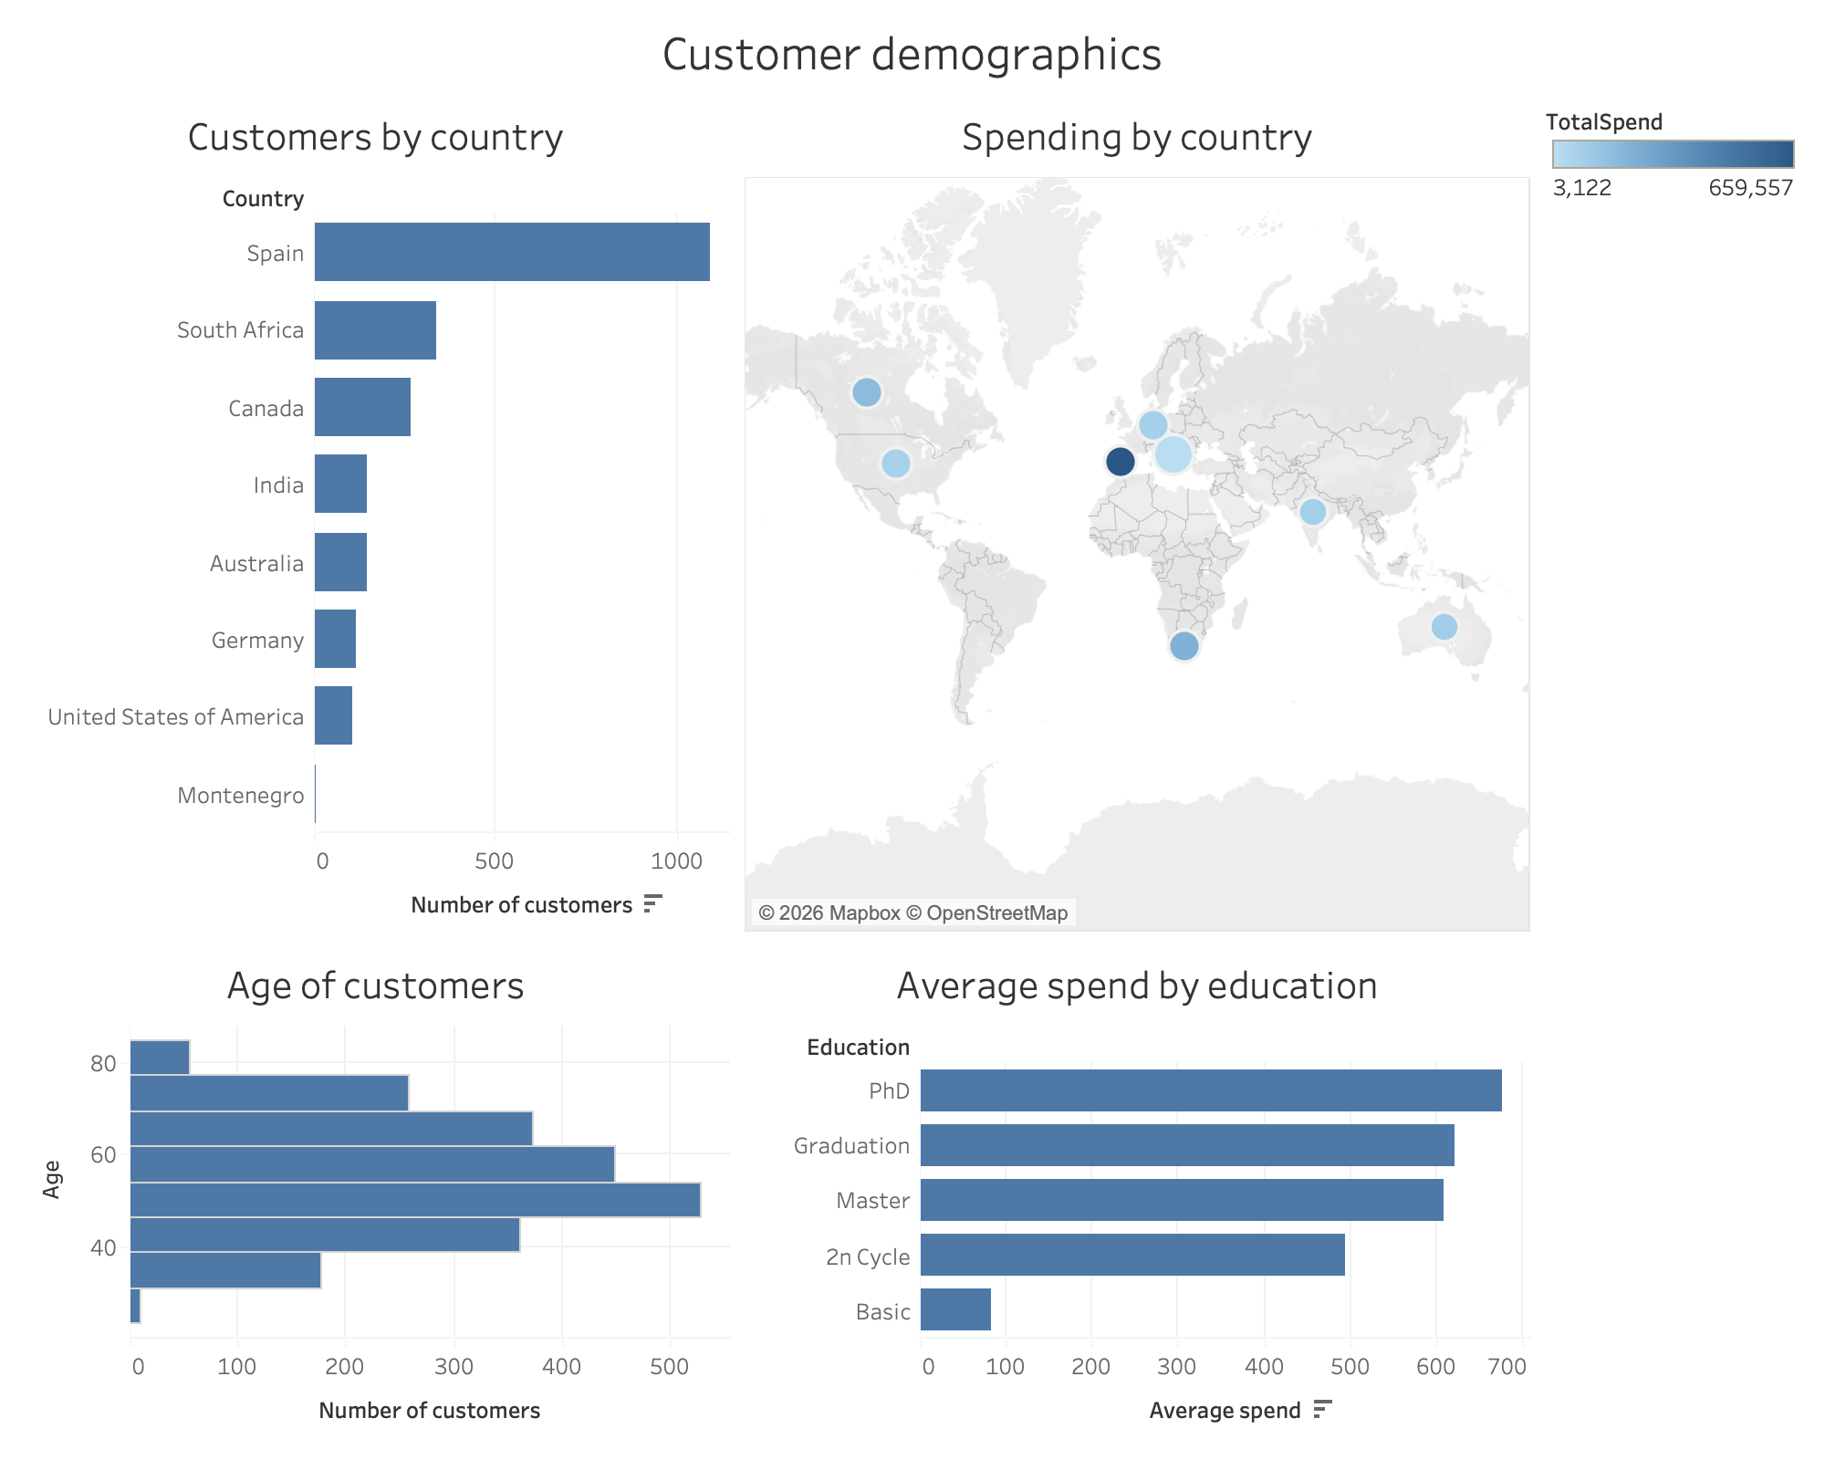

Slide 3
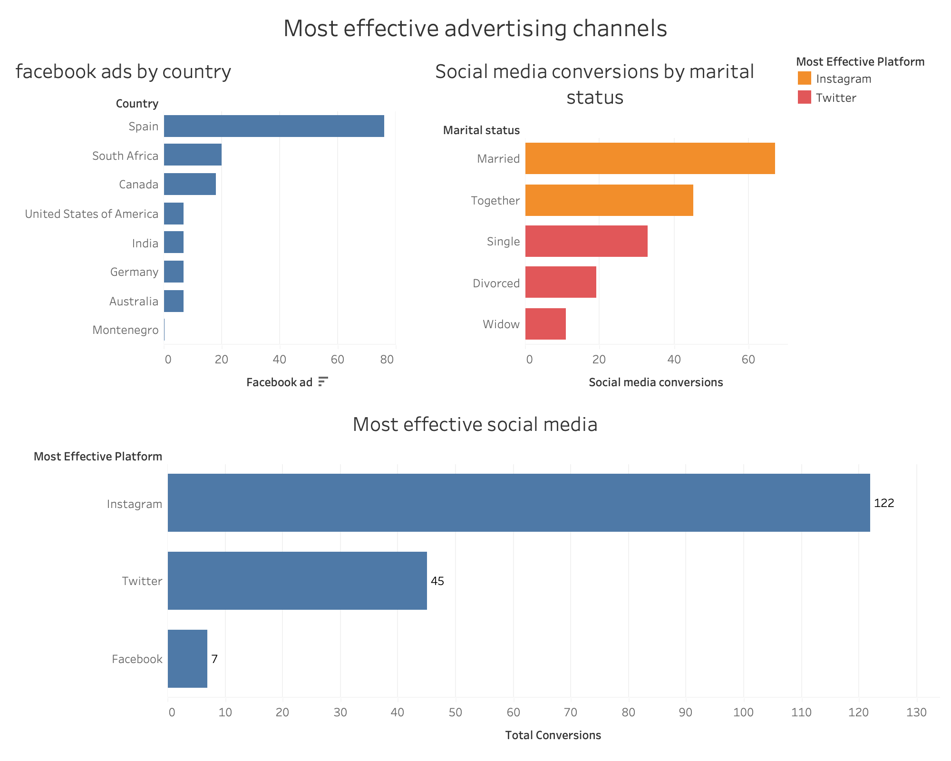

Slide 4
