Slide 1


“PROJECT TITLE”
A
Project Work Power Point Presentation
Submitted in partial fulfilment of the requirements for the degree of
BACHELOR OF TECHNOLOGY
In
COMPUTER SCIENCE & ENGINEERING
By
(Name: 1, 2, 3, 4, 5 & 6)
(Student’s ID: 1, 2, 3, 4, 5, & 6)
Under the Supervision of
Guide Name
(Assistant Professor/Associate Professor/Professor)
Computer Science & Engineering Department
Invertis University, Bareilly
To
Department of Computer Science & Engineering
Invertis University
Lucknow National Highway, NH-24, Bareilly, Uttar Pradesh - 243123
April- 2026

Slide 2

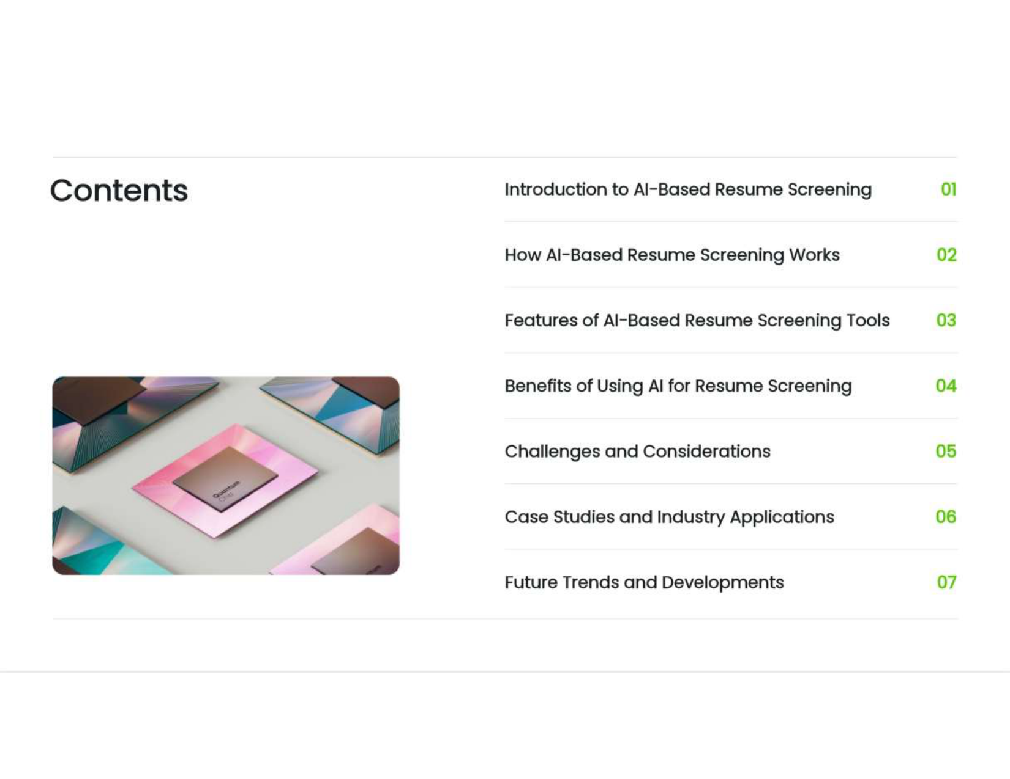
CONTENT
Abstract
Objectives (Specific about work)
Motivation
Literature Survey (with merits and demerits)
Challenges
Requirements (Hardware and Software Requirements)
Flow Chart
Block Diagram
Tools & Technology Used
Project Methodology
Implementation (Project Work) Describe the project work that you have done very clearly using screenshots of your project)
Testing
Applications
Conclusion and Future Scope
References

Slide 3

ABSTRACT

Slide 4

OBJECTIVES

Slide 5

MOTIVATION

Slide 6

LITERATURE SURVEY
S. No. | Paper Title | Authors | Year | Method/Model Used | Key Findings | Limitations
1 | ... | ... | 2023 | ANN | High accuracy but slow | Needs large data
2 | ... | ... | 2024 | SVM | Fast, small data OK | Less accurate
Include 3 to 5 key papers (adjust based on time).
Keep text minimal, use short phrases, not full sentences.

Slide 7
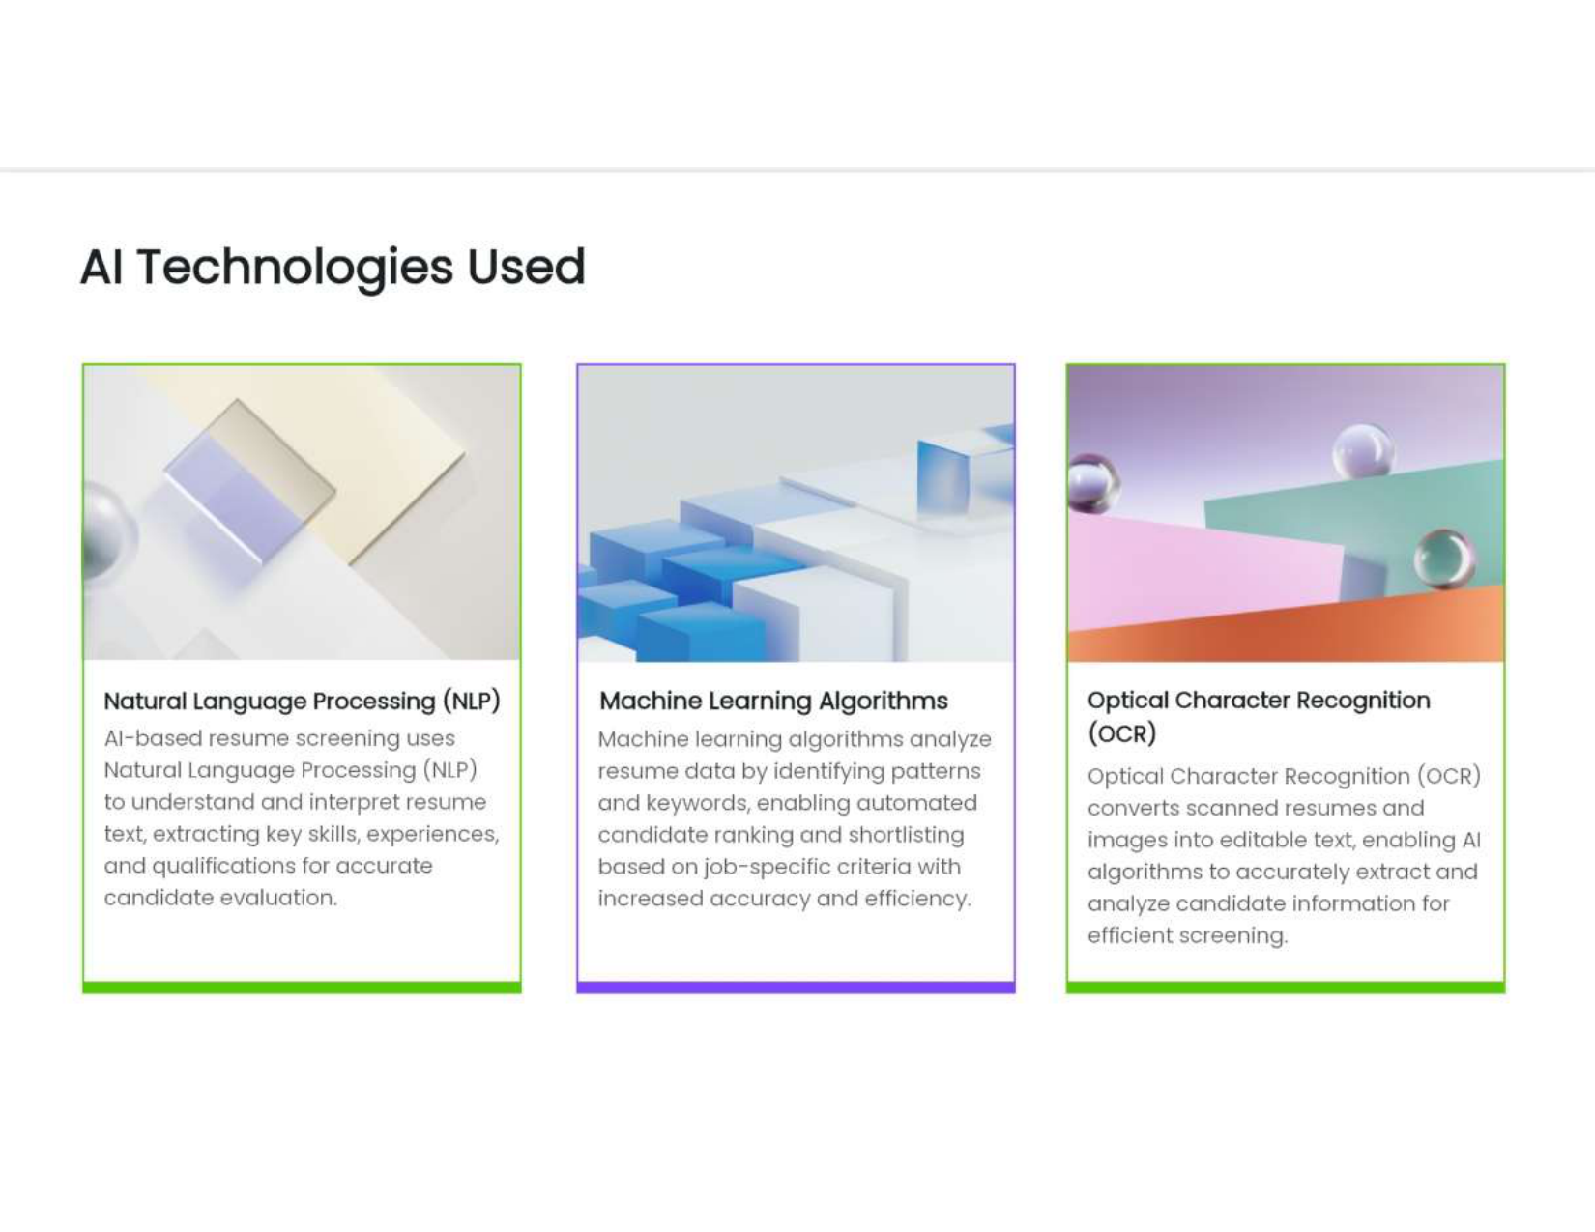
CHALLENGES

Slide 8
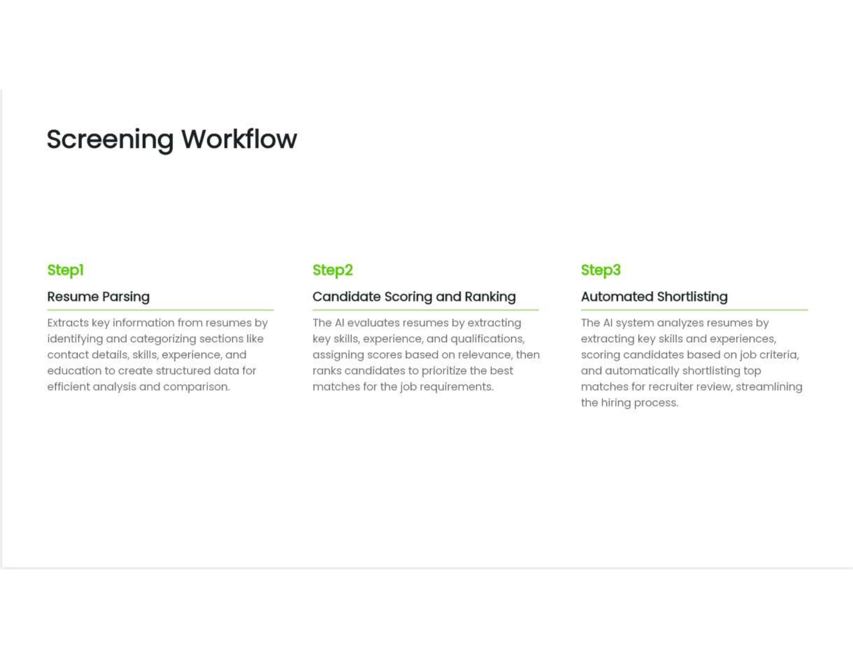
REQUIREMENTS
Give Hardware & Software Requirements

Slide 9

Flow Chart
Give Flow Chart of Your Project

Slide 10
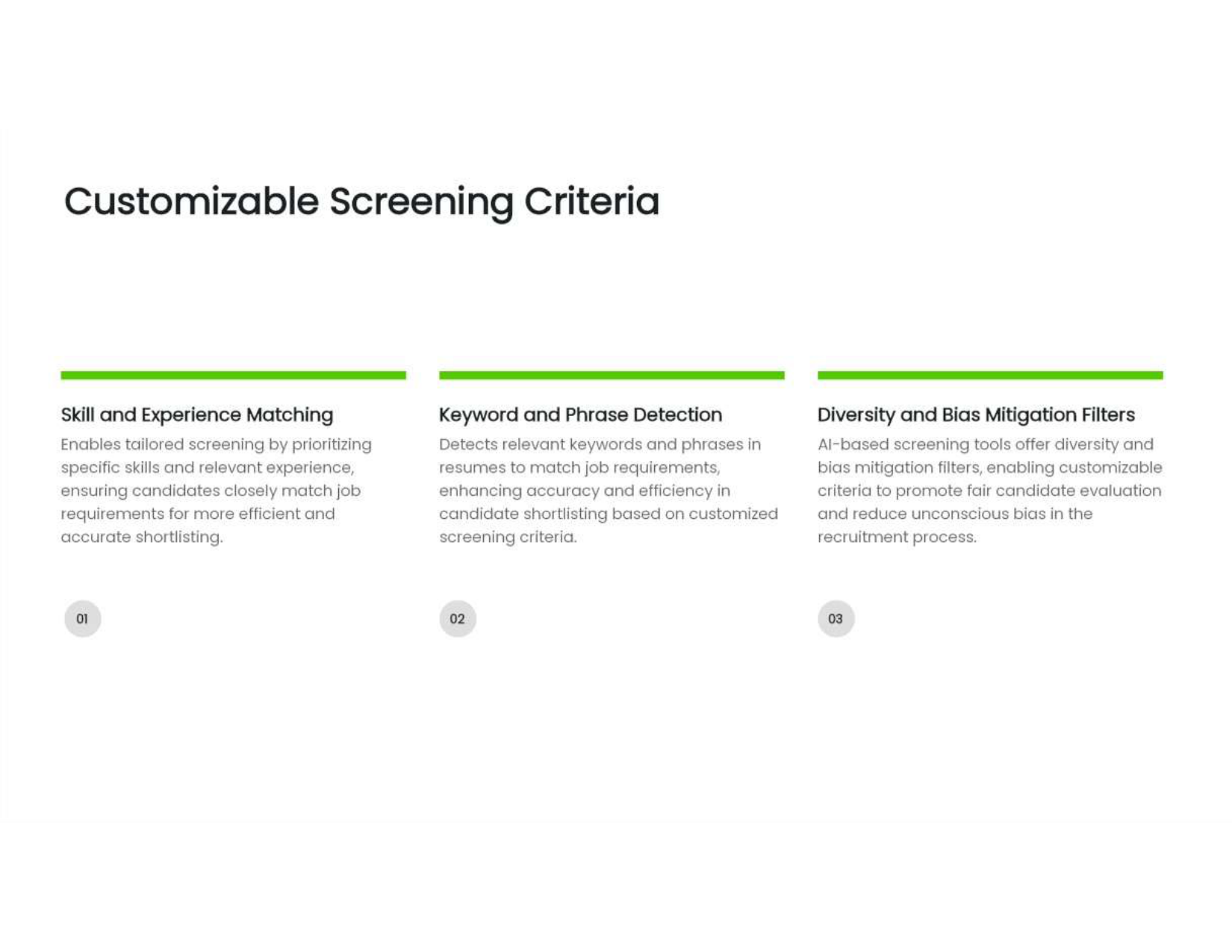
BLOCK DIAGRAM
Give Block Diagram of Project

Slide 11
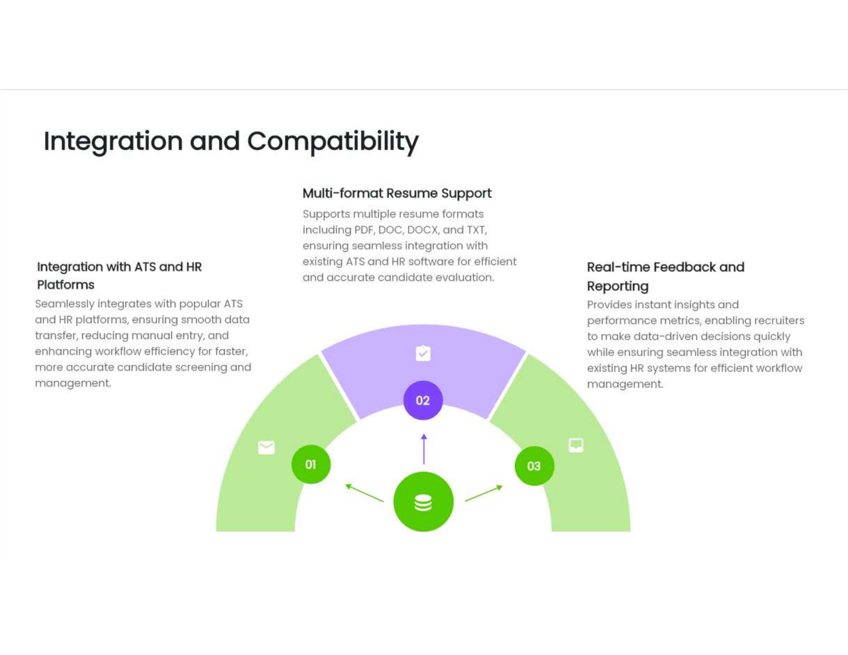
TOOLS & TECHNOLOGY USED

Slide 12

PROJECT METHODLOGY
Describe Project Methodology that you have used to develop your project.
Example:
Waterfall
Spiral
Agile
Rapid Application Development
Evolutionary
Iterative
Scrum
Prototype
DevOps
Lean

Slide 13
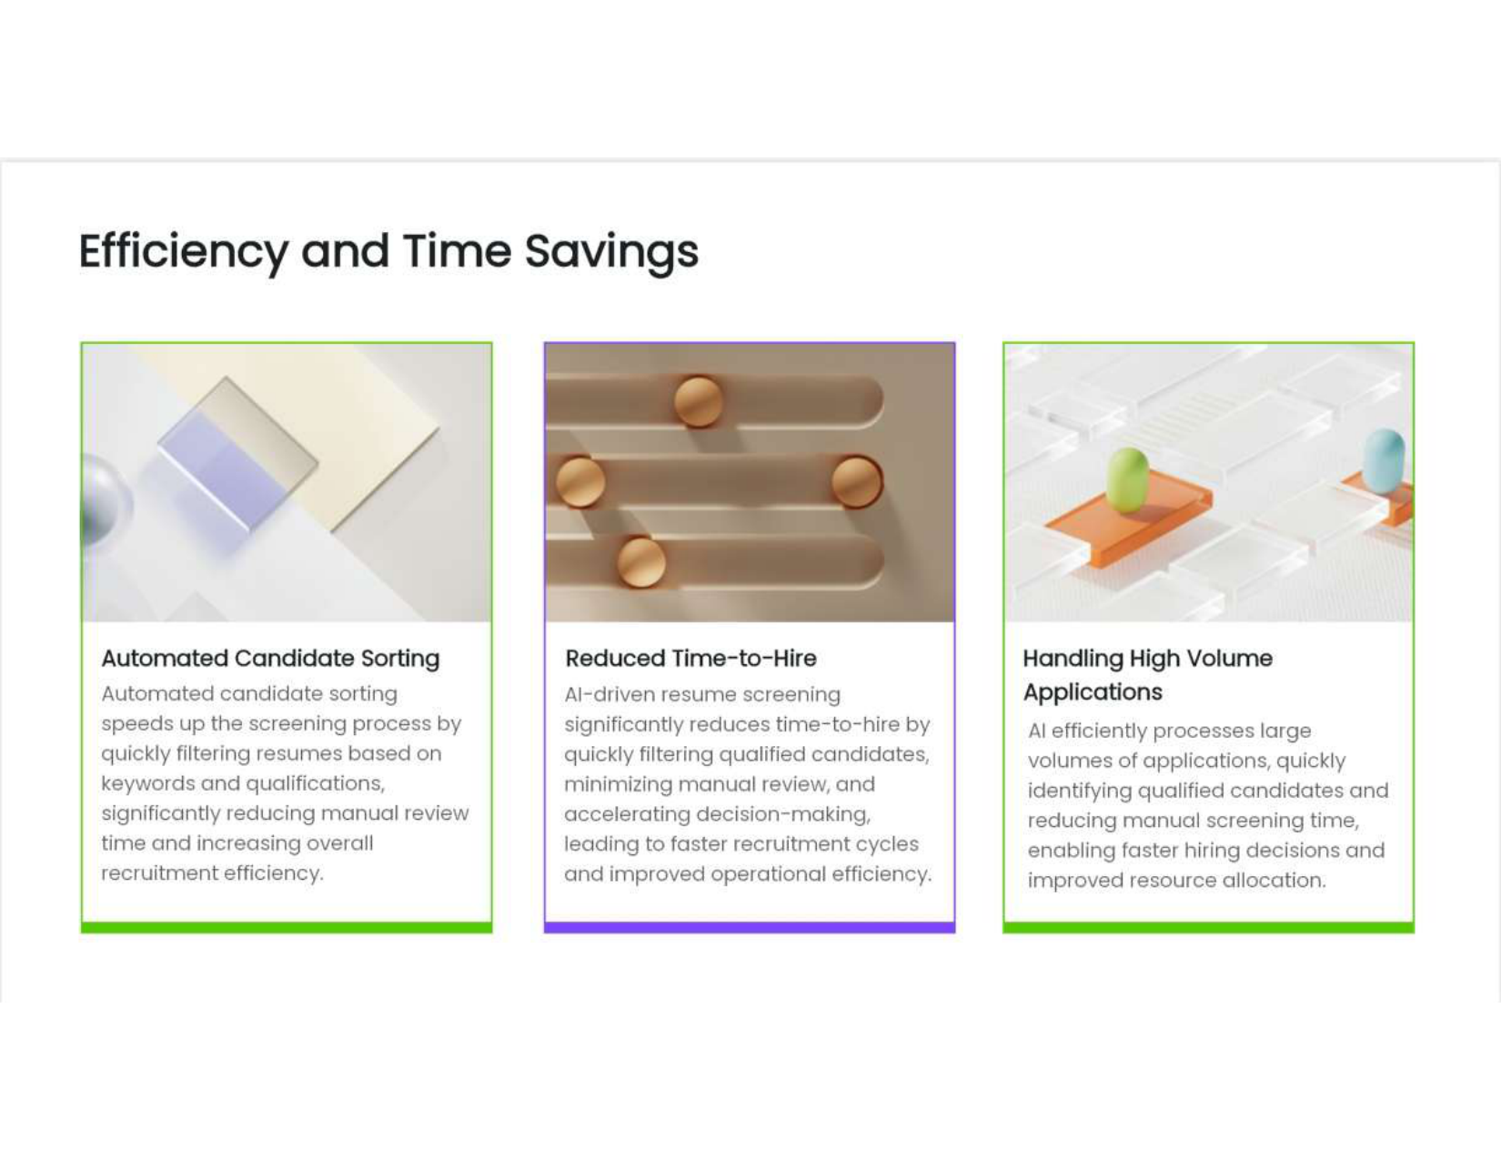
IMPLEMENTATION
Describe your project’s work very clearly using screenshots of your project. Highly emphasise on this section and you may choose number of ppt slides for the same as per your needs. //10 to 15 ppt slides

Slide 14
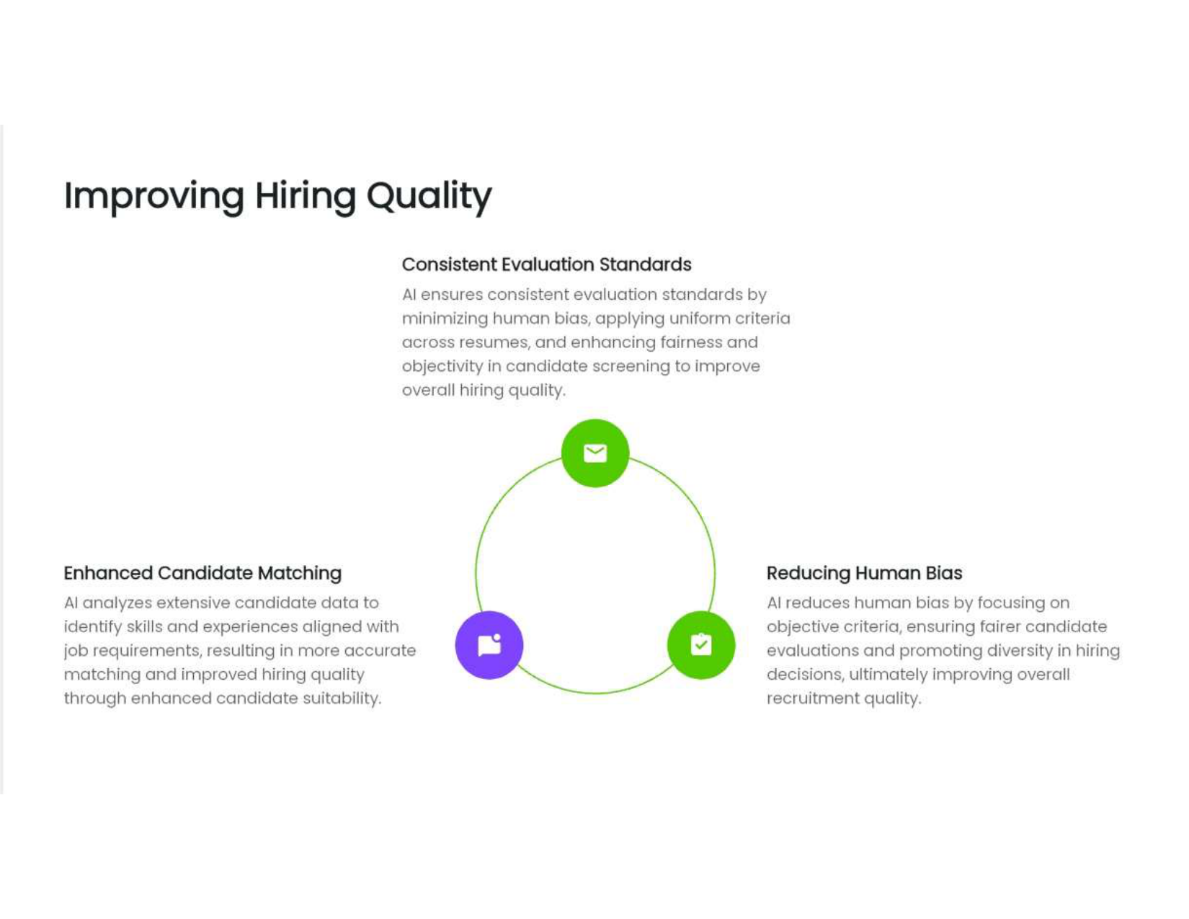
TESTING
Describe, how, you have done testing of your projects and what, methodologies you have used for the same.
Example:
Unit Testing, Integration Testing, System Testing, Alpha Testing, Beta Testing, Stress Testing, Smoke Testing, Load Testing etc.

Slide 15

APPLICATIONS

Slide 16
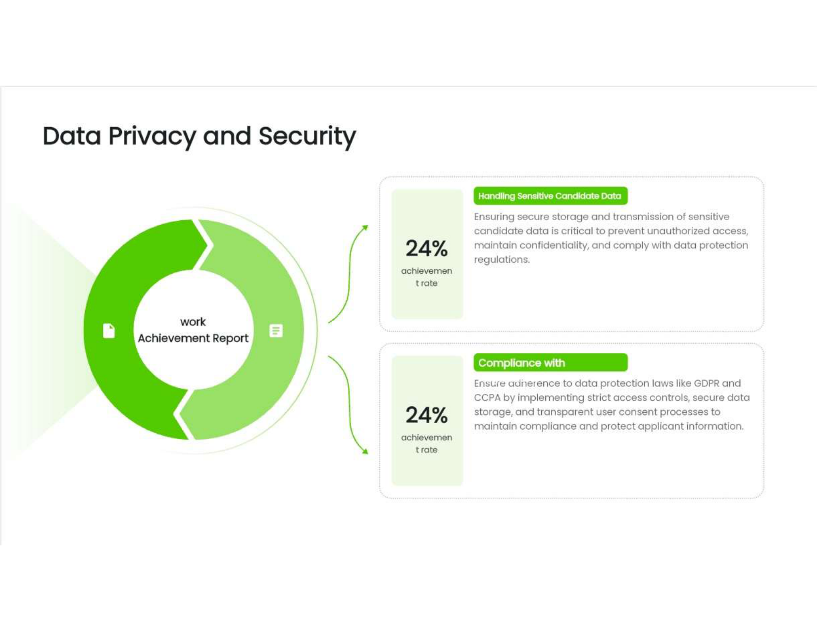
CONCLUSION AND FUTURE SCOPE

Slide 17
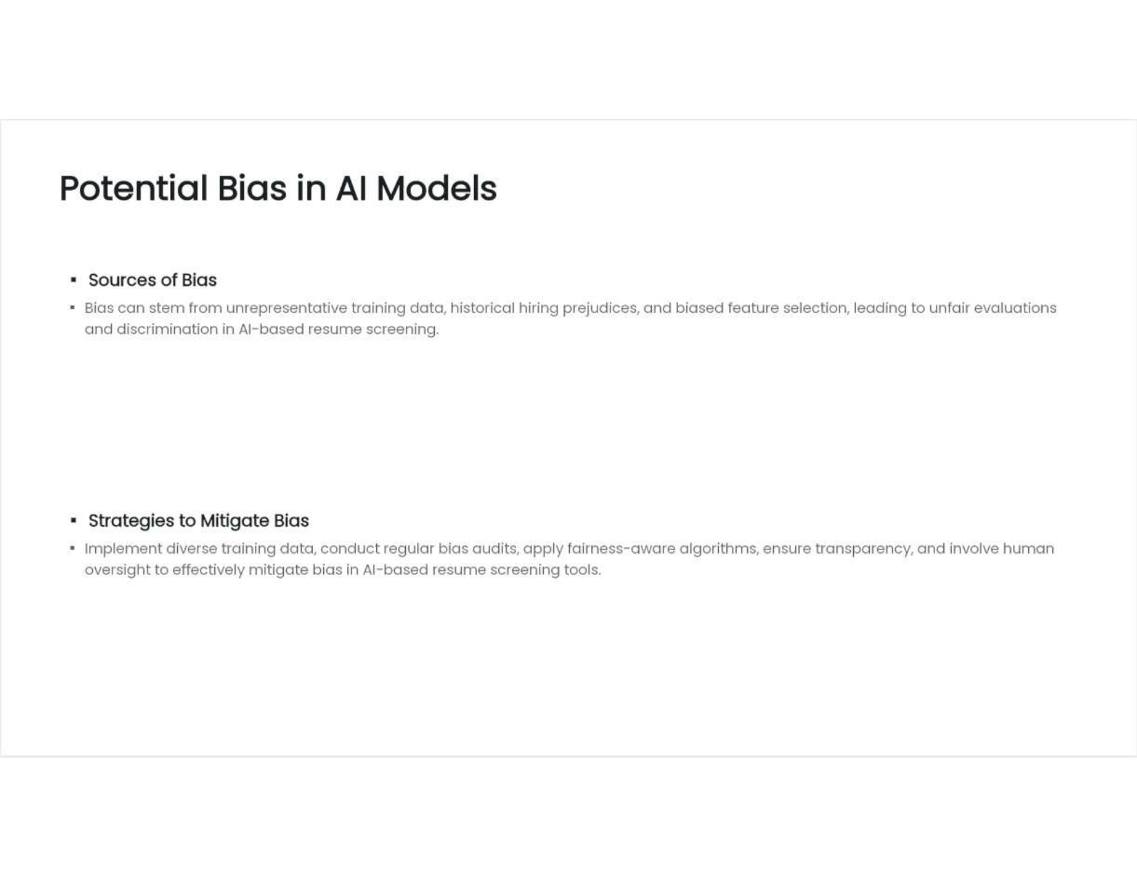
REFERENCES
[1] DR. Dr. I. M. Korachagaon et al, “Zigbee Based Railway Automation System with Advanced Applications,” International Journal of Innovations in Engineering, Research and Technology, IJIERT-ICITER-16, ISSN:2394-3696 26th June, 2016.
[2] B. Kumar Sanjiv, Srilaxmi. P, Pandu Ranga.V, “Zigbee based Railway Gate Controlling” International Journal of Innovative Technology and Exploring Engineering (IJITEE) ISSN: 2278-3075, Volume-8 Issue-4S2 March, 2019.

Slide 18

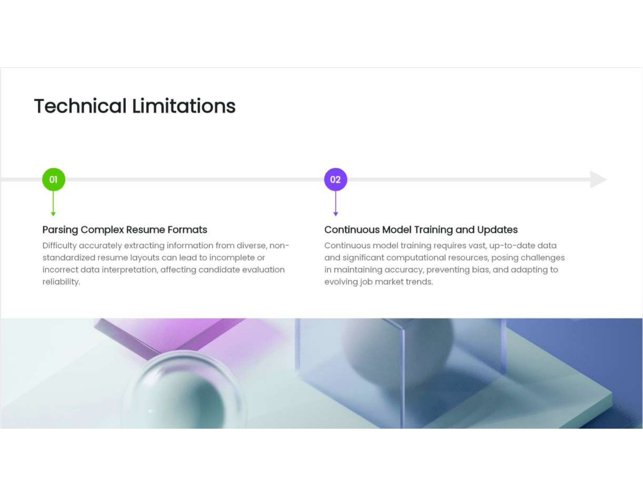
THANK YOU

Slide 19


Slide 20
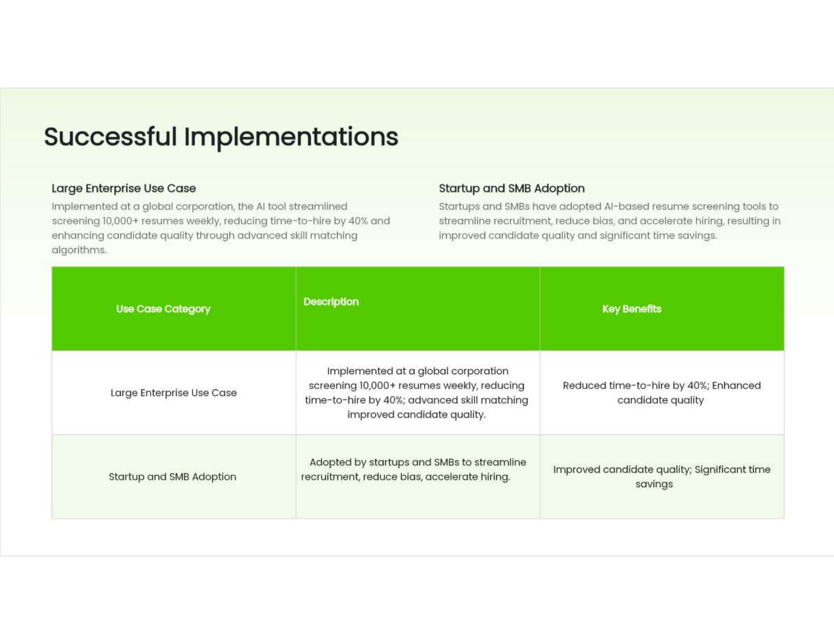

Slide 21
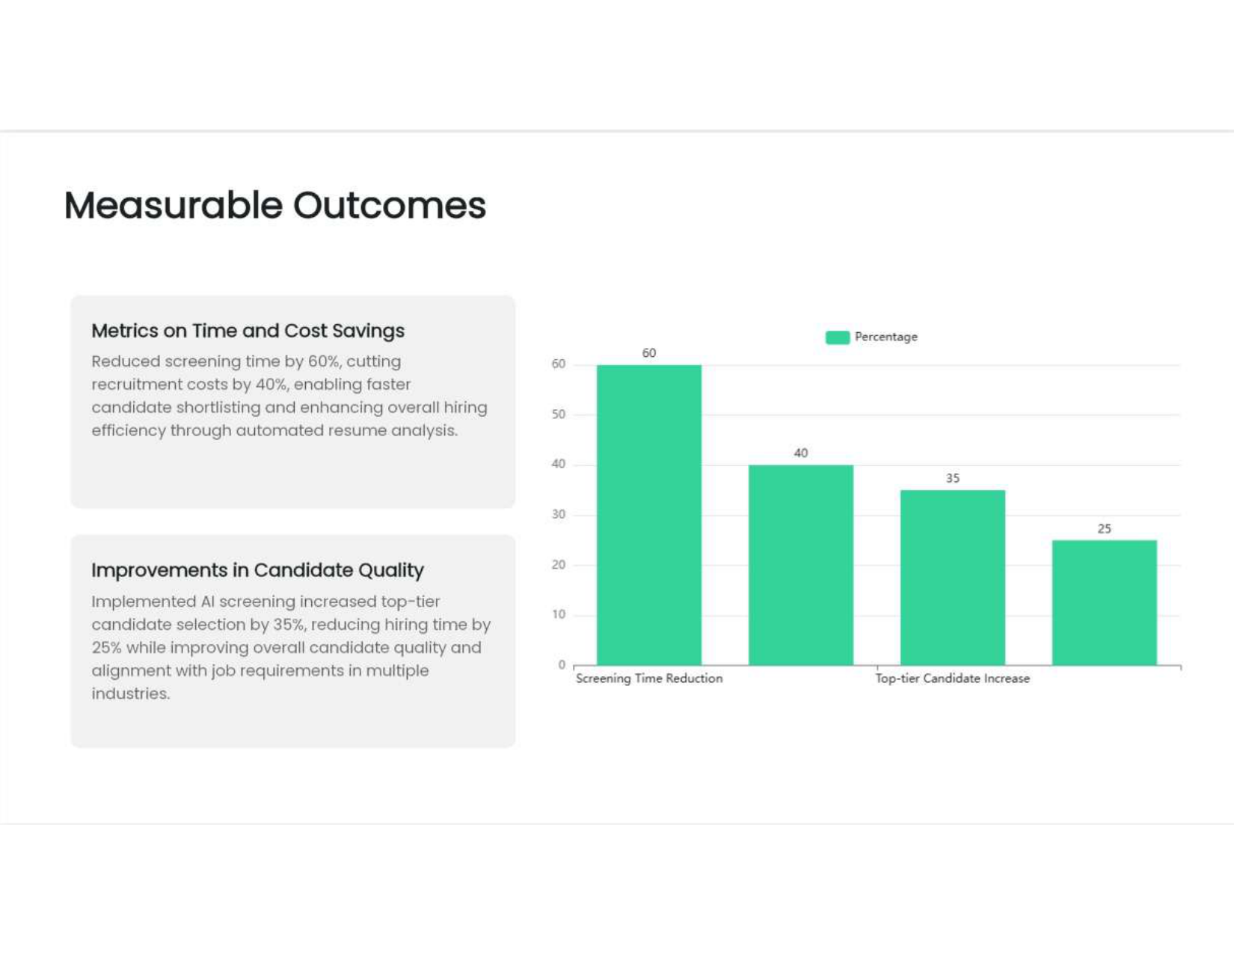

Slide 22


Slide 23
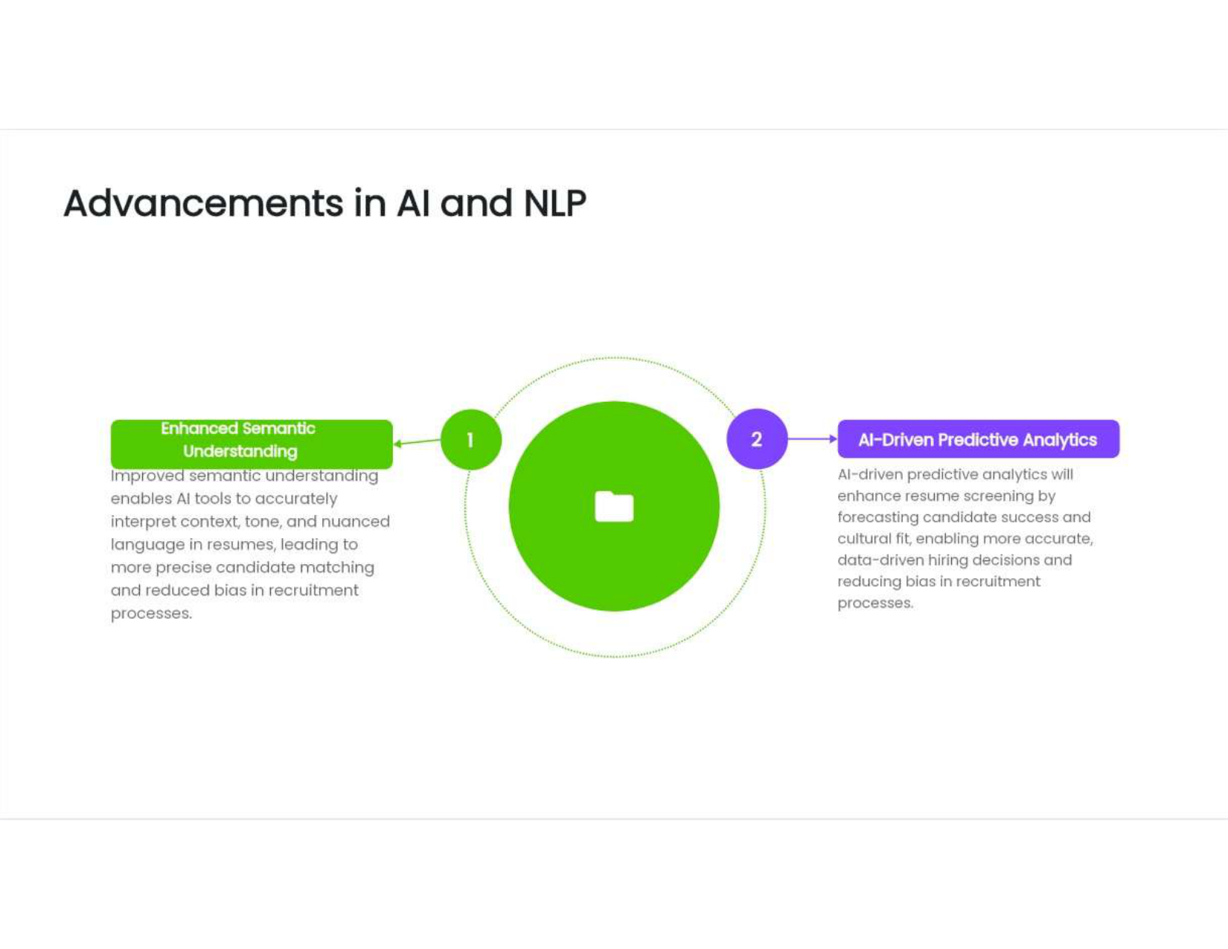

Slide 24


Slide 25


