Slide 2
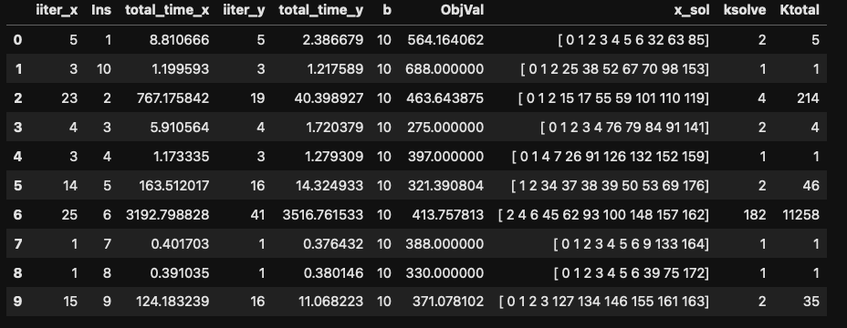
N30, Comp main – Strat4

Slide 3
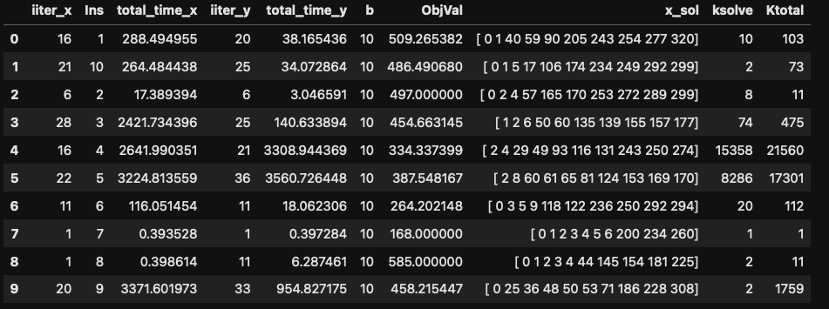
N40, Comp main – Strat4

Slide 4
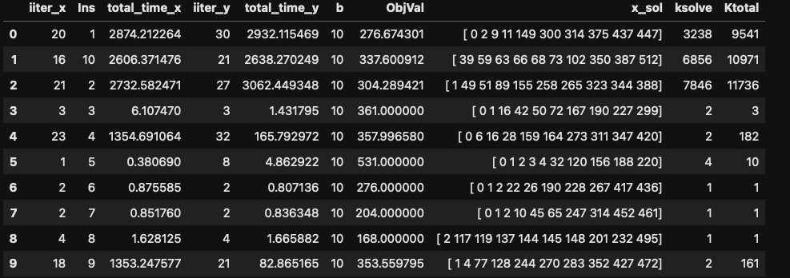
N50, Comp main – Strat4

