Slide 1
Terminating conditions
z^{k} - g(x, c^{k}) <= delta1
g(x, c^{k}) – h(x, c^{k}) <= delta2
Cell k
A cost realization
main
Solve MP, get x and z^{k}, for each k in K
For each cell k in K:
Check if z^{k} - g(x, c^{k}) <= delta1 for all cells in K
If 2 is satisfied, for each cell k in K:
Check if g(x, c^{k}) – h(x, c^{k}) <= delta2 for all cells in K
Yes: Move on
No: Split cell k into 2.
Confidence Interval from Sequential Sampling
Original Bounding Models
UB_{Orig} = g(x, c^{k})
UB_{Seq} = from CI
(True Unknown) Expected shortest-path cost
Sample-based Expected shortest-path cost
LB_{Orig} = h(x, c^{k})
LB_{Seq} = ?
If we have LB_{Orig}<= LB_{Seq} <= UB_{Seq} <= UB_{Orig} then we don’t partition k even if UB_{Orig} – LB_{Orig} > delta2

Slide 2
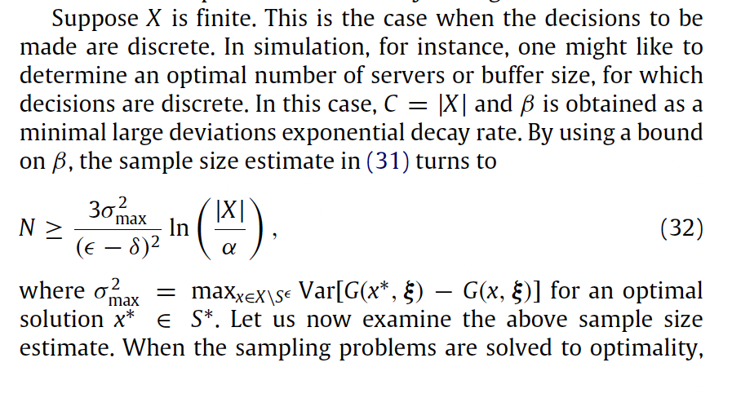
Terminating conditions
z^{k} - g(x, c^{k}) <= delta1
g(x, c^{k}) – h(x, c^{k}) <= delta2
main
Solve MP, get x and z^{k}, for each k in K
For each cell k in K:
Check if z^{k} - g(x, c^{k}) <= delta1 for all cells in K
If 2 is satisfied, for each cell k in K:
Check if g(x, c^{k}) – h(x, c^{k}) <= delta2 for all cells in K
Yes: Move on
No: Split cell k into 2.
Cell k
Compare it with g(x, c^{k})?
If True:
Done with cell k
If False:
Pick N using (32)
Variance?
Epsilon = 1% of the original delta2
𝛿 = 0
|X| = size of the set of feasible interdiction solutions
𝛼=0.01
or

Slide 3
2
20
1
11

Slide 4

x
x
x
x
x
x
x
x
x
x
x
x
Arc $(i,j)$

