Slide 1
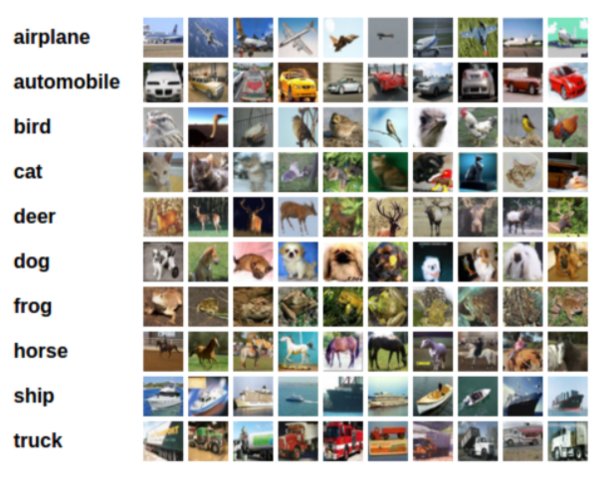
Introduction
Trains Convolutional Neural Network to classify images from the CIFAR-10 database.
Each of the images (32x32x3) fall into one of ten classes
Fig. 1 : Images in this database

Slide 2
Overview
Data preprocessing (Load and Augment)
Visualization of a batch of training data
Definition the network architecture
Specification of loss and optimizer
Training of the network
Testing of the trained network
Visualization of the sample test results

Slide 3
Data Preprocessing

Slide 4
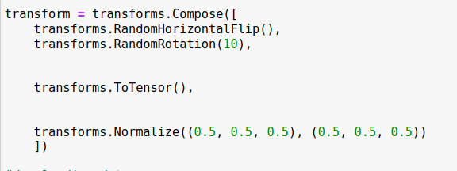
Data Preprocessing : Augmentation
Performs data augmentation
Converts each image pixels into float tensor
Normalizes the image pixels using mean and Standard deviation
Data Augmentation
Conversion
Normalization (mean, SD)

Slide 5
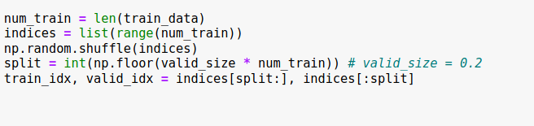
Data Preprocessing: Downloading, Splitting
Downloads data for training and testing
Splits training data into train(80%) and validation set (20%)

Slide 6
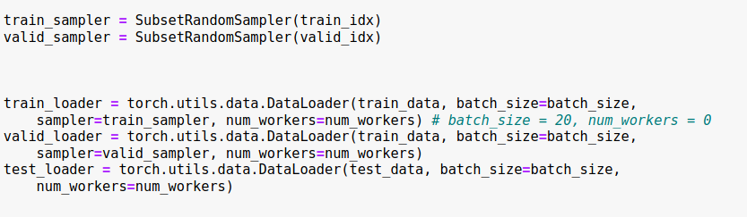
Data Preprocessing: Data Loader, Prediction
Prepares DataLoader with batch size 20
Takes random samples
Defines classes

Slide 7
Visualization of a batch of training data

Slide 8
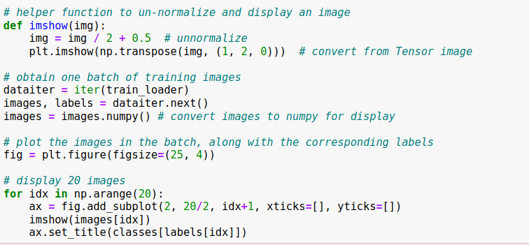
Visualization: Plotting after conversion
Un-normalizes and converts from tensor images
Displays one batch (20) input images from train dataset

Slide 9
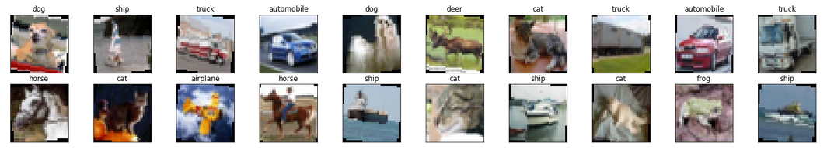
Visualization :displaying images

Slide 10
Defining Network Architecture

Slide 11
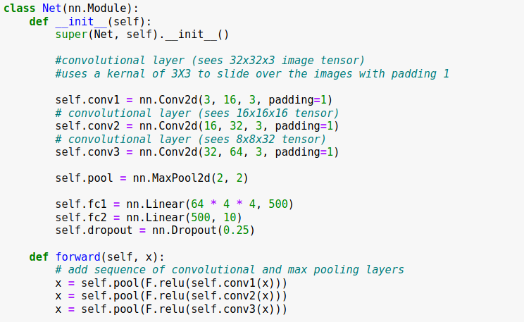
Defining Network Architecture: 1
Defining Layers
Pooling layer applied after each convolutional layer

Slide 12
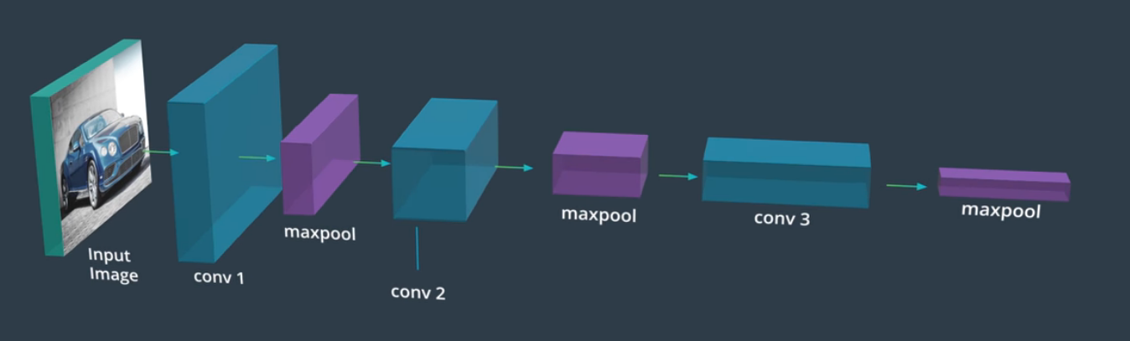
Defining Network Architecture: 2
Depth: 64
Size: 4x4
Depth: 3
Size: 32X32
Depth: 16
Size: 32x32
Depth: 32
Size: 16x16
Depth: 64
Size: 8x8

Slide 13
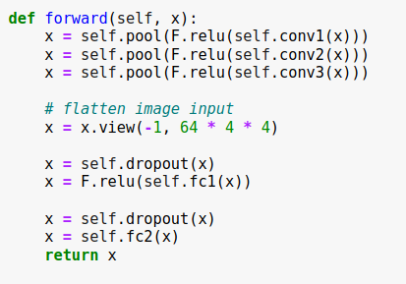
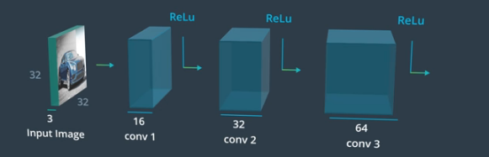
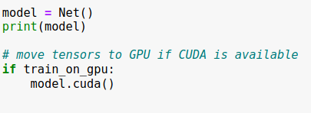
Defining Network Architecture: 3
Model is instantiated .
Model is moved to GPU

Slide 14
Defining Loss and Optimizer

Slide 15

Loss and Optimizer

Slide 16
Training The Network

Slide 17
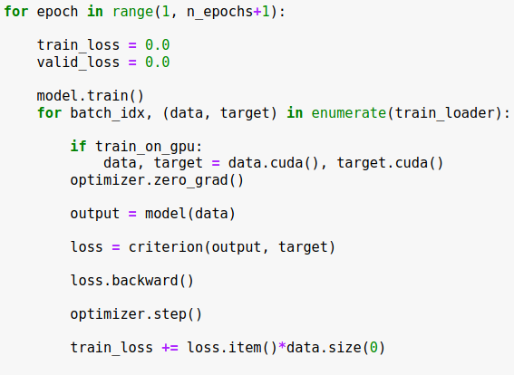
Training the Network : on train dataset
Optimizer.zero_grad() : sets the gradient to zero
Model(data) : calculates predicted output
Criterion(,) : computes loss
Backward(): computes gradient of the loss
Optimizer.step(): updates weights in the network

Slide 18
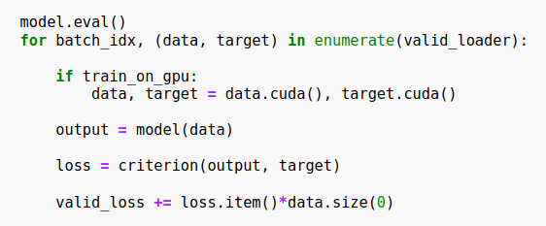
Training the Network : on validation dataset
No Backpropagation

Slide 19
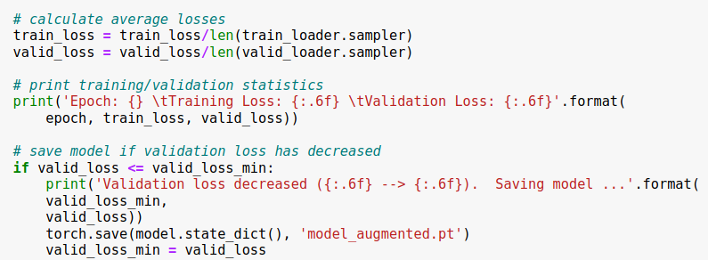
Training the Network : calculating loss

Slide 20
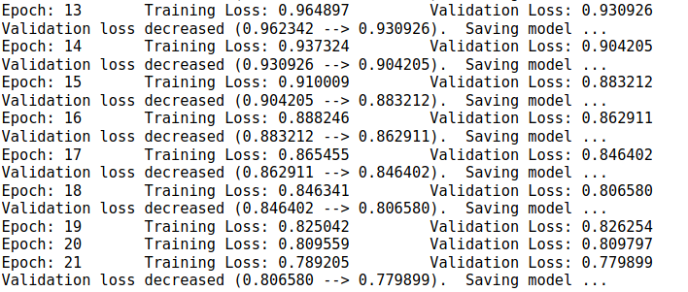
Training the Network : Saving model

Slide 21
Testing the Trained Network

Slide 22
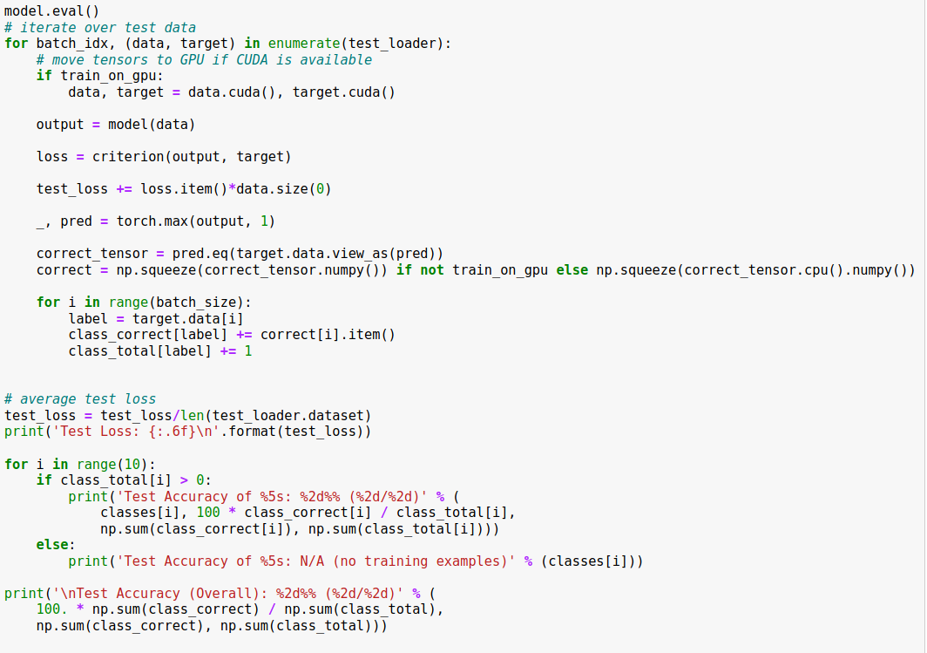
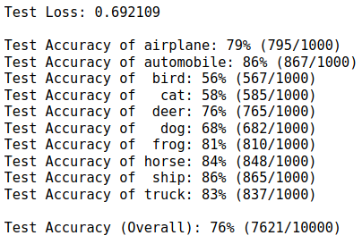
Testing Trained Network
Output

