Slide 1
Captum
A model interpretability library

Slide 2
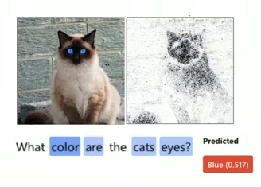
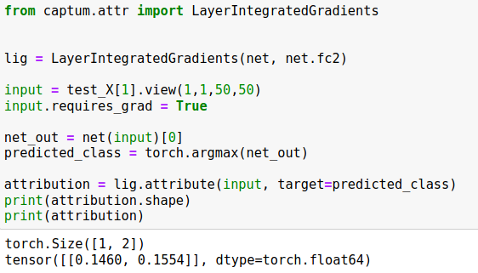
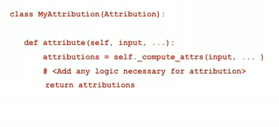
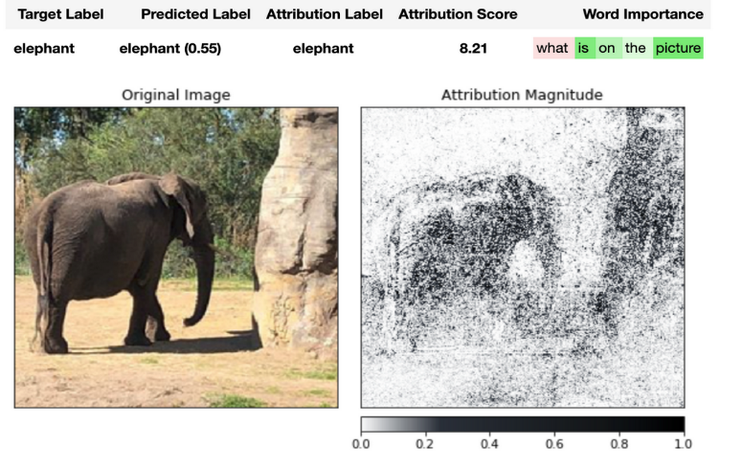
Captum : Characteristics
MULTIMODAL
EXTENSIBLE
EASY TO USE

Slide 3
What Does The Captum Library Offer?
Attribute algorithms to interpret:
  Output predictions with respect to inputs
  Output predictions with respect to layers
  Neurons with respect to inputs
Possible to extend with Perturbation based Algorithms

Slide 4
Interpret output predictions with respect to inputs

Slide 5
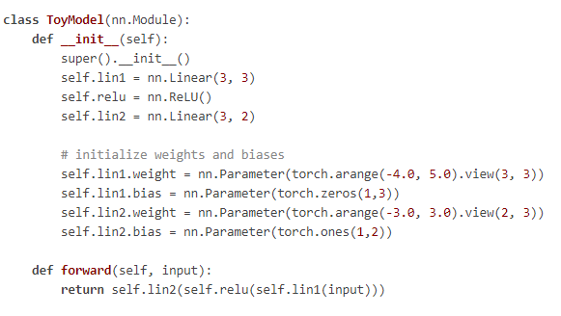
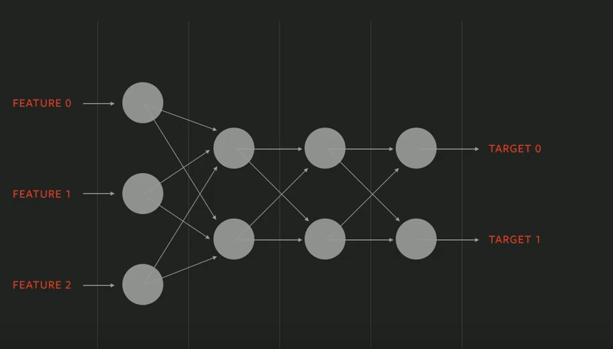
Toy Model

Slide 6
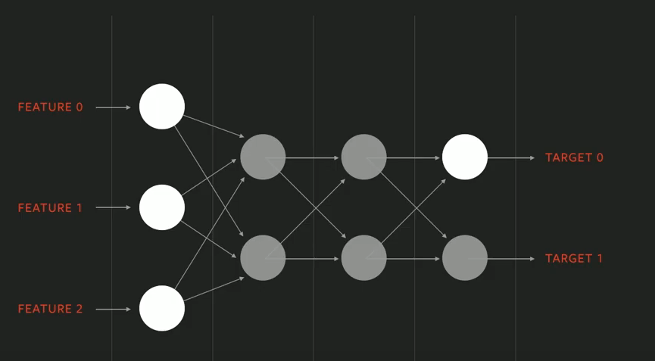

Integrated Gradients: Explanation
Output
Positive attribution score means that the input in that particular position positively contributed to the final prediction and negative means the opposite.
Zero attribution score means no contribution from that particular feature.

Slide 7
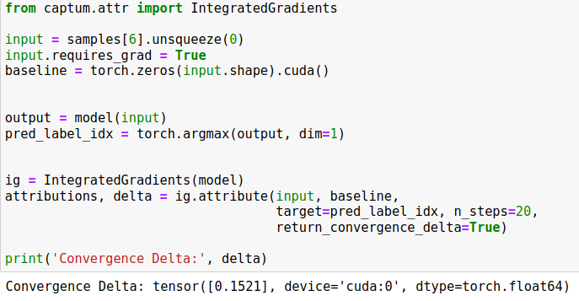
Integrated Gradient: applied on image input
Input: an image from Test set
Baseline: defines the starting point for calculating feature importance
pred_label_idx: output indices for which gradients are computed
Calculate attributions and delta.
The lower the absolute value of the convergence delta the better is the approximation.

Slide 8
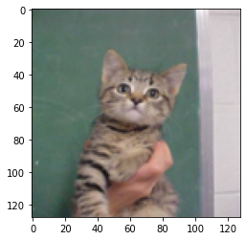
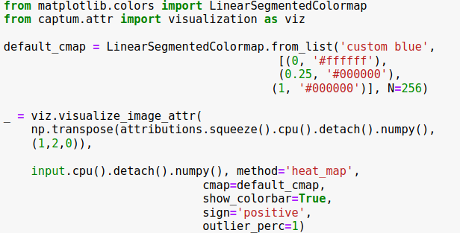
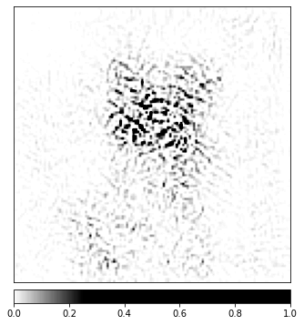
Integrated Gradient: Output
Original image
captum.attr.visualization.visualize_image_attr:
Visualizes attribution for a given image by normalizing attribution values of the desired sign (positive, negative, absolute value, or all).
Displays them using the desired mode in a matplotlib figure.
Integrated Gradient

Slide 9
Integrated Gradients + Smoothgrad_sq

Slide 10
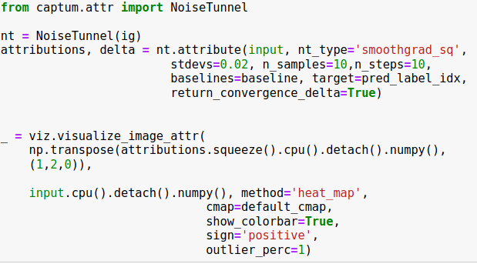
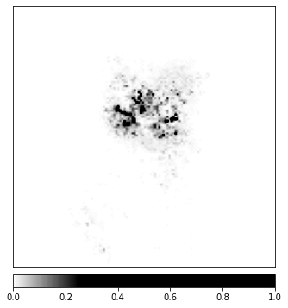
Integrated Gradient + Smoothgrad_sq
NoiseTunnel allows us to use SmoothGrad, SmoothGrad_Sq and VarGrad techniques to smoothen the attributions for multiple noisy samples that were generated by adding gaussian noise.
Smoothgrad_sq : represents the mean of the squared sample attribution
Original image
Integrated Gradient
Integrated Gradient + Smoothgrad_sq

Slide 11

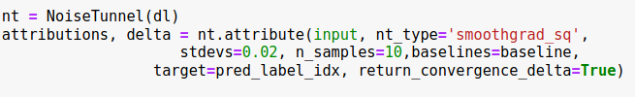
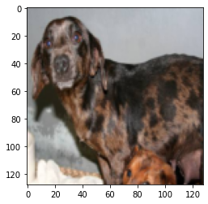
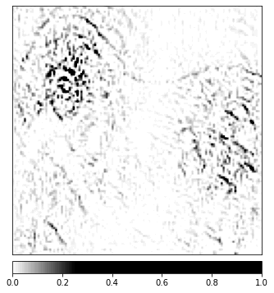
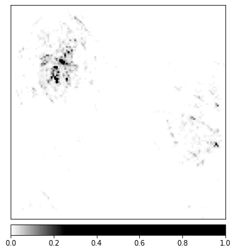
DeepLift : another gradient based algorithm
Original image
DeepLift
DeepLift + Smoothgrad_sq

Slide 12
Interpret output predictions with respect to layers

Slide 13
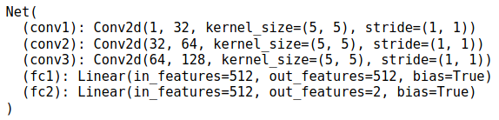
Layer Integrated Gradients
Resulting attributions shows importance of each neurons in fc2.
Computes integral of gradients for output target w.r.t fc2 and fc2 w.r.t to the input features.
Attributions will always be the same dimensionality as input/output of the given layer.

Slide 14
Interpret neurons with respect to inputs

Slide 15
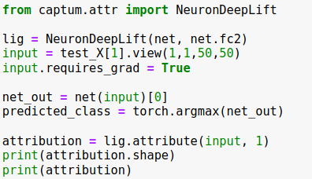
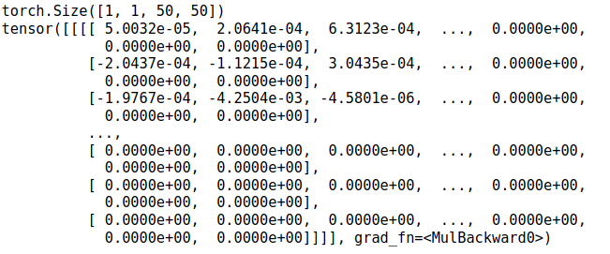
Neuron DeepLift
Computes attributions using Deeplift’s rescale relu for particular neuron (neuron 1 in fc2) w.r.t each input feature.
Resulting attributions shows importance of each input index
Attributions will always be the same dimensionality(50 x 50) as the provided inputs
Output:

Slide 16
Out of memory Error!
For Integrated gradients, Conductance, Internal influence or other algorithms, try reducing n_steps argument.
For Deeplift, try reducing size of n_samples
Reduce batch size and number of epoch. Use torch.cuda.empty_cache() before running algorithm.
Restart!!

Slide 17
Reference
https://github.com/pytorch/captum
https://captum.ai/api/

Slide 18
Thank You!

