Slide 1
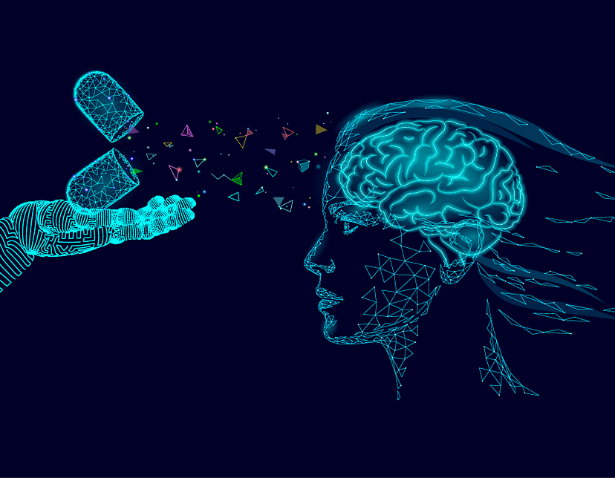
Psychological State Detection Using AI
An AI Model for Audio Analysis with TensorFlow and LSTM
Team Members:
Mostafa Tarek
Abd El-Rahman Osama
Mohamed Ezz Al-Regal
Abd El-Rahman Wael

Slide 2
Abstract
Brief overview of the presentation's content.
Emphasize the significance of knowing psychological states during judgment.
Mention the AI model and tools used for analysis.

Slide 3
Introduction
Define "Psychological State" and "Judgment."
Discuss the relevance of understanding psychological states during judgment.
Highlight the limitations of traditional methods for assessing psychological states.

Slide 4
The Importance
Explore why knowing psychological states during judgment matters:
Decision-making improvement
Mental health assessment
Personalized recommendations
Include relevant statistics or case studies.

Slide 5
Challenges
Identify challenges in assessing psychological states:
Lack of non-intrusive methods
Subjectivity in self-reporting
Real-time assessment difficulties

Slide 6
Our Solution - AI Model
Introduce the AI model:
TensorFlow and LSTM
Explain their relevance in audio analysis
Briefly describe how AI can decode psychological states from audio.

Slide 7
Data Collection
Discuss the importance of audio data collection:
Ethical considerations
Data diversity
Mention the sources and types of data used in training the AI model

Slide 8
Streamlit Integration
Describe how the AI model is implemented and accessed through Streamlit:
User interface design
Real-time analysis capabilities
Accessibility for non-technical users

Slide 9
Model Training
Explain the training process:
Data preprocessing
Model architecture
Training parameters
Mention the importance of labeled data.

Slide 10
Thank You

