Slide 1

Medical Expenditure Prediction System
RNS INSTITUTE OF TECHNOLOGY
BENGALURU - 98
DEPARTMENT OF INFORMATION SCIENCE & ENGINEERING
Presentation on Internship
Candidate Name:Samarth Aithal
USN: 1RN18IS091
Candidate Name:Sandesh A Ram
USN: 1RN18IS093
New Age Solutions Technologies
Internal Guide
Dr. Prakasha S
Associate Professor, Dept of ISE, RNSIT
External Guide
Mr. Deepak Garg
Founder, NASTECH, Bangalore

Slide 2
AGENDA
Abstract
About the Company
Introduction
Literature Survey
Requirements
System Design
Implementation
Result
Conclusion and Future Enhancements
References

Slide 3
ABSTRACT
Medical Expenditure prediction project focuses on providing an estimate on the health insurance for a particular person.
By analyzing certain conditions such as a person’s age, bmi, sex, number of children, whether the person smokes or not, speculated prices will be estimated for the health insurance of that person.
The motive of this project is to help the customers to estimate the health insurance price for their family.
Some of the related factors that impact the cost were also taken into considerations such as physical conditions, concept and location etc.

Slide 4
About the Company
NASTECH is formed with the purpose of bridging the gap between Academia and Industry.
NASTECH is one of the leading Global Certification and Training service providers for technical and management programs for educational institutions.
They collaborate with educational institutes to understand their requirements and form a strategy in consultation with all stakeholders to fulfill those by skilling, reskilling and upskilling the students and faculties on new age skills and technologies.

Slide 5
INTRODUCTION
Medical expenditure prediction project focuses on providing a price estimate to the health insurance company customers.
Medical expenditure prediction on a data set has been done by using Gradient booster regression technique.
Moreover, this project can be considered as a further step towards more evidence-based decision making for the benefit of these stakeholders.
The aim of our project is to build a predictive model for estimating the health insurance price for a person based on certain geography and other dependent variables.

Slide 6
LITERATURE SURVEY
A manual method is currently used in the market to predict the insurance price. The problem with this is that it is very time consuming and tedious process for the insurance company to manually provide this for every customer.
To overcome this, insurance companies tend to hire an agent which again increases the cost of the process.
Moreover, there is a chance that the agent might be prone to manual error or bribery.
To eliminate the drawback of manual method, Machine learning algorithms can be used by insurance companies to provide a fast, easy and customer friendly approach for the problem. Also, the new system will be cost and time efficient. This will have simple operations.
The proposed system works on Gradient Boosting Regression Algorithm.

Slide 7
Requirements
Hardware Requirements
- Processor: Pentium IV or above
- RAM: 4 GB or more
- Hard Disk: 2GB or more
Software Requirements
- Operating System: Windows 7 or above
- IDE: Google Colab
Tools/Languages/Platforms
- Python

Slide 8
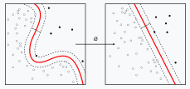
System Design
Gradient boosting is a machine learning technique used in regression and classification tasks, among others. It gives a prediction model in the form of an ensemble of weak prediction models, which are typically decision trees. When a decision tree is the weak learner, the resulting algorithm is called gradient-boosted trees; it usually outperforms random forest. A gradient-boosted trees model is built in a stage-wise fashion as in other boosting methods, but it generalizes the other methods by allowing optimization of an arbitrary differentiable loss function.

Slide 9
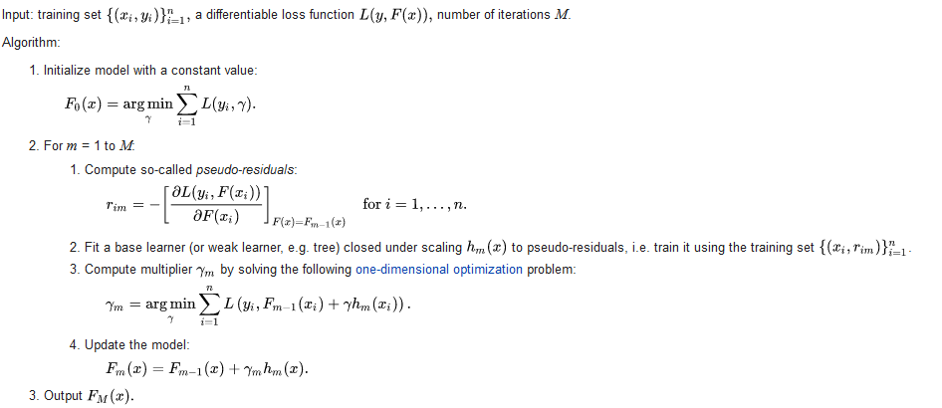
Algorithm
Gradient Booster Regression

Slide 10
Coding
Evaluation on Test Data
from sklearn.ensemble import GradientBoostingRegressor
gb = GradientBoostingRegressor(random_state=0)
gb.fit(x_train,y_train)
grad_train_pred = gb.predict(x_train)
grad_test_pred = gb.predict(x_test)
GbMae = metrics.mean_absolute_error(y_test, grad_test_pred)
GbMse = metrics.mean_squared_error(y_test, grad_test_pred)
GbRmse = np.sqrt(metrics.mean_squared_error(y_test, grad_test_pred))
GbVar = metrics.explained_variance_score(y_test,grad_test_pred)
##Evaluating the performance of the algorithm
print('Mean Absolute Error:%.2f' %GbMae )
print('Mean Squared Error:%.2f' %GbMse )
print('Root Mean Squared Error:%.2f' %GbRmse )
print('Varscore:%.2f' %GbVar)
Visualizing Our predictions based on different algorithms
predict = pd.DataFrame(data = models, columns=['Model','MAE', 'MSE', 'RMSE', 'Variance Score'])
predict
Perfect predictions
new_gb = GradientBoostingRegressor(learning_rate=0.01,n_estimators=400)
new_gb.fit(x_train,y_train)

Slide 11
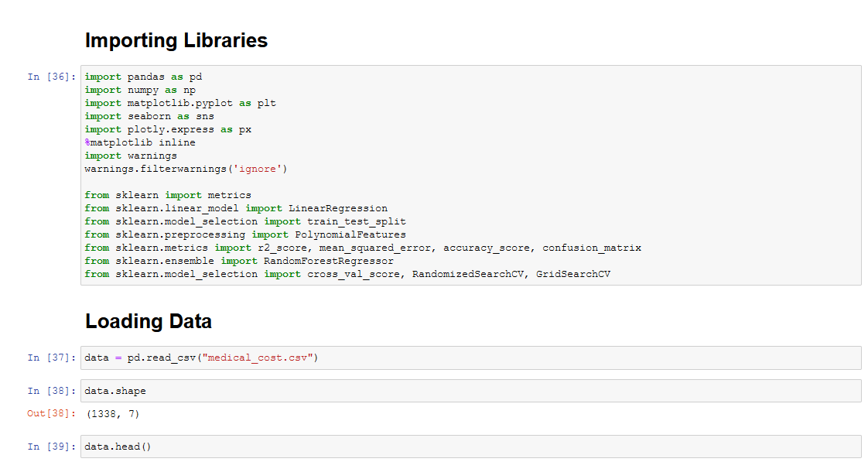
Implementation
Reading CSV File

Slide 12
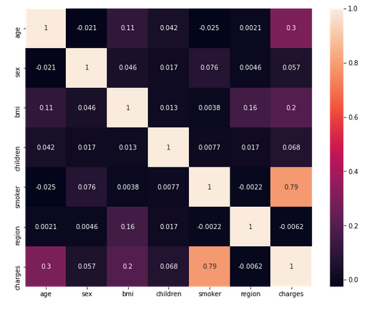
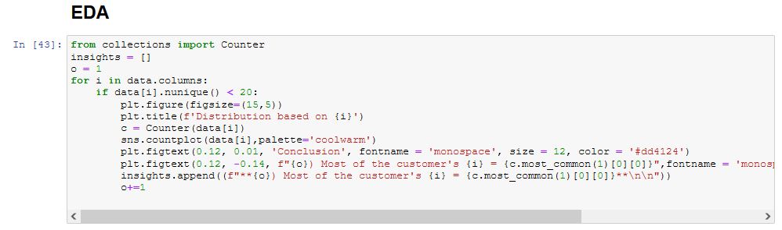
Implementation
Dataset Preparation

Slide 13
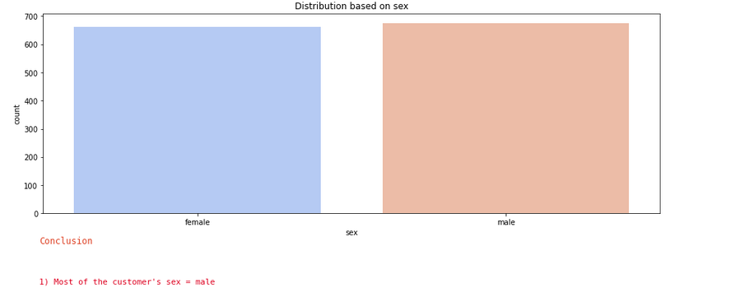
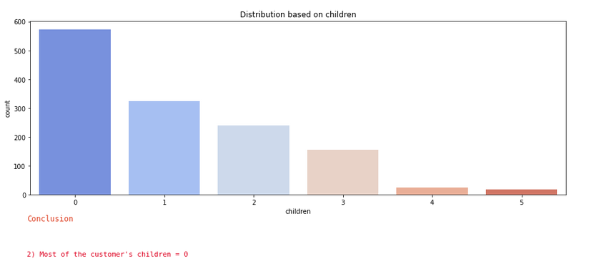
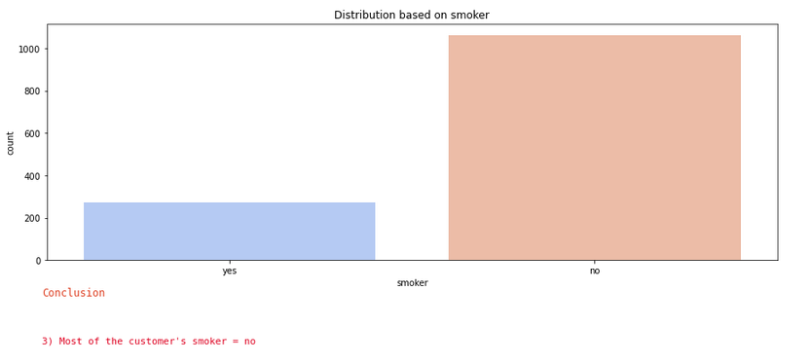
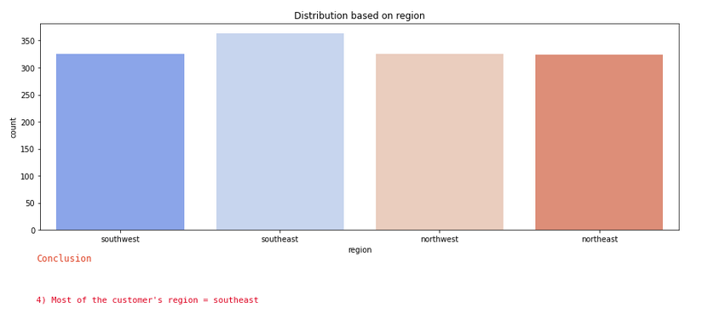
Implementation
Exploratory Data Analysis

Slide 14
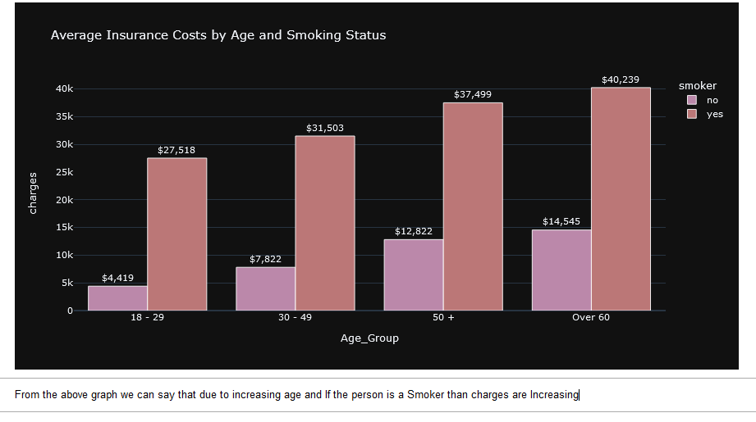
Implementation

Slide 15
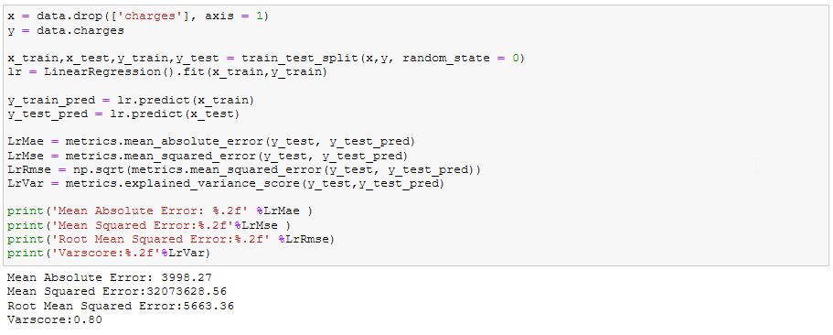
Implementation
Linear Regression
Linear regression estimates are used to explain the relationship between one dependent variable and one or more independent variables. y = a*X + b where:
y – Dependent Variable X – Independent variable b – intercept a – Slope

Slide 16
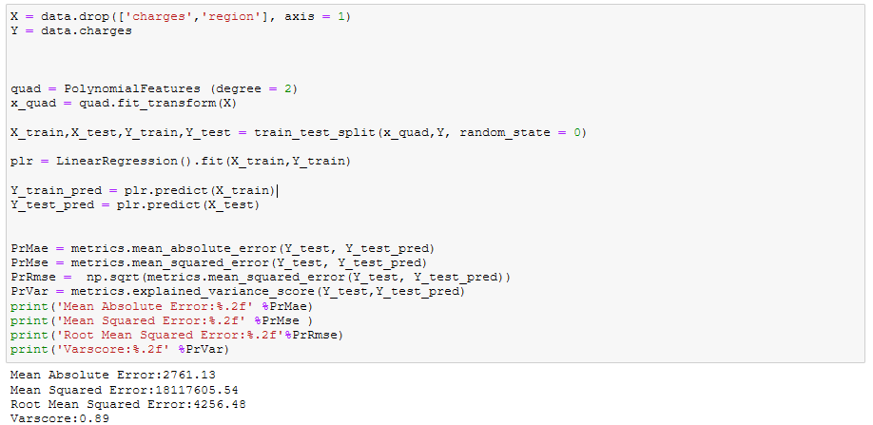
Implementation
Polynomial Regression
It is a basic and commonly used type of predictive analysis. These regression estimates are used to explain the relationship between one dependent variable and one or more independent variables. y = b + a1X + a1X^2 + a1X^3 + a1X^4 where:
y – Dependent Variable X1, X2, X3, X4 – Independent variable b – intercept a1, a2, a3 – Coefficients of independent variable

Slide 17
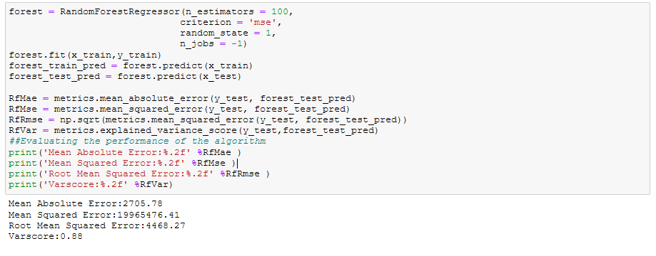
Implementation
Random Forest Regression
Random Forest combines multiple trees to predict the class of the dataset, it is possible that some decision trees may predict the correct output, while others may not. But together, all the trees predict the correct output.

Slide 18
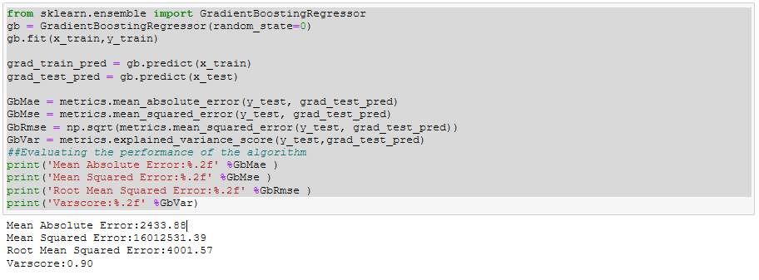
Implementation
Gradient Boosting Regression
Gradient boosting is a machine learning technique used in regression and classification tasks, among others. It gives a prediction model in the form of an ensemble of weak prediction models, which are typically decision trees. When a decision tree is the weak learner, the resulting algorithm is called gradient-boosted trees; it usually outperforms random forest. A gradient-boosted trees model is built in a stage-wise fashion as in other boosting methods, but it generalizes the other methods by allowing optimization of an arbitrary differentiable loss function.

Slide 19
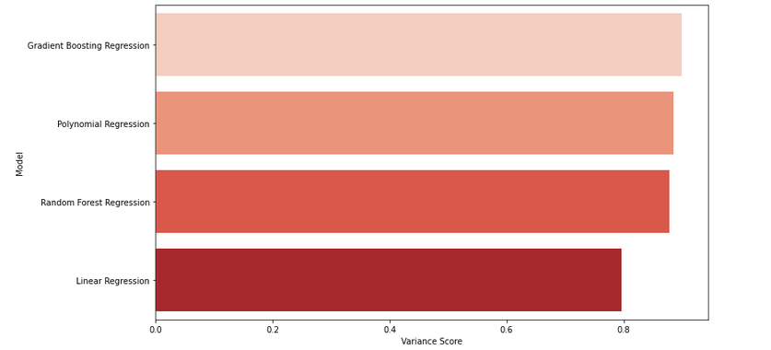
Implementation
Comparison of the algorithms to find the best model

Slide 20
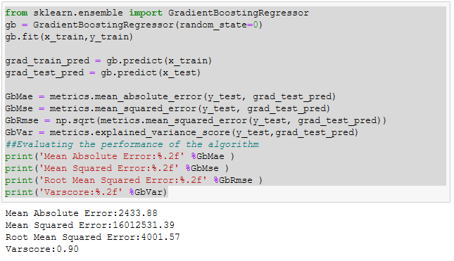
RESULTS
We are calculating mean absolute error, mean square error and variable score to check the accuracy of this algorithm.
It is clearly seen that this approach is 90% accurate. Therefore Gradient boosting regression model is followed to calculate results.

Slide 21
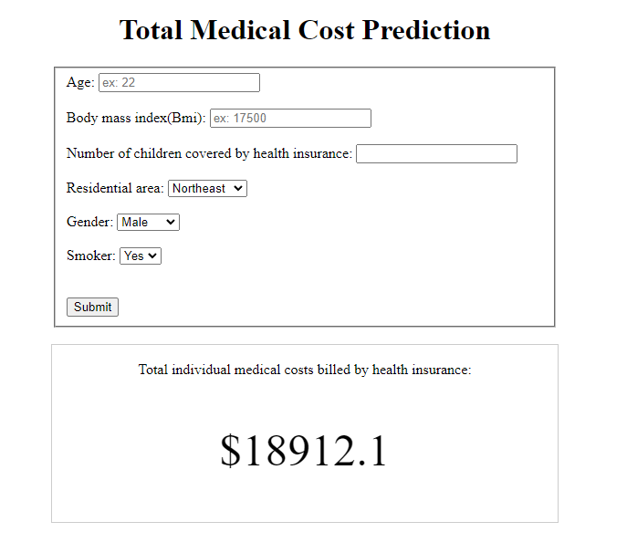
RESULTS
The insurance amount is finally calculated and displayed using the Gradient boosting regression model.

Slide 22
Conclusion
The proposed model is the best substitute for the manual method where a third party is involved as the middleman and is potentially vulnerable along with it being cheaper for the end customers.
Based on the results, it can be concluded that such ML-driven predictions are easily comprehendible and significant from a data-analytics point of view.
When correctly implemented, a high rate of accuracy can be achieved.

Slide 23
Future Enhancements
To make the interface more informative and user-friendly by implementing better GUI designs.
Using bigger training data sets to get a more accurate estimate of the prices.
Implementing other machine learning algorithms which can improve the accuracy of the model.

Slide 24
REFERENCES
1) Multi-View Deep Learning Framework for Predicting Patient Expenditure in Healthcare XIANLONG ZENG 1, SIMON LIN2, AND CHANG LIU 3 (Member, IEEE) DOI: 10.1109/OJCS.2021.3052518
2) Medicine Expenditure Prediction via a VarianceBased Generative Adversarial Network SHRUTI KAUSHIK 1 , (Member, IEEE), ABHINAV CHOUDHURY1 , SAYEE NATARAJAN2 , LARRY A. PICKETT, JR.2 , AND VARUN DUTT1 , (Senior Member, IEEE) DOI: 10.1109/ACCESS.2020.3002346
3) Medicine Expenditure Prediction via a Variance- Based Generative Adversarial Network by Abhinav Choudhury; Sayee Natarajan; Larry A. Pickett; Varun Dutt DOI: 10.1109/ACCESS.2020.3002346

Slide 25
THANK YOU

