Slide 1
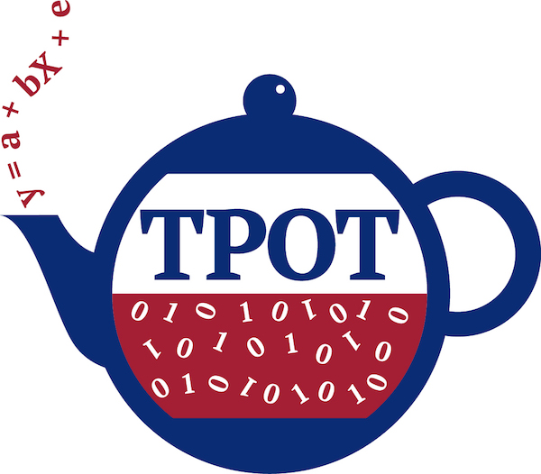

Slide 2
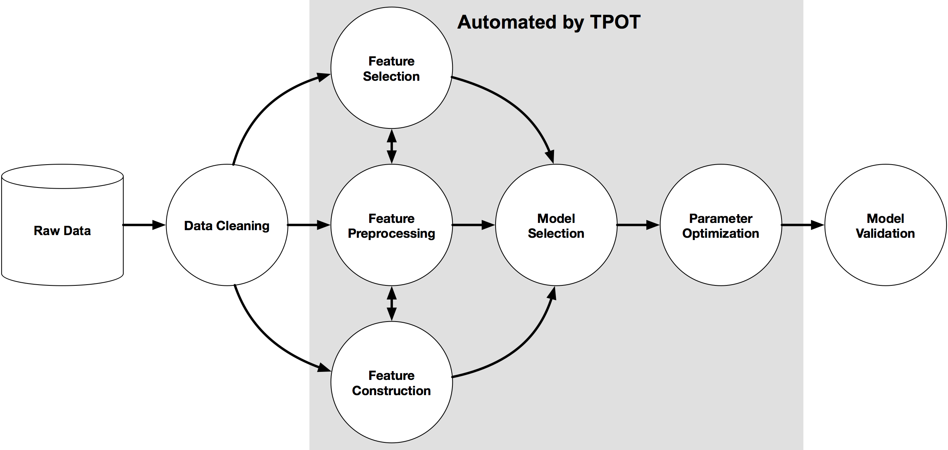


Slide 3
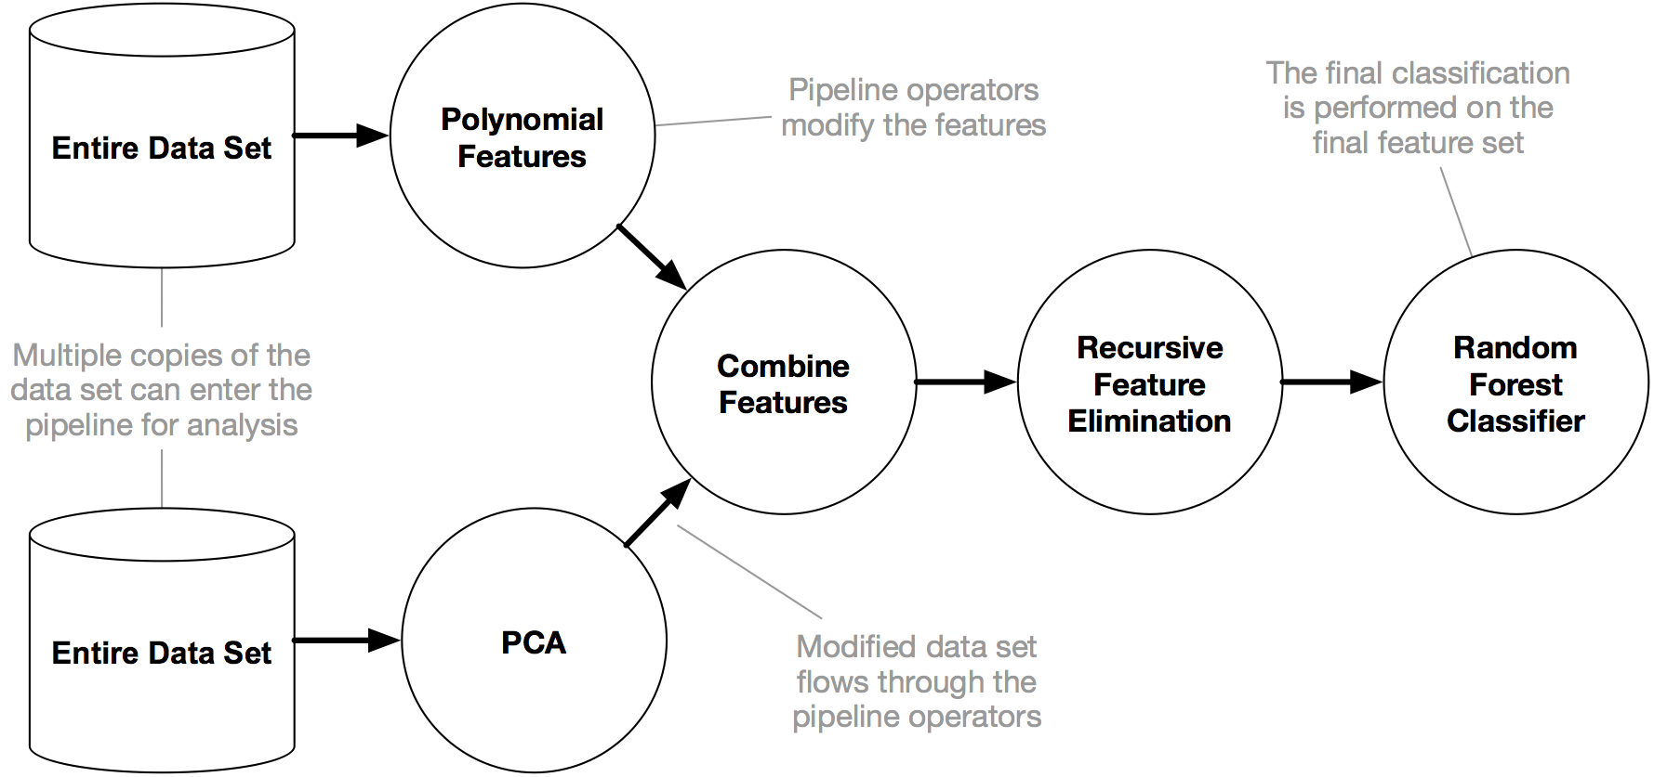


Slide 4

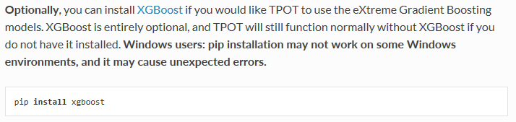
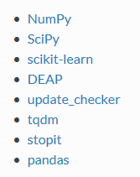

Slide 5
What to expect from AutoML software
AutoML algorithms can take a long time to finish their search
AutoML algorithms aren't as simple as fitting one model on the dataset; they are considering multiple machine learning algorithms (random forests, linear models, SVMs, etc.) in a pipeline with multiple preprocessing steps (missing value imputation, scaling, PCA, feature selection, etc.), the hyperparameters for all of the models and preprocessing steps, as well as multiple ways to ensemble or stack the algorithms within the pipeline.
As such, TPOT will take a while to run on larger datasets, but it's important to realize why. With the default TPOT settings (100 generations with 100 population size), TPOT will evaluate 10,000 pipeline configurations before finishing. To put this number into context, think about a grid search of 10,000 hyperparameter combinations for a machine learning algorithm and how long that grid search will take. That is 10,000 model configurations to evaluate with 10-fold cross-validation, which means that roughly 100,000 models are fit and evaluated on the training data in one grid search. That's a time-consuming procedure, even for simpler models like decision trees.
Typical TPOT runs will take hours to days to finish (unless it's a small dataset), but you can always interrupt the run partway through and see the best results so far. TPOT also provides a warm_start parameter that lets you restart a TPOT run from where it left off.

Slide 6
What to expect from AutoML software
AutoML algorithms can recommend different solutions for the same dataset
If you're working with a reasonably complex dataset or run TPOT for a short amount of time, different TPOT runs may result in different pipeline recommendations. TPOT's optimization algorithm is stochastic in nature, which means that it uses randomness (in part) to search the possible pipeline space. When two TPOT runs recommend different pipelines, this means that the TPOT runs didn't converge due to lack of time or that multiple pipelines perform more-or-less the same on your dataset.

Slide 7
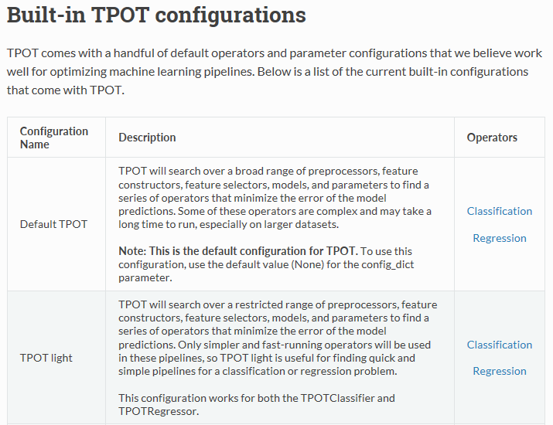
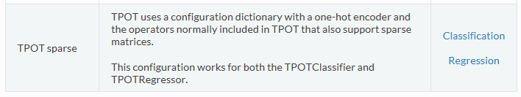

Slide 8
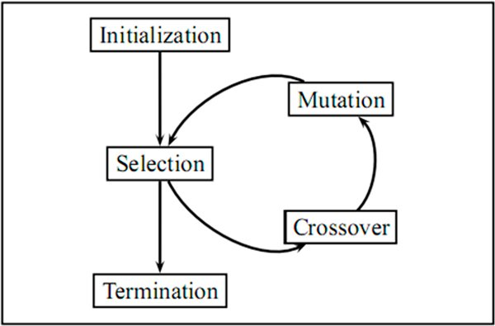
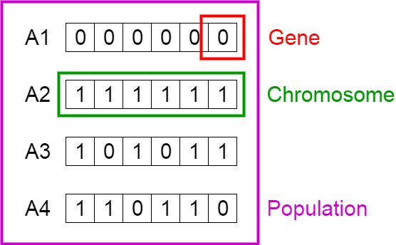

Slide 9
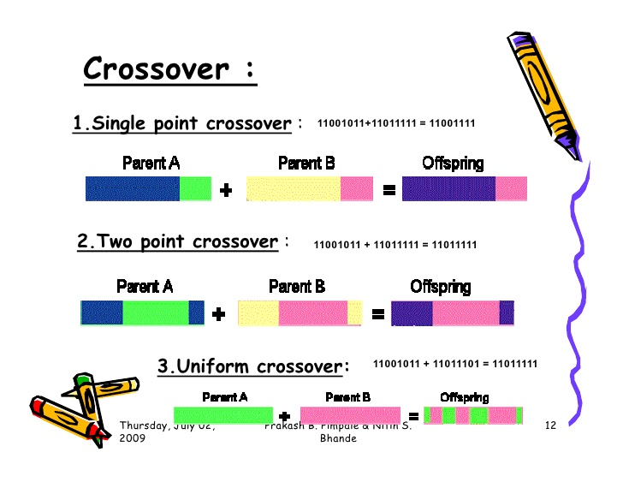
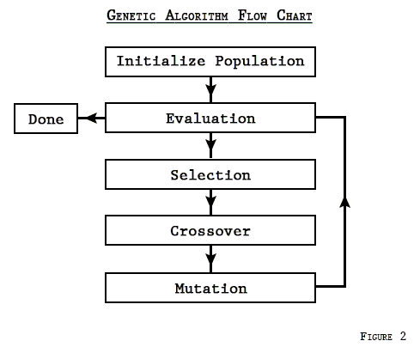

Slide 10
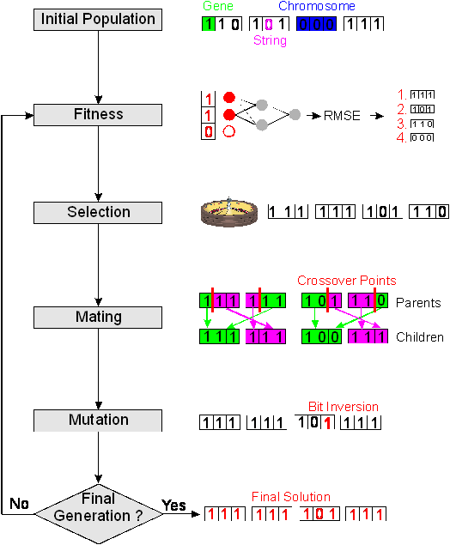

Slide 11
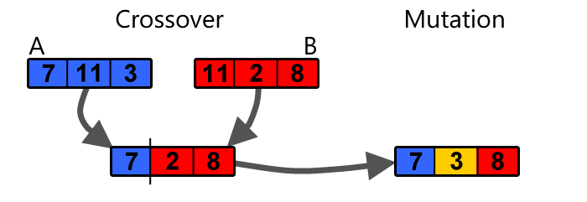

Slide 12
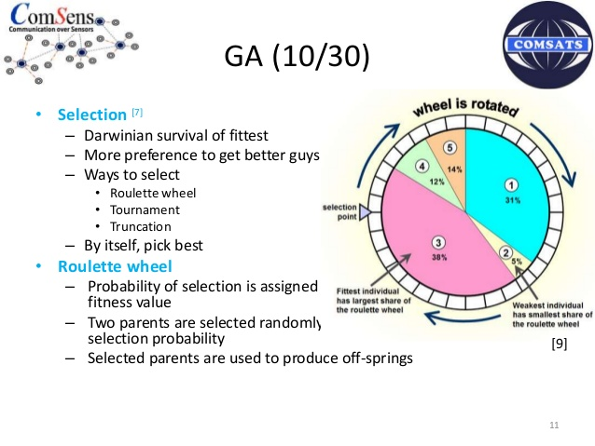

Slide 13
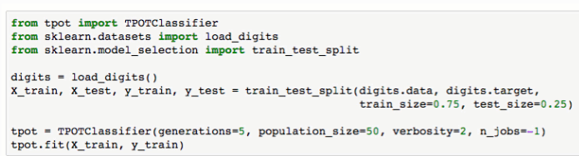
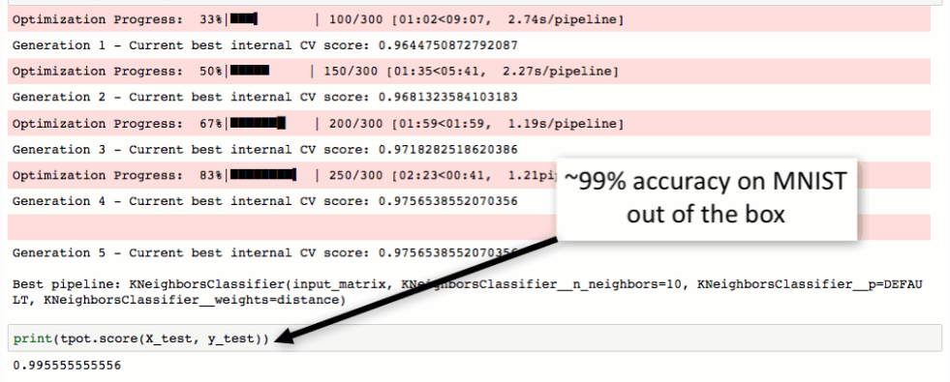
TPOT with code

Slide 14
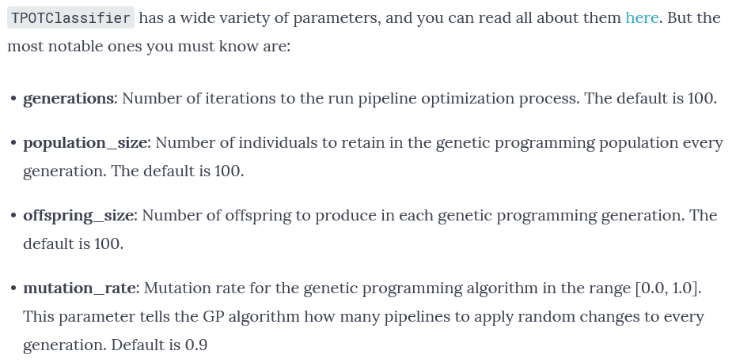

Slide 15
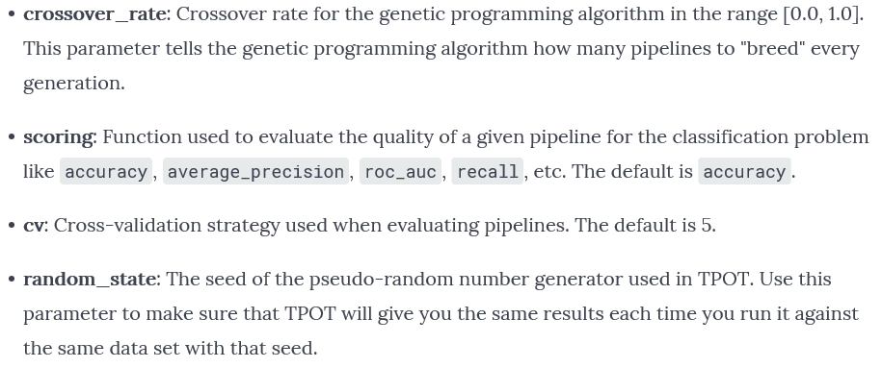

Slide 16
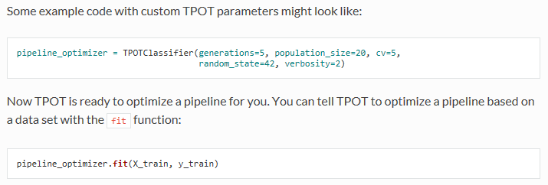

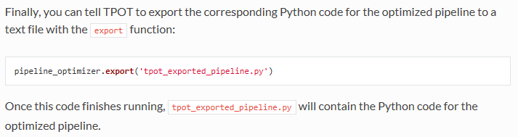
TPOT with code

Slide 17
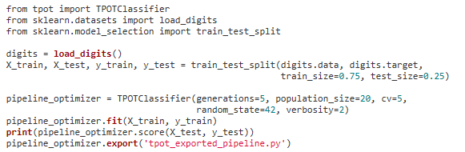
TPOT with code
https://epistasislab.github.io/tpot/using/

Slide 18
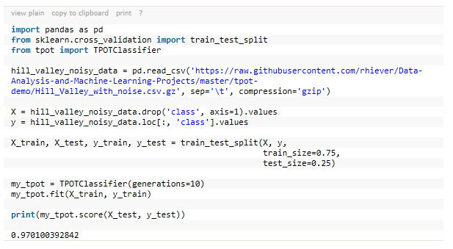
TPOT with code

Slide 19
