Slide 1
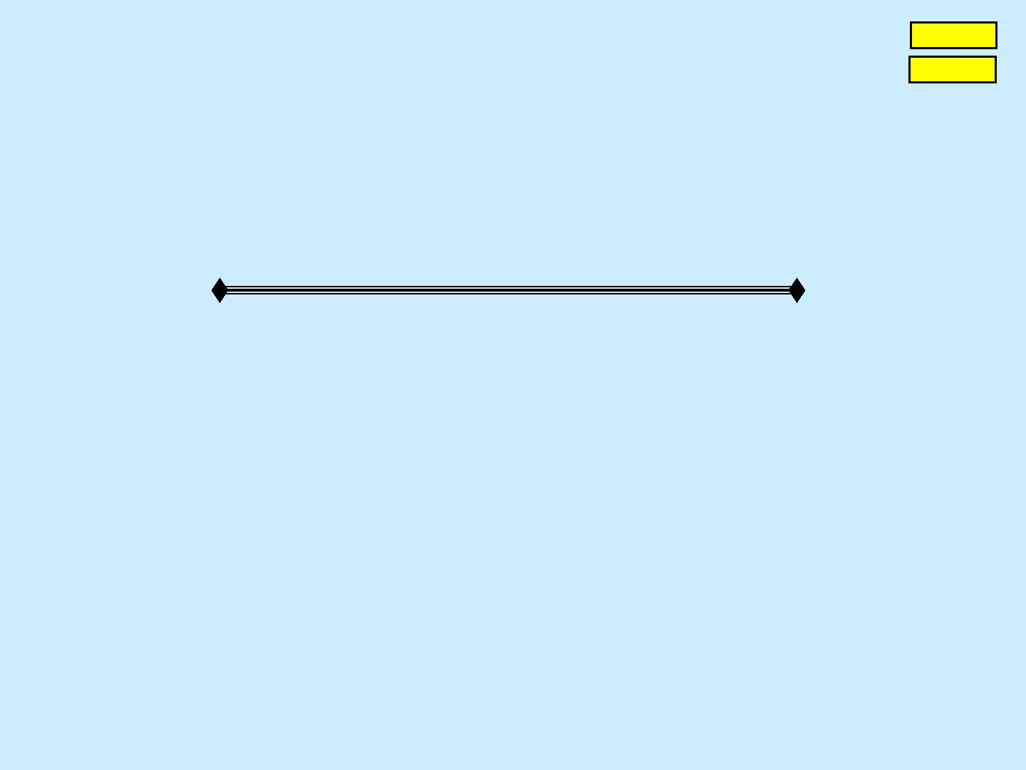
Forward
S.A. Matasov
Main
Prospects of CRC endoscopic screening
Part 1
Aseptic method of infection safety of colono- and gastroscopy
“The risk associated with improperly cleaned, disinfected, and sterilized
endoscopes is the “most critical patient safete I have encountered in my
30 years in healthcare“ Nancy Chobin, 2011, [1]
Contents of slides
1. Risk of cross-infection (CI) of patients with colon- and gastroscopes.
2. Business and risk of CI.
3. Multi-channel endoscope.
4. What creates the risk of CI.
5. Base of Aseptic method of infection safety of colono- and gastroscopy.
6. 1-channel endoscope.
7. Illustrations to the method of HLD, storage and transportation of 1-channel endoscope.
8. Comment to the method of HLD, storage and transportation of 1-channel endoscope.
9. Differences of the new method of infection safety of colono- and gastroscopy.
10. Conclusion.
11, 12. Basic sources of information.
13. Enclosure 1: 2013 year‟s data about CI risk from Lawrence F. Muscarella PhD [15]
14. Enclosure 2: 2014 year‟s data about CI risk from Lawrence F. Muscarella PhD [15]
15. Enclosure 3: Key details, bundles and aspects of the Aseptic method.
© Reference on www.coloncancer.lv is obligatory

Slide 2
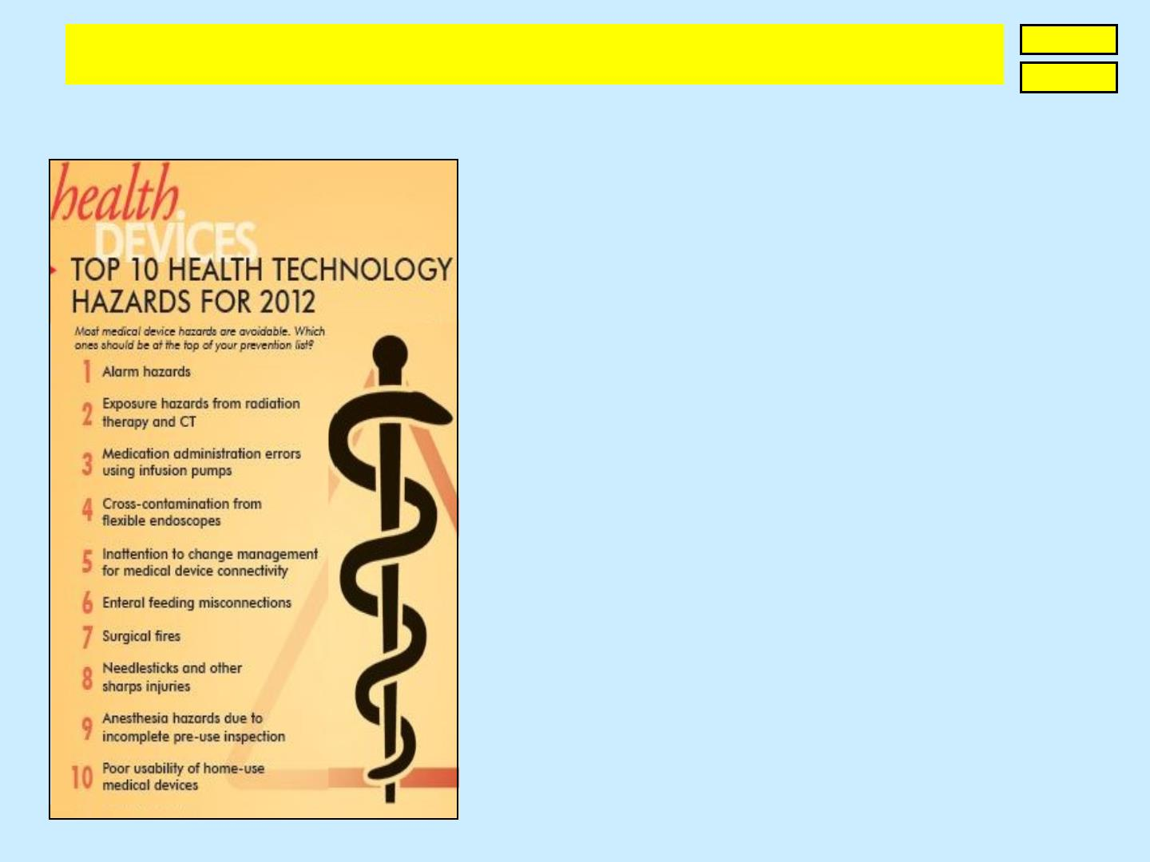
S.A. Matasov. Prospects of CRC endoscopic screening
Part 1. Aseptic method of infection safety of colono- and gastroscopy
Forward
Back
1. Risk of cross-infection (CI) of patients with colon- and gastroscopes
The ECRI (USA) forecasts annually top 10 most
hazard procedures: in 2010 CI risk was on the 1st
place, in following years - on the 3rd, 4th, 8th. 2014 CI
risk will increase again – tooks the 6th place [2].
As guilty of CI risk are named doctors and nurses,
however problem‟s analysis showed that it is not so.
Gastrointel endoscopes transmit more than 390
infections [3], among which HIV, hepatitis B and C
viruses; there are described group disease cases.
Pioneer in these endoscopes‟ manufacturing is Japan;
probably it„s why in 2006 there were almost ln
infected with hepatitis C virus – 2,3% of population [4]?
Hepatitis C is a cross-infection with threat of cirrhosis
and, probably, hepatic cancer. In common, CI
consequences are very difficult to be revealed and
assessed - clinic may appear months or years later but,
likely, not everytime. Despite it, the basic requirements
of medicine do not allow disregard the risk of CI: the
world is increasingly talking about crimes against
humanity, but what is concealed infectioning of millions
of people?
© Reference on www.coloncancer.lv is obligatory
1

Slide 3
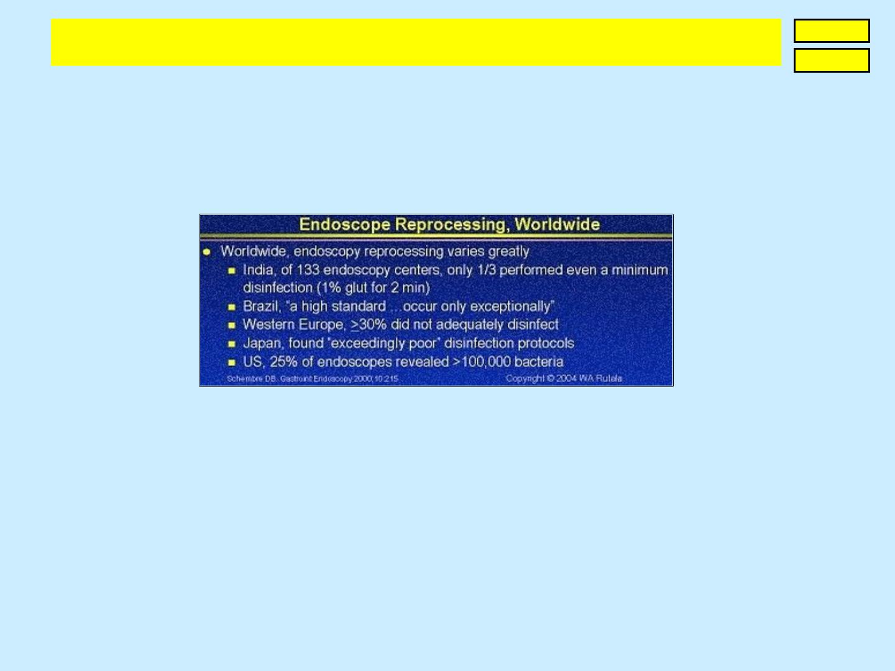
S.A. Matasov. Prospects of CRC endoscopic screening
Part 1. Aseptic method of infection safety of colono- and gastroscopy
Forward
Back
2. Business and risk of CI
Flexible endoscopes is a $2,5 billion market growing at an average 8-10% annuahe
automated endoscope reprocessing is a $1 billion market growing at 10-12% annually [5]
Analysis of first 3 decades of flexible endoscopy revealed the eral inadequate high-level
disinfection (HLD). Here are corresponding data by W.A. Rutala [3]
The last 10 years not only does not reduced CI risk [6-12]but transformed it into misleading
business and financial burden for medicine: while creating and selling very expensive
washing-disinfection machines, cabinets for endoscopes‟ storage, transportation containers,
manufacturers ignore 3 indisputable facts:
1) the main obstacle to adequate HLD is an inadequate design of endoscopes,
2) HLD adequaticy is defined not by machine, but by manual brushing of endoscope,
3) chain "machine-cabinet-container" has a risk of secondary infectioning of endoscope.
Thus, CI is the scaled, concealed everywhere except the USA and Canada, problem (see
slide 12). Organisers of medicine ignore top-reasons of CI and obtain dangerous equipment,
that can lead to dramatic consequences for each of us.
© Reference on www.coloncancer.lv is obligatory
2

Slide 4
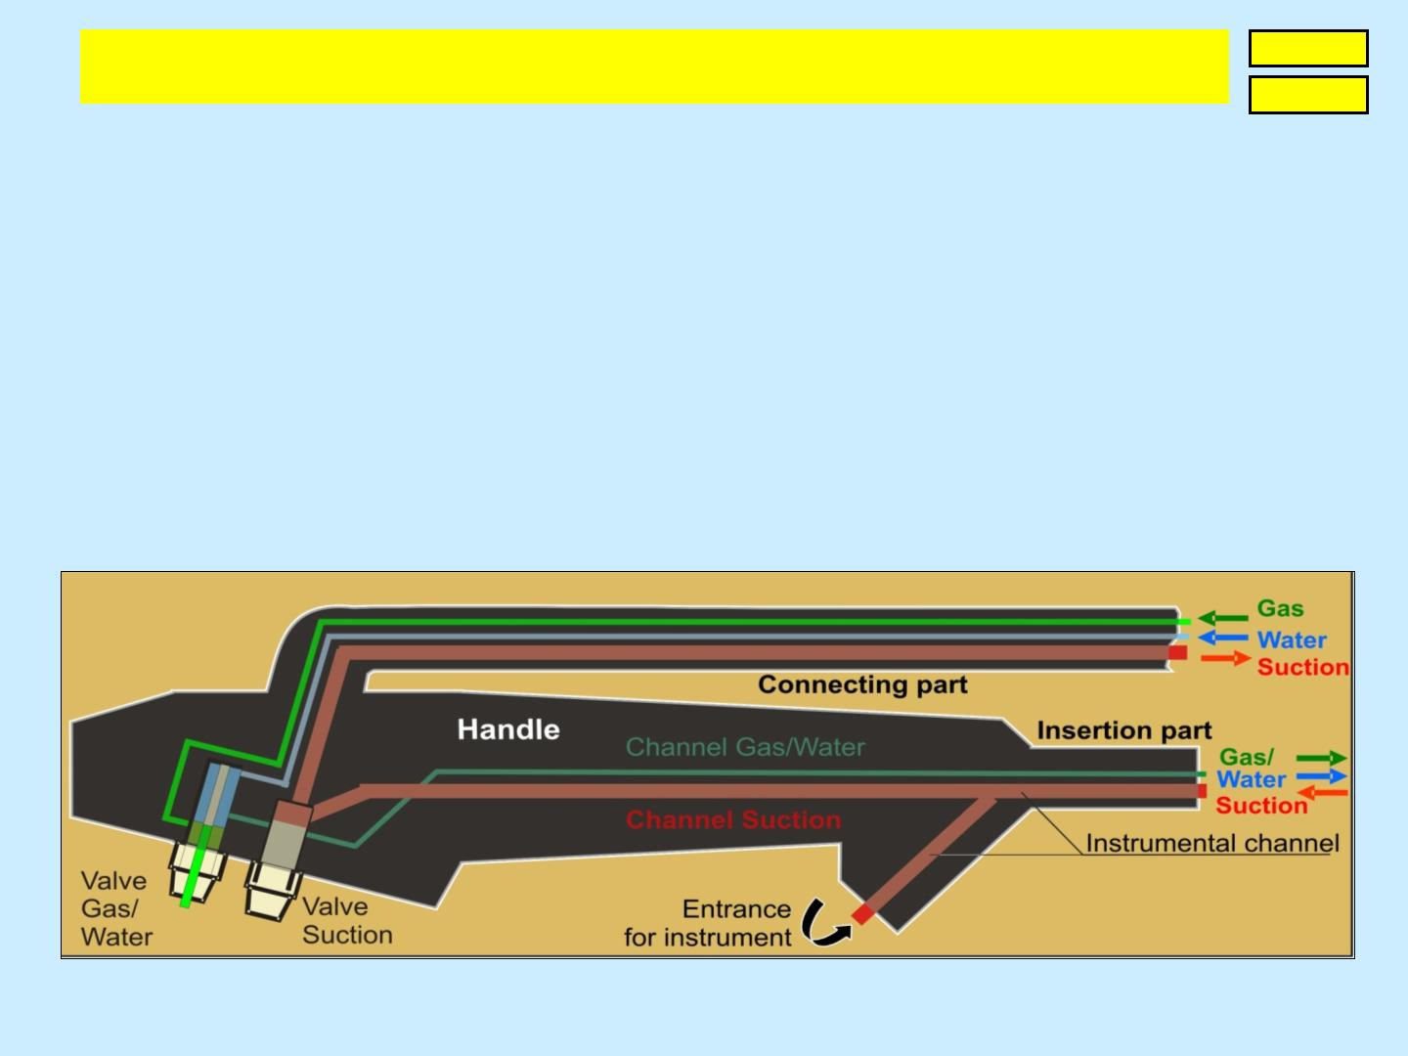
S.A. Matasov. Prospects of CRC endoscopic screening
Part 1. Aseptic method of infection safety of colono- and gastroscopy
Forward
Back
3. Multi-channel endoscope
According to E.Spaulding biopsy forceps and other instrument which penetrates mucosa, are
critical items; flexible endoscopes are semi-critical ones, as their separate zones anyhow are
in contact with mucosa, mucus, contents. Instrument could be sterilized by high temperature,
flexible endoscopes could treat only cold HLD.
In the multi-channel endoscopes there are minimum 12 contact, or more exactly – semi-
critical zones, which require manual brushing. These are:
• 2 channels of insertion part, nozzle of objective,
• segment of Suction channel, located in a handle; 2 valves, their shafts,
• 3 channels of connecting part, its connector.
Scheme of multi-channel endoscope
© Reference on www.coloncancer.lv is obligatory
3

Slide 5

S.A. Matasov. Prospects of CRC endoscopic screening
Part 1. Aseptic method of infection safety of colono- and gastroscopy
Forward
Back
4. What creates the risk of CI
1. Zones which require manual brushing. As more they are, and as less they are accessible
– the higher is CI risk. The old endoscopes have not less than 12 such zones.
2. Large length and small diameter of channels. Channels of old colonoscopes reaches
7,5m, of gastroscopes - 6,5 m. Channels with diameter 3-4 mm are cleaned by manual
brushes, the small ith diameter 1,2 mm) are flushed by liqlow, however the
biofilms formed therein [13] require manual brushing of all channels [14].
3. Non-hermecity of endoscope. Infection, which penetrated inside the device, could
become a source of group infection.
4. The chain "machine-cabinet-container". The existing system of disinfection, storage and
transportation of old endoscopes has a risk of their secondary infection:
4.1. Sterilization of chain‟s parts is impossible and disinfection is difficult. In this regard
there could be breeded infection from endoscopes, which were there before.
4.2. At junction of chain‟s parts endoscopes are contaminated by hospital infection.
4.3. Open device‟s storage allows next endoscopy during 3 hours after HLD, at
storage in special cabinet - during 3 days. Whether these conditions could be
compared with storage of disposable means!
5. Infectioning of population. In connection with factors 1-4 and this one, thof infection
by hepatitis C virus, for example in Egypt is 36 times higher, than in Italy [4]
6. Traumacity of endoscopy. Abrazions and microtrauma of mucosa which inevitably follow
endoscope's insertion, as well as biopsy and other endoscopy operations, in combination
with factors 1-5, increase the CI risk.
© Reference on www.coloncancer.lv is obligatory
4

Slide 6
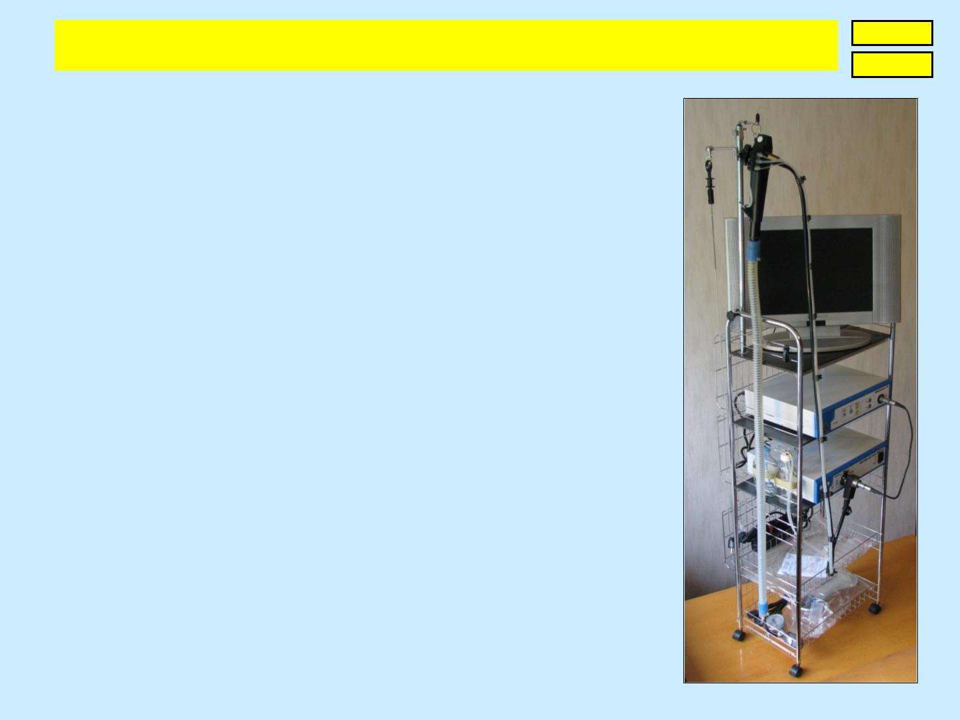
S.A. Matasov. Prospects of CRC endoscopic screening
Part 1. Aseptic method of infection safety of colono- and gastroscopy
Forward
Back
5. Base of Aseptic method
of infection safety of colono- and gastroscopy
Risk of CI by disposable means is everywhere close to 0. In
Western Europe ≥30% of endoscopes are disinfected inadequately,
in the in 25% of endoscopes are revealed more than 100.000
bacteria [3]in other regions the risk is higher.
Disposable flexible endoscopes are very expensive; alternative to
them, to multi-channel endoscopes at all, disinfection machines,
cabinets, transporting containers is the Method proposed. It is
based on 2 inventions:
1. “Endoscope with single-channel endoscopic tube and
disposable set which connects channel we
sources” (patents of Latvia, China, Japan [161718];
applications in the UK, EAPO, USA, DE). Technical effect of
invention - minimization of zones, which require manual
brushing.
2. "Aseptic method of HLD, storage and transportation of a
flexible endoscoand device for implementation"
(patent of Latvia [19]application PCT [20]. Technical task
of invention - replacement of three-part chain "machine-
cabinet-container" by a single device.
© Reference on www.coloncancer.lv is obligatory
5

Slide 7
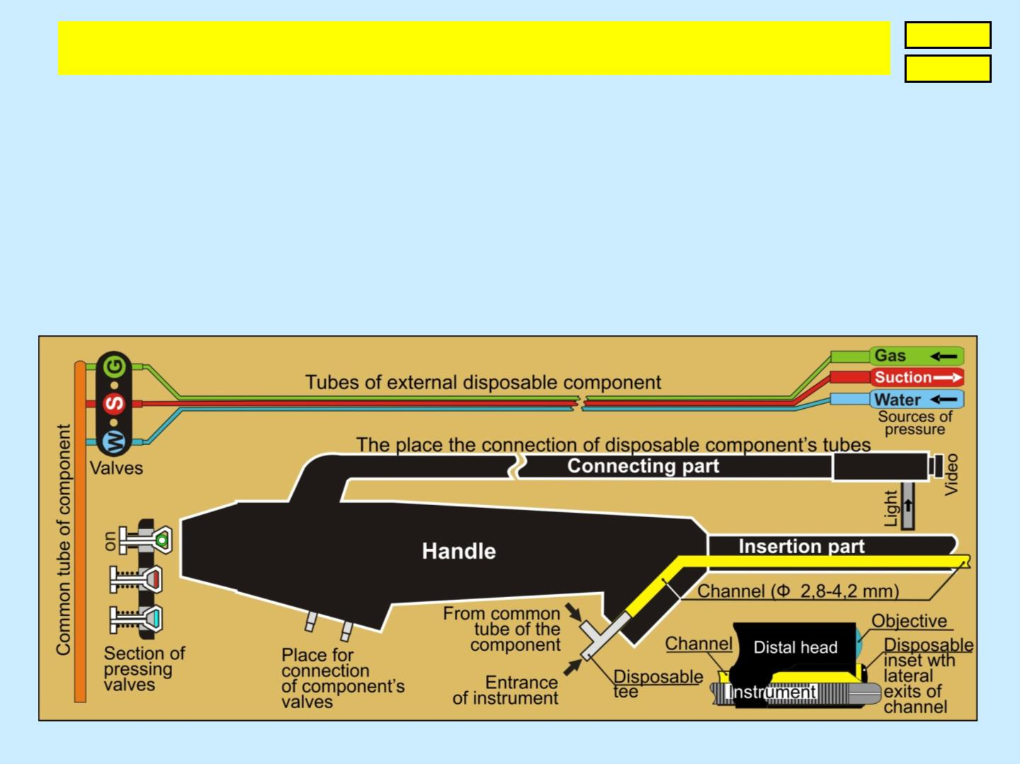
S.A. Matasov. Prospects of CRC endoscopic screening
Part 1. Aseptic method of infection safety of colono- and gastroscopy
Forward
Back
6. 1-channel endoscope
The new endoscopic tube has not valves and has only 1 channel which connects with 3 tubes
of external disposable component with the help of pressing valves and tee. The channel, 3
tubes, their valves, tee provide supplying of gas and water, evacuation of contents; for
washing of 3 lenses at the end of channel there is disposable inset with 3 lateral outputs, at
that the direct output should be closed by the end of instrument.
Thus, new endoscope has only 2 semi-critical zones: sheath and channel of insertion part;
manual brushing is required only the channel with diameter is 3-4 mm, length – 1 m or 1,6 m.
© Reference on www.coloncancer.lv is obligatory
6

Slide 8
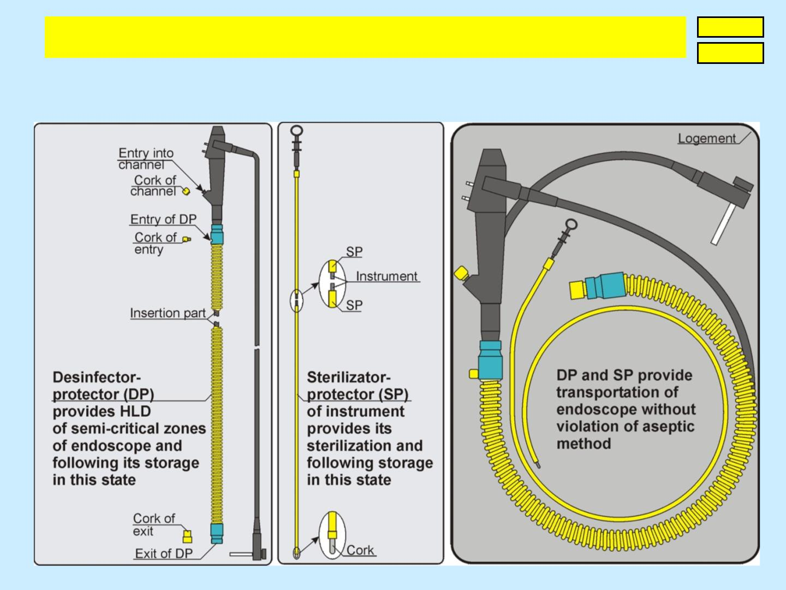
S.A. Matasov. Prospects of CRC endoscopic screening
Part 1. Aseptic method of infection safety of colono- and gastroscopy
Forward
Back
7. Illustrations to the method of HLD,
storage and transportation of 1-channel endoscope
© Reference on www.coloncancer.lv is obligatory
7

Slide 9
S.A. Matasov. Prospects of CRC endoscopic screening
Part 1. Aseptic method of infection safety of colono- and gastroscopy
Forward
Back
8. Comment to the method of HLD,
storage and transportation of new endoscope
The optimal variant of reprocessing of 1-channel non-valve endoscope supposes 4 stages:
1. Pre-cleaning.
2. Thorough cleaning-disinfecton of all surfaces of endoscope.
3. HLD of sheath and channel of the insertion part.
4. Hermetization sheath and channel of the insertion part.
The 1st and 2nd reprocessing stages are made as usually, the 3rd stage uses disenfector-
protector (DP) in the shape of sterile corrugated silicone tube (see on slide 7), putted on the
insertion part. The 3rd stage requires only about 0.2 l of disinfectant. Following the washing
and drying of sheath and channel of the insertion part as well as DP cavity, the 4th stage is to
be realised – hermetization of semi-critical zones by sterile corks (see on slide 7).
Thus DP ensures high-level disinfection of semi-critical zones of single-channel non-valve
endoscopic tube, their long-term storage and transportation in HLD state.
The method of sterilization and storage of biopsy forceps is similar to the described above.
After cleaning-disinfection, the forceps are sterilized together with silicone tube, which
hermetizes its insertion part and is called sterilizer-protector (SP) – see on slide 7.
© Reference on www.coloncancer.lv is obligatory
8

Slide 10
S.A. Matasov. Prospects of CRC endoscopic screening
Part 1. Aseptic method of infection safety of colono- and gastroscopy
Forward
Back
9. Differences of the Aseptic method
of infection safety of colono- and gastroscopy
As not all channels of multi-channel endoscopes are acessible to manual brushing, but
equipment for disinfection, storage and transportation of endoscopes is not accessible for
sterilization, the existing method of infection safety of colono- and gastroscopy could not be
concerned as an aseptic.
1-channel non-valve endoscope reduced:
1.1. total number of zones which require manual brushing from 12 to 1,
1.2. number of valves and their shafts, requiring manual brushing, from 4 to 0,
1.3. number of channels, which require manual brushing, from 6 to 1,
1.4. number of channels, inaccessible for manual brushing, from 3 to 0,
1.5. length of channels of colonoscope from 7,5m till 1,6m, of gastroscopes from 6,5m till 1m,
1.6. diameter of the insertion part of endoscopic tube.
Disinfector-protector of semi-critical zones of 1-channel non-valve endoscope:
2.1. could be sterilized,
2.2. excluded secondary contamination of semi-critical zones,
2.3. significally longer saves semi-critical zones in the HLD state,
2.4. reduced equipment price up to thousand times – till € 40,
2.5. reduced amount of disinfectant and sterile water to dozens times,
2.6. does not require premises.
© Reference on www.coloncancer.lv is obligatory
9

Slide 11
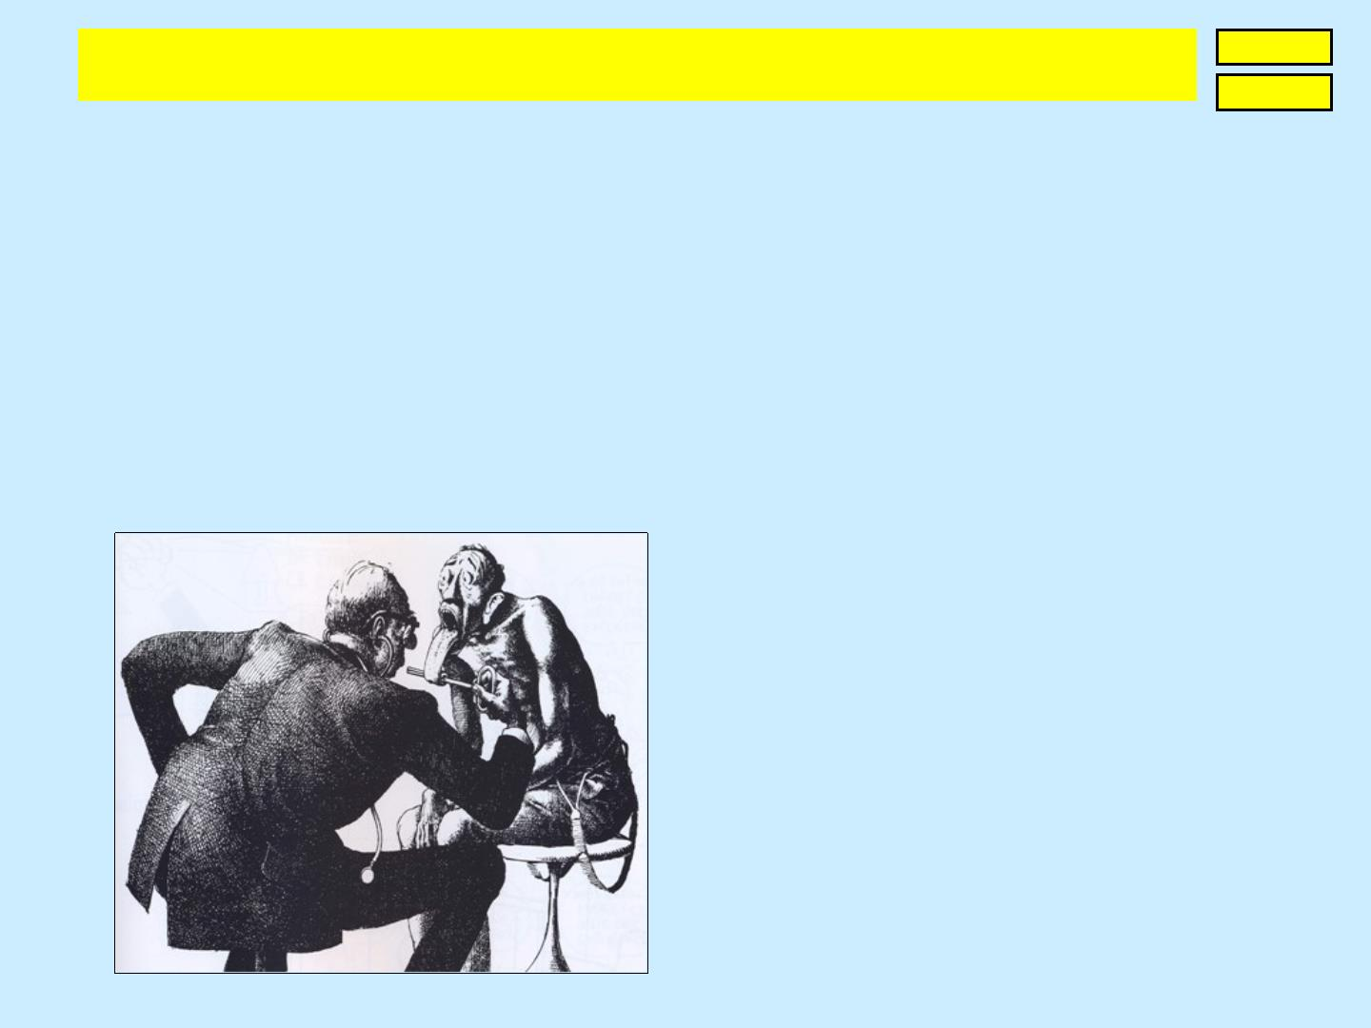
S.A. Matasov. Prospects of CRC endoscopic screening
Part 1. Aseptic method of infection safety of colono- and gastroscopy
Forward
Back
10. Conclusion
1. Inadequate HLD of multi-channel endoscopes is a result of their inadequate construction.
Namely for this reason washing-disinfecting machines did not improve situation with CI:
ECRI forecasts that in 2014 CI risk will displace from 8th to 6th place.
2. The proposed Method reduced from 12 till 1 the number of endoscope's zones, which
require manual brushing, and till 2 - the common number of semi-critical zones; provided
its HLD, storage and transportation in a sterilized tube, which has the small price.
3. The substitution of dangerous endoscopic technique will be defined by legal motivation of
its manufacturers.
One more alternative to gastroscopy. ☺ .
Interpretation of Claude Serre sketch.
© Reference on www.coloncancer.lv is obligatory
10

Slide 12
S.A. Matasov. Prospects of CRC endoscopic screening
Part 1. Aseptic method of infection safety of colono- and gastroscopy
Forward
Back
1. http://www.aami.org/meetings/summits/reprocessing/materials/endoscopes_BIT_MJ_2011.pdf M. Vockley. Probing the Challenges of
n & Technology. AAMI. May/June 2011.
2. https://www.ecri.org/Press/Pages/2014_Top_Ten_Hazards.aspx gy hazards for 2014. Nov.2013.
3. http://www.learningace.com/doc/3151386/51a39ce9394060602825e2730f809d69/endoscope W.A.Rutala. Endoscope
endations.2004.
4. http://www.pkids.org/files/pdf/phr/03-06hcvglobal.pdf
5. www.infectioncontroltoday.com/news/2013/11/hoya-group-to-set-up-joint-venture-with-wassenburg-medical-devices-in- the-field-of-
endoscopy.aspx
6. http://www.dissercat.com/content/otsenka-infektsionnoi-opasnosti-manipulyatsii-gibkimi-endoskopami-v-lechebno-profilaktichesk
Гренкова Т.А. Оценка инфекционной опасности манипуляций гибкими эндоскопами в лечебно-профилактических
Федерации, автореферат диссертации. 2009.
7. http://crie.ru/vbi2/1-4-01.pdf Cелькова Е.П., Гренкова Т.А. Проблемы инфекционной безопасности в гибкой эндоскопии. ФГУН
8. http://medlib.dp.gov.ua/vidannya/2011/Повнотекстові%20ресурси/ft3/13.pdf Гренкова Т.А., Cелькова Е.П. Риски передачи
ная диагностика, Москва. 2011.
9. http://www.patientsafetyauthority.org/advisories/AdvisoryLibrary/2010/dec7(4)/pages/135.aspx The Dirt on Flexible Endoscope
10. http://www.usmedicine.com/articles/nearly-half-of-all-department-of-veterans-affairs-facilities-not-in-compliance-with-proper-safety-
protocols.html#.UO7S0m9lngM early Half of all Department of Veterans Affairs Facilities Not in Compliance with proper Safety
11. https://www.ecri.org/Documents/Reprints/Preventing_Patient_Cross-Contamination_from_Flexible_Endoscopes(TechNation).pdf
ntamination from Flexible Endoscopes. ECRI, TechNation. July 2011
12. http://crie.ru/vbi2/1-4-04.pdf Груздева О.А., Гвелесиани Г.А., Уварова А.В. О результатах исследований эндоскопического
.
13. http://www.ncbi.nlm.nih.gov/pubmed/23554415 Transmission of infection by flexible gastrointestinal endoscopy and bronchoscopy.
ner JE. Apr, 2013.
14. http://www.pentax-med.ru/news/super_w.doc Yumiko Ishino с соавторами. Подводные камни при обработке эндоскопов после
использования: очистка каналов воды и воздуха обязательна для высокоуровневой дезинфекции. Gastrointestinal Endoscopy,
2001.
15. http://myendosite.com
16. http://worldwide.espacenet.com/publicationDetails/originalDocument?FT=D&date=20090220&DB=worldwide.espacenet.com&loc
ale=en_EP&CC=LV&NR=13860B&KC=B&ND=4 Matasov S., Endoscope with single-chanel endoscopic tube and disposable sterile
set connecting its chanel with pressure sources, patent of Latvia LV13860, 20.02.2009.
© Reference on www.coloncancer.lv is obligatory
11

Slide 13
S.A. Matasov. Prospects of CRC endoscopic screening
Part 1. Aseptic method of infection safety of colono- and gastroscopy
Forward
Back
17. http://worldwide.espacenet.com/publicationDetails/originalDocument?FT=D&date=20110216&DB=EPODOC&locale=en_EP&CC=
CN&NR=101977540A&KC=A&ND=4 Matasov S., Endoscope with single-chanel endoscopic tube and disposable sterile set
18. http://worldwide.espacenet.com/publicationDetails/originalDocument?FT=D&date=20131030&DB=EPODOC&locale=en_EP&CC=
JP&NR=5331870B2&KC=B2&ND=4 Matasov S., Endoscope with single-chanel endoscopic tube and disposable sterile set
, 30.10.2013.
19. http://www.lrpv.gov.lv/sites/default/files/media/vestnesis/20110620.pdf Matasov S., Aseptic method of HLD, storage and transportation
of a flexible endoscope and device for its implementation, patent of Latvia No. 14318, 20.06.2011.
20. Matasov S., Aseptic method of HLD, storage and transportation of a flexible endoscope and device for its implementation, application
PCT/IB2011/04518, 16.12.2011
© Reference on www.coloncancer.lv is obligatory
12

Slide 14

S.A. Matasov. Prospects of CRC endoscopic screening
Part 1. Aseptic method of infection safety of colono- and gastroscopy
Forward
Back
13. Enclosure 1: 2013 year’s data about risk of CI from Lawrence F. Muscarella, PhD [15]
•
From January 02, 2013. US Air Forces Veteran and his wife has won the lawsuit of $750.000 and $500.000 against
federal government – epatitis C after a colonoscopy.
http://www.myajc.com/news/news/456-piedmont-patients-warned-about-improperly-
clea/nXckK/?icmp=ajc_internallink_invitationbox_apr2013_ajcstubtomyajcpremium
• From January 10, 2013. USA, The Veterans Affairs Office of Inspector General, Reports of 2009, 2010. 10.373
potential risk of HIV, hepatitis B and C infection.
http://www.va.gov/oig/54/reports/VAOIG-09-01784-146.pdf
• From May 01, 2013. 456 patien
lanta, USA. http://www.timesfreepress.com/news/2013/may/01/456-colonoscopy-patients-atlanta-
surgery-center-wa/
• From June 03, 2013. 1.000 patients should be test
http://www.cbc.ca/news/canada/montreal/story/2013/06/03/quebec-
levis-hotel-dieu-infection-risk-hiv-hepatitis-colonoscopy -endoscopy.html
• From June 07, 2013. 15% of flexible endoscopes in 5 checked hospitals after cleaning (before HLD) contained “bio-
terial from previously examined patients. Agency CNBC, USA.
http://www.cnbc.com/id/100798338
• From July 07, 2013. USA, DC Medical Malpractice & Patient Safety Blog. Las Vegas owner of endoscopy clinic was
convicted on criminal for a 2007
outbreak of hepatitis C. http://www.protectpatientsblog.com/2013/07/too_many_endoscopes_arent_disi_1.html
• From July 16, 2013. 240 patients who had colonoscopy from Januar
the hepatitits B and C viruses. Kansas, USA. http://www.ksn.com/2013/07/16/hospital-patients-
at-small-risk-for-infection
• From July 18, 2013. About
http://www.ksbw.com/news/central-california/salinas/natividad-medical-center-sends-letter-to-
patients-about-possible-infection/-/5738906/21036650/-/4u05y9z/-/index.html
• On November 5, 2013 Lawrence F. Muscarella
http://app.expressemailmarketing.com/get.link?linkid=5965292&subsc
riberid=430335583&campaignid=1632098&linkurl=http%3a%2f%2fwww.myendosite.com%2farticles%2fForbesComplaint.
pdf
© Reference on www.coloncancer.lv is obligatory
13

Slide 15
S.A. Matasov. Prospects of CRC endoscopic screening
Part 1. Aseptic method of infection safety of colono- and gastroscopy
Forward
Back
14. Enclosure 2: 2014 year’s data about risk of CI from Lawrence F. Muscarella, PhD [15]
Data about risk of CI in USA and Canada - only over-water part of iceberg, there are no
anajogic publications in EU, others parts of the world. But whether American and Canadian
data is insufficient to understand, that guilty in regular mass CI risk are not medicals, but
manufacturers of endoscopic equipment and managers, who approved it? Who is guilty in
accidents – driver or manufacturer of automobile with defective construction? Stabile
dangerous situation with CI requires replacement of world park of colono- and
gastroscopes, but this requires juridical motivation of Japan monopolies: Olympus, Pentax,
Fujinon, who define the endoscopic paradigma.
•
From January 23, 2014. Canada, Ontario. 2 patients infected by Hepatitis C on May 20 and November 8, 2013.
Reason of infection is nuly implemented.
http://www.bchsys.org/hospital/services-list/infection-control/endoscopy-ambulatory-care-investigation
© Reference on www.coloncancer.lv is obligatory
14

Slide 16
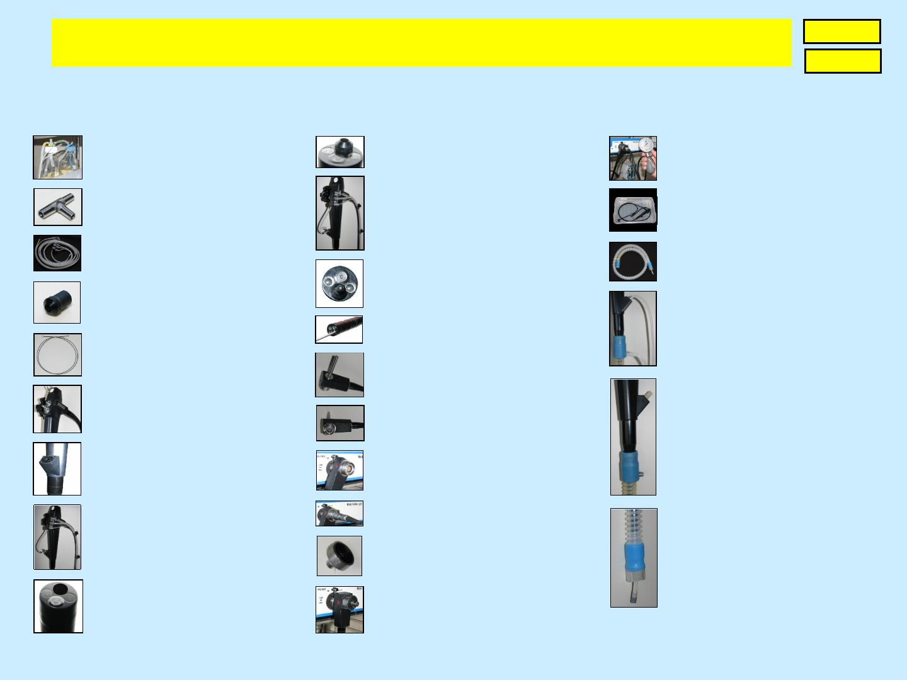
S.A. Matasov. Prospects of CRC endoscopic screening
Part 1. Aseptic method of infection safety of colono- and gastroscopy
Main
Back
15. Enclosure 3: Key details, bundles and aspects of the Aseptic method
(click on photo to enlarge it)
1. Disposable bottles
Suction, Gas/Water
10. Tip of endoscope; exit of
channel occupied by inset
20. Hermecity test
2. Disposable tee of
entrance into channel
11. Entrance into channel
is closed by obturator
21. Complete cleaning-
disinfection
3. Disposable tubular
component with valves
22. Disinfector
-protector (DP)
12. Straight exit of inset is
closed by obturator
4. Disposable inset for
23. HLD, flushing, drying
of channel, sheath of
insertion part and cavity
of DP
channel‟s exit
13. Straight exit of inset is closed by forceps
5. Disposable obturator of
straight exit of inset
14. Connector; view on core of light-bundle
6. Handle of single-channel
endoscope, view on
supports of valves
24. Hermetization of
channel, sheath of
15. Connector, view on
nest of Processor cable
insertion part and cavity
of DP; entrances of
channel and DP are
closed by sterile corks
7. Handle of endoscope;
entrance into channel
16. Connector; core of light-bundle is in block Light
17. Connector is connected
with Processor cable
8. Handle with component
and tee
25. Hermetization of channel, sheath of insertion part and
cavity of DP; DP exit is
closed by sterile cork
18. Cork of the nest
of Processor cable
9. Tip of endoscope;
exit of channel is free
19. Preparation to the hermecity test
© Reference on www.coloncancer.lv is obligatory
15

