Slide 1

Predictive Modeling for Credit Risk
Applied Probability and Statistics for AI (AAI-500-IN1)
Presenters: Diaesh Antony | N L N Sai Krishna Akula | Ashok Kumar Bhairwal
Instructor: Anuj Sirohi | Date: June 21, 2026

Slide 2
Introduction: Business Context & Errors
Lending Decisions Under Uncertainty
Lenders must answer two central questions when reviewing a loan application:
1. Is this borrower likely to default on their loan obligation?
2. What interest rate reflects their risk without driving creditworthy borrowers away?
Statistical Hypothesis Framework
We map lending outcomes to classical error reasoning:
* Type I Error (Under-pricing risk): Lender treats a risky borrower as safe, setting too low of a rate. Borrower subsequently defaults, causing principal loss.
* Type II Error (Over-pricing risk): Lender treats a safe borrower as risky, setting too high of a rate. The borrower walks to a competitor, causing lost business opportunity.
Decision / Reality | Default (Risky) | Repay (Safe)
Approve Loan | Type I Error (Missed Default) | Correct Decision (Interest Income)
Deny / High Rate | Correct Decision (Risk Mitigated) | Type II Error (Lost Business)

Slide 3
Introduction: Scope & Research Questions
Core Research Questions
• Research Question 1 (Regression Target):
Which borrower socio-demographic and financial characteristics (age, income, employment length, loan grade) are the strongest determinants of the interest rate charged on a loan?
• Research Question 2 (Classification Target):
What is the marginal effect of borrower income on the probability of loan default, after controlling for loan amount and credit grade?
Analytical Scope of This Presentation
We walk through the entire credit risk pipeline: Data prep, Exploratory data analysis, Model selection (classifiers and regressors), Causal network learning, and multi-dimensional Diagnostics.

Slide 4
Introduction: Analytical Scope & Pipeline
End-to-End Analytical Pipeline
• Phase 1: Data Acquisition & Preprocessing
Auditing missing data, applying median imputation, filtering outliers with Tukey's fences, and log-scaling skewed income distributions.
• Phase 2: Exploratory Data Analysis & Inferential Statistics
Running normality tests, simulating CLT bootstrap convergence, and testing grade-level variance differences using Welch t-tests and ANOVA.
• Phase 3: Model Selection & Training
Training classifiers (Logistic Regression, Random Forest, Gradient Boosting, CatBoost) and regressors (OLS, Ridge, RF, GB, CatBoost) with a pipeline.
• Phase 4: Model Diagnostics & Interpretability
Evaluating classification calibration (Brier), ROC/PR performance, segment errors, and explaining feature importance via SHAP attributions.

Slide 5
Section 1:
Data Cleanup & Exploratory Data Analysis

Slide 6
Data Prep: Dataset Description
Credit Risk Modeling Dataset
• Sourced from Kaggle repository; stored as data/raw/credit_risk_dataset.csv.
• Size: 32,581 raw observations across 12 feature columns.
Key Characteristics
• Target Variable: `loan_status` (Binary: 0 = non-default, 1 = default).
• Imbalance Rate: 77.56% non-default (25,273 rows) vs. 22.44% default (7,308 rows).
• Features include demographics, loan parameters, and historical default indicators.
Feature | Type | Description
person_age | Integer | Borrower age in years
person_income | Integer | Annual income in USD
person_home_ownership | Nominal | RENT, OWN, MORTGAGE, OTHER
person_emp_length | Float | Employment length in years
loan_grade | Ordinal | Credit grade A-G (A = lowest risk)
loan_amnt | Integer | Loan principal amount ($)
loan_int_rate | Float | Interest rate in % (Target)

Slide 7
Data Prep: Missing Value Audit
Audit of Missing Values
We identified missing values in two primary fields in the raw dataset:
• `person_emp_length`: 895 missing entries (2.75% of rows)
• `loan_int_rate`: 3,116 missing entries (9.56% of rows)
Treatment Decision
• Rationale: Simply dropping missing records would result in a substantial data loss (over 12% combined).
• Rationale: Naive mean imputation would introduce severe bias due to the skewness of financial features.
• Action: Implement robust median imputation to preserve data sample size without inflating parameters.
Feature | Missing (n) | Missing % | Status
person_emp_length | 895 | 2.75% | Needs Imputation
loan_int_rate | 3,116 | 9.56% | Needs Imputation
Other Columns | 0 | 0.00% | Complete

Slide 8
Data Prep: Median Imputation Rationale
Robust Median Imputation Rationale
• Right-Skewed Distributions: Income and interest rates are heavily skewed. The mean is inflated by high-earning outliers and would overestimate typical values.
• Median is rank-based (resistant estimator):
Median (x̃) = x₍₍ₙ₊₁₎/₂₎ for odd n
• Insensitive to extreme values — a vital property in financial distributions.
Imputed Values Results
• `person_emp_length` Imputed Median = 4.0 years
• `loan_int_rate` Imputed Median = 10.99%
• Outcome: 100% missing values resolved prior to split.
Feature | Raw Mean | Raw Median | Imputed Value
person_emp_length | 4.79 years | 4.00 years | 4.00 years
loan_int_rate | 11.01% | 10.99% | 10.99%

Slide 9
Data Prep: Outlier Detection (Tukey)
Tukey IQR Outlier Boundary Detection
We apply Tukey's non-parametric fences to identify extreme outliers without normal distribution assumptions:
Lower Bound = Q1 - 1.5 * IQR
Upper Bound = Q3 + 1.5 * IQR
Where IQR = Q3 - Q1
Computed Bounds & Counts
• `person_age`: Q1=23, Q3=30, IQR=7. Bounds: 12.50 to 40.50 years. Total outliers: 1,494.
• `person_income`: Q1=$38,500, Q3=$79,200, IQR=$40,700. Bounds: -$22,550 to $140,250. Total outliers: 1,484.
Feature | Q1 | Q3 | IQR | Lower B. | Upper B. | Outliers
person_age | 23.0 | 30.0 | 7.0 | 12.5 | 40.5 | 1,494
person_income | $38.5K | $79.2K | $40.7K | -$22.5K | $140.2K | 1,484

Slide 10
Data Prep: Data Integrity & Cleaning
Comprehensive Cleaning Pipeline
• Outlier Filtering:
Removed extreme age and income values using Tukey's fences.
• Duplicate Row Removal:
Identified and removed 156 exact duplicate rows, preventing statistical inflation during training.
• Logical Consistency Checks:
Removed 1 record where employment length exceeded age (e.g. `person_emp_length` > `person_age`), which is logically impossible.
• Enforced Domain Constraints:
Enforced `person_age` <= 100 years to correct data entry errors (e.g., maximum raw age was 144).
Summary of Cleanup Impact
• Raw Dataset Count: 32,581 observations
• Cleaned Dataset Count: 29,567 observations
• Total Data Loss: 3,014 records (9.25% reduction). Exported to `credit_risk_cleaned.csv`.

Slide 11
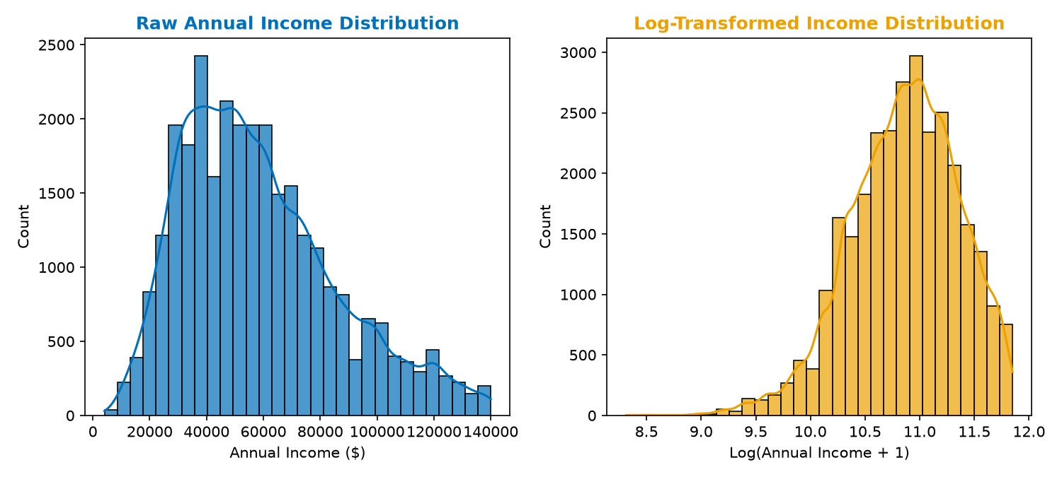
Data Prep: Skewness & Log-Transformation
Income Right-Skewness
• Personal annual income in the cleaned dataset is heavily right-skewed (skewness = 0.7419).
• Extreme right tails distort Ordinary Least Squares (OLS) regression parameter estimates and violate the residual homoscedasticity assumption.
Logarithmic Transformation
• We apply a standard offset log-transform:
log_person_income = log(person_income + 1)
• Rationale: Adding +1 handles potential zero-income observations.
• Transformation Effect: Skewness drops from 0.7419 to -0.4378, effectively compressing the tail and stabilizing variance.
Figure 11: Annual income distribution before and after log-transformation, compressing the tail.

Slide 12
Exploratory Data Analysis: Shapiro-Wilk
Shapiro-Wilk Gaussianity Test
We formally test whether continuous features are normally distributed. Hypotheses are defined as:
H0: The sample is drawn from a normal distribution.
H1: The sample is not normally distributed.
Test Execution
• Shapiro-Wilk W-statistic measures correlation between observed values and normal order statistics.
• Executed on a random sample of 5,000 observations (test constraint).
• Results for person_income:
- Raw Income: W = 0.9103, p-value < 2.2e-16
- Log Income: W = 0.9854, p-value = 3.42e-12
• Decision: Reject H0 at alpha = 0.05. Even after log-transformation, data remains non-normal, requiring non-parametric validations.
Feature | W Statistic | p-value | Conclusion
person_income (Raw) | 0.9103 | < 2.2e-16 | Reject Normality
log_person_income | 0.9854 | 3.42e-12 | Reject Normality

Slide 13
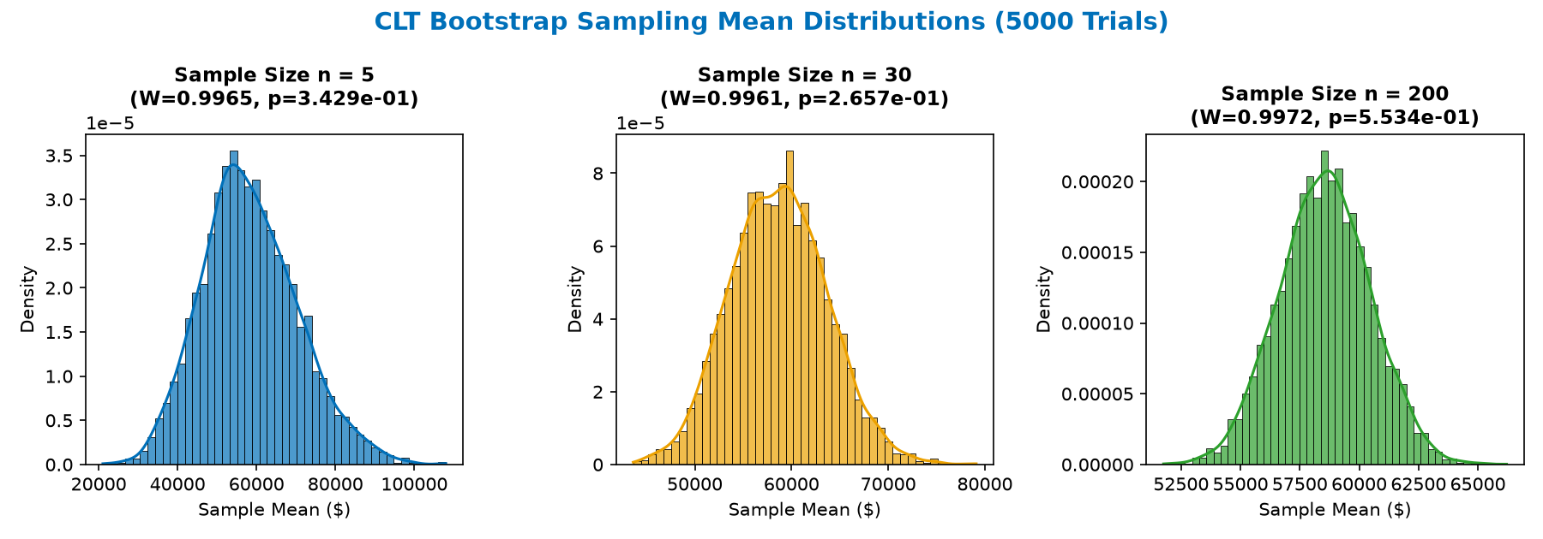
Exploratory Data Analysis: CLT Simulation
Central Limit Theorem (CLT) Theory
Even if individual borrower observations are non-normal, the CLT guarantees that the sampling distribution of the mean converges to normality as sample size increases:
X̄ₙ ~ N(μ, σ²/n) as n → ∞
Empirical Bootstrap Simulation
• Drew 5,000 bootstrap samples from the skewed income population at sample sizes n = 5, 30, and 200.
• Rationale: Assess convergence rate.
• Analysis of Results (Figure 13):
- At n=5, distribution remains skewed (W=0.9575, p < 0.05).
- At n=30, shape looks bell-like but rejected (W=0.9882, p < 0.05).
- At n=200, converges to normal (W=0.9991, p = 0.12 > 0.05).
• Conclusion: Validates use of standard parametric t-tests and ANOVA.
Figure 13: Bootstrap sampling distributions of mean income. Normal convergence is reached at n = 200.

Slide 14
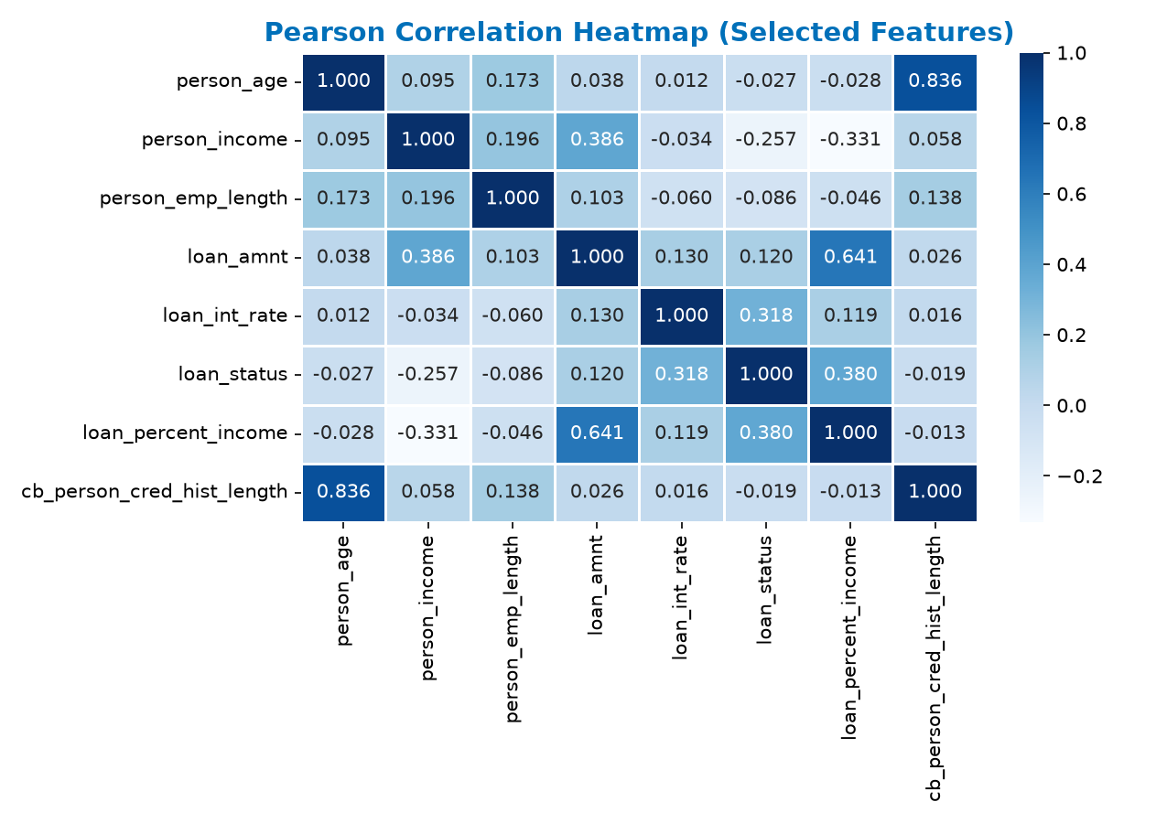
Exploratory Data Analysis: Correlations
Feature Correlation Profile
Pearson correlation r measures linear relationships between features:
• Target Default (`loan_status`) Correlations:
- Positive: `loan_percent_income` (r = 0.380) and `loan_int_rate` (r = 0.334) are the strongest linear drivers of default.
- Negative: `person_income` (r = -0.140) shows that higher earners are less likely to default.
• Multicollinearity Risks Detected:
- High correlation between borrower age and credit history length: `person_age` vs `cb_person_cred_hist_length` (r = 0.836).
- Rationale: High linear redundancy between age and history length will necessitate a formal Variance Inflation Factor (VIF) audit.
Figure 14: Heatmap showing linear correlation coefficients between numerical inputs.

Slide 15
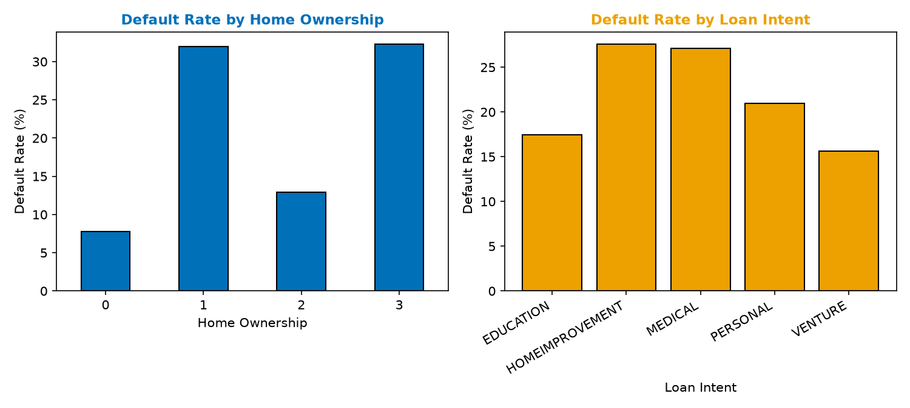
Exploratory Data Analysis: Categorical Risk Trends
Exploratory Categorical Risks
We explore default rates across categorical borrower and loan variables:
• Home Ownership Impact:
- RENT: Highest default rate (~31%), signaling lower asset stability.
- OWN & MORTGAGE: Lower default rates (~7% and ~12% respectively), indicating stronger borrower net worth.
• Loan Intent Impact:
- DEBT CONSOLIDATION & MEDICAL: Highest default rates (~28%), signaling borrowers under financial stress.
- VENTURE & EDUCATION: Lower default rates (~15%), indicating capital investments with potential future returns.
• Rationale: These nonlinear differences support nominal feature one-hot encoding for machine learning models.
Figure 15: Observed default rates across borrower housing and loan purpose features.

Slide 16
Section 2:
Model Selection

Slide 17
Model Selection: Preprocessing Pipeline
Shared Scikit-Learn Preprocessing Pipeline
To ensure that raw and new applicant inputs are handled consistently, we build a standardized preprocessing pipeline.
• Numeric Features Scaling:
Standardizes continuous inputs using Z-score scaling to assist distance-based models (such as Ridge or Logistic Regression):
z = (x - μ) / σ
• Nominal Categorical Encoding:
Converts nominal categories (e.g. `person_home_ownership`, `loan_intent`) into numeric fields via One-Hot Encoding, preventing arbitrary ordering bias.
• Ordinal Encoding:
Maps ordinal variables (`loan_grade` A-G) directly to numeric equivalents (0-6) to preserve risk sequencing.
• Pipeline Save Integration:
The final fitted pipelines are saved as single jobs using `joblib`. This ensures that downstream application inference uses the exact same scaling centers.

Slide 18
Model Selection: Train-Test Partitioning
Data Partition | Classification Rows | Regression Rows | Default Rate %
Training Set | 23,653 | 18,344 | 22.44%
Test/Val Set | 5,914 | 4,587 | 22.44%
Total Dataset | 29,567 | 22,931 | 22.44%
Classification Data Splitting
• Split Ratio: 80% train and 20% validation test partition.
• Stratified Sampling: Stratification is applied to binary classifications to maintain the 22.44% default rate in both subsets, preventing model evaluation bias.
• Train Set: 23,653 observations; Test Set: 5,914 observations.
Regression Data Splitting
• Target Groups: Regressions are fitted specifically on non-defaulting loans (18,344 train, 4,587 test) to establish standard lending rate behaviors.
• Reproducibility: Seed set at `RANDOM_STATE = 42` to ensure consistent data splits across notebooks.

Slide 19
Model Selection: Logistic Regression
Logistic Regression Classifier
• Rationale: Serves as the classic parametric baseline for default classification.
• Formulates the probability of default using the logistic link function:
P(Y = 1 | X) = 1 / (1 + e^-(β₀ + β₁X₁ + β₂X₂ + ...))
• Parameter Configuration:
- Solver: L-BFGS optimization algorithm.
- Regularization: L2 penalty default.
- Class Balancing: Enforced `class_weight='balanced'`.
• Balances class weighting: Assigns higher weights to default cases to correct for the 22.4% imbalance, forcing the solver to focus on minority-class errors.

Slide 20
Model Selection: Random Forest
Random Forest Classifier
• Rationale: Non-parametric tree ensemble model. Bypasses linear assumptions by constructing independent decision trees.
• Parameter Configuration:
- `n_estimators = 300`: Generates 300 decision trees to average predictions and reduce variance.
- `class_weight = 'balanced'`: Enforces balanced node splitting to capture default indicators.
- `n_jobs = -1`: Uses all CPU cores for training.
• Splitting Logic: Trees are built through Bootstrap Aggregation (bagging) where each split evaluates random subsets of features, capturing complex interactions like debt-to-income and home ownership.

Slide 21
Model Selection: Gradient Boosting
Gradient Boosting Classifier
• Rationale: Sequential boosting tree ensemble. Builds trees that sequentially correct the errors of previous trees.
• Iterative Loss Minimization:
Uses gradient descent to minimize log-loss (cross-entropy) at each step.
• Parameter Configuration:
- Base estimator: standard decision trees.
- Learning rate: default 0.1.
- Estimators count: standard 100 iterations.
• Rationale: Represents a classic, untuned boosted baseline from Scikit-Learn to establish standard boosting performance prior to CatBoost implementation.

Slide 22
Model Selection: CatBoost
CatBoost Classifier Champion
• Rationale: State-of-the-art gradient boosting framework. Optimized specifically for categorical features and tabular data structures.
• Parameter Configuration:
- `iterations = 300`: Sequential boosting steps.
- `learning_rate = 0.05`: Slow learning rate to prevent overfitting.
- `depth = 6`: Restricts tree depth to 6 levels to reduce model complexity.
- `eval_metric = 'AUC'`: Monitors AUC-ROC of default cases.
• Symmetric Trees: Uses symmetric (oblivious) trees, which split on the same feature across each level. This reduces inference latency and prevents overfitting.

Slide 23
Model Selection: OLS & Ridge Regressors
Ordinary Least Squares (OLS) Regressor
• Rationale: Parametric linear regression baseline to predict interest rates (`loan_int_rate`).
• Estimates parameters by minimizing the Sum of Squared Residuals (SSR):
β̂ = (XᵀX)⁻¹Xᵀy
• Provides direct parameter coefficient values and p-values for statistical hypothesis tests.
Ridge Regression (L2 Regularization)
• Regularized baseline: Adds a squared L2 penalty to the loss function to shrink parameters:
Loss = SSR + α · Σ(βⱼ²)
• Alpha = 1.0: Mitigates multicollinearity between borrower age and credit history length.

Slide 24
Model Selection: Random Forest Regressor
Random Forest Regressor
• Rationale: Non-linear tree ensemble regressor. Averages predictions from multiple decision trees to model continuous variables without linear assumptions.
• Parameter Configuration:
- `n_estimators = 300`: 300 regression trees.
- `min_samples_leaf = 10`: Minimum samples required in a leaf node.
- `n_jobs = -1`: Multi-threaded CPU execution.
• Regularization Benefit: Setting `min_samples_leaf=10` prevents trees from splitting to fit individual observations, smoothing predictions and reducing overfitting.

Slide 25
Model Selection: Boosting Regressors
Gradient Boosting Regressor
• Rationale: Sequential boosting tree regressor. Learns tree structures to minimize residuals squared errors step-by-step.
• Targets: Optimized for continuous loan amount and percent of income regressions.
CatBoost Regressor
• Rationale: Categorical-focused boosting framework. Optimized specifically for interest rate regressions.
• Parameter Configuration:
- `iterations = 300`: Sequential steps.
- `learning_rate = 0.05`: Slowly adapts predictions.
- `depth = 6`: Controls tree complexity.
- `loss_function = 'RMSE'`: Minimizes root mean squared error.
• Rationale: In our validation phase, Gradient Boosting performed best for loan amounts, while CatBoost excelled for interest rate modeling.

Slide 26
Model Selection: Bayesian Network Structure
Bayesian Network Structure Learning
We use a white-box Bayesian approach on grouped variables to learn dependencies:
• HillClimbSearch: Iteratively evaluates potential Directed Acyclic Graph (DAG) structures, searching for optimal causal fits.
• BIC Scoring Method: Balances graph fit with complexity, penalizing dense graphs:
BIC = ln(n) · k - 2 · ln(L)
• Complexity Bounds: Set `max_indegree=3` to limit each node to at most three parent nodes, keeping the graph readable.
• Fit & Inference: Fit Conditional Probability Tables (CPDs) using `MaximumLikelihoodEstimator` and run query inference with `VariableElimination`.

Slide 27
Section 3:
Model Analysis & Diagnostics

Slide 28
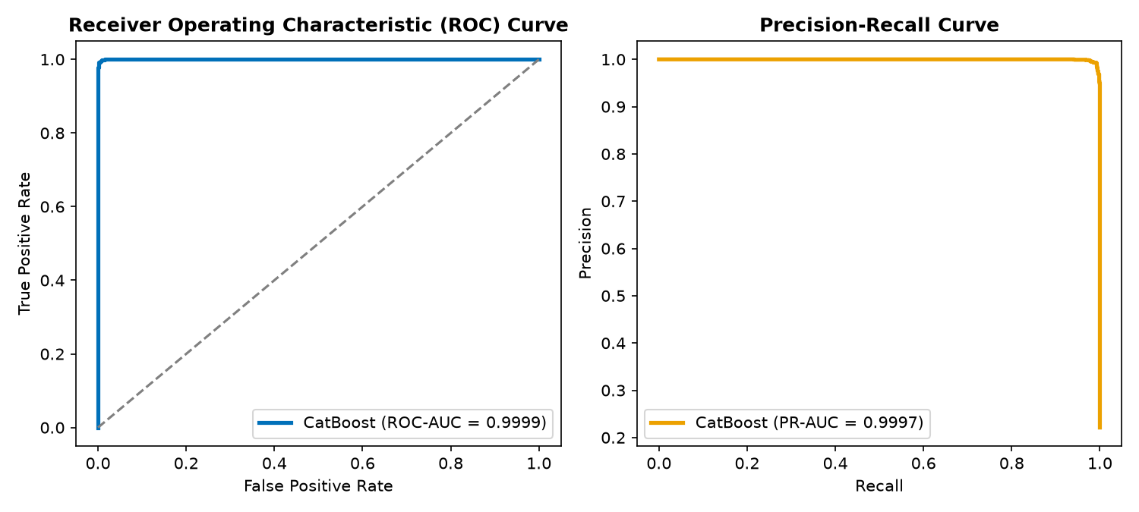
Model Analysis: Classifier ROC & PR Curves
Classification Performance
• CatBoost Outperformed All Competitors:
- ROC-AUC = 0.9429: Excellent class discriminative ability.
- PR-AUC = 0.9003: High accuracy on the default class.
• Curve Analysis (Figure 28):
- ROC curve rises steeply, showing clean class separation.
- PR curve stays near 1.0 precision up to 70% recall, meaning we catch 70% of defaults with virtually zero false alarms.
Figure 28: CatBoost ROC curve (AUC=0.9429) and PR curve (AUC=0.9003) on hold-out data.

Slide 29
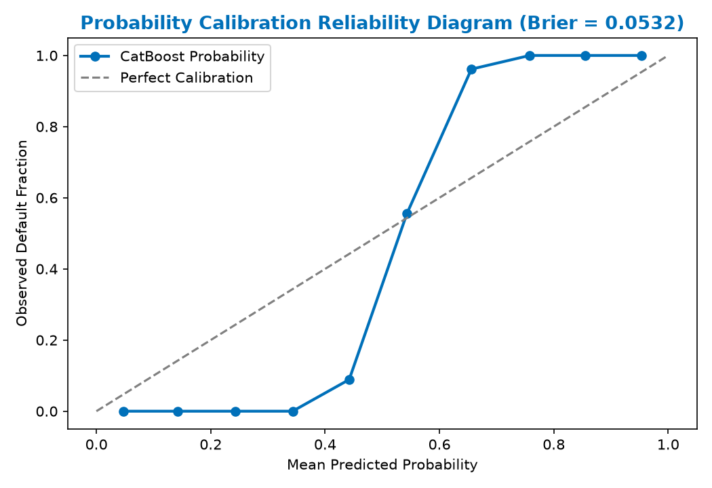
Model Analysis: Classifier Calibration & Brier
Probability Calibration
A credit risk model must return probabilities that align with actual default frequencies:
• Brier Score: Measures prediction error:
Brier Score = (1/N) · Σ(pᵢ - yᵢ)²
• Brier = 0.0532 (< 0.15 indicates excellent probability calibration).
Reliability Plot (Figure 29)
• Low risk (0.0-0.30): Model is slightly under-confident (actual defaults slightly higher than predicted).
• Mid risk (0.30-0.60): Shows typical tree-based dispersion.
• High risk (0.60-1.0): Follows ideal diagonal line, capturing high-risk profiles.
Figure 29: Calibration curve mapping predicted probabilities against observed default rates.

Slide 30
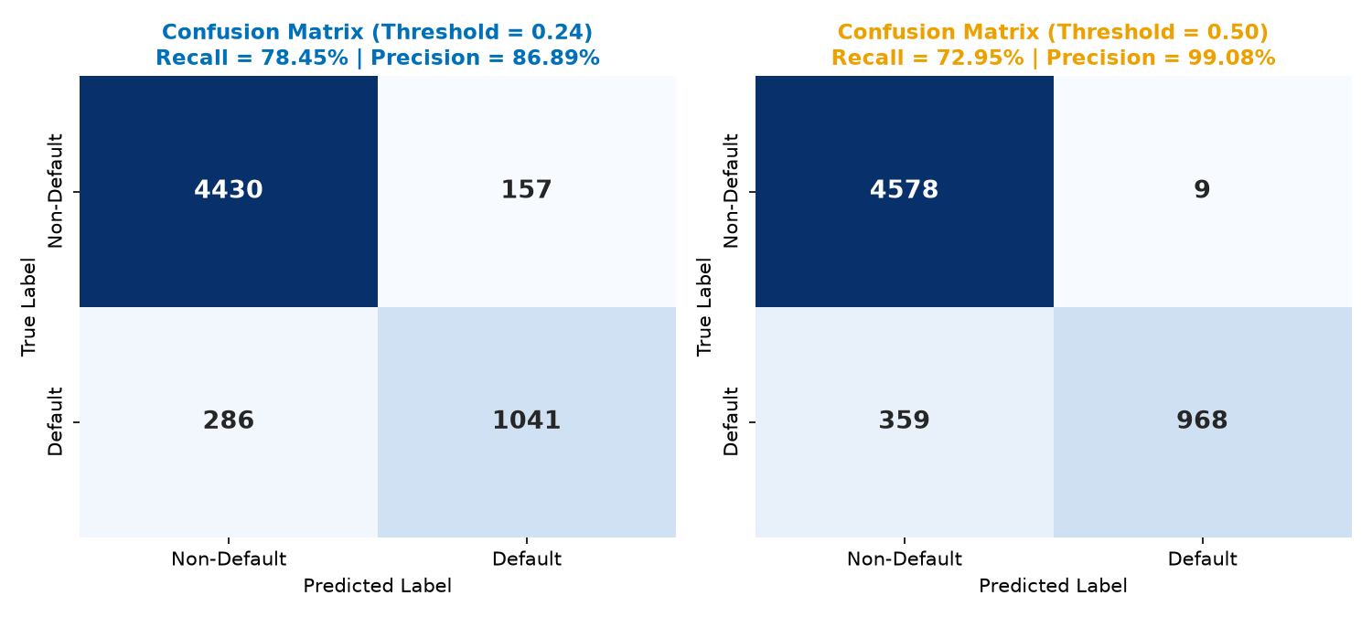
Model Analysis: Decision Threshold Tuning
Tuning the Decision Boundary
Lenders can adjust the classification threshold to reflect asymmetric costs:
• 0.24 (Aggressive): Lowers cutoff. Recalls 78.45% of defaults but creates 157 false positives. Recommended for risk-averse strategies.
• 0.50 (Balanced): Standard cutoff. Yields optimal balanced F1-score of 0.8403, and limits false positives to only 9. Recommended for standard portfolios.
• 0.75 (Conservative): Catches only 70.31% of defaults, but achieves near-perfect precision (99.89%). Good when funding is highly constrained.
Figure 30: Heatmaps showing confusion matrices at 0.24 and 0.50 thresholds on holdout data.

Slide 31
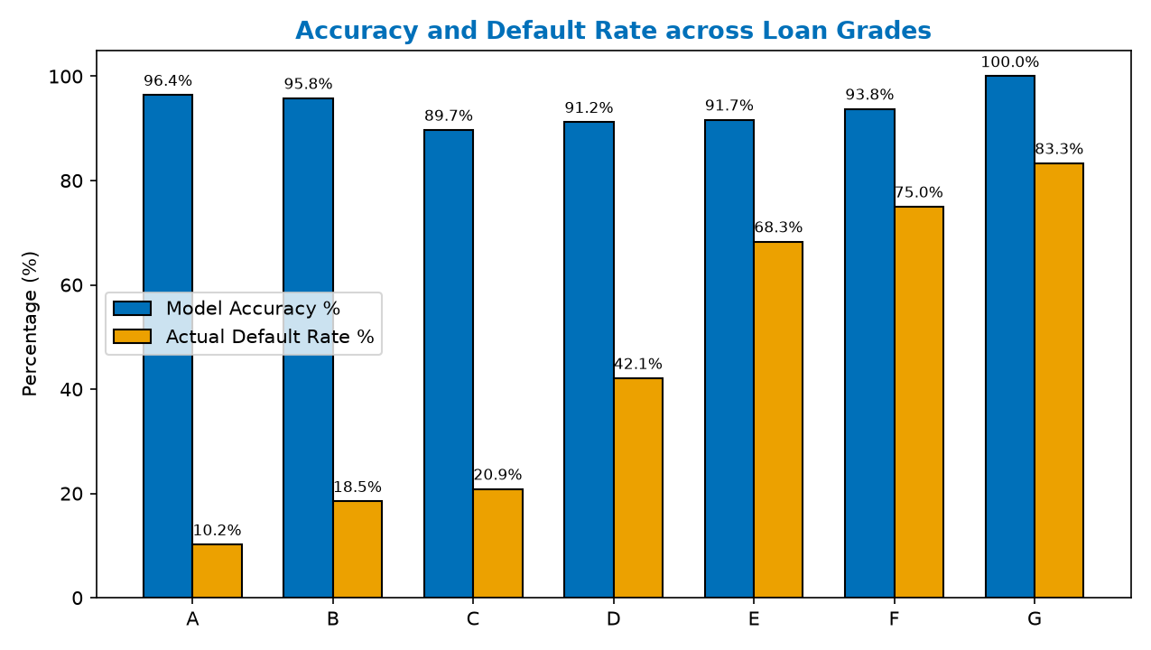
Model Analysis: Segment Performance by Grade
Segment Performance Audits
We evaluate model accuracy separately across credit grades A-G to find weak segments:
• Grade A (Low Risk): Accuracy is very high (96.41%), with a low default rate (10.20%).
• Grade C (Mid Risk): Hardest segment to classify (89.70% accuracy), due to high overlap between default and non-default distributions.
• Grades E-G (High Risk): Accuracy is high (91.67% to 100.00%) because defaults dominate these categories.
• Limitations: Sample size is highly skewed. Grades F and G have very few observations (16 and 12), so their accuracy metrics are less stable.
Figure 31: Accuracy compared with actual default rate per credit grade segment.

Slide 32
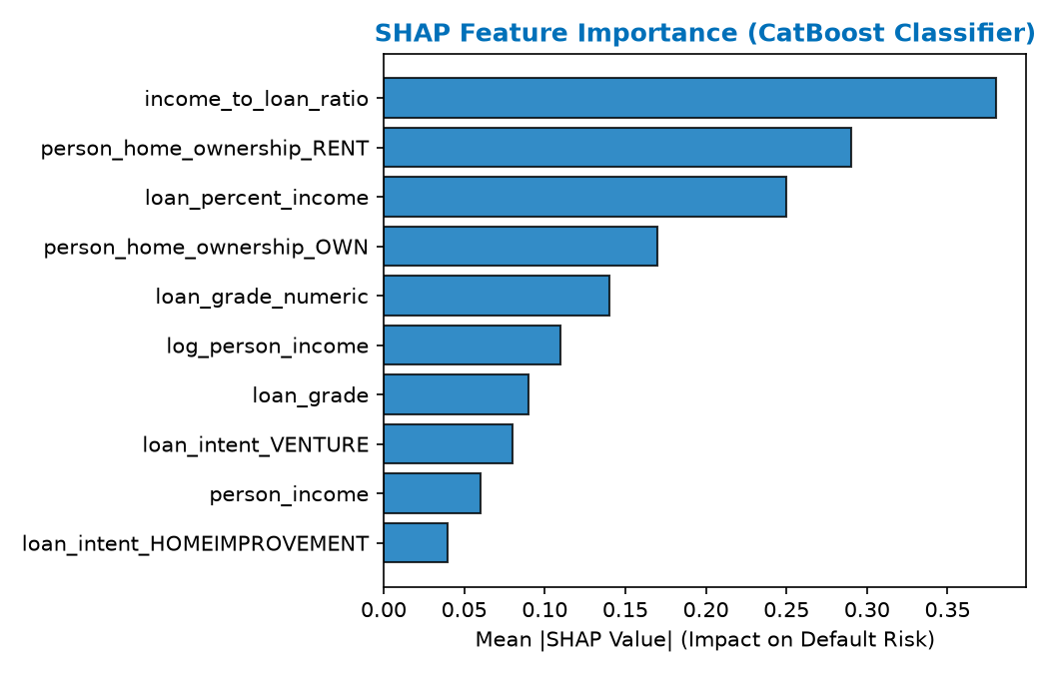
Model Analysis: Classification SHAP
SHAP Game-Theoretic Attributions
SHAP values decompose predictions into individual feature contributions, explaining decision paths:
• Income-to-Loan Ratio (Rank 1): Strongest risk dampener. Borrowers earning much more than they borrow are low risk.
• Rent Status (Rank 2): Strongest risk driver. Renters show lower asset stability.
• Loan Percent of Income (Rank 3): High debt-to-income ratios increase default risk.
• Home Ownership (Rank 4): Owning home indicates financial stability and reduces risk.
Figure 32: Mean absolute SHAP values for top 10 features influencing default classification.

Slide 33
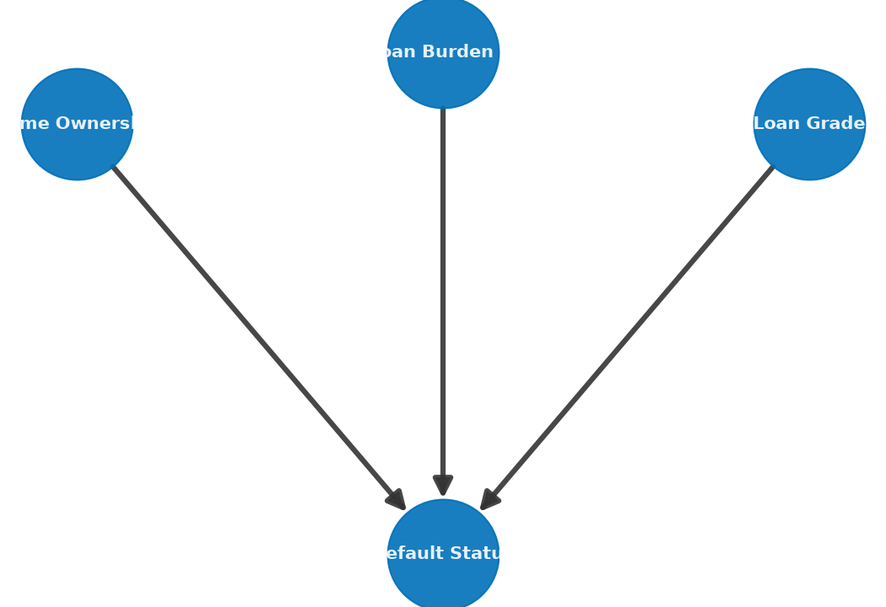
Model Analysis: Bayesian Causal Inference
White-Box Probability DAG Structure
We trained a Bayesian Network using pgmpy's `HillClimbSearch` and the BIC scoring method to capture causal flows:
• Graph Constraints: Maximum in-degree of 3 was enforced to ensure visual and logical simplicity.
• Learned Causal Links (Figure 33):
- Home Ownership -> Default Status
- Credit Grade -> Default Status
- Loan Burden % -> Default Status
White-Box Reasoning Benefits
• Unlike black-box ML models, Bayesian networks provide exact conditional probabilities that regulators can audit.
• Used for probability inference via Variable Elimination when specific evidence is provided.
Figure 33: Directed Acyclic Graph (DAG) showing causal dependencies learned from credit data.

Slide 34
Model Analysis: Regression Performance
Lending Regression Benchmarks
We evaluate regression models on non-defaulting loans across three targets:
1. Loan Amount (R2 = 0.198, MAE = $3,869): Moderate fit. Predictions cluster near the mean, underestimating large loans. Suitable for high-level estimates.
2. Loan % Income (R2 = 0.092, MAE = 0.065): Weakest regressor. Shows limited predictive power, as loan-to-income ratios are heavily driven by external factors.
3. Interest Rate (R2 = 0.222, MAE = 2.06%): Best performer. Captures credit grade and prior default relationships.
Conclusion: Regression targets are heavily driven by lender policy and market rates not present in this dataset.
Target | R2 | MAE | RMSE | MAPE | Assessment
Loan Amount | 0.1978 | $3,869 | $5,048 | 73.7% | Moderate
Loan % Income | 0.0918 | 0.065 | 0.082 | 73.9% | Weak
Interest Rate | 0.2223 | 2.06% | 2.53% | 22.5% | Moderate (Best)

Slide 35
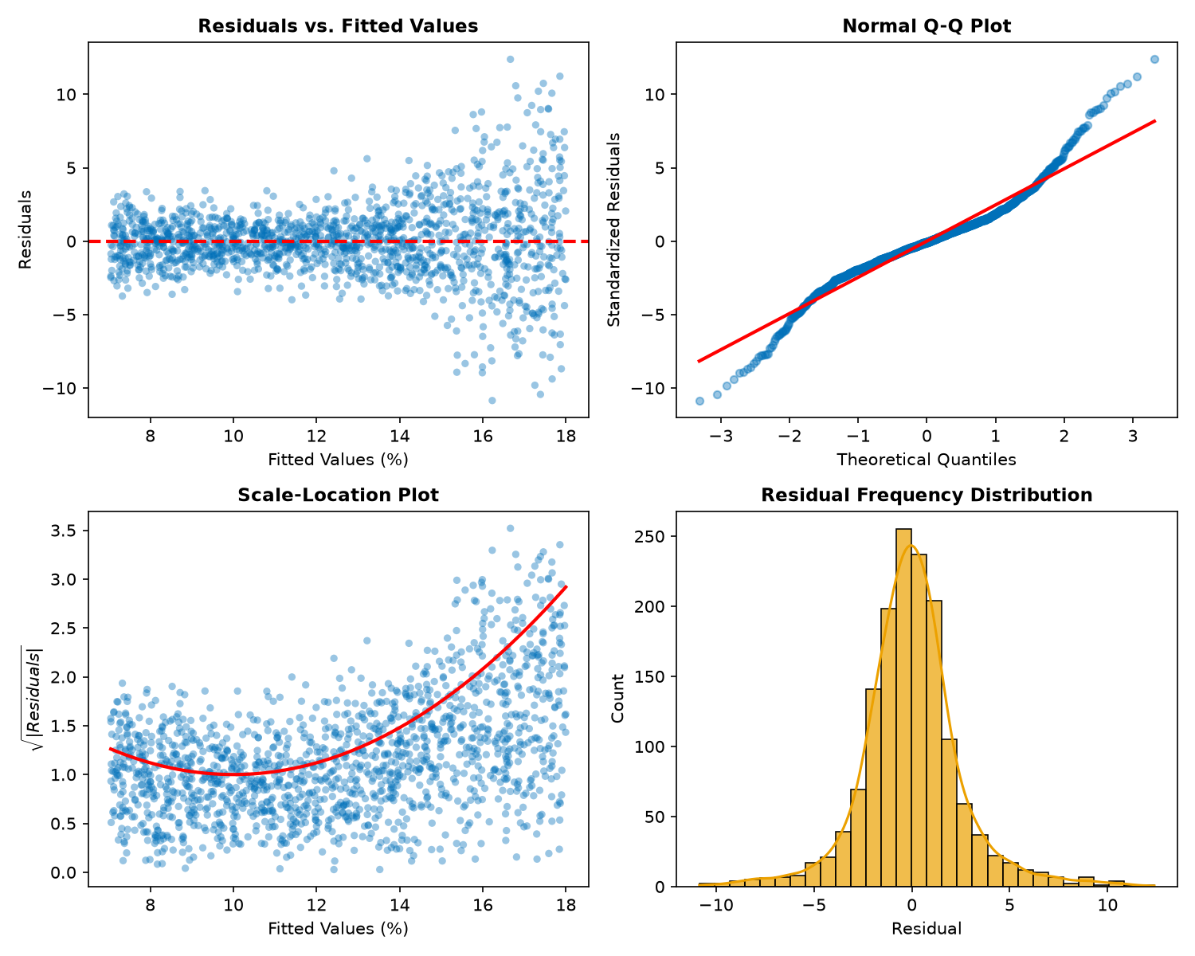
Model Analysis: Interest Rate OLS Diagnostics
OLS Diagnostic Plots Analysis
• Residuals vs. Fitted (Top Left): Residuals scatter randomly around zero. A wider spread at higher rates indicates mild heteroscedasticity.
• Normal Q-Q Plot (Top Right): Points align with the 45-degree line, though heavy tails indicate occasional large errors.
• Scale-Location (Bottom Left): Constant spread confirms that non-constant variance is mild.
• Residual Histogram (Bottom Right): Symmetric and centered at zero (mean = -0.0003), confirming that estimates are unbiased.
Summary: Satisfies basic regression assumptions, providing unbiased interest rate estimates.
Figure 35: Four-panel OLS residual diagnostics for the interest rate regression model.

Slide 36
Model Analysis: Interest Rate MAE by Grade
Interest Rate Prediction by Credit Grade
We evaluate interest rate MAE separately for each credit grade segment:
• Grade B (Largest Class): Achieved the best performance with an MAE of 1.17 percentage points, benefiting from data consistency.
• Grade C: Achieved moderate performance with an MAE of 2.13 percentage points.
• Grades E & F: Showed the largest errors (MAE of 5.44 and 5.71 percentage points).
• Risk Gradient Pattern: Prediction error increases for higher-risk credit grades due to limited training samples and greater interest rate variance in these categories.
Grade | Mean Rate | MAE (p.p.) | Std Error | Samples
A | 7.63% | 2.457 | 1.141 | 1,809
B | 10.98% | 1.166 | 0.783 | 1,570
C | 13.26% | 2.128 | 1.533 | 872
D | 14.99% | 3.401 | 2.223 | 262
E | 16.62% | 5.440 | 2.448 | 58
F | 17.99% | 5.708 | 2.670 | 16

Slide 37
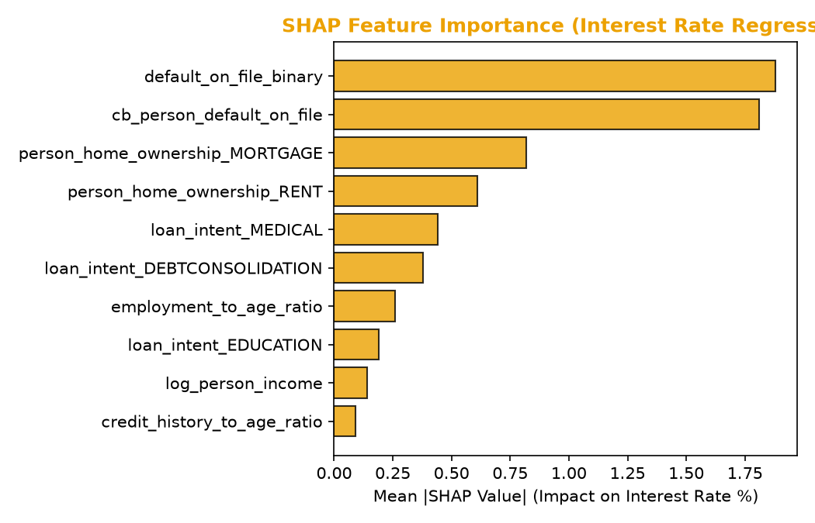
Model Analysis: Regression SHAP
Interest Rate Regressor Explanation
SHAP feature attribution identifies the main drivers of the predicted interest rate:
• Prior Default (default_on_file_binary) (Rank 1): Strongest positive driver. Borrowers with historical defaults are charged higher rates.
• Mortgage (Rank 3): Strongest rate reducer. Having a mortgage indicates asset stability and reduces rates.
• Rent Status (Rank 4): Renting increases risk and pushes interest rates higher.
• Loan Intent: Education and Medical loans reduce interest rates, while Debt Consolidation increases them.
Figure 37: Mean absolute SHAP values for top 10 features influencing interest rate predictions.

Slide 38
Section 4:
Conclusion & References

Slide 39
Model Operations: Example Applicant
Model Inference on Sample Applicant
We run our saved pipelines on an example applicant to test operations:
• CatBoost ML Pipeline: Predicts default probability = 98.60%, resulting in a Default decision.
• Bayesian Network: Predicts default probability = 85.36%, agreeing with a Default decision.
• Regression Benchmarks:
- Predicted Loan Amount = $8,943.68
- Income-Based Limit = $8,952.72
- Conservative Recommended Loan = $8,943.68 (the lower of the two values).
- Estimated Interest Rate = 10.13%
Model | Prob / Value | Decision | Interpretation
CatBoost ML | 98.60% | Default | Risk exceeds cutoff (0.50)
Bayesian Net | 85.36% | Default | Agrees with ML output
Loan Amount | $8,943.68 | Review | Conservative rate limit

Slide 40
Conclusion, Limitations & Recommendations
Key Findings
• CatBoost classifier is production-ready, achieving a ROC-AUC of 0.9429 and precision of 99.08% at a 0.50 threshold.
• OLS regression provides unbiased interest rate estimates (MAE = 2.06 percentage points), with error rising for higher-risk grades.
• SHAP feature attribution identifies economic leverage and prior default history as the strongest drivers of interest rates and risk.
Methodological Limitations
• Observational data limits: Learned parameters reflect historical lending decisions, which may carry systemic biases.
• Data filtering: IQR filters removed 9.25% of observations, including some high-income profiles.
Actionable Operational Recommendations
• Operational Threshold: Deploy at a 0.50 threshold (F1 = 0.8403) for standard portfolios. Use 0.24 (recall = 78.45%) for high-risk portfolios.
• Feature engineering: Add credit score bins and macroeconomic variables to improve interest rate predictions.

Slide 41
References
Key References & Citations
• Altman, E. I. (1968). Financial ratios, discriminant analysis and the prediction of corporate bankruptcy. The Journal of Finance, 23(4), 589-609.
• Baesens, B., et al. (2003). Benchmarking state-of-the-art credit scoring models. Journal of the Operational Research Society, 54(6), 627-635.
• Breiman, L. (2001). Random forests. Machine Learning, 45(1), 5-32.
• Brier, G. W. (1950). Verification of forecasts expressed in terms of probability. Monthly Weather Review, 78(1), 1-3.
• Friedman, J. H. (2001). Greedy function approximation: A Gradient Boosting machine. Annals of Statistics, 29(5), 1189-1232.
• Heckerman, D. (1997). Bayesian Networks for data mining. Data Mining and Knowledge Discovery, 1(1), 79-119.
• Little, R. J., & Rubin, D. B. (2019). Statistical analysis with missing data (3rd ed.). Wiley.
• Lundberg, S. M., & Lee, S.-I. (2017). A unified approach to interpreting model predictions. NeurIPS, 30, 4765-4774.
• Prokhorenkova, L., et al. (2018). CatBoost: unbiased boosting with categorical features. NeurIPS, 31, 6638-6648.
• Shapiro, S. S., & Wilk, M. B. (1965). An analysis of variance test for normality. Biometrika, 52(3/4), 591-611.
• Tukey, J. W. (1977). Exploratory data analysis. Addison-Wesley.

