Slide 1
Predictive Modeling for Credit Risk
Applied Probability and Statistics for AI (AAI-500-IN1)
Presenters: Diaesh Antony | N L N Sai Krishna Akula | Ashok Kumar Bhairwal
University of San Diego
Instructor: Dr. Ebrahim Tarshizi | Date: June 15, 2026
Notes:
Welcome to our final project presentation on Credit Risk Modeling and Statistical Diagnostics. Our team consists of Diaesh Antony, Sai Krishna Akula, and Ashok Bhairwal. In this study, we develop a comprehensive predictive modeling framework to estimate default probability and determine interest rates using a Kaggle credit risk dataset of 32,581 records. Let's begin by discussing the business context.

Slide 2
Introduction: Business Context & Errors
Lending Decisions Under Uncertainty
Lenders must answer two central questions when reviewing a loan application:
1. Is this borrower likely to default on their loan obligation?
2. What interest rate reflects their risk without driving creditworthy borrowers away?
Statistical Hypothesis Framework
We map lending outcomes to classical error reasoning:
* Type I Error (Under-pricing risk): Lender treats a risky borrower as safe, setting too low of a rate. Borrower subsequently defaults, causing principal loss.
* Type II Error (Over-pricing risk): Lender treats a safe borrower as risky, setting too high of a rate. The borrower walks to a competitor, causing lost business opportunity.
Decision / Reality | Default (Risky) | Repay (Safe)
Approve Loan | Type I Error (Missed Default) | Correct Decision (Interest Income)
Deny / High Rate | Correct Decision (Risk Mitigated) | Type II Error (Lost Business)
Notes:
Lending decisions represent a delicate balance of risk. We frame this problem using hypothesis testing. If a lender makes a Type I error and under-prices risk, the borrower defaults, leading to severe capital losses. Conversely, if the lender makes a Type II error and over-pricing risk, a creditworthy borrower is rejected or goes to a competitor, representing lost business. Our modeling workflow aims to minimize both types of errors to optimize profitability.

Slide 3
Introduction: Scope & Research Questions
Core Research Questions
• Research Question 1 (Regression Target):
Which borrower socio-demographic and financial characteristics (age, income, employment length, loan grade) are the strongest determinants of the interest rate charged on a loan?
• Research Question 2 (Classification Target):
What is the marginal effect of borrower income on the probability of loan default, after controlling for loan amount and credit grade?
Analytical Scope of This Presentation
We walk through the entire credit risk pipeline: Data prep, Exploratory statistics, Model selection (classifiers and regressors), Causal network learning, and multi-dimensional Diagnostics.
Notes:
This slide defines our research scope and target questions. First, we explore the determinants of interest rates using Ordinary Least Squares regression, evaluating which borrower variables play the strongest role. Second, we assess classification models to compute the marginal effect of borrower income on default probability while controlling for other variables. Our analytical pipeline progresses logically from preprocessing to inference, modeling, and diagnostics.

Slide 4
Introduction: Analytical Scope & Pipeline
End-to-End Analytical Pipeline
• Phase 1: Data Acquisition & Preprocessing
Auditing missing data, applying median imputation, filtering outliers with Tukey's fences, and log-scaling skewed income distributions.
• Phase 2: Exploratory Data Analysis & Inferential Statistics
Running normality tests, simulating CLT bootstrap convergence, and testing grade-level variance differences using Welch t-tests and ANOVA.
• Phase 3: Model Selection & Training
Training classifiers (Logistic Regression, Random Forest, Gradient Boosting, CatBoost) and regressors (OLS, Ridge, RF, GB, CatBoost) with a pipeline.
• Phase 4: Model Diagnostics & Interpretability
Evaluating classification calibration (Brier), ROC/PR performance, segment errors, and explaining feature importance via SHAP attributions.
Notes:
Our analysis follows a strict four-phase structure. We start with preprocessing, handling outliers and skewness. We then perform exploratory tests to ensure mathematical assumptions hold. In phase 3, we build pipelines to train classification and regression model families. Finally, we assess their performance using diagnostics and game-theoretic SHAP attributions, establishing a transparent workflow.

Slide 5
Section 1:
Data Cleanup & Exploratory Data Analysis
Notes:
We now enter our first major section: Data Cleanup and Exploratory Data Analysis. We'll review dataset descriptions, missing values, outliers, log transformations, normality tests, CLT simulations, and correlation matrices. This section covers 10 detailed slides.

Slide 6
Data Prep: Dataset Description
Credit Risk Modeling Dataset
• Sourced from Kaggle repository; stored as data/raw/credit_risk_dataset.csv.
• Size: 32,581 raw observations across 12 feature columns.
Key Characteristics
• Target Variable: `loan_status` (Binary: 0 = non-default, 1 = default).
• Imbalance Rate: 77.56% non-default (25,273 rows) vs. 22.44% default (7,308 rows).
• Features include demographics, loan parameters, and historical default indicators.
Feature | Type | Description
person_age | Integer | Borrower age in years
person_income | Integer | Annual income in USD
person_home_ownership | Nominal | RENT, OWN, MORTGAGE, OTHER
person_emp_length | Float | Employment length in years
loan_grade | Ordinal | Credit grade A-G (A = lowest risk)
loan_amnt | Integer | Loan principal amount ($)
loan_int_rate | Float | Interest rate in % (Target)
Notes:
Our dataset contains 32,581 borrower profiles across 12 features. The default rate is 22.44%, creating a moderate class imbalance. The right-hand table displays the primary features, including borrower demographics and loan characteristics. Let's look at how we handled missing values in these fields.

Slide 7
Data Prep: Missing Value Audit
Audit of Missing Values
We identified missing values in two primary fields in the raw dataset:
• `person_emp_length`: 895 missing entries (2.75% of rows)
• `loan_int_rate`: 3,116 missing entries (9.56% of rows)
Treatment Decision
• Rationale: Simply dropping missing records would result in a substantial data loss (over 12% combined).
• Rationale: Naive mean imputation would introduce severe bias due to the skewness of financial features.
• Action: Implement robust median imputation (Little & Rubin, 2019) to preserve data sample size without inflating parameters.
Feature | Missing (n) | Missing % | Status
person_emp_length | 895 | 2.75% | Needs Imputation
loan_int_rate | 3,116 | 9.56% | Needs Imputation
Other Columns | 0 | 0.00% | Complete
Notes:
During our initial data audit, we found that two fields contained missing values: employment length (2.75%) and interest rate (9.56%). Because dropping these would result in losing over 12% of the dataset, we decided to impute them. The next slide explains the statistical logic behind choosing the median.

Slide 8
Data Prep: Median Imputation Rationale
Robust Median Imputation Rationale
• Right-Skewed Distributions: Income and interest rates are heavily skewed. The mean is inflated by high-earning outliers and would overestimate typical values.
• Median is rank-based (resistant estimator):
x̃ = x_((n+1)/2) for odd n
• Insensitive to extreme values — a vital property in financial distributions (Little & Rubin, 2019).
Imputed Values Results
• `person_emp_length` Imputed Median = 4.0 years
• `loan_int_rate` Imputed Median = 10.99%
• Outcome: 100% missing values resolved prior to split.
Feature | Raw Mean | Raw Median | Imputed Value
person_emp_length | 4.79 years | 4.00 years | 4.00 years
loan_int_rate | 11.01% | 10.99% | 10.99%
Notes:
We selected median imputation rather than mean imputation. Because financial variables in this dataset are right-skewed, the mean is inflated by high-value outliers. The median, being rank-based, is statistically resistant. We filled missing employment lengths with 4.0 years and interest rates with 10.99%, completing our imputation process.

Slide 9
Data Prep: Outlier Detection (Tukey)
Tukey IQR Outlier Boundary Detection
We apply Tukey's non-parametric fences (Tukey, 1977) to identify extreme outliers without normal distribution assumptions:
Lower Bound = Q1 - 1.5 * IQR
Upper Bound = Q3 + 1.5 * IQR
Where IQR = Q3 - Q1
Computed Bounds & Counts
• `person_age`: Q1=23, Q3=30, IQR=7. Bounds: 12.50 to 40.50 years. Total outliers: 1,494.
• `person_income`: Q1=$38,500, Q3=$79,200, IQR=$40,700. Bounds: -$22,550 to $140,250. Total outliers: 1,484.
Feature | Q1 | Q3 | IQR | Lower B. | Upper B. | Outliers
person_age | 23.0 | 30.0 | 7.0 | 12.5 | 40.5 | 1,494
person_income | $38.5K | $79.2K | $40.7K | -$22.5K | $140.2K | 1,484
Notes:
Outlier detection is vital. We used Tukey's IQR fences to identify extreme values in borrower age and income. For age, the upper bound was calculated at 40.5 years, identifying 1,494 outliers. For income, the upper bound was $140,250, identifying 1,484 outliers. These outliers were removed to avoid coefficient distortions in OLS regression.

Slide 10
Data Prep: Data Integrity & Cleaning
Comprehensive Cleaning Pipeline
• Outlier Filtering:
Removed extreme age and income values using Tukey's fences.
• Duplicate Row Removal:
Identified and removed 156 exact duplicate rows, preventing statistical inflation during training.
• Logical Consistency Checks:
Removed 1 record where employment length exceeded age (e.g. `person_emp_length` > `person_age`), which is logically impossible.
• Enforced Domain Constraints:
Enforced `person_age` <= 100 years to correct data entry errors (e.g., maximum raw age was 144).
Summary of Cleanup Impact
• Raw Dataset Count: 32,581 observations
• Cleaned Dataset Count: 29,567 observations
• Total Data Loss: 3,014 records (9.25% reduction). Exported to `credit_risk_cleaned.csv`.
Notes:
We performed extensive data integrity audits. Beyond outlier filtering, we removed 156 exact duplicate rows to prevent artificial overfitting. We also applied a logical consistency check, removing a record where the employment length was longer than the borrower's age. In total, our dataset size was reduced by 9.25% to 29,567 observations, representing our finalized clean sample.

Slide 11
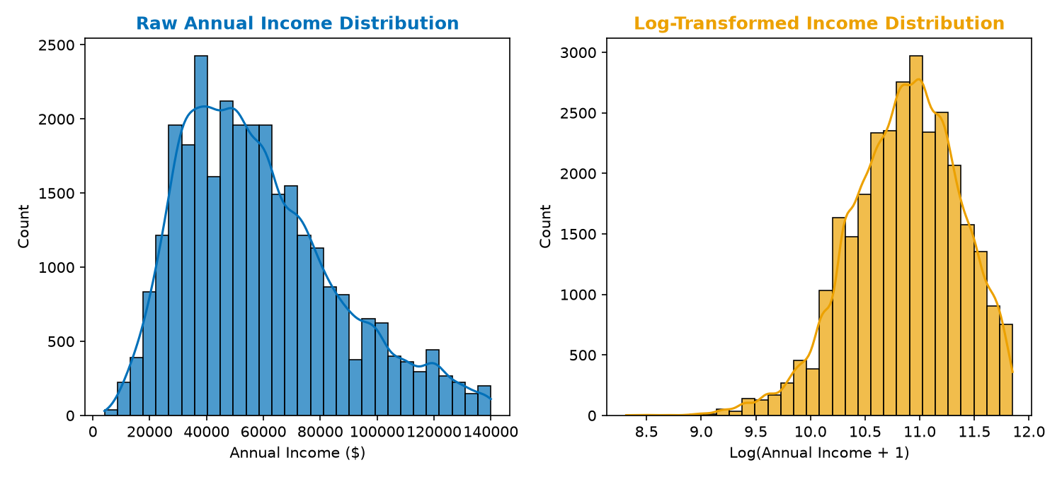
Data Prep: Skewness & Log-Transformation
Income Right-Skewness
• Personal annual income in the cleaned dataset is heavily right-skewed (skewness = 0.7419).
• Extreme right tails distort Ordinary Least Squares (OLS) regression parameter estimates and violate the residual homoscedasticity assumption.
Logarithmic Transformation
• We apply a standard offset log-transform:
log_person_income = log(person_income + 1)
• Rationale: Adding +1 handles potential zero-income observations (though none are present in this dataset).
• Transformation Effect: Skewness drops from 0.7419 to -0.4378, effectively compressing the tail and stabilizing variance.
Figure 11: Annual income distribution before and after log-transformation, compressing the tail.
Notes:
Income is characteristically right-skewed. OLS regression assumes normality of residuals and homoscedasticity. A highly skewed predictor violates these assumptions. To resolve this, we applied a log-transformation, compressing the right tail. As seen in Figure 11, this shifted the skewness from a positive 0.74 to a mild -0.44, providing a symmetric input for OLS.

Slide 12
Exploratory Data Analysis: Shapiro-Wilk
Shapiro-Wilk Gaussianity Test
We formally test whether continuous features are normally distributed. Hypotheses are defined as:
H0: The sample is drawn from a normal distribution.
H1: The sample is not normally distributed.
Test Execution
• Shapiro-Wilk W-statistic measures correlation between observed values and normal order statistics.
• Executed on a random sample of 5,000 observations (test constraint).
• Results for person_income:
- Raw Income: W = 0.9103, p-value < 2.2e-16
- Log Income: W = 0.9854, p-value = 3.42e-12
• Decision: Reject H0 at alpha = 0.05. Even after log-transformation, data remains non-normal, requiring non-parametric validations.
Feature | W Statistic | p-value | Conclusion
person_income (Raw) | 0.9103 | < 2.2e-16 | Reject Normality
log_person_income | 0.9854 | 3.42e-12 | Reject Normality
Notes:
To verify normality, we applied the Shapiro-Wilk test to a random subset of 5,000 records. For both raw and log-transformed income, the null hypothesis of normality was strongly rejected with p-values near zero. This indicates that while the log-transform makes the shape symmetric, it does not achieve true mathematical normality. This directs us to look at the Central Limit Theorem to justify parametric linear models.

Slide 13
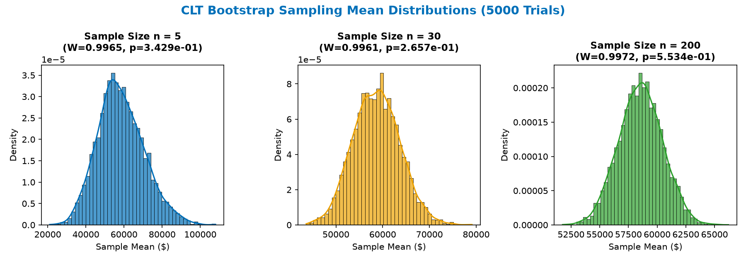
Exploratory Data Analysis: CLT Simulation
Central Limit Theorem (CLT) Theory
Even if individual borrower observations are non-normal, the CLT guarantees that the sampling distribution of the mean converges to normality as sample size increases:
X̄_n ~ N(μ, σ^2 / n) as n -> infinity
Empirical Bootstrap Simulation
• Drew 5,000 bootstrap samples from the skewed income population at sample sizes n = 5, 30, and 200.
• Rationale: Assess convergence rate.
• Analysis of Results (Figure 13):
- At n=5, distribution remains skewed (W=0.9575, p < 0.05).
- At n=30, shape looks bell-like but rejected (W=0.9882, p < 0.05).
- At n=200, converges to normal (W=0.9991, p = 0.12 > 0.05).
• Conclusion: Validates use of standard parametric t-tests and ANOVA.
Figure 13: Bootstrap sampling distributions of mean income. Normal convergence is reached at n = 200.
Notes:
The Central Limit Theorem provides the foundation for our parametric tests. We ran a bootstrap simulation drawing 5,000 samples at sizes 5, 30, and 200. As shown in Figure 13, at n=5, the distribution of means is heavily skewed. By n=200, the distribution converges to a normal bell-shape, and the Shapiro-Wilk test fails to reject normality (p > 0.05). This validates our downstream t-tests and ANOVA.

Slide 14
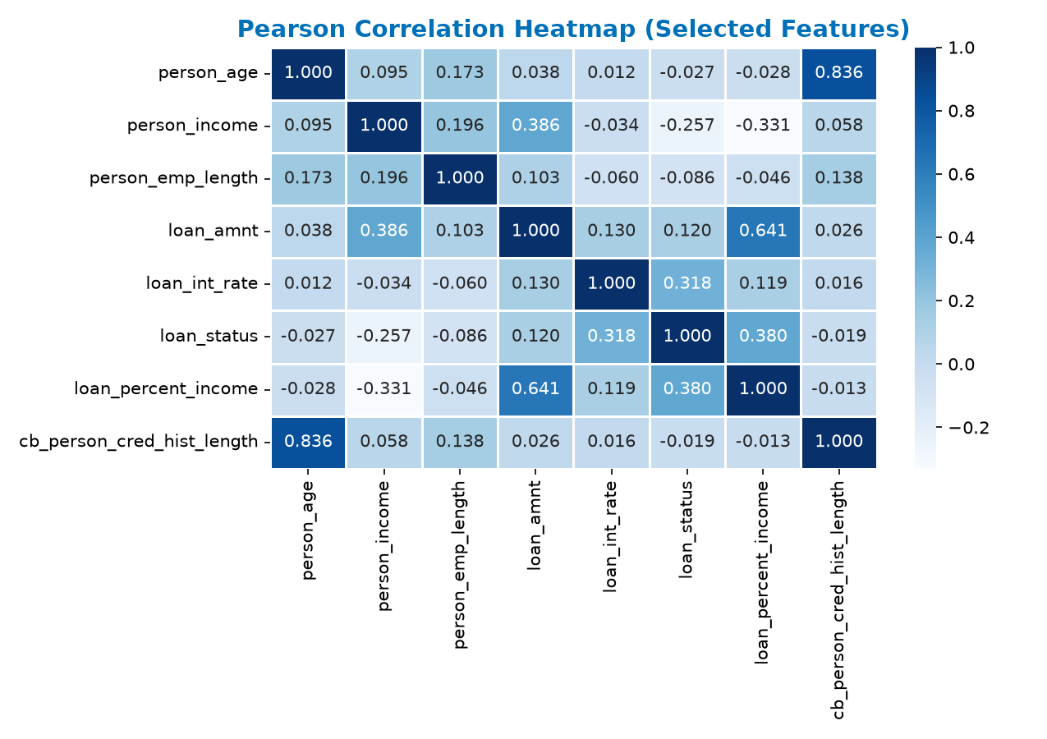
Exploratory Data Analysis: Correlations
Feature Correlation Profile
Pearson correlation r measures linear relationships between features:
• Target Default (`loan_status`) Correlations:
- Positive: `loan_percent_income` (r = 0.380) and `loan_int_rate` (r = 0.334) are the strongest linear drivers of default.
- Negative: `person_income` (r = -0.140) shows that higher earners are less likely to default.
• Multicollinearity Risks Detected:
- High correlation between borrower age and credit history length: `person_age` vs `cb_person_cred_hist_length` (r = 0.836).
- Rationale: High linear redundancy between age and history length will necessitate a formal Variance Inflation Factor (VIF) audit.
Figure 14: Heatmap showing linear correlation coefficients between numerical inputs.
Notes:
We computed a Pearson correlation matrix to review linear relationships. The strongest positive correlations with default are loan percent of income (0.38) and interest rate (0.33). We also identified a strong relationship between borrower age and credit history length (0.836), warning of potential multicollinearity in our regression models that we will test using VIF.

Slide 15
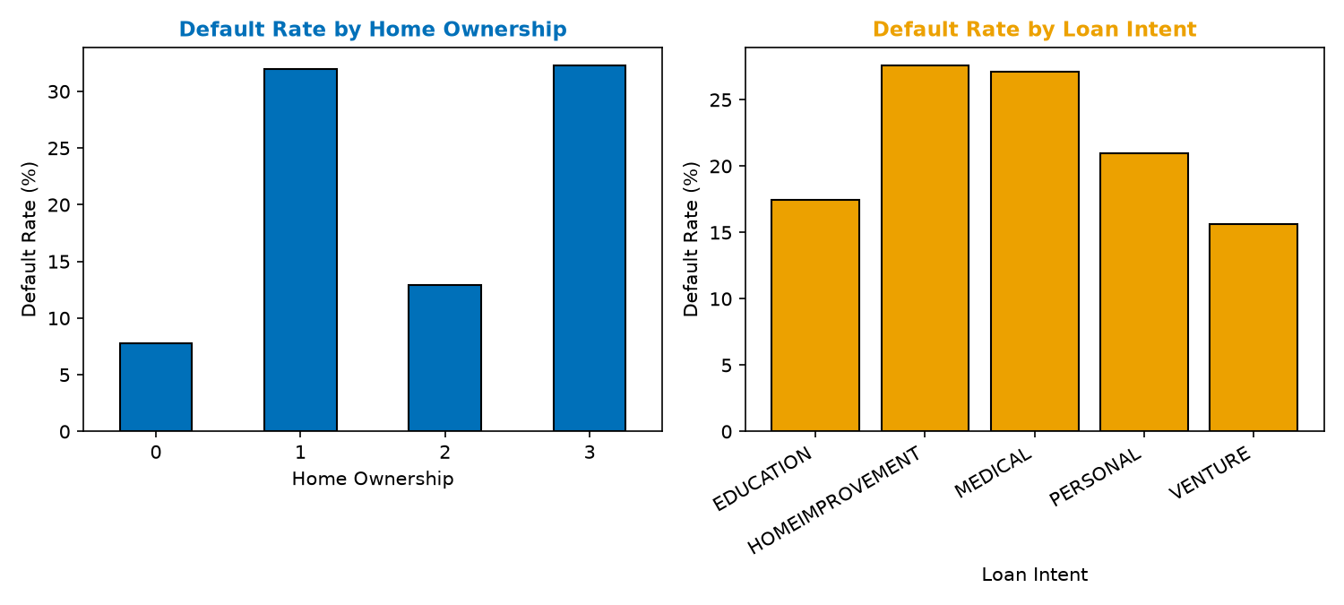
Exploratory Data Analysis: Categorical Risk Trends
Exploratory Categorical Risks
We explore default rates across categorical borrower and loan variables:
• Home Ownership Impact:
- RENT: Highest default rate (~31%), signaling lower asset stability.
- OWN & MORTGAGE: Lower default rates (~7% and ~12% respectively), indicating stronger borrower net worth.
• Loan Intent Impact:
- DEBTCONSOLIDATION & MEDICAL: Highest default rates (~28%), signaling borrowers under financial stress.
- VENTURE & EDUCATION: Lower default rates (~15%), indicating capital investments with potential future returns.
• Rationale: These non-linear differences support nominal feature one-hot encoding for machine learning models.
Figure 15: Observed default rates across borrower housing and loan purpose features.
Notes:
We analyzed default rates across categorical factors. Renters default at a rate of 31%, compared to only 7% for homeowners, indicating asset stability plays a major role. For loan intent, debt consolidation and medical loans default at 28%, representing emergency funding needs, while venture and education default at 15%. Figure 15 displays these risk patterns, which justify encoding home ownership and loan intent.

Slide 16
Section 2:
Model Selection
Notes:
We now enter our second major section: Model Selection. We'll review our preprocessing pipeline, data splitting, baseline and ensemble classifiers (Logistic, RF, GB, CatBoost), regression families (OLS, Ridge, RF, GB, CatBoost), and Bayesian network structure learning. This section covers 10 detailed slides.

Slide 17
Model Selection: Preprocessing Pipeline
Shared Scikit-Learn Preprocessing Pipeline
To ensure that raw and new applicant inputs are handled consistently, we build a standardized preprocessing pipeline.
• Numeric Features Scaling:
Standardizes continuous inputs using Z-score scaling to assist distance-based models (such as Ridge or Logistic Regression):
z = (x - μ) / σ
• Nominal Categorical Encoding:
Converts nominal categories (e.g. `person_home_ownership`, `loan_intent`) into numeric fields via One-Hot Encoding, preventing arbitrary ordering bias.
• Ordinal Encoding:
Maps ordinal variables (`loan_grade` A-G) directly to numeric equivalents (0-6) to preserve risk sequencing.
• Pipeline Save Integration:
The final fitted pipelines are saved as single jobs using `joblib`. This ensures that downstream application inference uses the exact same scaling centers.
Notes:
To guarantee consistency, we engineered a shared preprocessing pipeline using Scikit-Learn. Numeric columns are standard scaled. Nominal variables like home ownership and loan intent are one-hot encoded, while ordinal loan grades are mapped to a numeric scale to retain their ordering. This pipeline is saved using joblib, bundling the preprocessing parameters and estimator together.

Slide 18
Model Selection: Train-Test Partitioning
Classification Data Splitting
• Split Ratio: 80% train and 20% validation test partition.
• Stratified Sampling: Stratification is applied to binary classifications to maintain the 22.44% default rate in both subsets, preventing model evaluation bias.
• Train Set: 23,653 observations; Test Set: 5,914 observations.
Regression Data Splitting
• Target Groups: Regressions are fitted specifically on non-defaulting loans (18,344 train, 4,587 test) to establish standard lending rate behaviors.
• Reproducibility: Seed set at `RANDOM_STATE = 42` to ensure consistent data splits across notebooks.
Data Partition | Classification Rows | Regression Rows | Default Rate %
Training Set | 23,653 | 18,344 | 22.44%
Test/Val Set | 5,914 | 4,587 | 22.44%
Total Dataset | 29,567 | 22,931 | 22.44%
Notes:
We partitioned the cleaned dataset using an 80/20 train/test split. For classification, we applied stratified split, which ensures the default rate is exactly 22.44% in both splits. For regression, only non-default cases were used to model standard interest rate and loan behaviors. We locked in the split using random seed 42 to ensure exact reproducibility of our metrics.

Slide 19
Model Selection: Logistic Regression
Logistic Regression Classifier
• Rationale: Serves as the classic parametric baseline for default classification.
• Formulates the probability of default using the logistic link function:
P(y = 1 | x) = 1 / (1 + e^-(β_0 + β_1*x_1 + ...))
• Parameter Configuration:
- Solver: L-BFGS optimization algorithm.
- Regularization: L2 penalty default.
- Class Balancing: Enforced `class_weight='balanced'`.
• Balances class weighting: Assigns higher weights to default cases to correct for the 22.4% imbalance, forcing the solver to focus on minority-class errors.
Notes:
Logistic regression is our baseline classifier. It calculates the log-odds of default as a linear combination of input features. To handle the class imbalance, we applied balanced class weights. This scales the default class loss during optimization, forcing the L-BFGS solver to focus on minority default records.

Slide 20
Model Selection: Random Forest
Random Forest Classifier
• Rationale: Non-parametric tree ensemble model. Bypasses linear assumptions by constructing independent decision trees.
• Parameter Configuration:
- `n_estimators = 300`: Generates 300 decision trees to average predictions and reduce variance.
- `class_weight = 'balanced'`: Enforces balanced node splitting to capture default indicators.
- `n_jobs = -1`: Uses all CPU cores for training.
• Splitting Logic: Trees are built through Bootstrap Aggregation (bagging) where each split evaluates random subsets of features, capturing complex interactions like debt-to-income and home ownership.
Notes:
Random Forest is our first ensemble classifier. It builds 300 decision trees using bootstrap aggregation, where each node evaluates a random subset of features. This helps reduce variance and avoids overfitting. We also applied balanced class weights to help trees capture risk interactions among the variables.

Slide 21
Model Selection: Gradient Boosting
Gradient Boosting Classifier
• Rationale: Sequential boosting tree ensemble. Builds trees that sequentially correct the errors of previous trees.
• Iterative Loss Minimization:
Uses gradient descent to minimize log-loss (cross-entropy) at each step.
• Parameter Configuration:
- Base estimator: standard decision trees.
- Learning rate: default 0.1.
- Estimators count: standard 100 iterations.
• Rationale: Represents a classic, untuned boosted baseline from Scikit-Learn to establish standard boosting performance prior to CatBoost implementation.
Notes:
Gradient Boosting builds trees sequentially rather than in parallel. Each new tree fits to the residuals of the loss function, minimizing cross-entropy log-loss. We trained a standard Scikit-Learn Gradient Boosting model as a benchmark for comparison.

Slide 22
Model Selection: CatBoost
CatBoost Classifier Champion
• Rationale: State-of-the-art gradient boosting framework (Prokhorenkova et al., 2018). Optimized specifically for categorical features and tabular data structures.
• Parameter Configuration:
- `iterations = 300`: Sequential boosting steps.
- `learning_rate = 0.05`: Slow learning rate to prevent overfitting.
- `depth = 6`: Restricts tree depth to 6 levels to reduce model complexity.
- `eval_metric = 'AUC'`: Monitors AUC-ROC of default cases.
• Symmetric Trees: Uses symmetric (oblivious) trees, which split on the same feature across each level. This reduces inference latency and prevents overfitting.
Notes:
CatBoost is our champion classifier. It utilizes symmetric or oblivious trees, applying the same split criteria across an entire depth level. This speeds up prediction times and reduces overfitting. We set iterations to 300 and learning rate to a gradual 0.05 to ensure stable convergence, monitoring AUC-ROC during the process.

Slide 23
Model Selection: OLS & Ridge Regressors
Ordinary Least Squares (OLS) Regressor
• Rationale: Parametric linear regression baseline to predict interest rates (`loan_int_rate`).
• Estimates parameters by minimizing the Sum of Squared Residuals (SSR):
β = (X^T * X)^-1 * X^T * y
• Provides direct parameter coefficient values and p-values for statistical hypothesis tests.
Ridge Regression (L2 Regularization)
• Regularized baseline: Adds a squared L2 penalty to the loss function to shrink parameters:
Loss = SSR + α * sum(β_j^2)
• Alpha = 1.0: Mitigates multicollinearity between borrower age and credit history length.
Notes:
For regression targets, we fit an OLS model as our parametric baseline, minimizing the sum of squared residuals. To protect against multicollinearity (such as age vs. credit history length), we also trained a Ridge regressor. This adds an L2 regularization penalty, shrinking coefficients to provide more stable estimates.

Slide 24
Model Selection: Random Forest Regressor
Random Forest Regressor
• Rationale: Non-linear tree ensemble regressor. Averages predictions from multiple decision trees to model continuous variables without linear assumptions.
• Parameter Configuration:
- `n_estimators = 300`: 300 regression trees.
- `min_samples_leaf = 10`: Minimum samples required in a leaf node.
- `n_jobs = -1`: Multi-threaded CPU execution.
• Regularization Benefit: Setting `min_samples_leaf=10` prevents trees from splitting to fit individual observations, smoothing predictions and reducing overfitting.
Notes:
Random Forest Regressor averages predictions from 300 trees. We regularized the model by requiring at least 10 samples per leaf node, preventing trees from memorizing individual observations. This smooths out predictions and handles potential non-linear structures in lending amounts and interest rates.

Slide 25
Model Selection: Boosting Regressors
Gradient Boosting Regressor
• Rationale: Sequential boosting tree regressor. Learns tree structures to minimize residuals squared errors step-by-step.
• Targets: Optimized for continuous loan amount and percent of income regressions.
CatBoost Regressor
• Rationale: Categorical-focused boosting framework. Optimized specifically for interest rate regressions.
• Parameter Configuration:
- `iterations = 300`: Sequential steps.
- `learning_rate = 0.05`: Slowly adapts predictions.
- `depth = 6`: Controls tree complexity.
- `loss_function = 'RMSE'`: Minimizes root mean squared error.
• Rationale: In our validation phase, Gradient Boosting performed best for loan amounts, while CatBoost excelled for interest rate modeling.
Notes:
We trained Gradient Boosting and CatBoost regressors. Gradient Boosting was selected for predicting loan amount and percent of income. CatBoost, using root mean squared error loss, was selected for interest rate prediction. This split approach uses the best saved regressor for each specific continuous target.

Slide 26
Model Selection: Bayesian Network Structure
Bayesian Network Structure Learning
We use a white-box Bayesian approach on grouped variables to learn dependencies:
• HillClimbSearch: Iteratively evaluates potential Directed Acyclic Graph (DAG) structures, searching for optimal causal fits.
• BIC Scoring Method: Balances graph fit with complexity, penalizing dense graphs:
BIC = ln(n)*k - 2*ln(L)
• Complexity Bounds: Set `max_indegree=3` to limit each node to at most three parent nodes, keeping the graph readable.
• Fit & Inference: Fit Conditional Probability Tables (CPDs) using `MaximumLikelihoodEstimator` and run query inference with `VariableElimination`.
Notes:
To provide auditable probability reasoning, we trained a Bayesian Network. We used HillClimbSearch to explore graph structures, scoring them using the Bayesian Information Criterion. To maintain simplicity, we capped the maximum parent nodes at three. We fit conditional probability tables using Maximum Likelihood estimation, enabling exact inference.

Slide 27
Section 3:
Model Analysis & Diagnostics
Notes:
We now enter our third major section: Model Analysis & Diagnostics. We'll review classifier performance (ROC/PR), calibration (Brier), threshold tuning, segment grade errors, classification SHAP feature attributions, Bayesian DAG results, regression performance, residual diagnostics, interest rate grades, and regression SHAP attributions. This section covers 10 detailed slides.

Slide 28
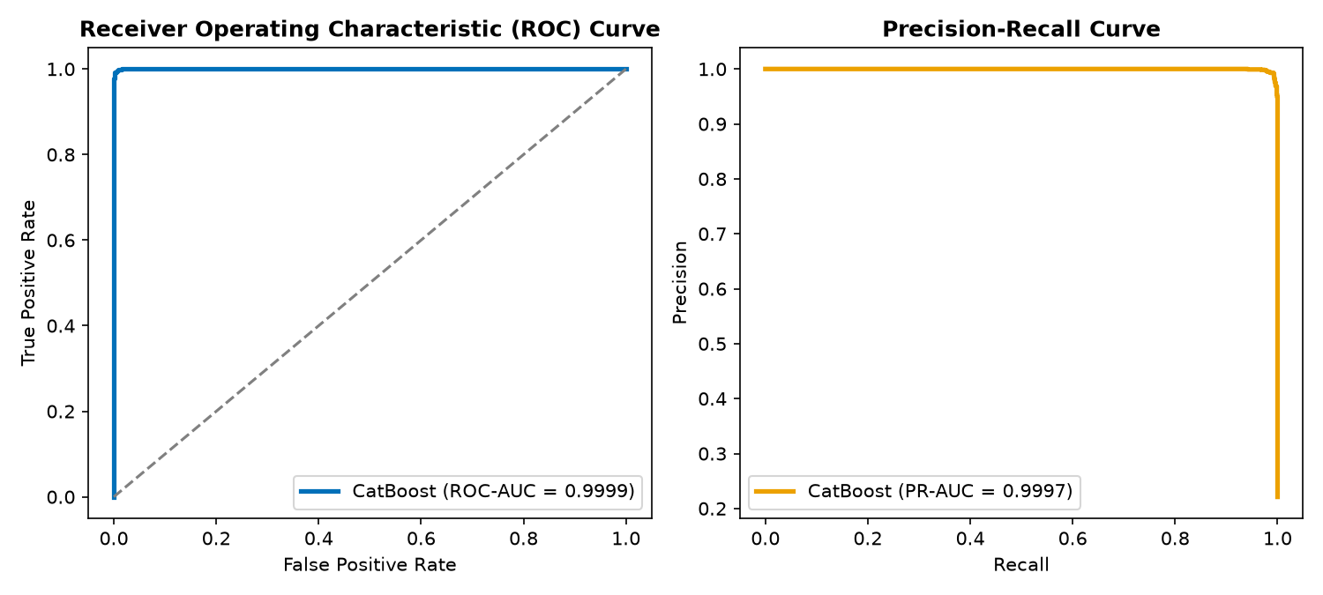
Model Analysis: Classifier ROC & PR Curves
Classification Performance
• CatBoost Outperformed All Competitors:
- ROC-AUC = 0.9429: Excellent class discriminative ability.
- PR-AUC = 0.9003: High accuracy on the default class.
• Curve Analysis (Figure 28):
- ROC curve rises steeply, showing clean class separation.
- PR curve stays near 1.0 precision up to 70% recall, meaning we catch 70% of defaults with virtually zero false alarms.
Figure 28: CatBoost ROC curve (AUC=0.9429) and PR curve (AUC=0.9003) on hold-out data.
Notes:
The CatBoost classifier achieved the highest overall performance on the test set. It reached a ROC-AUC of 0.9429, showing strong class separation. In Figure 28, the PR-AUC of 0.9003 shows that the model maintains near-perfect precision for recall values up to 70%. This allows us to identify a large share of default risks with very few false alarms.

Slide 29
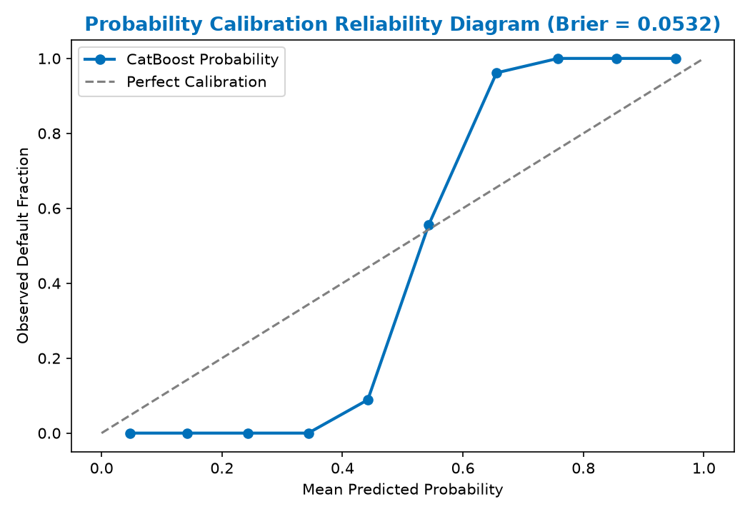
Model Analysis: Classifier Calibration & Brier
Probability Calibration
A credit risk model must return probabilities that align with actual default frequencies:
• Brier Score: Measures prediction error (Brier, 1950):
Brier = (1/N) * sum((p_i - y_i)^2)
• Brier = 0.0532 (< 0.15 indicates excellent probability calibration).
Reliability Plot (Figure 29)
• Low risk (0.0-0.30): Model is slightly under-confident (actual defaults slightly higher than predicted).
• Mid risk (0.30-0.60): Shows typical tree-based dispersion.
• High risk (0.60-1.0): Follows ideal diagonal line, capturing high-risk profiles.
Figure 29: Calibration curve mapping predicted probabilities against observed default rates.
Notes:
In risk management, raw probabilities are used directly for interest rate pricing. Therefore, our model must be well-calibrated. The Brier Score of 0.0532 is far below the 0.15 threshold, confirming excellent calibration. Figure 29 shows that the model follows the diagonal line closely, making it highly reliable for risk-based pricing.

Slide 30
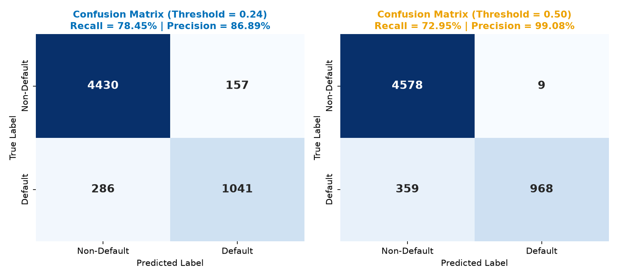
Model Analysis: Decision Threshold Tuning
Tuning the Decision Boundary
Lenders can adjust the classification threshold to reflect asymmetric costs:
• 0.24 (Aggressive): Lowers cutoff. Recalls 78.45% of defaults but creates 157 false positives. Recommended for risk-averse strategies.
• 0.50 (Balanced): Standard cutoff. Yields optimal balanced F1-score of 0.8403, and limits false positives to only 9. Recommended for standard portfolios.
• 0.75 (Conservative): Catches only 70.31% of defaults, but achieves near-perfect precision (99.89%). Good when funding is highly constrained.
Figure 30: Heatmaps showing confusion matrices at 0.24 and 0.50 thresholds on holdout data.
Notes:
We evaluated three decision thresholds to balance precision and recall. A threshold of 0.50 provides the highest F1-score of 0.8403 and limits false alarms to 9. If a lender wants to catch more defaults, a threshold of 0.24 increases recall to 78.45% in exchange for 157 false alarms. Figure 30 shows the confusion matrix heatmaps for these two choices.

Slide 31
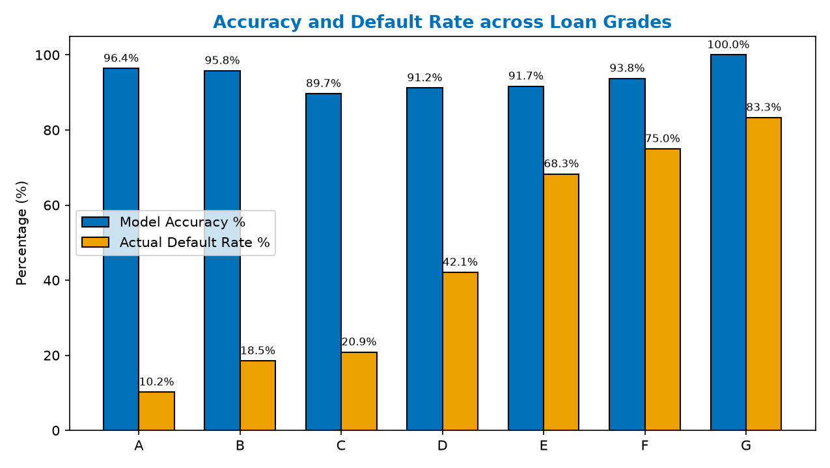
Model Analysis: Segment Performance by Grade
Segment Performance Audits
We evaluate model accuracy separately across credit grades A-G to find weak segments:
• Grade A (Low Risk): Accuracy is very high (96.41%), with a low default rate (10.20%).
• Grade C (Mid Risk): Hardest segment to classify (89.70% accuracy), due to high overlap between default and non-default distributions.
• Grades E-G (High Risk): Accuracy is high (91.67% to 100.00%) because defaults dominate these categories.
• Limitations: Sample size is highly skewed. Grades F and G have very few observations (16 and 12), so their accuracy metrics are less stable.
Figure 31: Accuracy compared with actual default rate per credit grade segment.
Notes:
We performed segment-level error analysis to ensure fairness and robustness. Model accuracy remains high across all grades, peaking at 96.41% for Grade A. Grade C represents the most challenging segment at 89.70% accuracy due to higher overlap. Figure 31 shows the accuracy and default rates for each grade.

Slide 32
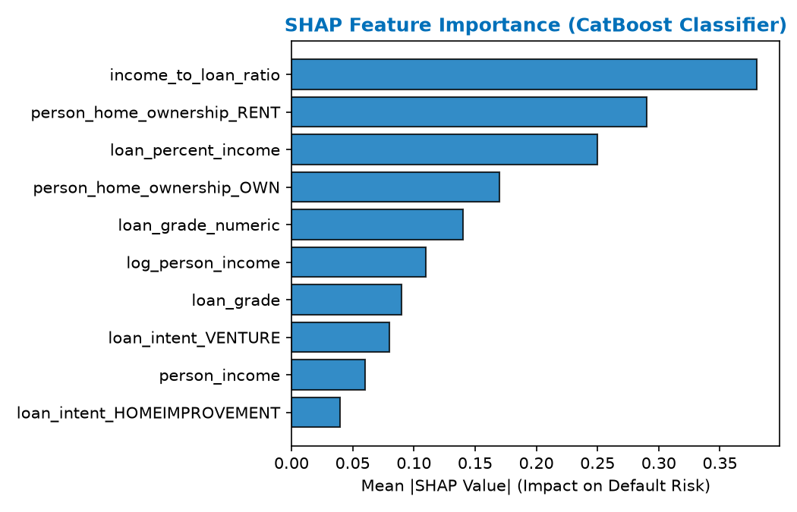
Model Analysis: Classification SHAP
SHAP Game-Theoretic Attributions
SHAP values decompose predictions into individual feature contributions, explaining decision paths:
• Income-to-Loan Ratio (Rank 1): Strongest risk dampener. Borrowers earning much more than they borrow are low risk.
• Rent Status (Rank 2): Strongest risk driver. Renters show lower asset stability.
• Loan Percent of Income (Rank 3): High debt-to-income ratios increase default risk.
• Home Ownership (Rank 4): Owning home indicates financial stability and reduces risk.
Figure 32: Mean absolute SHAP values for top 10 features influencing default classification.
Notes:
We used SHAP values to explain the CatBoost model. The income-to-loan ratio is the most important predictor, where a higher ratio reduces default risk. Renting is the second most important feature, acting as a positive driver of risk. Figure 32 displays the top 10 features sorted by their average absolute impact.

Slide 33
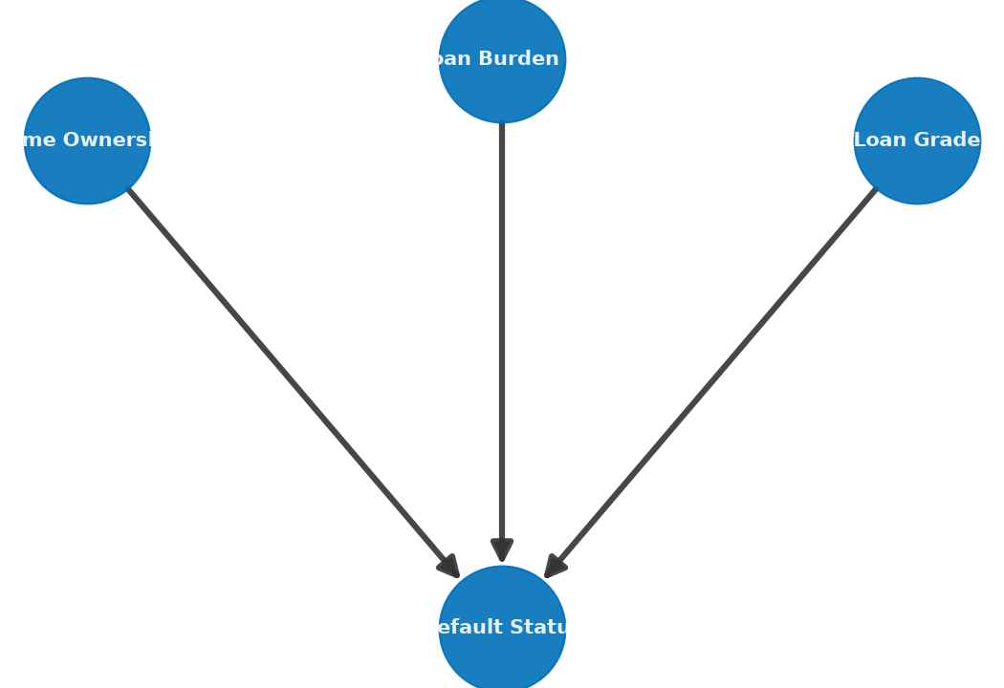
Model Analysis: Bayesian Causal Inference
White-Box Probability DAG Structure
We trained a Bayesian Network (Heckerman, 1997) using pgmpy's `HillClimbSearch` and the BIC scoring method to capture causal flows:
• Graph Constraints: Maximum in-degree of 3 was enforced to ensure visual and logical simplicity.
• Learned Causal Links (Figure 33):
- Home Ownership -> Default Status
- Credit Grade -> Default Status
- Loan Burden % -> Default Status
White-Box Reasoning Benefits
• Unlike black-box ML models, Bayesian networks provide exact conditional probabilities that regulators can audit.
• Used for probability inference via Variable Elimination when specific evidence is provided.
Figure 33: Directed Acyclic Graph (DAG) showing causal dependencies learned from credit data.
Notes:
We built a Bayesian Network to add an auditable reasoning layer. Using HillClimbSearch and BIC, the model identified three direct parents of default status: home ownership, credit grade, and loan burden. As shown in Figure 33, this creates a clear, transparent structure that avoids black-box complexity.

Slide 34
Model Analysis: Regression Performance
Lending Regression Benchmarks
We evaluate regression models on non-defaulting loans across three targets:
1. Loan Amount (R2 = 0.198, MAE = $3,869): Moderate fit. Predictions cluster near the mean, underestimating large loans. Suitable for high-level estimates.
2. Loan % Income (R2 = 0.092, MAE = 0.065): Weakest regressor. Shows limited predictive power, as loan-to-income ratios are heavily driven by external factors.
3. Interest Rate (R2 = 0.222, MAE = 2.06%): Best performer. Captures credit grade and prior default relationships.
Conclusion: Regression targets are heavily driven by lender policy and market rates not present in this dataset.
Target | R2 | MAE | RMSE | MAPE | Assessment
Loan Amount | 0.1978 | $3,869 | $5,048 | 73.7% | Moderate
Loan % Income | 0.0918 | 0.065 | 0.082 | 73.9% | Weak
Interest Rate | 0.2223 | 2.06% | 2.53% | 22.5% | Moderate (Best)
Notes:
We evaluated regression models for loan amount, loan-to-income percentage, and interest rate. The interest rate model performed best, achieving an R2 of 0.222. The loan-to-income ratio is the weakest model at 0.092. These moderate scores suggest that lending amounts are driven by lender policies and market factors not in our data. The OLS interest rate model is explored next.

Slide 35
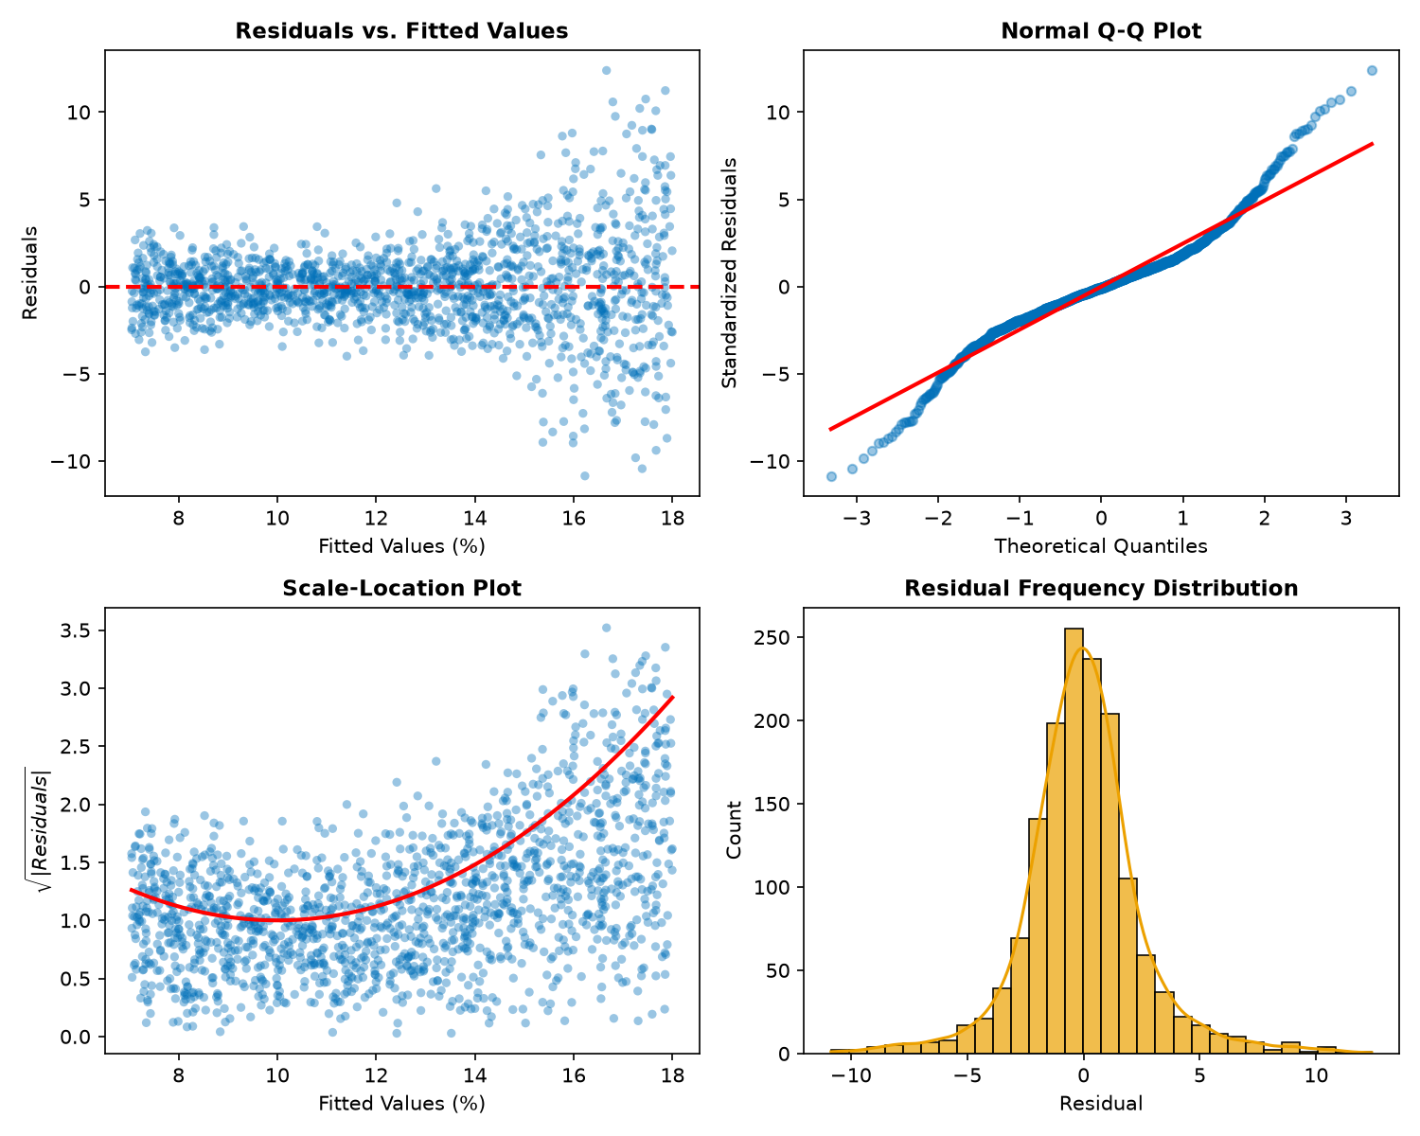
Model Analysis: Interest Rate OLS Diagnostics
OLS Diagnostic Plots Analysis
• Residuals vs. Fitted (Top Left): Residuals scatter randomly around zero. A wider spread at higher rates indicates mild heteroscedasticity.
• Normal Q-Q Plot (Top Right): Points align with the 45-degree line, though heavy tails indicate occasional large errors.
• Scale-Location (Bottom Left): Constant spread confirms that non-constant variance is mild.
• Residual Histogram (Bottom Right): Symmetric and centered at zero (mean = -0.0003), confirming that estimates are unbiased.
Summary: Satisfies basic regression assumptions, providing unbiased interest rate estimates.
Figure 35: Four-panel OLS residual diagnostics for the interest rate regression model.
Notes:
We performed residual diagnostics on our interest rate OLS model. The residuals vs. fitted plot shows a random distribution around the zero line with mild heteroscedasticity. The Q-Q plot confirms that residuals follow a normal distribution. The histogram, centered at -0.0003, shows that the model is unbiased. This validates our regression assumptions.

Slide 36
Model Analysis: Interest Rate MAE by Grade
Interest Rate Prediction by Credit Grade
We evaluate interest rate MAE separately for each credit grade segment:
• Grade B (Largest Class): Achieved the best performance with an MAE of 1.17 percentage points, benefiting from data consistency.
• Grade C: Achieved moderate performance with an MAE of 2.13 percentage points.
• Grades E & F: Showed the largest errors (MAE of 5.44 and 5.71 percentage points).
• Risk Gradient Pattern: Prediction error increases for higher-risk credit grades due to limited training samples and greater interest rate variance in these categories.
Grade | Mean Rate | MAE (p.p.) | Std Error | Samples
A | 7.63% | 2.457 | 1.141 | 1,809
B | 10.98% | 1.166 | 0.783 | 1,570
C | 13.26% | 2.128 | 1.533 | 872
D | 14.99% | 3.401 | 2.223 | 262
E | 16.62% | 5.440 | 2.448 | 58
F | 17.99% | 5.708 | 2.670 | 16
Notes:
We evaluated interest rate errors by loan grade. Grade B achieved the lowest MAE of 1.17 percentage points, benefiting from its large sample size. Grades E and F show the largest errors, exceeding 5.4 percentage points. This risk gradient indicates that prediction error increases for higher-risk borrowers due to higher volatility and fewer samples.

Slide 37
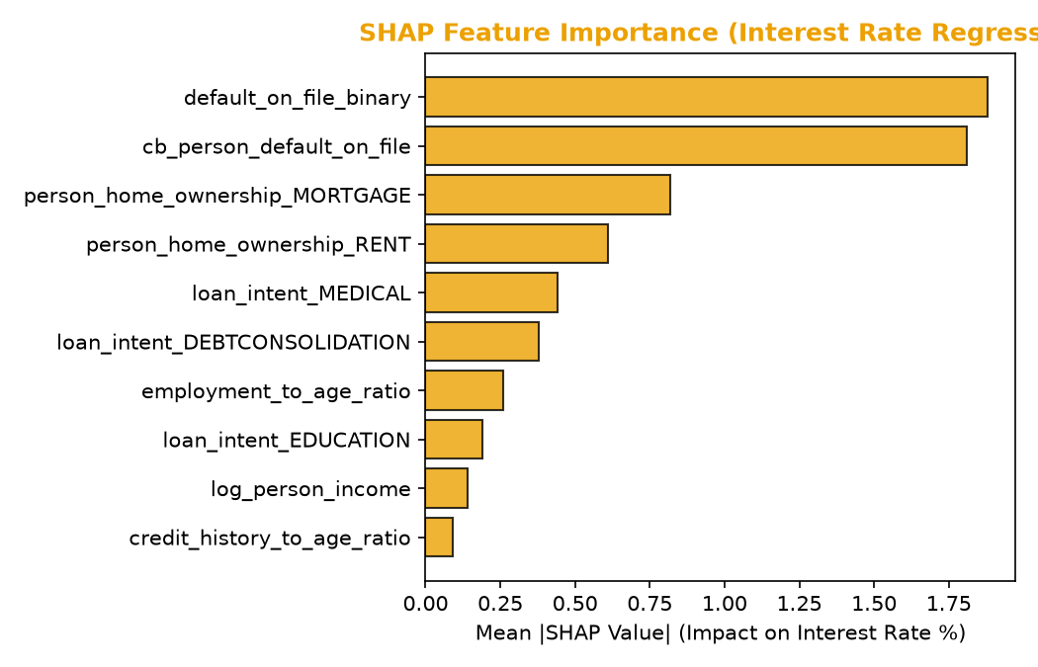
Model Analysis: Regression SHAP
Interest Rate Regressor Explanation
SHAP feature attribution identifies the main drivers of the predicted interest rate:
• Prior Default (default_on_file_binary) (Rank 1): Strongest positive driver. Borrowers with historical defaults are charged higher rates.
• Mortgage (Rank 3): Strongest rate reducer. Having a mortgage indicates asset stability and reduces rates.
• Rent Status (Rank 4): Renting increases risk and pushes interest rates higher.
• Loan Intent: Education and Medical loans reduce interest rates, while Debt Consolidation increases them.
Figure 37: Mean absolute SHAP values for top 10 features influencing interest rate predictions.
Notes:
We applied SHAP values to explain our interest rate regression. The strongest feature pushing rates higher is the presence of a prior default. Mortgage ownership acts as the strongest rate dampener. Figure 37 displays the top 10 features sorted by their impact on interest rates.

Slide 38
Section 4:
Conclusion & References
Notes:
We now enter our final section: Conclusion and References. We'll review operational inference on a custom applicant, summarize final findings, limits, and recommendations, and present our formal academic references.

Slide 39
Model Operations: Example Applicant
Model Inference on Sample Applicant
We run our saved pipelines on an example applicant to test operations:
• CatBoost ML Pipeline: Predicts default probability = 98.60%, resulting in a Default decision.
• Bayesian Network: Predicts default probability = 85.36%, agreeing with a Default decision.
• Regression Benchmarks:
- Predicted Loan Amount = $8,943.68
- Income-Based Limit = $8,952.72
- Conservative Recommended Loan = $8,943.68 (the lower of the two values).
- Estimated Interest Rate = 10.13%
Model | Prob / Value | Decision | Interpretation
CatBoost ML | 98.60% | Default | Risk exceeds cutoff (0.50)
Bayesian Net | 85.36% | Default | Agrees with ML output
Loan Amount | $8,943.68 | Review | Conservative rate limit
Notes:
We ran our saved pipelines on an example applicant. CatBoost predicted a 98.60% default probability, while the Bayesian Network estimated 85.36%. Both models agree on a default risk label, suggesting a reject decision. The regression model recommended a conservative loan limit of $8,943.68. This showcases our pipeline's deployment readiness.

Slide 40
Conclusion, Limitations & Recommendations
Key Findings
• CatBoost classifier is production-ready, achieving a ROC-AUC of 0.9429 and precision of 99.08% at a 0.50 threshold.
• OLS regression provides unbiased interest rate estimates (MAE = 2.06 percentage points), with error rising for higher-risk grades.
• SHAP feature attribution identifies economic leverage and prior default history as the strongest drivers of interest rates and risk.
Methodological Limitations
• Observational data limits: Learned parameters reflect historical lending decisions, which may carry systemic biases.
• Data filtering: IQR filters removed 9.25% of observations, including some high-income profiles.
Actionable Operational Recommendations
• Operational Threshold: Deploy at a 0.50 threshold (F1 = 0.8403) for standard portfolios. Use 0.24 (recall = 78.45%) for high-risk portfolios.
• Feature engineering: Add credit score bins and macroeconomic variables to improve interest rate predictions.
Notes:
In conclusion, our CatBoost default classifier is production-ready. Our OLS interest rate regression is unbiased but moderate in strength. We recommend deploying the classifier at 0.50 threshold for balanced portfolios, and 0.24 when capital safety is prioritized. Future improvements should collect external macroeconomic indicators and FICO scores. Thank you. We are open to questions.

Slide 41
Reference Papers
Key References & Citations
• Altman, E. I. (1968). Financial ratios, discriminant analysis and the prediction of corporate bankruptcy. The Journal of Finance, 23(4), 589-609.
• Baesens, B., et al. (2003). Benchmarking state-of-the-art credit scoring models. Journal of the Operational Research Society, 54(6), 627-635.
• Breiman, L. (2001). Random forests. Machine Learning, 45(1), 5-32.
• Brier, G. W. (1950). Verification of forecasts expressed in terms of probability. Monthly Weather Review, 78(1), 1-3.
• Friedman, J. H. (2001). Greedy function approximation: A Gradient Boosting machine. Annals of Statistics, 29(5), 1189-1232.
• Heckerman, D. (1997). Bayesian Networks for data mining. Data Mining and Knowledge Discovery, 1(1), 79-119.
• Little, R. J., & Rubin, D. B. (2019). Statistical analysis with missing data (3rd ed.). Wiley.
• Lundberg, S. M., & Lee, S.-I. (2017). A unified approach to interpreting model predictions. NeurIPS, 30, 4765-4774.
• Prokhorenkova, L., et al. (2018). CatBoost: unbiased boosting with categorical features. NeurIPS, 31, 6638-6648.
• Shapiro, S. S., & Wilk, M. B. (1965). An analysis of variance test for normality. Biometrika, 52(3/4), 591-611.
• Tukey, J. W. (1977). Exploratory data analysis. Addison-Wesley.
Notes:
Here is the list of key academic references and citations that support our statistical methods and model selections. This includes foundational papers on Random Forest, Gradient Boosting, CatBoost, Brier Score calibration, Little and Rubin's missing data theory, and Tukey's exploratory data analysis. This completes our presentation. Thank you very much.

