Slide 1
why javascript crypto sucks
and why it sucks less with
bring-your-own-data

Slide 2
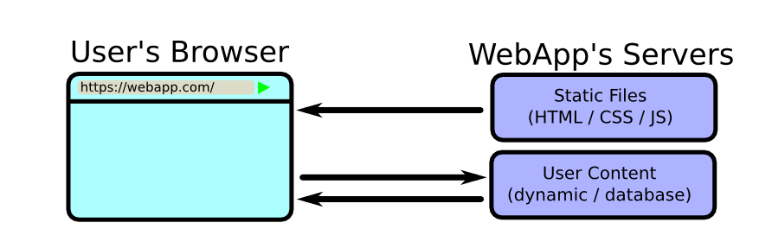
typical webapp flow

Slide 3
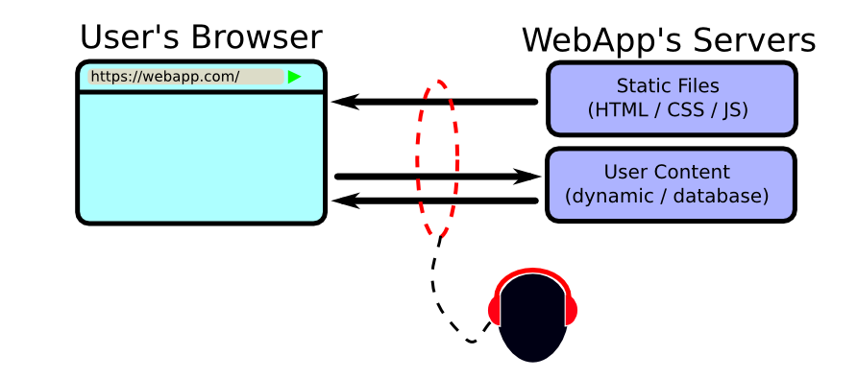
easy to tap

Slide 4
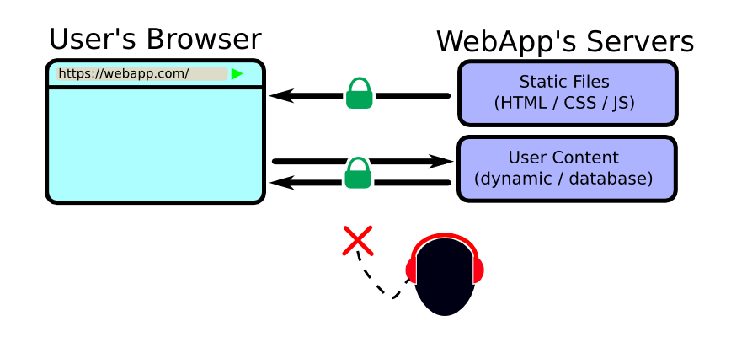
https to the rescue

Slide 5
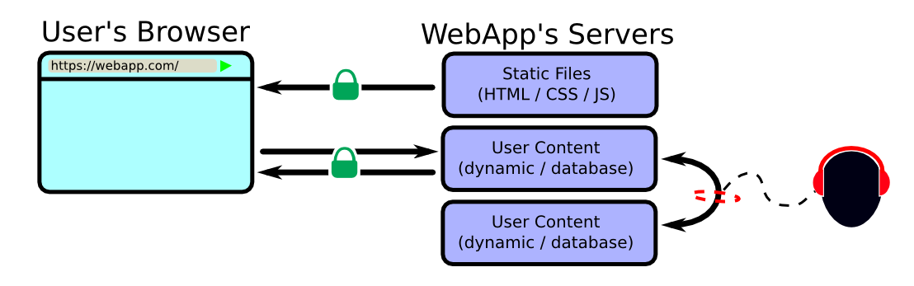
intra-company taps

Slide 6
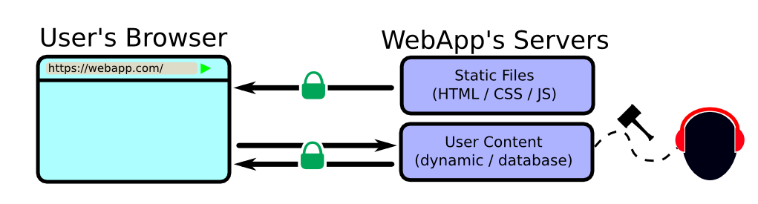
secret blanket court orders

Slide 7
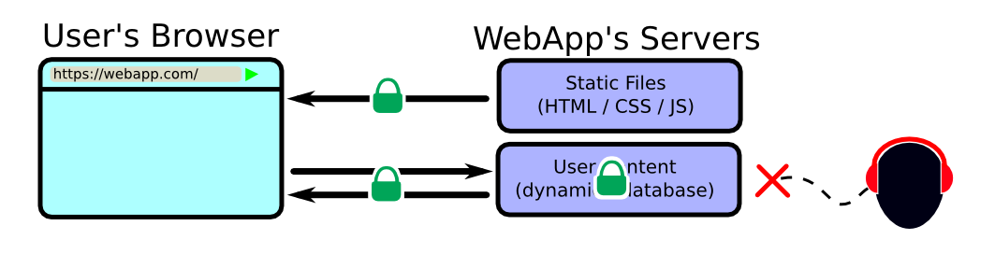
internal encryption to the rescue

Slide 8
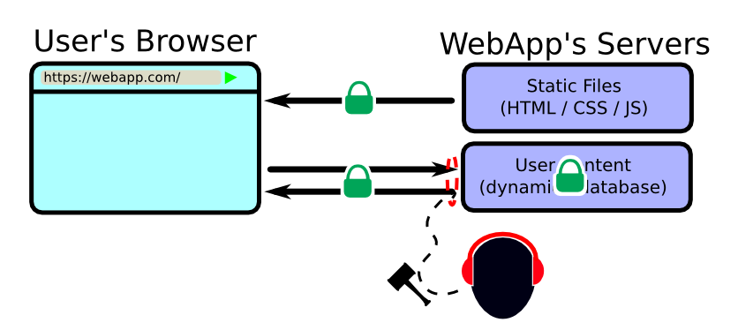
get ssl key via court order

Slide 9
end of confirmed attacks

Slide 10
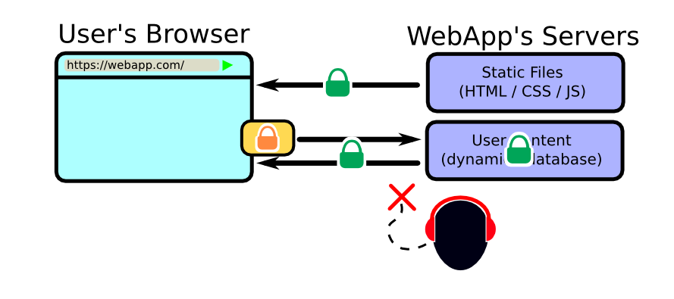
end-to-end encryption to the rescue

Slide 11
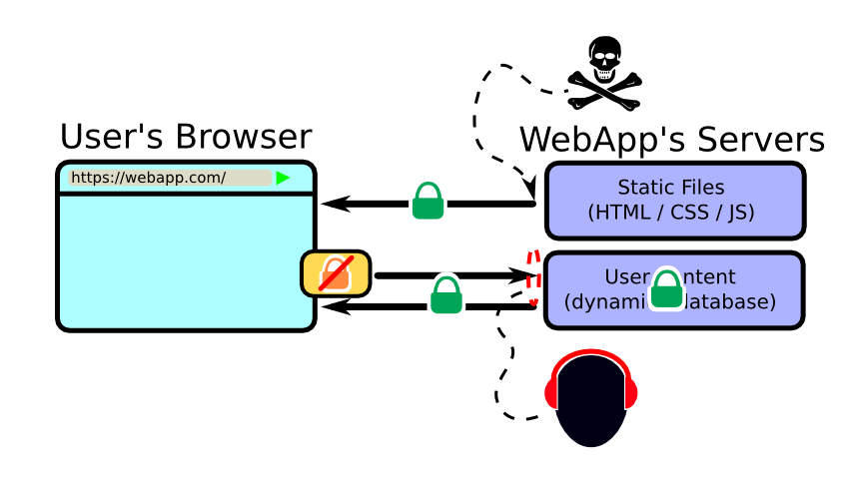
malicious javascript injection

Slide 12
fundamental flaw of js crypto

Slide 13
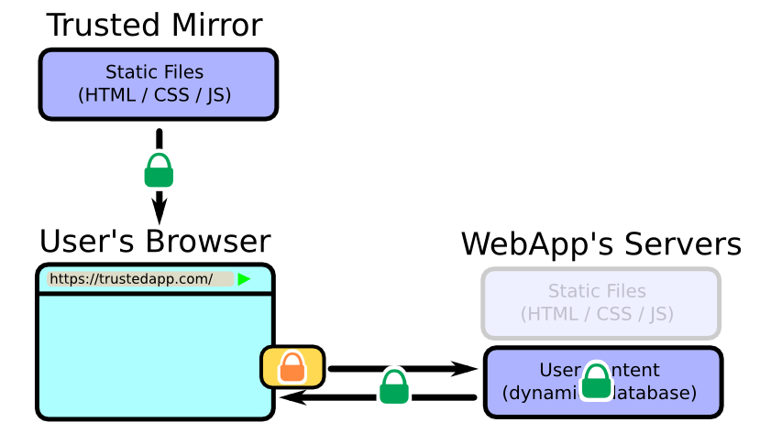
BYOD to the rescue

Slide 14
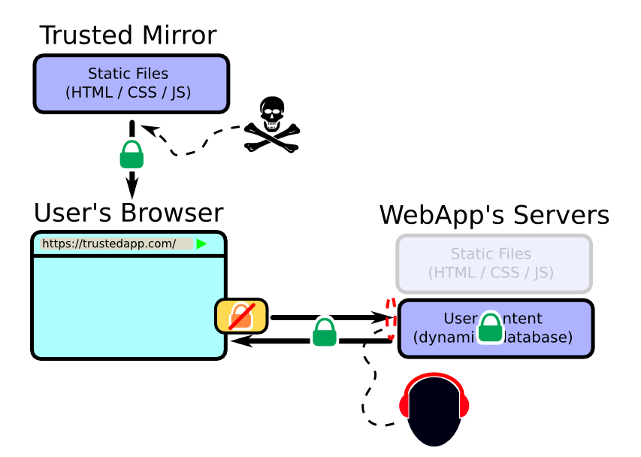
same fundamental flaw

Slide 15
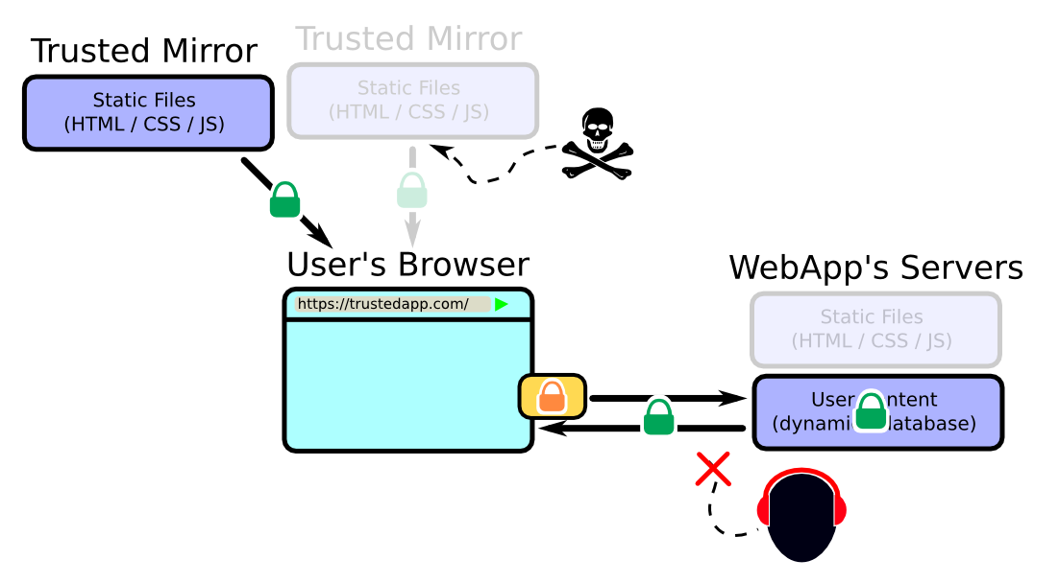
game of cat and mouse

Slide 16
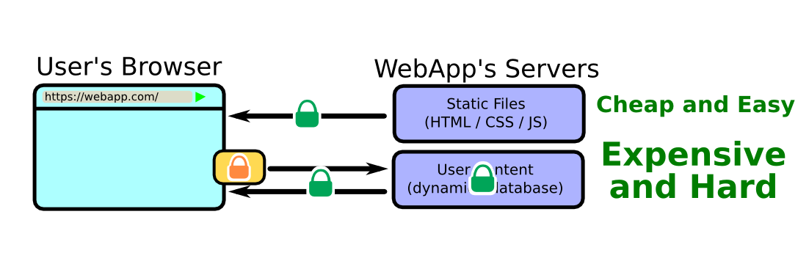
let's talk about money

Slide 17
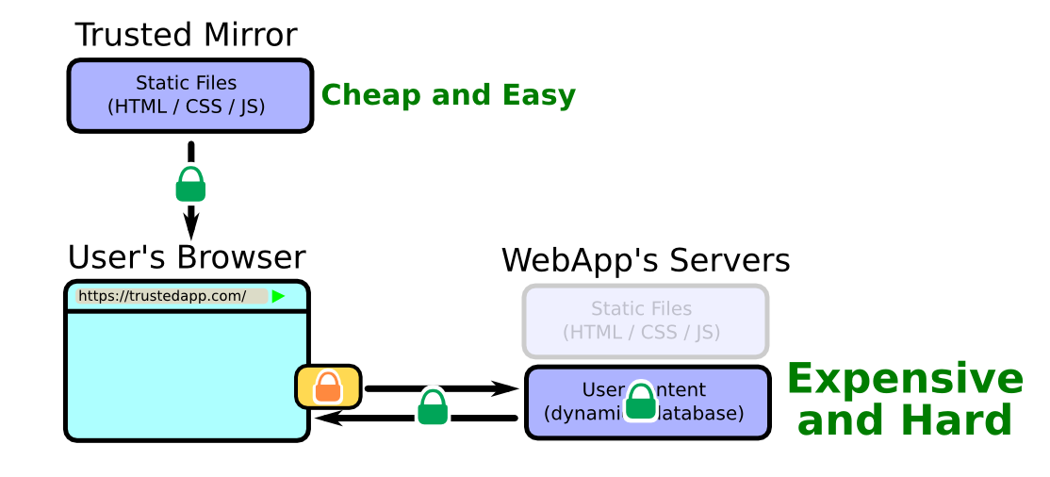
let's talk about money

Slide 18
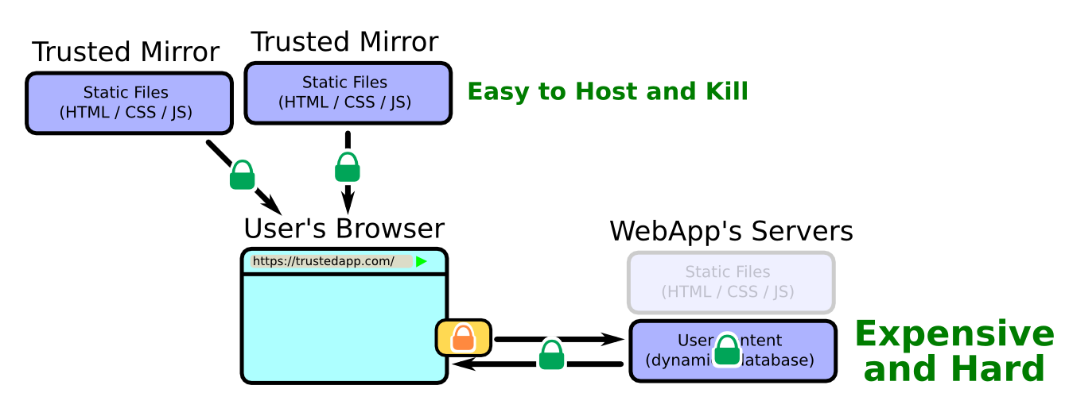
easy to host and kill

Slide 19
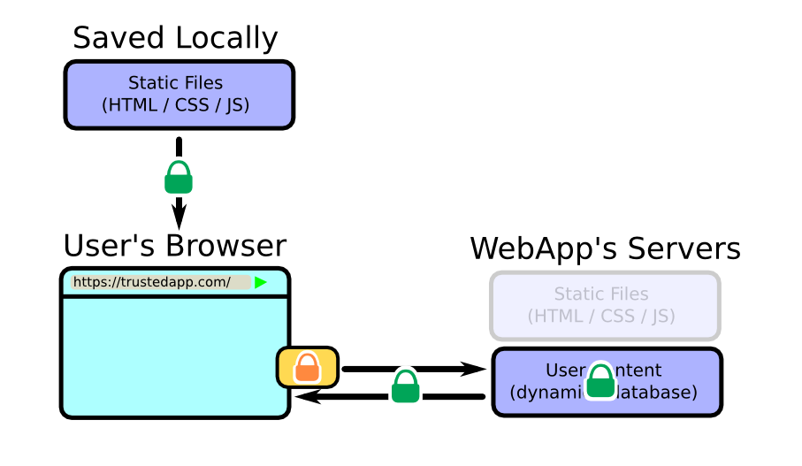
you can even save it locally

Slide 20
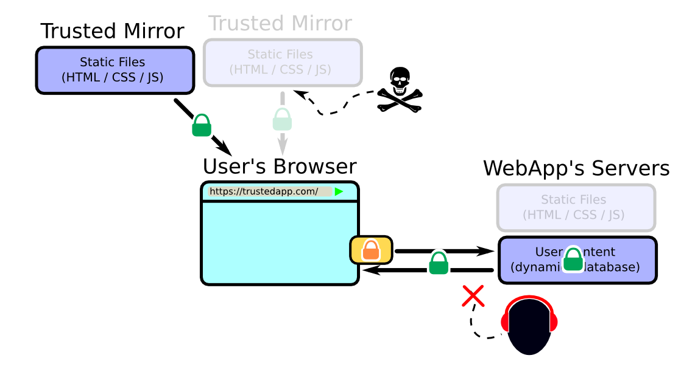
BYOD lessens the fundamental flaw

Slide 21
demo

