Slide 1
How Smart Meters Can Ruin
Distributed Generation
By Daniel Roesler
(Playing Devil's Advocate)
Notes:
Howdy, my name is Daniel Roesler, and my talk is about how smart meters can ruin distributed generation.
Before we get started, I do really think smart meters are great for sustainability, but for 60 seconds I figured I'd play the devil's advocate.

Slide 2
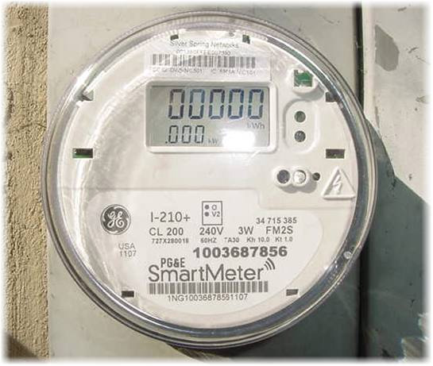
Notes:
Smart meters are becoming the default. Over the past decade utilities have been replacing analog meters left and right.

Slide 3
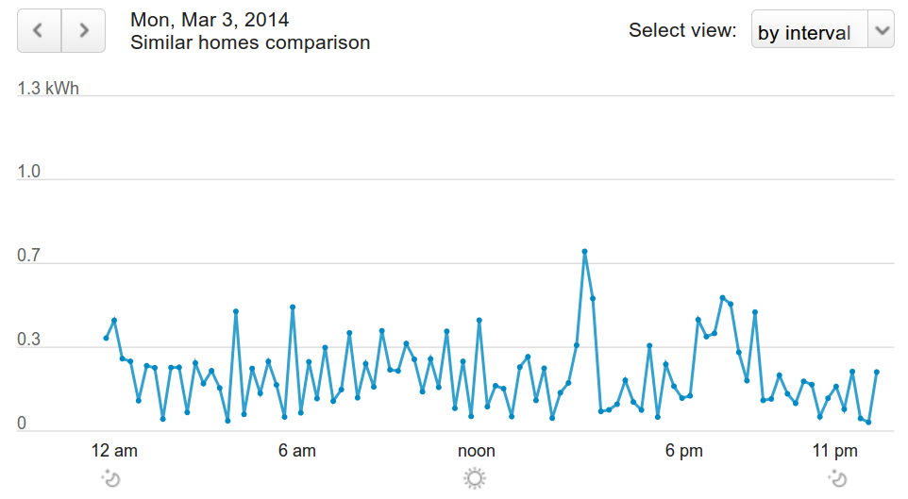
Notes:
They offer incredible usage resolution, which can be used by the energy efficiency industry to reduce customer demand.

Slide 4
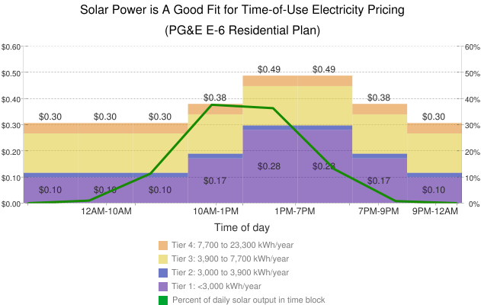
Notes:
However, this kind of data resolution lets utilities introduce new tariff structures.

Slide 5
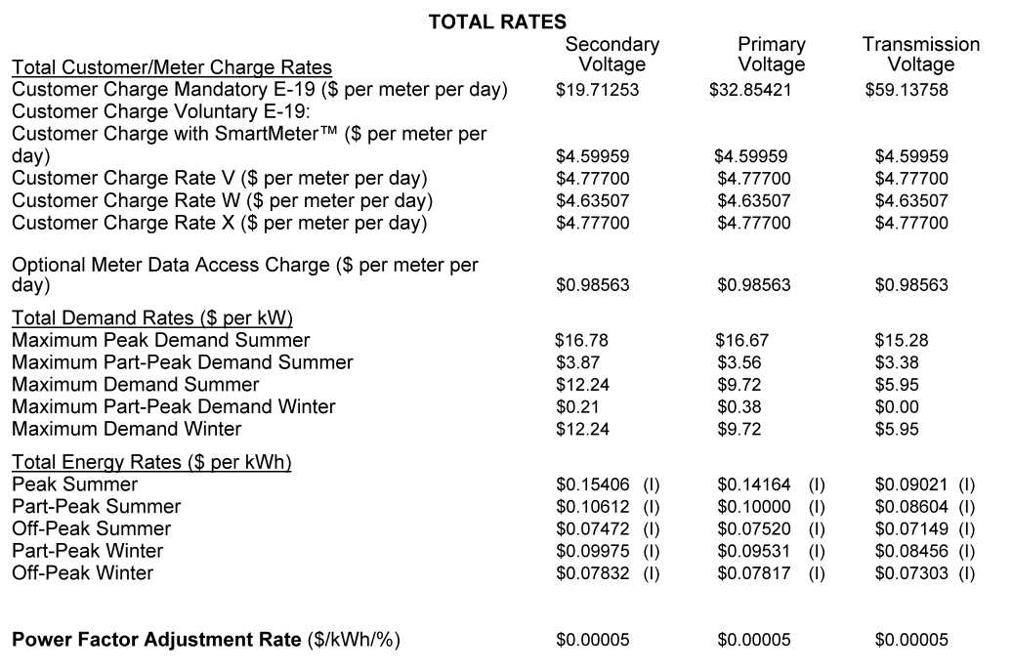
Notes:
This is PG&E's E-19. As you can see, now you not only have to worry about consumption rates, you have worry about time of use buckets.

Slide 6
Notes:
But wait, there's more! Not only do you have to deal with time of use. Now you also have to deal with demand charges that are derived from just one 15 minute interval during the whole month.

Slide 7
Example – Normal User
Usage
Tariff
Total
Monthly Usage:
Peak Demand:
Fixed Fee:
1,000 kWh x
10kW x
$0.15/kWh =
$10/kW =
$50/mo =
$150
$100
$50
Total Bill $300
Notes:
But everyone here knows this, so let's take an example of how tariffs can be used as a weapon. Here's a simplistic normal customer who pays $300 per month.

Slide 8
Example – New Tariff
Usage
Tariff
Total
Monthly Usage:
Peak Demand:
Fixed Fee:
1,000 kWh x
10kW x
$0.05/kWh =
$20/kW =
$50/mo =
$50
$200
$50
Total Bill $300
(No change)
Notes:
Next, the utility introduces a new tariff that decreases the consumption charges and increases the demand charges. It doesn't affect the total bill for the normal customer, so it seems pretty harmless.

Slide 9
Example – Solar Installed
Usage
Tariff
Total
Monthly Usage:
Peak Demand:
Fixed Fee:
0 kWh x
10kW x
$0.15/kWh =
$10/kW =
$50/mo =
$0
$100
$50
Total Bill $150
(Saves $150)
Notes:
However, let's go back and look at what would have happened if that customer had installed solar on their building. For the original tariff, they would have saved 50% of their bill, a pretty significant chunk.

Slide 10
Example – Solar Installed
Usage
Tariff
Total
Monthly Usage:
Peak Demand:
Fixed Fee:
0 kWh x
10kW x
$0.05/kWh =
$20/kW =
$50/mo =
$0
$200
$50
Total Bill $250
(Only saves $50)
Notes:
When the tariff changes, however, that savings drops by 2/3rds, and they only end up saving 17% of their bill.
Now we see why the utility made the tariff change. It was targeted to hurt the economics of solar installers.

Slide 11
Conclusion
Smart meters allow utilities to surgically target distributed generation to make it less economical.

