Slide 1
Project 1.1 – Phase 2
Amazing Chromatic Adventure
Group 10:
Rudy Wessels
Oskar Wielgos
Michal Jarski
Tu Anh Dinh
Vaishnavi Velaga
Louis Mottet

Slide 2
agenda
Problem Statement
Interface
Demo
Algorithms
Conclusion
Plan For Phase 3

Slide 3
Problem statement
Making a graph-coloring game with different game modes and providing hint buttons to help the player.

Slide 4

Interface
Menu:
Play button
Choose the game mode
SecondFrame: Set number of nodes and number of edges
GraphFrame: Show the graph and allow coloring

Slide 5
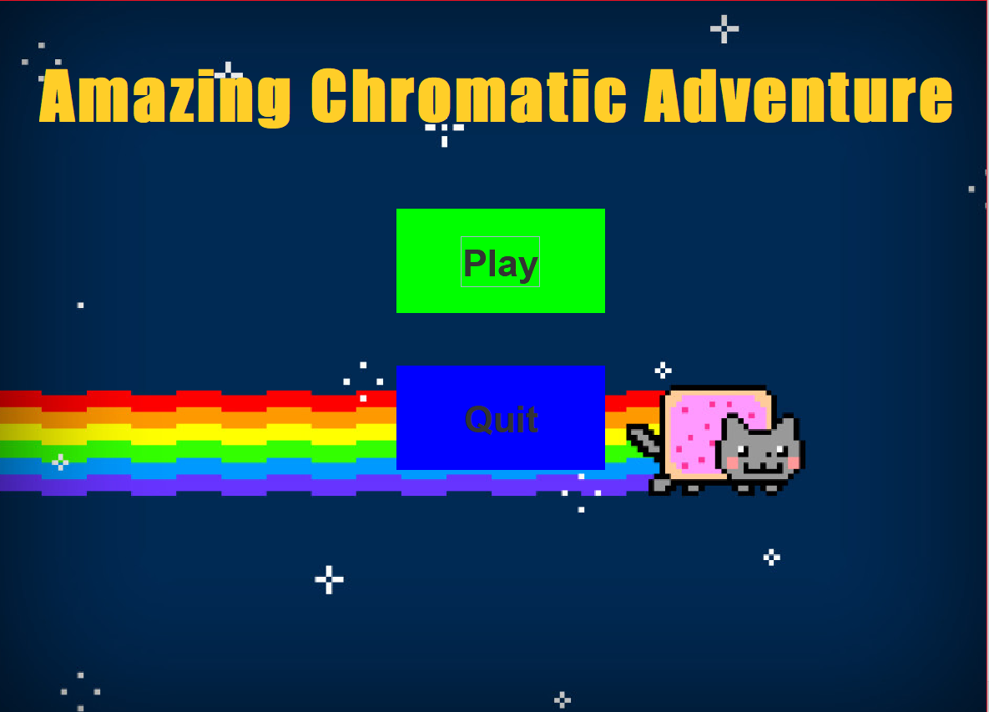
Demo

Slide 6
Algorithms
Graphic User Interface
Game modes
Hints:
Chromatic number
Suggest a color to an uncolored node
Red lines
Show the colored graph for 3 seconds

Slide 7
Algorithms
Graph JComponent
(GraphDisplay)
GraphFrame
SecondFrame
y - edges
z - vertices
START
Mouse Click Listener
Color buttons
Color Array

Slide 8
Algorithms
Graphic User Interface
Game modes
Hints:
Chromatic number
Suggest a color to an uncolored node
Red lines
Show the colored graph for 3 seconds

Slide 9
Conclusion
Make a game
Role of GUI
Hints

Slide 10
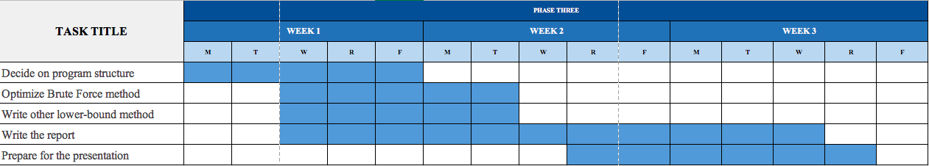
Plan for phase 3

