Slide 1
Project 1.1 – Phase 2
Amazing Chromatic Adventure
Group 10:
Rudy Wessels
Oskar Wielgos
Michal Jarski
Tu Anh Dinh
Vaishnavi Velaga
Louis Mottet

Slide 2
agenda
Problem Statement
Interface
Demo
Algorithms
Conclusion

Slide 3
Problem statement
Making a graph-coloring game with different game modes, providing hint buttons to help the player.

Slide 4

Interface
Menu: Play button, choose the game mode
SecondFrame: Set number of nodes and number of edges
GraphFrame: Show the graph and allow coloring

Slide 5
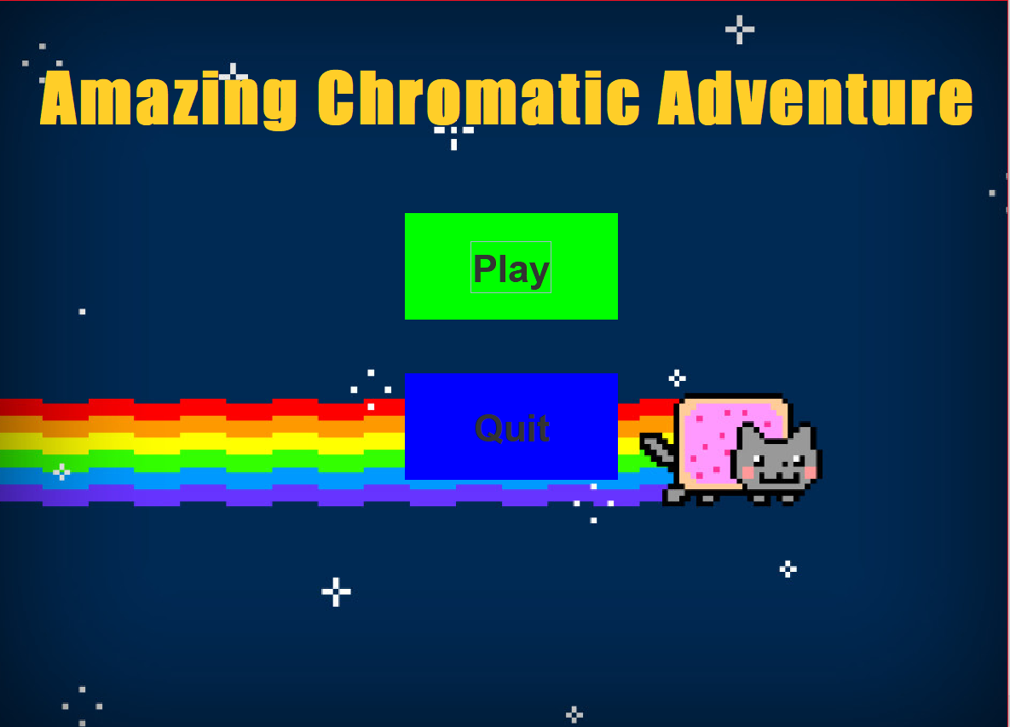
Demo

Slide 6
Algorithms
Graphic user interface
Game modes
Hints: - Show the colored graph for 3 seconds - Suggest a color to an uncolored node - Chromatic number

Slide 7
Conclusion
Make a game
Role of GUI
Hints

Slide 8
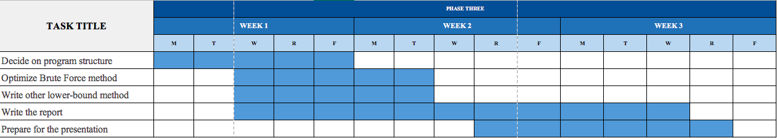
Plan for phase 3

