Slide 1
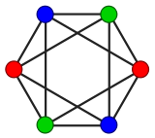
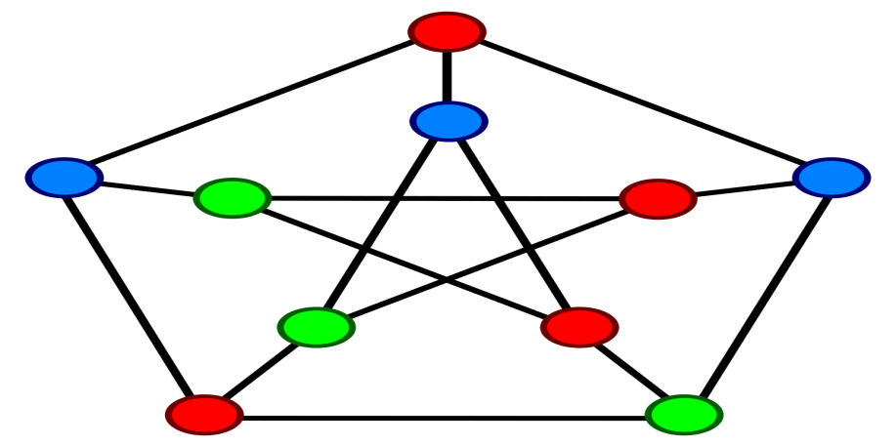
GRAPH-COLORING
PROJECT1.1
(Group 10)

Slide 2
Group-members
Tu Anh Dinh
Vaishnavi Velaga
Rudy Wessels
Oskar Wielgos
Michal Jarski
Louis Mottet

Slide 3
AGENDA
Problem Statement
Flow Chart
Algorithms
Experiments
Results
Conclusion.

Slide 4
Problem Statement
“Computing the chromatic number of different graphs”

Slide 5
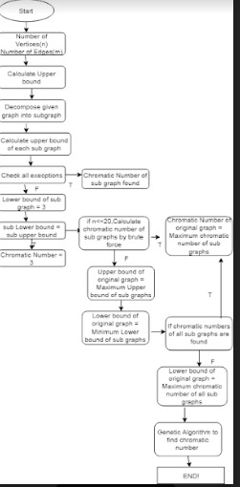
Flow Chart

Slide 6
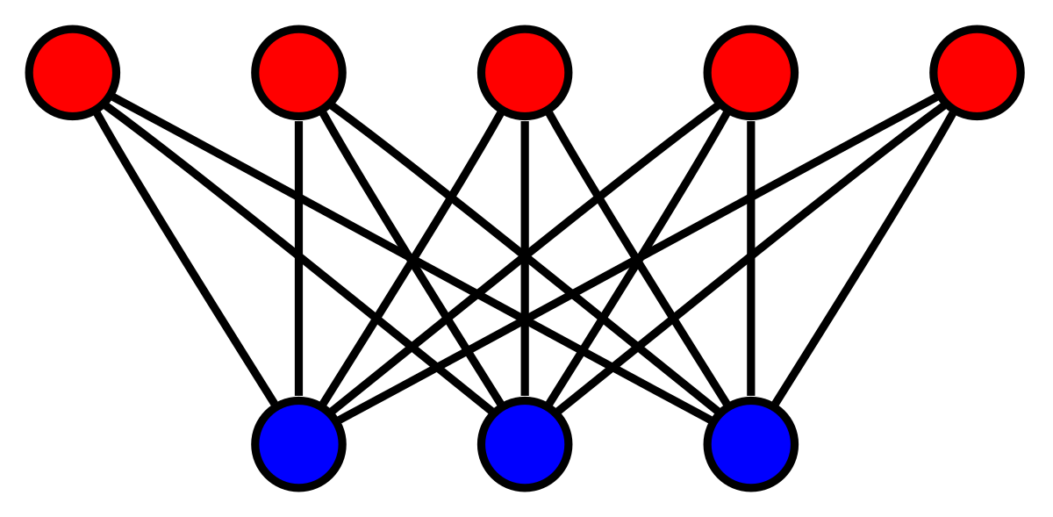
Algorithms
Graph decomposition
Greed Algorithm
Brute Fore
Exceptions
Genetic Algorithm

Slide 7
Experiments

Slide 8
Results- Part1
Graphs | Upper Bound | Lower Bound | Chromatic Number
Graph 1 | 3 |  | 3
Graph 2 | 5 | 3
Graph 3 | 8 | 6
Graph 4 | 7 | 3
Graph 5 | 4 |  | 2
Graph 6 | 3 |  | 3
Graph 7 | 12 | 3
Graph 8 | 98 | 3
Graph 9 | 6 | 3
Graph 10 | 3 |  | 3

Slide 9
Results-Part2
Graphs | Upper Bound | Lower Bound | Chromatic Number
Graph 11 | 15 | 3
Graph 12 | 3 |  | 2
Graph 13 | 14 | 3
Graph 14 | 5 | 3
Graph 15 | 10 | 3
Graph 16 | 4 | 3
Graph 17 | 8 | 3
Graph 18 | 11 | 3
Graph 19 | 11 | 3
Graph 20 | 9 | 3

Slide 10
Conculsion

