Slide 1
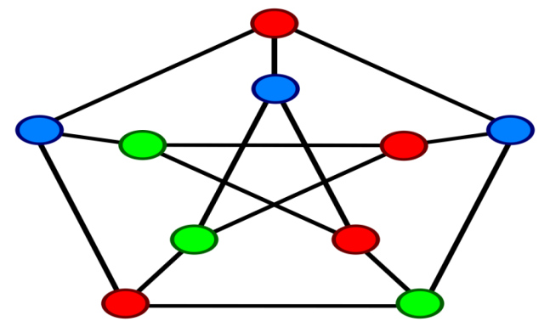
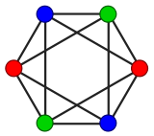
GRAPH-COLORING
PROJECT1.1
(Group 10)

Slide 2
Group-Members
Tu Anh Dinh
Vaishnavi Velaga
Rudy Wessels
Oskar Wielgos
Michal Jarski

Slide 3
Problem Statement
“How to compute the chromatic number of different graphs?”

Slide 4
AGENDA
Problem Statement
Work Flow
Algorithms
Experiments
Results
Conclusion

Slide 5
General Work Flow
Find upper bound - Greedy Algorithm
Decompose the graph
For each subgraph – check special cases –Find sub upper & lower bound(Greedy Algorithm) -run Brute Force
Genetic Algorithm

Slide 6
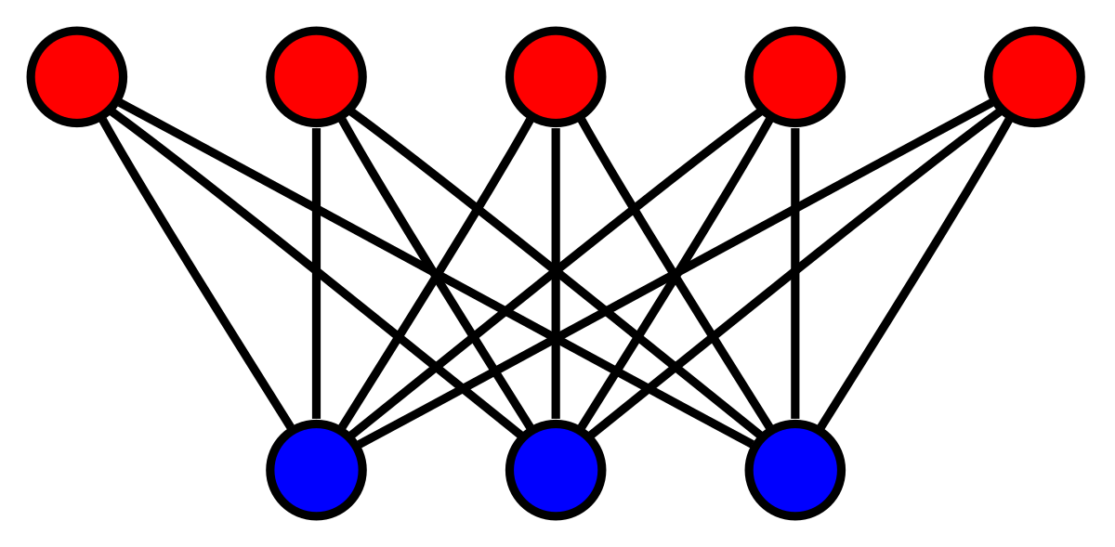
Algorithms
Graph Decomposition
Upper Bound
Lower Bound
Special Cases
Brute Force
Genetic Algorithm

Slide 7
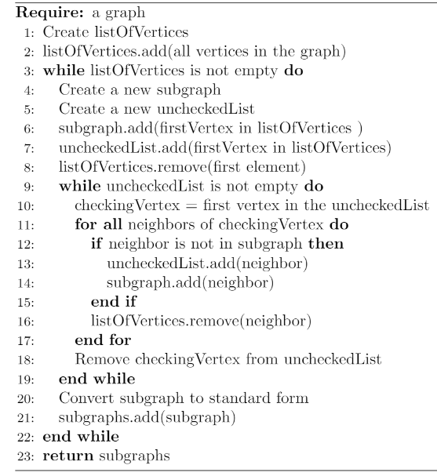
GRAPH DECOMPOSITION

Slide 8
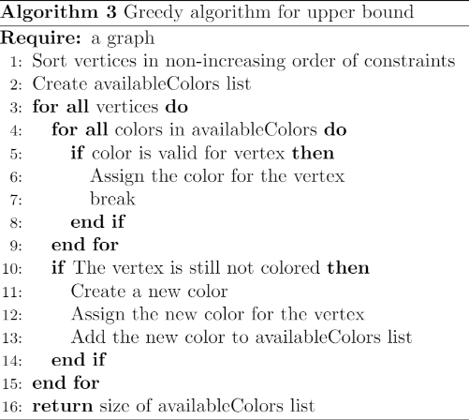
UPPER BOUND(Greedy Algorithm)

Slide 9
LOWER BOUND(GREEDY ALGORITHM)

Slide 10
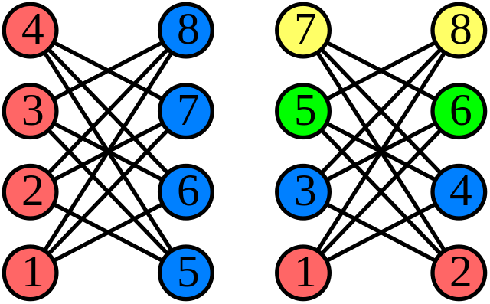
Special Cases
No Vertices Graph
Null Graph
Odd Cycle Graph
Bipartite Graph
Complete Graph

Slide 11
BRUTE FORCE

Slide 12
Genetic Algorithm
Fitness
Selection
Crossover
Mutation

Slide 13
Experiments
Experiments on the different structure graphs
Genetic Algorithm
-Genetic VS Greedy
-Altering population/rates

Slide 14
Results-Part1
Graphs | Upper Bound | Lower Bound | Chromatic Number
Graph 1 | 3 |  | 3
Graph 2 | 5 | 3
Graph 3 | 8 | 6 | 6
Graph 4 | 5 | 4
Graph 5 | 2 |  | 2
Graph 6 | 3 |  | 3
Graph 7 | 12 | 8
Graph 8 | 98 | 98 | 98
Graph 9 | 6 | 3
Graph 10 | 3 |  | 3

Slide 15
Results-Part2
Graphs | Upper Bound | Lower Bound | Chromatic Number
Graph 11 | 15 | 15 | 15
Graph 12 | 2 | 2 | 2
Graph 13 | 11 | 9
Graph 14 | 5 | 3
Graph 15 | 10 | 5
Graph 16 | 4 | 3
Graph 17 | 8 | 8 | 8
Graph 18 | 11 | 10
Graph 19 | 11 | 11 | 11
Graph 20 | 9 | 8

Slide 16
Conclusion
Our algorithms work better for smaller graphs and special structured graphs.
Greedy Algorithm works faster than Genetic Algorithm.
Genetic Algorithm gives better results than Greedy Algorithm.

