Slide 1
Dilemma
The Prisoner’s Dilemma App using the Nimbus architecture

Slide 2
The Prisoner’s Dilemma
The Prisoner's Dilemma is a classic game theory concept that illustrates the tension between individual rationality and collective well-being. It highlights how two individuals acting in their own self-interest may end up with a worse outcome than if they had cooperated. The dilemma is often presented as a scenario where two suspects are arrested and interrogated separately. Each suspect must choose whether to cooperate with the other by remaining silent or to betray the other by confessing

Slide 3
The Prisoner’s Dilemma (cont.)
The Scenario:
Two suspects are arrested for a crime.
They are interrogated separately and cannot communicate with each other.
Each suspect has two options:
Cooperate: Remain silent (not confessing).
Betray the other suspect.
The Possible Outcomes:
Both cooperate: Each suspect receives a light sentence (e.g., one year in jail).
Both betray: Each suspect receives a moderate sentence (e.g., three years in jail).
One betrays, the other cooperates: The betrayer goes free, and the cooperator receives a harsh sentence.

Slide 4
The Prisoner’s Dilemma (cont.)
The Dilemma:
If the other suspect cooperates, betraying leads to freedom (the best outcome). However, if both suspects betray, they both end up with a worse outcome (moderate sentence) than if they had both cooperated (light sentence).
Repeated Prisoner's Dilemma:
When the game is played repeatedly, players can develop strategies based on past interactions, potentially leading to cooperation.

Slide 5
Nimbus Architecture (See provisional patent)
Nimbus enables enhanced social interactivity by allowing users within close physical proximity to discover each other using a close range communication system, such as Bluetooth. Upon mutual discovery, users may form ad hoc groups in person or through online services. These groups can then participate in a variety of social or transactional activities, including but not limited to gaming, dating, and commerce. The system supports identity advertisement and optional authentication features, allowing for trust-based interactions among participants. Nimbus emphasizes the seamless integration of real-world proximity and internet-based platforms, aiming to enrich online interactions through the opportunity for meaningful in-person engagement.

Slide 6
The Dilemma App
Use Bluetooth LE (Low-Energy) advertising and discovery to find peers in a local area.
Select peer to challenge:
Secretly enter “cooperate” or “betray”.
Target peer responds in kind.
App determines score (Elo-like scoring to rank peers).
Can have multiple challenges concurrently.
Code on GitHub: https://github.com/dialectek/Dilemma
Download Android app: http://dialectek.com/Nimbus/Dilemma.apk

Slide 7
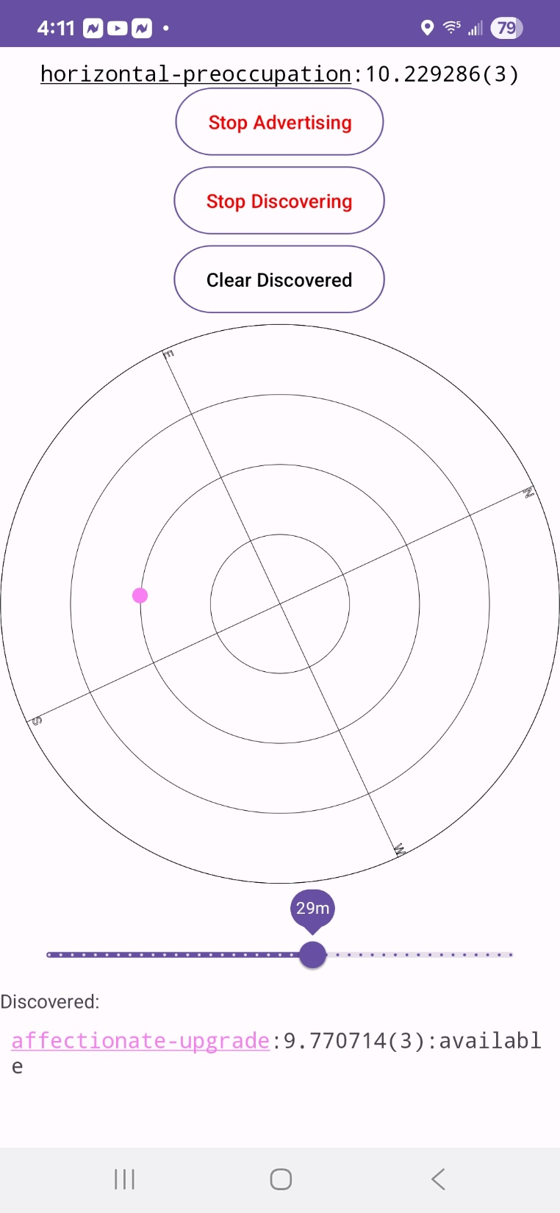
Dilemma App Operation
Name and score
Bluetooth LE peer advertising/discovery
Color-coded peer in vicinity
Peer names, scores, and status (click to interact with)

Slide 8
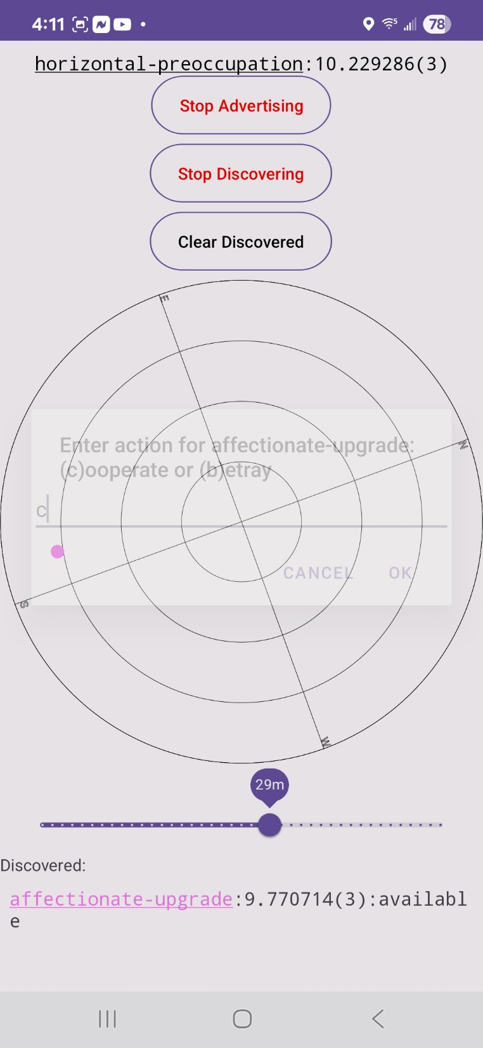
Challenging peer:
cooperate or betray

Slide 9
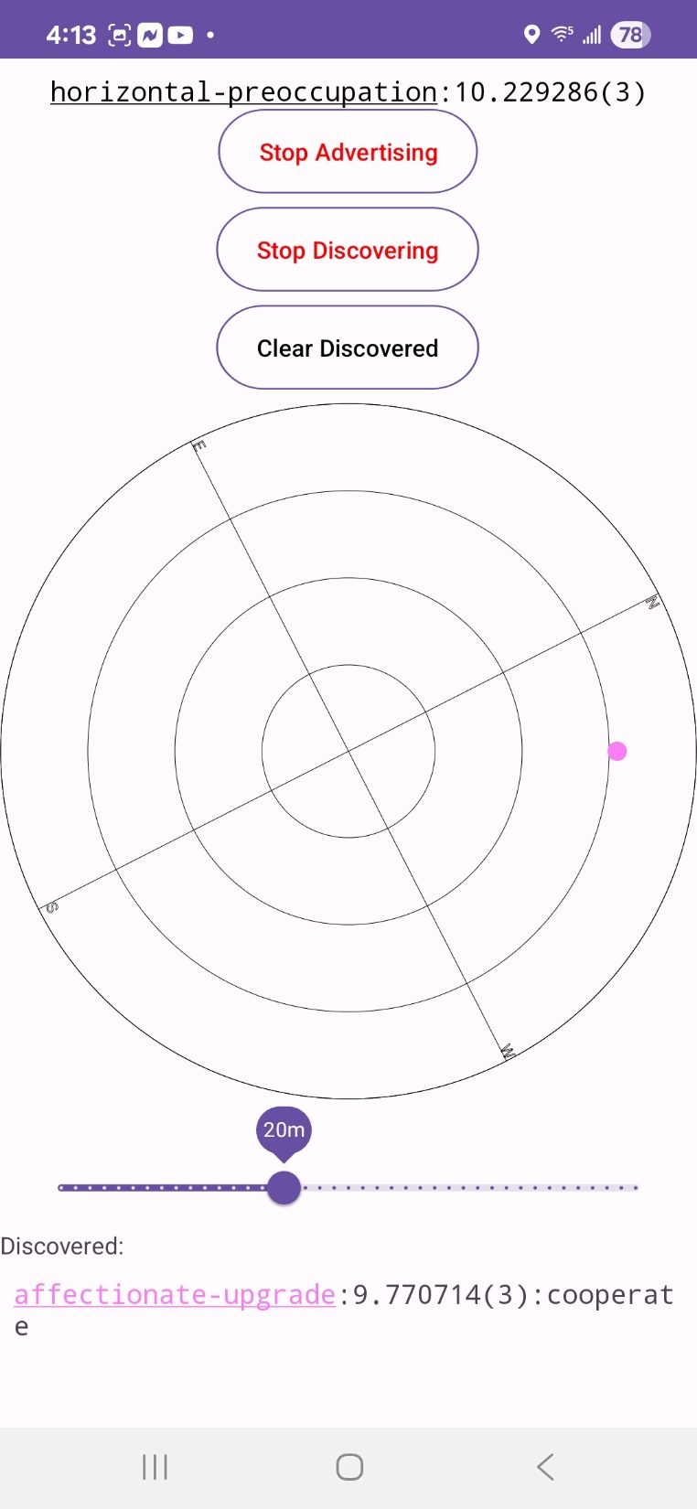
Challenge status. Target to respond.

Slide 10
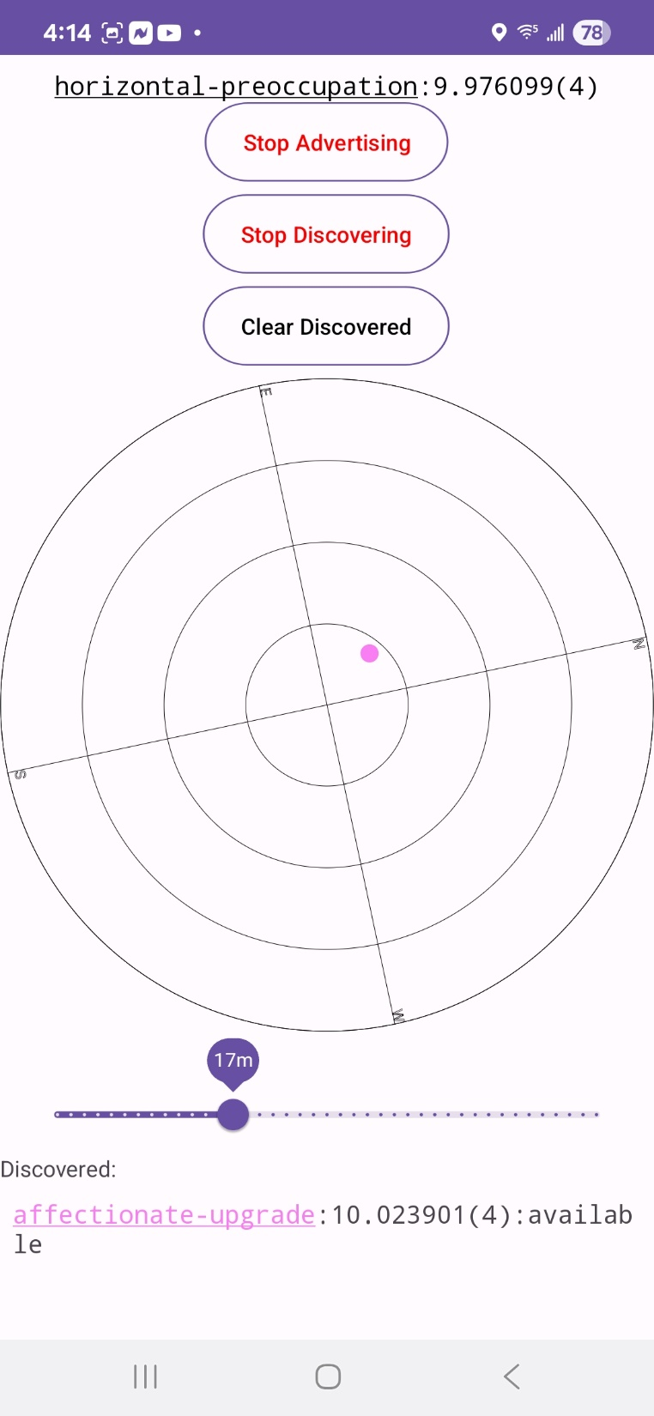
Target betrayed. Score downgraded.

