Slide 1
Dilemma
The Prisoner’s Dilemma App using the Nimbus architecture

Slide 2
The Prisoner’s Dilemma
The Prisoner's Dilemma is a classic game theory concept that illustrates the tension between individual rationality and collective well-being. It highlights how two individuals acting in their own self-interest may end up with a worse outcome than if they had cooperated. The dilemma is often presented as a scenario where two suspects are arrested and interrogated separately. Each suspect must choose whether to cooperate with the other by remaining silent or to betray the other by confessing

Slide 3
The Prisoner’s Dilemma (cont.)
The Scenario:
Two suspects are arrested for a crime.
They are interrogated separately and cannot communicate with each other.
Each suspect has two options:
Cooperate: Remain silent (not confessing).
Betray the other suspect.
The Possible Outcomes:
Both cooperate: Each suspect receives a light sentence (e.g., one year in jail).
Both betray: Each suspect receives a moderate sentence (e.g., three years in jail).
One betrays, the other cooperates: The betrayer goes free, and the cooperator receives a harsh sentence.

Slide 4
The Prisoner’s Dilemma (cont.)
The Dilemma:
From an individual perspective, betraying is always the "rational" choice. If the other suspect cooperates, confessing leads to freedom (the best outcome). If the other suspect betrays, confessing still leads to a better outcome than remaining silent (a shorter sentence).
However, if both suspects act rationally and betray, they both end up with a worse outcome (moderate sentence) than if they had both cooperated (light sentence).
Repeated Prisoner's Dilemma:
When the game is played repeatedly, players can develop strategies based on past interactions, potentially leading to cooperation.

Slide 5
Nimbus Architecture (See provisional patent)
Nimbus enables enhanced social interactivity by allowing users within close physical proximity to discover each other using a close range communication system, such as Bluetooth. Upon mutual discovery, users may form ad hoc groups through a centralized or distributed online services. These groups can then participate in a variety of social or transactional activities, including but not limited to gaming, dating, and commerce. The system supports identity advertisement and optional authentication features, allowing for trust-based interactions among participants. Nimbus emphasizes the seamless integration of real-world proximity and internet-based platforms, aiming to enrich online interactions through the opportunity for meaningful in-person engagement.

Slide 6
The Dilemma App
Use Bluetooth LE (Low-Energy) advertising and discovery to find peers in a local area.
Select peer to challenge:
Secretly enter “cooperate” or “betray”.
Target peer responds in kind.
App determines score (Elo-like scoring to rank peers).
Can have multiple challenges concurrently.
Code on GitHub: https://github.com/dialectek/Dilemma
Download Android app: http://dialectek.com/Nimbus/Dilemma.apk

Slide 7
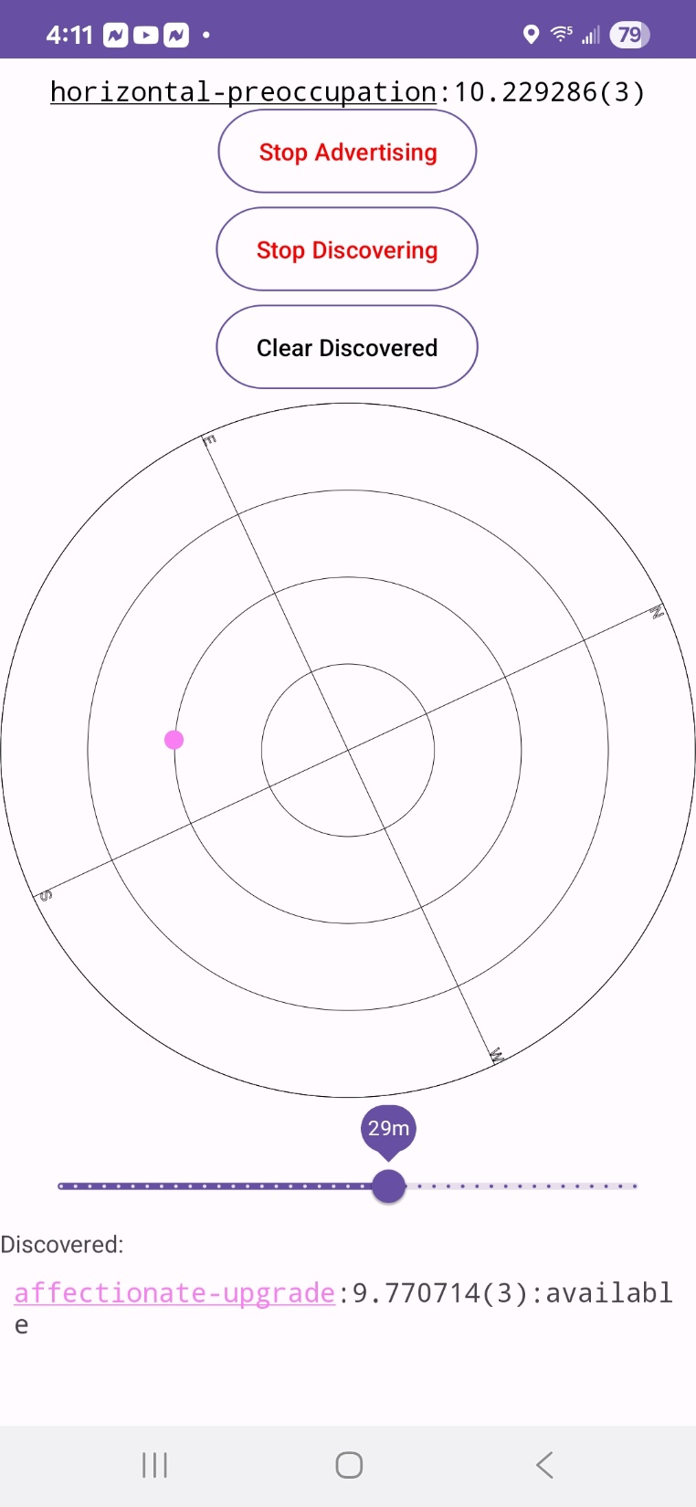
Dilemma App Operation
Name and score
Bluetooth LE peer advertising/discovery
Color-coded peer in vicinity
Peer names, scores, and status (click to interact with)

Slide 8
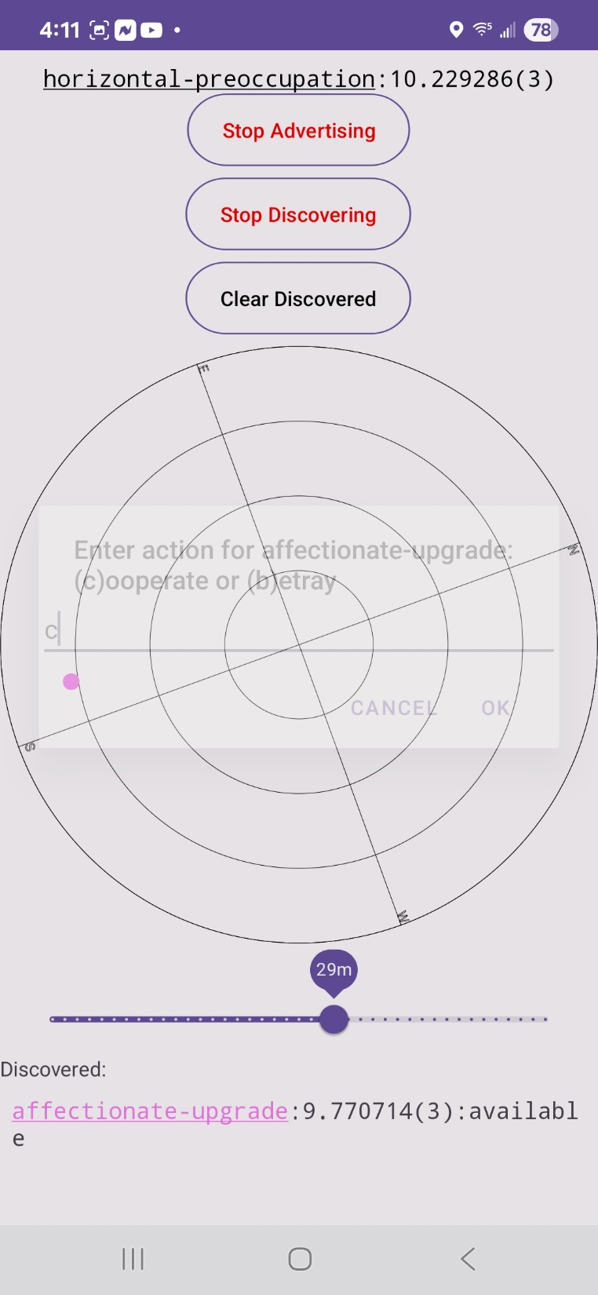
Challenging peer:
cooperate or betray

Slide 9
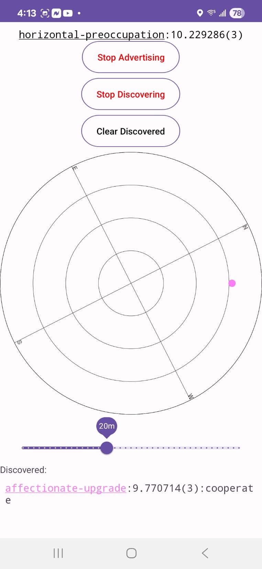
Challenge status. Target to respond.

Slide 10
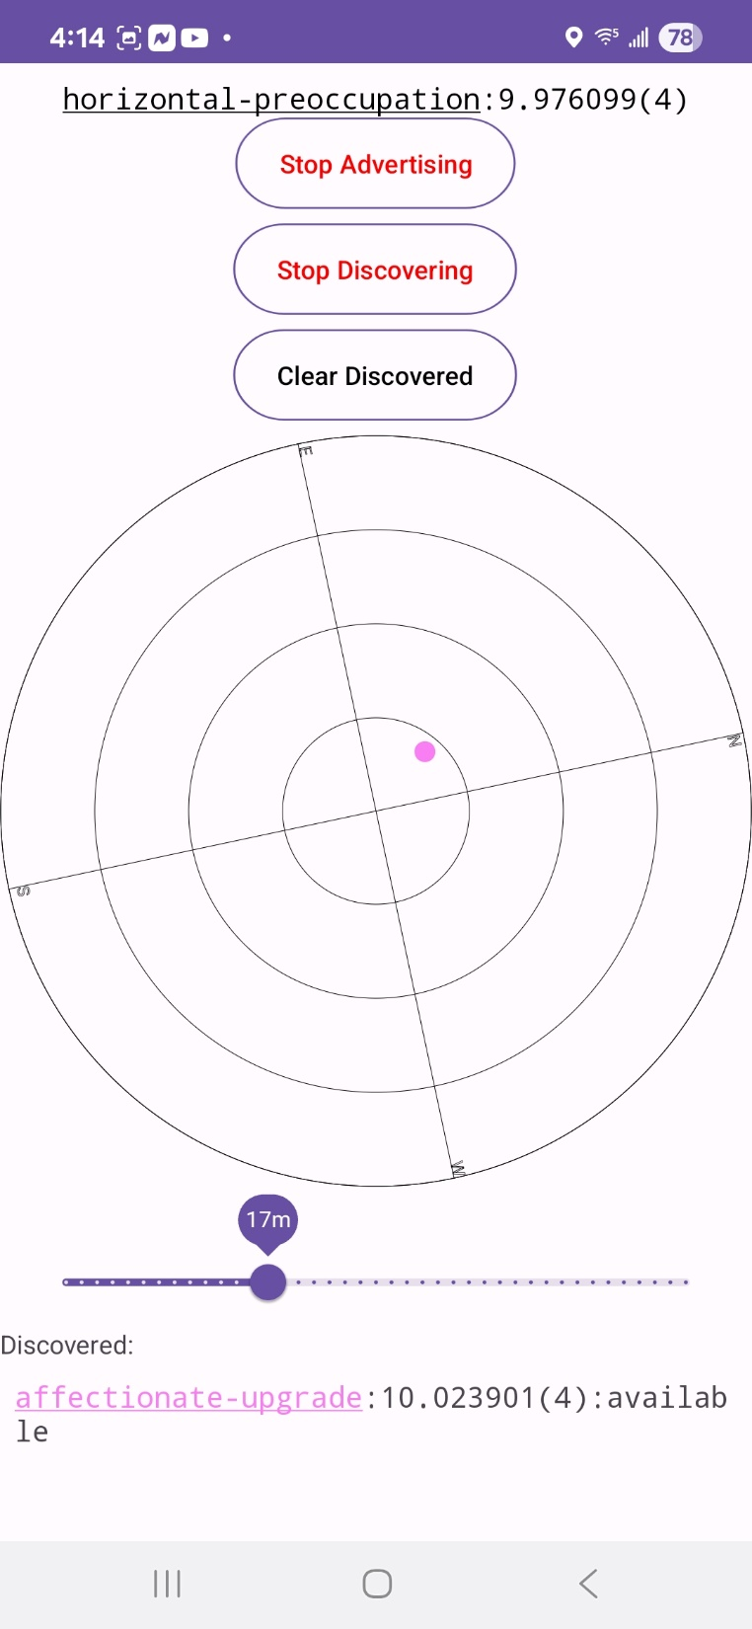
Target betrayed. Score downgraded.

