Slide 1


Deep Learning Methods For Automated Discourse
CIS 700-7
Fall 2017
http://dialog-systems-class.org/
João Sedoc with Chris Callison-Burch and Lyle Ungar
joao@upenn.edu
January 24th, 2017

Slide 2
Office Hours
Tuesdays 5-6 in Levine 512
Sign up to present HW 1

Slide 3
Homework 2 due date moved to Jan 31st.
Does everyone have a group?
Has everyone asked for permission for AWS p2.xlarge instance?

Slide 4
Optimization of Neural Network
An exploration in the the dark arts.

Slide 5
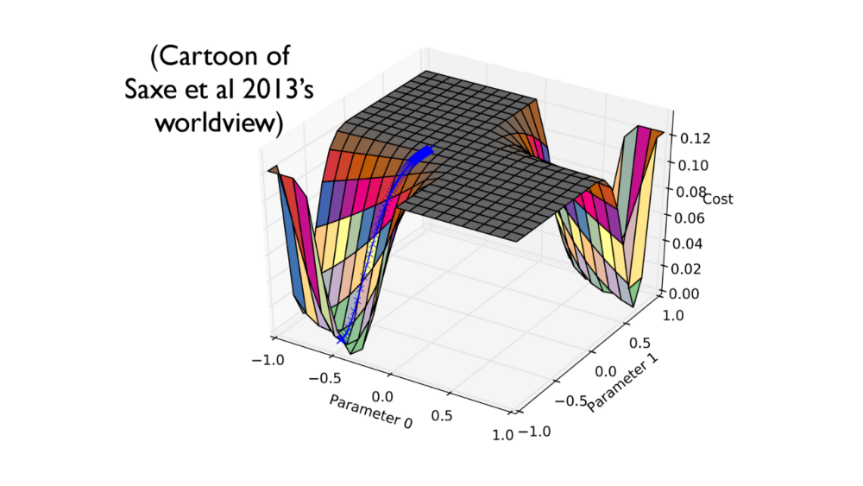

Slide 6
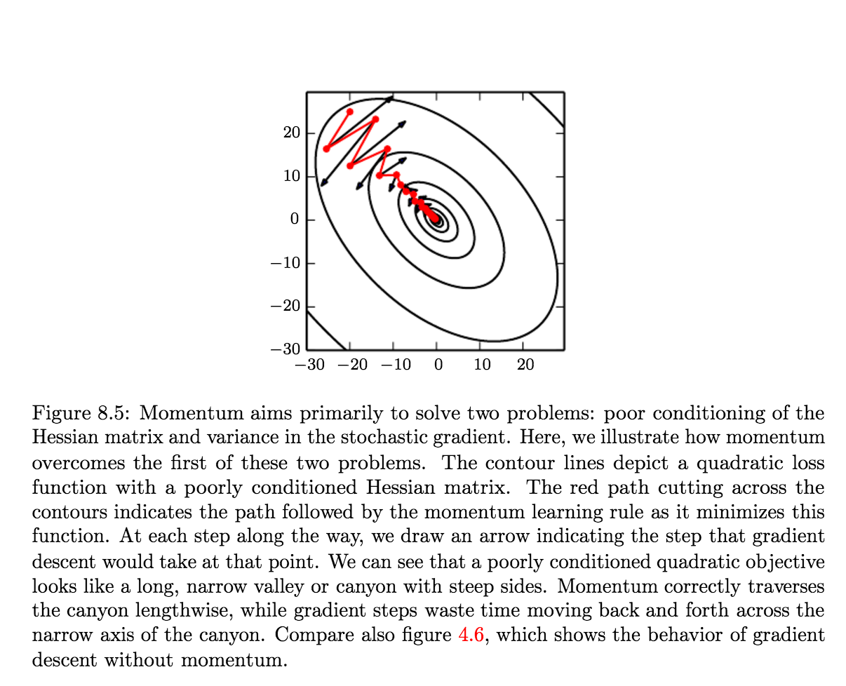

Slide 7
Minibatch
Shuffling data important
Processed in parallel (usually on GPU) in powers of 2
Batches as a regularizer?
Why can’t we have 10k batch sizes, which allow for second order derivatives?
Newton’s method, or the saddle free augmentation still not possible, but maybe soon.

Slide 8
Minibatch
Usually, I have seen projects using mini batch size of 128 ? Is there any intuition behind coming up with this value? In general, how to chose our mini batch size as per our system configuration (GPUs, memory, etc.)
If no memory or time constraints are present, do second-order optimization algorithms work better than the first order ones, because I had read that in practice first order algorithms work fairly well even for small problems? Also, are there certain classes of problems in which one works better than the other?
Datasets are growing rapidly in size in comparison to computing power and thus not all of training data is used. Is there value in data augmentation as a tool for regularization in this case since the training data is chosen stochastically or no?

Slide 10
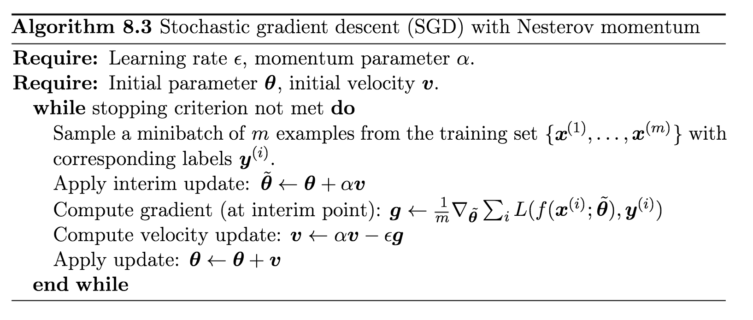
Learning rate and momentum

Slide 11
Learning rate and momentum
What’s interaction between batch size and learning rate/momentum?
How would you adjust learning rate if at all?

Slide 12
Parameter initialization
Optimization perspective suggests that the weights should be large enough to propagate information successfully, but some regularization concerns encourage making them smaller
SGD parameters near to initialization point
Why is gradient descent with early stopping similar to weight decay? Is this L2 btw?

Slide 13
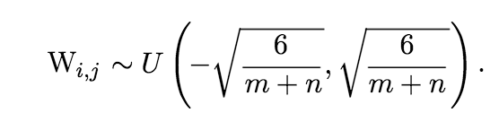
Parameter initialization
m – inputs and n - outputs
Sparse initialization for deep wide networks

Slide 14
Parameter initialization
Why are we not randomly initializing biases? In initializing weights what are the heuristic to decide the scale of the distribution?
When talking about normalization in weight initialization they comment that a certain choice of initialization is designed to achieve equal activation variance at each function and equal gradient variance. What does this mean?
What does it mean to initialize parameters as a orthogonal matrix?
In initialization, we does not initialize the bias randomly because would it affect the model or is it an overdo ? Also, assigning to zero would not always be true as it would also depend on the activation function. For example, in sigmoid, at x=0, the value is 0.5; so does that mean in this case we need to initialize it with large negative value ?
Is sparse initialization of weight akin to dropout at initialization time and does it also help in regularization? Also, I do not understand fully how having a high bias at initialization time (which sparse initialization introduces) effects maxout units?

Slide 15
Optimizers
What was your favorite and why?

Slide 16
Optimizers
Adagrad – learning rate inversely proportional square root of the sum of all of their historical squared values
RMSProp – learning rate inversely proportional to entire gradient history
Adam - combination of RMSProp and momentum with a few important distinctions
Conjugate gradients
Newton’s Method – with finite memory

Slide 17
Conjugate gradient
There is an alternative to going to the minimum in one step by multiplying by the inverse of the curvature matrix.
Use a sequence of steps each of which finds the minimum along one direction.
Make sure that each new direction is “conjugate” to the previous directions so you do not mess up the minimization you already did.
  “conjugate” means that as you go in the new direction, you do not change the gradients in the previous directions.

Slide 18
A picture of conjugate gradient
The gradient in the direction of the first step is zero at all points on the green line.
So if we move along the green line we don’t mess up the minimization we already did in the first direction.

Slide 19
Optimizers
What is the motivation behind Adam?
Why isn't Adam better than AdaGrad when it is basically RMSProp with momentum where RMSProp is supposedly a modified AdaGrad that is better in non-convex models like ones for Deep Learning?
Could we know under which condition, which optimization algorithm might work better?
Where does the bias that is corrected by in the Adam algorithm seep in through? Is this the bias introduced by the initial values assigned for the weights and the "bias" at initialization?

Slide 20
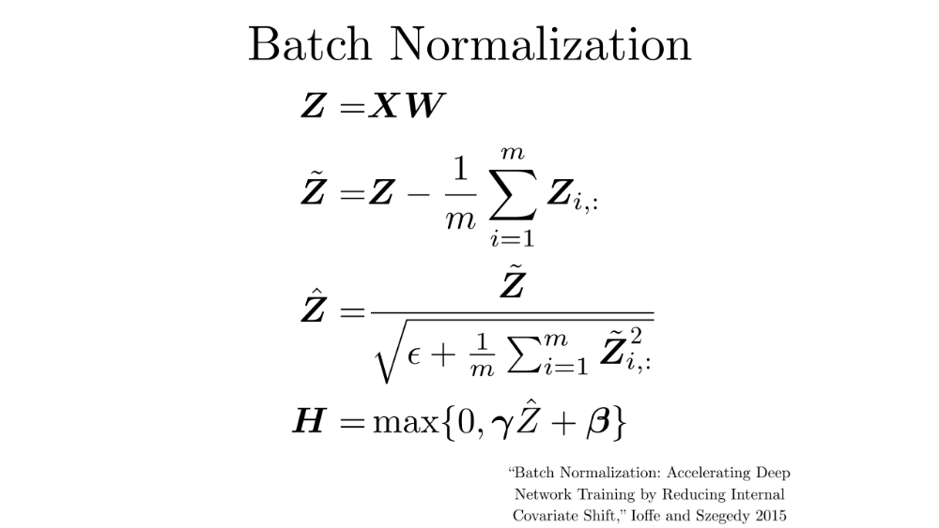
Notes:
Gamma and beta is learned – beta 0 and gamma 1
Different for every layer
Representations still general

Slide 21
Batch Normalization
“One of the most import method in deep learning in the last five years.”
Faster training and more accurate
Constant learning rate
Larger networks
Can train sigmoid without pre-training
Expensive for recurrent neural networks? -
Is there a relationship between batch normalization and dropout?
Notes:
Layer normalization – along units

Slide 22
Batch normalization
The theory and experiments show that batch normalization smooths and speeds up the learning process. Does it also increase the accuracy? If so, why?
Since in batch normalization, as we are finding H' on every minibatch rather than on entire batch, is it similar to adding random noise in hidden layers? Would this lead to regularization as well?
In batch normalization, the input to each layer is whitened first (zero mean, unit sd). I have read that whitening can exaggerate the noise in the data, since it stretches all dimensions (including the irrelevant dimensions of tiny variance that are mostly noise) to be of equal size in the input. Won't it create a problem?

Slide 23
Batch normalization
Why are standard deviation of gradient and activations important?
Why normalizing solves the problem of many layers and of simultaneous updates? And isn't it more complicated to train lower layers, since now we have to take the derivative of the standard deviation and mean? Why do we do it for mini batches and not all the dataset?
How does this relate to activation function?

Slide 24
Next lecture
Chapter 10: Recurrent neural networks!
Please read chapter 10 very carefully

Slide 25
AWS – headache
Where is everyone on AWS?
Do you have access to p2.xlarge?
Please pay attention to cost!!!!

Slide 27
Questions
1. Since in batch normalization, as we are finding H' on every minibatch rather than on entire batch, is it similar to adding random noise in hidden layers? Would this lead to regularization as well?
2. Is there any algorithm on how to divide features into blocks in block coordinate descent?
3. In batch normalization, the input to each layer is whitened first (zero mean, unit sd). I have read that whitening can exaggerate the noise in the data, since it stretches all dimensions (including the irrelevant dimensions of tiny variance that are mostly noise) to be of equal size in the input. Won't it create a problem?

Slide 28
Questions
1. Recently, Adam is quite popular in optimizing deep learning models. However, the book says there's no consensus on choosing which optimization algorithms to use. Could we know under which condition, which optimization algorithm might work better?
2. As the book states, batch normalization is one of the most exciting innovations in deep learning community. The theory and experiments show that batch normalization smooths and speeds up the learning process. Does it also increase the accuracy? If so, why?
3. The book illustrates the greedy layer-wise supervised pre-training in detail as it is one of the main algorithms that make the deep networks working before 2011. Is this still important? How do we interpret this idea today?

Slide 29
Questions
- Why are we not randomly initializing biases? In initializing weights what are the heuristic to decide the scale of the distribution?
- Why are standard deviation of gradient and activations important?
- Why normalizing solves the problem of many layers and of simultaneous updates? And isn't it more complicated to train lower layers, since now we have to take the derivative of the standard deviation and mean? Why do we do it for mini batches and not all the dataset?

Slide 30
Questions
Section 8.5.4 says “there is currently no consensus on this point” for choosing the right optimization algorithm. Should we try different algorithms in small data set and validate it against testing set? Because, our ultimate goal is to do good prediction in test set and not overfit the data. Also, I have heard that keeping learning rate constant does not hurt much as our main concern is not to overfit. A very good converge in training error might result in overfitting. Is it true ?
In initialization, we does not initialize the bias randomly because would it affect the model or is it an overdo ? Also, assigning to zero would not always be true as it would also depend on the activation function. For example, in sigmoid, at x=0, the value is 0.5; so does that mean in this case we need to initialize it with large negative value ?
Usually, I have seen projects using mini batch size of 128 ? Is there any intuition behind coming up with this value? In general, how to chose our mini batch size as per our system configuration (GPUs, memory, etc.)

Slide 31
Questions
1) Is sparse initialization of weight akin to dropout at initialization time and does it also help in regularization? Also, I do not understand fully how having a high bias at initialization time (which sparse initialization introduces) effects maxout units?
2) Where does the bias that is corrected by in the Adam algorithm seep in through? Is this the bias introduced by the initial values assigned for the weights and the "bias" at initialization?
3) If no memory or time constraints are present, do second-order optimization algorithms work better than the first order ones, because I had read that in practice first order algorithms work fairly well even for small problems? Also, are there certain classes of problems in which one works better than the other?

Slide 32
Questions
When talking about normalization in weight initialization they comment that a certain choice of initialization is designed to achieve equal activation variance at each function and equal gradient variance. What does this mean?
Why is gradient descent with early stopping similar to weight decay? Is this L2 btw
What is the motivation behind Adam?

Slide 33
Questions
1. What does it mean to initialize parameters as a orthogonal matrix? Also, does this mean all hidden layers has the same number of hidden units / and thus should the number of input parameters and output need to be the same?
2. In the batch and minibatch section, they mentioned how datasets are growing rapidly in size in comparison to computing power and thus not all of training data is used. Is there value in data augmentation as a tool for regularization in this case since the training data is chosen stochastically or no?
3. Why isn't Adam better than AdaGrad when it is basically RMSProp with momentum where RMSProp is supposedly a modified AdaGrad that is better in non-convex models like ones for Deep Learning?

