Slide 1

Deep Learning Methods For Automated Discourse
CIS 700-7
Fall 2017
http://dialog-systems-class.org/
João Sedoc
joao@upenn.edu
January 12th, 2017

Slide 2
Alexa Prize Motivation
Main arc of this class is to develop a socialbot which will be an Alexa skill that allows a dialog between users and the Alexa device
The Amazon Alexa Prize defines it as “socialbot will be an Alexa skill that converses coherently and engagingly with humans on popular topics and news events. ”
This course is comprized of 3 parts:
learning how to interface with Alexa SDK
learning tensorflow and how to train (particularly also get the data and manipulate it) and create a chatbot
Developing a foundation in deep learning and dialog systems and subsequently recent papers for dialog systems

Slide 3
About the class
This class is in “alpha” form, so you will be the first to try out the assignments
We intend of the class to be group based and collaborative
Discussion about papers and implementation problems is a large part of this class, not just programming
The syllabus is still a bit fluid
The readings will be posted at the end of next week
BRING YOUR COMPUTERS TO CLASS

Slide 4
Prerequisites for the class
CIS 419/519 or CIS 520
Proficiency in Python

Slide 5
Grading
Credit for reading material
  1 day before class post 3 or more sentences about the paper and 3 questions on Piazza
Leading a paper discussion
  Leading the discussion
  Writing a synopsis of the paper and how it relates, and what we discussed
  Write up of the algorithm from the paper in your own words
Programming assignments – groups ~ 3 people
Final Project [2 intermediate checkpoints] – group project
  6 page paper
  Working systems

Slide 6
Class Format
50-60 minutes of discussion of papers
  Understanding the key concepts of dialog systems
  Learning to critically read papers and analyze results
20-30 minutes of active programming
  Group discussion of common problems
  Relating readings back to code and trying to incorporate concepts into systems
  Debugging and making sure that we are all moving forward

Slide 7
Computing Resources
AWS Lambda
AWS GPU server
Amazon Echo
TensorFlow
Alexa Skills Kit (ASK)
Git!

Slide 8
Please fill out the questionnaire at http://www.seas.upenn.edu/~joao/qc7.html

Slide 9
Taxonomy of Dialog Systems
RETRIEVAL-BASED VS. GENERATIVE MODELS
  Retrieval-based models (easier) use a repository of predefined responses and some kind of heuristic to pick an appropriate response based on the input and context.
  Generative models (harder) don’t rely on pre-defined responses. They generate new responses from scratch.
LONG VS. SHORT CONVERSATIONS
  Short-Text Conversations (easier) where the goal is to create a single response to a single input.
  long conversations (harder) where you go through multiple turns and need to keep track of what has been said.
OPEN DOMAIN VS. CLOSED DOMAIN
  open domain (harder) where the user can take the conversation anywhere.
  closed domain (easier) where only a specific topic is covered. (Shopping assistant)
From: http://www.wildml.com/2016/04/deep-learning-for-chatbots-part-1-introduction/

Slide 10
Deep Learning Models
Sequence to Sequence Model
Attention and Memory augmentation
Context Sensitive Models
Hierarchical extension
Reinforcement Learning

Slide 11
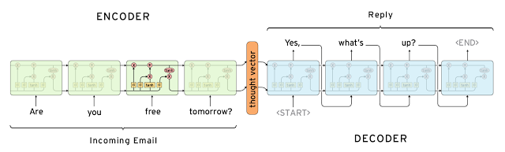
Basic Sequence to Sequence Model Idea

Slide 12
OK, let’s start to sign up for AWS

