Slide 1

AEROWIND
Productivity Improvement of The Lighthouse Wind Farm
Diamela Dego
Bootcamp Unicorn Academy 9.0
December 2025

Slide 2
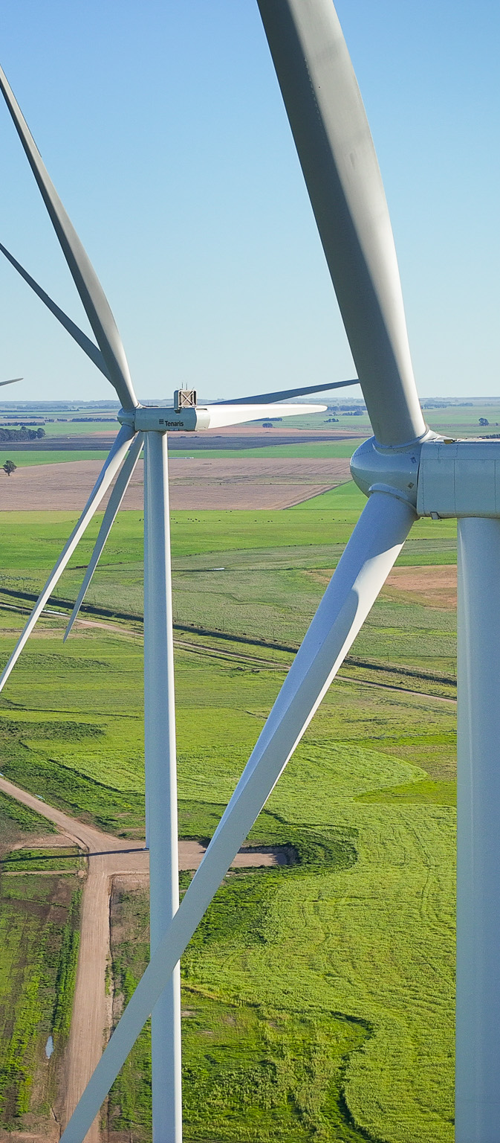
Table of Contents
    1. Introduction & Context
    2. Wind Farm Characteristics
    3. Project Purpose
    4. Dataset & Architecture
    5. Dashboard & Key Indicators
    6. Exploratory Analysis
    7. Conclusions & Recommendations

Slide 3


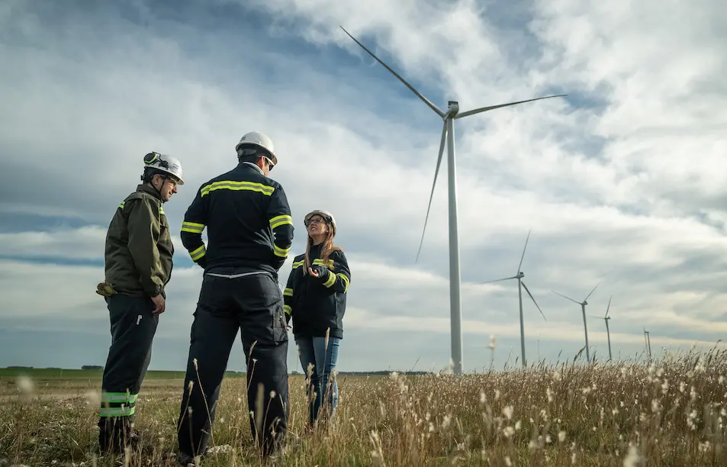
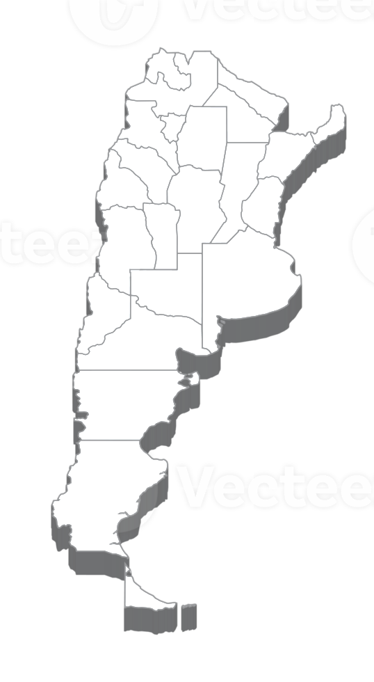


About Me
I am a Chemical Engineer specialized in continuous improvement, data analytics, process optimization and business intelligence solutions.
My work focuses on transforming complex data into actionable insights through statistical analysis, process improvement methodologies and data visualization techniques to enhance operational performance and support strategic decisions.
AEROWIND
Strategically located in the coastal region of Buenos Aires, Argentina, known for its intense and stable wind regime.
Necochea, Buenos Aires, Argentina
Aerowind contacted me to conduct a comprehensive operational performance analysis of the ‘Lighthouse’ Wind Farm, strategically located in the coastal region of Buenos Aires Province, an area known for its strong, stable and high-frequency wind regime, making it highly suitable for wind energy generation.
|| 1. INTRODUCTION & CONTEXT
|| Objective del

Slide 4
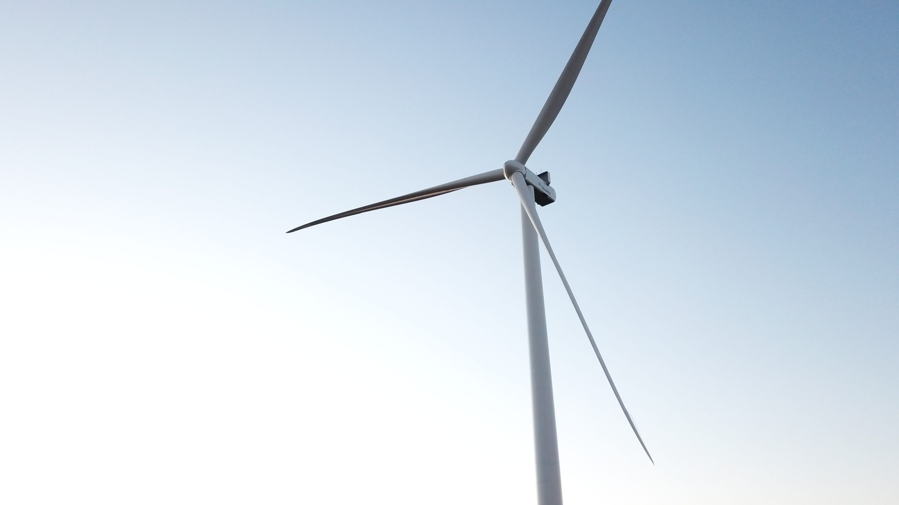

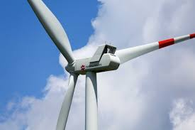
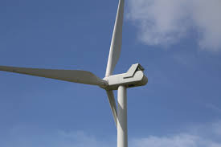
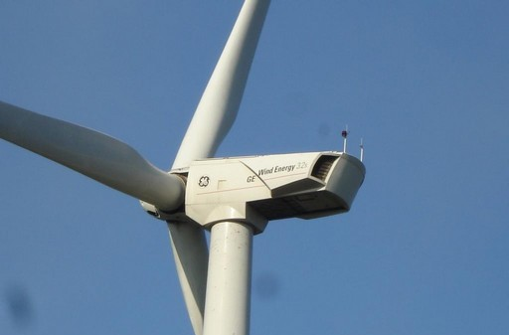


Installed Turbines
2023
2024
2025
AEROWIND lacks an integrated system to objectively measure its operational performance.
Data is currently fragmented across multiple sources, leading to visibility gaps and inconsistent decision criteria across the organization.
5
2
3
Vestas V100
Vestas V110
GE 2.5-116
10 wind turbines
21.9 MW installed capacity
48 GWh in 2025
CUSTOMER NEEDS
Define and calculate the farm’s main KPIs.
Design an interactive dashboard for real-time performance monitoring to support strategic decisions.
Provide a reliable, data-driven tool to replace manual reports and enable more precise and efficient management.
Answer business questions and increase energy efficiency.
|| 2. WIND FARM CHARACTERISTICS

Slide 5



Objective
a
The main objective is to evaluate the wind farm’s operational efficiency and historical performance, identifying production deviations and analyzing the impact of weather, operational and maintenance factors.
Due to wind variability, historical data analysis is essential to identify performance trends and seasonal patterns.
3 essential components were analyzed
b
Production fluctuations allow identification of energy losses and understanding of real performance.
a.
Climate
Production
Maintenance
b.
c.
c
Proper maintenance planning impacts turbine availability and energy generation.
|| 3. PROJECT PURPOSE

Slide 6


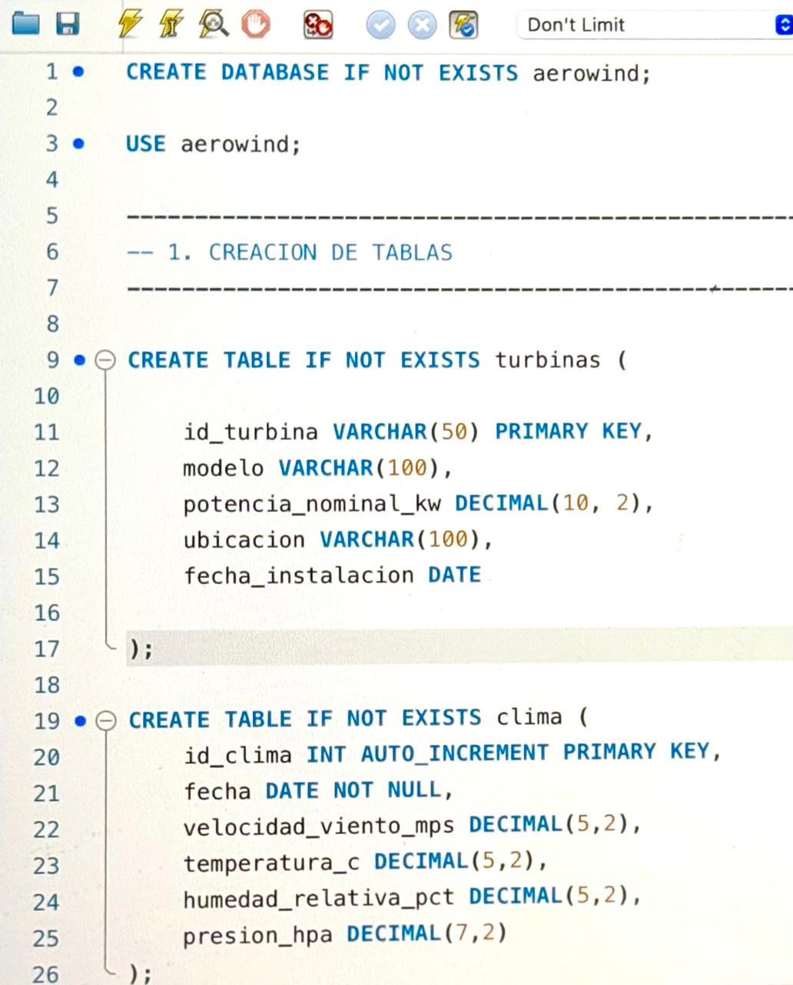


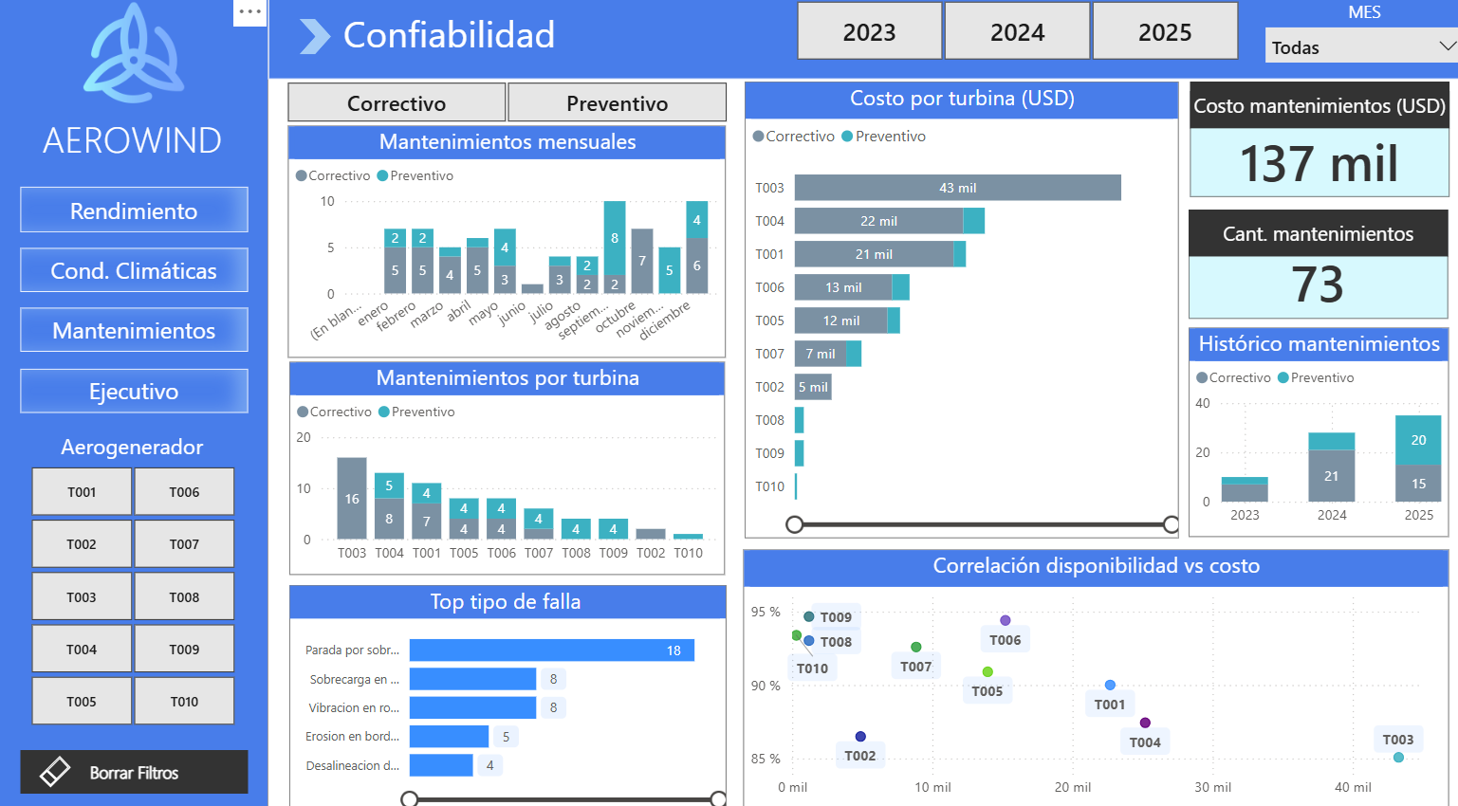
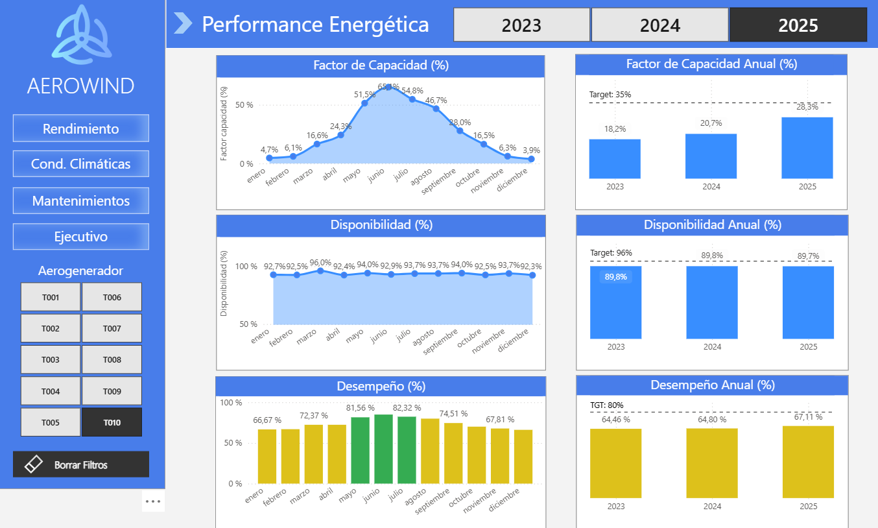
Tools Used
A
6 databases were generated:
production
maintenance
climate
turbines
price
theoretical_curves
B
Cleaning & queries in MySQL.
FACT TABLES
A
Chat GPT
Database generated with artificial intelligence.
DIMENSION
TABLES
B
MySQL
Data validation and cleaning.
C
Dashboard for data visualization.
C
Power BI
Data visualization.
|| 4. DATASET & ARCHITECTURE

Slide 7
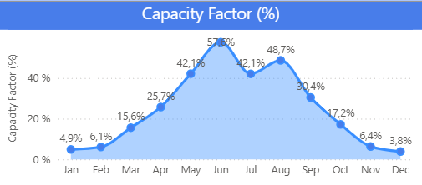
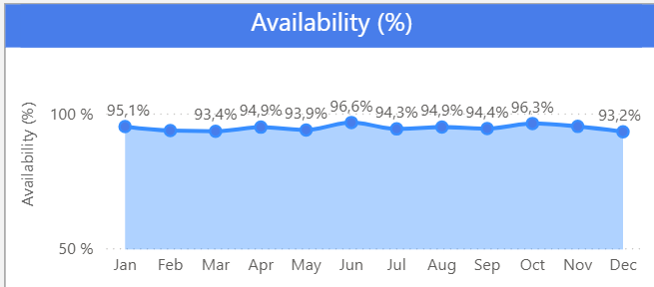
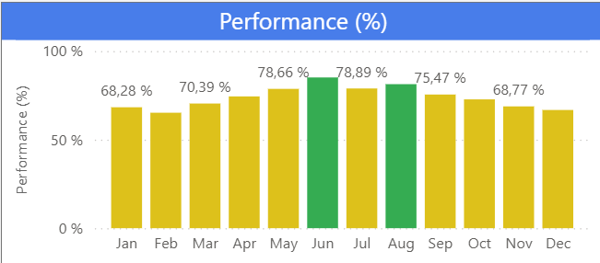

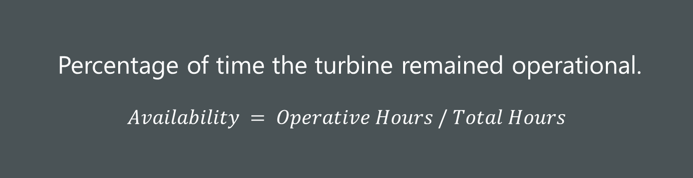
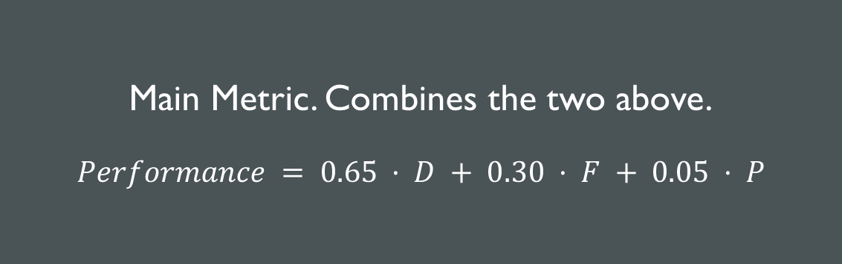
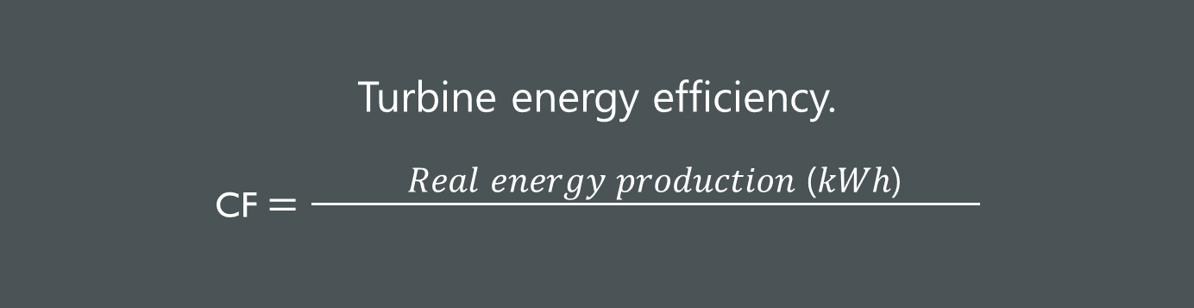
Capacity Factor (%)
Use of installed capacity.
CF $=\frac{ \text{Real} \text{energy} \text{production}\text{ (}\text{kW}\text{h}\text{)} }{}$
TARGET
25%
$$\text{Maximum} \text{possible} \text{energy} \text{production}\text{ (}\text{kWh}\text{)}$$
Availability (%)
TARGET
95%
Percentage of time the turbine remained operational.
$$Availability = Operative Hours / Total Hours$$
Performance (%)
TARGET
80%
Main Metric. Combines the two above.
$$Performance = 0.65 · D + 0.30 · F + 0.05 · P$$
< 60%
80-60%
80-100%.
|| 5. DASHBOARD & KEY INDICATORs

Slide 8
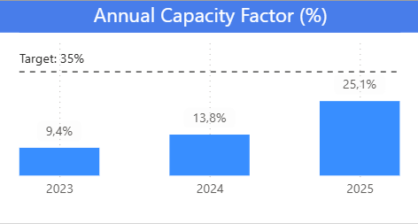
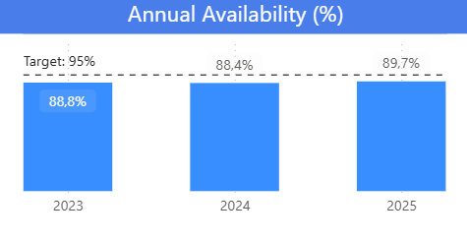
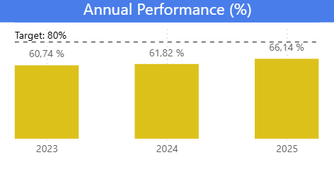
The Capacity Factor increases from 19.1% to 26.6%, with a stable wind resource and similar values across all turbine models in 2025.
It exceeded the 25% target in 2025 and can still improve.
Availability remains at high levels close to 90% year after year.
A more challenging target of 95% has been set.
The Performance remains stable at acceptable values close to 65%.
The goal is to bring it to optimal values of 80%.
|| 6. EXPLORATORY ANALYSIS

Slide 9
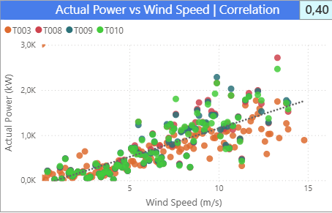
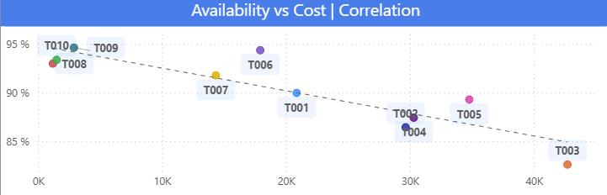
Turbine Performance Identification
Turbine T003 shows real power values below the newer units (T008, T009, T010) at high wind speeds, where generation potential is greatest.
Part of this gap is expected, since the GE units have a larger rotor and 2.5 MW of rated power versus 2.0 MW. However, T003 also delivers about 6% less power than the other V100 units at the same wind speeds.
Conclusion: T003 underperforms, even within its own model.
This chart reinforces the diagnosis: T003 stands as an outlier, combining one of the highest maintenance costs with below average availability.
Conclusion: T003 has the highest maintenance costs and lowest availability in the farm.
In contrast, turbines installed last year (GE 2.5-116) show optimal availability and cost levels.
Conclusion: T008/T009/T010 are consolidated as benchmark turbines of the wind farm.
|| 6. EXPLORATORY ANALYSIS

Slide 10
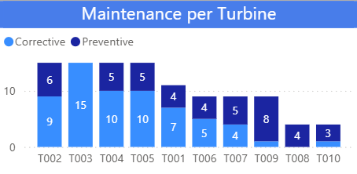
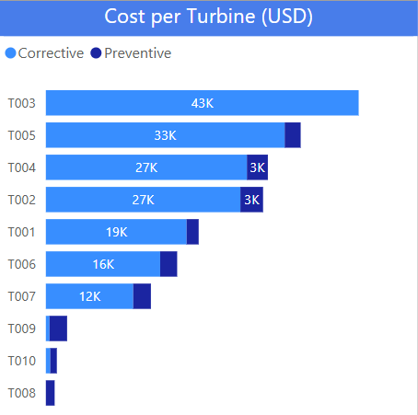


Operational Reliability
T008, T009 and T010 show minimal maintenance activity, mostly preventive (only 2 corrective interventions), indicating strong operational reliability.
T003 records the highest number of corrective maintenance events in the fleet, with no preventive interventions recorded.
Highest costs: T003
  This is explained by the
  lower cost of preventive maintenance compared
  to corrective maintenance:
  AVG preventive: $432 USD
  AVG corrective: $2,858 USD
Lowest costs: T008, T009 and T010
|| 6. EXPLORATORY ANALYSIS

Slide 11
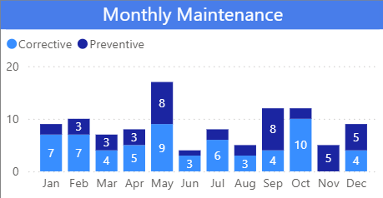
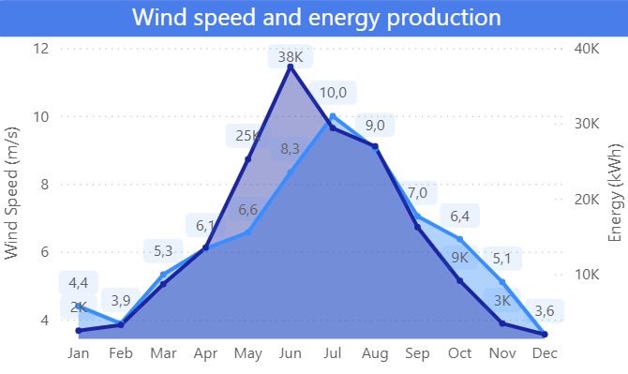
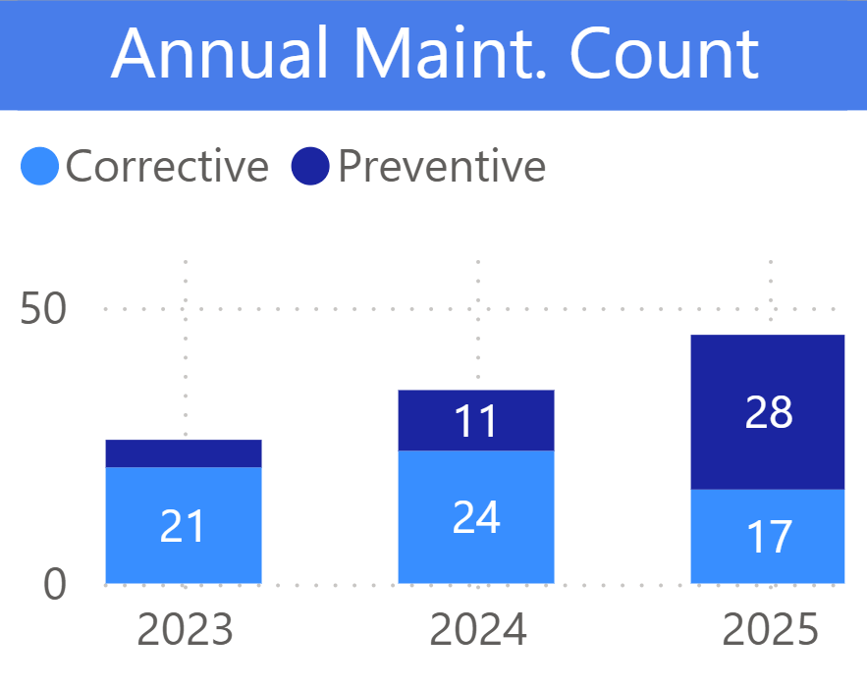

Operational Reliability
Maintenance activities are not strategically scheduled, creating opportunities for operational optimization.
Preventive maintenance should be concentrated during low-production periods to minimize interventions during peak generation hours.
High-wind months with greatest energy generated
Low-production months, optimal for performing maintenance.
At the annual level, a positive evolution of the strategy is observed: corrective maintenance predominated in 2023 and 2024, while in 2025 preventive increased significantly.
This trend shows a transition toward a more planned and efficient scheme that should be sustained and deepened.
|| 6. EXPLORATORY ANALYSIS

Slide 12
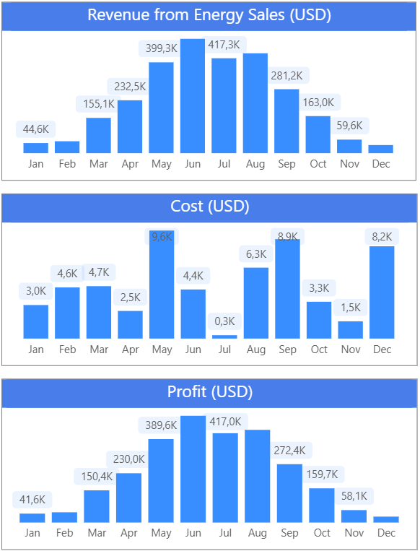

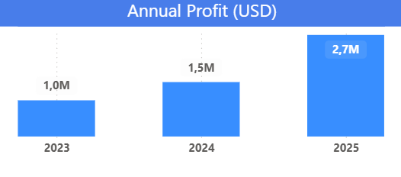

Profitability
Economic Result Calculation
profitThe farm profit is determined as the difference between income from energy sold and associated operational costs.
PROFIT = Revenue – Costs
Result Evolution
The year-over-year comparison shows a sustained improvement in profit, with significant growth in 2025, driven by greater energy generation and efficient cost control, even with a larger farm.
+87%
|| 6. EXPLORATORY ANALYSIS

Slide 13


Conclusions
1
The wind farm shows strong profitability potential, supported by a favorable cost structure and opportunities for operational improvement that could further enhance long-term performance.
Although the farm remains profitable despite certain operational inefficiencies, current performance is not fully optimized. The analysis identified avoidable efficiency losses and cost overruns which, if left unaddressed, could negatively impact future profitability and operational sustainability.
2) The analysis shows the need for a different asset management approach for turbines with recurring low performance, including specific technical actions and a review of the current maintenance strategy.
This performance gap reveals a clear opportunity to improve operational efficiency through technological standardization, stronger preventive maintenance practices, and prioritized intervention on critical assets, enhancing overall performance without requiring additional infrastructure expansion.
2
|| 7. CONCLUSIONS & RECOMMENDATIONS

Slide 14

What action lines emerge from these results?
A
Lifecycle management for critical turbines (T003)
Benchmark performance against T008, T009 and T010 to quantify the economic impact of reaching similar operating standards.
Strengthen preventive and predictive maintenance
Increase scheduled inspection frequency and use historical cost and availability data to optimize maintenance planning and budget allocation.
Optimize maintenance scheduling based on seasonality
Shift non-critical maintenance activities to low-generation periods to minimize generation losses.
Standardize future expansions with GE 2.5-116 turbines
Prioritize GE 2.5-116 models in future expansion projects due to their higher availability and lower costs.
B
C
D
|| 7. CONCLUSIONS & RECOMMENDATIONS

Slide 15

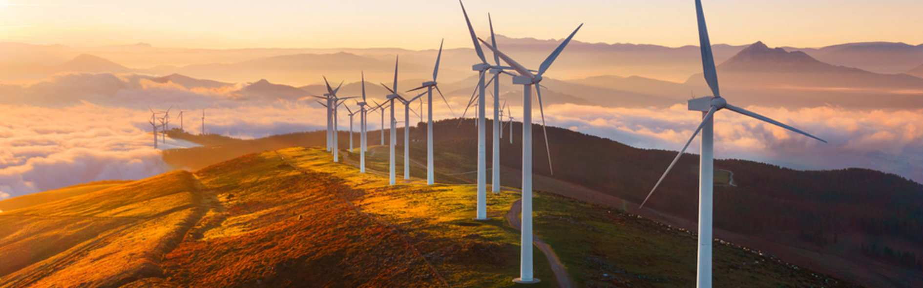
Thank You!

