Slide 1
Random Name Generator
Presentation by
Kent Hazen

Slide 2
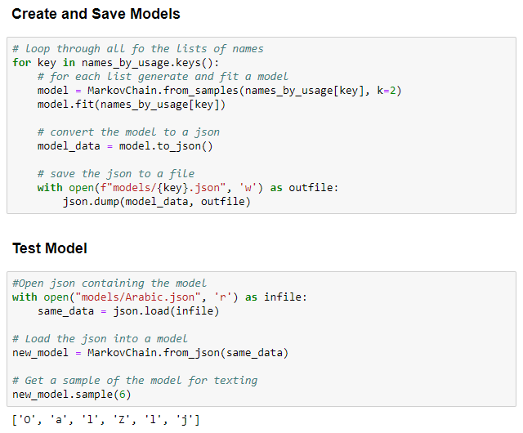
Demonstration

Slide 3
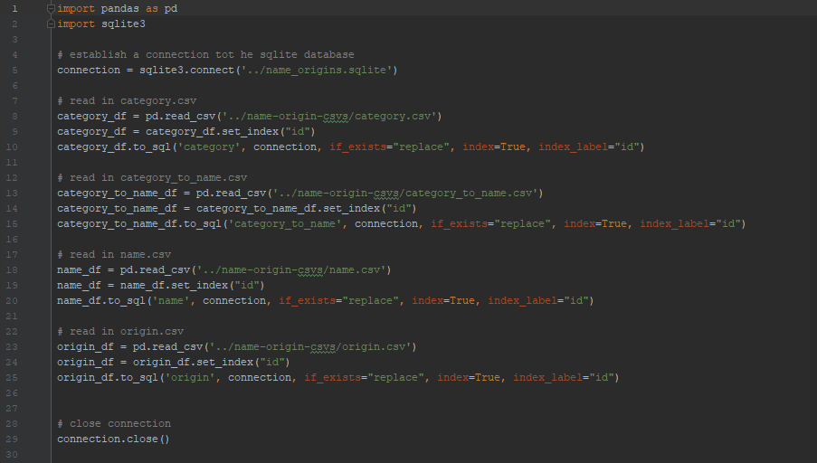
Importing Data into SQLite Database

Slide 4
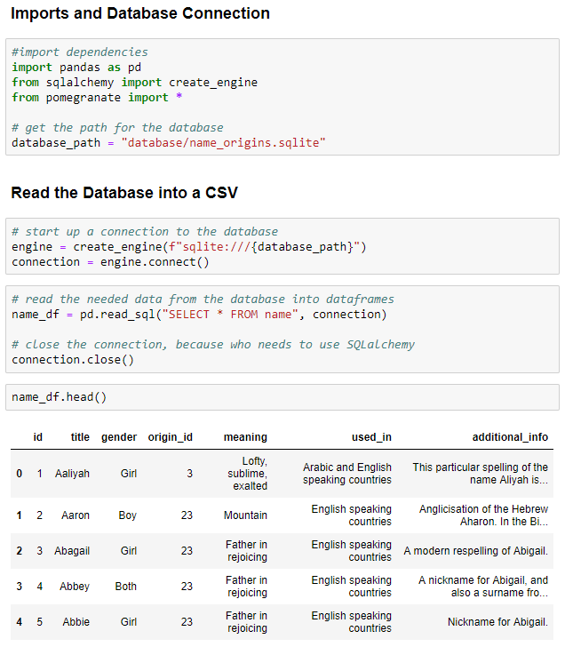
Importing the Data into a Pandas Dataframe

Slide 5
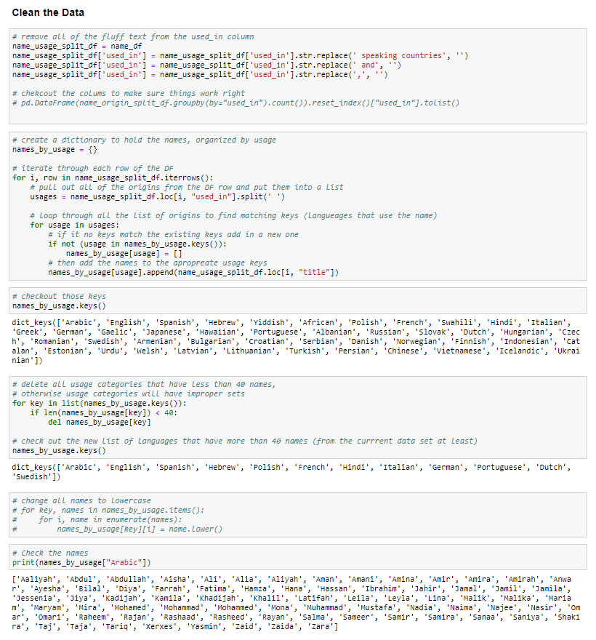
Restructuring the Data to be used by Pomegranate

Slide 6
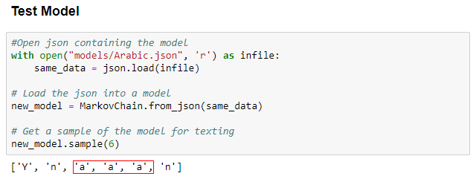
Issue 1: Too many repeat letters

Slide 7
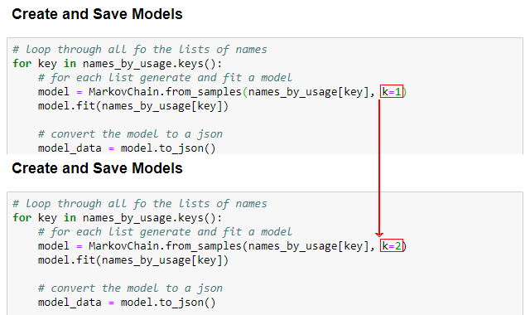
Changing k

Slide 8
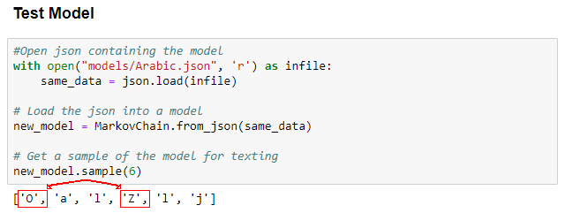
Issue 2: Capital Letters?

Slide 9
Potential Reason 1: Model Overwrite

Slide 10
Potential Reason 2: Problem Reading/Writing

