Slide 1

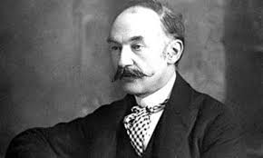
Thomas Hardy Team
OOP Teamwork
Thomas Hardy is a Victorian realist writer

Slide 2
OUR TEAM
Иво Спасов – ivossss
Делян Николов – delyan_nikolov_1992
Силвена Митева – smile7
Иван Трендафилов – Wanker
Диана Станчева – diana.satncheva
Теодора Петрова - tlpetrova

Slide 3
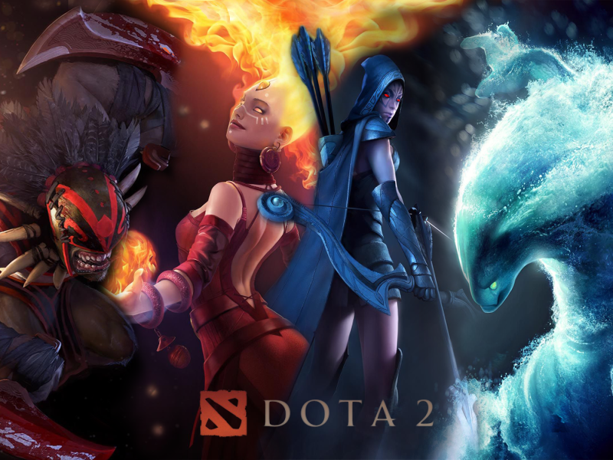

Slide 4
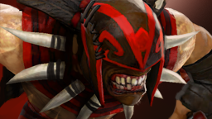
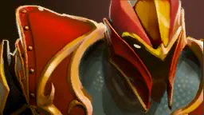
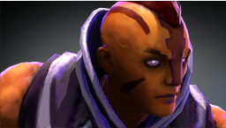
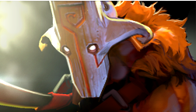

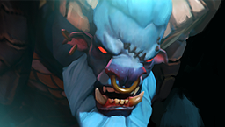
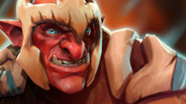
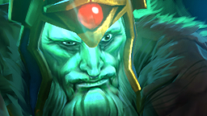
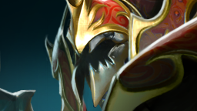
Heroes
Bloodseeker
Dragon Knight
Anti-Mage
Juggernaut
Morphling
Spirit Breaker
Troll Warlord
Wraith King
Nyx Assassin

Slide 5
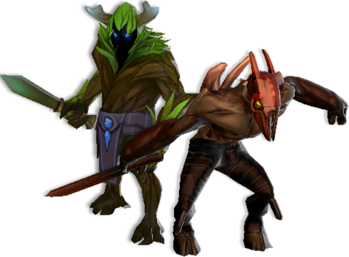
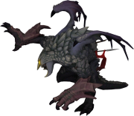
Characters
Creeps
Roshan

Slide 6
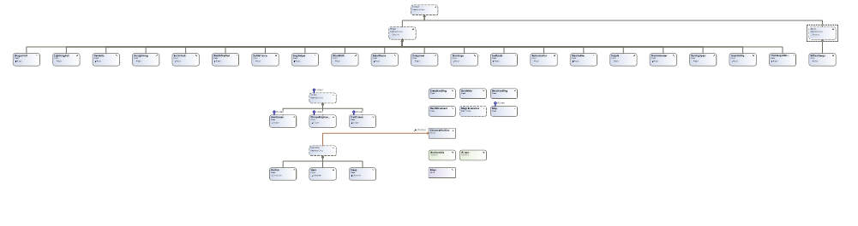
CLASS DIAGRAM
31 classes
5 abstract classes
1 static class
1 interface
1 structure
1 enumeration
1 design pattern – Singleton
3 levels depth

