Slide 1
Java Servlets
PAO – lab 12

Slide 2
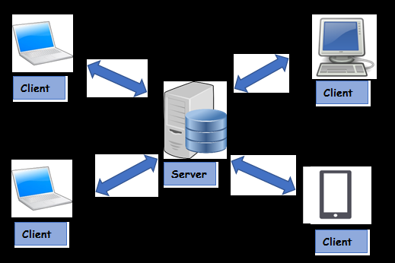
Introduction to web development Client-server model
Client-server model: a distributed application structure that partitions tasks or workloads between the providers of a resource or service, called servers, and service requesters, called clients.
Clients make requests
Servers respond to the requests

Slide 3
Client-server model
Client:
When we talk the word Client, it mean to talk of a person or an organization using a particular service. Similarly in the digital world a Client is a computer (Host) i.e. capable of receiving information or using a particular service from the service providers (Servers).
Example of clients: a browser, a mobile phone
Example of client applications: a browser app, a mobile app - frontend applications (HTML, CSS, JavaScript for browser apps)
Servers:
Similarly, when we talk the word Servers, It mean a person or medium that serves something. Similarly in this digital world a Server is a remote computer which provides information (data) or access to particular services.
Example of server applications: apps used to feed information towards the client ones - backend applications (example of programming languages: Java, C#)

Slide 4
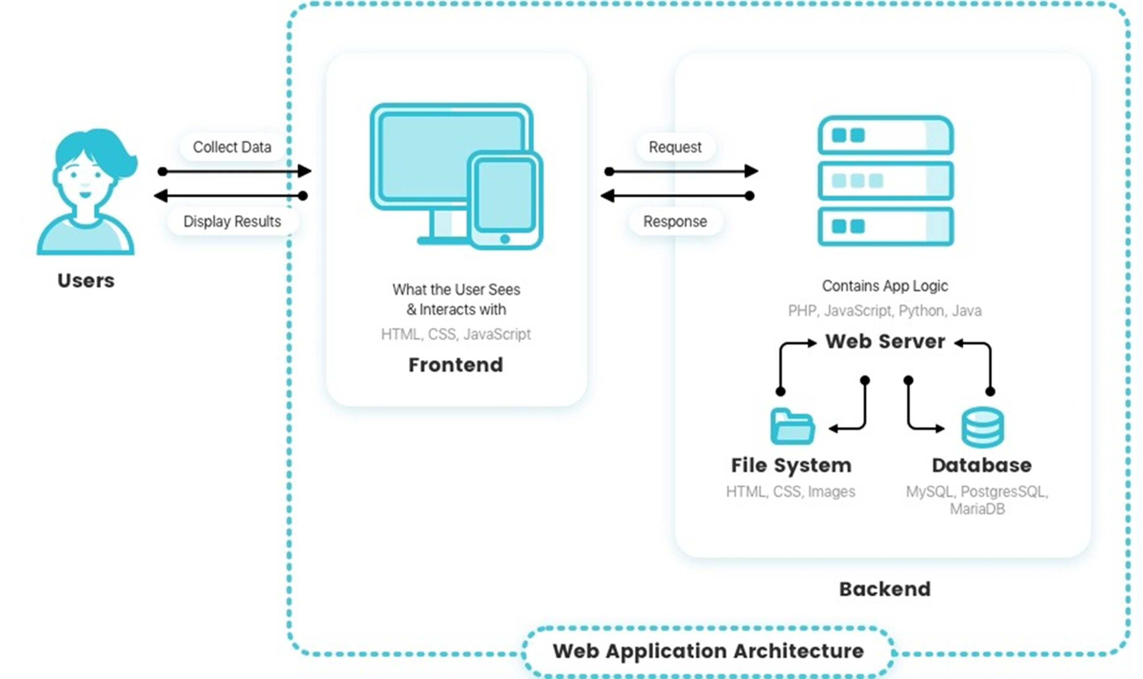

Slide 5
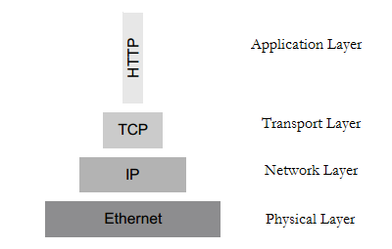
Communication protocols
Communication protocol
set of rules used to make the communication between network entities possible
a protocol defines the rules, syntax, semantics and synchronization of communication and possible error recovery methods
must be agreed by the entities
protocols are layered to form a protocol stack

Slide 6
HTTP (Hypertext Transfer Protocol)
foundation of data communication over the www
Server-client exchange: request-response
Default port: 80 (but other ports can be used as well)
Connectionless - the HTTP client (a browser) initiates an HTTP request and waits for the response. The server processes the request and sends a response back after which client disconnect the connection. So, client and server knows about each other during current request and response only. Further requests are made on new connection like client and server are new to each other.
Stateless - neither the client nor the browser can retain information between different requests across the web pages
Media independent - any type of data can be sent by HTTP as long as both the client and the server know how to handle the data content

Slide 7
HTTP
The HTTP "client" (Web browser or any other client) establishes a connection to a server. After the server accepts the connection, it sends the HTTP request message
The HTTP "server" accepts the connection and then sends a HTTP response message.
HTTP makes use of the URL (Uniform Resource Locator) to identify a given resource and to establish a connection
URI – Uniform Resource Identifier
"http:" "//" host [ ":" port ] [ abs_path [ "?" query ]]
http://www.onlineshop.com/products?category=it

Slide 8
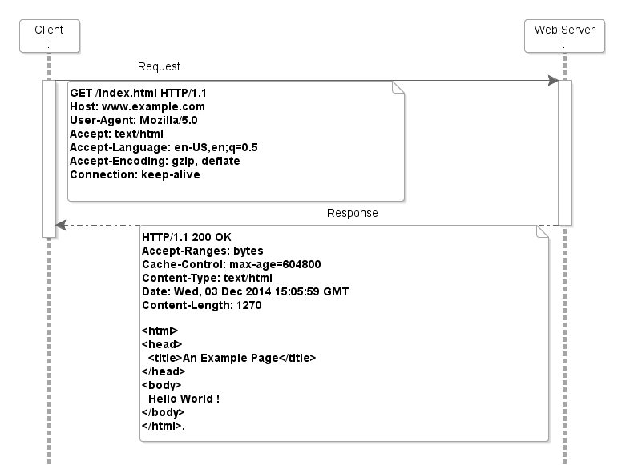
Headers & message body
HTTP header fields provide required information about the request or response, or about the object sent in the message body (key-value pairs, metadata)
Message body - is used to carry the entity-body associated with the request or response. If entity body is associated, then usually Content-Type and Content-Length headers specify the nature of the body associated. It is optional

Slide 9
Request methods
The request method indicates the method to be performed on the resource identified by the given Request URL
Most used methods:
GET – get a resource
POST – create a resource
PUT – update a resource
DELETE – delete a resource

Slide 10
Response status codes
1xx info
2xx success
3xx redirect
4xx client error
5xx server error
All status codes: https://httpstatuses.com/

Slide 11
Java Servlets
A Servlet is a class that handles requests, processes them and replies back with a response.
A Java Servlet is a Java object that responds to HTTP requests. A servlet is part of a Java Web Application.
A Java web application can contain other components than servlets. It can also contain Java Server Pages (JSP) and Web Services.
It runs inside a Servlet container.
A Servlet container may run multiple web applications at the same time, each having multiple servlets running inside.

Slide 12
Servlet container
Java servlet containers are usually running inside a Java web server such as Jetty, Tomcat, etc.
Java web server = software that accepts HTTP requests
Tomcat Setup:
Download Tomcat from ​ https://tomcat.apache.org/​ - Tomcat 9.0 zip file
Unzip and add the folder in a location of your preference
In your IDE create a new project: ​ Java Enterprise and set up the application server as the downloaded tomcat web server.

Slide 13
HTTP request-response
The browser sends an HTTP request to the Java web server.
The web server checks if the request is for a servlet.
If it is, the servlet container is passed the request.
The servlet container will then find out which servlet the request is for, and activate that servlet. The servlet is activated by calling the Servlet.service() method.
Once the servlet has been activated via the service() method, the servlet processes the request, and generates a response.
The response is then sent back to the browser.

Slide 14
Servlet lifecycle
A servlet follows a certain life cycle.
The servlet life cycle is managed by the servlet container.
The life cycle contains the following steps:
1. Load Servlet Class.
2. Create Instance of Servlet.
3. Call the servlets init() method.
4. Call the servlets service() method.
5. Call the servlets destroy() method.

Slide 15
A Java Servlet is just an ordinary Java class which implements the interface javax​.servlet.Servlet​
The easiest way to implement this interface is to extend the class HttpServlet.
The HttpServlet class reads the HTTP request, and determines if the request is an HTTP GET, POST, PUT, DELETE,etc. and calls the corresponding method.
To respond to HTTP GET requests you will extend the HttpServlet class, and override the doGet() method.

Slide 16
Servlet code example
// Import required java libraries
import java.io.*;
import javax.servlet.*;
import javax.servlet.http.*;
// Extend HttpServlet class
@WebServlet​(name = ​"Servlet"​, urlPatterns={​"/Hello"​}
public class HelloWorld extends HttpServlet {
private String message;
@Override
public void init() throws ServletException {
// Do required initialization
message = "Hello World";
}
@Override
public void doGet(HttpServletRequest request, HttpServletResponse response) throws ServletException, IOException {
// Set response content type
response.setContentType("text/html");
// Actual logic goes here.
PrintWriter out = response.getWriter();
out.println("<h1>" + message + "</h1>");
}
@Override
public void destroy() {
// do nothing.
}
}

Slide 17
Servlets
Servlets are not limited to the HTTP protocol.
Servlet is a generic interface and the HttpServlet is an extension of that interface – adding HTTP specific support – such as doGet and doPost.
The Servlet technology is also the main driver of a number of other web technologies such as JSP- JavaServer Pages, Spring MVC, etc

Slide 18
JSP (Java Server Pages)
JavaServer Pages (JSP) allows dynamic content injection into static contents using Java and Java Servlets.
We can make requests to a Java Servlet, perform relevant logic, and render a specific view server-side to be consumed client-side.
JavaServer Pages (JSP) enabled Java-specific data to be passed into or placed within a .jsp view and consumed client-side.
JSP files are essentially .html files with some differences:
some extra syntax to inject the dynamic data
the .html suffix is replaced with .jsp (it's considered a .jsp file type)
the following tag is added to the top of the .html markup elements:
<%@​ page contentType​=​"text/html;charset=UTF-8"​ ​language​=​"java"​ %>

Slide 19
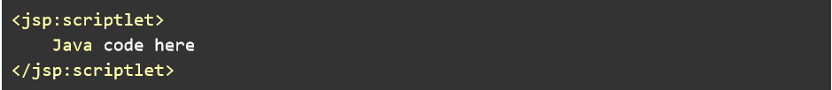
JSP Syntax
There are two ways to add Java code to a .jsp.
1. We can use basic Java Scriptlet ​syntax which involves placing Java code blocks within two Scriptlet tags:
2. The second method is specific to XML:

Slide 20
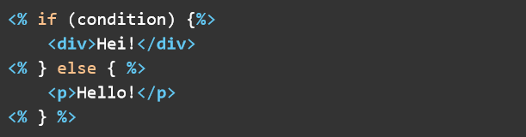
JSP Syntax
We can use conditional logic client side with JSP by using if, then, and else clauses and then wrapping the relevant blocks of markup with those brackets.

Slide 21
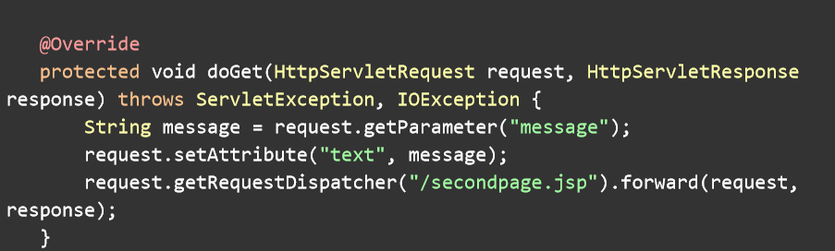
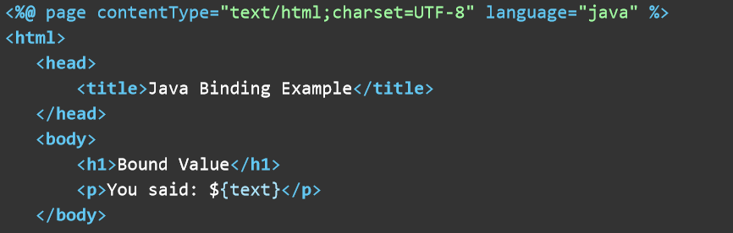
JSP example

Slide 22
RESTful Webservices
REST = REpresentational State Transfer.
an architecture style for designing loosely coupled applications over HTTP, that is often used in the development of web services
REST is web standards based architecture and uses HTTP Protocol (although it can be used with any resource based protocol).
It revolves around resource where every component is a resource and a resource is accessed by a common interface using HTTP standard methods.
In REST architecture, a REST Server simply provides access to resources and REST client accesses and modifies the resources. Here each resource is identified by URIs/ global IDs.
REST uses various representation to represent a resource like text, JSON, XML. JSON is the most popular one.

Slide 23
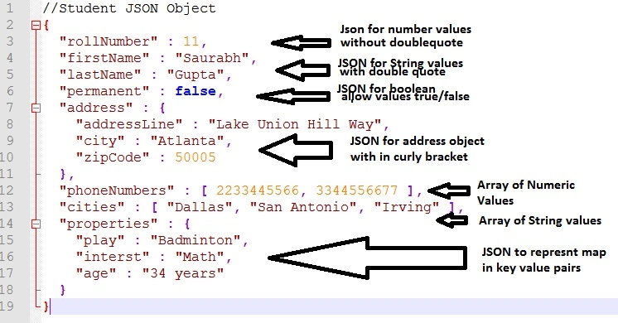
JSON (JavaScript Object Notation)

Slide 24
Principles of REST
Client–server – By separating the user interface concerns from the data storage concerns, we improve the portability of the user interface across multiple platforms and improve scalability by simplifying the server components.
Stateless – Each request from client to server must contain all of the information necessary to understand the request, and cannot take advantage of any stored context on the server. Session state is therefore kept entirely on the client.
Cacheable – Cache constraints require that the data within a response to a request be implicitly or explicitly labeled as cacheable or non-cacheable. If a response is cacheable, then a client cache is given the right to reuse that response data for later, equivalent requests.

Slide 25
Principles of REST
Uniform interface – By applying the software engineering principle of generality to the component interface, the overall system architecture is simplified and the visibility of interactions is improved. In order to obtain a uniform interface, multiple architectural constraints are needed to guide the behavior of components. REST is defined by four interface constraints: identification of resources; manipulation of resources through representations; self-descriptive messages; and, hypermedia as the engine of application state.
Layered system – The layered system style allows an architecture to be composed of hierarchical layers by constraining component behavior such that each component cannot “see” beyond the immediate layer with which they are interacting.
Code on demand (optional) – REST allows client functionality to be extended by downloading and executing code in the form of applets or scripts. This simplifies clients by reducing the number of features required to be pre-implemented.

Slide 26
REST resources
The key abstraction of information in REST is a resource. Any information that can be named can be a resource: a document or image, a temporal service, a collection (or subcollection) of other resources, an object; URIs are used to access the resources
Resource naming conventions:
Use nouns
Be consistent across the service
Lowercase in URIs
No trailing “/”
Use “-” to increase readability in URIs, not “_”
More here: https://restfulapi.net/resource-naming/

Slide 27
REST resource methods
Another important thing associated with REST is resource methods to be used to perform the desired transition (and uniform across the services)
In the context of REST APIs, when making multiple identical requests has the same effect as making a single request – then that REST API is called idempotent.
These duplicate requests may be unintentional as well as intentional some time (e.g. due to timeout or network issues). You have to design fault-tolerant APIs in such a way that duplicate requests do not leave the system unstable.
POST – not idempotent
The rest of the methods (GET, PUT, DELETE, etc) – should be idempotent

Slide 28
Steps to design a REST API
1. Identify the resources
Online shop: Category, Subcategory, Product
2. Create the URIs
/categories
/categories/{id}
/categories/{id}/subcategories
/categories/{id}/subcategories/{id}
/products
/products/{id}

Slide 29
Steps to design a REST API
3. Assign HTTP methods
GET /categories : get all categories
POST /categories : create new category
GET /categories/{id} : get single category by id
PUT /categories/{id} : update category with id
DELETE /categories/{id} : delete category with id
(…)

Slide 30
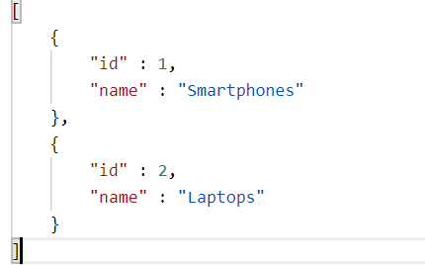
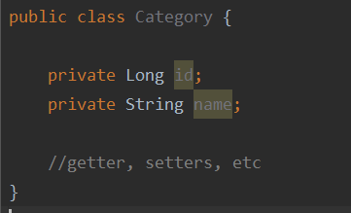
Steps to design a REST API
4. Determine (JSON) representations for the resources

Slide 31
Resources
https://www.javatpoint.com/computer-network-client-and-server-model
https://www.tutorialspoint.com/http/http_overview.htm
https://dzone.com/articles/what-servlet-container
https://www.tutorialspoint.com/servlets/index.htm
https://www.baeldung.com/jsp
https://restfulapi.net/

