Slide 1
Chicago 311 Service Requests Pipeline
Airflow - dbt - DuckDB
ROSU DIANA

Slide 2
The assignment's requirements
Common (any dataset)
Airflow + DuckDB + dbt, staging → marts structure
At least one SCD Type 2 dimension, via dbt snapshot
5+ dbt tests: not_null, unique, relationships, + custom SQL
DAG with 4+ stages, retries, idempotent, fails
on critical validation
Written documentation, weighted equally with the code
Specific to Chicago 311
Real incremental extraction (created_date>:cursor)
Watermark in a DuckDB control table, not an Airflow Variable
Text normalization (status, sr_type, sr_short_code)
Incremental fact table, merge on sr_number
dim_wardSCD2 — correct historical ward attribution
Register a free Socrata app token as an Airflow Connection to avoid rate limiting
- An incremental data pipeline - Apache Airflow for orchestration, DuckDB as the local warehouse, dbt for transformation and testing - that ingests Chicago's 311 Service Requests from the Socrata open-data API, models them into a star schema, and answers one operational question: where is the city falling behind on service response times, and is it getting better or worse?

Slide 3
Star Schema - Gold Layer
dim_service_request_type
sr_short_code (PK)
service_request_type
fct_311_requests (7M millions)
sr_id (PK)
sr_short_code (FK)
service_request_type
status
origin
created_date / _day (FK)
last_modified_date / _day (FK)
closed_date / _day (FK)
location_id (FK)
community_area (FK)
ward (FK)
duplicate
legacy_record
parent_sr_number
ward_map_version_at_request
dim_location (~788,535)
location_id (PK)
street_number
street_direction
street_name
street_type
city
state
dim_date (5,844)
date_day (PK)
year
quarter
month
month_name
day_of_week
is_weekend
day_of_year
dim_community_area (77)
community_area (PK)
community_area_name
dim_ward - SCD2 (100)
ward (PK) map_version
dbt_scd_id
dbt_updated_at
dbt_valid_from / dbt_valid_to

Slide 4
Left in Silver
Administrativ
- owner_department
- created_department
Adresă brută
- street_address
- zip_code
Poliție
- police_sector
- police_district
- police_beat
- precinct
- electrical_district
- electricity_grid
Coordonate
- x_coordinate
- y_coordinate
- latitude
- longitude
Timp derivat din sursă
- created_hour
- created_day_of_week

Slide 5
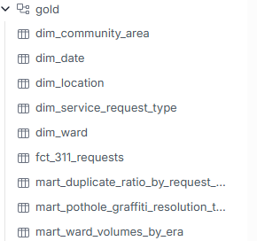
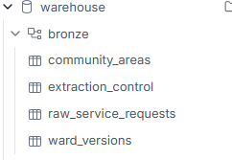


Slide 6
How Airflow, DuckDB, and dbt connect
Stage | Schema | Table(s)
1. extract | bronze | extraction_control (watermark: source, last_run_date - updated after every page)
2. load | bronze | raw_service_requests (upsert: delete by sr_number, insert)
3. dbt_seed | bronze | community_areas, ward_versions
4. transform_staging | silver | stg_311_requests (view)
5. dbt_snapshot | gold / silver | dim_ward (SCD2), snap_service_requests_status (SCD2)
6. transform_marts | gold | fct_311_requests, dim_service_request_type, dim_location, dim_community_area, dim_date, and the 3 marts
7. validate | - | reads everything above - no new table, runs dbt test
8. dbt_docs_generate | - | reads everything above - no new table, refreshes docs/lineage

Slide 7
dim_ward: the history of a map
pipeline started here (2026)
2015-01-01
2023-05-15
today
old_map
redistricting
new_map
The problem
A live dbt snapshot can only observe the current state - it can't retroactively produce the old_map -> new_map transition.
The fix
A one-time backfill script inserted pre-2023 history matching dbt's own SCD2 schema. Join uses dbt_valid_from <= created_date < dbt_valid_to.

Slide 8
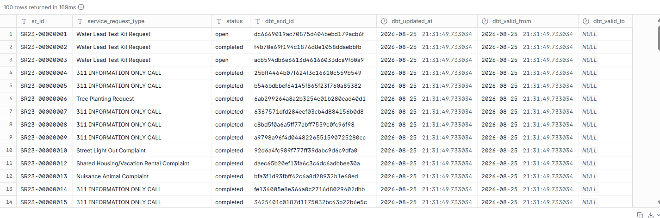
snap_service_requests_status: the history of a request

Slide 9
Folder Layout
dags/ingest_dag.py - The Airflow DAG - all 8 tasks
dbt_project/models/staging/ - stg_311_requests - clean/typed, no business logic
dbt_project/models/marts/ - Dimensions, fact table, 3 deliverable marts
dbt_project/snapshots/ - SCD2: dim_ward, snap_service_requests_status
dbt_project/seeds/ - community_areas.csv, ward_versions.csv
dbt_project/tests/ - Custom SQL tests
scripts/backfill_dim_ward.py - One-time SCD2 backfill
raw/ - Landed Parquet files (git-ignored)
warehouse.duckdb - The DuckDB database file (git-ignored)
docker-compose.yml, Dockerfile - Airflow + Postgres; image built once
docs/, README.md - Documentation and run instructions

Slide 10
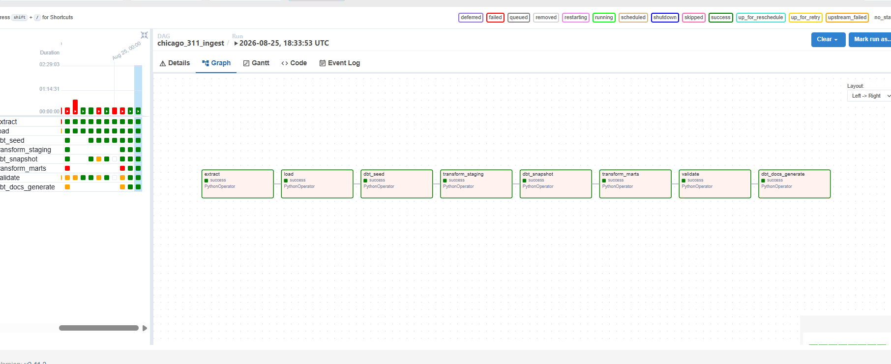
Successful Pipeline Run

Slide 11
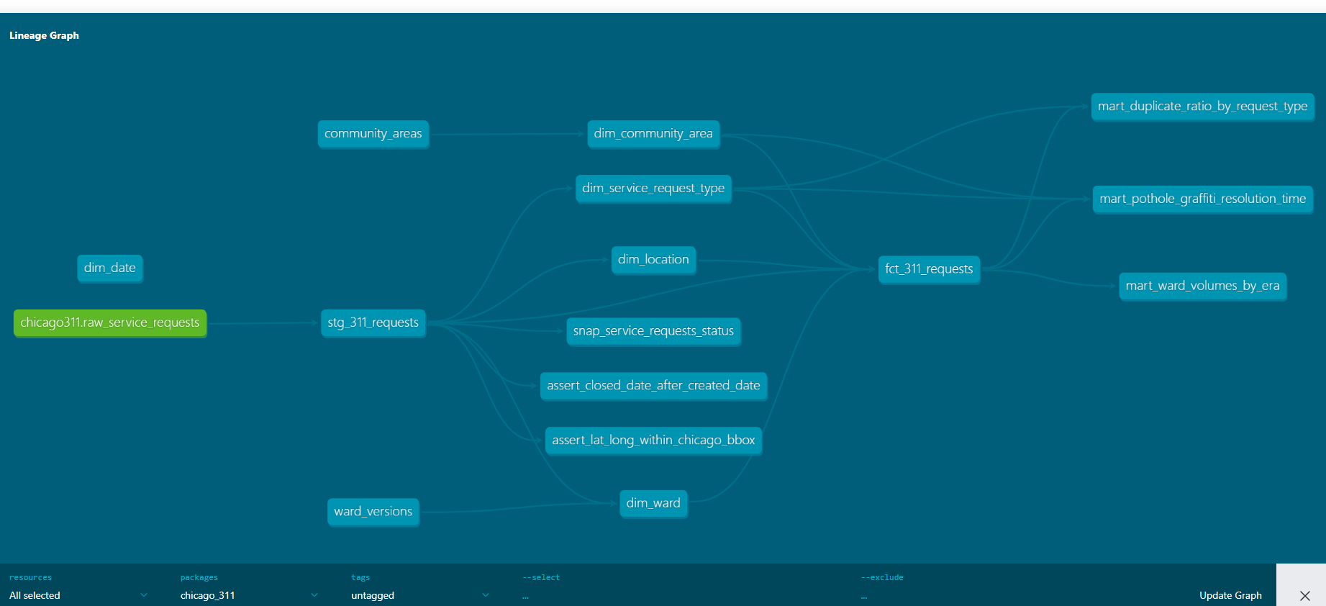
dbt Lineage

Slide 12
Tests Implemented
Test | Severity | Why it exists
unique / not_null: sr_id | error | Primary key of every request - must be unique and present
not_null: created_date | error | Drives incremental logic and every date-based mart
accepted_values: status | error | Domain rule - catches a new, unmapped source value immediately
lat/long within Chicago bbox | error | Custom SQL test - catches geocoding errors
closed_date >= created_date | warn | Custom SQL test - 1 known legacy row violates this
not_null: community_area | warn | Known dirty data (~0.1% of rows) from the source itself
relationships: location_id -> dim_location | warn | Known incomplete/ungeocoded addresses
relationships: sr_short_code -> dim_service_request_type | error | Every fact row must resolve to a known type
unique/not_null on every dimension key | error | Dimension natural/surrogate key integrity

Slide 13
Q1 - Pothole / Graffiti Resolution Time
Which community areas have the slowest median resolution time, and has it improved or worsened year-over-year?
Area | 2023 | 2024 | 2025 | 2026 | Overall
O'Hare | 8.2 | 6.9 | 22.0 | 8.2 | 10.9
Edison Park | 6.8 | 12.0 | 19.7 | 6.5 | 10.1
Norwood Park | 4.1 | 8.9 | 21.0 | 6.9 | 8.6

Slide 14
Q2 - Duplicate / Reopened Ratio
Which request types have the highest ratio of reopened/duplicate complaints (same location, same type, within a short window)?
Request type | Total | Dup %
Liquor Establishment | 295 | 45.8%
Divvy Bike Parking | 11,658 | 45.7%
Open Fire Hydrant | 25,014 | 43.9%
Traffic Signal Out | 96,859 | 41.0%
City Vehicle Sticker | 16,395 | 35.9%

Slide 15
Q3 - Ward Volumes Across the Redistricting
Do ward-level volumes differ when attributed to the ward in effect at the time vs. the current map, across the 2023 redistricting?
Ward | old | new | Excess
43 | 29.8 | 51.5 | +43.3
44 | 20.7 | 34.1 | +34.9
39 | 39.3 | 63.0 | +30.4
14 | 52.1 | 58.7 | -17.1

Slide 16
What didn’t work initially

