Slide 1
Main Economic Indicators of Kazakhstan

Slide 2
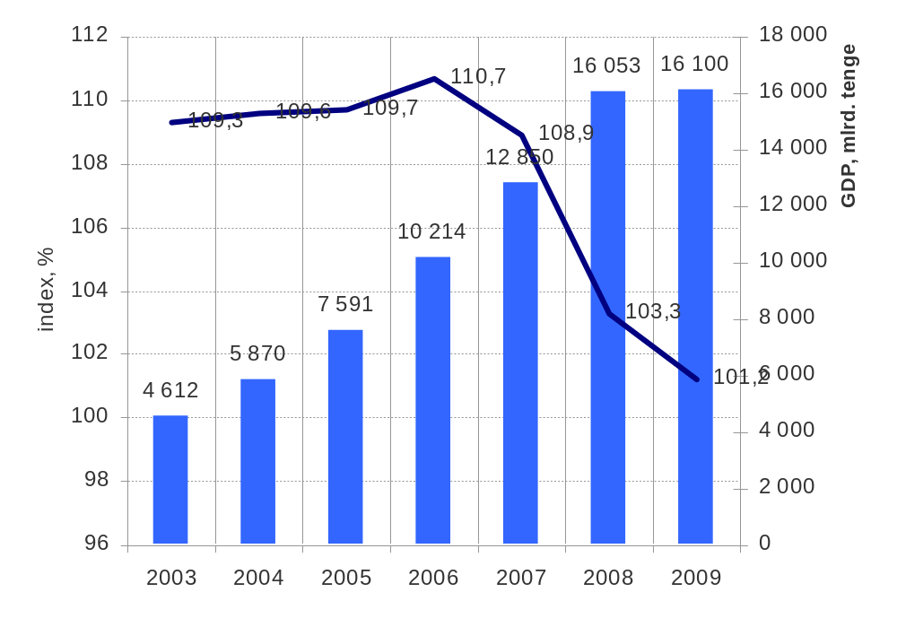
Economic background
As shows diagram In 2009 there was a recession in economy of Kazakhstan. Annual GDP has grown only on 1,2 %.
If to consider data for the first quarters we will see, that in 2010 GDP has increased on 7%.
The reason was the considered state policy about an exit from crisis, state support of domestic bank system, a good conjuncture in the raw materials markets, absence of a panic at the population and business of Kazakhstan and the good relation to Kazakhstan in the world markets.
Index of actual volume, GDP of RoK (1Q 2007-1Q 2009)

Slide 3
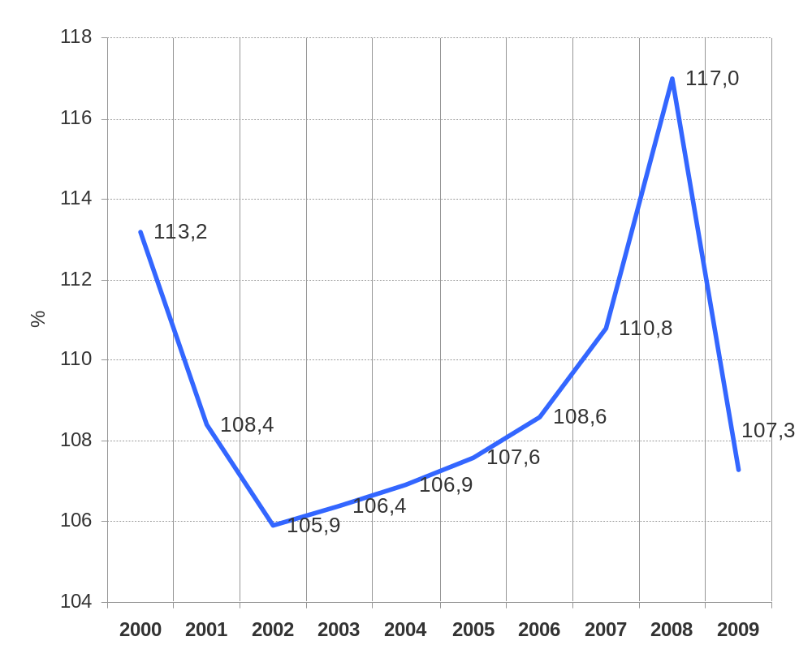
Economic background
Consumer Price Index in RoK (2000-2009)
Diagram shows the "heating" of national economy from 2003 to 2007. Sharp growth of consumer prices in 2008 first of all has been caused by the crisis in economy and unavailability of the government to such rapid influence.
But in 2009 a situation shows has strongly changed consumer price index has come nearer to optimum values and has became about 7 %.

Slide 4
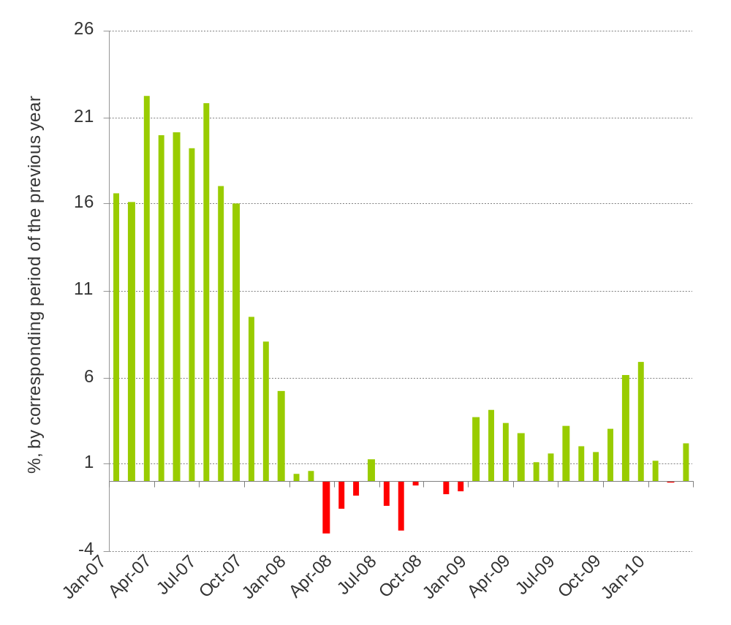
Economic background
index of real wages in RoK (2007-2010)
Till autumn of 2007 dynamics of the real wages index was very high (more than 15 %). Since September, 2007 this indicator starts reduce sharply, and in 2008 the real wages pass to a negative zone. It means that purchasing power of the inhabitants reduces.
But since January 2009 positive dynamics was restored and keeps and a positive zone throughout all year.

Slide 5
Main Indicators by oil, electricity, mining and automobile

Slide 6
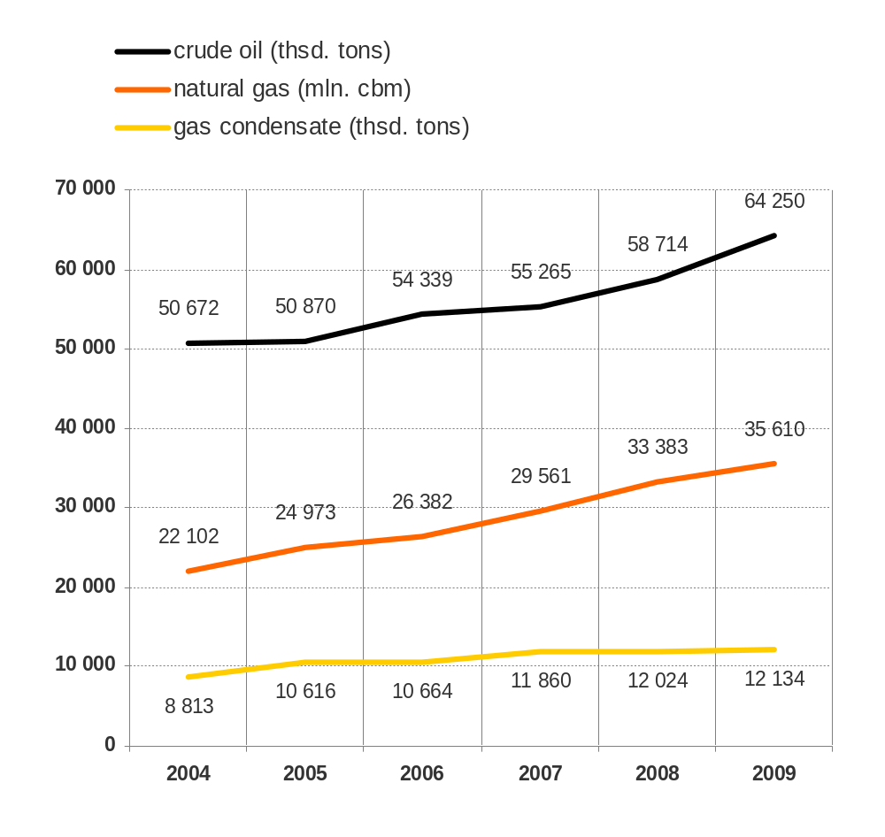
Oil & Gas
Volume of oil and gas production in RoK (2004-2009)
According to agency RK of statistic extraction of oil and gas products occupies more than half of all industrial production in Republic.
The confirmed strategic stocks include 169 hydrocarbonic minefields:
  87 of them are oil fields,
  17 gas
  30 oil and gas and others
Oil and gas area occupy the territory about 1,7 million sq. km (approximately 62 % of territory of Kazakhstan).
In Kazakhstan the proved reserves is near 2,8 billion tons of oil and 1,8 bln. cubic metres of gas, And prognostic- about 12 billion tons of oil and a condensate and about 3 bln. cubic metres of gas.

Slide 7
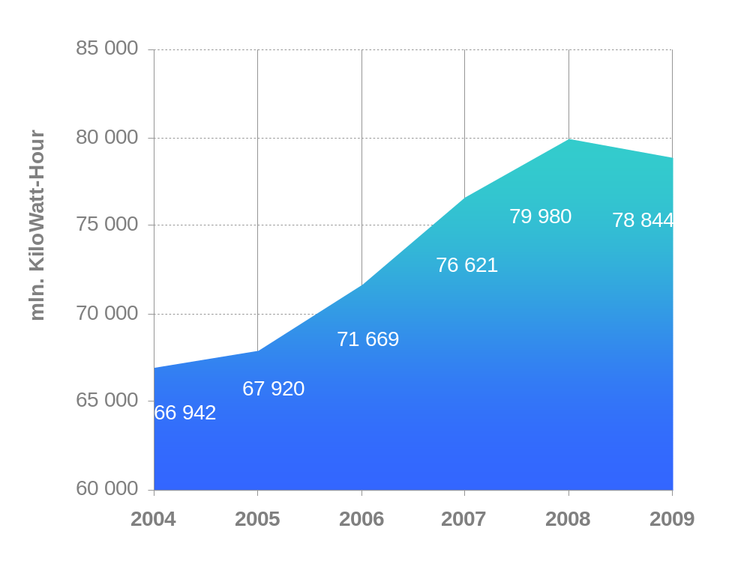
Power industry
The basis of generating capacities of Kazakhstan is the thermal power stations – 88%. 12% is hydroelectric power stations.
The nuclear and alternative power in Kazakhstan is not developed or in general is absent. All electro power objects are united in the United electro power system of Kazakhstan with voltage 220-1150кW.
Company KEGOC is the system operator, using NEN (National electric network) with voltage 220-1150кW And realizing operatively-dispatching administration of the NEN.
Volume of the electric power production in RoK (2004-2009)

Slide 8
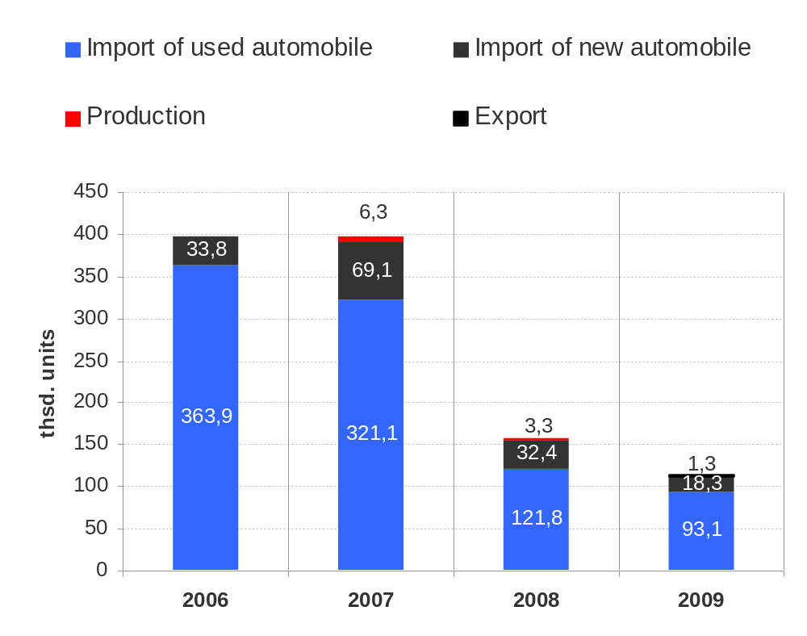
Automobile market
Major factor of influence on a car market today is the joining to the Customs union. This event will cardinally change structure and dynamics of the market the next 3-5 years.
For autodealers working with the Russian cars, the Customs union will create additional price advantages that will provoke growth of sales in 2010-2012 in this market segment. Import from Russia in the nearest years could rise from 4th place (in 2009 4th place and 6 % of all import new cars) to 1st place with 40-50% share of new car's segment Autodealers working with other countries will be compelled to adapt their price and service policy for new market conditions with a rigid price competition.
Automobile market size in Kazakhstan (2006-2009)

Slide 9
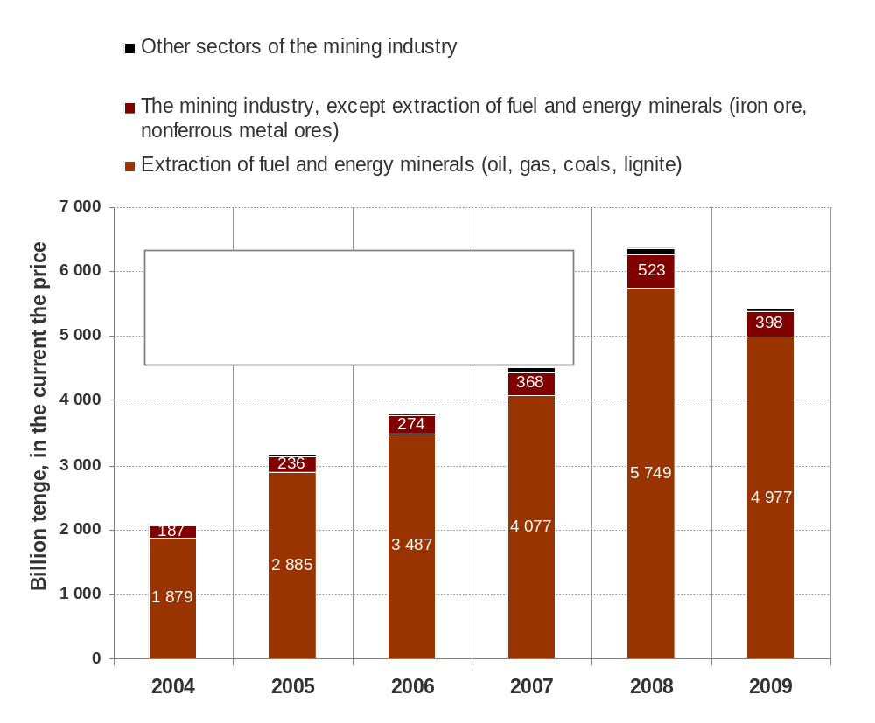
Mining industry
Volume of production of the mining industry (2004-2009) in Kazakhstan
Kazakhstan has commercial reserves of 3 ferrous metals, 29 nonferrous, 2 precious, 84 kinds of industrial minerals, and also the major energy resources.
One of key problems of a mining and smelting complex of Kazakhstan is - Low technological level of production. Our mining companies in comparison with leading foreign firms allows losses of ore more than 8-10 %, Power consumption of a domestic production is in 1,5-1,8 times higher, than at the advanced enterprises of the world, and labor productivity on all repartitions are lower in 1,5-2 times.

