Slide 1
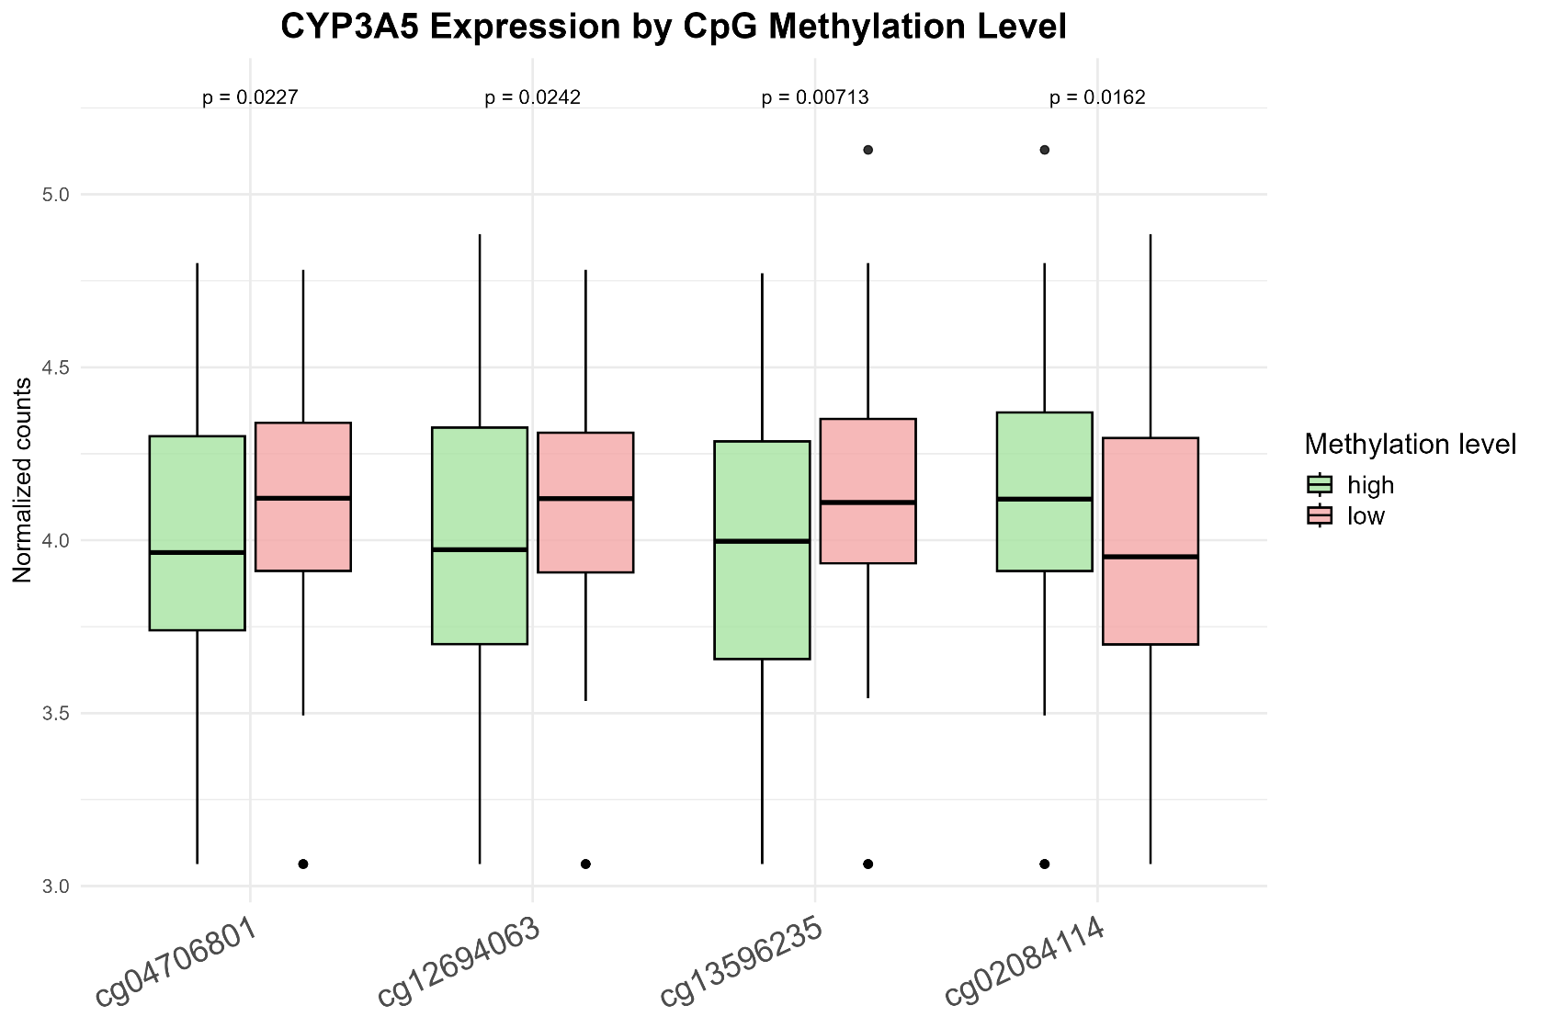
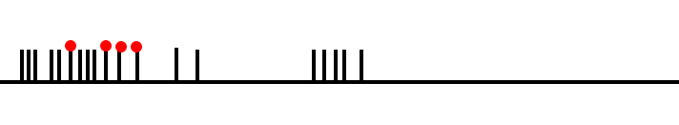
chr7: 99618778-99648278
chr15: 97960483-97960722

