Slide 1
Parents’ Portal
Diana Collins

Slide 2
Purpose
The purpose of this website is to provide a central location for student profiles, teacher grade books and lesson plans, and an interface for parents to stay informed.
This project focused on the parental interface, the Parents’ Portal.

Slide 3
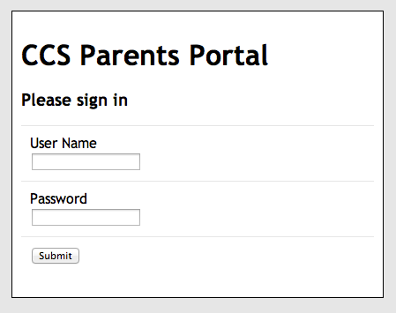
Login
Unique User Name
Encrypted password

Slide 4
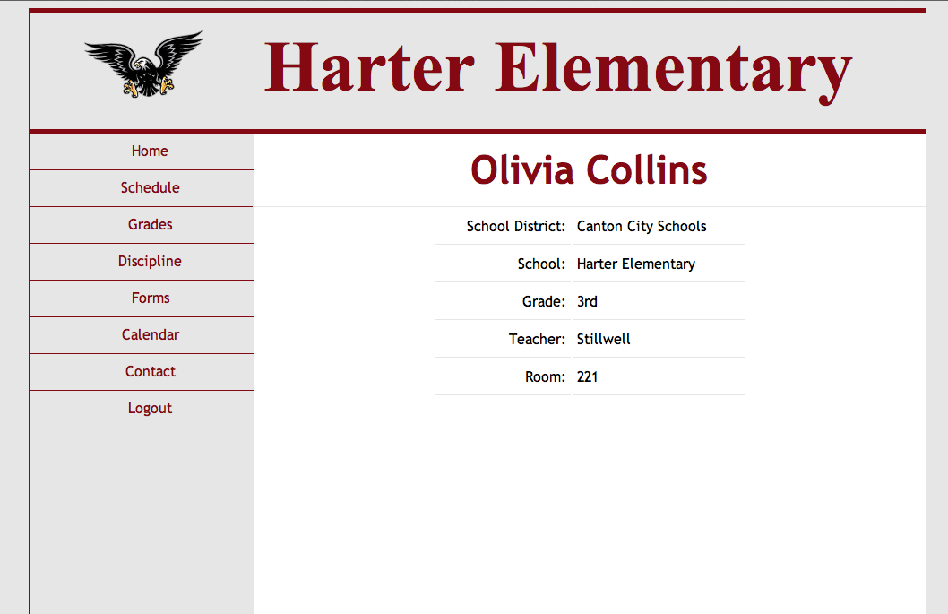
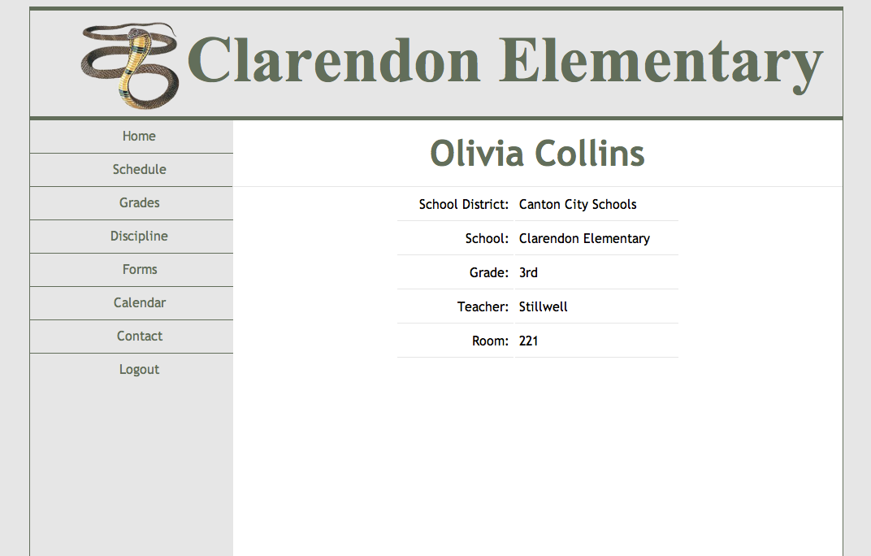
Home

Slide 5
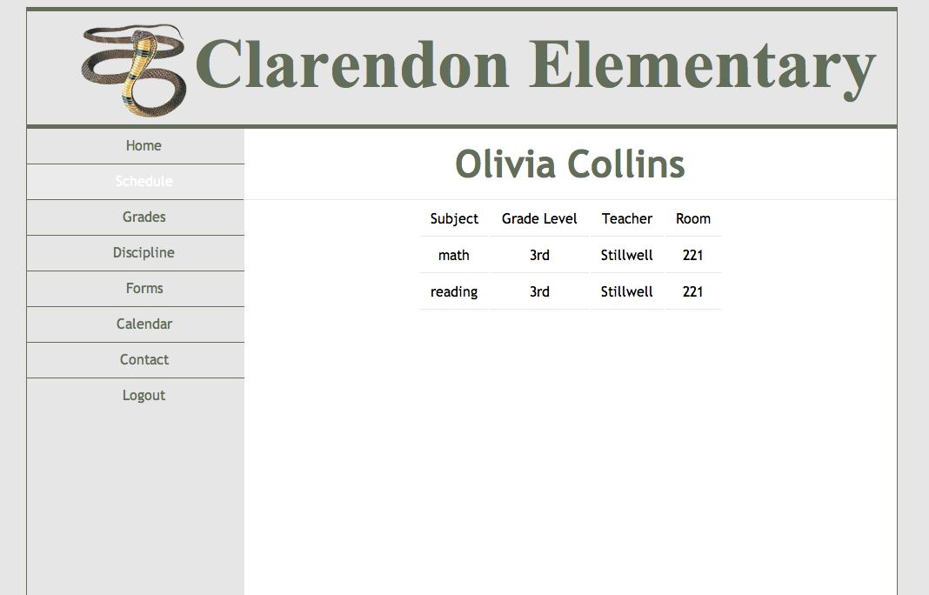
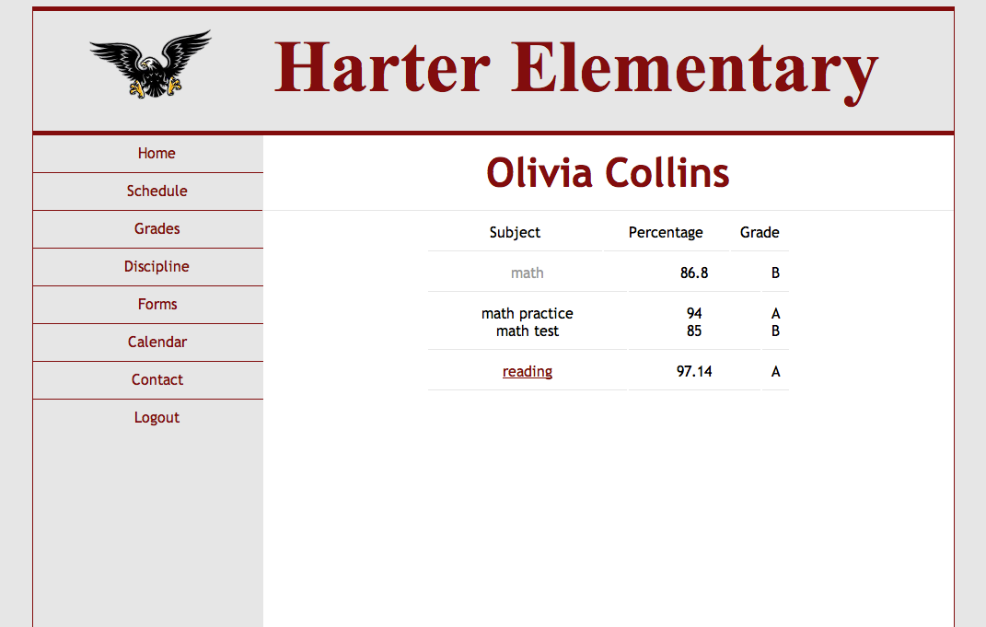
Schedule & Grades

Slide 6
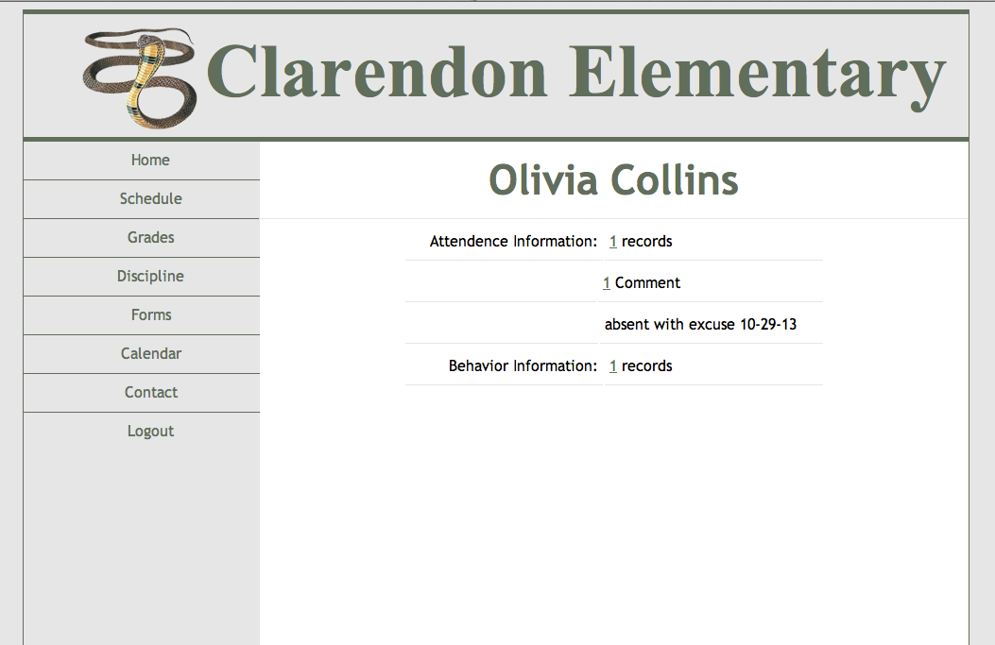
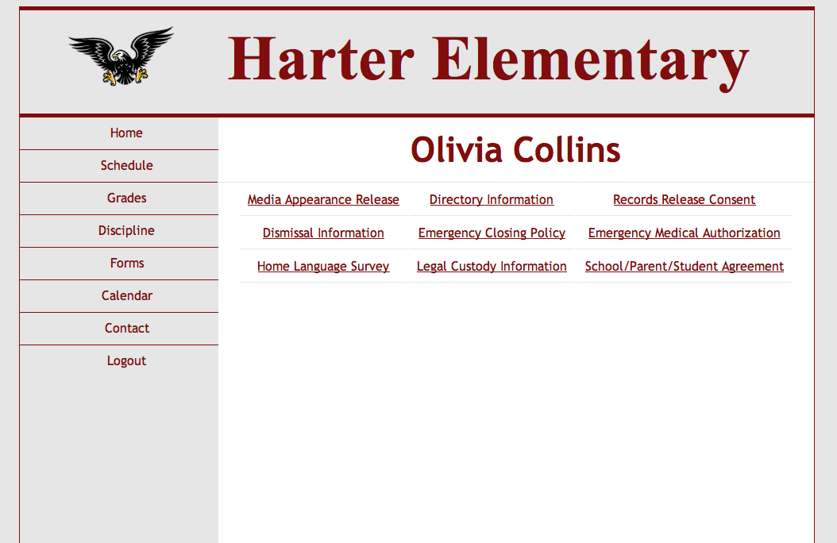
Discipline & Forms

Slide 7
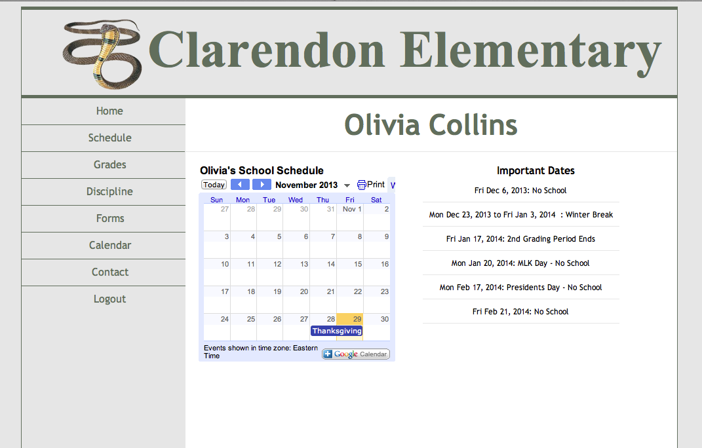
Calendar

Slide 8
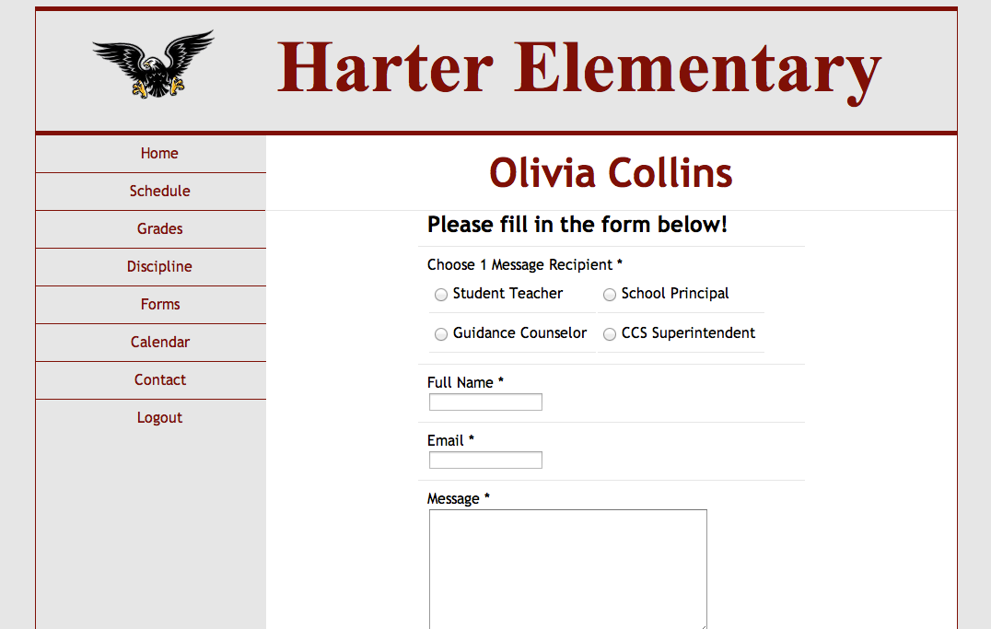
Contact

