Slide 1

Turtle Games: Predicting Future Outcomes
By: Iulia-Diana Cristolovean

Slide 2
Background & context
TURTLE GAMES
QUESTIONS TO ANSWER
A game manufacturer and retailer
How do customers engage with and accumulate loyalty points?
How can customers be segmented into groups, and which groups can be targeted by the marketing department?
How can we use social data to understand customers?
OBJECTIVE
Improving overall sales performance by analysing and considering customer trends

Slide 3

Analysis Method
Predictive Models
Natural Language Processing
Possible customer behaviors
Customer segmentation
Customer opinions (reviews) on the website
Tools used: Python , R

Slide 4
Our take on the questions:
Question from Turtle Games
How we approached the analysis
How do customers engage with and accumulate loyalty points?
How can customers be segmented into groups, and which groups can be targeted by the marketing department?
How can we use social data to understand customers?
………………………………………………………….Regression analysis
…………………………………………….K-Means clustering analysis
…………………….......Natural Language Processing analysis

Slide 5
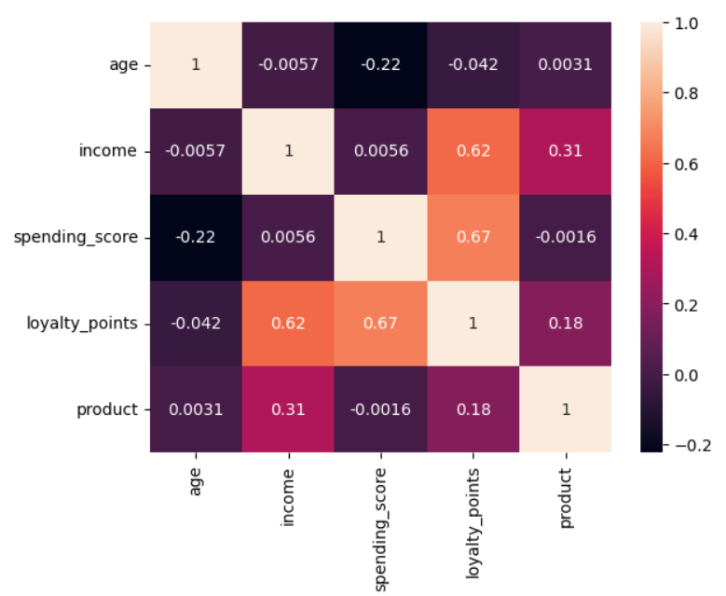
Factors influencing loyalty points
Income moderately correlates with loyalty points (0.62).
Spending score has a slightly stronger correlation (0.67).
Age has no linear link to loyalty points.

Slide 6
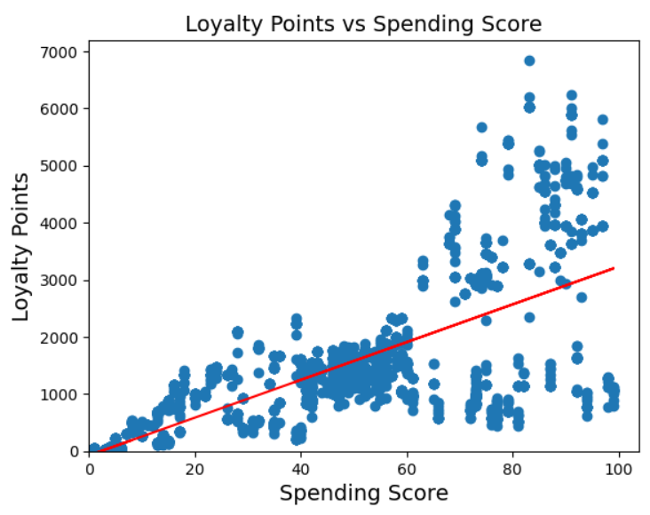
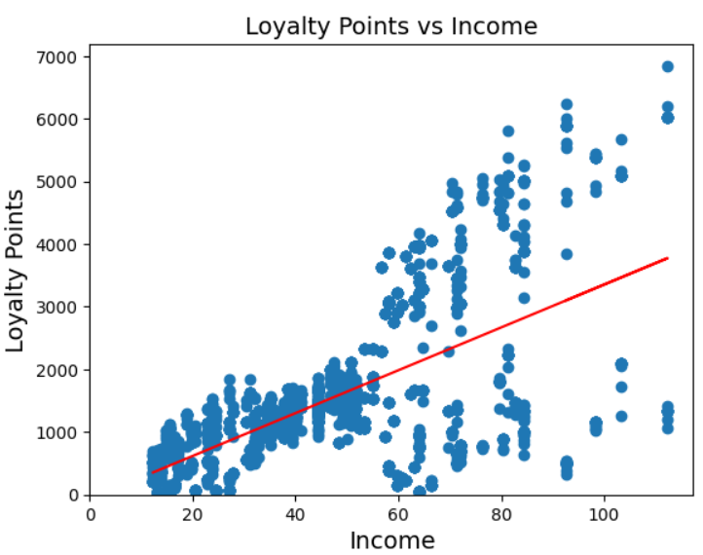
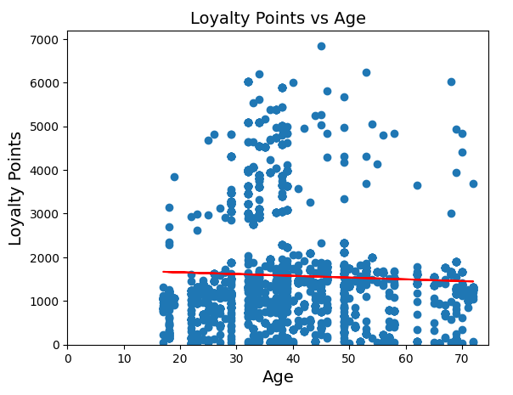
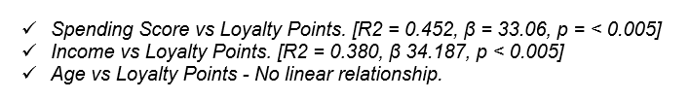
To compute the statistical significance and explanatory power of these numerical variables on loyalty points accumulation, we used Simple Linear Regression Models.

Slide 7
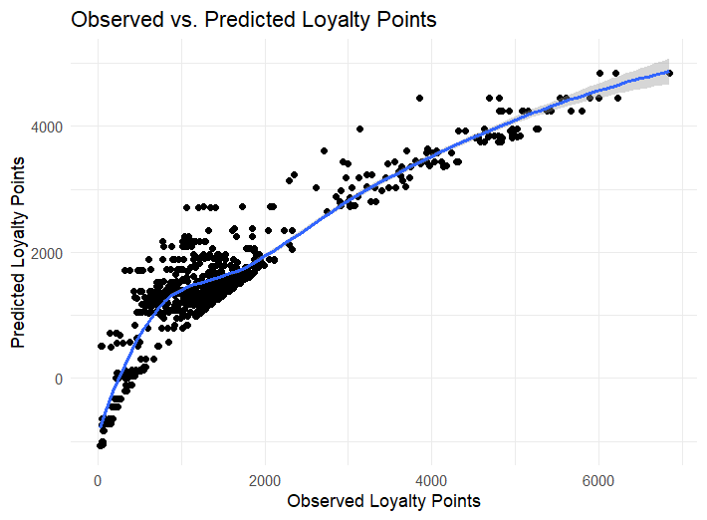
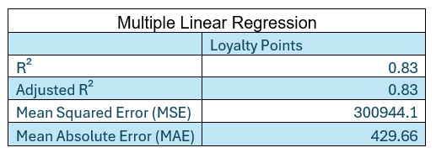
We used Multiple Linear Regression (MLR) with income and spending score
Income and Spending Score explained 83% of the variation in loyalty points.

Slide 8
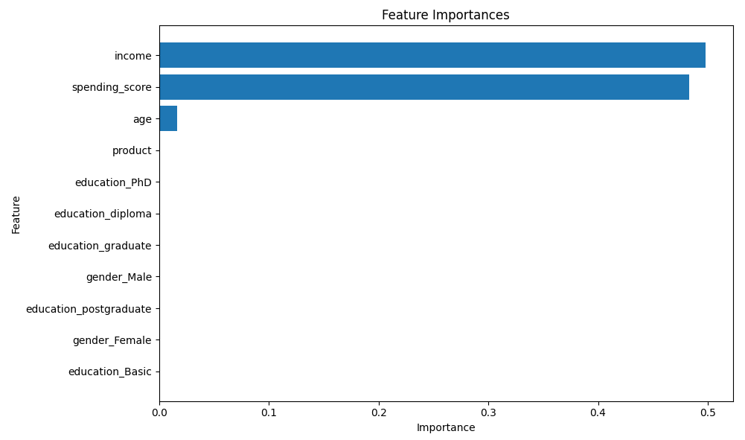
To better understand which factor contributes to the loyalty points more, we used a Decision Tree Regressor because it manages non-linear relations well.
We determined the variables with the most contribution.

Slide 9

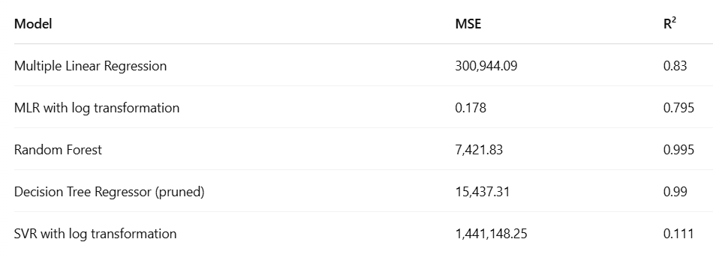
Key Insights on Predictors of Loyalty Points:
Random Forest — it’s clearly the best-performing model in our lineup, both in terms of predictive power (R²) and low error (MSE). If interpretability is more important than performance, the pruned Decision Tree or the Linear Regression models might still be worth considering.

Slide 10
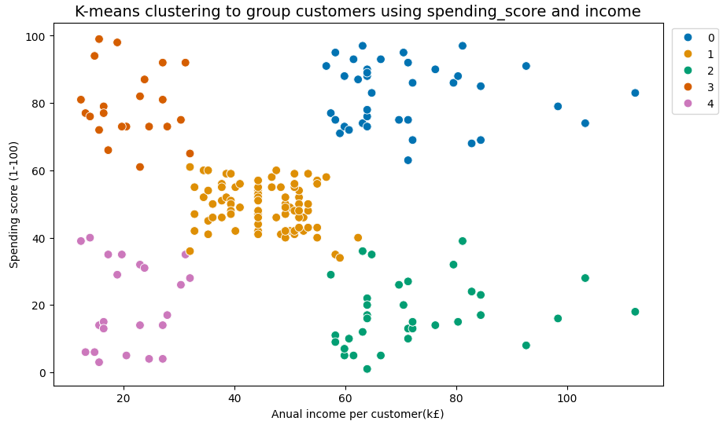
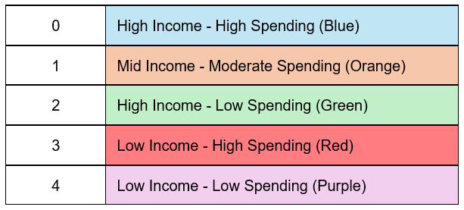
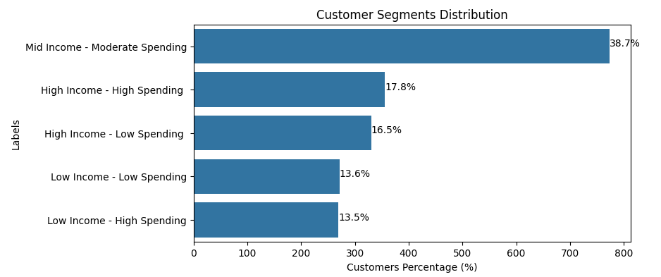
How can customers segmentation help drive targeted marketing?

Slide 11
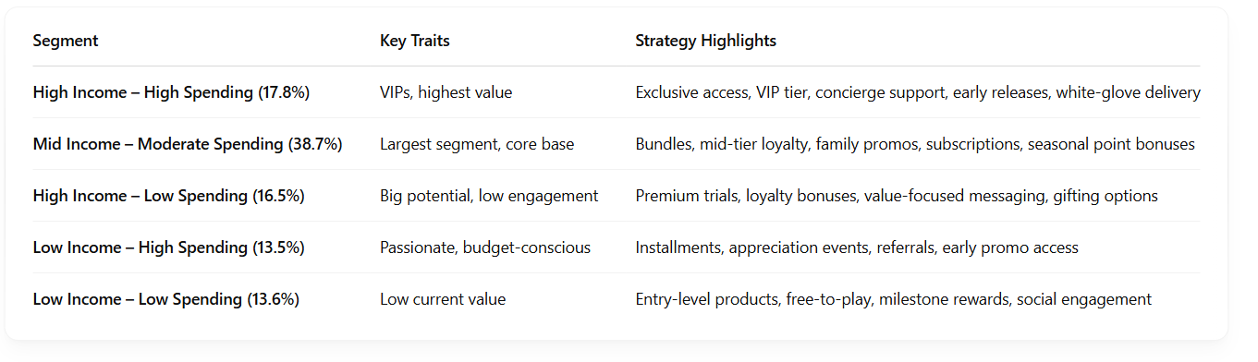
Recommended Marketing Strategies by Segment
Projected Outcomes from Loyalty Initiatives
+15–20% spending increase from High Income – Low Spending segment (within 6 months)
+5–10% retention boost among High Income – High Spending VIPs
+7–12% overall engagement uplift across loyalty program participants
References: https://symphony-solutions.com/insights/personalization-boosts-customer-retention-in-gaming
https://kobie.com/gamification-in-loyalty-programs-driving-customer-engagement-and-retention/
https://poket.com/gamification-in-loyalty-programs-boosting-engagement-and-retention/

Slide 12
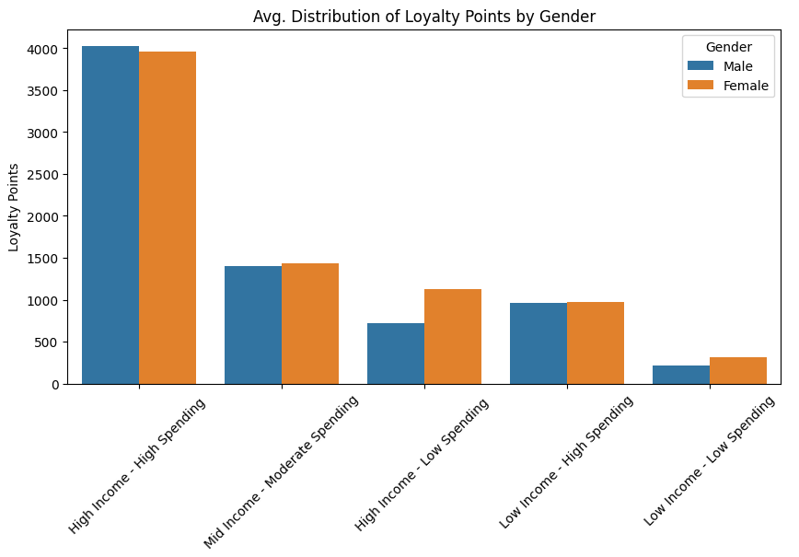
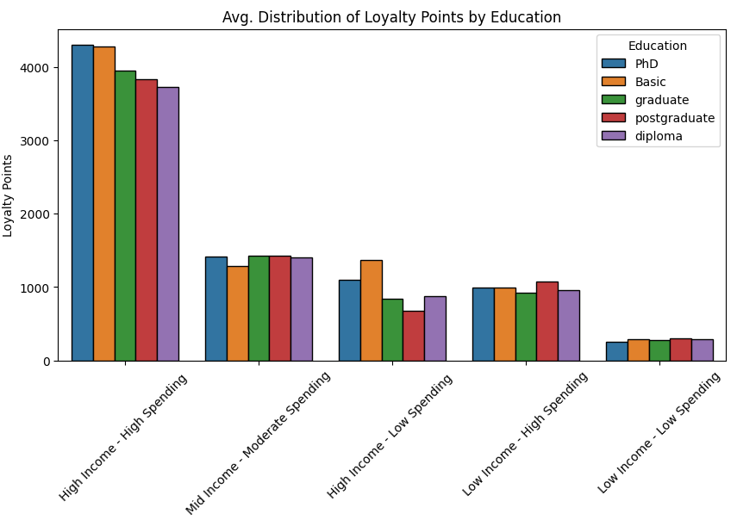
Gender and education interactions with the loyalty program were analysed.
Education showed no clear pattern, but females engaged slightly more with loyalty points.

Slide 13
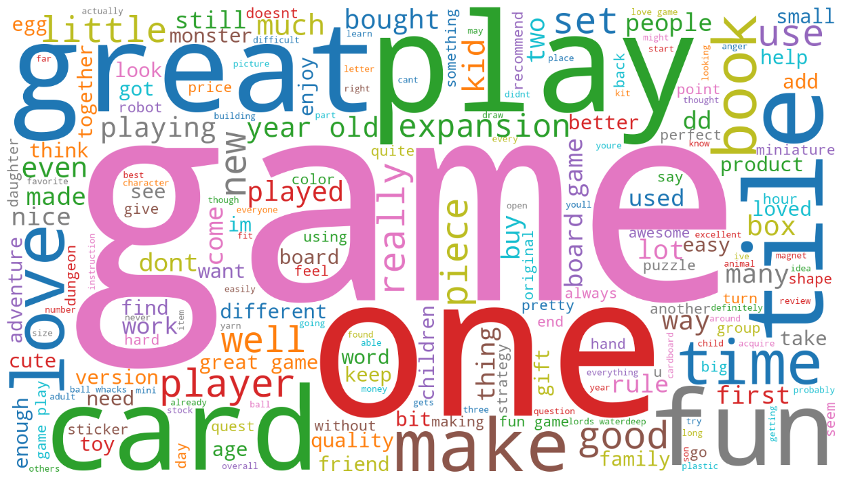
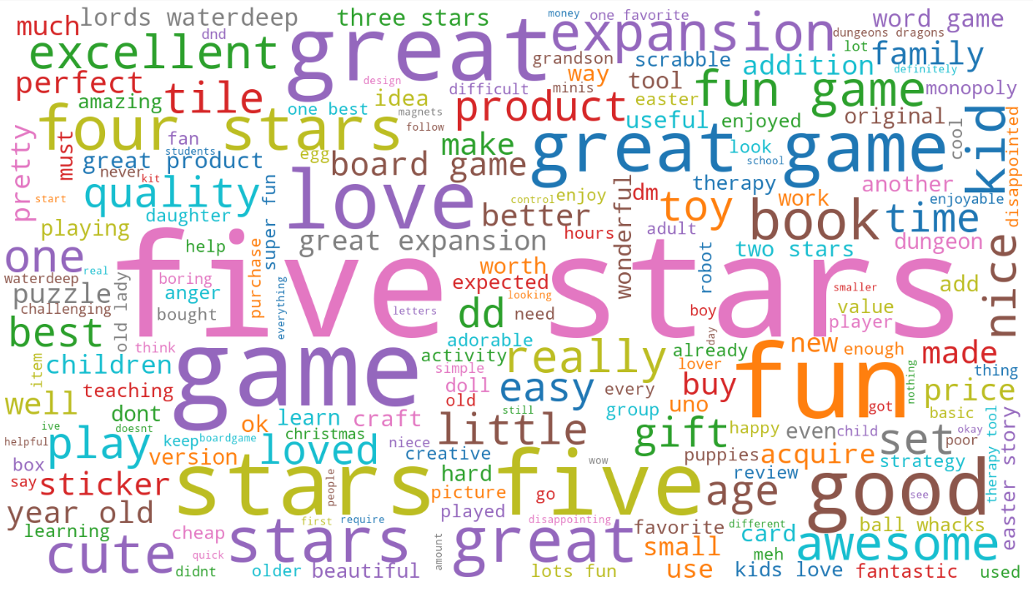
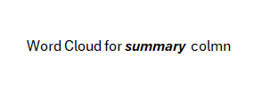

To consider language analysis we used Natural Language Processing

Slide 14
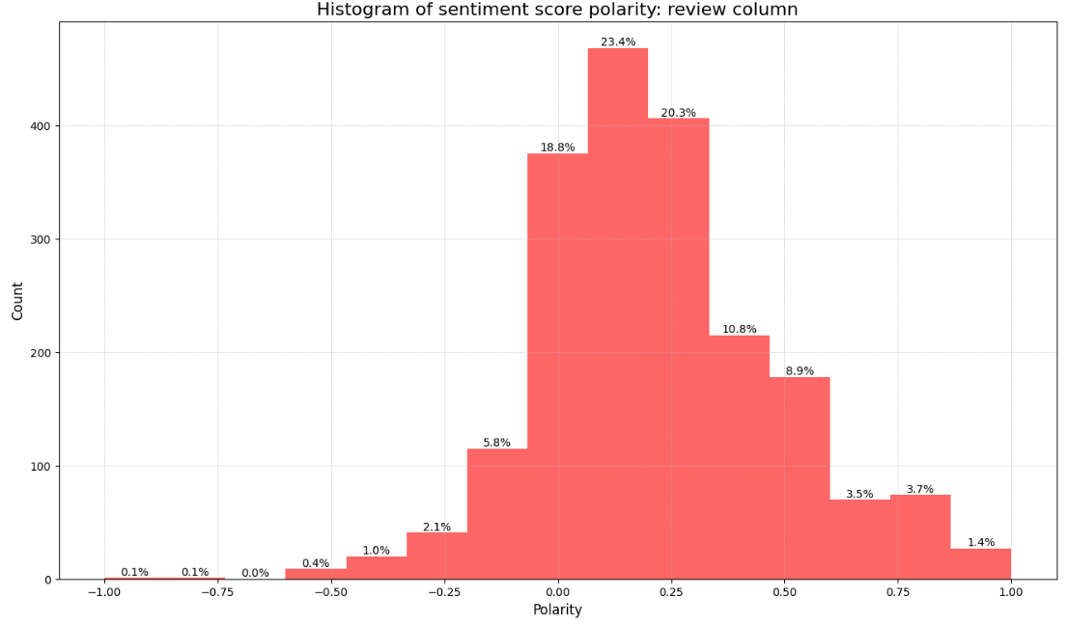
Social Data : what can we learn from customers reviews?
Most review polarities are weakly positive (avg: 0.22), suggesting general satisfaction but not strong enthusiasm.
Neutral reviews are over-represented—likely due to limitations in the sentiment model (e.g., rating "5 stars" as neutral).

Slide 15
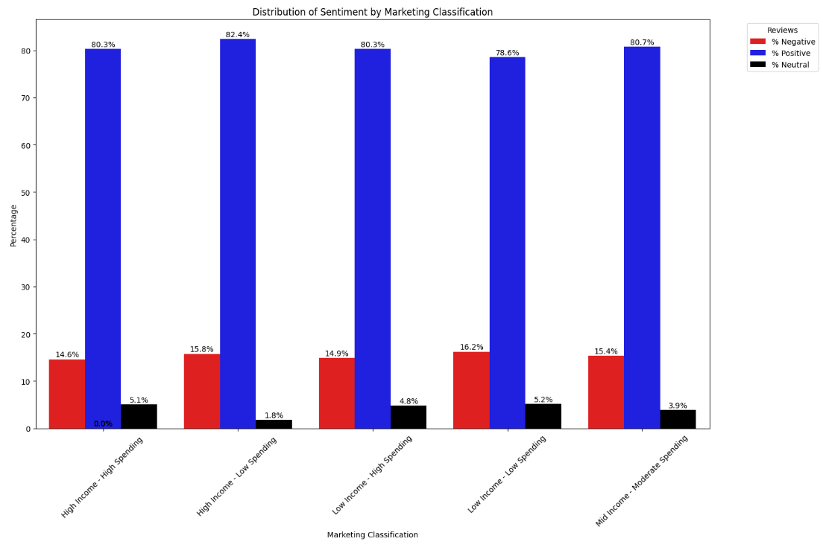
Most groups have a high rate of positive reviews.
Conservative and practical spenders are the most satisfied.
Occasional shoppers and conservative spenders are least satisfied—likely due to higher expectations—so targeting them could boost satisfaction.

Slide 16
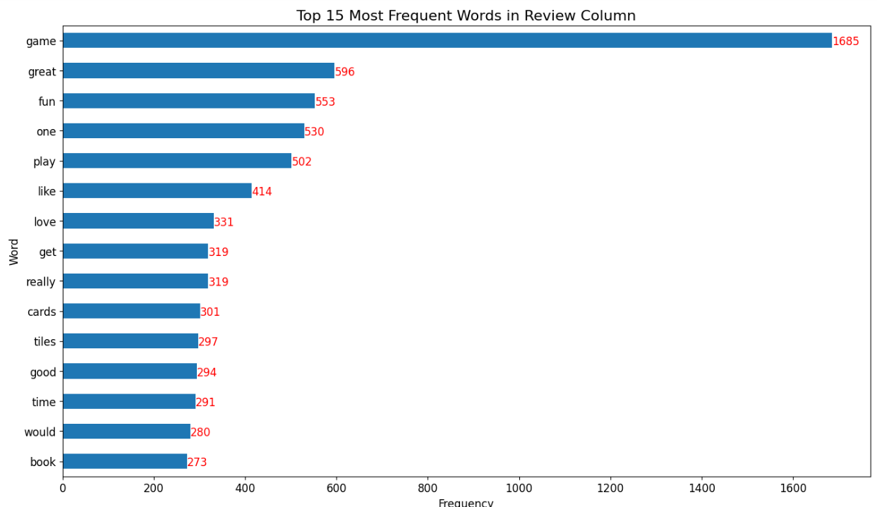
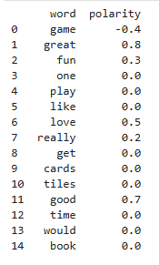
Polarity of the top 15 review words shows “game” as negative (-0.4), while “great” (0.8), “good” (0.7), and “love” (0.5) are the most positive. Notably, 9 out of 15 words are neutral (0.0).

Slide 17
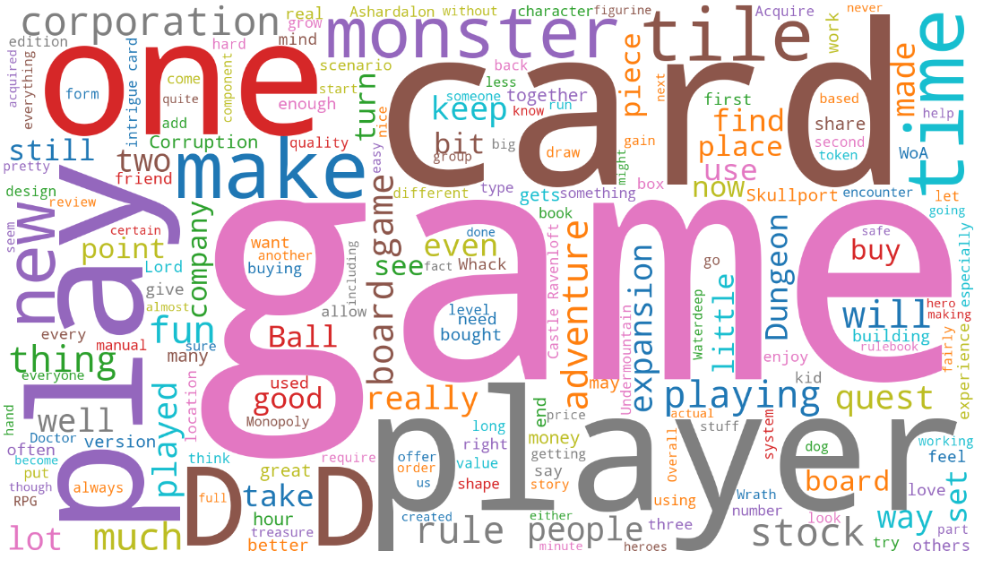
Many positive reviews centre around board games, cards, expansions and corporation.

Slide 18
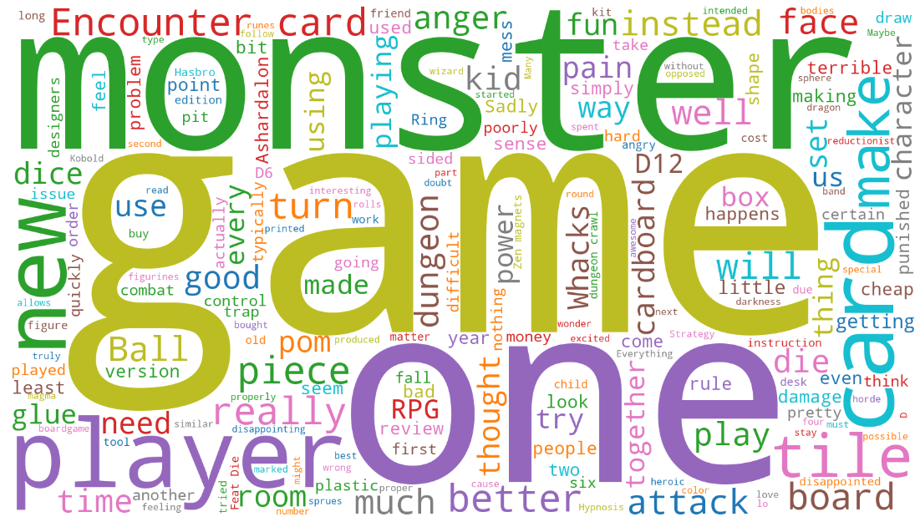
Given the higher risk posed by negative reviews for Turtle Games, we created a WordCloud revealing frequent complaints about board games, cards, quality, and usefulness.

Slide 19
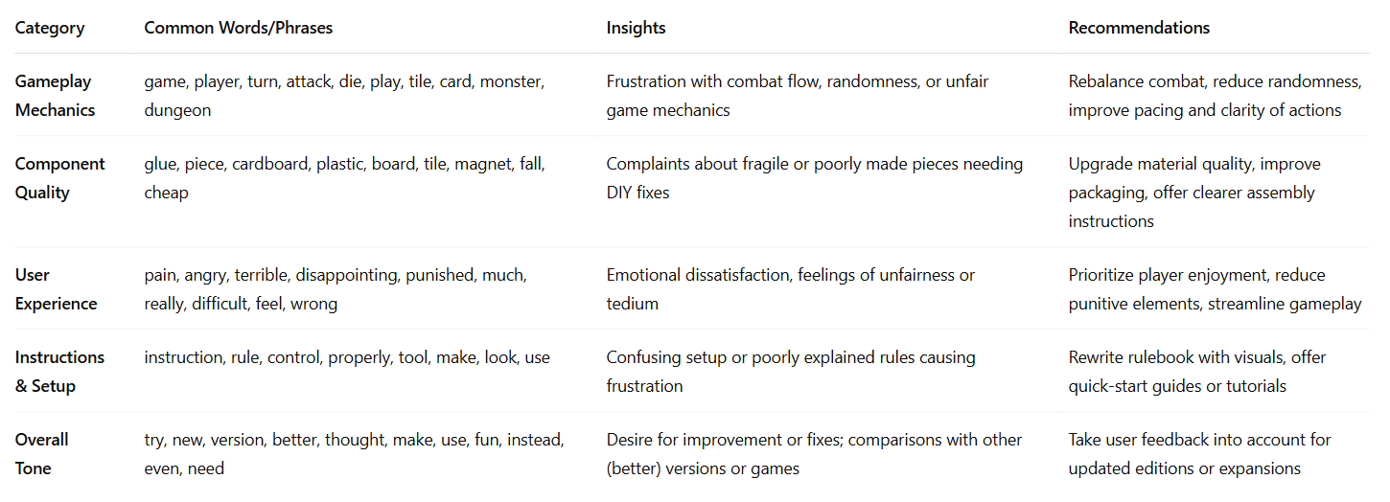
Here’s a summary table based on the word cloud analysis of negative feedback:

Slide 20
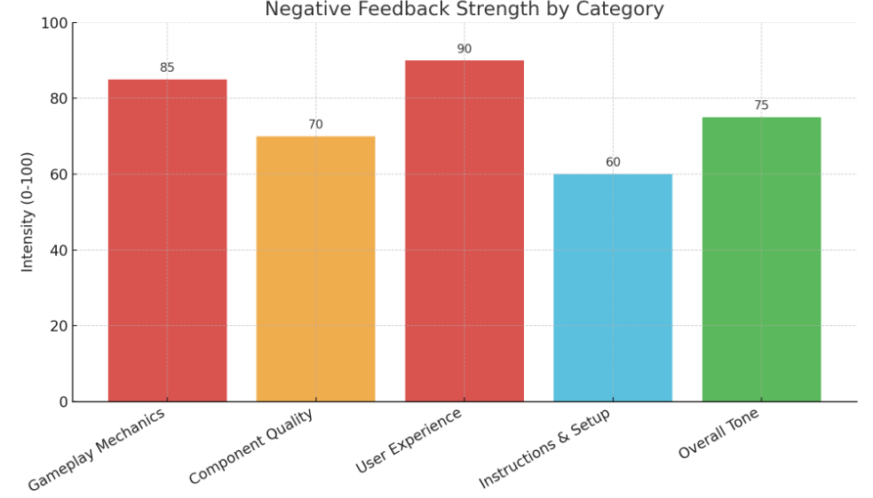
Negative Feedback Highlights:
Strongest Criticism: User Experience & Gameplay — frustration with feel and mechanics.
Other Concerns: Component Quality (durability) and Overall Tone (disappointment).
Moderate Issues: Instructions & Setup — clarity and ease of use.

Slide 21
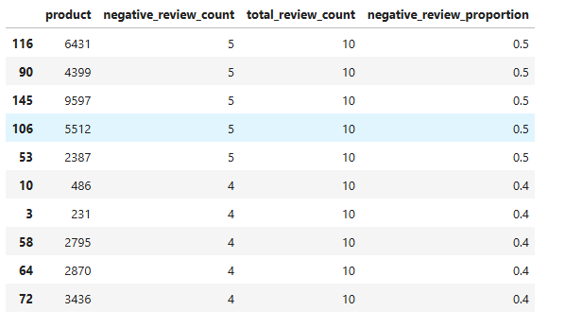
To guide marketing strategies and product development, I made a list of products with the highest number of negative reviews.

Slide 22

Insights and recommendations
Top Drivers: Income & Spending Score explain 83% of Loyalty Points—useful for predicting and segmenting valuable customers.
Customer Segmentation:
Target High-Income, High-Spending and Mid-Income, Moderate-Spending groups with tailored campaigns.
Females show higher loyalty engagement—consider gender-specific strategies.
Loyalty Engagement: Wide variance in loyalty points suggests inconsistent engagement—opportunity for personalized rewards.
Sentiment Insights:
Positive Reviews: Highlight in SEO, thank loyal users.
Negative Themes: Focus on product quality, age-fit, and clarity.
Improve Quality Control, simplify instructions, clarify age ratings, and respond to feedback.
Modeling Tips:
Use linear regression for targeting.
Consider SVR for handling non-linear outliers.
References: https://symphony-solutions.com/insights/personalization-boosts-customer-retention-in-gaming
https://kobie.com/gamification-in-loyalty-programs-driving-customer-engagement-and-retention/
https://poket.com/gamification-in-loyalty-programs-boosting-engagement-and-retention/
https://live.agency/insights/gamification-tactics-for-enhanced-customer-loyalty/

