Slide 1

Web App

Slide 2
Founding Members:
Diana Duran
Gonzalo Espinel
Manoj Kutty
Romain Dallemand
Juan Magana
NutriSearch

Slide 3
Roles and Responsibilities
Front-End Team (HTML, CSS, BootStrap, Jquery):
Responsible of the aesthetics of the website. Properly plan a layout and offer hooks for the backend team. If possible, need to implement routines to add or remove objects from the HTML that can be called by the backend team.
Back-End Team:
(JavaScript, Jquery, and JSON)
Responsible of connecting to the various APIs. Able to iterate thru the responses of each end point and provide the necessary data onto the HTML hooks for end user presentation. Developing the logic behind the app.
NutriSearch

Slide 4
About the App:
The purpose of this app is to help people get basic nutrient information by food item, food group, or manufacturer’s name. The app will display Calories, Total Fat, Sugars, Fiber, and Protein.
Are you sure you want to eat that brand of food for breakfast?
NutriSearch

Slide 5
Technical Integrations
USDA Food Composition Databases:
https://ndb.nal.usda.gov/ndb/doc/apilist/API-FOOD-REPORTV2.md
https://ndb.nal.usda.gov/ndb/doc/apilist/API-SEARCH.md
Giphy API:
https://developers.giphy.com
Chart.js
http://chartjs.org/
BootStrap:
4.0
Jquery:
3.2.1
NutriSearch

Slide 6
Web App Skills
AutoComplete Options: Users will be able to search a food item and get a list of possible items as user types the name of the food item they are searching for.
Submit Request: After making a selection from the AutoComplete users will be able to search for the nutrients of the item of choice.
Offer Visual Feedback: It will provide a Pie Chart displaying the different levels of each nutrient for the food that was searched.
NutriSearch

Slide 7
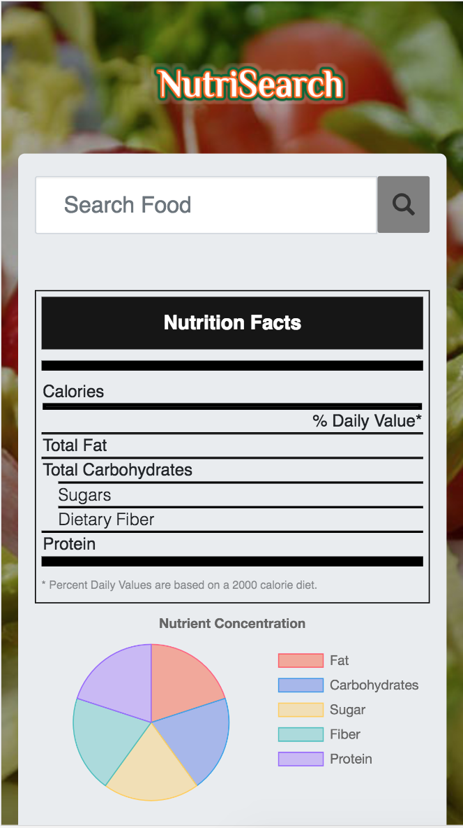
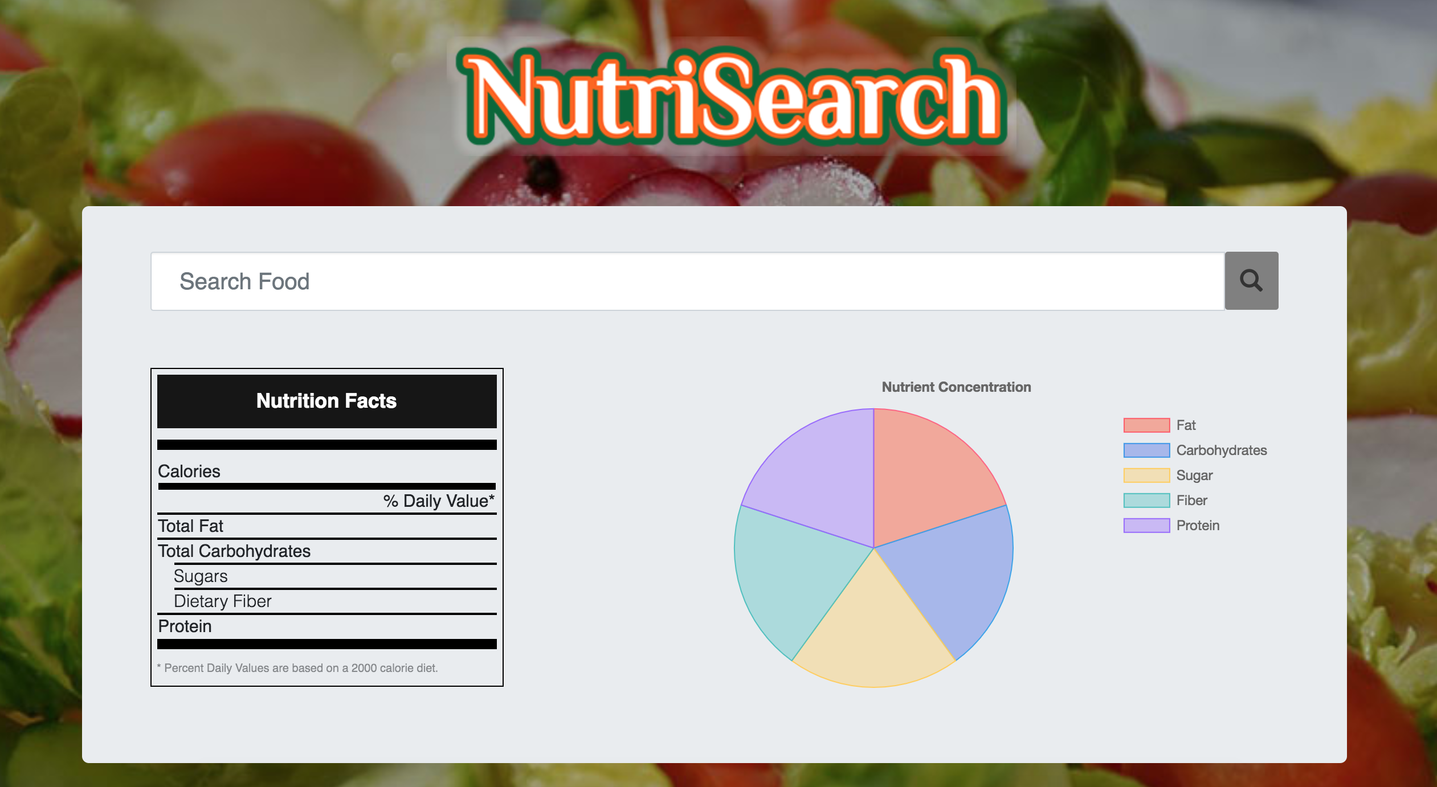
Desktop and Mobile Views (DRAFTS):
NutriSearch

Slide 8
DEMO….Stration
NutriSearch

Slide 9
Future Enhancements
Adding Tracking Tool: Install a Website Analytics package such as Google Analytics to track user’s interactions.
Adding a rating Tool: This is in the form of a form asking users for feedback and rate us in terms of stars.
Adding a new recipes Page Section: Place where users can obtain different recipes for certain food items.
Allow users to customize the portions.
Utilize a third party framework for auto-Complete: Utilize a more browser friendly auto-Complete technique such as JQuery-UI autocomplete function. Or Select2 Framework.
NutriSearch

Slide 10
Functionality Walk-thru
NutriSearch

Slide 11
Demo 1 (Front-End 2 minutes)
The website was designed using Bootstrap, and custom CSS.
It contains custom Fonts from Google Fonts. Varela Round.
The HTML consists on:
A bootstrap Modal Element triggered on a SetTimeOut of 9 seconds.
It contains a tandom image from the Giphy API based on user input. And close buttons.
2 Div Containers, one for the Header that includes the logo, and one for the body.
The body container has a child Bootstrap JumboTron class with Fluid properties. This will make expand and contract as the device width changes.
Inside the JumboTron, There is a Form Element with just a Text-Input and a button to support the search functionality.
A Row containing the title that was selected by the search options.
A Row containing the Nutrion Facts and the Graph.
The Nutrion Facts has a bootstrap class of Table container.
The Chart has a Canvas HTML tag element which will be filled by the Chart.js
NutriSearch

Slide 12
Demo 2 (AutoComplete Search 2 Min)
We call the Search API as the user types using Jquery .keyup event listener.
We obtain the value from the Input field and if the length is more than 3 characters we call the Search USDA API with the input value onto the API.
Once the API responds, we parse thru the Response’s Data.List JSON object by using a Jquery .each() function to extract the individual Data.List.Name item from the response.
We clean the name of the item by using a substring method.
We dynamically build an Option HTML Tag/element and store the data attribute with the food item identifier. This will be used to get the nutrient information once the user clicks the search button.
If the Search input isn’t empty, we draw the value of the search field on the HTML as pure Text.
Once the user selects an option, we extract the data value of the options element that contains the food ID of the item selected. This Food ID will be used again once the user clicks search. Additionally, we also store the value of the input in a var for Giphy API call as it will be the query for it.
NutriSearch

Slide 13
Demo 3 (Search Button 2 Min)
The search button has been coded that on click we prevent submissions to post to itself by using preventDefault();
If the input search is not undefined, then we do an ajax call to the nutrients API information.
On success, we use a for loop to parse the JSON response, we store the Nutrient ID, its value, and the unit on local variables.
We made multiple If statements that if meeting the conditions for specific Nutrient IDs, we would dynamically populate onto the HTML Nutrition Fact table the specific nutrient value and unit. At the same time, we update the Chart.js data array with the specific nutrient value.
Lastly, we update the Chart Object so it represents the values that have been set. And, we call the getGiphy function that calls the Giphy API.
NutriSearch

Slide 14
Demo 4 (Graph (technology we have not used) 2 Min)
The Chart.js required to have a canvas node in order to render the chart onto the page. Think of it as a DIV.
We store the canvas html on a local variable.
Then we instantiate a new chart in a global variable by passing the Canvas node and some settings, in form of JSON objects, that include the actual data, the graph type, and its colors, as well as additional options for the graph title, the legends, and animation.
Data setting is an array of integers that gets updated dynamically, by the submit AJAX call, with nutrient values.
We update the Data array of our graph, stored in a global variable, by using the API response of the submit AJAX call.
All we need to do to update the graph in real time is call the method for our graph as such: myChart.update();
NutriSearch

Slide 15
Demo 5 (Giphy – 30 seconds)
We made a function that calls the Giphy API and queries a random GIF with the query from the input field value selected. The GIF is presented on a Bootstrap modal only after 9 seconds by using a setTimeout time handler.
The user is forced to click the close buttons otherwise, it won’t go away, and also on closing, it will clear the input field for the user while retaining the title of the search item as well as its nutrient stats.
NutriSearch

Slide 16
Thank you
Q&A
NutriSearch

