Slide 1
Introduction to UNIX and Linux Basics

Slide 2
Laboratory Attendance
Attendance: MANDATORY
Minimum attendances: 12 attendances (10 for repeating students)

Slide 3

UNIX Commands Structure
options can be:
a short option - a single letter preceded by a single hyphen (-);
a long option - a word preceded by a double hyphen (--);
values can be:
mandatory, optional or they might not exist;
the values from the command line are separated by spaces;
3. the interpreter (the shell) from the command line is case-sensitive;

Slide 4




examples

Slide 5
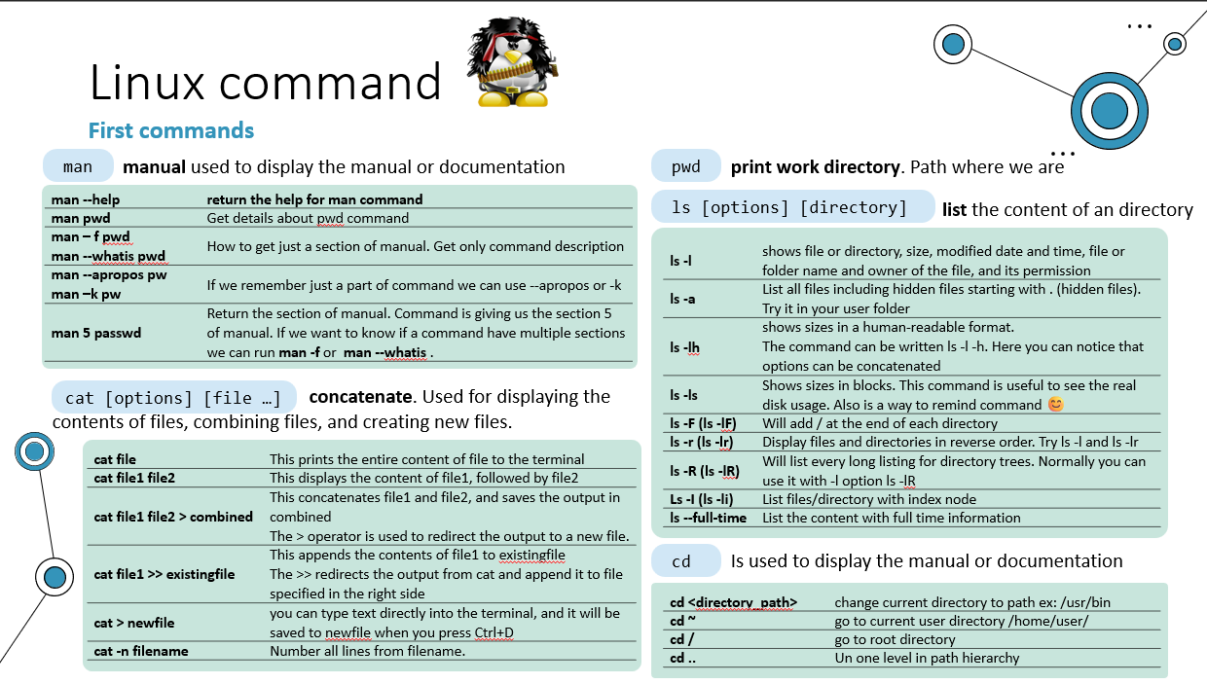

Slide 6


UNIX Commands and Shortcuts
grep
-i
“error” log.txt
ls
-l
ls
-a

Slide 7
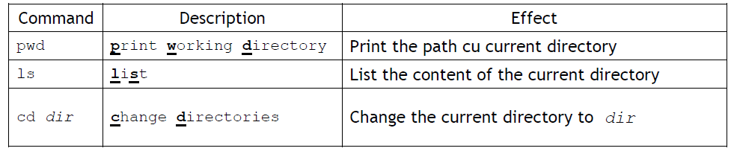
1. CMDS for navigating through the file system:

Slide 8
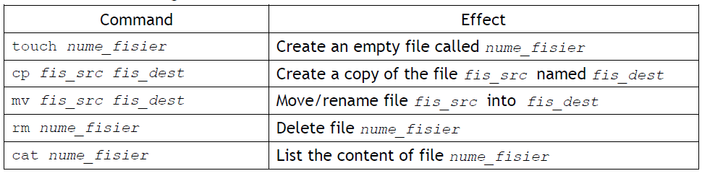
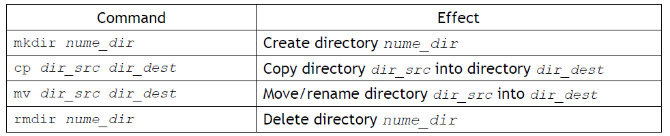
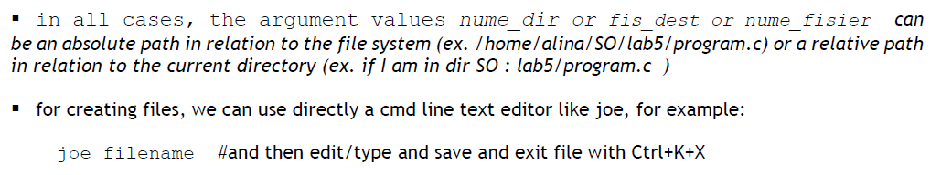
2. CMDS for working with files:
3. CMDS for directories:

Slide 9
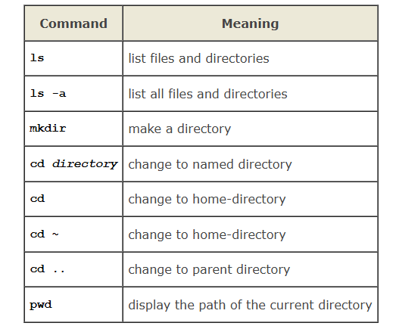
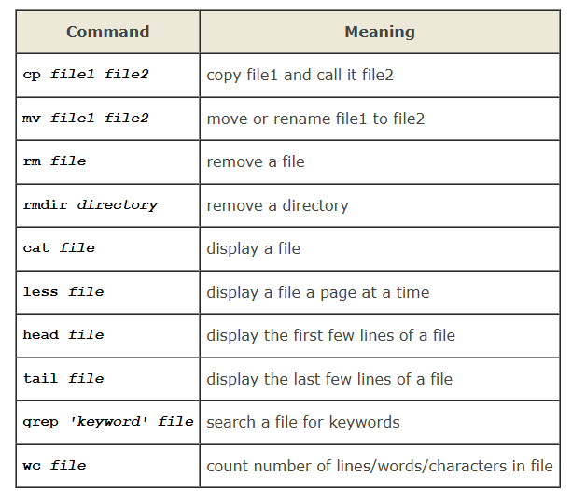
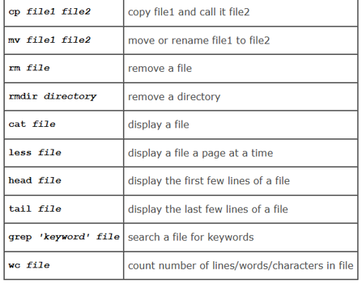
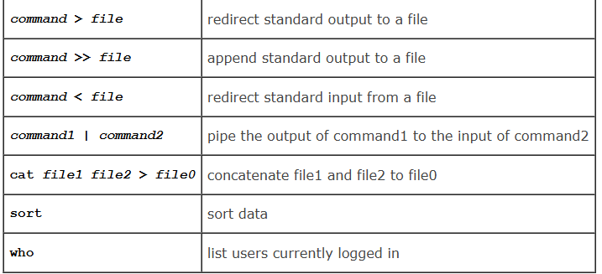
Commands:

Slide 10
Special keys
TAB - autocompletion of the command line (ex. long file name, type start of it then tab);
Arrows up ( ) and arrows down ( ) – you can navigate through written commands by you history;

Slide 11
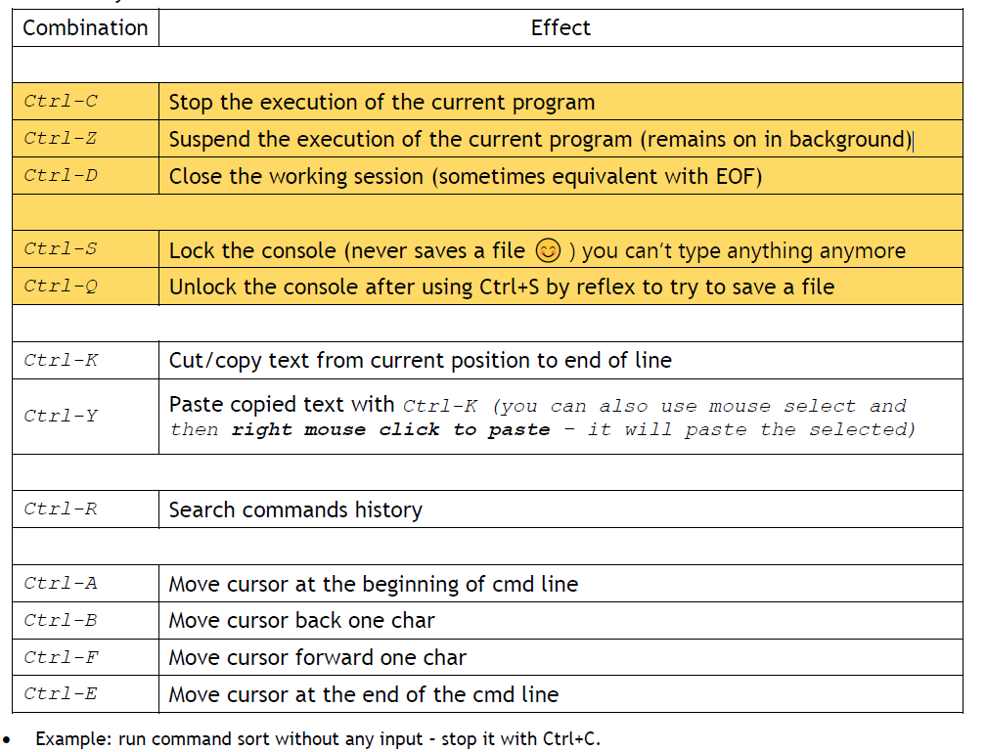
Useful key combinations:

Slide 12
File and Directory Permissions
Permissions: rwx (read, write, execute);
Groups: owner, group, others (ugo)
Change permissions: chmod +x file or chmod 755 file

Slide 13
Installing a Distribution locally
MacOS | Linux | Windows
Use Homebrew (https://brew.sh) | Use Ubuntu | Options include Virtual Machine, WSL, or dual-boot

Slide 14
Connecting to a Remote Server
MacOS | Linux | Windows | Server
Use PuTTY (https://putty.org) | Use 'ssh username@server -p port' | Use 'ssh username@server -p port' | www.scs.ubbcluj.ro or linux.scs.ubbcluj.ro

Slide 15
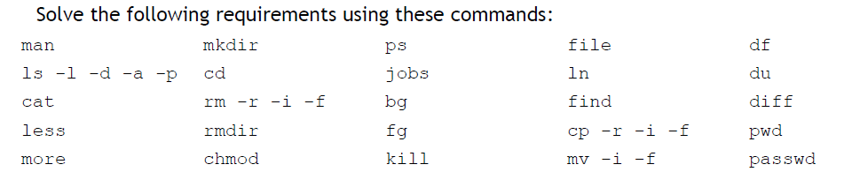
Practice Exercises

Slide 16
Homework

