Slide 1
EC 1152 - Using Big Data to Solve Economic and Social Problems
Review Session #1
TF: Diana Goldemberg
Prof: Raj Chetty
Harvard University
Spring 2019
Disclaimer: multiple TFs contributed to those slides. All mistakes are mine.

Slide 2

Logistics
I’m Diana.
Take 2 min to fill out this survey please [ bit.ly/ec1152d998 ] Find this prez at: https://github.com/dianagold/Ec1152_diana
We’ll meet every Friday @ 10.30-11.30am (Sever 201)
Advanced section, primarily for grad students but undergrads welcome!
Office Hours:
Wednesdays @ 4.30-6.30pm (Barker 103)
I’m also available by appointment and after sections.
Expectations:
Email (diana_goldemberg@g.harvard.edu) response times: within 24 hours M-F; 48 hours on the weekend
Google form to submit questions before section
Notes:
2

Slide 3
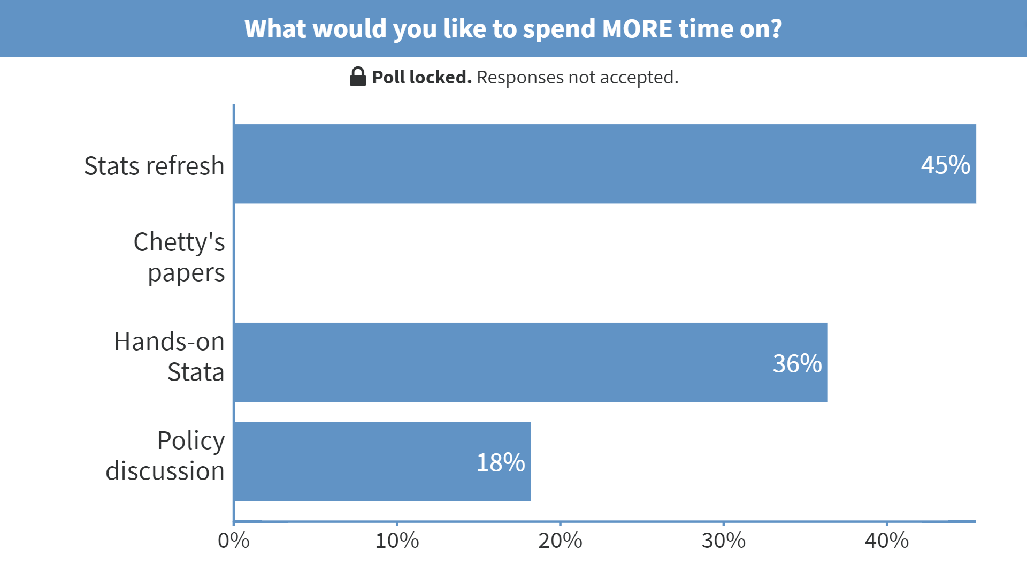
Notes:
What would you like to spend MORE time on? https://www.polleverywhere.com/multiple_choice_polls/ieWM6sFJSwr5I08nJUyAm

Slide 4
Stats Refresh

Slide 5
Statistical concepts to refresh
Summary Stats: mean, median, mode, percentile, st deviation, variance, probability distribution function (pdf), cumulative distribution function (cdf)
Statistical Inference: sample and population, estimate and st error, confidence intervals, hypothesis testing, p-values
Regression Analysis: motivation, interpreting coefficients (with/without standardizing variables), correlation is not causation
Note: look through the slides from the introductory section if you want a more basic (and spelled out) version
Notes:
5
Tell them to look at the intro prez if they want to.

Slide 6
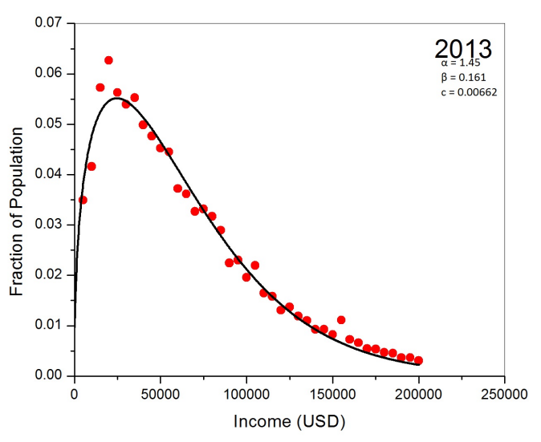
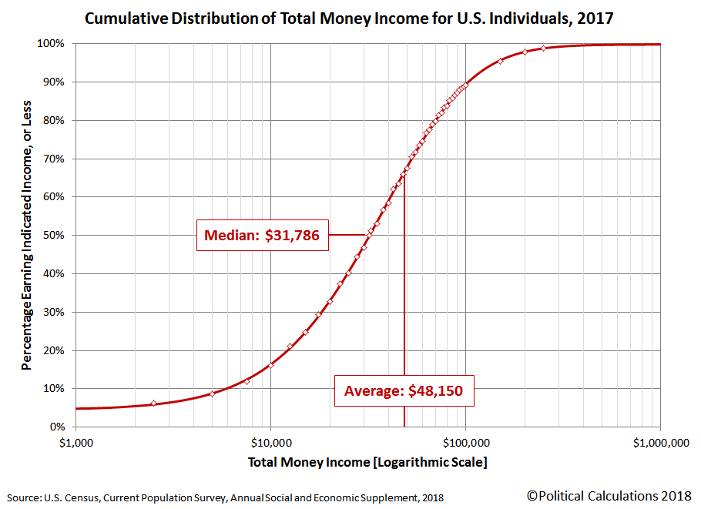
Summary Statistics
Probability Distribution Function
Cumulative Distribution Function
Notes:
The pdf is unfortunately from 2013, not 2017, but just ignore that – probably it didn’t change much anyways.
Talk about:
Common choice of logarithm scale for income
Median vs average
Ask them to answer the previous questions looking at those graphs [ballparks 5%, 35%]
Moreover, find the 25th pct (“low income” in the Opp Atlas) [ballpark $15k]
One important measure we’re not showing here?
Stdev or Var – why not?

Slide 7
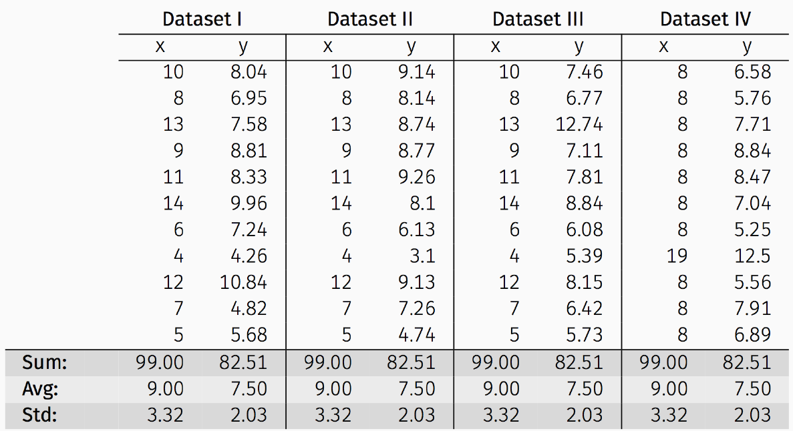
Anscombe’s Data
The following four datasets comprise the Anscombes Quartet (1973); all four sets of data have identical simple summary statistics
Note: slide shamelessly copied from CS109A
Notes:
7

Slide 8
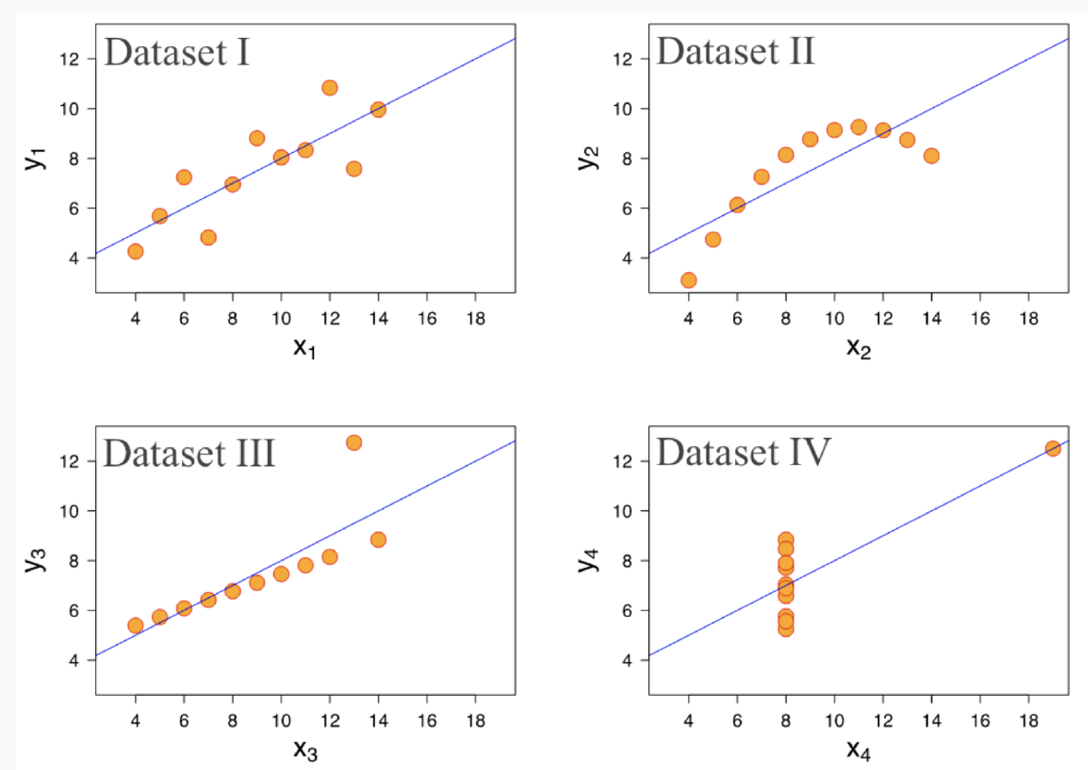
Anscombe’s Data
Same summary statistics also mean you fit the same regression line. But a picture can be worth a thousand words:
Note: slide shamelessly copied from CS109A
Notes:
8

Slide 9
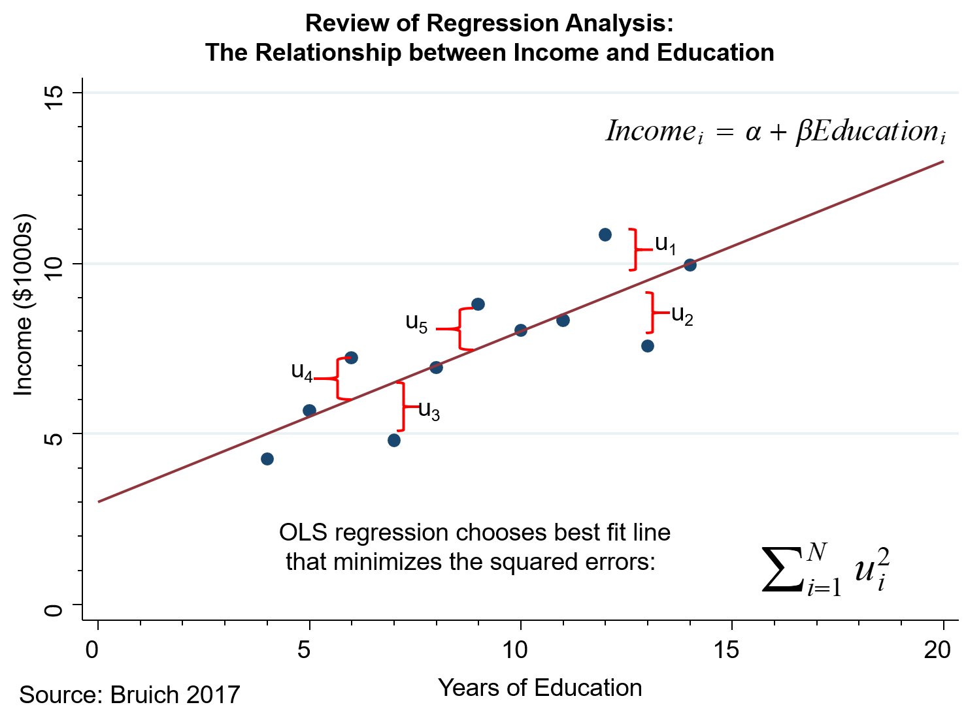
Regression Analysis
What's an interpretation of α and of β?
Inference for linear regression? (how well do we know α and β?)
Notes:
9

Slide 10
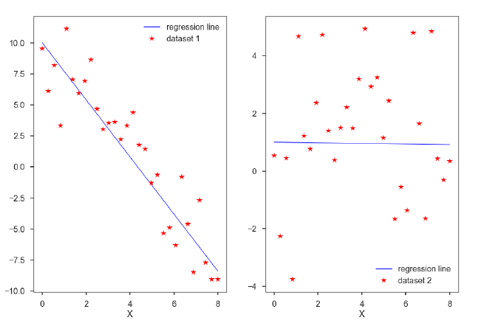
Evaluating Significance of Predictors
Note: slide shamelessly copied from CS109A
Notes:
10

Slide 11
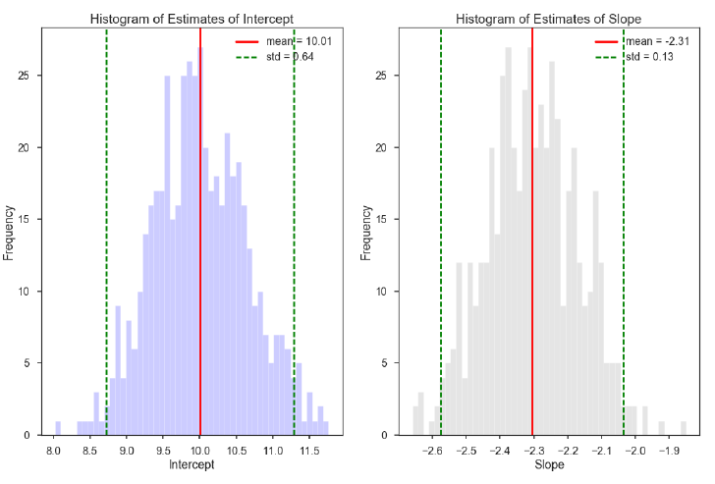
Evaluating Significance of Predictors
α-hat and β-hat for dataset 1
Note: slide shamelessly copied from CS109A
Notes:
11

Slide 12
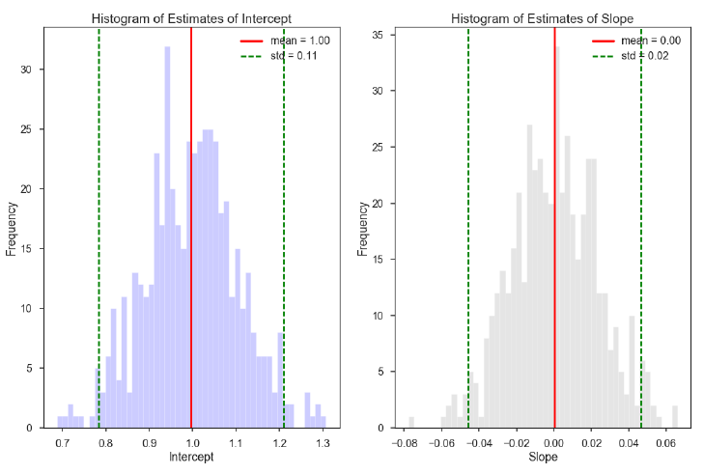
Evaluating Significance of Predictors
α-hat and β-hat for dataset 2
Note: slide shamelessly copied from CS109A
Notes:
12

Slide 13
Closer look at Chetty’s papers discussed in lecture
The Fading American Dream: Trends in Absolute Income Mobility Since 1940. Raj Chetty, David Grusky, Maximilian Hell, Nathaniel Hendren, Jimmy Narang. Science 356(6336): 398-406, 2017
The Opportunity Atlas: Mapping the Childhood Roots of Social Mobility. Raj Chetty, John Friedman, Nathaniel Hendren, Maggie R. Jones, Sonya R. Porter. NBER Working Paper, 2018
The Effects of Exposure to Better Neighborhoods on Children: New Evidence from the Moving to Opportunity Experiment. Raj Chetty, Nathaniel Hendren, Lawrence Katz. American Economic Review 106(4): 855-902, 2016
Disclaimer: slides in this section were copied from the corresponding ppts/papers in the Opportunity Insights website

Slide 14
Absolute Mobility
What data is behind each of those points?
Mean Rates of Absolute Mobility by Cohort
100
90
80
Pct. of Children Earning more than their Parents
70
60
50
1940
1950
1960
1970
1980
Child's Birth Cohort
Notes:
Figure 1b
Values: 92% in 1940 to 50% in 1984

Slide 15
Absolute Mobility
Percent of Children Earning More than their Parents
By Parent Income Percentile
100
1940
80
1950
60
1960
Pct. of Children Earning more than their Parents
40
1970
1980
20
0
0
20
40
60
80
100
Parent Income Percentile (conditional on positive income)

Slide 16
Household Income Distributions of Parents and Children at Age 30
For Children in 1940 Birth Cohort
80th percentile of parents distribution
Density
14th percentile of children's distribution
Parents
Children
0
27k
50k
100k
150k
Income (Measured in Real 2014$)
Notes:
Fig 2b

Slide 17
Household Income Distributions of Parents and Children at Age 30
For Children in 1980 Birth Cohort
80th percentile of parents distribution
Density
74th percentile of children's distribution
Parents
Children
0
50k
80k
100k
150k
Income (Measured in Real 2014$)
Notes:
Fig 2c

Slide 18
Child Rank Required to Earn More Than Parents
100
80
(80,74)
60
Child Income Percentile
1980
40
20
(80,14)
1940
0
0
20
40
60
80
100
Parent Income Percentile

Slide 19
Intergenerational Mobility
Think of measures that translate mobility
Mean Child Percentile Rank vs. Parent Percentile Rank
70
60
50
Mean Child Income Rank
40
30
20
0
10
20
30
40
50
60
70
80
90
100
Parent Income Rank
Notes:
19
Now the real US graph, from the paper.
Note that the y-axis range is smaller.
Ask them to come up with measures.
Hint: in EC10 you see the Lorenz curve, based on income distribution, and calculate the Gini coefficient to translate inequality
Rank-rank slope is a great one [but not the only one]

Slide 20
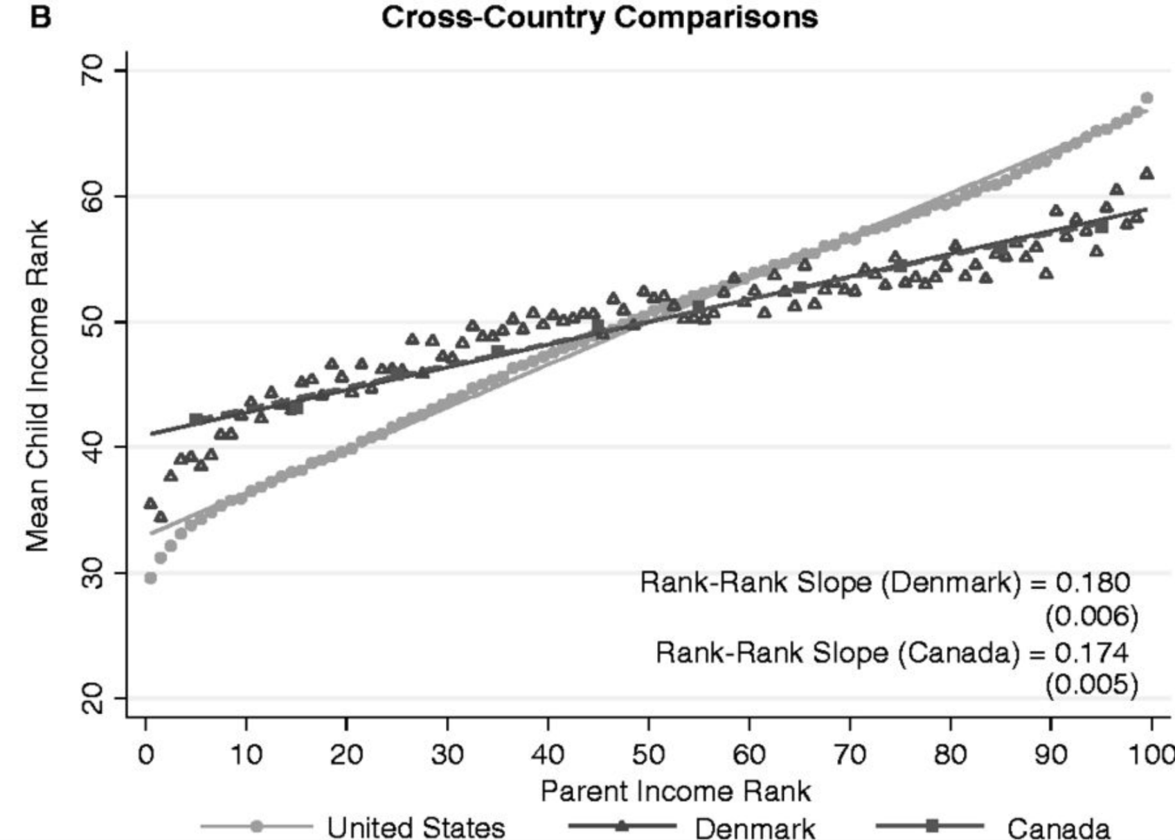
Intergenerational Mobility
In simple terms: how well do kids from poor parents do?
Rank-Rank Slope (U.S) = 0.341
(0.003)
Notes:
20
Hopefully you transition to this slide after someone comes up with the idea of rank-rank slope.
Now let’s say you want a much simpler measure of how well kids from poor parents do.
Answer: the prediction for the child of parent pct 25th.
Why the fitted line not the point (as explained in lecture)
Bridge to regression analysis

Slide 21
MTO: Estimating Treatment Effects
Regression specifications:
Treatment
Indicators
Site
Indicators
These intent-to-treat (ITT) estimates identify effect of being offered a voucher to move through MTO
From ITT to treatment-on-treated (TOT) estimates, needs to take into account voucher take-up (for young children: 48% for Exp and 66% for S8)
Notes:
21

Slide 22
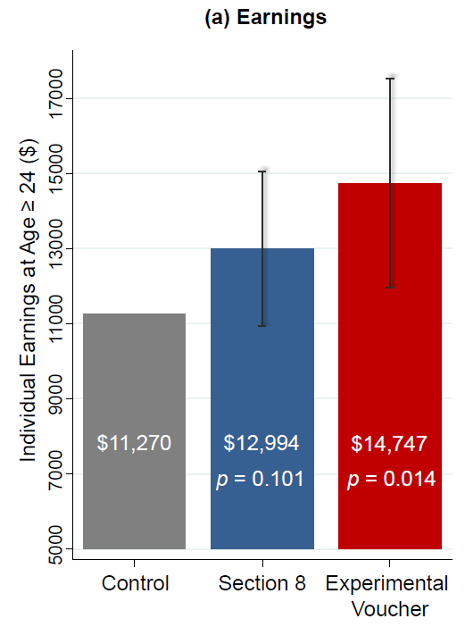
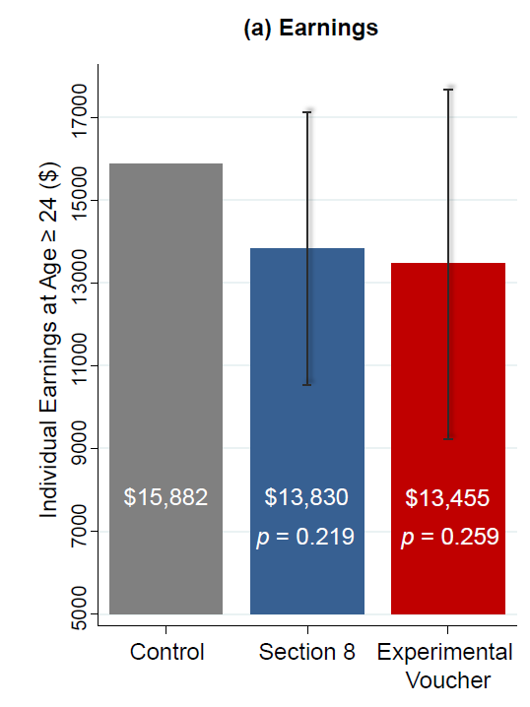
MTO: p-value is your friend!
Explain as simply as possible what is the p-value translating
Impacts of MTO on Children Below 13
Impacts of MTO on Children Age 13-18

Slide 23
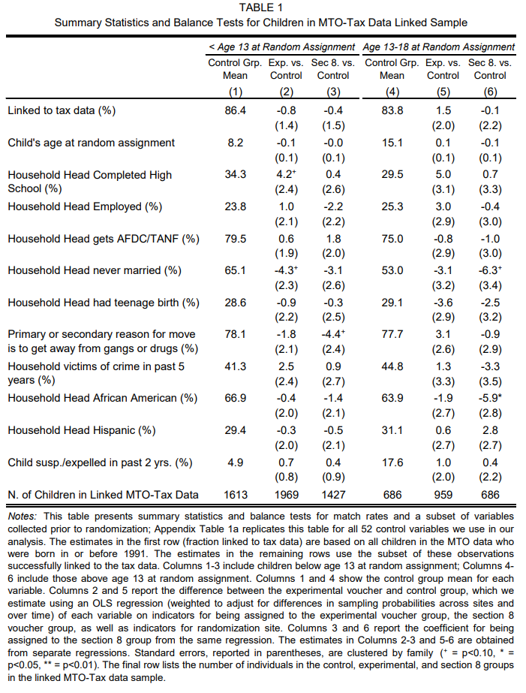
MTO: Can you read the tables?
[there were more lines in here]
Notes:
Can you tell me why is this table here, what is it doing, why is it important?
HINT: it’s the 1st table in the paper!

Slide 24
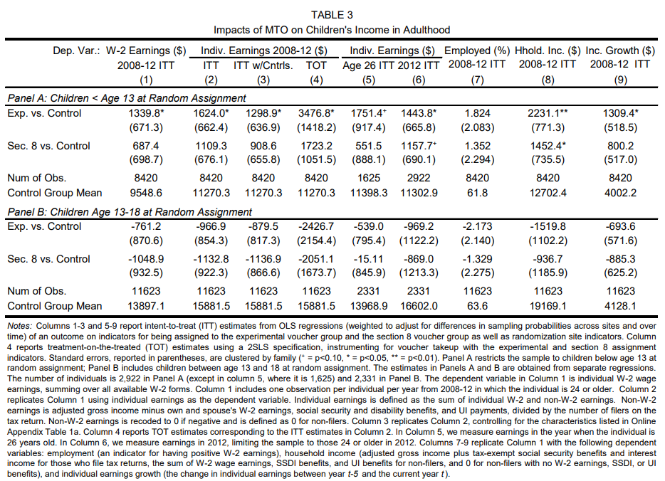
MTO: Can you read the tables?
Impacts of MTO on Children <13
Notes:
What about this one?
Can you spot the most important number?
HINT: here is the graph => Find where the graph and the table are speaking the same thing.

Slide 25
Stata hands-on demo
Stata will be used in section
But you’re very welcomed to follow the Jupyter notebooks for:
R
Python
All files at: https://github.com/dianagold/Ec1152_diana
Notes:
Note: Mention here that the software people use is flexible and what you will support.
Stata will be supported by the class, so we'll do a Stata example here.

Slide 26
Stata demo
Required files at: https://github.com/dianagold/Ec1152_diana
If you have Stata in your computer, you may want to do it along
How to install & hints: https://canvas.harvard.edu/courses/19323
Optional workshop: Monday at 5:30 pm in Emerson Hall 105
Why are we using Stata?
The most popular software used by economists for applied econometrics
Works for “big data”: up to 20 billion observations and 32 thousand variables (contingent on RAM)
Upward mobility (Y) as a linear regression of Bowling Alleys per capita (X)
Tasks:
Get means and stdevs
Standardize Y and X
Use OLS to estimate correlation coefficients
Notes:
26

Slide 27
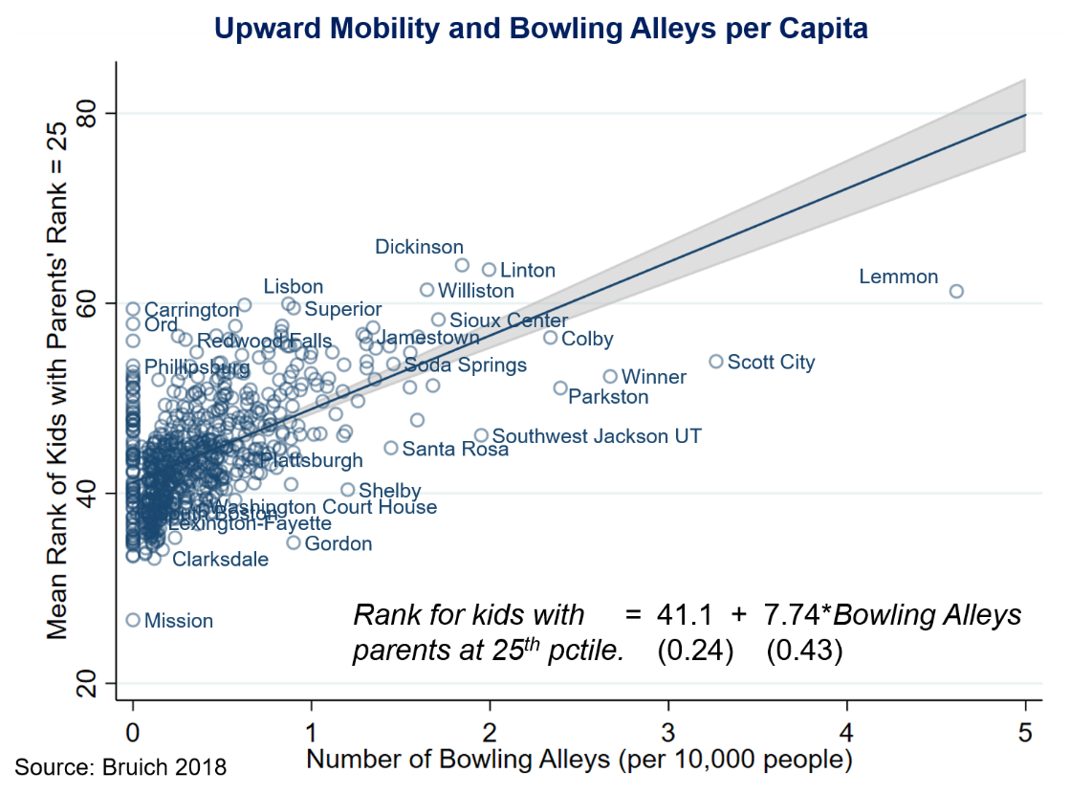
Stata demo [output today]
Notes:
27

Slide 28
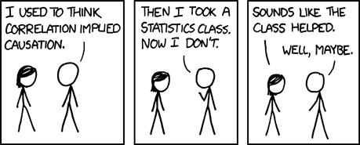
Correlation is not causation!
Have you seen this meme before?
Have you take a Stats class before?
Correlation or causation?
Notes:
28

Slide 29
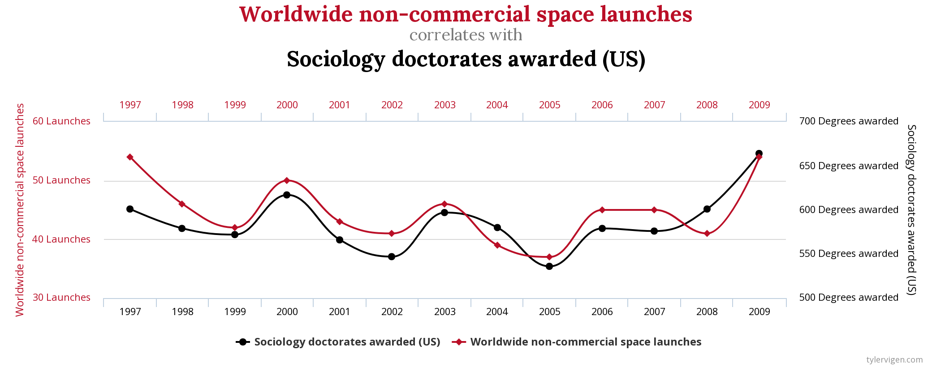
Correlation is not causation!
Notes:
Do sociology doctorates put us into space?

Slide 30
Policy Discussion

Slide 31
Policy discussion (starters)
Shaun Donovan on “the politics of getting it done”:
Can we spend money while actually saving money? The selling point for Culhane’s research
Mayors competing (what role for media & public attention?)
Chetty’s lecture on MTO:
Experimental vouchers as “investment in the future generation” Intertemporal compromises
“Opportunity bargains”: information and transaction costs (making the process seamless)

Slide 32
MTO Conclusion slide: Policy Lessons
How can we improve neighborhood environments for disadvantaged youth?
Short-term solution: Provide targeted housing vouchers at birth conditional on moving to better (e.g. mixed-income) areas
Taxpayers may ultimately gain from this investment [MTO experimental vouchers increased PDV of earnings by $100K for children who moved at young ages]
Long-term solution: improve neighborhoods with poor outcomes, concentrating on factors that affect children
Estimates here tell us which areas need improvement, but further work needed to determine which policies can make a difference
Disclaimer: slide copied from the corresponding ppt in the Opportunity Insights website

