Slide 1
EC 1152 - Using Big Data to Solve Economic and Social Problems
Review Session #3: Regression Discontinuity
TF: Diana Goldemberg
Prof: Raj Chetty
Harvard University
Spring 2019
Disclaimer: multiple TFs contributed to those slides. All mistakes are mine.

Slide 2

Outline: Regression Discontinuity
RDs as a tool for causal inference
Example (Lindo, Sanders and Oreopoulos, 2010)
Visualization
Estimation
Key Assumptions
Robustness Checks and Advanced Topics
Stata Code
Notes:
2
Last section, we discussed how it’s not always possible to randomize treatment to treatment and control groups, due to ethical and logistical constraints
RD methods as a type of quasi-experiment / observational study
Can be common in policy because it uses the financial/resource constraints to study outcomes

Slide 3
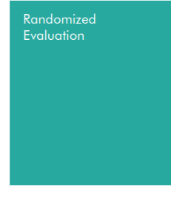
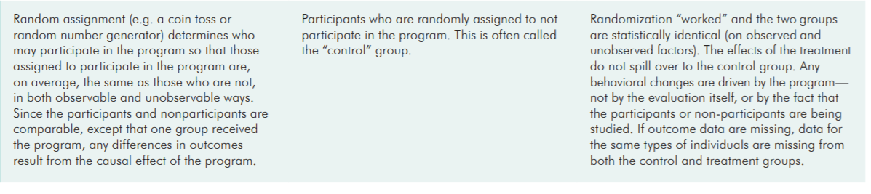
Causal Inference: Randomized is gold
example: MTO
Source: https://www.povertyactionlab.org/sites/default/files/resources/2016.08.31-Impact-Evaluation-Methods.pdf

Slide 4
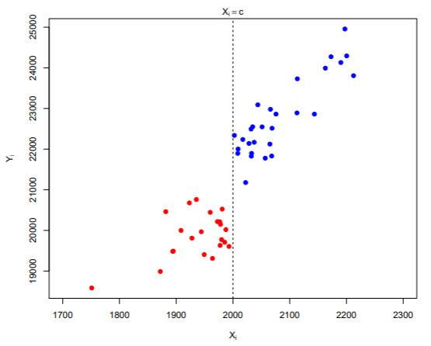
Intuition
Unfortunately, people were not randomized into scholarships (treatment).. but there was a rule to decide who got treated. Can we claim causal effects?
Below cutoff didn’t get it
(Treatment = 0)
Above cutoff got scholarship (Treatment = 1)
cut-off
Outcome: income
Running Variable: test score
Source: Yamamoto (2016)
Notes:
Could be:
Y = Income
Running variable = Score
Treatment = get a scholarship

Slide 5
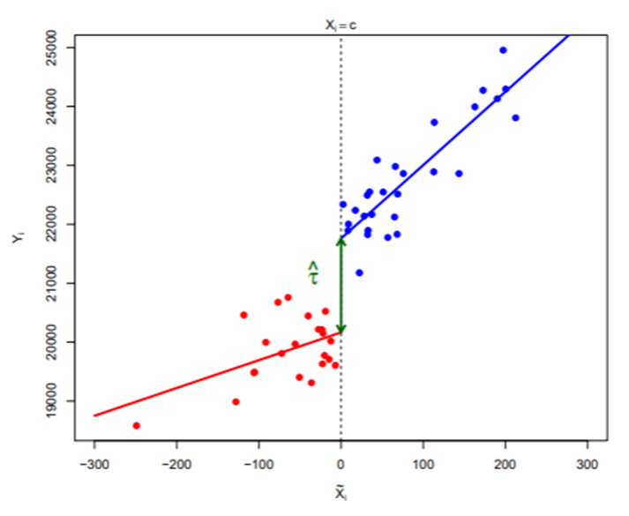
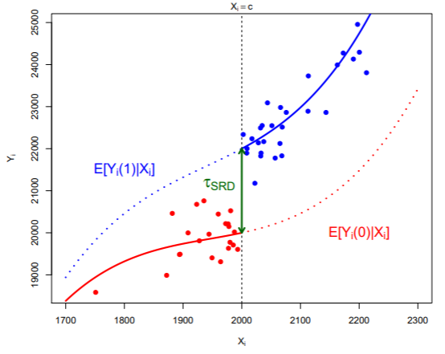
Intuition
Could use different extrapolation methods, but you’re interested in the jump, the discontinuity between those who almost got treated and almost didn’t
Treatment = 0
Treatment = 1
Treatment = 0
Treatment = 1
cut-off
cut-off
cut-off
Outcome
Outcome
Outcome
effect
effect
Running Variable
Running Variable
Source: Yamamoto (2016)

Slide 6
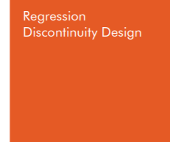
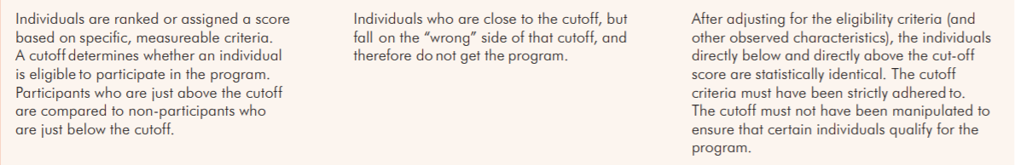
Causal Inference: Randomized vs RD
example: MTO
example: Zimmerman (2014): FIU
Source: https://www.povertyactionlab.org/sites/default/files/resources/2016.08.31-Impact-Evaluation-Methods.pdf
Notes:
Applicable when treatment is assigned according to a rule based on another variable (called the forcing or running variable)
Often useful for analysis in a “rule-based” world (administrative programs, elections, etc.)
Recall that any quasi-experimental approach requires “identification assumptions” to make it as good as an experiment
RDs use the fact that sometimes a treatment is determined by whether an individual’s value of a variable crosses a certain threshold
If the value of the variable is on one side of the threshold, the person is in the treated group
If the value of the variable is on the other side of the threshold, the person is in the control group
Thresholds often arise due to administrative decisions or ‘arbitrary’ rules

Slide 7
Example: Lindo, Sanders and Oreopoulos 2010
To estimate returns to a college education, LSO (2010) use data from Canadian university and a regression discontinuity design
Compares students just above and just below GPA cutoff in their 1st year for being put in academic probation:
Discourages some students from returning, reducing graduation rates
Improves subsequent performance for those who remain
Next we will go over:
How do we visualize this?
How do we estimate the causal effect?
What do we need to interpret a RD as causal?
Notes:
7
8 cohorts of students
Cutoff is 1.5 or 1.6 depending on campus

Slide 8
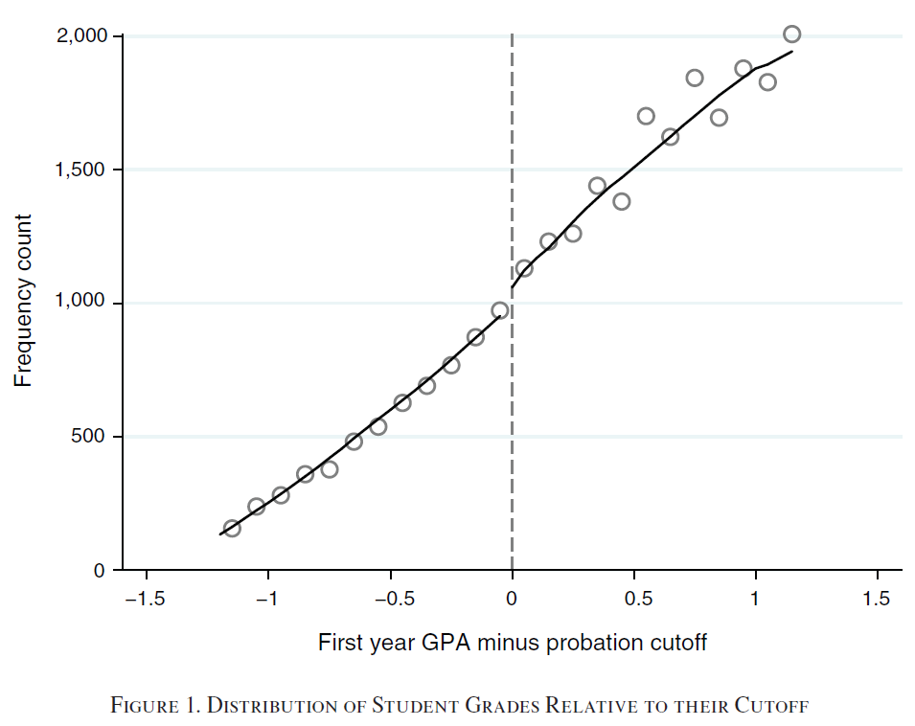
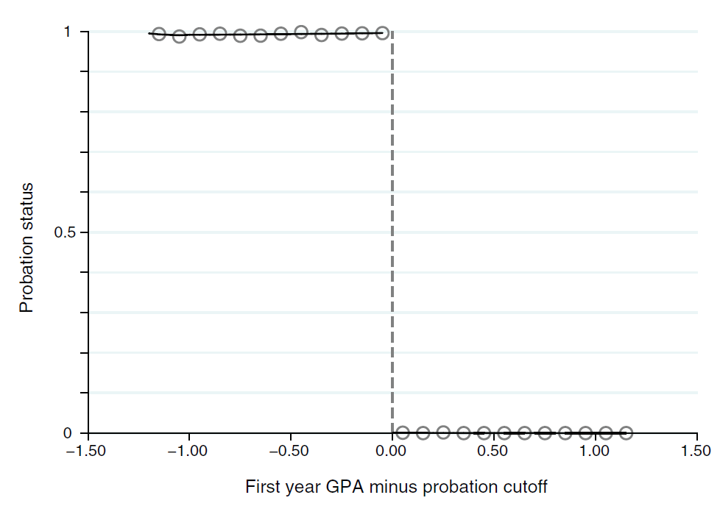
An arbitrary cut-off point, C, determines treatment assignment
GPA is the forcing variable or running variable (often re-centered at the cutoff to facilitate visualization/interpretation of estimates)
Visualizing Regression Discontinuities
Treatment = 1
Treatment = 0
Treatment = 1
Treatment = 0
Source: Lindo, Sanders and Oreopoulos (2010)
Notes:
8

Slide 9

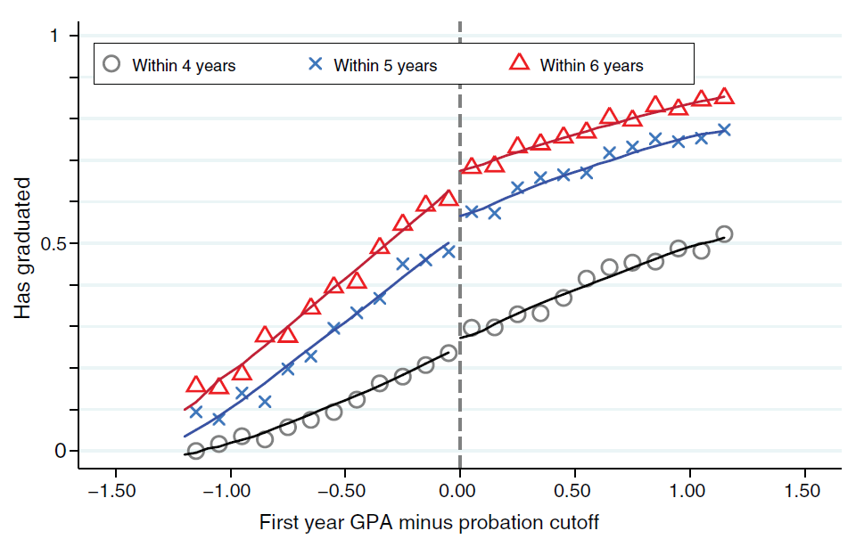
Jump at cutoff is significant => probation reduces graduation rates
Visualizing Regression Discontinuities
Treatment effects
Treatment = 1
Treatment = 0
Source: Lindo, Sanders and Oreopoulos (2010)
Notes:
9

Slide 10
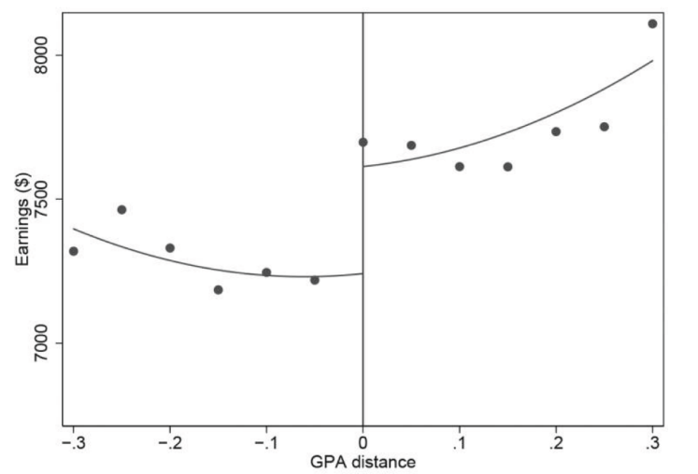
Example: Zimmerman (2014)
To estimate returns to a college education, Zimmerman compares students just above and just below state-level GPA cutoff for admission to the Florida State University System:
You will see this example in next Chetty’s lecture!!!
Mean Quarterly Earnings 8-14 Years after HS Graduation
Around FIU GPA Admissions Cutoffs
Treatment = 0
Treatment = 1
Treatment effect $372 or 5.1%
Source: Zimmerman (2014)
Notes:
10
Can briefly introduce the example / what we will go over in the next slides
Not sure if the threshold/cut-off is actually published
Zimmerman finds that students just above the admissions threshold at FIU are 23.4 percentage points more likely to be admitted to FIU and 11.9 percentage points more likely to attend any SUS campus than students just below the admissions threshold. On average, students induced to attend college by “threshold-crossing” attend a SUS campus for an additional 3.8 years, and they graduate at rates similar to those in the broader student population. Threshold-crossing produces a $372 gain in quarterly earnings between 8 and 14 years after high school completion, corresponding to a $1,593 increase in quarterly earnings per marginal admission. This is equal to 22% of expected earnings just below the threshold. Driving earnings gains are large effects for male students ð$4,191 per marginal admissionÞ and free-lunch recipients ð$2,695 per marginal admissionÞ. Gains for female students and students who do not receive free lunch are close to zero.

Slide 11
Can you think of other RD examples?
Discuss with a partner or two!
Close elections
Social program eligibility cut-off
Scholarships
Education admissions
Tax brackets
Pregnancy induction
Birth weight
Address determining school district assignment
Notes:
11
TF team: Alternatively, feel free to move this slide up before discussing assumptions. You could replace these bullets with examples that students come up with – and use them to discuss how they might hold or not under the 3 assumptions

Slide 12
Regression Discontinuity Estimation
Typical steps:
Re-center running variable: X = GPA – cutoff C
Treatment dummy: T = 1 if GPA< cutoff (probation) and T = 0 if GPA > cutoff (no probation)
Regress:
Linear: Y = β₀ + β₁T + β₂X + β₃T∙X + ε
Outcome
treatment dummy
re-centered running variable
Controls for slope of those without treatment
Controls for slope to the other side of the cutoff
Quadratic: Y = β₀ + β₁T + β₂X + β₃T∙X + β₄X² + β₅T*X² + ε
β₁
HAS causal interpretation
In these cases, ______ estimates the discontinuity of interest.
We estimate β₂ and β₃ separately because __________________________.
we don’t presume the same relationship at both sides of the cutoff
NO causal interpretation
We include β₄ and β₅ to allow for a quadratic form (more terms for cubic, etc).
Notes:
12
Can walk them through how we get an RD estimate in practice (will provide code later) (can flip back to graph to explain intuitively was B1 is estimating)
Note that we do not care about the slope of the line away from the threshold, just the jump at the threshold. This is something students often struggle with: they want to interpret the slope causally, so it is important to emphasize that it is only the jump at the threshold that can be given a causal interpretation.

Slide 13
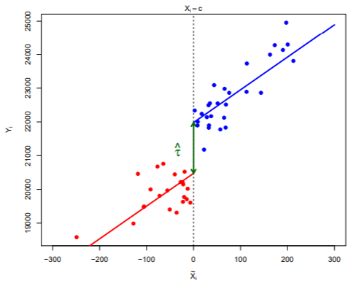

Common slope vs different slope RD
Estimated considering slope to be, around the cut-off:
Common Different
But only the jump has causal interpretation!!!
Source: Yamamoto (2016)

Slide 14
Regression Discontinuity Estimation Continued
To what population does this estimate apply?
RD is a local estimate
- The results are based on observations right above and below C
- Local average treatment effect (LATE)
For external validity, we would need additional data to make generalizations:
-Are people farther from the cut-off different than those closer?
-Other methods that ensure identifying assumptions remain satisfied
Notes:
14
*Results may not apply to people with GPA at the extremes (1.0 vs. 4.0)

Slide 15
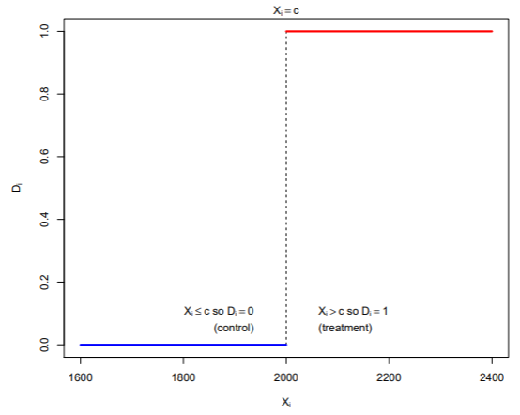
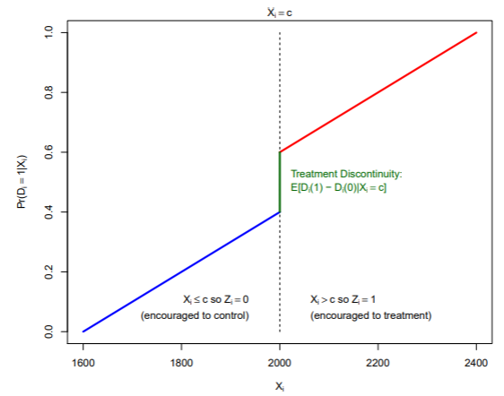
Sharp vs Fuzzy RD
Probability of Treatment in:
Sharp RDD Fuzzy RDD
Corresponding example:
Lindo Sanders Oreopoulos 2010 Zimmerman 2014

Slide 16
Regression Discontinuity Assumptions
What is necessary to interpret a RD as causal?
Key Assumptions
No manipulation of the running variable
No other discontinuities: other determinants of the outcome (covariates) evolve smoothly across the cut-off
No other treatments occur at the cut-off
Notes:
16
Can briefly introduce assumptions that we will go over in the next few slides

Slide 17
Assumption 1: No Manipulation
No manipulation (or imperfect control) of the running variable
Imagine if people could control whether they get the pill or a placebo
Manipulation introduces selection bias and differences in unobservables
How do we test if this assumption is violated?
Consider the setting & treatment: Is the cut-off published? How can individuals change their X, if at all?
McCrary Test – Can look at Density of Observations around the cutoff
It was figure 1 in the Lindo Sanders Oreoupoulos 2010 example
Notes:
17

Slide 18
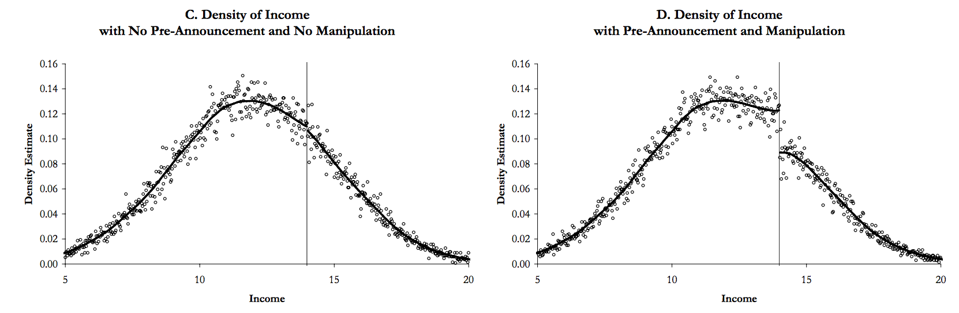
McCrary Test
McCrary Test – Look at Density of Observations around the cutoff for evidence of manipulation
No Discontinuity at X=C
Discontinuity at X=C
Source: Hypothetical Example: Gaming the System with an Income-Tested Job Training Program
https://eml.berkeley.edu/~jmccrary/mccrary2006_DCdensity.pdf
Notes:
18
If there’s manipulation, you can try a donut hole RD
Do a bounding exercise: see how much trouble this gives you

Slide 19
Assumption 2: No Other Discontinuities
Other determinants of treatment should evolve smoothly across the threshold
Imagine if treatment assignment were related to age, gender, income, etc.
Differences in observables may confound estimates
The treatment and control groups wouldn’t look similar
How do we test if this assumption is violated?
Visualize using binscatter
Show covariate balance
Notes:
19

Slide 20
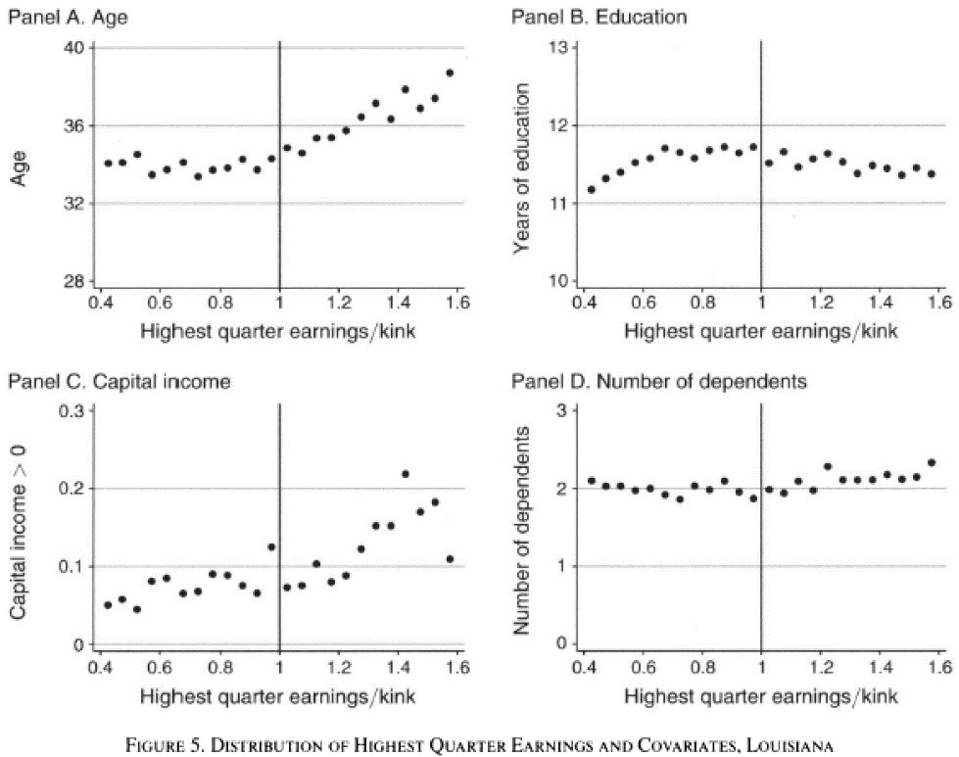
Landais (2015) used binscatter plots to check this assumption this for a paper evaluating UI
Assumption 2: No Other Discontinuities
Notes:
20
This makes groups above and below the cutoff comparable

Slide 21
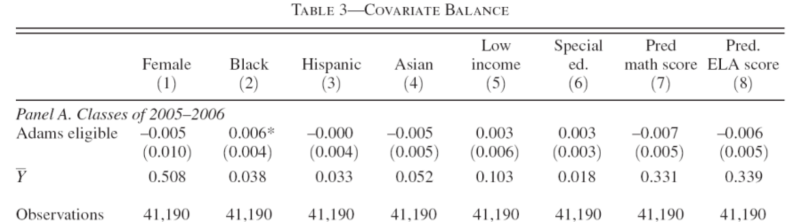
You can also show this in a table, like in Goodman & Cohodes (2014)
Replace the outcome with the covariates in the regression equation
Assumption 2: No Other Discontinuities
Measures discontinuity
$$Y= β_{0}+ β_{1}Treat+ β_{2}Distance+ β_{3}Distance∗Treat+ ε$$
Covariate
Controls for slope to the Left
Controls for slope to the Right
Notes:
21
Recall these are the B1’s
OK if 1 is statistically significant (expected when doing many tests)

Slide 22
Assumption 3: Only one treatment at the cutoff
No other treatment is taking place at the cut-off, C
Imagine if the program eligibility for food stamps, Medicaid, TANF, and EITC were the same
Then, it would be difficult to distinguish whether food stamps (or another program or another combinations of programs) are driving the results
How do we test if this assumption is violated?
Understand institutional details
Notes:
22
Any difference in outcome at the threshold must be due to the
discrete change in treatment

Slide 23
Robustness and Assumption Checks
Manipulation of running variable (McCrary test)
Donut hole to exclude manipulators
Placebo test
Covariates as outcomes
Fake cutoffs
Run regressions with multiple specifications
Bandwidth selection (what is “close” to cutoff)
Try different functional forms (linear, quadratic, cubic, etc)
Notes:
23

Slide 24
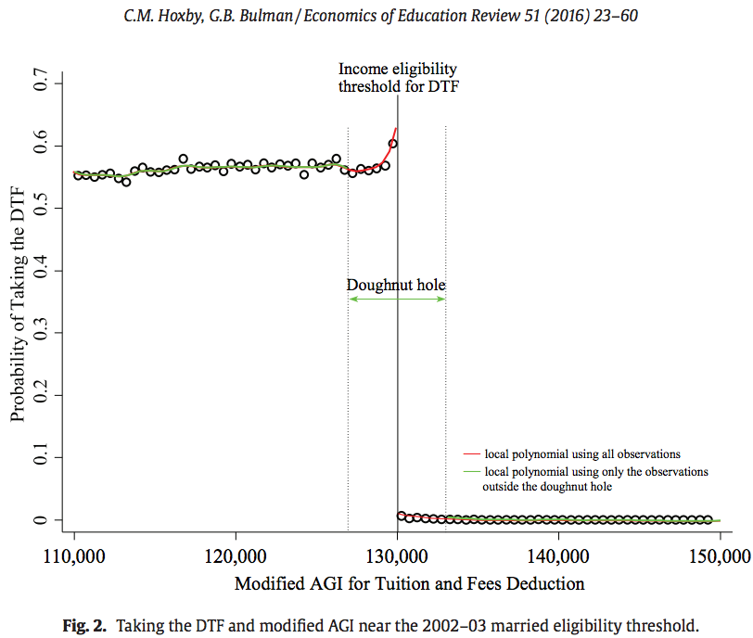
How to address manipulation: donut hole
Use a donut-hole RD to exclude the manipulators (Hoxby and Bulman, 2016)
Or focus on the subsample where people can’t manipulate (Card et al, 2008)
Notes:
24

Slide 25
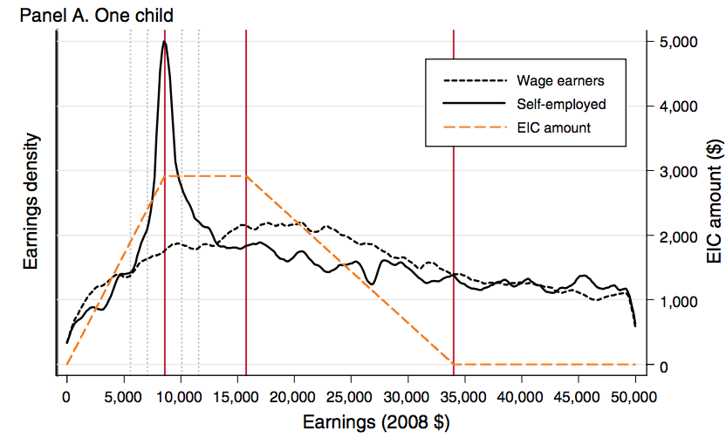
Evidence of Manipulation for Other Studies
Sometimes, manipulation can be informative.
Saez (2010): EITC bunching informs Chetty et al. use of EITC bunching as an instrument for knowledge of a program to evaluate EITC impact
Notes:
25

Slide 26
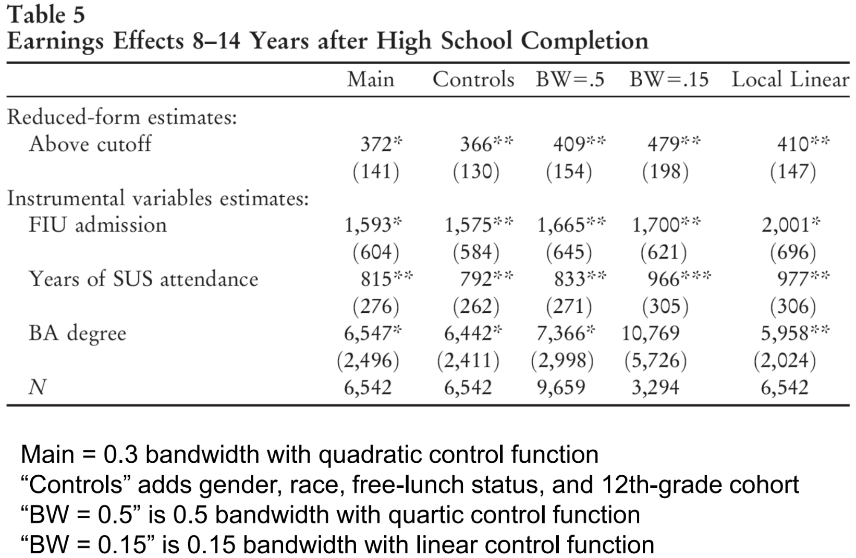
Back to Zimmerman (2014): results table
Zimmerman (2014)
Notes:
26
This paper presents strong evidence that education has a
causal effect on earnings
Admission into FIU resulted in 22% higher earnings in the
8–14 years following high school graduation for those who
just made the FIU GPA threshold relative to those who just
missed the admissions cutoff.
Choose a bandwidth – and show that results are robust to different bandwidths and specifications (e.g. quartic v linear)
Imbens & Kalyanaraman use data-driven optimal bandwidth: rdbwselect, bwselect
Implied Annual Internal Rate of Return: 8 to 15 percent
depending on horizon from 14 to 47 years

Slide 27
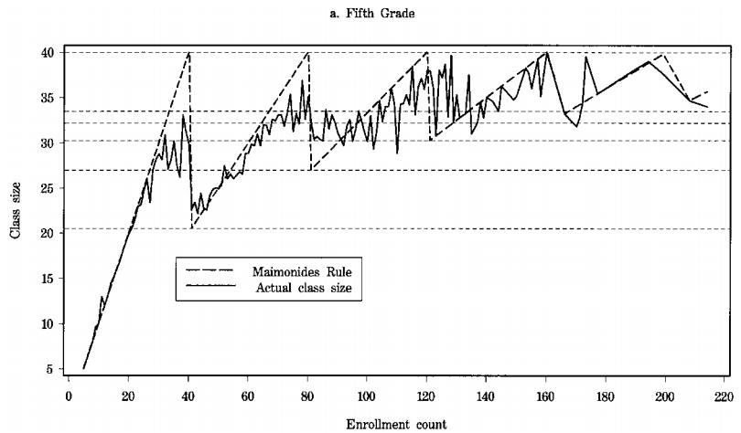
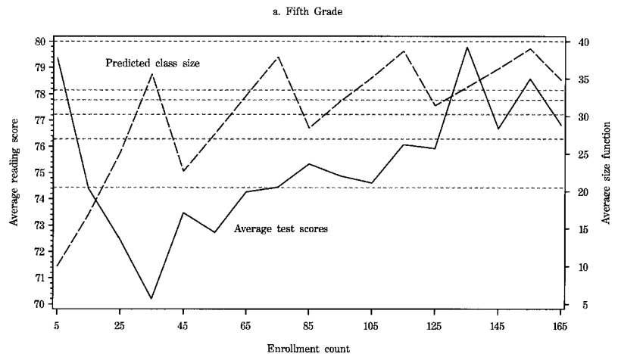
You can also have multiple cut-offs
Angrist & Lavy (1999) study the effect of class size on test scores
RD Basics & Another Visual with Multiple Cut-offs
Multiple cut-offs based on class size
Multiple treatment effects
Notes:
27

Slide 28
Practice Code
We will go over:
Creating the running variable
Binscatters
McCrary Test
RD Regression
Robustness Tests
STATA/R code is available on Canvas, please follow along!
[version I’m using in: bit.ly/ec1152drive ]
Notes:
28

