Slide 1
EC 1152 - Using Big Data to Solve Economic and Social Problems
Review Session #2
TF: Diana Goldemberg
Prof: Raj Chetty
Harvard University
Spring 2019
Disclaimer: multiple TFs contributed to those slides. All mistakes are mine.

Slide 2

Outline
Project #1
Stata crash workshop
Absolute Mobility and conditional probability
Also check the handout
Causal Effects
Randomized Experiments
(teaser) Quasi-Experiments
Propensity Score Reweighting
Notes:
2

Slide 3
Logistics
Office Hours:
Wed 4.30-6.30, Barker 103
Any outstanding issues with sectioning?
Remember, can always submit questions & anonymous feedback before sections using this Google form [https://goo.gl/forms/RAOQFBIj6SXdFOZJ3]
Find this prez and files at: https://github.com/dianagold/Ec1152_diana Or at GoogleDrive: http://bit.ly/ec1152drive
Notes:
3

Slide 4
Project #1
First project is due Thursday, 2/21 on Canvas
Some clarifications (see also the Canvas discussion)
Your 4-6 page narrative should address all of the main questions from the project document, but you do not need to include every figure you create in the document.
For example, when creating scatterplots and tables of mobility by race, choose a couple to discuss in the narrative, and just include the rest of them in your code/logs so that we can see you generated them.
You do not need to number each question as you answer them—we will be able to tell. Please structure your response as an essay, but make sure to answer all of the questions.
Notes:
4

Slide 5
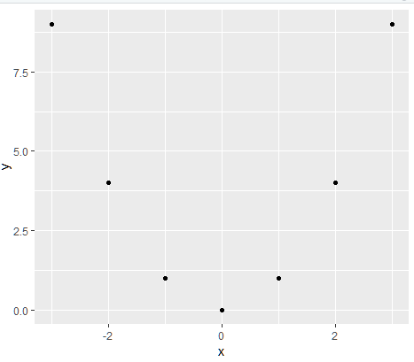
Project #1
Correlation coefficients measure linear correlation:
X | Y
-3 | 9
-2 | 4
-1 | 1
0 | 0
1 | 1
2 | 4
3 | 9
Are X and Y related? What do you think the correlation coefficient is?
Takeaway: Zero correlation does not mean X and Y are unrelated!
Covariates = Other variables that are (potentially) related to a variable of interest, typically included as an independent variable in a regression.
Notes:
5
Just in case they have variables that are non-linearly related (which is certainly possible with $$ as a variable), want them to know that correlation is not the be all/end all.

Slide 6
Stata hands-on demo
Stata will be used in section
But you’re very welcomed to follow the Jupyter notebook for Python and the hints at the end of the Assignment for the R commands
All files at: https://github.com/dianagold/Ec1152_diana
Notes:
Note: Mention here that the software people use is flexible and what you will support.
Stata will be supported by the class, so we'll do a Stata example here.

Slide 7
Absolute Mobility

Slide 8
Absolute Mobility
Chetty et al (2017) absolute mobility: What fraction of children have a higher standard of living than their parents did?
Three pieces of information needed:
Average parent income at age 30 at each percentile rank of the income distribution.
Average child income at age 30 at each percentile rank of the income distribution.
Joint distribution (“copula”) of parent and child income ranks
This is enough information to calculate absolute mobility!
Notes:
8
Start with handout.
May ask – why can’t you just compare parent and child income. Point is that this method is more flexible when don’t have IRS data, not crazy to assume copula is stable over time, etc.

Slide 9
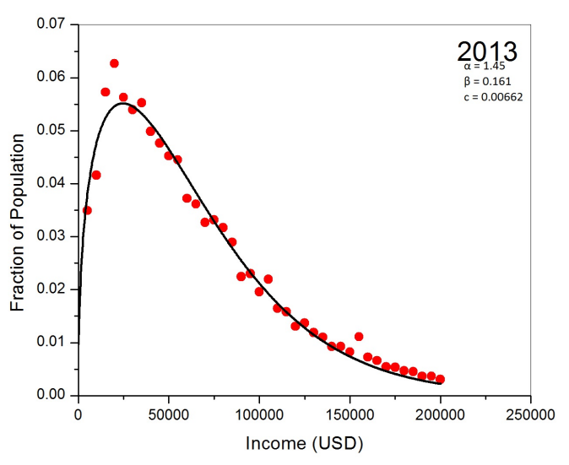
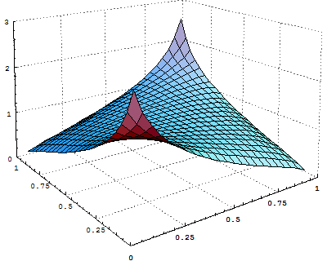
Wait, What’s a Joint Distribution?
Last Week: probability distribution functions (PDFs) in one variable
This Week: joint distribution functions in two variables
Graph shows probability X = some value, e.g. P(X = 5)
Graph shows probability X = some value AND Y = some value, e.g. P( X=5, Y= 10)
Notes:
9
Before showing pic of joint distribution, can ask what how they might visualize a joint distribution. If they say scatterplot, they’re on the right track, can think of height of joint distribution as describing the denseness of points in a scatterplot.

Slide 10
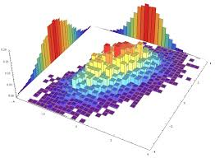
Wait, What’s a Joint Distribution?
Marginal distribution: P(X = x)
Marginal distribution: P(Y = y)
Joint distribution: P(X = x, Y = y)
Notes:
10
Just showing that can calculate marginals from joint distribution.

Slide 11
Wait, What’s a Joint Distribution?
May also be interested in the probability of X occurring, given that Y has occurred.
For example, probability a kid ends above the 80th percentile of income given that their parent was below the 20th percentile.
We call this conditional probability, and we can write it as:
Pr(K_rank > 80| P_rank < 20)
“The probability that Kid rank > 80 given that Parent rank < 20”
“The probability that Kid rank > 80 conditional Parent rank < 20”
This is related to the joint probability:
Pr(K_rank > 80 | P_rank <20) =
Pr(K_r>80 and P_r <20)
Pr(P_r<20)
Notes:
11
Introducing conditional probability notation.

Slide 12
Absolute Mobility: Example Calculation
Suppose you knew that child income had the following quintiles:
Rank | 20 | 40 | 60 | 80
Income | 20, 514 | 38,008 | 62,734 | 94,563
And similarly, for parent income:
Rank | 20 | 40 | 60 | 80
Income | 26,764 | 43,290 | 58,235 | 76,847
Parent Rank
 | < 20 | 20 - 40 | 40 - 60 | 60 - 80 | > 80
< 20 | .058 | .037 | .029 | .028 | .024
20 – 40 | .046 | .036 | .035 | .041 | .031
40 – 60 | .025 | .031 | .041 | .056 | .045
60 – 80 | .013 | .024 | .041 | .066 | .065
80 - 100 | .007 | .017 | .035 | .072 | .097
Child Rank
The joint rank distribution for Milwaukee, WI
Notes:
12
Go through the handout with this slide up. Can start with measures of mobility on the first page, then the animations are designed to walk the students through the calculation of absolute mobility.

Slide 13
Absolute Mobility: Example Calculation
Can fill in every box this way:
Parent Rank
 | < 20 | 20 - 40 | 40 - 60 | 60 - 80 | > 80
< 20 | .058 | .037 | .029 | .028 | .024
20 – 40 | .046 | .036 | .035 | .041 | .031
40 – 60 | .025 | .031 | .041 | .056 | .045
60 – 80 | .013 | .024 | .041 | .066 | .065
80 - 100 | .007 | .017 | .035 | .072 | .097
Child Rank
Can you calculate exact absolute mobility?
What about a lower bound? Absolute mobility is at least…
Add up green boxes = .234
What about an upper bound? Absolute mobility is at most…
Add up green and yellow boxes = .73
Big range! Real paper uses percentiles to make it smaller.
Notes:
13

Slide 14
Absolute Mobility: Example Calculation
Percent of Children Earning More than their Parents
By Parent Income Percentile
100
80
60
Pct. of Children Earning more than their Parents
40
1980
20
0
0
20
40
60
80
100
Parent Income Percentile (conditional on positive income)
Notes:
Fig 1a

Slide 15
Mean Rates of Absolute Mobility by Cohort
100
90
80
Pct. of Children Earning more than their Parents
70
This was to calculate this green point
60
50
1940
1950
1960
1970
1980
Child's Birth Cohort
Notes:
Figure 1b
Values: 92% in 1940 to 50% in 1984

Slide 16
Absolute Mobility: Potential Issues?
What are some possible issues threatening the validity of absolute mobility estimates?
Some debate over the proper inflation adjustment
Solution: Present results under a variety of inflation adjustments, general pattern is fairly robust.
Do not observe the parent/child rank joint distribution “copula” before 1971.
Solution A: Assume stability, i.e. that it was the same then as it is now.
Solution B: Derive bounds on the measure of mobility under different possible joint distributions. Once back to 1940-1950, it doesn’t matter much.
Notes:
16

Slide 17
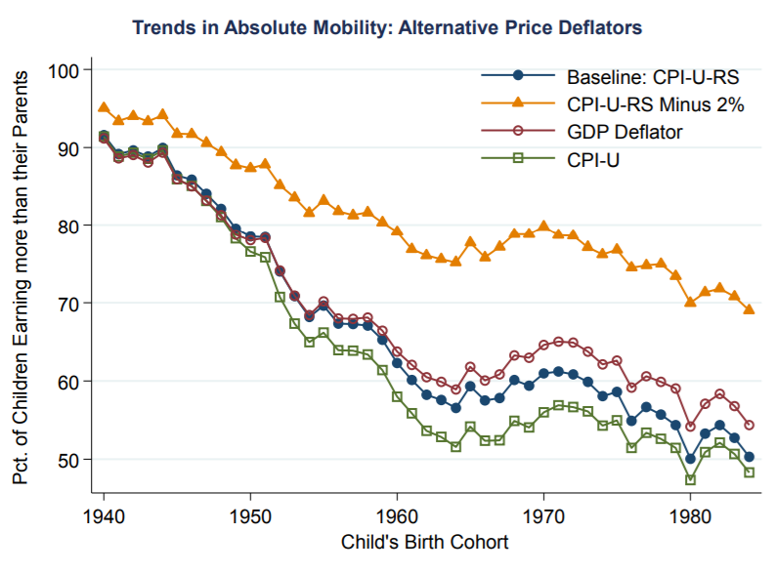
Absolute Mobility: Potential Issues?
Notes:
17

Slide 18
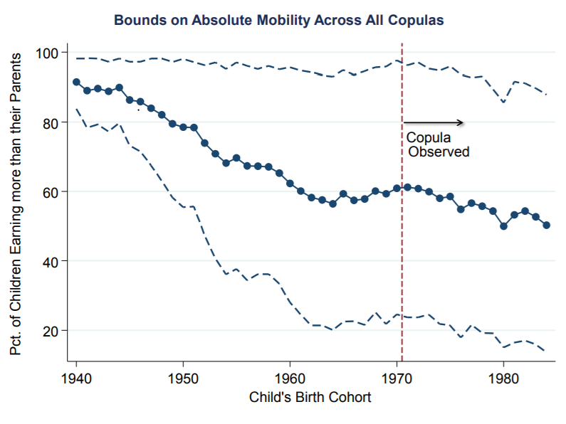
Absolute Mobility: Potential Issues?
Notes:
18

Slide 19
Household Income Distributions of Parents and Children at Age 30
For Children in 1940 Birth Cohort
80th percentile of parents distribution
Density
14th percentile of children's distribution
Parents
Children
0
27k
50k
100k
150k
Income (Measured in Real 2014$)
Notes:
Fig 2b

Slide 20
Household Income Distributions of Parents and Children at Age 30
For Children in 1980 Birth Cohort
80th percentile of parents distribution
Density
74th percentile of children's distribution
Parents
Children
0
50k
80k
100k
150k
Income (Measured in Real 2014$)
Notes:
Fig 2c

Slide 21
Child Rank Required to Earn More Than Parents
100
80
(80,74)
60
Child Income Percentile
1980
40
20
(80,14)
1940
0
0
20
40
60
80
100
Parent Income Percentile

Slide 22
Causal Effects

Slide 23
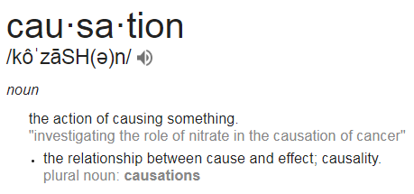
Causal Effects
Last week: correlation is not causation.
This week: What is causation?
Notes:
Kind of a throwaway slide, but thought the definition was funny. Hume text is the one with the problem of induction, i.e. can we ever truly infer “cause.”
Idea is to have brief, open-ended discussion. Probe a bit for their thoughts before linking causality and experiments on the next slide.

Slide 24
Causal Effects
In this class, and in economics and social science more generally, causal effects contrast the factual outcome and its counterfactual, often intimately linked to (real or hypothetical) experiments.
“If Jane would have gotten one more year of education, how would her wages be different?”
“If the Fed were to raise interest rates, how would unemployment change relative to if the Fed did not raise interest rates?
“If a child were to grow up in Minneapolis instead of Atlanta, how much more likely is it that she would become an inventor?”

Slide 25
Causal Effects: Partial Equilibrium vs. General
Think precisely about what causal effect you are interested in, in terms of the corresponding hypothetical experiment.
“What is the impact of moving to opportunity on future wages?”
“If we take one person, and move them from a low-opportunity neighborhood to a high-opportunity neighborhood, how will their future wage path be different than if we had not moved them?”
“If we move everyone in Seattle from a low-opportunity neighborhood to a high-opportunity neighborhood, how will the distribution of wages be different than if we had not moved them?”
Partial Equilibrium Effects
General Equilibrium Effects
Notes:
Before showing PE/GE stuff, see if you can get them to translate the question into a hypothetical experiment.

Slide 26
Causal Effects: Counterfactual
Notice in all the hypotheticals the idea of situations or people being “otherwise identical”. The counterfactual represents the state of the world in the absence of the policy/program you want to evaluate.
Jane vs. Jane with one more year of education
The US economy vs. the US economy with slightly higher interest rates
Problem: counterfactuals can not be directly observed (can’t compare a person to themselves)
Solution: we need to “mimic” or construct a credible counterfactual
What’s wrong with comparing participants and non-participants?
Better ways to achieve this?
Notes:
The hassle is to establish a credible comparison group – a group of individuals who in the absence of the program would have had outcomes similar to those who were exposed to the program.
However, in reality it is generally the case that individuals who participate in a program and those who were not are different: programs are placed in specific areas (for example, poorer or richer areas) individuals are screened for participation in the program (for example, on the basis of poverty or on the basis of their motivation) and, in addition, the decision to participate is often voluntary.
For all of these reasons, those who were not exposed to a program are often not a good comparison group for those who were, and any differences between the groups can be attributed to two factors: pre-existing differences (selection bias) and the impact of the program.
Since we have no reliable way to estimate the size of the selection bias, we typically cannot decompose the overall difference into a treatment effect and a bias term. Selection bias disappears in the case of randomization

Slide 27
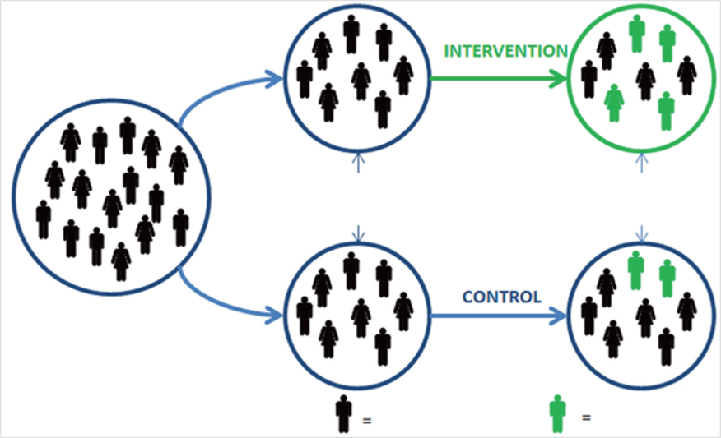
Causal Effects: Randomized Experiments
Exp. Vouchers
Sample is split into groups by random assignment
Outcomes for groups are measured
No Vouchers
Does not go to college
Goes to college
Note: Moving to Opportunity had two treatment (intervention) arms and one control, this is a simplification.
Notes:
What kind of factors could impact college going rates of kids?
Observable factors: gender, income, parents’ education
Unobservable factors: intelligence, diligence
Randomization ensures both types of factors are balanced across groups.

Slide 28
Causal Effects: Randomized Experiments
Randomized Experiments are the “Gold Standard” for creating comparable/“otherwise identical” groups. Why?
Key Point 1: Random assignment ensures that, at the outset of the experiment, members of the groups (treatment and control) do not differ systematically.
Key Point 2: Differences between the groups, which are solely due to chance, decrease with sample size.
Key Point 3: Thus, any difference that subsequently arises between them can be attributed to the intervention rather than to other factors.

Slide 29
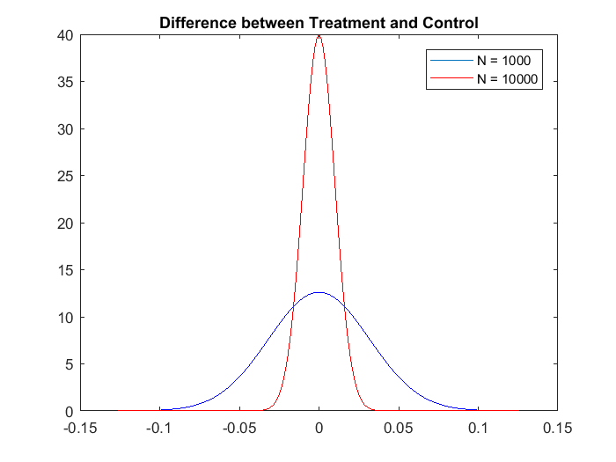
Causal Effects: Randomized Experiments
Illustrating Key Point 2
Population of 50% female, 50% male. Suppose you randomly assign N people, half to treatment, half to control.
Below is the (approximate) distribution of the difference between the fraction of the treatment group that is male and the fraction of the control group that is male, for N = 1,000 vs. N = 10,000:
Notes:
-Graph shows that even 1000 is pretty good, likely to be within 5 percentage points
-But 10000 is even better.

Slide 30
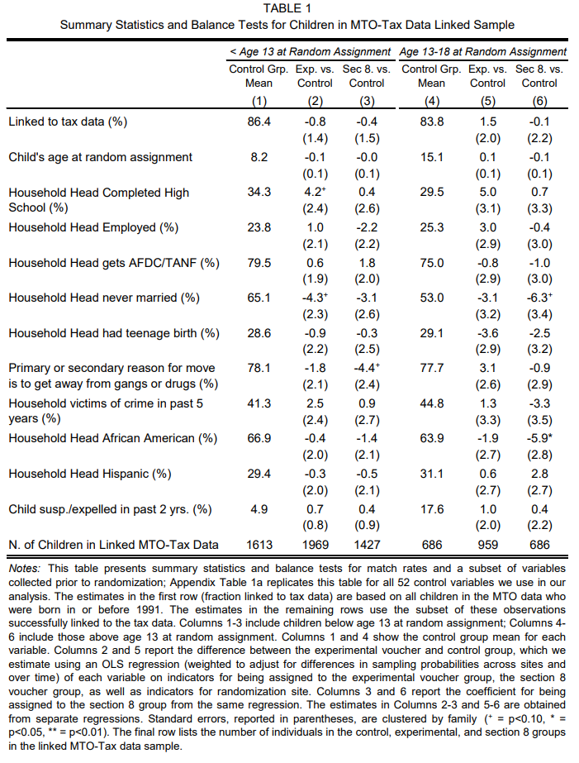
MTO: Can you read the tables?
[there were more lines in here]
Notes:
Can you tell me why is this table here, what is it doing, why is it important?
HINT: it’s the 1st table in the paper!

Slide 31
MTO: Estimating Treatment Effects
Regression specifications:
Treatment
Indicators
Site
Indicators
These intent-to-treat (ITT) estimates identify effect of being offered a voucher to move through MTO
From ITT to treatment-on-treated (TOT) estimates, needs to take into account voucher take-up (for young children: 48% for Exp and 66% for S8)
Notes:
31

Slide 32
Causal Effects: Randomized Experiments
Impacts of MTO on Children Below Age 13 at Random Assignment
Illustrating Key Point 3
(a) College Attendance (ITT)
20
15
College Attendance, Ages 18-20 (%)
10
5
16.5%
17.5%
19.0%
p = 0.435
p = 0.028
0
Control
Section 8
Experimental
Voucher

Slide 33
Randomized Experiments: Limitations
What are some limitations of randomized experiments? Consider the example of attempting to randomly assign people to move to opportunity.
Non-compliance: I don’t use my voucher
Attrition: I stop talking to the researchers/disappear.
Hawthorne effects: I know I’m in the treatment group and want to do really well.
John Henry effects: I know I’m in the control group and want to do really well (maybe because I want to show the researcher that my neighborhood should be more respected).
Small samples/Too expensive
Non-scalability: Can’t move everyone to opportunity, and can’t be sure what would happen if we did.
Notes:
Don’t just go through examples, ask them and see what they say, then touch on a few of these examples.
If they don’t have any answers, start to hint at some of these or describe them, but don’t make them stare a wall of text the whole time.
Bolded are from class.

Slide 34
Randomized Experiments: Limitations
Last Two Slides, Summarized:
Randomized experiments are the Gold Standard from estimating causal effects.
Randomized experiments can be expensive, non-generalizable, and feature many pitfalls.
So what can we do?
Big data helps solve/eliminate attrition: just use administrative records.
Quasi-experimental methods (stay tuned!!!)

Slide 35
Propensity Score Reweighting

Slide 36
Propensity Score Reweighting
One tool from econometrics that can help when we don’t have a random experiment.
Example: Suppose people are either tall or short, and wages are a function only of your height
Tall people make 2 dollars a day
Short people make 1 dollar per day
Initially we have 10 tall people and 10 short people working.
Average Income = [(10)*1 + (10)*2]/20 = 1.50 per day
Notes:
Start with simple example to build intuition, then do the inventors stuff.

Slide 37
Propensity Score Reweighting
Improve Earned Income Tax Credit
Tall people make 2.10 dollars a day
Short people make 1.20 dollar per day
More short people enter the workforce: Now have 20 short people and 10 tall people.
Average Income = [1.20(20) + 2.10(10)]/30 = 1.50 per day
Is the program a failure? Why or why not?

Slide 38
Propensity Score Reweighting
Key Point: The group before the change and the group after the change were not “otherwise identical.” They had different distributions of height!
Propensity Score Reweighting Approach: Weight the people after the change such that the distribution of height after the change matches the distribution of height before the change.
Optimal weights: 1/3 weight on short people,
2/3 weight on tall.
Re-weighted Average Income = [1.20(20)*.333 + 2.10(10)*.667]/30 = 1.65 per day
Notes:
Exact rates don’t matter here, just the ratio.
Point to understand: want as many tall as short, but only observe half as many, so weight them twice as much.

Slide 39
Who Becomes an Inventor? Propensity Score Reweighting
Relationship between becoming inventor and parent income?
8
Patent rate for top 1% parent income:
8.3 per 1,000
6
No. of Inventors per Thousand Children
4
2
Patent rate for below
median parent income:
0.84 per 1,000
0
0
20
40
60
80
100
Parent Household Income Percentile
Notes:
Try and get them to guess what the relationship would look like, can also elicit interpretations of top point and median points.
Does this mean having high income is causing kids to innovate more?

Slide 40
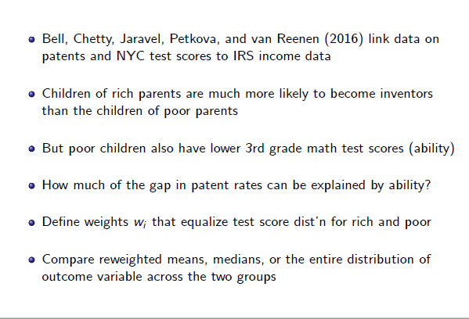
Who Becomes an Inventor? Propensity Score Reweighting

Slide 41
Distribution of Math Test Scores in 3rd Grade for Children of Low vs. High Income Parents
0.5
Fraction with Score in Top 10%
Parents below p80: 7%
Parents above p80: 23%
0.4
Parent Income below
80th percentile
Parent Income
above 80th percentile
0.3
Density
0.2
0.1
0
-3
-2
-1
0
1
2
3
Grade 3 Math Scores (Standardized)
Parent Income Below 80th Percentile
Parent Income Above 80th Percentile
Notes:
This is the key slide for understanding the intuition, so try to spend more time here than on the subsequent details.
First make sure they understand the graph.
-What does it mean that the red line is “to the right of the blue line” (higher 3rd grade math scores for high income kids)
-Why might this be a problem if we’re trying to see the effect of having high income parents on becoming an inventor? (might expect higher ability kids to become inventors…spurious correlation?)
Then give intuitive idea: We want to reweight the lower income population so that these distributions match.
-Remaining variation should not be due to ability differences alone (as measured by 3rd grade test)
-So put more weight on outcomes of low-income children with high ability (shift up the right side of the blue graph)
-And less weight on outcomes of low-income children with low ability (shift down the left side of the blue graph.
-Weighted distributions should be on top of each other.

Slide 42
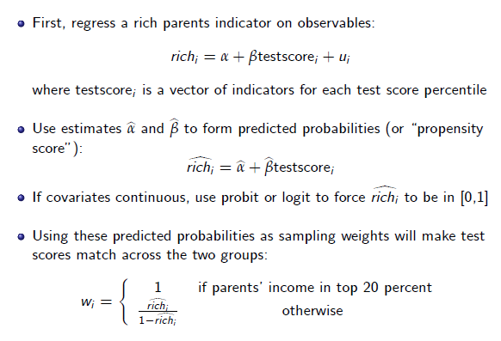
Who Becomes an Inventor? Propensity Score Reweighting
Weight on non-rich students increases in how much your test score “looks like” that of a rich person. (Upweight high-scoring, low-income students)

Slide 43
Who Becomes an Inventor? Propensity Score Reweighting
What Fraction of the Gap in Patenting by Parent Income is Explained by Differences in Test Scores?
 | Patent Rate (per 1000 Individuals) |  |  | Gap Relative to Above p80 Group
Above 80th Pctile. | 1.93
Below 80th Pctile. | 0.52 |  |  | 1.41
Below 80th Pctile. (Reweighting Scores) | 0.95 |  |  | 0.97
 |  |  |  | (= 1.93 – 0.95)
% of gap accounted for by 3rd grade scores |  |  |  | 31.2% (s.e. = 6.8%)
Notes:
Start with the first two lines: These are just capturing the idea we saw in the graph: richer parents= more inventions.
Third line is after you re-weight: By counting patents more for high test-scoring low income students, get higher “weighted patent rate”
But only explains 1/3 of the total variation…may ask “what else do you think is going on?”

Slide 44
Patent Rates by Race and Ethnicity
4
3
Reweighted to match parental incomes of whites
Inventors per Thousand
2
4.2
Raw rate
Reweighted to match 3rd grade test scores of whites
3.3
3.1
1
1.6
1.6
1.6
1.0
0.5
0.6
0
0.2
0.3
0.3
White
Black
Hispanic
Asian
Notes:
Fig 2
Share of Students By Race: Asian 9.6%, Hispanic 33.7%, Black 36.0 %, White 19.5%

