Slide 1
EC 1152 - Using Big Data to Solve Economic and Social Problems
Section 6
TF: Diana Goldemberg
Professor Raj Chetty
Harvard University
Spring 2019

Slide 2

Announcements
I need to reschedule section next week
Instead of this section on Thu Apr 4 4.30pm, please attend:
Tue Apr 2, 4.30pm in Lamont 240 => only for this section
Fri Apr 5, 10.30am in Sever 201
Other TFs sections from Tue Apr 2 to Mon Apr 8
I won’t hold OH on Wed Apr 3

Slide 3
Methodology to Estimate Life Expectancy
Goal: estimate expected age of death conditional on an individual’s income at age 40, controlling for differences in race and ethnicity
Period life expectancy: life expectancy for a hypothetical individual who experiences mortality rates at each age observed in a given year
Three steps:
Calculate mortality rates by income rank and age for observed ages
Estimate a survival model to extrapolate to older ages
Adjust for racial differences in mortality rates

Slide 4
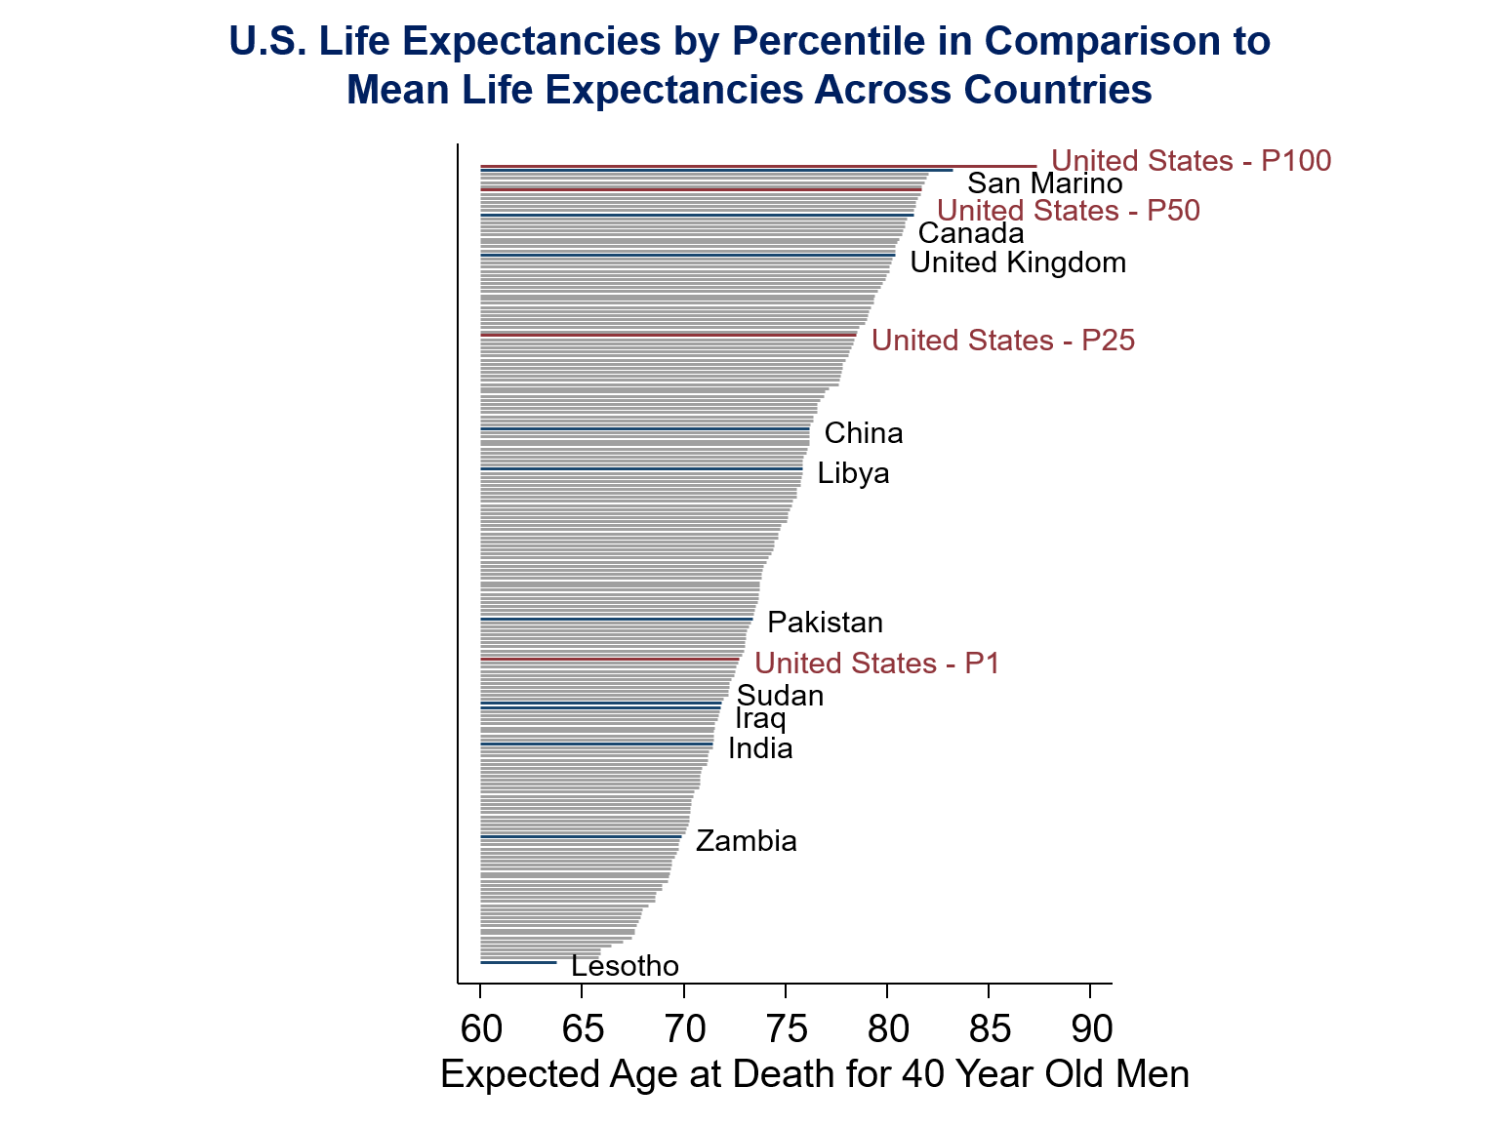

Slide 5
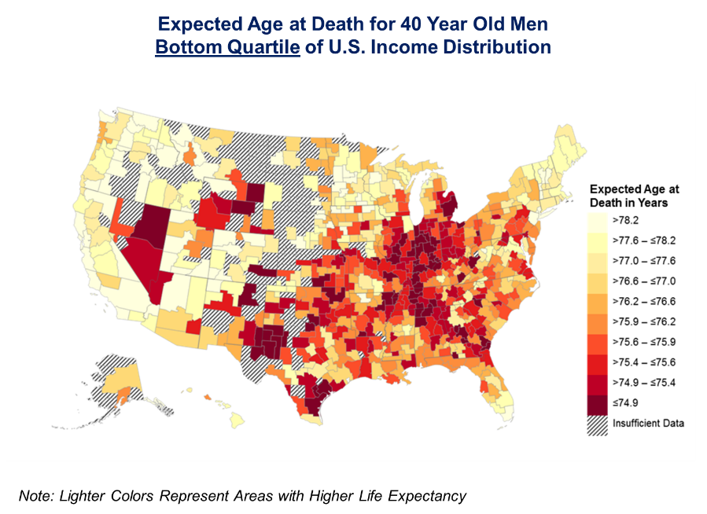

Slide 6
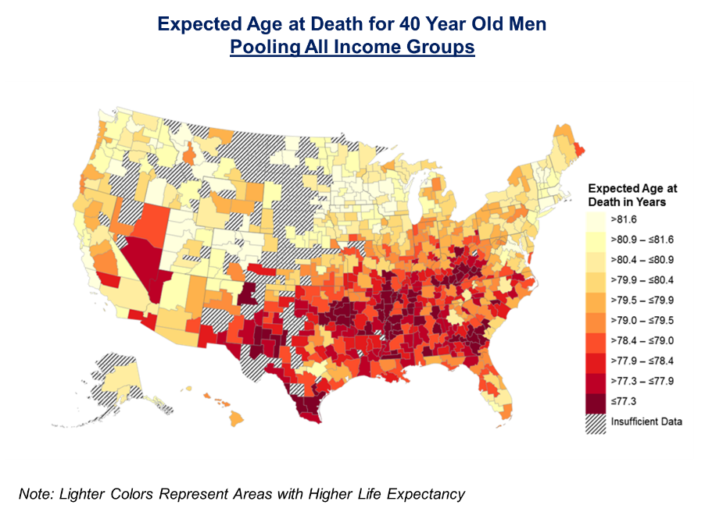
Question 1
What accounts for why these two maps differ?
Possible Answer: Low income households have lower life expectancy and there are more poor households in the South. Left graph is unconditional on income, right graph is conditional on income.

Slide 7
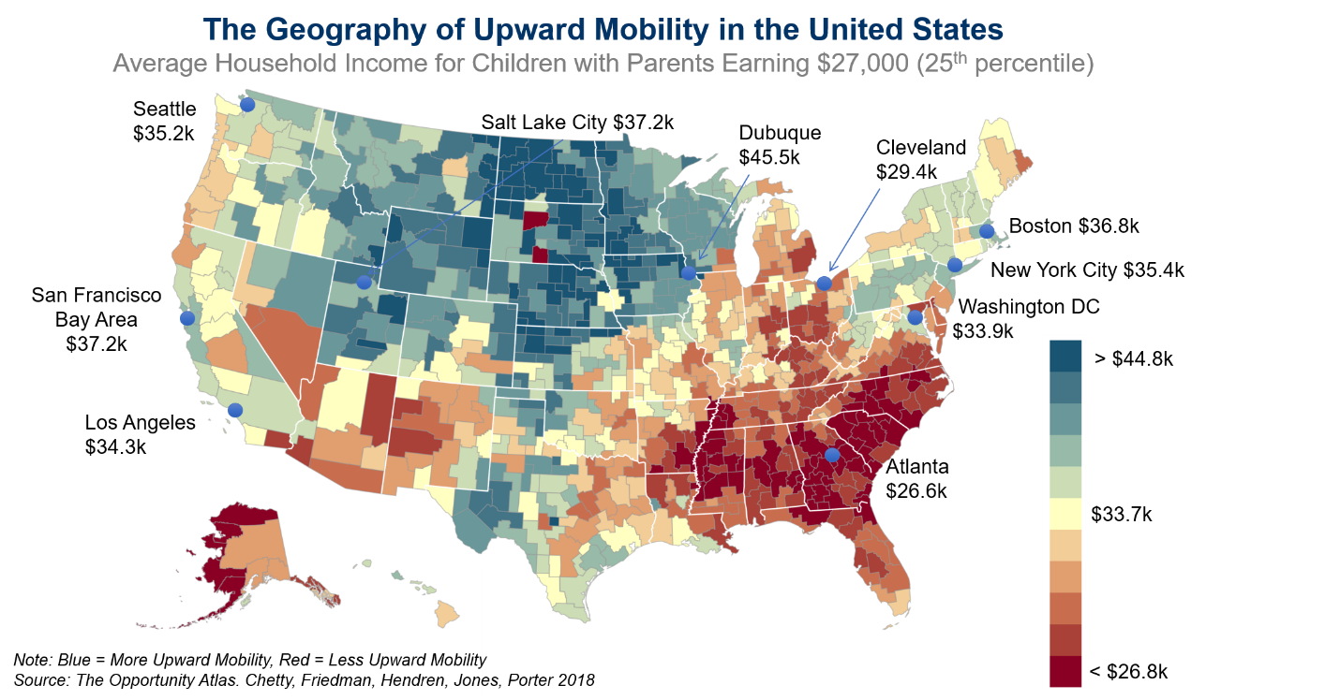
Question 2
Describe the geographic similarities and differences you observe between this map of life expectancy and the map of upward mobility from Chetty et al. (2018).

Slide 8
Question 2
Describe the geographic similarities and differences you observe between this map of life expectancy and the map of upward mobility from Chetty et al. (2018).
Possible Answer: Overall, there appear to be more geographic similarities than differences between the two maps, but the association appears to be at best weakly positive.
The Northeast and West Coast have high life expectancy and mobility, so this is one area of similarity between the two maps, although the highest levels of upward mobility present in the Great Plains are not paired with high life expectancy, so this is a difference between the two maps.

Slide 9
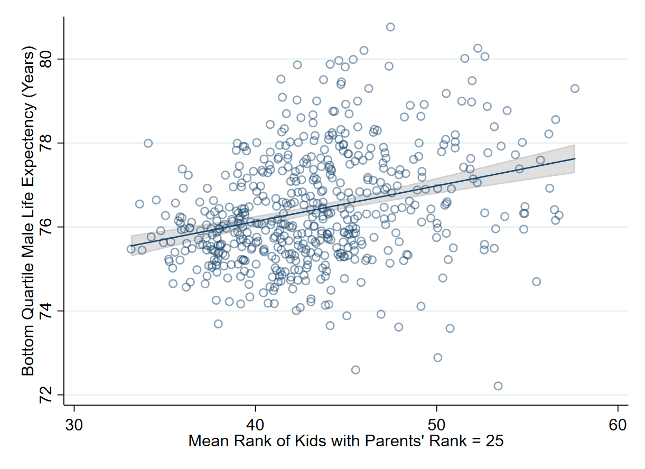
A Question
Relationship between Upward Mobility and Life Expectancy
Life expectancy = 72.7+ 0.0855*Rank
95% CI for Rank Coeff = [0.065, 0.106]
P-value for Rank Coeff = 0.000
R2 = 0.1030
Correlation= 0.3210
Notes:
standardized coefficient equals the correlation between Y and X (simple reg)
. corr le_raceadj_q1_M e_rank_b
(obs=595)
| le_r~1_M e_rank_b
-------------+------------------
le_racea~1_M | 1.0000
e_rank_b | 0.3210 1.0000
.
. reg le_raceadj_q1_M e_rank_b, r
Linear regression Number of obs = 595
F(1, 593) = 68.08
Prob > F = 0.0000
R-squared = 0.1030
Root MSE = 1.2544
------------------------------------------------------------------------------
| Robust
le_racea~1_M | Coef. Std. Err. t P>|t| [95% Conf. Interval]
-------------+----------------------------------------------------------------
e_rank_b | .0854787 .0103595 8.25 0.000 .065133 .1058245
_cons | 72.72802 .4325929 168.12 0.000 71.87842 73.57762
------------------------------------------------------------------------------

Slide 10
Question 3
Discuss a hypothesis grounded in what you learned from class and these two papers for why the geography of upward mobility and life expectancy for the poor is not perfectly positively correlated.
Possible Answer: It’s possible that there are different underlying mechanisms driving each of these outcomes. Moreover, some of these mechanisms (e.g., education and health behaviors) may be related, but they are not perfectly positively correlated. Therefore, we observe a positive, but not perfectly positive correlation between upward mobility and life expectancy.

Slide 11
Question 4
What has a higher correlation with life expectancy: access to healthcare or health behaviors?

Slide 12
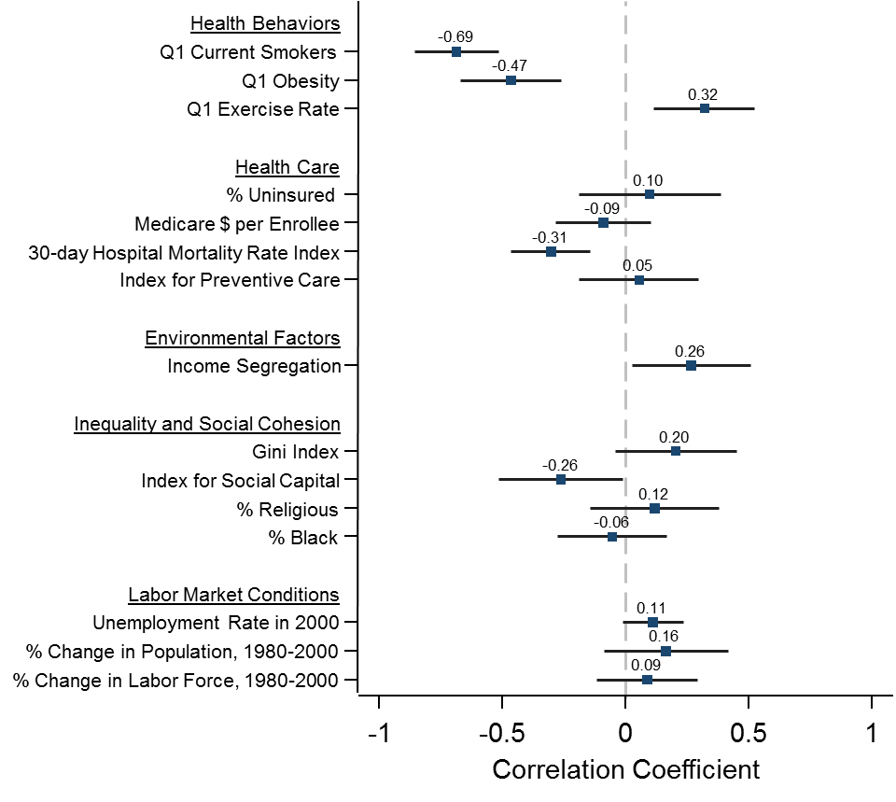
Correlations of Expected Age at Death with Health and Social Factors
For Individuals in Bottom Quartile of Income Distribution

Slide 13
Question 5
Are you convinced from these regressions and the evidence presented in the paper and lecture that there is an association between life expectancy and (i) health behaviors (ii) health insurance?
What type of empirical evidence would convince you that these relationships are causal?

Slide 14
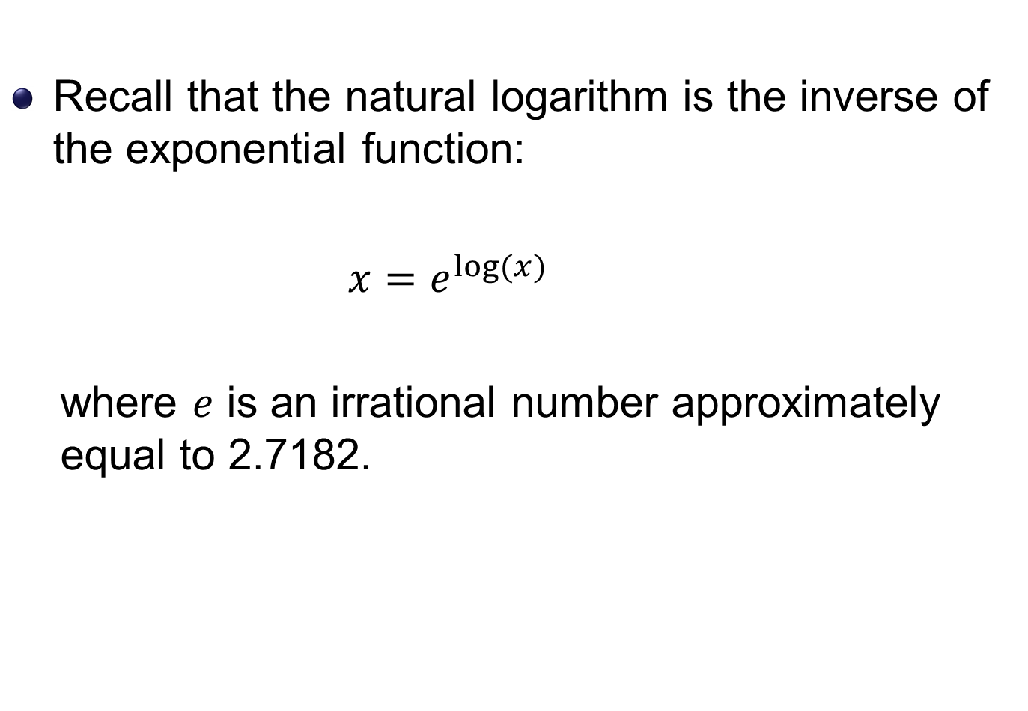
Natural logs
Recall that the natural logarithm is the inverse of the exponential function:
${x=e}^{log⁡(x)}$
where $e$ is an irrational number approximately equal to 2.7182.

Slide 15

The Gompertz (1925) model
Chetty et al. (2016) use the Gompertz model to estimate mortality rates $m\left(a\right)$ for ages $a=77,…,90$:
$$m\left(a\right)=ke^{β_{1}×a}$$

Slide 16
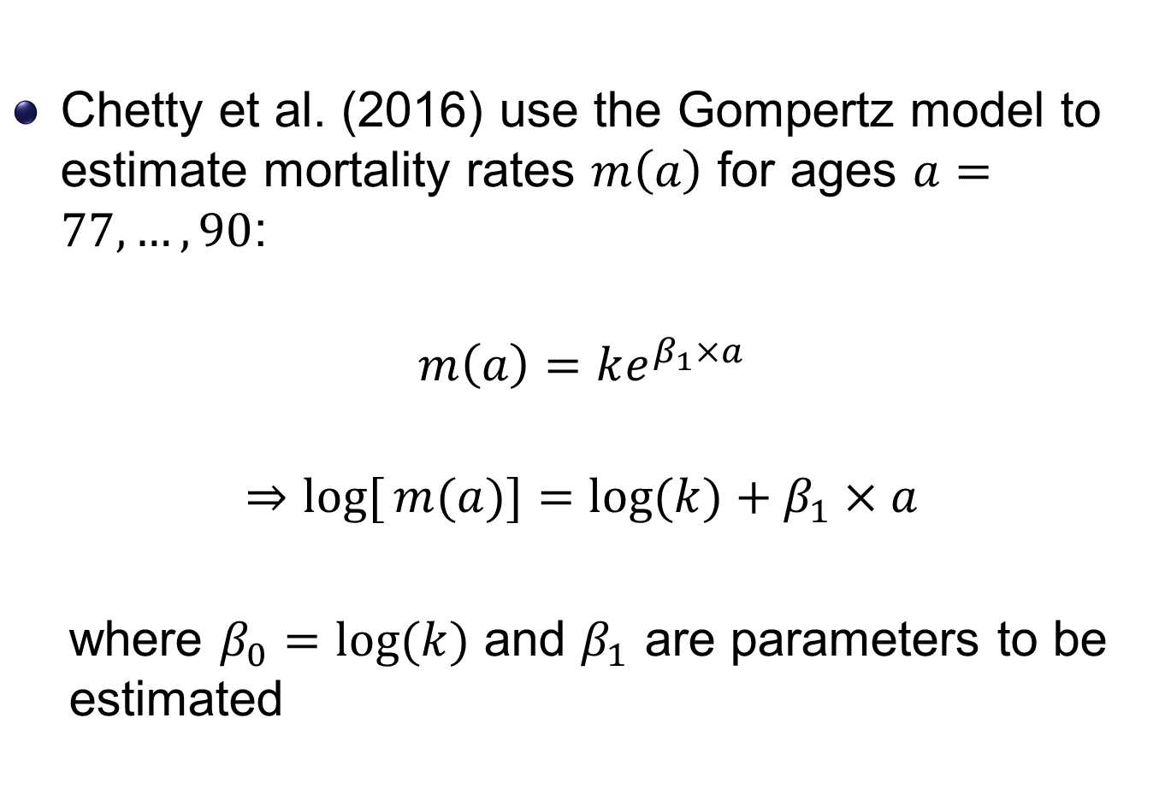
The Gompertz (1925) model
Chetty et al. (2016) use the Gompertz model to estimate mortality rates $m\left(a\right)$ for ages $a=77,…,90$:
$$m\left(a\right)=ke^{β_{1}×a}$$
$$⇒log[{m(a)]}=\log{(k)}+β_{1}×a$$
where $β_{0}=log{(k)}$ and $β_{1}$ are parameters to be estimated

Slide 17
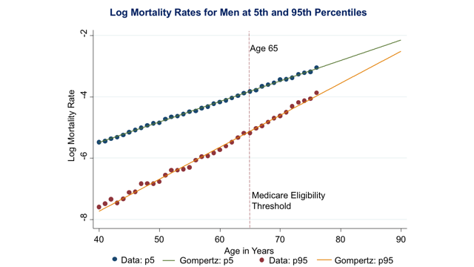
Using the Gompertz model for ages 77-90

Slide 18
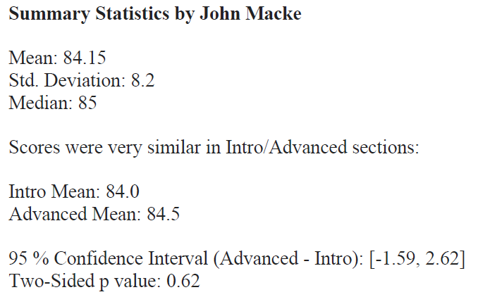
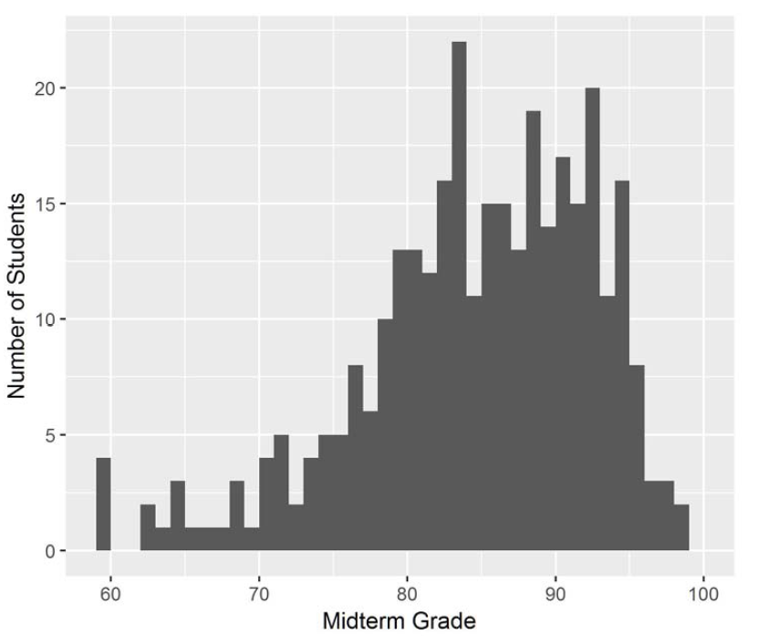
Midterm

Slide 19
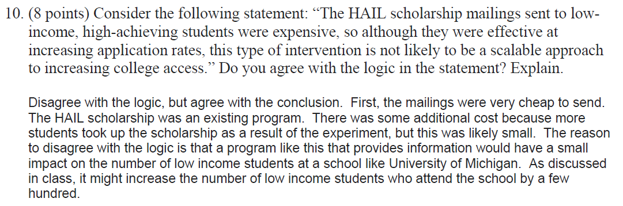
Midterm
Each question was graded by a single TF, for fairness
Re-grade request => regrade whole exam (total score may go down)
Most students loss points in the question below
Common wrong answer "It was cheap, and therefore scalable"
Notes:
(1) it was an inexpensive intervention, since mailings were cheap and the scholarship was already in place, and (2) that it's not scalable, since the target population (high-achieving, low income students) is relatively small, so it would not greatly increase low income access at schools like Michigan. Many people said something along the lines of "It was cheap, and therefore scalable", which they got partial credit for, but only few people also made the argument that low income access would not increase by a lot because of this.

Slide 20
Announcements
I need to reschedule section next week
Instead of this section on Thu Apr 4 4.30pm, please attend:
Tue Apr 2, 4.30pm in Lamont 240 => only for this section
Fri Apr 5, 10.30am in Sever 201
Other TFs sections from Tue Apr 2 to Mon Apr 8
I also won’t hold OH on Wed Apr 3

