Slide 1
EC 1152 - Using Big Data to Solve Economic and Social Problems
Review Session #1
TF: Diana Goldemberg
Prof: Raj Chetty
Harvard University
Spring 2019
Disclaimer: multiple TFs contributed to those slides. All mistakes are mine.

Slide 2

Logistics
I’m Diana.
Take 2 min to fill out this survey please [ bit.ly/ec1152d006 ] Find this prez at: https://github.com/dianagold/Ec1152_diana
We’ll meet every Thursdays @ 4.30-5.30pm (Sever 208)
Introductory level, no previous Stats background
Focus on intuition and applications
Office Hours:
Wednesdays @ 4.30-6.30pm (Barker 103)
I’m also available by appointment and after sections.
Expectations:
Email (diana_goldemberg@g.harvard.edu) response times: within 24 hours M-F; 48 hours on the weekend
Google form to submit questions before section
Notes:
2

Slide 3
Outline
Level the playing field: Summary Stats & Inference
Intergenerational Mobility main graph
Backdrop on Regression Analysis
Stata demo: regression on bowling alleys
Correlation is not causation (!)
Notes:
3

Slide 4
Summary Statistics
Suppose you have access to all of Professor Chetty's data
That means you know everyone's income in the USA in 2017
In 2017, the mean U.S. Individual Income was $48,150.
How many individuals made close to $48,150 (say within $1000)?
How many individuals made more than $48,150?
What pieces of information related to your data might you want to know...
To understand the "center" of the distribution?
To understand the "dispersion" of the distribution?
To visualize your distribution?
Notes:
4
-Can prompt to guess mean individual income if they're interested.
- How many made between $47-$49k?
Very few, ballpark is 5%
- How many made more than average?
If anyone answers 50%, use this as a hook to explain what median is.
Any answer lower than 50% gets the intuition of the long tail: 35% is ballpark
DO NOT GIVE THEM THE NUMERICAL ANSWERS YET, RATHER ASK IN THE NEXT SLIDE
- More generally, what graphs and summary stats are useful?
PDF & CDF, Median/Quartiles/Pctiles, StDev

Slide 5
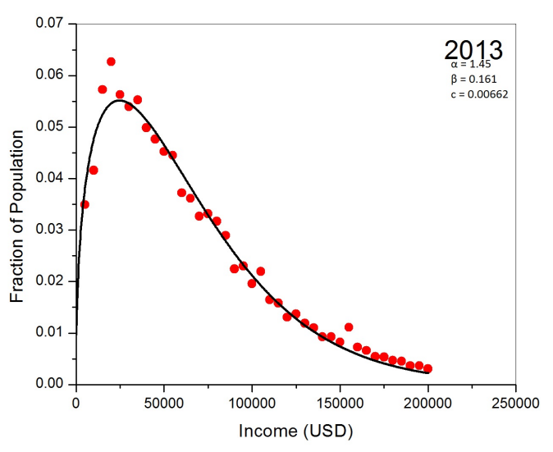
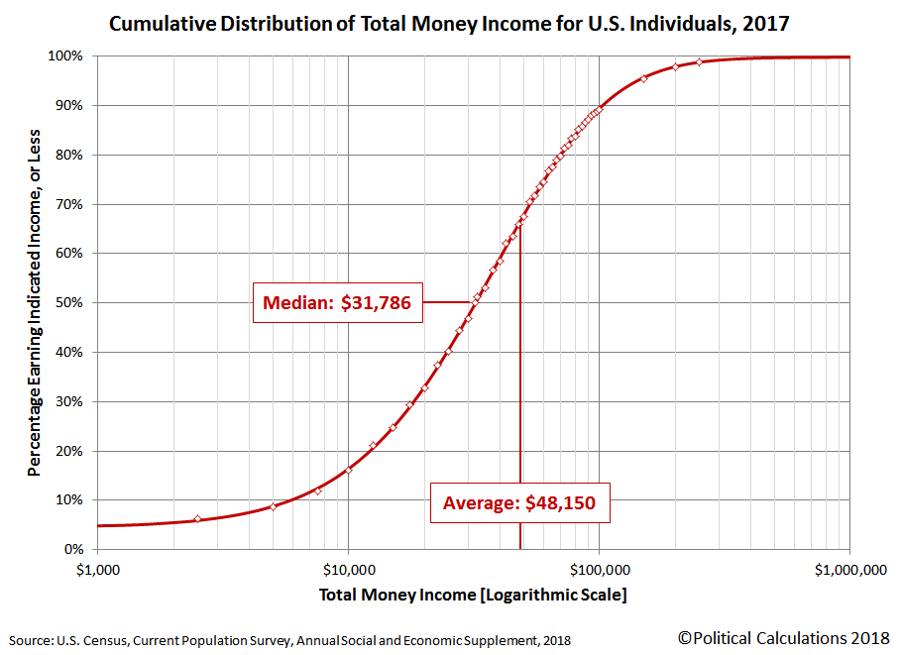
Summary Statistics
Probability Distribution Function
Cumulative Distribution Function
A “low income” person in 2017 (aka: 25th percentile) earns up to…?
Notes:
Generic example with cdf + pdf in the same graph may be helpful, but feel free to take it out.
If kept, make the point that in the case of income, if we put the 2 in the same y-axis, you would barely see the pdf
The pdf is unfortunately from 2013, not 2017, but just ignore that – probably it didn’t change much anyways.
Talk about:
Common choice of logarithm scale for income
Median vs average
- Definition of percentile
Ask them to answer the previous questions looking at those graphs [ballparks 5%, 35%]
Moreover, find the 25th pct (“low income” in the Opp Atlas) [ballpark $15k]
One important measure we’re not showing here?
Stdev or Var – why not?

Slide 6
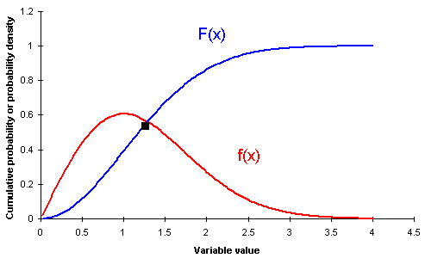
Summary Statistics
Notes:
How cdf and pdf fit together

Slide 7
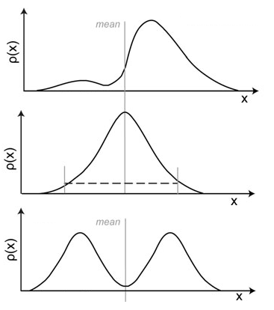
Summary Statistics
Three distributions with the same mean, and same variance / standard error
Always important to visualize when possible!

Slide 8

Summary Statistics: Takeaways I
Summary statistics and visualization are a good place to start when facing a new dataset.
There is no one summary statistic that tells you everything you need to know.
Common measures of centrality:
Mean: What is the "center of mass" of the data? If all the income were divided equally, how much would everyone receive?
Median: What is the "typical" value of the data? For what income level do half of people make more, and half of people make less? The 50th percentile.
Mode: What is the most common value of the data? If you had to guess the exact amount that a randomly chosen individual makes, what would be the best guess?
Notes:
Slides with the “Read operator symbol” will not receive much attention in section (i’ll let them read briefly and pass).
They are intended as a reference point for students to review while doing the project, looking at class notes, studying, etc.

Slide 9
Summary Statistics: Takeaways II
Common measures of dispersion:
Variance: Mean of squared deviations from the mean.
Standard Deviation: Square Root of the Variance. Has nice statistical properties for certain distributions (as does variance).
Interquartile range: What is the difference between the 75th percentile and the 25th percentile in your data? How spread out is the "middle half" of your data?
Visualizing a single variable:
Probability distribution function (PDF): Easiest to think of this as visualizing relative frequency of your data. Higher point in PDF means a value is more common in your data.
Cumulative distribution function (CDF): For each value in your data, plots what fraction of your data is less than that value. Always starts at zero and rises to one.
Notes:
Slides with the “Read operator symbol” will not receive much attention in section (i’ll let them read briefly and pass).
They are intended as a reference point for students to review while doing the project, looking at class notes, studying, etc.

Slide 10
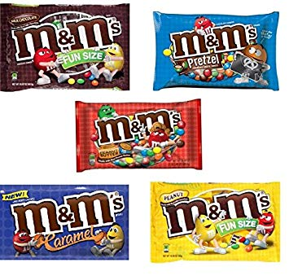
Population, Sample and Inference
Suppose that:
I only like BLUE m&m’s
Yesterday I opened one pack of each, finding
4 / 15 = 26.8%
4 / 20 = 20.0%
Should I only buy Peanut m&m’s from now on, trusting that they have a bigger share of BLUE m&m’s?
According to Mars, BLUE m&m’s represent 25.0% of their production in the NJ plant (but changes across their plants!), and does not varying between fillings (m/p/pb)
=> combining them: 8 / 35 = 22.9%
Notes:
I’m bringing m&m’s to section!

Slide 11
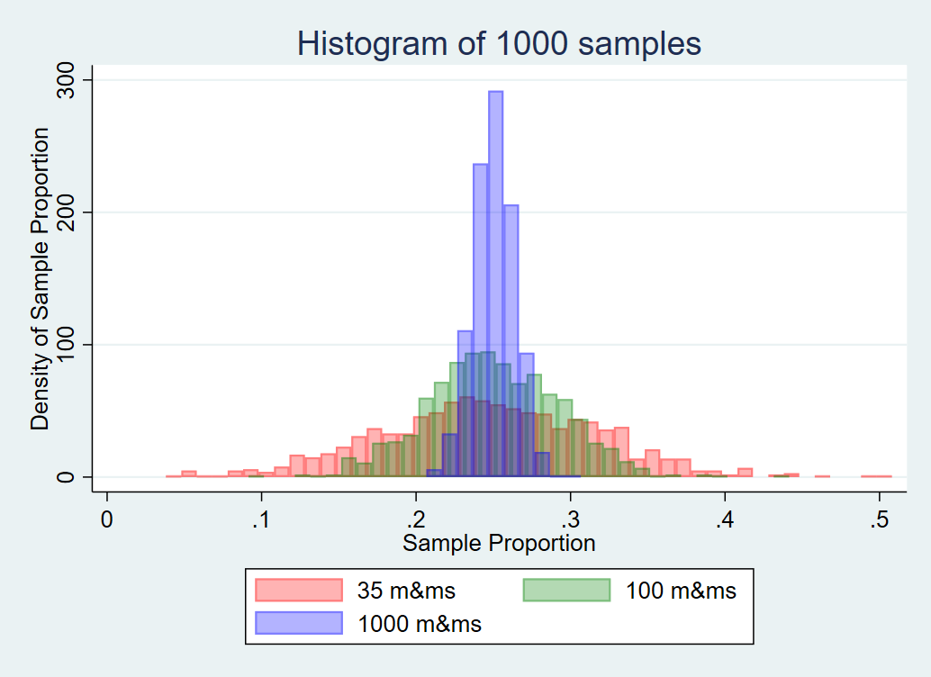
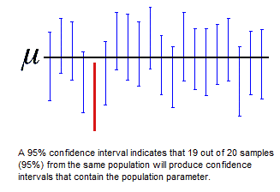
Population, Sample and Inference
Confidence intervals:
My sample: I estimate the true value that Mars uses as [8.9%, 36.8%] with 95% confidence, using my 35 sample, that is the 22.9% plus or minus 1.96*standard errors
Reality: a new sample of 35 m&m’s will have [10.7%, 39.3%] with 95% confidence, that is the 25.0% plus or minus 1.96*standard deviations

Slide 12
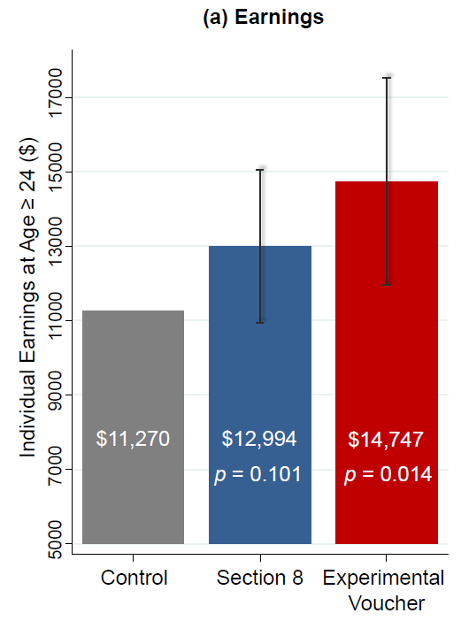
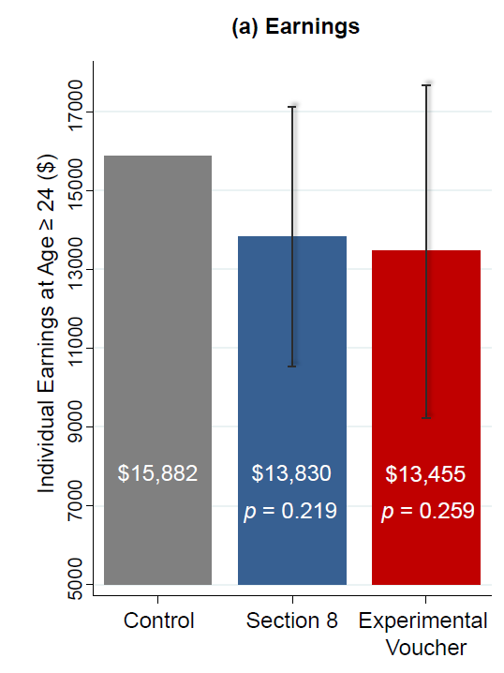
Population, Sample and Inference
P-values: a friendly answer to testing hypothesis
Peanut and peanut butter m&m’s have the same distribution of blues. p = 0.65
The m&m’s I ate follow the stated distribution of blues by Mars. p=0.78
Translate the chance that your hypothesis is true and you observed your result. Low p => reject hypothesis [stars]; High p => cannot reject hypothesis
Bringing it back to Chetty’s lecture on MTO…
Impacts of MTO on Children Below 13
Impacts of MTO on Children Age 13-18

Slide 13
Inference: Takeaways
Statistical inference is the theory, methods, and practice of forming judgments about the parameters of a population and the reliability of statistical relationships, typically on the basis of random sampling.
Randomness exists. Results on a sample of data will not always match the population value.
To deal with this, we calculate new statistics:
Standard errors tells us how far we might expect the sample mean to be from the true population mean.
Confidence intervals provide a net that we can use to try to "catch" the population mean with a pre-specified level of certainty.
P-values are the most friendly answer to hypothesis testing. Usually translates “what is the probability that we would observe such an extreme result by pure chance?”
Typical significance levels: p-value below 0.1, 0.05, 0.01? [stars]
All of these values are given by statistical software, but you need to know which ‘questions’ to ask. P-value is your friend, always look for the p-value and the test it is addressing!!!
Notes:
Slides with the “Read operator symbol” will not receive much attention in section (i’ll let them read briefly and pass).
They are intended as a reference point for students to review while doing the project, looking at class notes, studying, etc.

Slide 14
Intergenerational Mobility
Main graph?
Mean Child Percentile Rank vs. Parent Percentile Rank
100
80
No mobility?
Perfect mobility?
60
Mean Child Income Rank
40
20
0
0
10
20
30
40
50
60
70
80
90
100
Parent Income Rank
Notes:
14
Probe for axis first. Once they get it, show the axis (animation), then ask full/no mobility.
Probably some students will confuse both, so on purpose showing both at the same time so they can think again on which one is which.
Of course, the US is in the middle… before showing it, a couple questions:
- Why we put the child in the y and the parent in x, not vice-versa?
- Why use income rank instead of income $ (asked in lecture)?

Slide 15
Intergenerational Mobility
Think of some measures that translate mobility [this is the Figure I.A, Chetty et al 2018a]
Mean Child Percentile Rank vs. Parent Percentile Rank
70
60
50
Mean Child Income Rank
40
30
20
0
10
20
30
40
50
60
70
80
90
100
Parent Income Rank
Notes:
15
Now the real US graph, from the paper.
Note that the y-axis range is smaller.
Ask them to come up with measures.
Hint: in EC10 you see the Lorenz curve, based on income distribution, and calculate the Gini coefficient to translate inequality
Rank-rank slope is a great one [but not the only one]

Slide 16
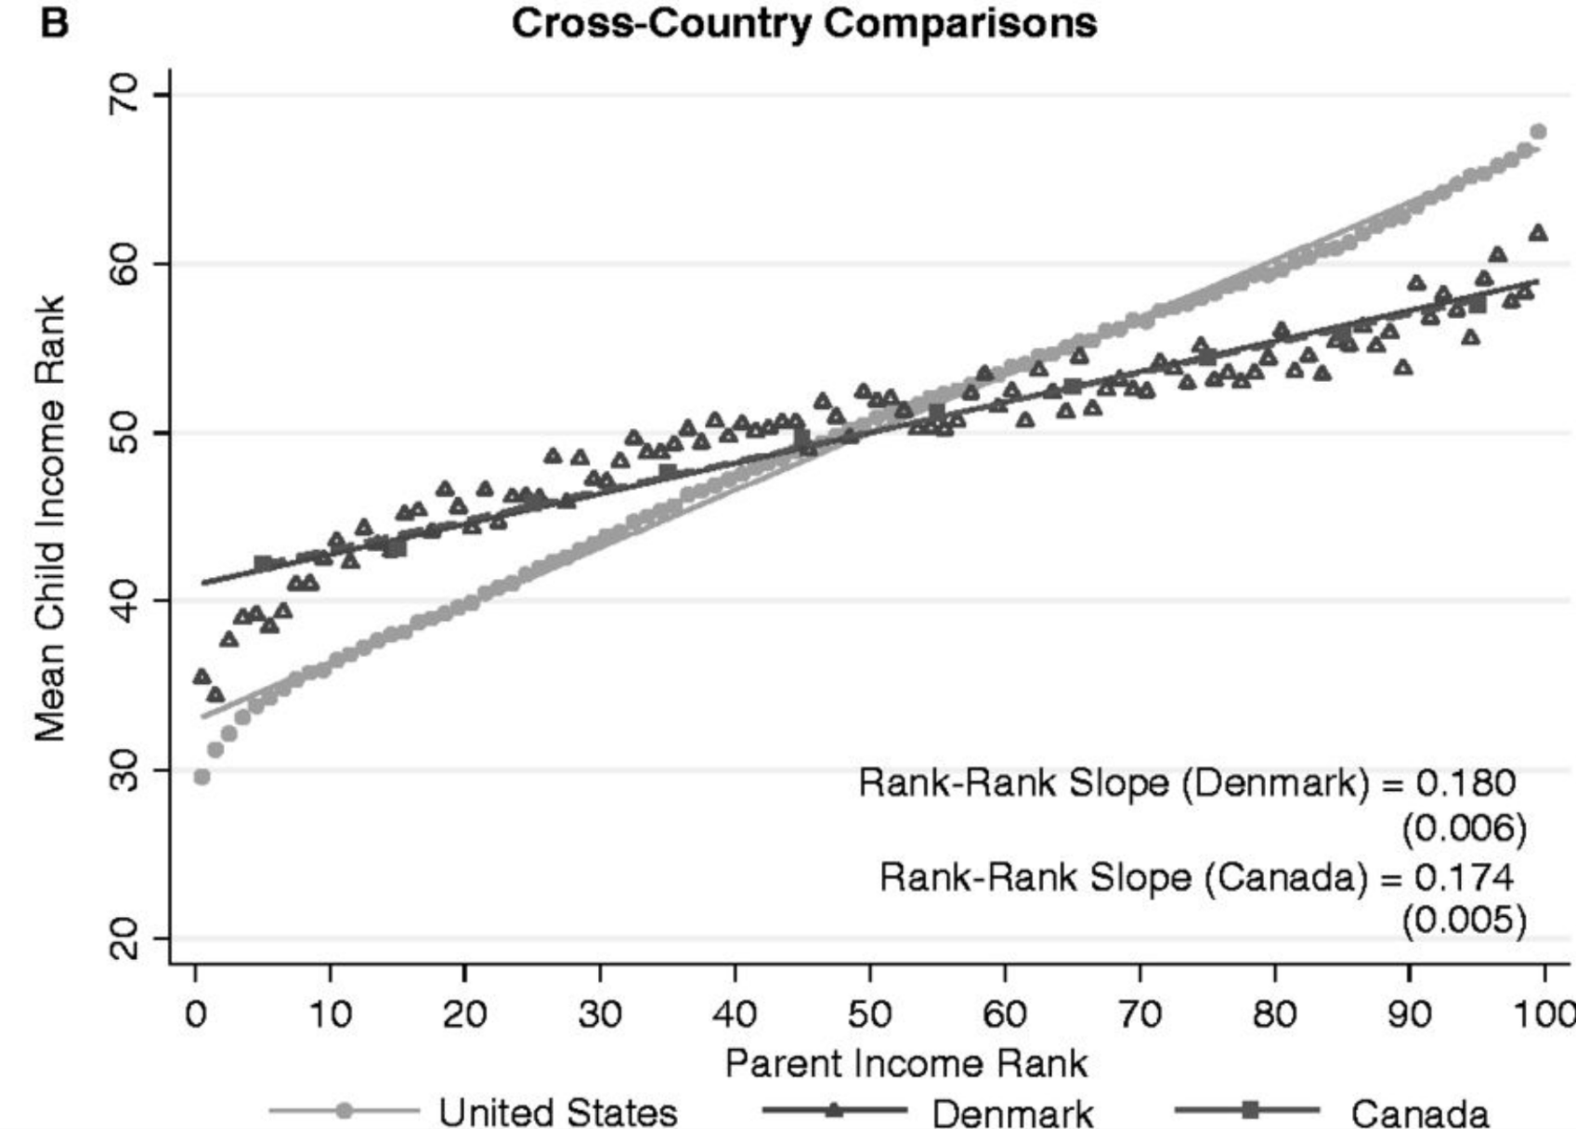
Intergenerational Mobility
In simple terms: how well do kids from poor parents do?
Rank-Rank Slope (U.S) = 0.341
(0.003)
Notes:
16
Hopefully you transition to this slide after someone comes up with the idea of rank-rank slope.
Now let’s say you want a much simpler measure of how well kids from poor parents do.
Answer: the prediction for the child of parent pct 25th.
Why the fitted line not the point (as explained in lecture)
Bridge to regression analysis

Slide 17
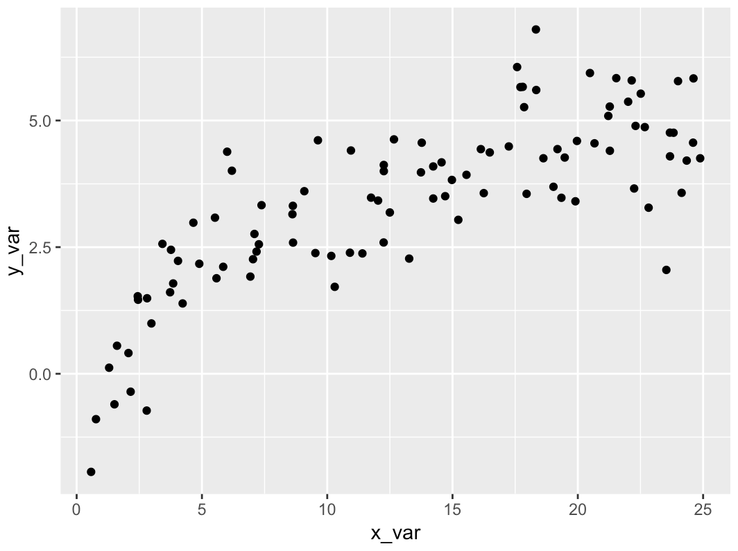
Backdrop on Regression Analysis
On the previous slides, we took a series of points from our data, and we drew a line through them
How did we even do that?
Suppose you have data on years of education and income for a group of people. How would you try to fit a line through that data?
Notes:
17
Probe for ideas about how to draw a line of best fit.
They might struggle with this in an intro class...
-One suggestion to help them along: draw a line through some points, ask "How could we measure how well this line fits this data?"
---If still nothing, ask "How about this point? How can we measure how far this point is from the line?"
-If they say something along the lines of "add up the distance from the points to the line" they've basically got it, but ask more questions:
------"If we have a point that is 2 units above the line, we can count that as being a distance of 2 away. What if we have a point that's 2 below the line?" (If they say -2, explain that you can draw a line like that with any slope. It's natural, but doesn't pin the line down. If they say 2, they've described least absolute deviation regression. Tell them good job, it's a nice technique, but it's not what most people use.
-If someone comes up with squared distance right away, probe why squared—they can explain to class in their words.

Slide 18
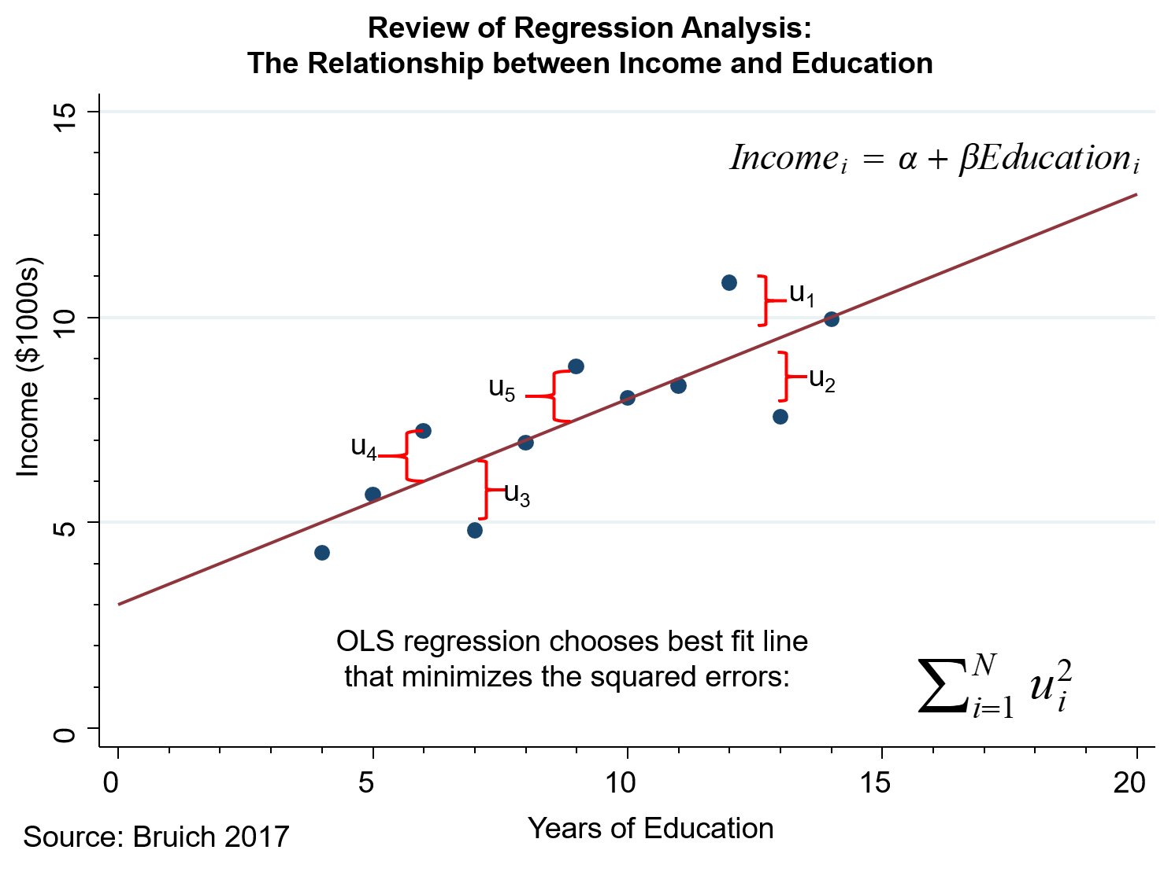
Backdrop on Regression Analysis
What's an interpretation of α and of β?
Does this line give results for the population or for a sample? To what consequences?
Notes:
18
We'll see how this goes – again, don't reveal answers until they guess a bit
-For the slope, see if they can guess it.
--If not, try and prompt by talking about the slope of a line, what does the slope tell you (change in y / change in x)? What if change in X is 1? Then change in y = slope = beta.
β tells you: on average, if a person has one additional year of education, their income is β thousand dollars higher.
-Intercept is less important, I didn't include a "right answer" on the slide, but it's a good opportunity to briefly mention external validity and outliers.

Slide 19
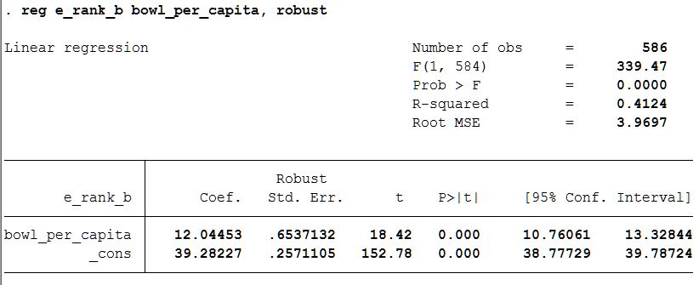
Regression Analysis: Common Output
Where is the regression slope? Intercept?
How precise are those estimates, or: where are their standard errors?
What is the probability that you would get this result (this slope estimate) even if the true population coefficient was zero? (This is the p-value, your best friend!!!)
Note that a p-value smaller than 5% means that the 95% CI will not include zero!
Notes:
19
Probably want to write on the board a bit what the regression is. Don't worry about the robust part for now.
We can go over this in a demo but depending on time, may have to speed demo up, want them to have a permanent reference.

Slide 20
Regression Analysis: Standardization
How can we compare the strength of relationship between different variables on a "level playing field?"
For example, how could we tell if average years of education in a district or fraction of people married in a district is more closely associated with income in that district?
Key point: we need a standardized measure of correlation
It turns out, we can run a very simple regression to get a correlation coefficient that:
Is always between –1 and 1.
Is –1 if variables are perfectly linearly related in a negative way
Is 1 if variables are perfectly linearly related in a positive way
Is 0 if variables are not at all linearly related
Notes:
20
Here we're trying to get them to think about a correlation coefficient.
If anyone provides an unstandardized measure, that's a good teaching opportunity to explain why you need to standardize. For example, they might say "compare beta across regressions"
If no one has anything to say, suggest "compare beta across regressions" and see if they can tell you why that's bad.

Slide 21
Regression Analysis: Standardization
Suppose you have variables Xi, Yi. Construct Xi* and Yi* as follows:
Yi - Mean(Yi)
Xi - Mean(Xi)
Yi* =
Xi* =
Std_Deviation(Yi)
Std_Deviation(Xi)
Then you can compute the least squares regression equation:
Yi* = a + r Xi*
Fact: When you compute the above regression, you will always find that:
The intercept a = 0
The slope r is a correlation coefficient of the type we described.
If you square r, ("R squared") you get a number between 0 and 1 that is equal to the fraction of variation in Y explained by a linear regression on X.
Notes:
21
This is the payoff from the previous slide. This slide is not too text-heavy, but the computation is a bit complicated—I mean we start this section assuming no knowledge of means or standard deviations, so let them know it's ok if it doesn't immediately make total sense. Picture on the next slide. Also emphasize that we will see an example of how to calculate this in Stata.

Slide 22
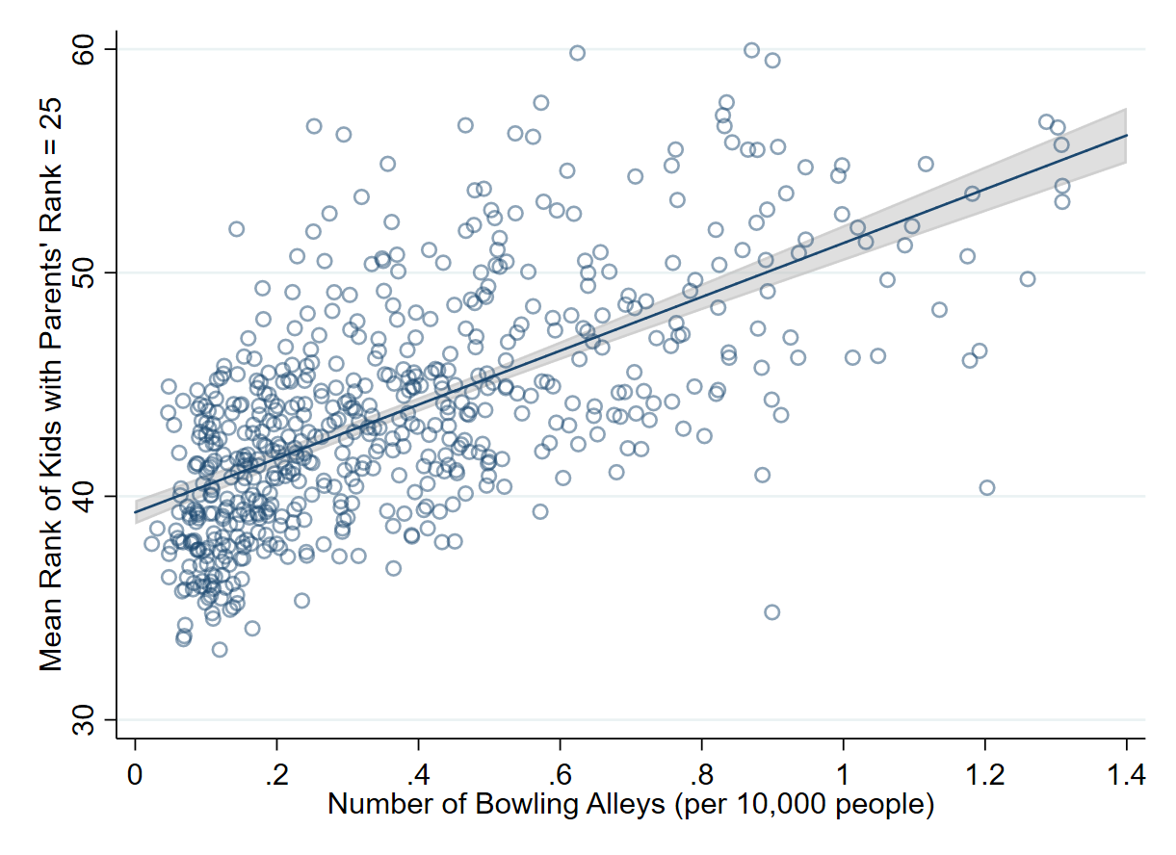
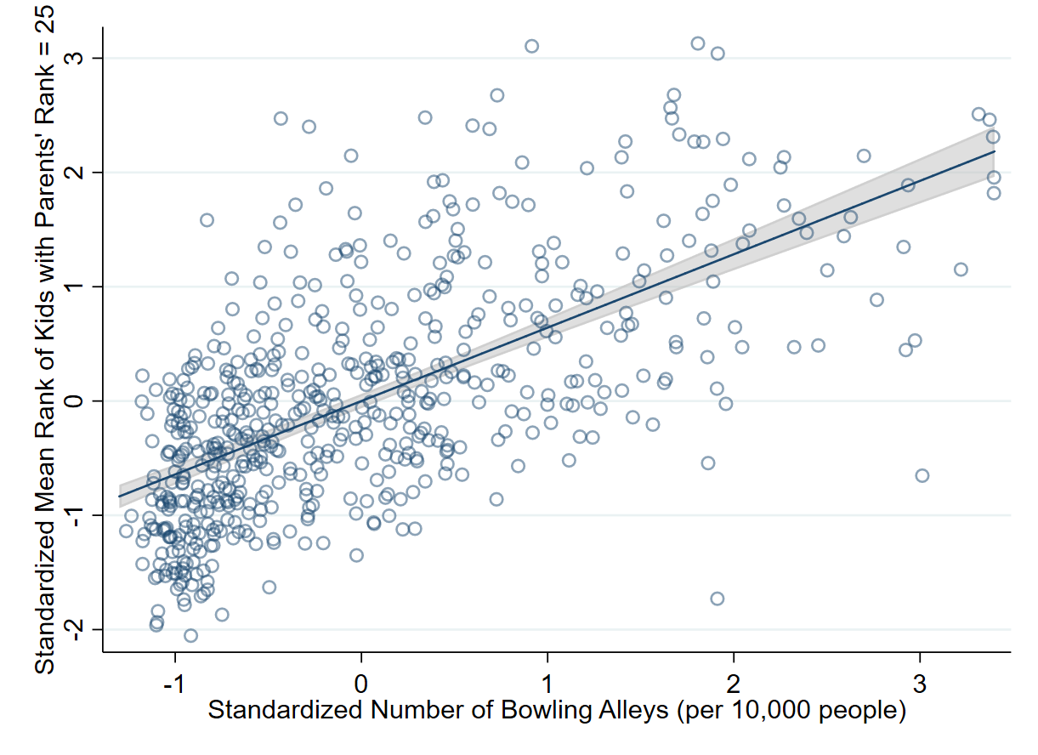
Regression Analysis: Standardization
Unstandardized slope (left) tells you that how much of an increase in mean rank of kids with parent rank = 25 is associated with one additional bowling alley per 10,000 people.
Standardized slope (left) tells you how correlated mean rank of kids with parent rank = 25 and bowling alleys per 10000 people are, on a scale of -1 to 1.
Notes:
22
After showing the first graph, can ask, "what do you think the standardized version of this would look like?"
--Alternatively, can show both and say "These look the same! Was standardizing a waste?"--Good opportunity to talk about axes, noticing subtle scaling in graphs, etc.
Similarly, can probe "what does the slope on the left tell you?" "What does the slope on the right tell you?"

Slide 23
Regression Analysis: Takeaways
Regression analysis allows us to fit a line to data in a systematic way.
In this class, we will begin with "Ordinary Least Squares" regression (OLS).
OLS minimizes sum of the squared errors between data points & the fitted line.
Nice features of OLS and other regression techniques:
The slope of the line often has a natural interpretation.
"One more year of education is associated with B in increased earnings"
When data is noisy, OLS allows you to focus in on the trends and patterns..
In certain circumstances, OLS constitutes our "best guess" at the Y value when all we know is X. "Knowing only a person's education is X, I'd guess their earnings are Y on average.“
Regression coefficient estimates come with their standard errors, which are needed to test hypothesis (inference and p-values!)
Notes:
23
Slides with the “Read operator symbol” will not receive much attention in section (i’ll let them read briefly and pass).
They are intended as a reference point for students to review while doing the project, looking at class notes, studying, etc.

Slide 24
Stata hands-on demo
Stata will be used in section
But you’re very welcomed to follow the Jupyter notebooks for:
R
Python
All files at: https://github.com/dianagold/Ec1152_diana
Notes:
Note: Mention here that the software people use is flexible and what you will support.
Stata will be supported by the class, so we'll do a Stata example here.

Slide 25
Stata demo
Required files at: https://github.com/dianagold/Ec1152_diana
If you have Stata in your computer, you may want to do it along
How to install & hints: https://canvas.harvard.edu/courses/19323
Optional workshop: Monday at 5:30 pm in Emerson Hall 105
Why are we using Stata?
The most popular software used by economists for applied econometrics
Works for “big data”: up to 20 billion observations and 32 thousand variables (contingent on RAM)
Upward mobility (Y) as a linear regression of Bowling Alleys per capita (X)
Tasks:
Get means and stdevs
Standardize Y and X
Use OLS to estimate correlation coefficients
Notes:
25

Slide 26
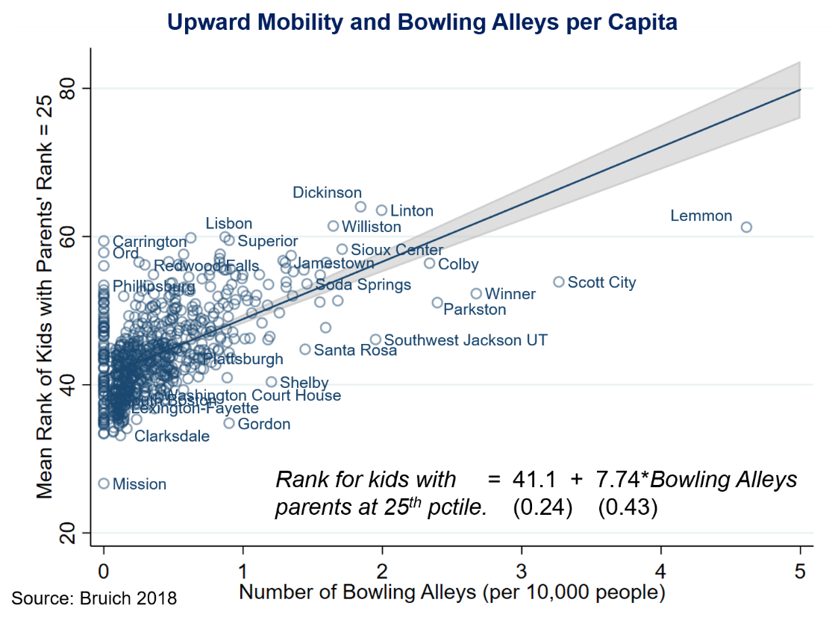
Correlation is not causation!
Notes:
26

Slide 27
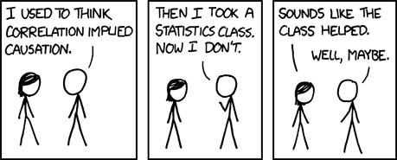
Correlation is not causation!
Have you seen this meme before?
Have you take a Stats class before?
Correlation or causation?
Notes:
27

Slide 28
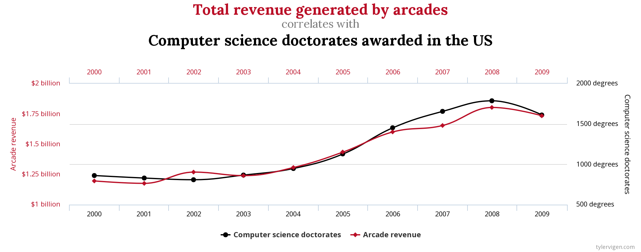
Correlation is not causation! Examples
Notes:
Does awarding computer science doctorates lead to arcade revenue?

Slide 29
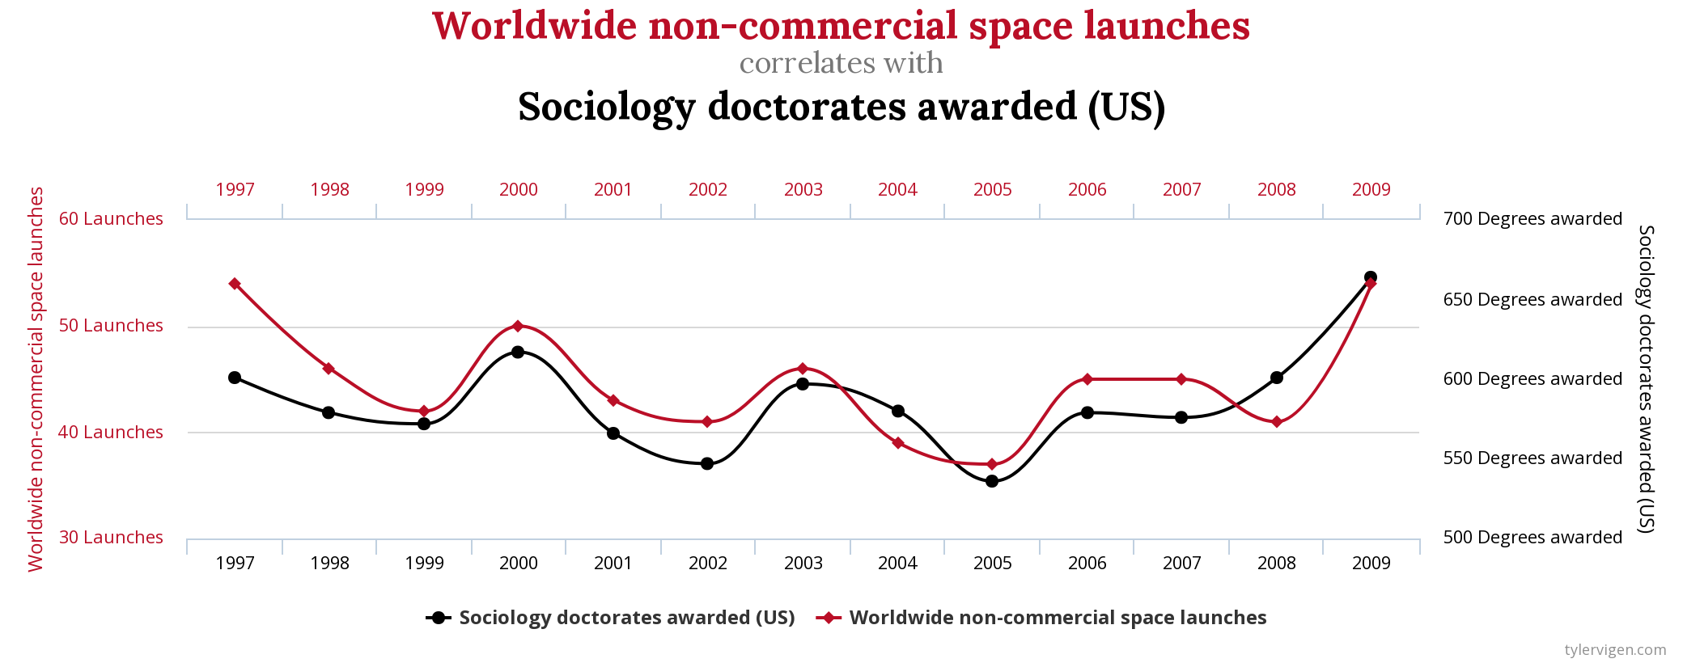
Correlation is not causation! Examples
Notes:
Do sociology doctorates put us into space?

Slide 30
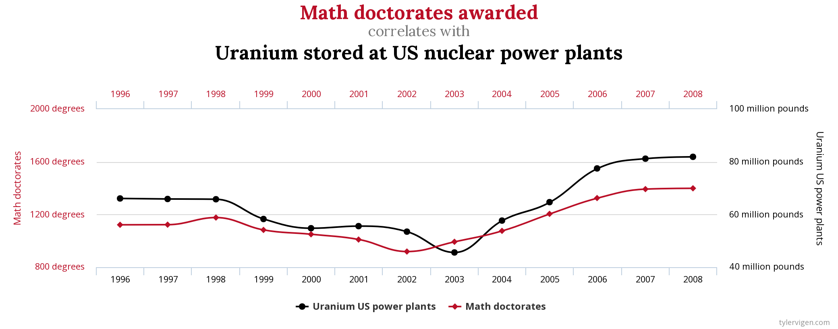
Correlation is not causation! Examples
Notes:
Do math doctorates enrich uranium?

