Slide 1
The DSpace Course
Repository Structure

Slide 2
Module Objectives
By the end of this module you will:
  Understand what a community is
  Understand what a collection is
  Have seen some example structures that are used in typical DSpace repositories.
  Know how to create communities
  Know how to create collections

Slide 3
The DSpace Community
Each DSpace service is comprised of Communities – the highest level of the Dspace content hierarchy
Communities may be:
    Departments
    Labs
    Research Centres
    Schools
Each community contains descriptive metadata about itself and the collections contained within it

Slide 4
The DSpace Collection
Each community in turn have collections which contain items or files
Collections can belong to a single community or multiple communities (collaboration between communities may result in a shared collection)
As with communities, each collection contains descriptive metadata about itself and the items contained within it

Slide 5
Example Structures
Structures may be based around organisational units:
Structures are hierarchical:
Community | Collection | Items
Department | Research Group | Items
Department | Item Type | Items
Faculty | School | Items
Community | Sub Community | Collection | Item
Department | Sub Department | Research Group | ....

Slide 6




Discussion: Repository Structure
Repository Structure
Do you currently have a repository?
Yes
No
How is your repository currently structured?
How might your repository be structured?

Slide 7
Creating a Community
To create a community, you must be an administrator and signed into DSpace
Creation of a typical Community Involves:
  Choosing the type of community
    Top level community
    Sub Community
  Completing the descriptive metadata for the community
  Configuring the community’s authorisations (access rights)

Slide 8
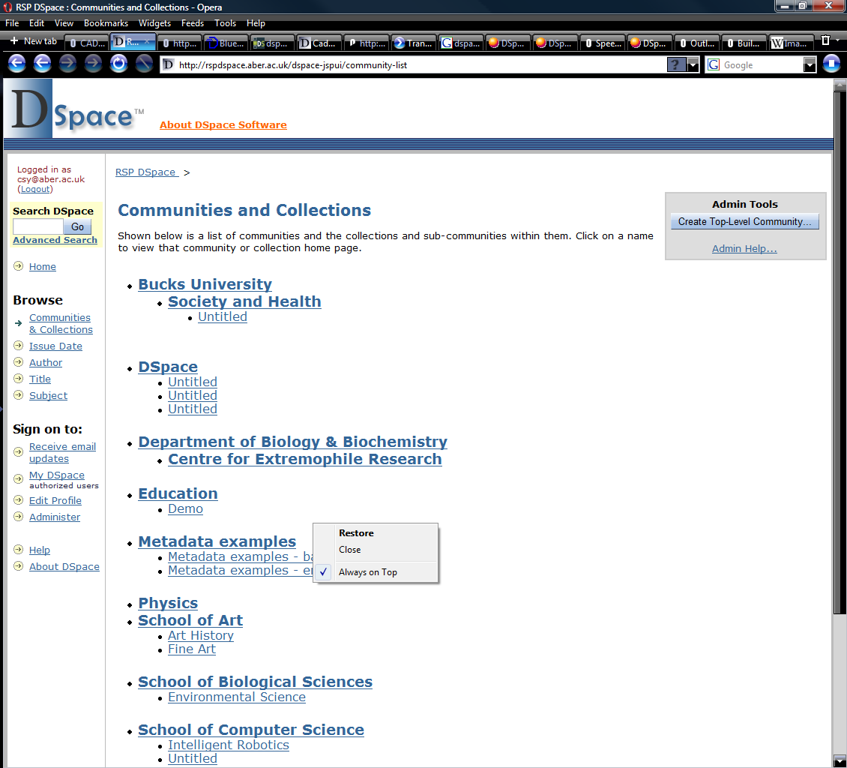
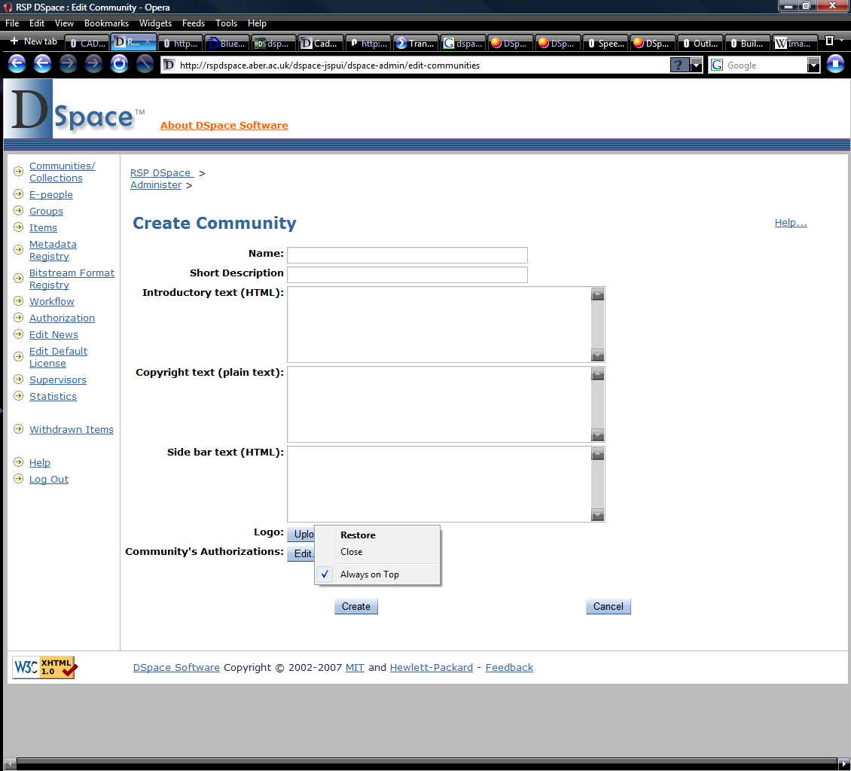
Creating a Community
Sign into Dspace as an administrator
Select ‘Community & Collection’ from the browse menu
Select ‘Create Top-Level Community’ from the Admin Tools menu
Compete the descriptive metadata for the Community
Click ‘Create’ to complete the Community

Slide 9
Creating a Collection
To create a collection, you must be an administrator of the parent community
Creation of a typical collection involves:
  Selecting the parent community of the collection
  Answering some initial questions about the collection
  Entering the descriptive metadata for the collection
  Setting the collections authorisations (users who can submit new items)
  Configuring the workflows for the collection (see module: Workflows)
  Configuring the collections authorisations (access rights)

Slide 10
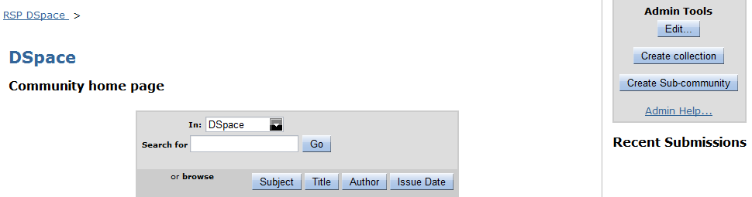
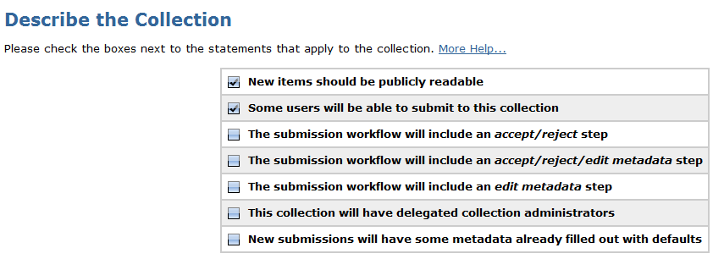
Creating a Collection
Navigate to the parent Community of the collection to be created
Select ‘Create Collection’ from the Admin Tools menu
Select the appropriate statements that apply to this collection

Slide 11
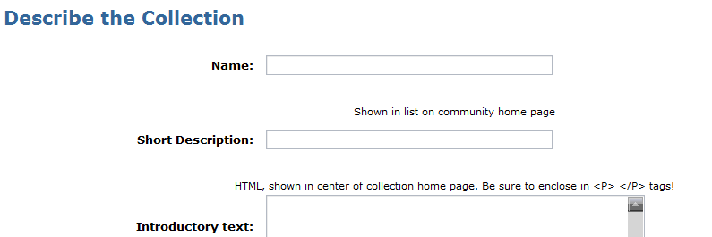
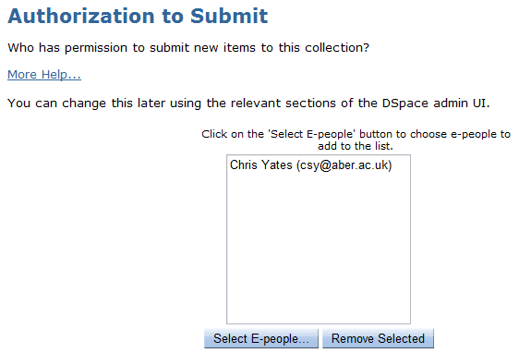
Creating a Collection
Compete the descriptive metadata for the Collection
Select the users who can submit to the Collection and the ‘Next’
Click ‘Update’ to complete the collection creation process

Slide 12
Practical: Create a Test Structure
Using some of the ideas from the earlier discussion create a test structure in your Dspace repository
  Create top level community
  Create a collection within this community
  Assign a user permission to submit to this collection

Slide 13



Credits
These slides have been produced by:
  Stuart Lewis & Chris Yates
  Repository Support Project
    http://www.rsp.ac.uk/
  Part of the RepositoryNet
  Funded by JISC
    http://www.jisc.ac.uk/

